Slide 1
Introduction to Trees
Jorge A. Cobb
The University of Texas at Dallas

Slide 2
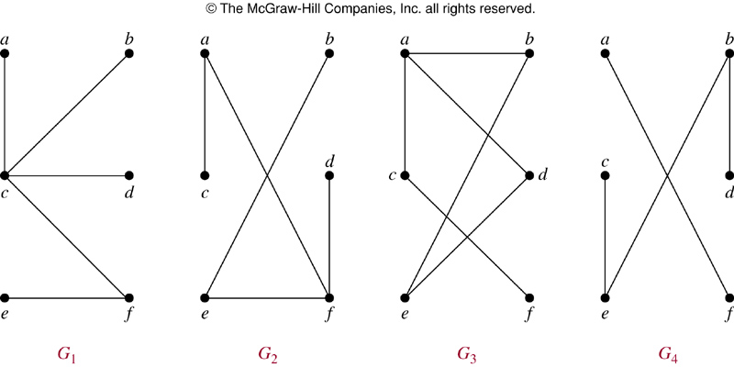
Definition
A tree is a simple connected undirected graph that has no circuits.
  Which of these are trees?

Slide 3
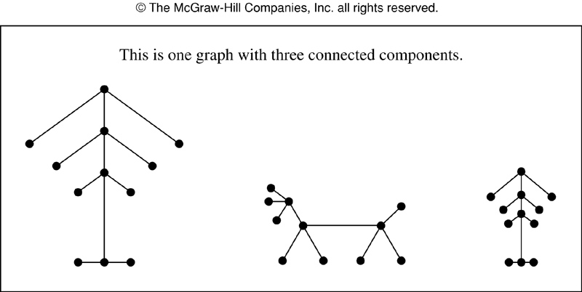
Forests
A forest is a collection of trees (i.e. a disconnected graph that has no simple circuits)

Slide 4
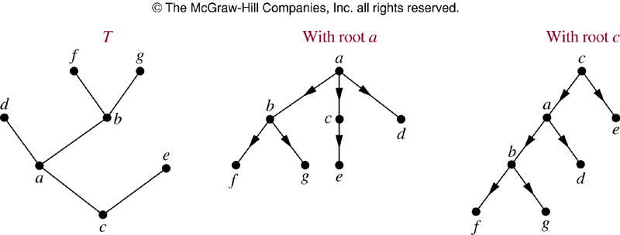
Rooted tree
A tree becomes rooted if you choose one particular node as “the root”
You can add direction to each edge (it is understood, not necessary) “away” from the root.

Slide 5
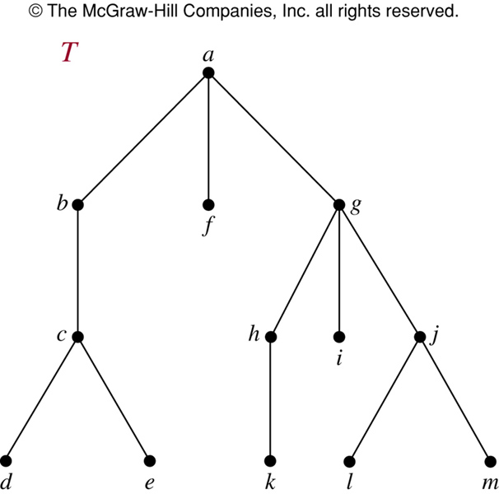
a is the root
the leaves are d,e,f,k,I,l,m
g is the parent of j
j is a child of g
g has three children
all nodes have only one parent (except the root)
h,i,j are all siblings (same parent)
the ancestors of j are g and a
the descendants of g are h,i,j,k,l,m

Slide 6
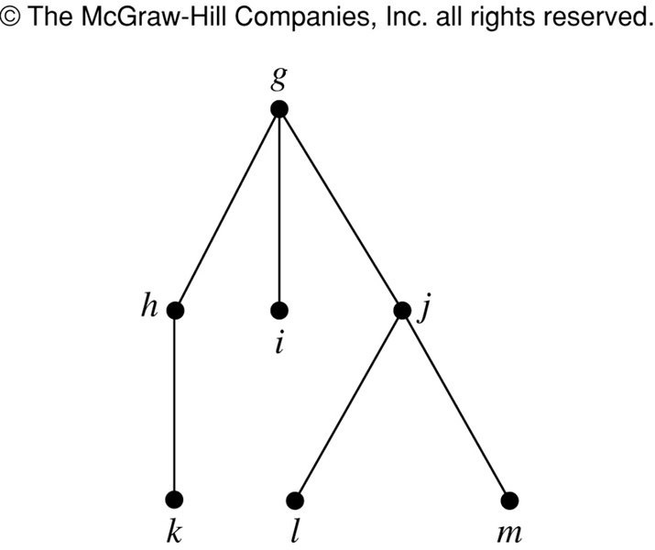
Subtrees
The subtree of g consists of the subgraph whose nodes are g and all its descendants

Slide 7
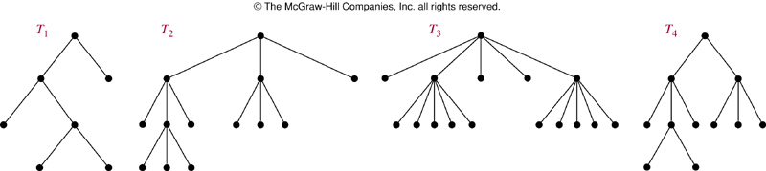
M-ary trees
An m-ary tree has at most m children at each node
  If m = 2 we call it a binary tree (used a lot in CS)
A full m-ary tree if each node has m children or none

Slide 8
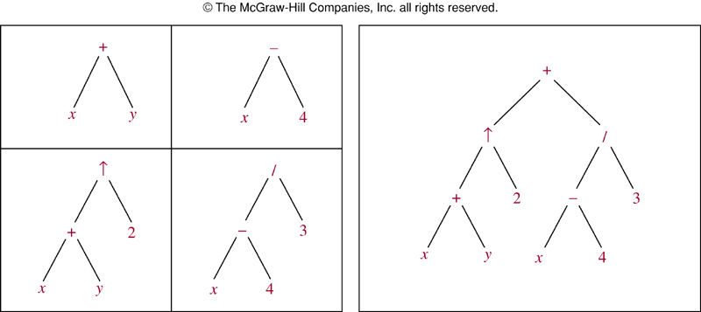
Ordered trees
A rooted tree is ordered if the children of each node are totally ordered.
For a binary tree (2 children) the node has a “left” child and a “right” child.

Slide 9
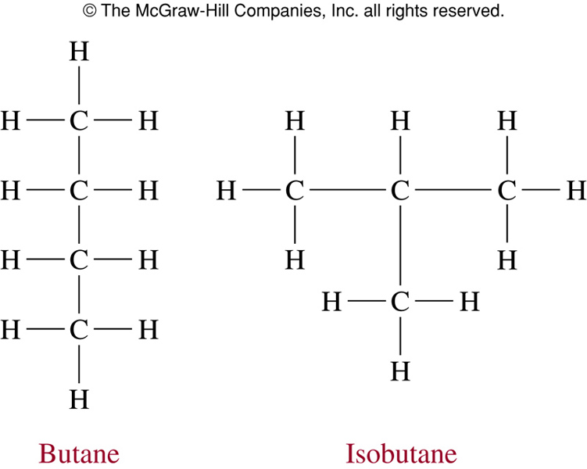
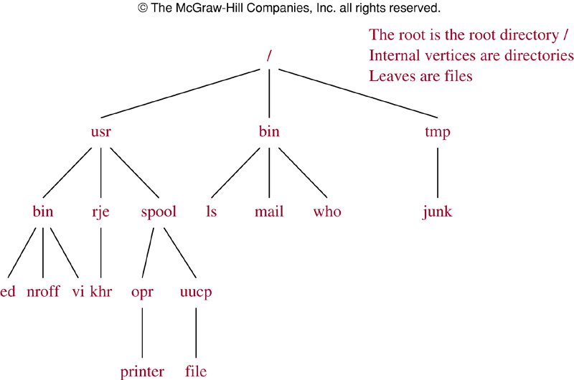
Trees as models of real-life structures

Slide 10
Tree properties
Theorem A tree with n vertices has n-1 edges
Trivial, start with the tree that only has the root (1 node 0 edges) and hence n-1 edges (n=1)
For each edge you add, you introduce one more node (n grows by 1 but so do the number of edges)

Slide 11
Height and Depth
Height of g: maximum length of path from g to a leaf
Depth of g: length of path from g to the root.
a: height=3; depth=0
g: height=2; depth=1
m: height=0; depth=3
f: height=0;depth=1

Slide 12
Tree height
The height of a tree is the length of the longest path from the root to a leaf (i.e., the largest depth of any node)
An m-ary tree of height k cannot have more than m^{k} leaves.
Why?
  Consider the depth levels
  The nodes at depth i+1 are at most m*(nodes at depth i)

Slide 13
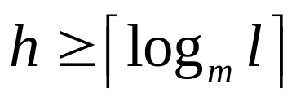
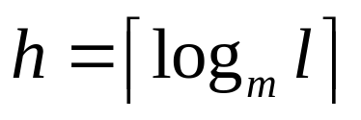
Corollary
If an m-ary tree of height h has l leaves, then
If the m-ary tree is full and balanced (all leaves have height h or h-1), then

Slide 14
Applications of Trees

Slide 15
Binary Search Trees
Organize data so that you can quickly search for an item.
A binary search tree is an ordered binary tree where each node is given a label
  For each node g, the labels in its left subtree are less than the label of g, and the labels in its right subtree are greater than those of g.

Slide 16
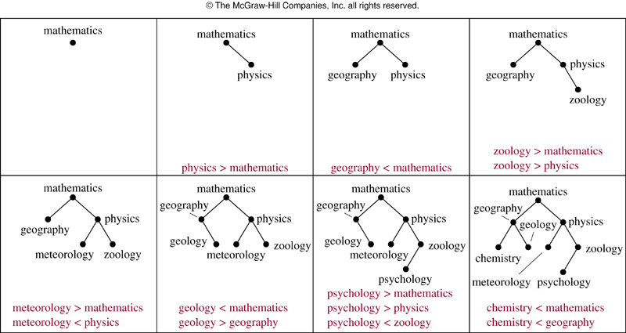
Adding/searching

Slide 17
Decision trees
You can model the sequence of decisions taken by an algorithm as a tree.
A vertex corresponds to a state of the system
The different children of a vertex correspond to the states reached from the different possible outcomes of the decision

Slide 18
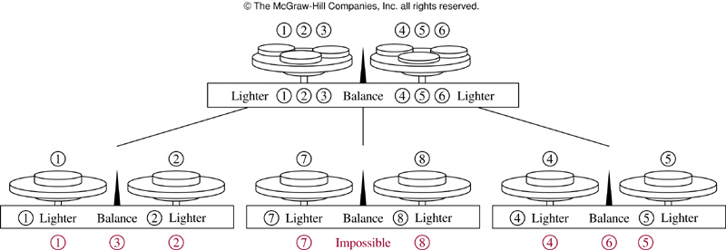
Example
How many weighings needed to find a fake (lighter) coin among 8 coins?

Slide 19
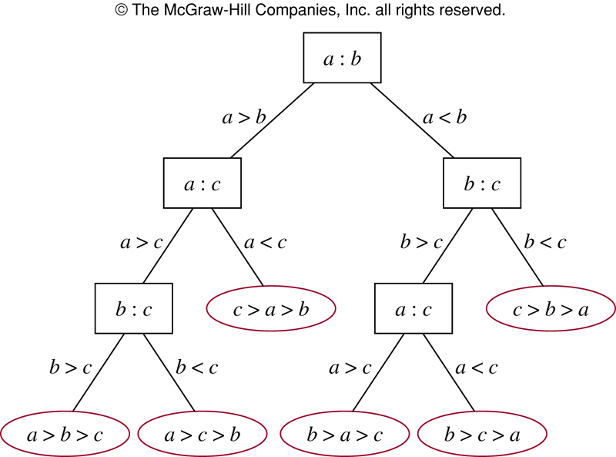
Another example: sorting 3 elements

Slide 20
Complexity of Sorting
n numbers to be sorted
n! different possible outcomes (leaves on tree)
From corollary 1, height is at least ceiling(log n!)
Ceiling(log n!) is Θ(n*log n) (bounded from above and below)
Hence, sorting complexity is (bounded from below) Ω(n*log n)

Slide 21
Prefix Codes and Compression
Assume you want to encode the 26 English letters using bit strings.
Five bits is enough (2^5 = 64)
ASCII uses 8 bits (since it encodes many symbols not just letters)
However, we want different letters to have different bit lengths
  Why? Some letters occur more often
  Frequent letters should be given shorter codes
  Longer letters should be given larger codes

Slide 22
Unique decoding
Assume a = “10” and e = “101” and f = “0”
  What is 101010? Is it “aef” or “aaa”?
For unique decoding, not letter can be bit encoded as a prefix of the bit encoding of another letter
a = “10” e = “11” and f = “0” is ok (if we only have those 3 letters ☺ )

Slide 23
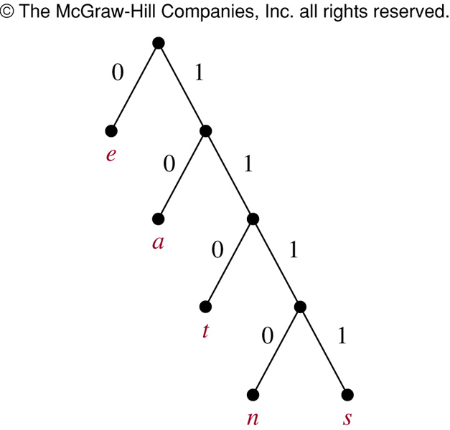
Prefix encoding
Build an ordered binary tree
Label each left edge “0” and each right edge “1”
Make the leaves be the letters (and only the leaves)
The encoding of each letter is its path from the root to the leaf
The tree can have any shape you want (not just the linear shape you see in the figure)

Slide 24
Huffman encoding
A particular way to build this prefix tree.
  We know in advance the frequency of occurrence of each letter (e.g. “a” occurs 1% of the time, d occurs .05% of the time, etc)
Start with a forest of single-node trees, one for each letter (note: in this case the root is also a leaf!)
As the algorithm progresses, these trees are merged until a single tree is obtained.
Each tree is labeled with the sum of the frequencies of the leaves of the tree
Always merge the two trees with lowest frequency

Slide 25
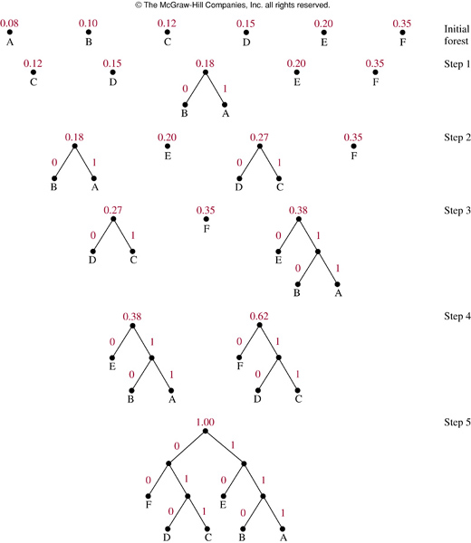

Slide 26
Game trees
They represent the sequence of moves made during a game
Vertices correspond to states of the game
Edges represent moves, i.e., moving from one state to another
Initial state is the root
Vertices at even levels correspond to the game before player 1 makes a move
  Even levels are states before player 2 makes a move

Slide 27
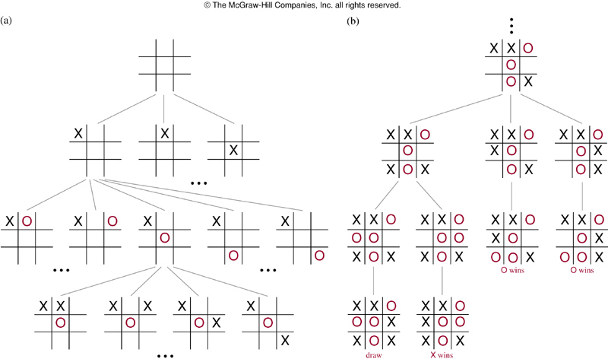

Slide 28
Vertex Values
Leaves (if the tree is finite) correspond to ending state (one of the players wins or it’s a draw)
Label a leaf with 1, 0, or -1 if player 1 wins, draws, or loses on that leaf.
We play the game from the perspective of player 1 (i.e. the one who makes the initial move).
  Playing it from player’s 2 is similar: wait for player 1 to make a move, the current state becomes the root of the tree, and player 2 is now “player 1” on this tree.

Slide 29
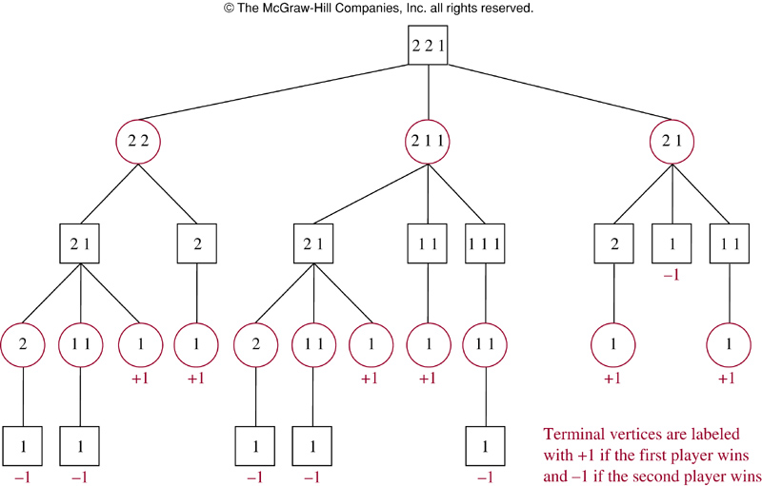

Slide 30
Min-Max strategy
Which move should player 1 make?
  We assume player 2 is as bright as they come
  We label each node with the outcome if each player would always make the best choice.
  Player 1 should then always choose the move that results in the maximum label (in our case: max{1,0,-1} = 1).

Slide 31
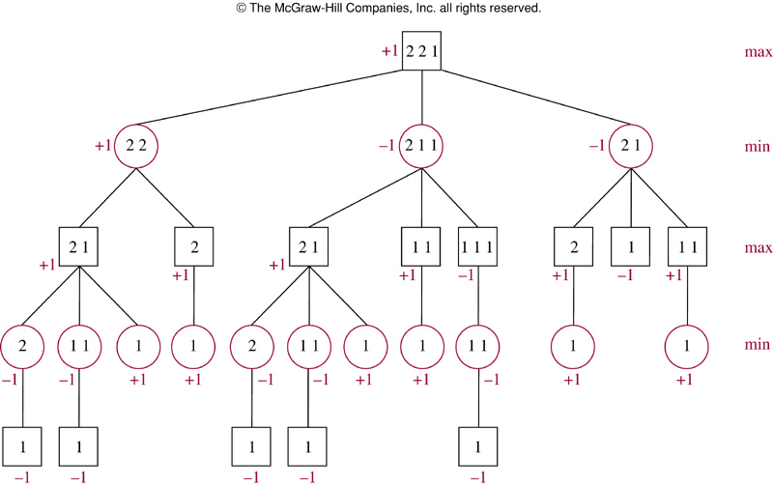

Slide 32
How to label a vertex?
If it is player 1’s turn (the vertex has even depth)
  Label the vertex with the maximum of the labels of its children
    This is because player 1 is smart enough to choose the best one
If it is player 2’s turn (the vertex has odd depth)
  Label the vertex with the minimum of the labels of its children
    This is because player 2 is smart enough to choose the best one for him/herself which is the worst for player 1.

Slide 34
Chess
How would you apply this to chess?
The number of vertices (states) is way to big to expand the whole tree.
So, how do you label nodes?

