Slide 1
GSE193531 · BOIARSKY ET AL. NAT COMMUN 2022
Vaccine targets for
smouldering myeloma
A ranked shortlist for an off-the-shelf preventive vaccine in SMM.
29,387
35
32
15
PLASMA CELLS
PATIENTS · 4 STAGES
CANDIDATES SCORED
SHORTLISTED

Slide 2
01 · WHAT COUNTS AS A GOOD TARGET
The product sets the safety bar
SMM patients are not yet sick and may never progress. Tolerance for off-tumour toxicity is close to zero.
Evidence layer | Weight | Why that weight
Differential expression | 0.30 | Most statistically grounded
Normal-tissue safety | 0.25 | Outlier test over ~50 tissues
Novelty-confidence | 0.25 | Known biology, existing programs
HLA-I presentation | 0.20 | Weakest — binding ≠ immunogenicity
TAKEAWAY
▸ Shared antigens, not neoantigens. No mutation calls here, and an off-the-shelf product needs a shared target.
▸ BCMA is correctly absent. TNFRSF17 sits at log2FC 0.13 — a plasma-cell marker, not a tumour antigen.
▸ Labels are expression-derived. Clustering, not inferCNV — so DE against them is partly circular.

Slide 3
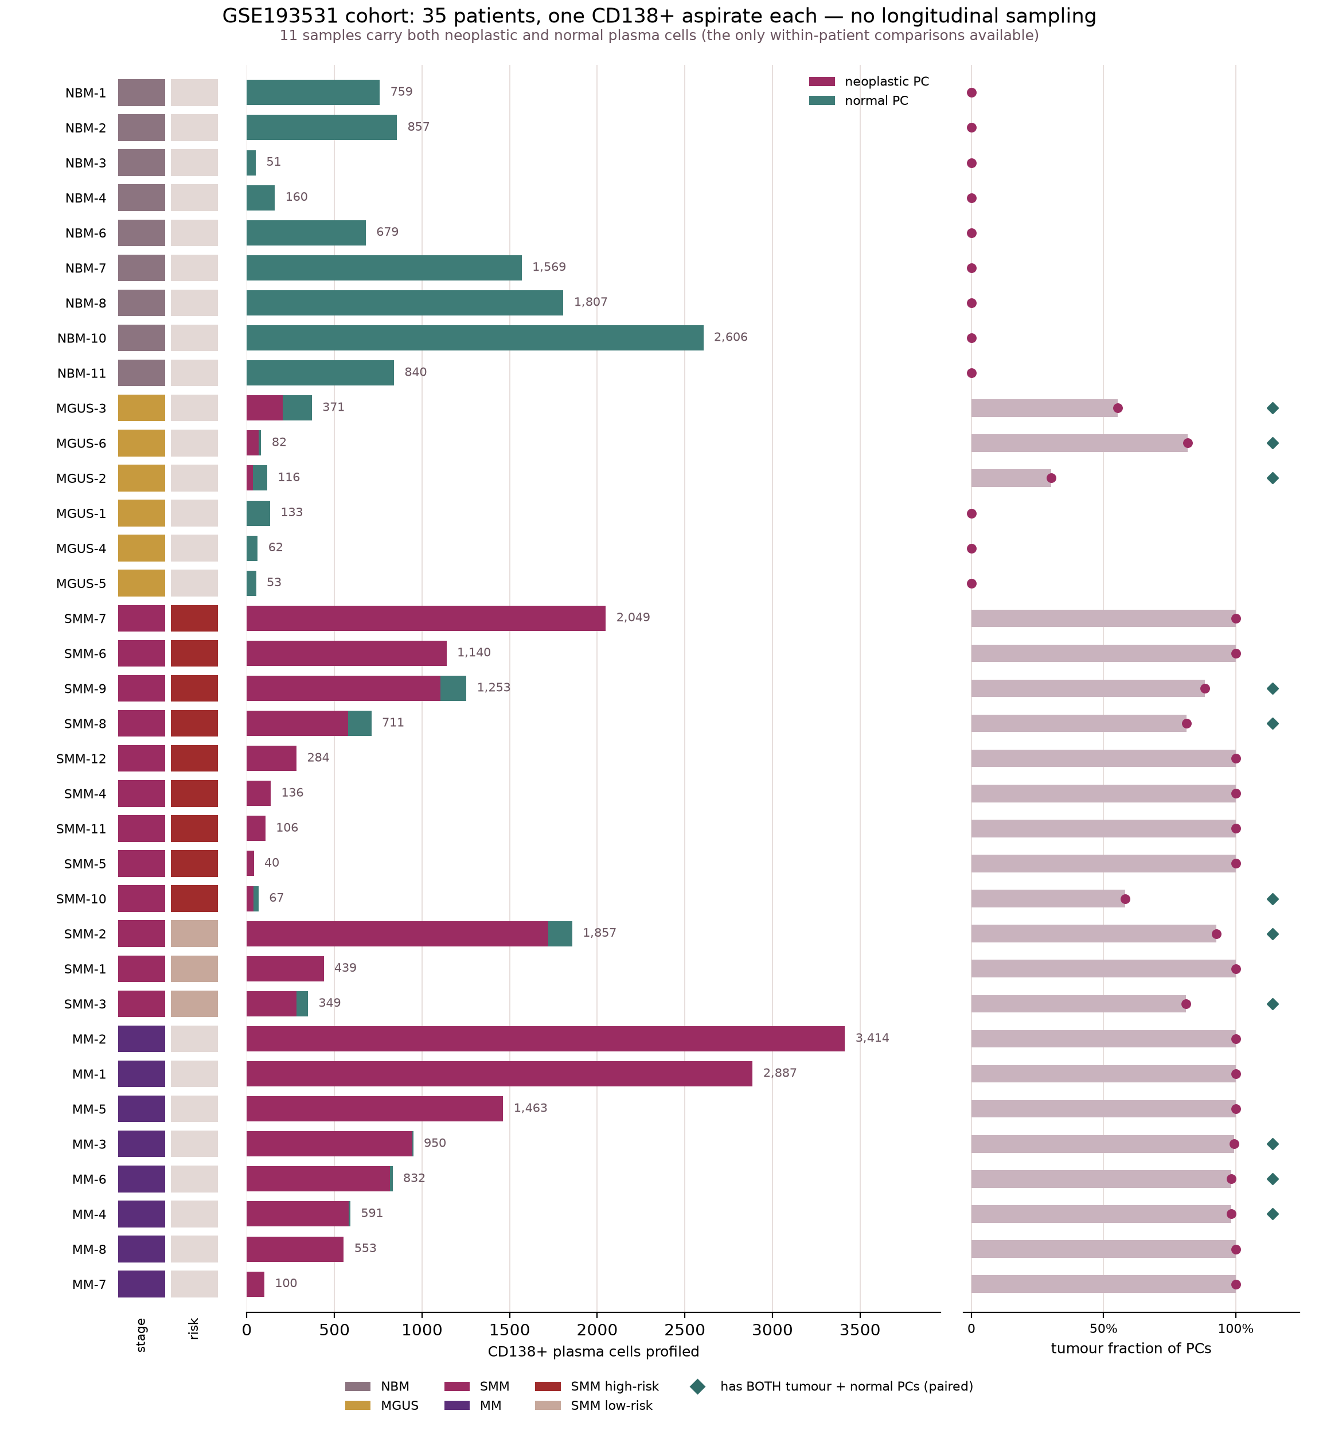
02 · THE COHORT
35 patients, one aspirate each
KEY TERMS IN THIS FIGURE
CD138+ plasma-cell surface marker — every library is this one sorted fraction
neoplastic PC magenta bar — the malignant plasma cells
normal PC teal bar — residual healthy plasma cells in the same aspirate
tumour fraction right panel: neoplastic ÷ total plasma cells
◆ sample has BOTH cell types — the only within-patient comparisons
stage / risk NBM healthy → MGUS → SMM → MM; SMM split high- vs low-risk
TAKEAWAY
▸ No longitudinal sampling — one aspirate each, so no progression trajectories.
▸ Only 11 of 35 are paired (MGUS 3 · SMM 5 · MM 3); the other 24 single-status.
▸ Risk recovered from barcodes. 9 of 12 SMM are high-risk — the enrolment population.

Slide 4
03 · PIPELINE
From 22,273 genes to 15 targets
00–01
Fetch GEO + HPA · align, QC, build AnnData
22,273
THE FOUR EVIDENCE LAYERS
02 differential expression, three contrasts
02b normal-tissue restriction, ~50 HPA tissues
04 HLA-I presentation, 27 alleles
05·05b literature knowledge, via Claude + a fixed grid
02
Genes with ≥10 pseudobulk counts
18,582
02
Significantly up in tumour, in any of three comparisons
857
03
Admitted on pooled signal must also be up in SMM itself
832
03
Drop immunoglobulin / HLA / mitochondrial
832
03
Expressed ≥5 CPM in ≥half of SMM tumours
242
02b·03
Reject genes also expressed in brain, heart, other vital tissue
146
03
Top 60 by effect size × reproducibility × tumour specificity
60
04
Has a UniProt protein · MHCflurry over 27 alleles
38
05·05b
Reject known housekeeping and broadly essential genes
32
06
Weighted ranking across all four evidence layers
15

Slide 5
04 · DIFFERENTIAL EXPRESSION
Between people, or within a person?
"Up in tumour" is ambiguous until you say compared with whose normal cells.
CONTRAST A
CONTRAST B
CONTRAST C
Tumour vs any normal PC
SMM tumour vs a healthy person
Tumour vs the patient's own normal
All tumour vs all normal, pooled. Widest net — but mixes healthy donors with patients' own cells.
12 SMM tumours vs 9 healthy donors. The clinical question, and the effect size used in the score.
The 11 paired patients, each against themselves. Controls for between-person variation.
 | Model | Rows | Normal side | Entry threshold | Admitted
A | ~status | 46 | 9 healthy donors + 14 patients' own | log2FC > 1 · padj < 0.05 | 629
B | ~status | 21 | 9 healthy donors | log2FC > 1 · padj < 0.05 | 561
C | ~patient + status | 22 | the same 11 patients | log2FC > 0.5 · padj < 0.05 | 21
 |  |  | A ∪ B ∪ C — a gene needs clear only one |  | 857
TAKEAWAY
▸ Union, not intersection. One contrast is enough — but anything admitted on pooled signal alone must still be up in SMM itself.
▸ Why B alone is not enough — EPHB1. B log2FC 5.87, C log2FC 0.07. Healthy donors sit at 0.0 CPM, so any expression looks enormous.

Slide 6
05 · BEYOND FOLD CHANGE
Three questions a log2FC cannot answer
REPRODUCIBILITY
OFF-THE-SHELF GATE
DURABILITY
Recurrence
SMM coverage
MM retention
In how many of the 11 paired patients is the gene up — log2FC ≥ 0.25 AND ≥5 CPM? Counting, not pooling, so no stage dominates.
In how many of the 12 SMM tumours is it on at ≥5 CPM? A shared product cannot rest on an antigen most patients lack.
Given at SMM to block progression. An antigen lost on the way to MM fails precisely when it is needed.
WHY EACH GATE EXISTS
▸ Detection-prevalence had to go. EDNRB reached rank 5 on a >1-UMI gate while clearing 5 CPM in only 3 of 12 SMM tumours.
▸ Direction alone is not enough. NEB in MGUS-3 is 1.3 vs 1.2 CPM. A magnitude gate cut perfect recurrence from 112 genes to 7.
▸ Specificity is measured on SMM, not pooled. The pooled tumour set is 57% MM cells. IFITM1 is 46% of it but only 21% of SMM cells. Spearman between versions: 0.575.
▸ MGUS is annotated, never gated. 3 samples, 307 tumour cells — subtypes sampled, not biology.

Slide 7
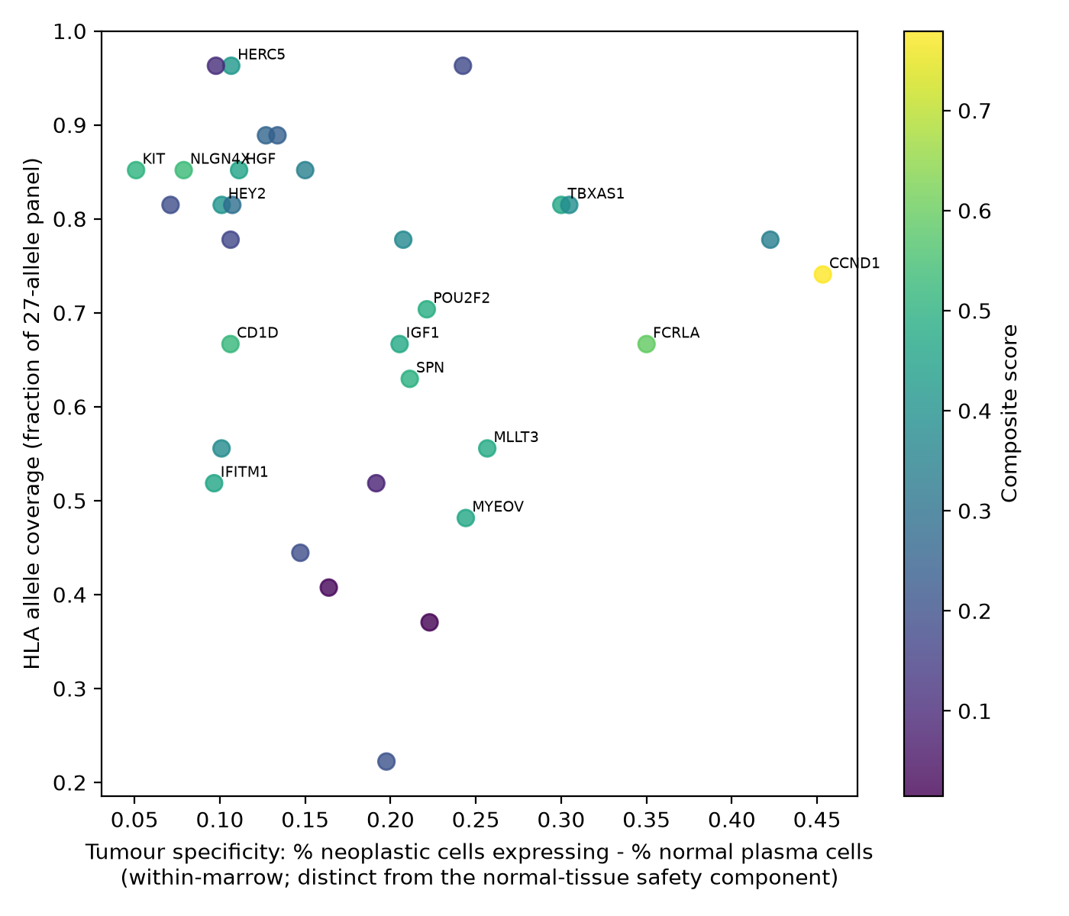
06 · NORMAL-TISSUE SAFETY
Restricted to which tissue, not how many
KEY TERMS IN THIS FIGURE
x-axis TUMOUR specificity — % SMM tumour cells expressing minus % normal plasma cells. Within-marrow.
y-axis HLA allele coverage — fraction of the 27-allele panel with a strong binder.
colour composite score, the final weighted rank.
NOT THE SAME AS THE 0.25 SAFETY WEIGHT
Tier | TISSUE safety — restricted to | Score
1a | bone marrow / lymphoid | 1.00
1b | testis — cancer-testis antigen | 1.00
2 | elsewhere, non-vital | 0.60
3 | neural or vital organ | rejected
4 | nothing — broadly expressed | 0.20
TAKEAWAY
▸ Two specificities: the x-axis is within marrow, the table across ~50 tissues.
▸ It removed 9 of an earlier 15. CADM1 retina, CD200 hypothalamus, IFI6 choroid plexus — seven had held the maximum safety score.
▸ Marrow pooled with lymphoid, on purpose. HPA marrow is 1% plasma cells — a marrow outlier is a myeloid signature.

Slide 8
07 · THE KNOWLEDGE LAYER
Two categories, combined by a grid
Confidence | is it plausibly a myeloma antigen?
A | established myeloma antigen or oncogene
B | plausible — pathway, family or lineage
C | no known myeloma role
D | housekeeping / essential → REJECTED
THE GRID → NOVELTY_CONFIDENCE, 0–10
conf ↓ / nov → | 1a | 1b | 2 | 3 | 4
A | 10 | 3 | 8 | 9 | –
B | 8 | 2 | 7 | 7 | 6
C | 5 | – | 5 | 4 | 3
D | 0 | 0 | 0 | 0 | 0
Novelty | how far has it already been developed?
1a | vaccine in clinical study in another cancer
1b | vaccine in clinical study in myeloma — crowded
2 | CAR / antibody / ADC / bispecific in myeloma
3 | published relevance, no clinical program
4 | not previously described as a myeloma marker
TAKEAWAY
▸ Why a grid, not a weighted sum. Confidence is monotonic — A always beats D. Novelty is not: already in a myeloma trial means validated but taken.
▸ These are hand-set ordinals, not fitted values. So the ordering is what carries the argument, not the spacing — replacing every value with its pure rank keeps 14 of 15 shortlisted genes.
▸ And the ranking barely depends on them. Perturbing every cell by ±1 across 500 grids leaves ranks 1–11 unchanged; only slots 14–15 move. The top-left cell is empty in this run.
WHERE THE NUMBERS COME FROM
confidence sets the band A 8–10 · B 6–8 · C 3–5 · D 0. How likely this is a real myeloma antigen.
novelty positions within it de-risking raises, crowding lowers: 1a > 3 ≈ 2 > 4.
1b drops out of the band 10 → 3 at confidence A. Someone already has a vaccine — that overrides everything else.

Slide 9
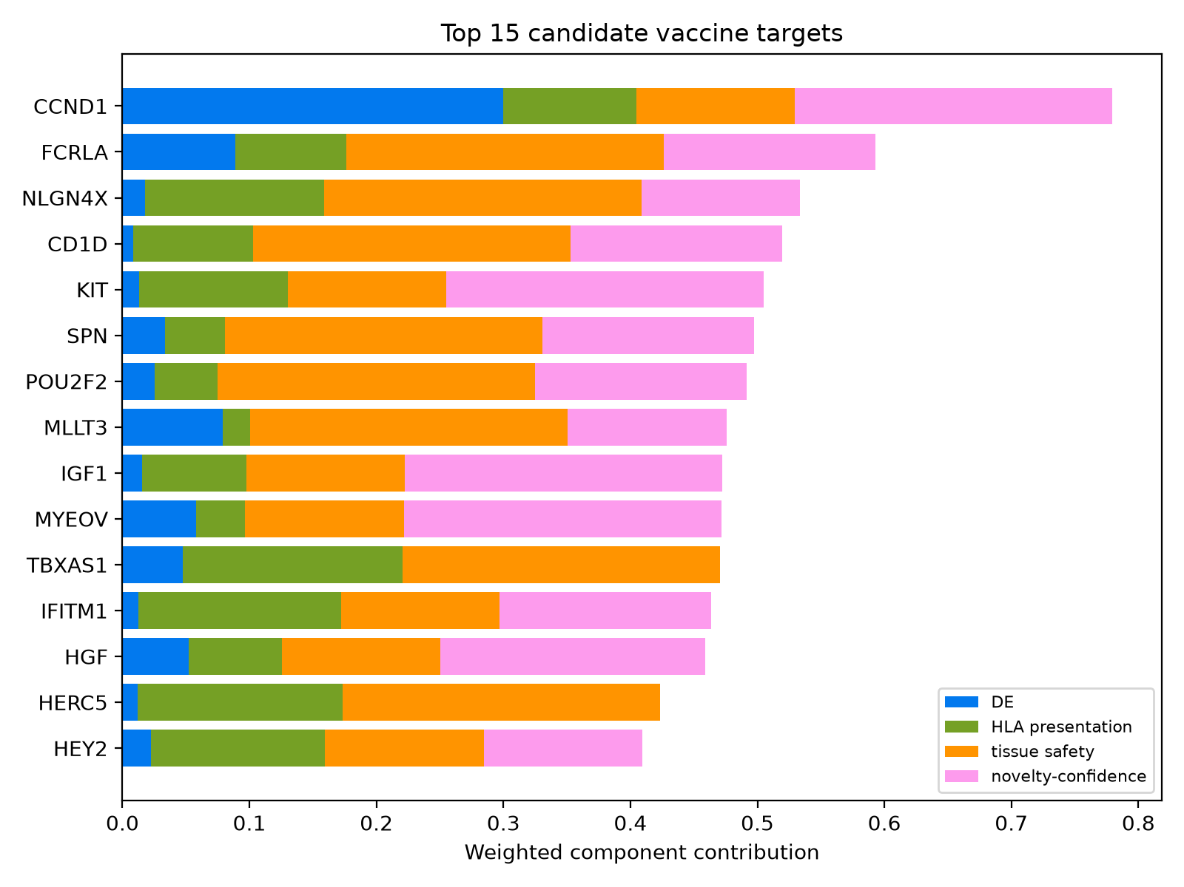
08 · COMPOSITE SCORE
Where each target's score comes from
KEY TERMS IN THIS FIGURE
x-axis weighted contribution — each segment is component × its weight; the bar total IS the composite score.
blue DE evidence · 0.30 — log2FC × recurrence × tumour specificity
green HLA presentation · 0.20 — epitope density × allele coverage
orange tissue safety · 0.25 — the tier score from ~50 HPA tissues
pink novelty-confidence · 0.25 — the grid value, rescaled
TAKEAWAY
▸ Read the composition, not the total — a long bar of one colour is fragile.
▸ CCND1 maxes two layers. The full 0.30 on DE and the full 0.25 on novelty-confidence — the only gene to top both. Its brake is tissue: tier 2, not lymphoid.
▸ Two targets score zero on a whole layer. TBXAS1 and HERC5 contribute nothing from novelty-confidence — a quarter of the scale, empty.

Slide 10
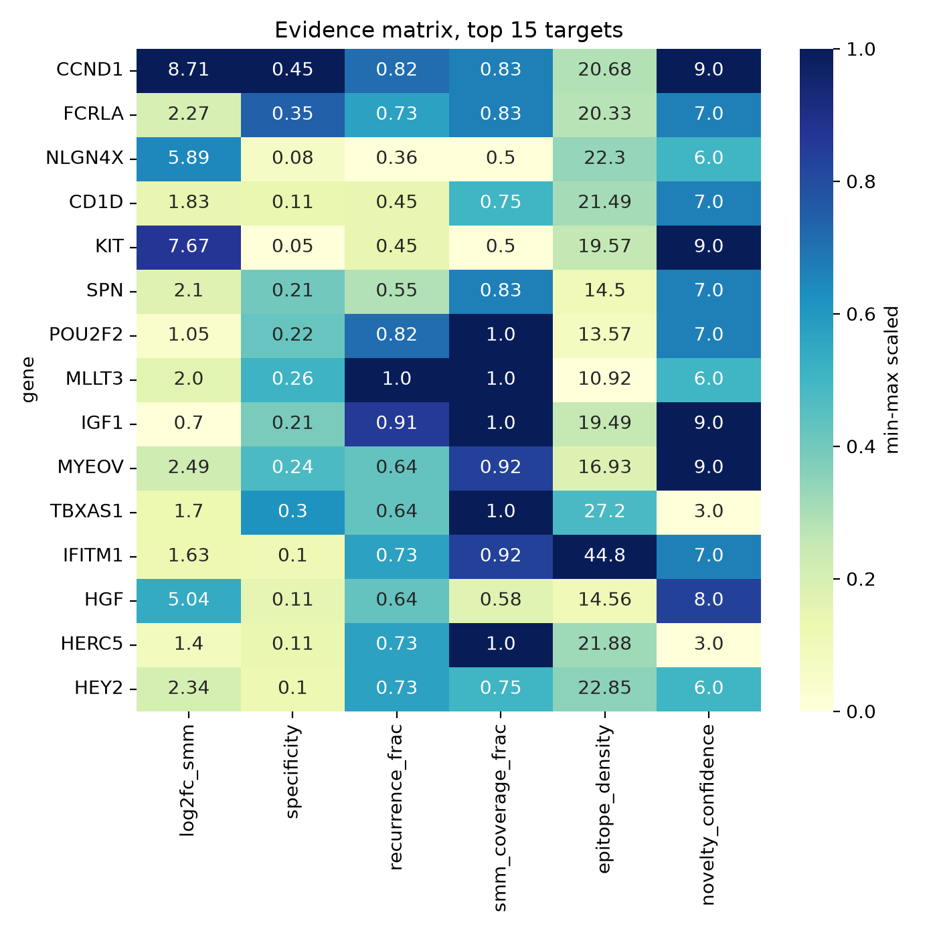
09 · EVIDENCE MATRIX
The six quantities the composite runs on
KEY TERMS IN THIS FIGURE
log2fc_smm effect size — SMM tumour vs healthy donor (contrast B)
specificity % tumour cells expressing minus % normal plasma cells
recurrence_frac fraction of the 11 paired patients where the gene is genuinely up
smm_coverage_frac fraction of the 12 SMM tumours expressing it at ≥5 CPM
epitope_density strong HLA-I binders per 100 aa — length-normalised
novelty_confidence 0–10 from the grid on the previous slide
TAKEAWAY
▸ Colour is scaled within each column. Compare down a column, never across. The printed number is raw.
▸ HERC5 rides one column. 59% of its score is tissue safety alone.
▸ CCND1 pairs the largest fold change with maximum novelty-confidence.
▸ TBXAS1 and MLLT3 show full SMM coverage on modest effect sizes.

Slide 11
10 · SHORTLIST
15 candidates of 32, evidence visible
# | Gene | Score | N-C | Cf | Nv | Tis | Recur | SMM pr | SMM cov
1 | CCND1 | 0.779 | 9 | A | 3 | 2 | 9/11 | 5/5 | 10/12
2 | FCRLA | 0.593 | 7 | B | 3 | 1a | 8/11 | 3/5 | 10/12
3 | NLGN4X | 0.534 | 6 | B | 4 | 1a | 4/11 | 2/5 | 6/12
4 | CD1D | 0.520 | 7 | B | 3 | 1a | 5/11 | 2/5 | 9/12
5 | KIT | 0.505 | 9 | A | 3 | 2 | 5/11 | 3/5 | 6/12
6 | SPN | 0.498 | 7 | B | 3 | 1a | 6/11 | 4/5 | 10/12
7 | POU2F2 | 0.491 | 7 | B | 3 | 1a | 9/11 | 4/5 | 12/12
8 | MLLT3 | 0.476 | 6 | B | 4 | 1a | 11/11 | 5/5 | 12/12
9 | IGF1 | 0.472 | 9 | A | 3 | 2 | 10/11 | 4/5 | 12/12
10 | MYEOV | 0.471 | 9 | A | 3 | 2 | 7/11 | 2/5 | 11/12
11 | TBXAS1 | 0.471 | 3 | C | 4 | 1a | 7/11 | 5/5 | 12/12
12 | IFITM1 | 0.464 | 7 | B | 3 | 2 | 8/11 | 4/5 | 11/12
13 | HGF | 0.459 | 8 | A | 2 | 2 | 7/11 | 3/5 | 7/12
14 | HERC5 | 0.423 | 3 | C | 4 | 1b | 8/11 | 4/5 | 12/12
15 | HEY2 | 0.410 | 6 | B | 4 | 2 | 8/11 | 4/5 | 9/12
COLUMNS
N-C novelty-confidence, 0–10
Cf / Nv confidence letter / novelty tier
Tis tissue tier from the safety test
rose row tier 1a/1b — lymphoid or testis-restricted, the two safest tiers
amber row antigen NOT retained into MM
Recur · SMM pr · SMM cov paired patients · paired SMM · SMM tumours
TAKEAWAY
▸ Six are lymphoid-restricted AND confidence A/B. FCRLA, NLGN4X, CD1D, SPN, POU2F2, MLLT3 — two independent lines agreeing.
▸ FCRLA is the strongest. Tightest lymphoid restriction (FDR 9.5e-09), 10/12 SMM coverage, 8/8 in MM.
▸ NLGN4X is what data alone could not find. Its Y-paralogue is an H-Y minor histocompatibility antigen.
▸ CCND1 at rank 1 is a trap. Not retained into MM, t(11;14)-restricted, partly definitional.

Slide 12
11 · WHAT THE PIPELINE CAUGHT, AND WHAT IT CANNOT
Honest uncertainty
BUGS THIS PIPELINE CAUGHT
WHAT IT STILL CANNOT DO
▸ A filter that discarded 38 real genes. startswith("IG") removed the entire IGF axis.
▸ Two artifacts in an earlier top 15. Direction-only recurrence counted near-ties on near-zero values as enrichment.
▸ A cardiac safety flag. ST3GAL6 at rank 2, seen only with the full HPA reference.
▸ A gene flat in the indication. SLC1A5 reached rank 15 at B log2FC 0.20.
▸ Silent gene loss to a timeout. Two candidates vanished on a UniProt fetch.
▸ Self-tolerance is unmodelled. Affinity is not immunogenicity; the T-cell repertoire may already be deleted. The biggest reason a shortlist like this fails in the lab.
▸ One LLM claim was checked, and it drifted. NCT03591614 is a real DKK1 vaccine in SMM — but dendritic-cell, not the DNA plasmid named, wrong sponsor, withdrawn at zero enrolment. NLGN4X at rank 3 is still unchecked.
▸ Everything is RNA. CPQ stains highest in kidney and liver — that would be tier 3.
▸ The labels are partly circular. Neoplastic status came from clustering, so DE re-derives cluster genes.

