Slide 1
What is a Database?
Collection of related data central to a given enterprise
Examples:
Banking – savings/checking accounts, mortgage, etc
Vehicle registration – car registration, year, make, etc
Student registration – name, PID, GPA, last semester enrolled, etc
Electronic Medical Records – name, SSN, date of birth, address, symptoms, diseases, medication, test results, etc
Sales – customer purchase transactions, customer complaints, etc

Slide 2
Database Management System (DBMS)
A collection of programs that enables users to create and maintain a database
Examples of DBMS
MS Access, MS SQL Server, IBM DB2, Oracle, Sybase, Postgres, mySQL, and many more
These are relational DBMS (which mean, these systems would model the data as a collection of relations/tables)
We will use mySQL as our DBMS for this class

Slide 3
SQL (Structured Query Language)
A language provided by relational DBMS to
Create a table
Alter the schema (structure) of a table
Insert data records into a table
Delete data records from a table
Query a table
etc

Slide 4
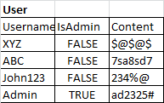

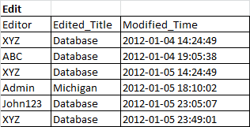
Example: Wikipedia Database
Edit is a relationship between user and article

Slide 5
CREATE TABLE
CREATE TABLE Edit (
Editor VARCHAR(50),
Edited_Title VARCHAR(50),
Modified_Time DATETIME,
PRIMARY KEY(Editor, Edited_Title, Modified_Time);
FOREIGN KEY (Editor) REFERENCES User(Username), FOREIGN KEY (Edited_Title) REFERENCES Article(Title)
);
A foreign key is used to enforce the constraint that rows which were referenced in the Edit table exists in the referenced table

Slide 6
DROP TABLE
Delete a table from the database
After deletion, the table can no longer be used in queries, updates, or any other commands since its description no longer exists
Example: DROP TABLE USER;

Slide 7
Retrieval Queries in SQL
Basic form of the SQL retrieval queries:
SELECT <attribute list>
FROM <table list>
WHERE <condition>
<attribute list> is a list of column names whose values are to be retrieved by the query
<table list> is a list of table names required to process the query
<condition> is a conditional (Boolean) expression that identifies the rows to be retrieved by the query

Slide 8
SQL Query for 2 Tables
Query: Find the titles of Wikipedia articles edited by administrators
SELECT Edited_Title
FROM User AS U, Edit AS E
WHERE U.Editor = E.Username AND U.IsAdmin = True;
Join condition

Slide 9
NoSQL
Not only SQL (does not mean No SQL)
Supports distributed data storage and processing across multiple servers
Motivation
Lots of new applications that require large data storage
Traditional database systems provide many functionalities (e.g., powerful query languages, concurrency control) that are overly complex and not needed by the applications
The structured data model used by traditional database systems is also too restrictive for the new applications
E.g., Schema is often fixed and not flexible enough

Slide 10
MongoDB
An open-source, document database
Stores data as collections of documents in binary JSON (BSON) format
Each document in a given collection has a unique id (key)
MongoDB database
Collection 1
Collection 2
Set of JSON Documents
Set of JSON Documents

Slide 11
CRUD Operations
Create: create a document to be inserted into collection
db.<collection_name>.insert(<document(s)>)
Read: find a document in the collection
db.<collection_name>.find(<condition>)
Update: update a document in the collection
db.<collection_name>.update(<condition>)
Delete: remove a document from the collection
db.<collection_name>.remove(<condition>)
http://api.mongodb.com/python/current/tutorial.html

Slide 12
Data Quality Issues
What are the data quality issues and how do they arise in your data?
Noise
Outliers
Missing values
Duplicate data

Slide 13
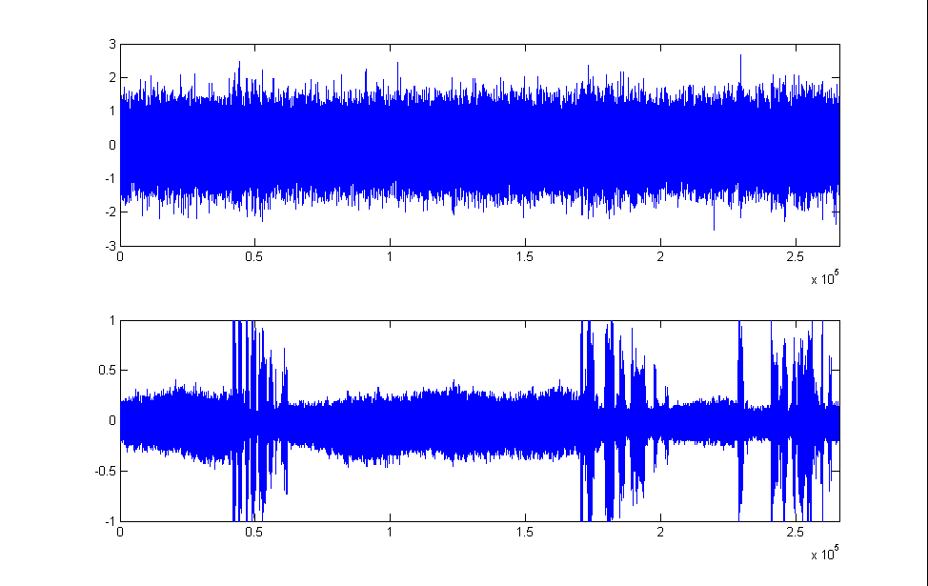
Noise
Noise refers to incorrect/modified values of the data
E.g., distortion of a person’s voice when talking on a poor phone
Noisy Audio
Original audio
Audio source: http://www.nasa.gov/mission_pages/apollo/apollo11_audio.html

Slide 14
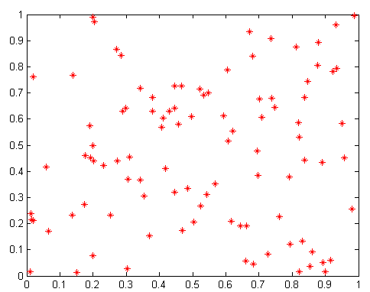
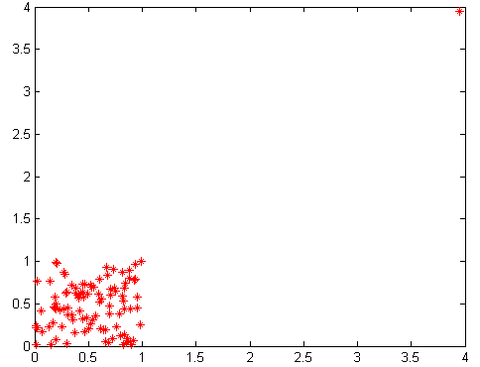
Outliers
Outliers are data objects with characteristics that are considerably different than most of the other data objects in the data set
Outlier
Outliers may inadvertantly increase correlation of data
Correlation = 0.0628
Correlation = 0.6278

Slide 15
Missing Values
Reasons for missing values
Information is not collected (e.g., people decline to give their age and weight)
Attributes may not be applicable to all cases (e.g., annual income is not applicable to children)
Handling missing values
Eliminate Data Objects with Missing Values
Estimate the Missing Values (Imputation methods)
Ignore the Missing Value During Analysis
Replace with all possible values (weighted by their probabilities)

Slide 16
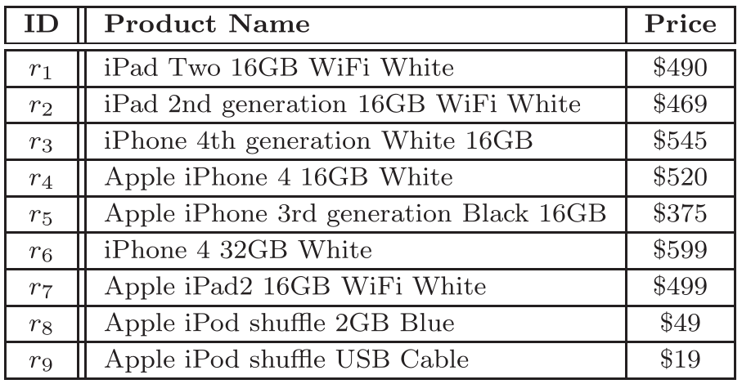
Duplicate Data
Data set may include data objects that are duplicates
Major problem when merging data from multiple sources
Examples:
Product table:
Paper citations:
L. Breiman, L. Friedman, and P. Stone, (1984). Classication and Regression. Wadsworth, Belmont, CA.
Leo Breiman, Jerome H. Friedman, Richard A. Olshen, and Charles J. Stone. Classification and Regression Trees. Wadsworth and Brooks/Cole, 1984.
Deduplication/Entity Resolution
Process of dealing with duplicate data issues

Slide 17
Discretization
Ordinal attribute
shirt size (small/medium/large), hurricane (category 1 – 5)
Numeric attribute:
Weight, height, salary, # days since Jan 1 2000.
Discretization is used to split the range of a numeric attribute into discrete number of intervals
Age can be discretized into [child, young adult, adult, and senior].
There may be no apparent relationship between age attribute and tendency to buy a particular product
But the relationship may exist only among certain age groups (e.g.young adults)

Slide 18
Unsupervised Discretization
Equal interval width
Split the range of the numeric attribute into equal length intervals (bins)
Pros: cheap and easy to implement
Cons: susceptible to outliers
Equal frequency
Split the range of the numeric attribute in such a way that each interval (bin) has the same number of points
Pros: robust to outliers
Cons: more expensive (must sort data), may not be consistent with inherent structure of the data

Slide 19
Supervised Discretization Example
Let “Buy” be the class attribute
Suppose we’re interested to discretize the Age attribute
We also want the intervals (bins) to contain data points from the same class (i.e., we want the bins to be as close to homogeneous as possible)
Age | Buy
10 | No
15 | No
18 | Yes
19 | Yes
29 | Yes
30 | Yes
31 | Yes
40 | No
44 | No
55 | No
64 | No

Slide 20
Entropy-based Discretization
A widely-used supervised discretization method
Entropy is a measure of impurity
Higher entropy implies data points are from a large number of classes (heterogeneous)
Lower entropy implies most of the data points are from the same class
Age | Buy
10 | No
15 | No
18 | Yes
19 | Yes
29 | Yes
30 | Yes
31 | Yes
40 | No
44 | No
55 | No
64 | No
Entropy-based Discretization with 3 bins
Where p_{j} is the proportion of data points belonging to class j

Slide 21
Summarization of Data Stream
Consider a data stream containing m tokens (items):
D = {t₁, t₂, t₃, t₄, …., t_{m}}
where each token t_{i} is an item chosen from the set {i₁, i₂, i₃, …, i_{n}}
The “items” could be integers, real numbers, strings, videos, etc.
Example of analysis tasks:
Numeric items: calculate mean and standard deviation
Symbolic items: Find most frequently occurring items

Slide 22
Mean and Standard Deviation
3
4
5
2
5
8
Memory
N
Sum
Sum of square
2
7
25
3
12
50
4
14
54
5
19
79
6
27
143
1
3
9
We only need 3 counters
Mean = 27/6 = 4.5; Std deviation = $\sqrt{\frac{6×143−{\left(27\right)}^{2}}{6×5}}$ = 2.07

Slide 23
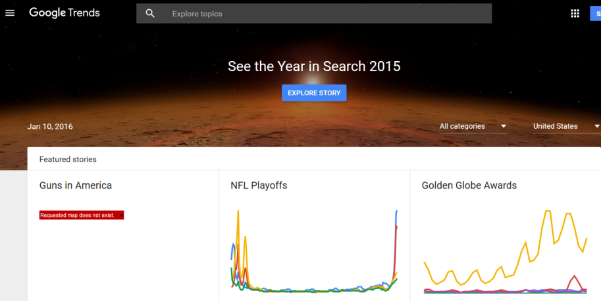
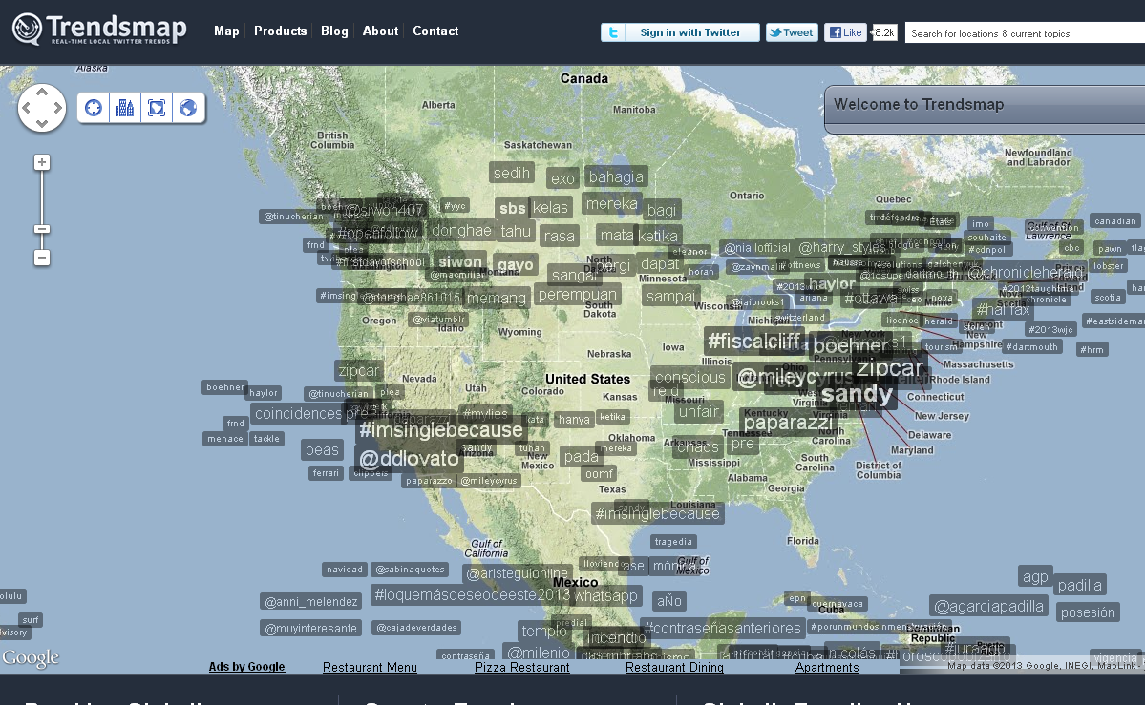
Heavy Hitter (Frequent Item) Problem
Consider the problem of identifying frequent items (e.g., trending hashtags on Twitter)
http://trendsmap.com/
http://www.google.com/trends/

Slide 24
Misra Gries (Streaming/Online Algorithm)
An approximate online learning algorithm
Let
m be the length of the data stream
n be the number of unique items
k-1 is the number of memory buffers available to store counters
Goal:
Identify all items whose frequency > m/k
Constraint
Storage complexity ~ O(k) instead of O(n)

Slide 25
Misra-Gries Algorithm
Initialize: f ← empty dictionary
for each token in the data stream
Let i be the corresponding item of the token
If i is in f then
f{i} ← f{i} + 1 (increment frequency count for f{i})
else if |f| < k – 1 then (if array is not full; k-1 is size of array)
f{i} ← 1 (insert item into array and set its frequency to 1)
else
for each i in I do f{i} ← f{i} – 1
if f{i} = 0 then remove i from f
for each item i in f do
add i to the result set

Slide 26
Predictive Modeling Framework
Classification or Regression technique

Slide 27
Predictive Modeling Techniques
Single Models
Decision Tree Methods
Rule-based Methods
Nearest-neighbor Methods
Artificial Neural Networks
Probabilistic Methods
Support Vector Machine/Regression
Ensemble Models
Boosting, Bagging, Random Forests

Slide 28
Decision Tree Induction Algorithm
1. Start with an initial node (let D₀ be the training instances)
2. Check whether a leaf node needs to be expanded (based on stopping criteria)
If not needed, then assign a class to the node based on the majority class of training instances in D₀.
D₀
D₀
Class=No
?
Home Owner
Yes
No
D₁
D₂
b. Else
i. Find the best attribute split condition
Ii, Distribute the training instances to their corresponding child nodes based on the outcome of the split condition.
3. Repeat Step 2 for each leaf node that has not been tested

Slide 29
How to determine the Best Split
Greedy approach:
Nodes that have purer class distribution after splitting are preferred
D₀
D₀
X
Y
Yes
No
Yes
No
D₁
D₂
D₁
D₂
Y is preferred over X to split the data D₀

Slide 30
Finding the Best Split
For each candidate attribute
Compute impurity measure of each child node
Compute the weighted average impurity measure of the children
Choose the attribute split condition that produces the lowest weighted impurity measure
I₁
I₂
…..
I_{p}

Slide 31
Measures of Node Impurity
Consider a k-class problem where the class label is either {1, 2, 3, …, k}
Let p(j) be the proportion of training instances of class j
2 popular measures for node impurity:

Slide 32
Example: Gini Index of a Single Node
P(C1) = 0/6 = 0 P(C2) = 6/6 = 1
Gini = 1 – P(C1)² – P(C2)² = 1 – 0 – 1 = 0
P(C1) = 1/6 P(C2) = 5/6
Gini = 1 – (1/6)² – (5/6)² = 0.278
P(C1) = 2/6 P(C2) = 4/6
Gini = 1 – (2/6)² – (4/6)² = 0.444

Slide 33
Model Evaluation
Accuracy is not suitable for imbalanced classes
If 90% of the data belongs to only 1 class, then a classifier that predicts every example to be in the majority class will be 90% accurate even if we’re more interested in predicting the rare class
Examples: intrusion/cyberthreat detection, disease prediction, fraud detection, earthquake prediction, etc
Alternative measures are needed
F-measure
Area under ROC curve

Slide 34
Training and Test Set Creation
Holdout Method
Reserve k% for training and (100-k)% for testing
Limitation: evaluation result may vary depending on how you split the data into training/test sets
Data
Training
k%
Testing
100% - k%

Slide 35
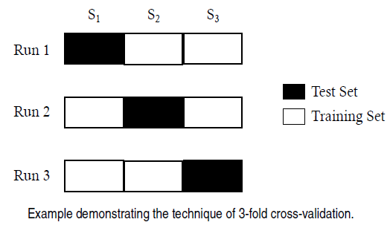
Training and Test Set Creation
Cross validation
Partition the data into k disjoint subsets
k-fold: train on k-1 partitions, test on remaining one
Leave-one-out: k=n

Slide 36
Model Overfitting
Goal of predictive modeling:
To build a model with low training and test errors
But this is a challenge because a model with low training error does not guarantee it will have low test error
This is due to an artifact known as model overfitting problem

Slide 37
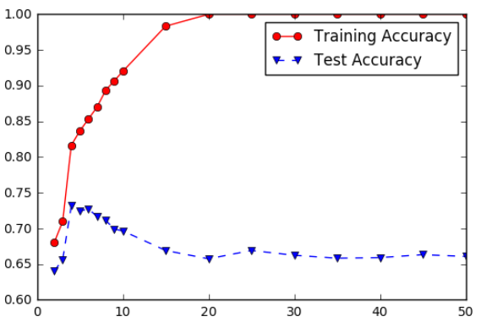
Model Overfitting and Underfitting
Underfitting: when model is too simple, both training and test accuracies are poor
Overfitting: when model is too complex, training accuracy is high but test accuracy is low

Slide 38
Overfitting
An overfitted model is undesirable because
The model may fit noise (mislabeled examples) in the training data
The model may fit exceptional cases (rather than the norm) in the training data

Slide 39
Lessons on Overfitting
Training error does not truly reflect how well the classifier performs on previously unknown data instances
Overfitting results in models that are more complex (larger) than necessary
Complexity can be measured in terms of size of tree, number of model parameters, etc.
Need a way to control complexity of the model during training
This is known as the model selection problem

Slide 40
Model Selection Using Validation Set
A general model selection approach that does not depend on the predictive modeling technique used
Divide the training data into two parts:
“Training” set: for model building
Validation set: for estimating generalization error; choose the model parameter that gives the lowest error on validation set
Drawback:
Less data would be available for training

Slide 41
Nearest-Neighbor Method
Given a test example:
Compute its distance to all the training examples
Identify its k nearest neighbors
Use the target values of the k nearest neighbors to predict the target value of test example
For classification, take majority vote
For regression, take the average value

Slide 42
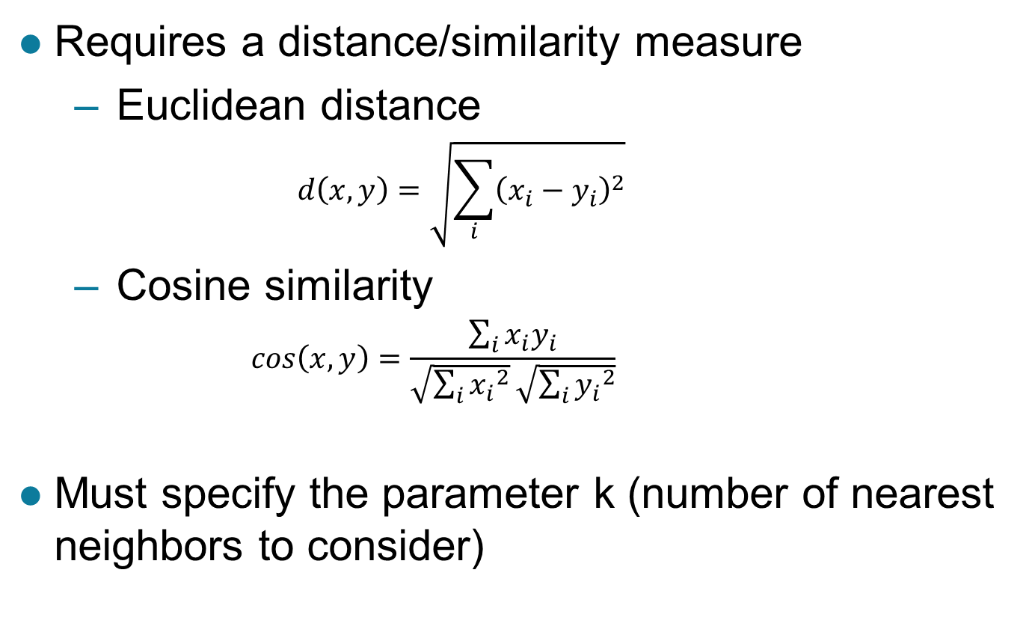
Nearest Neighbor Method
Requires a distance/similarity measure
Euclidean distance
$$d\left(x,y\right)=\sqrt{\sum_{i}{{\left(x_{i}−y_{i}\right)}^{2}}}$$
Cosine similarity
$$cos\left(x,y\right)=\frac{\sum_{i}{x_{i}y_{i}}}{\sqrt{\sum_{i}{{x_{i}}^{2}}}\sqrt{\sum_{i}{{y_{i}}^{2}}}}$$
Must specify the parameter k (number of nearest neighbors to consider)

Slide 43
Linear Method
Construct a linear decision boundary to separate training examples from different classes
+

Slide 44
Linear Method
General form of a linear model:
w’s are the model parameters
Many learning algorithms available to find the best linear model that fits w to the training data
Perceptron (single-layer neural network)
Support vector machine
Logistic regression

Slide 45
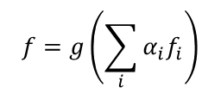
Ensemble Methods

Slide 46
Association rules: Problem Definition
Market-Basket transactions
Given: a set of transactions, where each transaction contains a set of items
Goal: extract a set of rules that represent the interesting relationships among items

Slide 47
Example: Market Basket Data
Market-Basket transactions
Association rule: X → Y
Interpretation:
Customers who buy X will also likely buy Y
X: rule antecedent
Y: rule consequent
Example of Association Rules
{Milk, Diaper} → {Beer}, {Bread} → {Milk}, {Milk} → {Bread}

Slide 48
Rule Evaluation Measures
Given an association rule X → Y
Support: measures the rule prevalence (i.e., how often it can be applied to the data)
Confidence (c): measures the strength of implication
I is an indicator function
T is number of transactions
Number of transactions that contain X and Y
Number of transactions that contain X

Slide 49
Rule Evaluation Measures: Examples

Slide 50
Clustering: Problem Definition
Given a collection of data instances
Each instance is by characterized by an attribute set x
Task:
Partition the data in such a way that instances in the same partition (cluster) are more similar to each other than to instances in other partitions (clusters)

Slide 51
Lots of Clustering Methods available
Partitional clustering
K-means and its variants (self-organized maps, bisecting k-means, fuzzy k-means, kernel k-means)
Spectral clustering
Support vector clustering
Density-based clustering
Hierarchical clustering
Agglomerative (Single-link, complete-link, group average, Ward’s method)

Slide 52
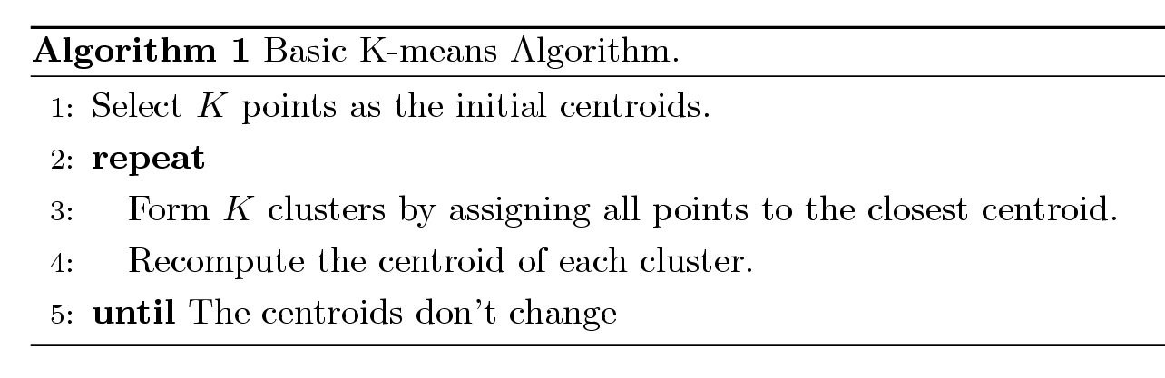
K-means Clustering
Partitional clustering approach
Each cluster is associated with a centroid (center)
Number of clusters, K, must be specified

Slide 53
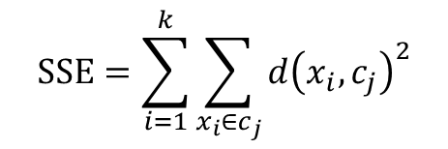
K-means Clustering – Details
Designed to minimize sum of square error (SSE)
SSE measures the sum-of-squared distance between every data point x_{i} to their cluster centroid c_{j}

Slide 54
Hierarchical Clustering
Produces nested clusters organized as a tree
Does not assume any particular number of clusters
Any desired number of clusters can be obtained by ‘cutting’ the dendrogram at the proper level
The tree may correspond to meaningful taxonomies

Slide 55
Agglomerative Hierarchical Clustering
Clusters are generated in a bottom-up fashion
Compute the proximity matrix
Let each data point be a cluster
Repeat
Merge the two closest clusters
Update the proximity matrix
Until only a single cluster remains
Key operation is the computation of the proximity of two clusters
There are many ways to define proximity between clusters

Slide 56
How to Define Inter-Cluster Proximity
p1
p2
p3
p4
p5
. . .
p1
p2
p3
p4
p5
MIN
MAX
Ward’s Method
.
.
.
Proximity Matrix
MIN (single-link): distance between 2 clusters A and B is given by shortest distance between a data point in A and a data point in B

Slide 57
How to Define Inter-Cluster Proximity
p1
p2
p3
p4
p5
. . .
p1
p2
p3
p4
p5
MIN
MAX
Ward’s Method
.
.
.
Proximity Matrix
MAX (complete-link): distance between 2 clusters A and B is given by largest distance between a data point in A and a data point in B

Slide 58
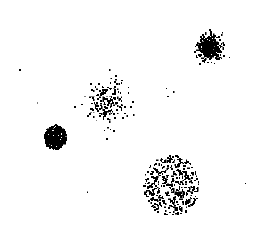
Anomaly Detection: Problem Definition
Given a collection of data instances
Each instance is by characterized by an attribute set x
Task:
Find a subset of instances whose characteristics are considerably different than the remainder of the data
Problem is also known as outlier, deviation or novelty detection

Slide 59
Basic Strategy in Anomaly Detection
Assumption: there are more “normal” than “anomalous” instances in the given data
General Approach
Build a profile of the “normal” behavior
A profile is a set of patterns or summary statistics characterizing the overall population
Use the “normal” profile to flag the anomalies
Anomalies are observations whose characteristics differ significantly from the normal profile

Slide 60
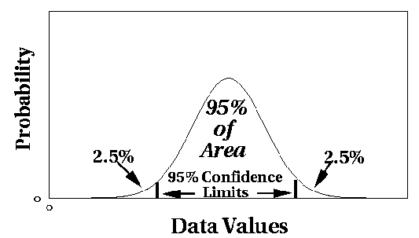
Z-Score Approach
Assume the data follows a Gaussian distribution
Outlier score for a data point x
Where μ is the mean and σ or Σ is a measure of dispersion (std deviation or covariance matrix)

