Slide 1
CSE 491/891
Lecture 8B (Hadoop on Amazon Web Services)

Slide 2
Using Amazon Web Service (AWS)
Sign up for the Service:
  Go to http://aws.amazon.com and click Sign Up Now.
  Follow the on-screen instructions. (Give your credit card information. You will be given a $100 amazon web service credit for this course, so you will not be charged until your credits run out)
  AWS will notify you by email when your account is available to be used
To redeem your AWS credit
  Email the instructor for your AWS credit code
  Enter the code: http://aws.amazon.com/awscredits

Slide 3
Services in AWS
Amazon Elastic Compute Cloud (EC2)
  Provides access to the cloud computing platform
  You can launch an SSH terminal to interact with the server
Amazon Elastic MapReduce (EMR)
  A server with Hadoop installed
Amazon S3
  For storing the data you want to process

Slide 4
Creating Key Pairs on EC2
Sign in to AWS (aws.amazon.com)
Click on the "Amazon Elastic EC2" tab.
Click on the "Key Pairs" link.
Click on the "Create Key Pair" button.
Enter a name and save the key file. Record the name and the path to the location of your key file as you will need it later

Slide 5
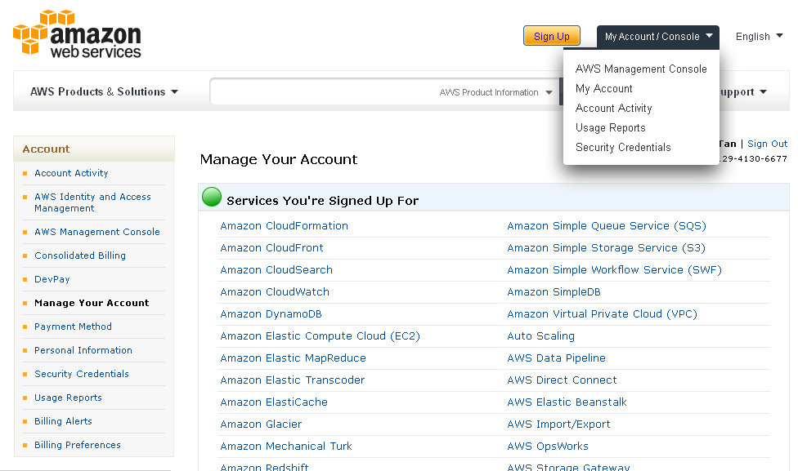
After Logging In…
Click here to create access keys

Slide 6
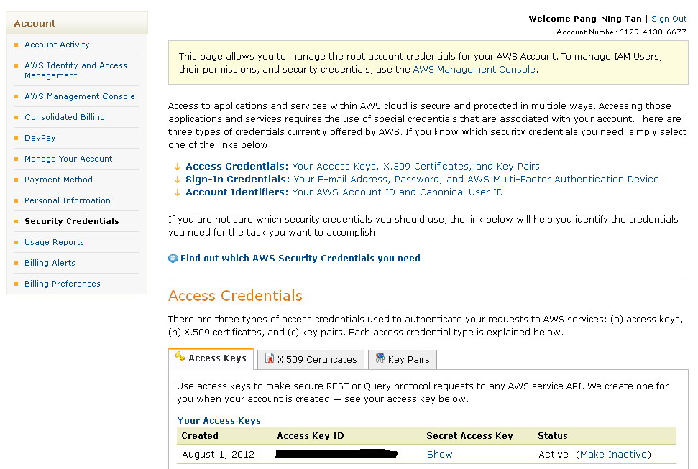
Creating Access Keys

Slide 7
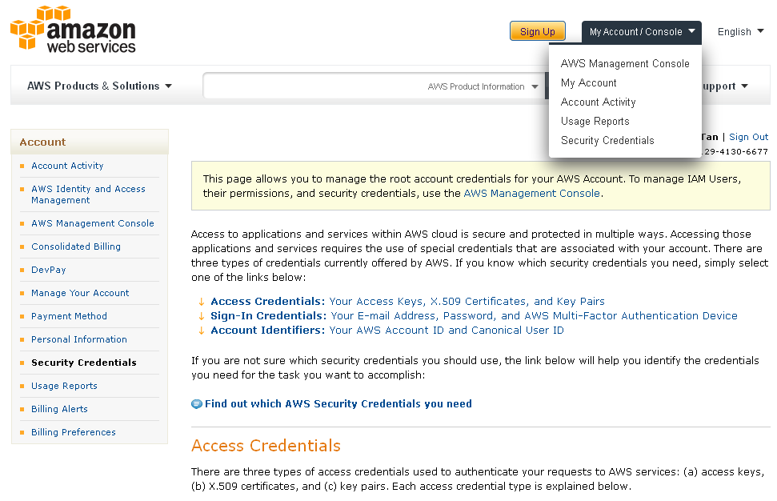
AWS Management Console
Go to main console

Slide 8
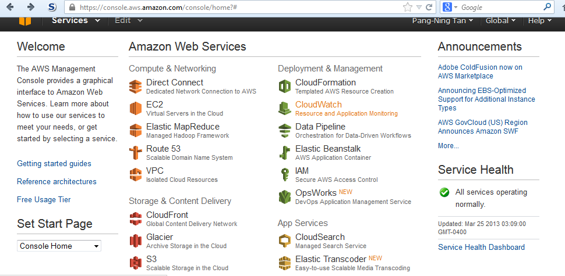
AWS Management Console
After logging in, click on Amazon Elastic MapReduce (EMR )

Slide 9
Amazon Elastic MapReduce
Simplifies running Hadoop and related big-data applications on AWS
Amazon EMR provides several types of clusters that you can launch to run Hadoop jobs
  Custom JAR
    Run your custom map-reduce program written in Java.
  Streaming
    Run a single Hadoop job based on map and reduce functions implemented in Ruby, Perl, Python, PHP, R, Bash, C++.
  Cascading
    This type of cluster installs the Cascading Java library, which provides features such as splitting and joining data streams.

Slide 10
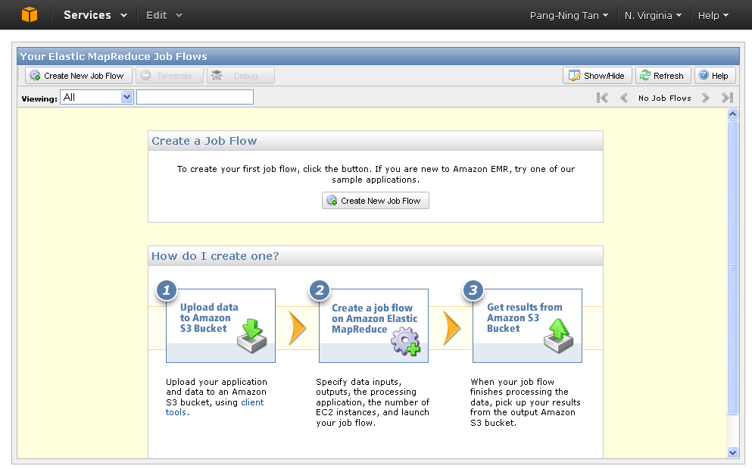
Amazon EMR
See tutorial: http://docs.aws.amazon.com/ElasticMapReduce/latest/DeveloperGuide/emr-get-started-count-words.html

Slide 11
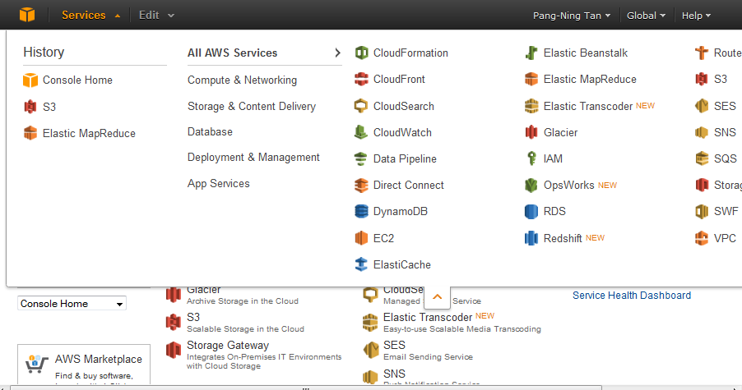
Step 1: Create Amazon S3 Bucket
Click on the Services menu and select S3

Slide 12
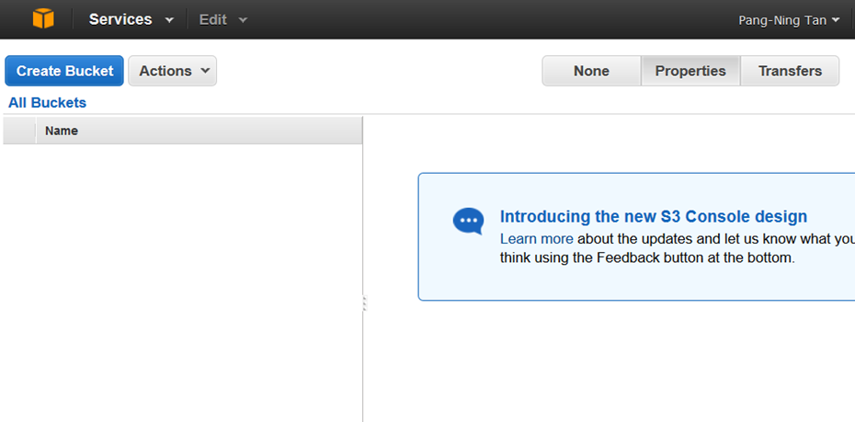
Step 1: Create Amazon S3 Bucket
Click Create Bucket

Slide 13
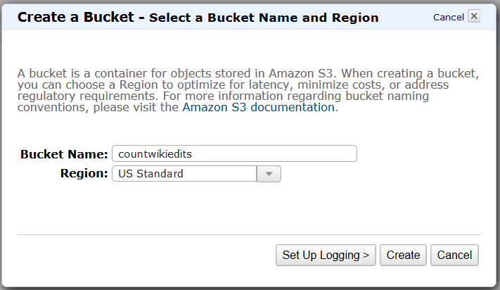
Step 1: Create Amazon S3 Bucket
Create a Bucket for storing objects (data, source code, output files, etc) associated with a project

Slide 14

Step 1: Create Amazon S3 Bucket
Enter a bucket name in the Bucket Name field.
  Name must be unique across all buckets in Amazon S3.
  IMPORTANT: Bucket name must contain only lowercase letters, numbers, periods (.), and dashes (-).
Select the Region for your bucket.
  To avoid paying cross-region bandwidth charges, create the Amazon S3 bucket in the same region as the job flow you'll launch

Slide 15
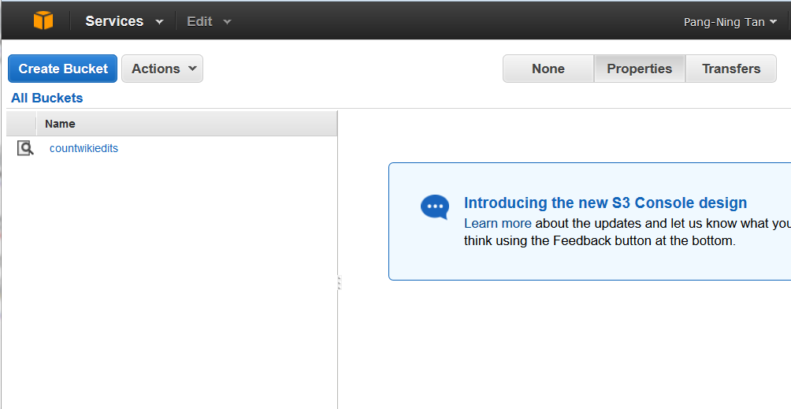
Step 1: Create Amazon S3 Bucket
Created a bucket called countwikiedits to store data files and source code (wiki.jar and wiki_edit.txt from lecture 16)

Slide 16
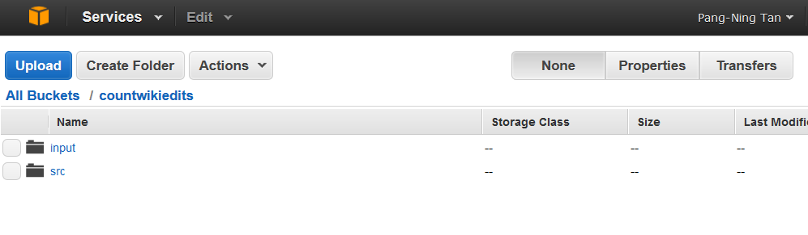
Step 2: Upload Files
Create folders to upload data and source code
  Click on create folder button
  Click on upload button
Created an input folder to store the data file (wiki_edit.txt)
Created a src folder to store the jar file (wiki.jar)
URI for the files are s3n://<bucketname>/<foldername>

Slide 17
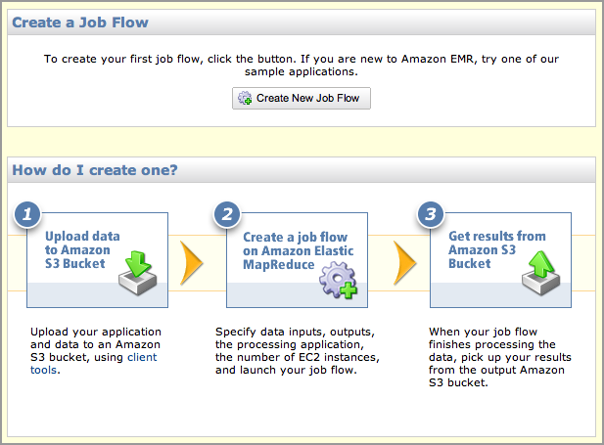
Step 3: Launch the Job Flow
Go to the AWS Management Console and open the Amazon Elastic MapReduce console
Click on Create New Job Flow

Slide 18
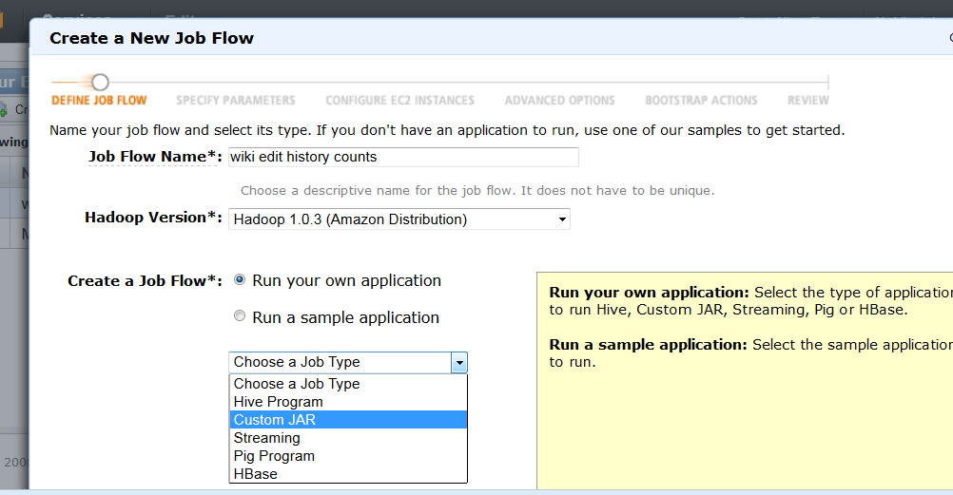
Step 3a: Create New Job Flow
Choose custom JAR if you have your own JAR file to run

Slide 19
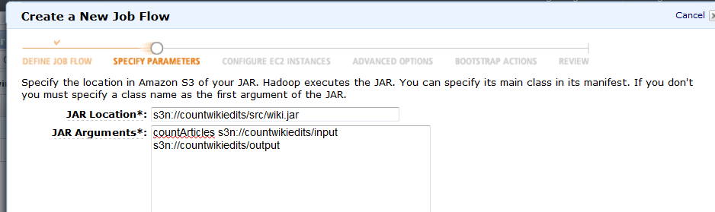
Step 3b: Define the Job Flow
Suppose you want to run the following:
hadoop wiki.jar CountArticles input output
JAR location: s3n://<bucketname>/<path>/<jarfile>
JAR arguments: countArticles s3n://<bucketname>/<inputdir>
s3n://<bucketname>/<outputdir>
IMPORTANT: Make sure output directory does not exist (otherwise there will be an error)

Slide 20
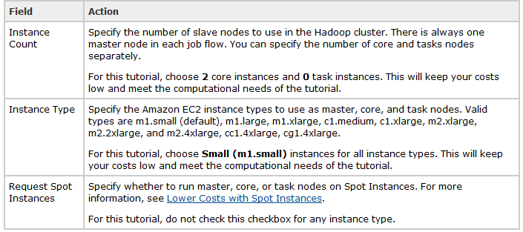
Step 3c: Configure the Job Flow
Configure the setting for the job flow
  To save money, don’t use too many instances (nodes) and select the job size to be small

Slide 21
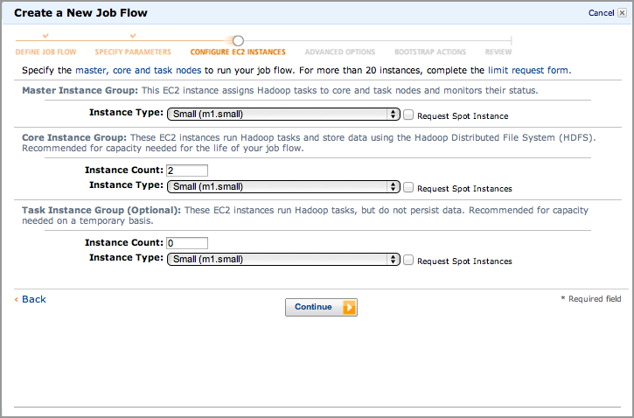
Step 3c: Configure the Job Flow

Slide 22
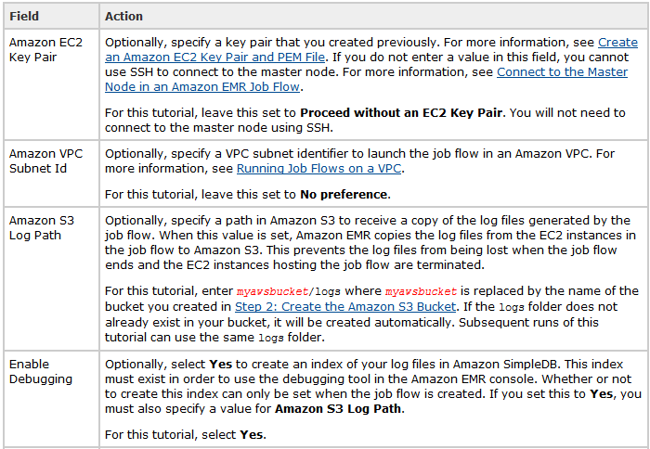
Step 3d: Configure Advanced Options
Set the additional configuration options

Slide 23
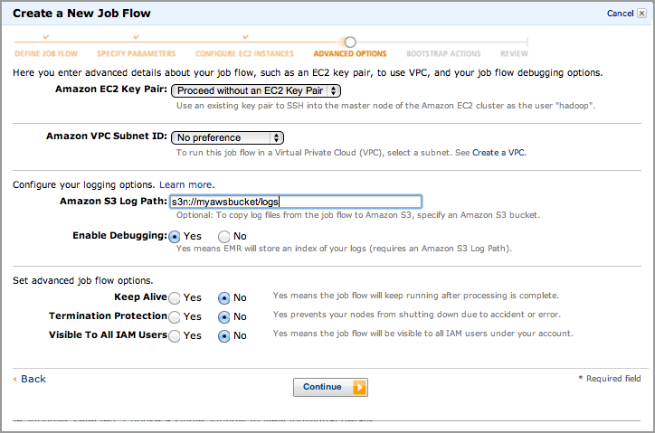
Step 3d: Configure Advanced Options

Slide 24
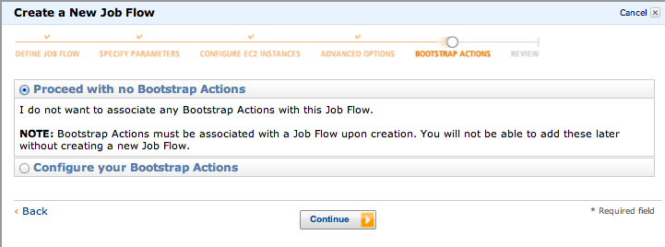
Step 3e: Configure Bootstrap Options
Bootstrap actions allow you to pass a reference to a script stored in Amazon S3. The script can contain configuration settings and arguments related to Hadoop or Elastic MapReduce. Bootstrap actions are run before Hadoop starts and before the node begins processing data.

Slide 25
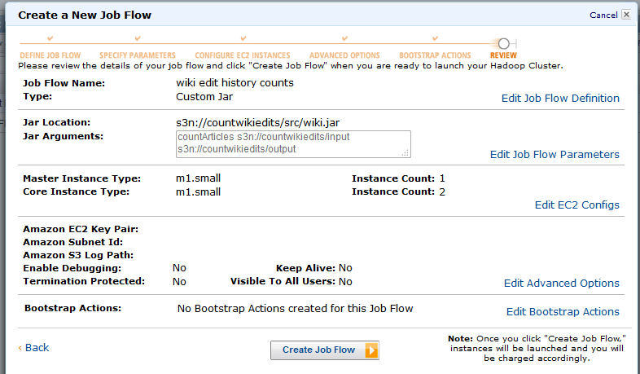
Step 3f: Review the Job Flow
Review the information, edit if necessary to correct any of the values, and then click Create Job Flow.

Slide 26
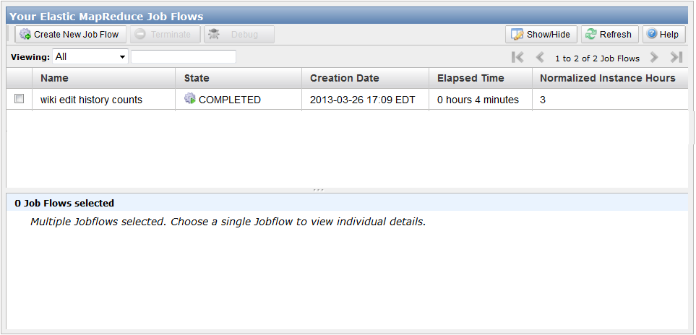
Step 3g: Wait till Completion
EMR console shows status of the new job flow; wait until job completes (you can log off and then log back in again some time later for jobs that take a long time)

Slide 27
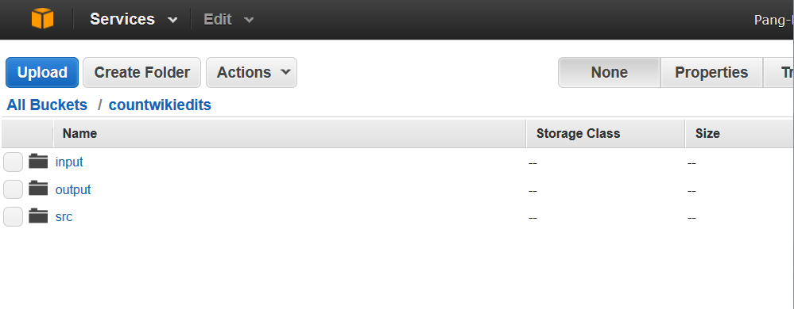
Step 4: Review the Results
Go to Amazon S3; look for the output directory in the bucket (which you had specified in the job arguments)
Click on the output folder to view the results

Slide 28
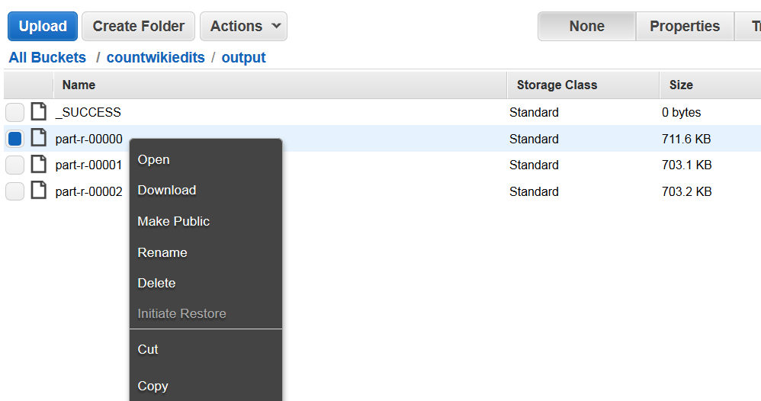
Step 4: Review the Results
You can download your results after running the job

Slide 29
Step 5: Clean Up (Important)
You should delete the Amazon S3 bucket to ensure it does not accrue additional storage charges
You do not need to delete the completed job flow. After a job flow ends, it terminates the associated Amazon EC2 instances and no longer accrues Amazon EMR maintainance charges.

Slide 30
Step 5: Clean Up (Important)
You should also ensure that logging for your Amazon S3 bucket is disabled. Otherwise, logs might be immediately written to your bucket after you delete your bucket's objects.
To disable logging
  Open the Amazon S3 console at https://console.aws.amazon.com/s3/.
  Right-click your bucket and select Properties. The Properties pane appears.
  Click the Logging tab.
  Deselect the Enabled check box to disable logging.

