Slide 1
CSE 482
Overview for Final Exam

Slide 2
Intro to MapReduce and Hadoop
What is Hadoop and MapReduce?
Why use Hadoop/MapReduce?
What is Hadoop distributed file system (HDFS)?
How to use HDFS?
How to run a MapReduce job on Hadoop cluster?

Slide 3
Hadoop Distributed File System (HDFS)
Important: Before you run any Hadoop jobs, you must first upload your data set to HDFS
After the job has completed, you can copy the results from HDFS to your local filesystem
Thus, when executing a Hadoop program, you must be able to distinguish between the local filesystem and the Hadoop filesystem (HDFS)

Slide 4

Basic HDFS commands
Syntax:
To list files in current directory:
To view the subdirectories:
To make a directory:
To copy a file from HDFS to local filesystem
To copy a file from local filesystem to HDFS

Slide 5


Basic HDFS Commands
To view a file
If file is too large, can pipe it to a Linux command
To display the last kilobyte of the file
To delete a file
To remove a directory

Slide 6
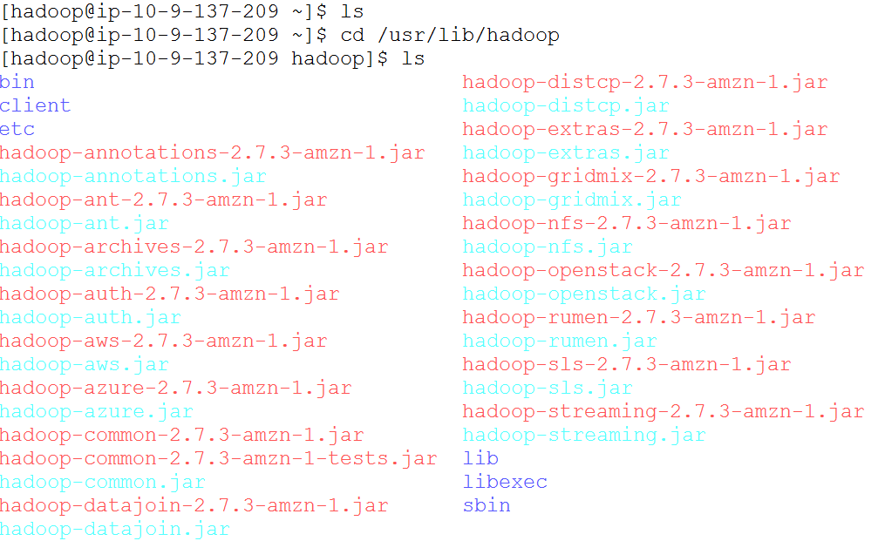
Running a Hadoop Job
Directory that contains hadoop installation on AWS

Slide 7
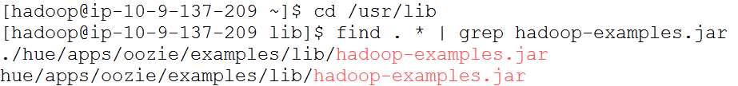
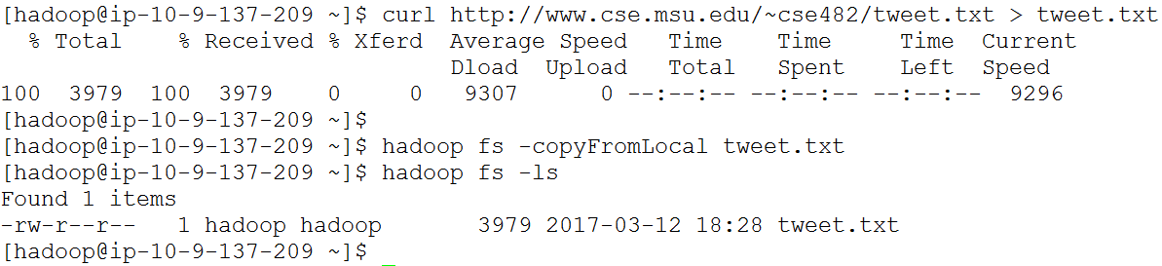
WordCount Example
Part of hadoop-examples.jar code
Example: count frequency of terms that appear in tweets from CDCgov

Slide 8

WordCount Example
Every line in the tweet.txt file corresponds to a separate tweet message

Slide 9
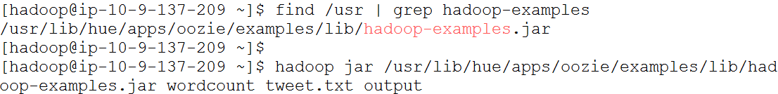
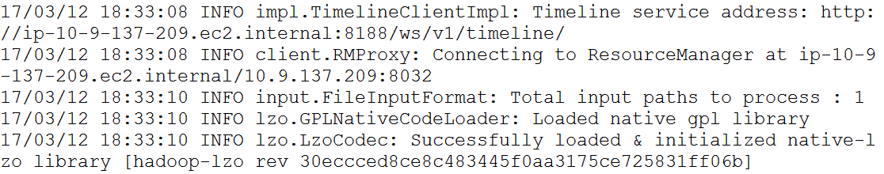

WordCount Example
First, you need to locate hadoop-examples.jar file.
Next, you will run the hadoop wordcount program on the tweet.txt file

Slide 10
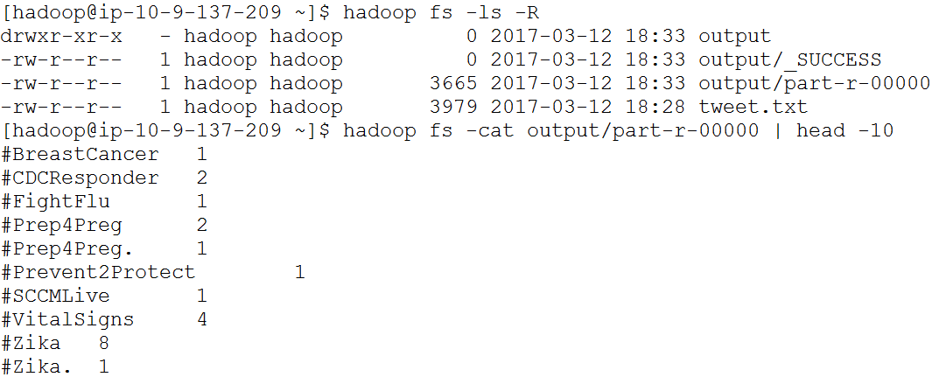
WordCount Example
After the program has been successfully completed, you can visualize the solution in output/part-r-00000

Slide 11
Hadoop Programming Model
To write a Hadoop program, we need to decompose the computational problem into a set of map and reduce tasks
Map task
Performs local computation at each node
Reduce task
Aggregates the partial results generated by the mapper nodes to obtain the “global” solution
Input and output of map and reduce tasks are key-value pairs

Slide 12
Hadoop Programming Model
Mapper: transforms its block of input data into a form that can be aggregated by the reducers
Input: (key1, value1) pairs
Output: (key2, value2) pairs
Reducer: aggregates the list of values associated with each key and writes it to the output
Input: (key2, list of value2) pairs
Key2 is the same type as output key of the mapper task
Input records are sorted based on key2
Output: (key3, value3) pairs

Slide 13
Distributed Word Count Example
Input data files
key-value pairs
key-value pairs
Mapper
(0, This is a cat!)
(14, cat is ok)
(24, walk the dog)
…
(this, 1)
(is, 1)
(a, 1)
(cat, 1)
(cat, 1)
(is, 1)
…
map() function
cat *
Mapper input
Mapper output
Sorting, partitioning, shuffling
Output (part-r-00000)
(a, 6)
(and, 2)
(be, 3)
(cat, 4)
(dog, 2)
…
Reducer
(a, [1, 1, 1, 1, 1, 1])
(and, [1, 1])
(be, [1, 1, 1])
(cat, [1, 1, 1, 1])
(dog, [1, 1])
…
reduce() function
Reducer output
Reducer input
key-value pairs
Key, list of values pairs

Slide 14
Combiners
If you have a billion records, the mappers may generate more than a billion key-value pairs
Combiners help by performing a local reduce on each key before sending the output to the reducers
Combiner function performs the same transformation to the intermediate results as the reduce function
Note: The combiner function may be applied zero, one, or more times
Not all reduce operations can be refactored into combiners:
max ([list1, list2]) = max( [max(list1), max(list2)] )
avg ([list1, list2]) ≠ avg( [avg(list1), avg(list2)] )

Slide 15
Combiner (A local reducer)
Input data files
key-value pairs
Mapper
(this, 1)
(is, 1)
(a, 1)
(cat, 1) …
(0, This is a cat!)
(14, cat is ok)
(24, walk the dog)
…
map() function
cat *
Combiner
reduce()
Output (part-r-00000)
(a, 6)
(and, 2)
(be, 3)
(cat, 4)
(dog, 2)
…
Reducer
(a, [1, 1, 1, 1, 1, 1])
(and, [1, 1])
(be, [1, 1, 1])
(cat, [1, 1, 1, 1])
(dog, [1, 1])
…
(this, 1)
(is, 2)
(a, 1)
(cat, 2)
(ok, 1)
…
reduce() function
Sorting, partitioning, shuffling
Combiner performs a local reduce before sending the output to a reducer

Slide 16
Partitioner
When there are multiple reducers, we need to determine which reducer to send the key-value pairs
Default partitioning approach is to hash the key
Output (part-r-00000)
(a, [1, 1, 1, 1, 1, 1])
(be, [1, 1, 1])
(cat, [1, 1, 1, 1])
(frog, [1, 1])
…
Sorting, partitioning, shuffling
(a, 6)
(be, 3)
(cat, 4)
(frog, 2)
…
Reducer
reduce() function
Mappers outputs
(part-r-00001)
Reducer
(and, [1, 1, 1, 1])
(big, [1, 1, 1])
(can, [1, 1, 1, 1, 1])
(dog, [1, 1, 1])
…
(and, 4)
(big, 3)
(can, 5)
(dog, 3)
…
reduce() function

Slide 17
Compiling a Hadoop Java Program
To compile the hadoop Java program
hadoop com.sun.tools.javac.Main <filename>.java
Output of compilation: a collection of *.class files
*.class includes the main class of the program, mapper class, reducer class, and partitioner class (if defined)
You need to “archive” them into a single (jar) file
To create the jar file, type the following:
jar cf <jarfilename>.jar *.class

Slide 18
Executing Hadoop Program
First, you must upload the input data to HDFS
Execute the program by typing the following:
hadoop jar <jarfile> <classfile> <arguments>
Example:
hadoop jar myHadoop.jar mainClass inputDir outputDir
Download the results from HDFS
If you have only 1 reducer
hadoop fs -copyToLocal outputDir/part-r-00000 results.txt
If you have more than 1 reducer
hadoop fs -getMerge outputDir results.txt

Slide 19
Hadoop Data Types for Keys & Values
Key and value cannot be arbitrary types because the Hadoop framework has a certain way of serializing the key/value pairs to move them across the cluster’s network
Only classes that support this kind of serialization can function as keys or values in the framework
Classes that implement the WritableComparable interface can be either keys or values
Classes that implement the Writable interface can be used as data type for values

Slide 20
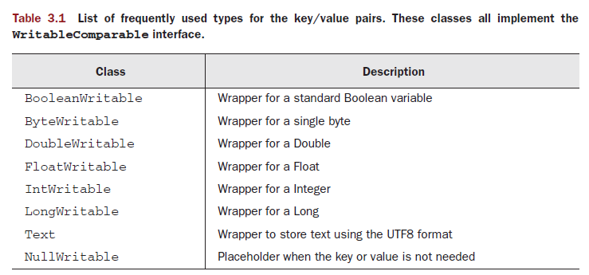
Hadoop Data Types for Keys & Values
These classes are defined in org.apache.hadoop.io package

Slide 21
Hadoop Data Types for Keys & Values
Use get and set functions to convert the variable between Hadoop and standard data types
Example:
Intwritable count = new Intwritable(50);
int value = count.get(); // value = 50
Text word = new Text();
String str = new String(“twitter”);
word.set(str); // word is assigned to “twitter”

Slide 22
Mapper Class
You only need to implement the map() function
public static class TokenizerMapper extends Mapper < Object, Text, Text, IntWritable > {
public void map (Object key, Text value, Context context) throws IOException, InterruptedException { …
} }
Context object is used to interact with Hadoop system
E.g., to write key-value pairs as mapper/reducer output
context.write(key, value)

Slide 23
Reducer Class
You only need to implement the reduce() function
public static class IntSumReducer extends Reducer < Text, IntWritable, Text, IntWritable > {
public void reduce (Text key, Iterable<IntWritable> values, Context context) throws IOException, InterruptedException { …
} }
values is an Iterable object
In the reduce function, you will often iterate through the values while applying some aggregation function

Slide 24
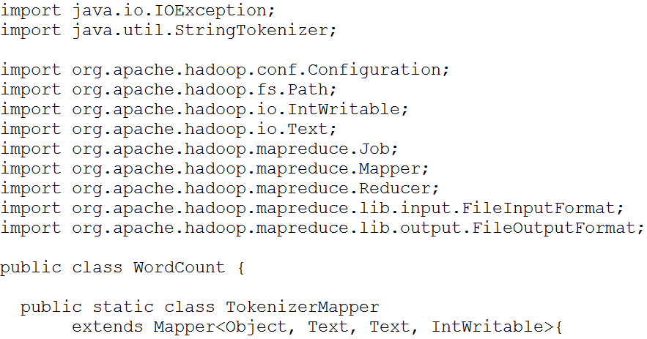
Main Program
…

Slide 25
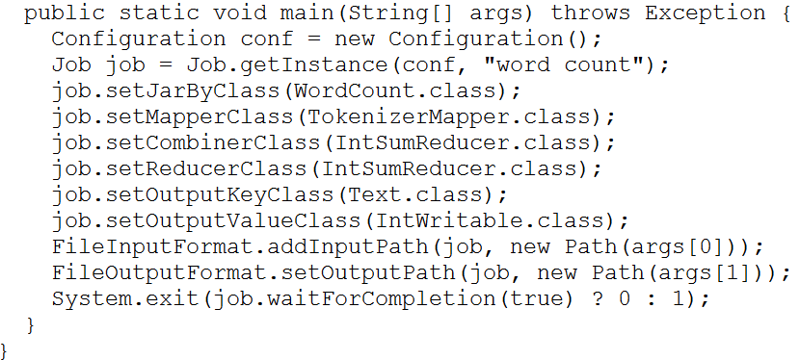
Main Program
…

Slide 26
Hadoop I/O
Hadoop configuration, generic options, and parameter passing
InputFormat and OutputFormat
SequenceFiles
Data Compression

Slide 27
Configuration
You can change the configuration properties by
Providing another configuration file. For example:
hadoop --config <config_dir> jar <jarfile> <classfile>
Modifying the configuration explicitly within the code
Configuration conf = new Configuration();
conf.set(“property1”,”value1”);
Modifying the configuration property with generic options:
hadoop jar <jarfile> <classfile> -D property=value

Slide 28
InputFormat (for Mappers)
Default input format is TextInputFormat, where
Each record is a line
Key is byte offset and value is content of the line
Hadoop also supports other input formats
To specify the input format:
public static void main(String[] args) throws Exception {
Job job = new Job(); … job.setInputFormatClass(TextInputFormat.class); // default input format }

Slide 29
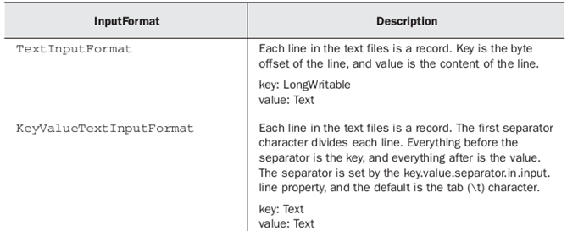
InputFormat (for Mappers)
TextInputFormat is the default format
To use another input format, make sure you import their corresponding package from org.apache.hadoop.mapreduce.lib.input.*

Slide 30
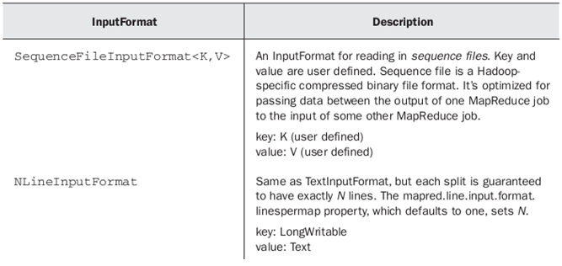
InputFormat (for Mappers)

Slide 31
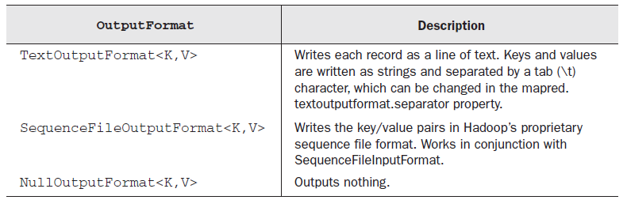
OutputFormat (for Reducers)
Classes are defined in the package org.apache.hadoop.mapreduce.lib.output.*
public static void main(String[] args) throws Exception {
Job job = new Job(); … job.setOutputFormatClass(TextOutputFormat.class);
}

Slide 32
Mapper and Reducer Outputs
If the key/value pairs for mappers have different data types than the key/value pairs for reducers, you need to specify them in the program
Job job = Job.getInstance(getConf(),“program name"); job.setJarByClass(mainClass.class); job.setInputFormatClass(TextInputFormat.class); job.setOutputFormatClass(TextOutputFormat.class); job.setMapperClass(MapperClass.class); job.setReducerClass(ReducerClass.class); job.setMapOutputKeyClass(Text.class); job.setMapOutputValueClass(IntWritable.class); job.setOutputKeyClass(Text.class); job.setOutputValueClass(Text.class); …

Slide 33
Data Compression
Two reasons for compression
Reduce the space needed to store large files
Speeds up data transfer across the network
Various compression formats (*.gz, *.bz2, etc); all exhibit a space-time trade-off
Fast compression/decompression comes at the expense of smaller space savings
Example: 1(optimize for speed), 9(optimize for space)
gzip -1 <filename>

Slide 34
Codecs
A codec is an implementation of a compression-decompression algorithm
In Hadoop, a codec is defined by an implementation of CompressionCodec interface
Hadoop can read and process compressed input files automatically without the need to change the code
hadoop jar <jarfile> <classfile> input.txt.gz output
Format | Splittable? | HadoopCompressionCodec
DEFLATE | No | org.apache.hadoop.io.compress.DefaultCodec
gzip | No | org.apache.hadoop.io.compress.GzipCodec
bzip2 | Yes | org.apache.hadoop.io.compress.BZip2Codec
LZO | No | org.apache.hadoop.io.compress.LzopCodec
Snappy | No | org.apache.hadoop.io.compress.SnappyCodec

Slide 35
Compressing Reducer Output
If output is too large, you may want to compress it
Output file: part-r-00000.bz2
public static void main(String [] args) {
…
Job job = new Job();
…
FileOutputFormat.setCompressOutput(job, true);
FileOutputFormat.setOutputCompressorClass(job, BZip2Codec.class);
…
}

Slide 36
Compressing Mapper Output
Useful to compress mapper output
public static void main(String [] args) {
…
Configuration conf = new Configuration();
conf.setBoolean(“mapreduce.map.output.compress”, true);
conf.setClass(“mapreduce.map.output.compress.codec”, BZip2Codec.class, CompressionCodec.class);
Job job = new Job(conf, “Job name”);
…
}

Slide 37
Hadoop Distributed Caching, Chaining, and Streaming
Minimal Hadoop program
Accessing Hadoop file systems
Hadoop distributed cache
Chaining Hadoop jobs
Using Hadoop with other programming languages

Slide 38
Minimal Hadoop Program
Hadoop has default classes
Default mapper is Mapper.class
Each record is a line in a file; key is LongWritable (offset from beginning of line) and value is Text
Writes its input directly to output (no filtering/transformation)
Default reducer is Reducer.class
Writes its input directly to output (no aggregation)
Default partitioner is HashPartitioner.class
So, we can write a very small program using the default mapper, reducer, and partitioner classes

Slide 39
Hadoop File System
You can write Hadoop program to directly access the local filesystem and HDFS
The main classes for file manipulation in Hadoop are in the package org.apache.hadoop.fs
Basic Hadoop file operations include open, read, write, close
Hadoop file API is generic and can be used for working with filesystems other than HDFS
Example:
Suppose you want to concatenate a set of data files in the local file directory and upload the concatenated file to HDFS

Slide 40
Hadoop Distributed Cache
Many Hadoop programs require distributing a set of files to be shared by all the nodes that perform the mapreduce tasks
Examples
Distribute the list of stopwords to all mappers for word count
Distribute the initial set of centroids to all mappers for k-means clustering

Slide 41
Hadoop Distributed Cache
To use Hadoop distributed cache, you need to add the cache file to the job configuration
To specify the shared files:
Configuration conf = new Configuration(); Job job = Job.getInstance(conf);
…
job.addCacheFile( URI );
To retrieve the files in mappers/reducers:
Path[] inputPaths = context.getLocalCacheFiles();

Slide 42
Chaining
For complex problems, it is often necessary to run multiple MapReduce jobs sequentially
Input of next job depends on output of previous job
Typical Hadoop/MapReduce job:
Configuration conf = new Configuration(); Job job = Job.getInstance(conf, “program name”); job.setJarByClass( … ); job.setMapperClass( … ); job.setReducerClass( … ); job.setOutputKeyClass(<ClassType>); job.setOutputValueClass(<ClassType>); FileInputFormat.addInputPath(job, new Path( … )); FileOutputFormat.setOutputPath(job, new Path( … ));

Slide 43
ChainMapper and ChainReducer
Interleave the preprocessing and postprocessing with mappers and reducers
Map | …. | Map | Reduce | Map | … | Map
(preprocess) (postprocess)
Jobs can run multiple mappers in sequence to preprocess the data and after running the reduce, it can optionally run multiple mappers in sequence to postprocess the results
This is accomplished using ChainMapper and ChainReducer

Slide 44
Hadoop Streaming
Hadoop supports other programming languages via a generic API called Streaming
The jar library for streaming is located at /usr/local/hadoop/contrib/streaming/hadoop-streaming-*.jar
Hadoop Streaming interacts with programs using the Unix streaming paradigm
Programs read inputs from STDIN and writes outputs to STDOUT

Slide 45

CSE 491/891
Lecture 21 (Pig)

Slide 46
What is Pig?
Pig is a Hadoop extension that simplifies programming by providing a high-level data processing language on top of Hadoop
Created at Yahoo! to make it easier for researchers and engineers to process massive datasets
Main use of Pig is to help users transform data or compute summary statistics from the data

Slide 47
What can Pig Latin Do?
It provides commands to interact with HDFS
It allows you to manipulate data stored in HDFS
It allows you to select certain attributes
It allows you to apply aggregate functions
It allows you to join data from different “tables”
In other words, you can manipulate the data just like what SQL does, except
you’re working with HDFS (instead of relational db)
Similar operators but different language than SQL

Slide 48
Pig Latin
A high-level scripting language that allows users to manipulate large-scale data stored in HDFS
In this lecture, assume Pig is runn in distributed mode
Summary of Pig Latin syntax and commands
Read-write from/to HDFS
Data types
Diagnostic
Expressions and functions
Relational operators (UNION, JOIN, FILTER, etc)
Note: no commands for INSERT, DELETE, UPDATE

Slide 49
Typical WorkFlow of a Pig Latin Program
Load data from HDFS into an alias
alias = LOAD filename AS (…)
Manipulate the alias using relational operators, functions, etc
Each manipulation creates a new alias
new_alias = pig_command(old_alias)
dump alias to display it on the Grunt shell or store alias in a HDFS directory (if distributed mode)

Slide 50
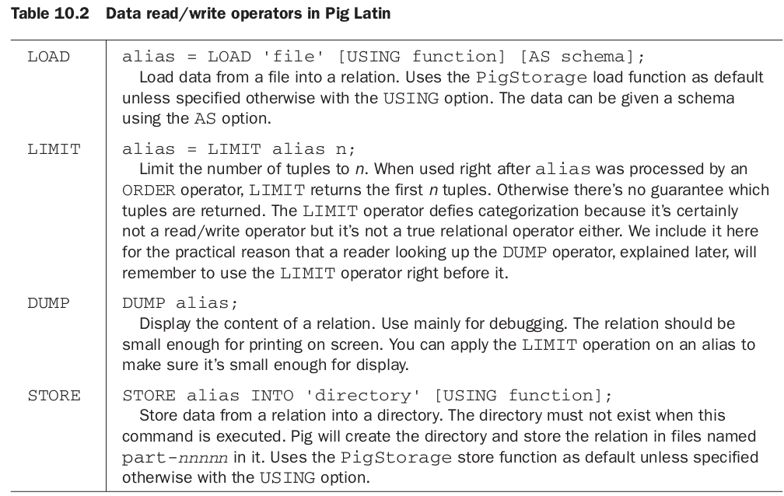
Read-Write Operations

Slide 51
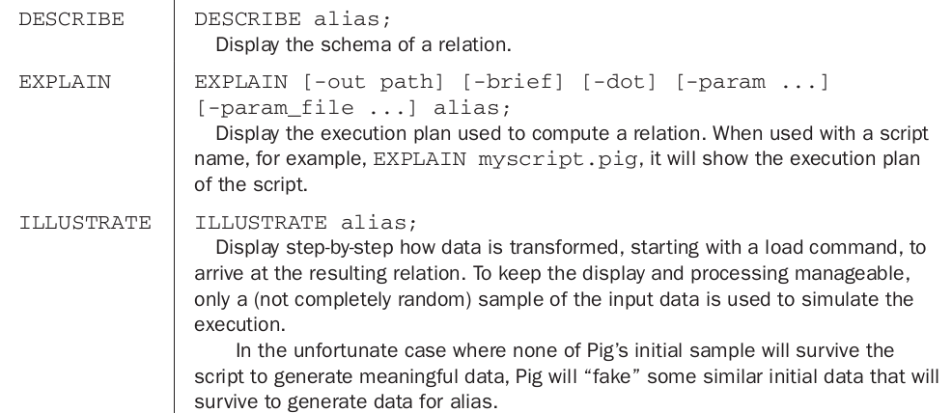
Diagnostic operators in Pig Latin

Slide 52
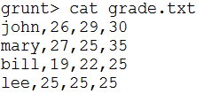
Relational Operators
FOREACH
FILTER
ORDER BY Example:
SPLIT
UNION
DISTINCT
GROUP
JOIN
Name, hw1, hw2, hw3

Slide 53
Macros
Macros provide a way to package reusable code
DEFINE <macro> (<args>) RETURNS <returnvalue> {
Pig latin code for macro definition
}
Example: wordcount.pig
DEFINE wordcount(text) RETURNS counts { tokens = foreach $text generate TOKENIZE($0) as terms; wordlist = foreach tokens generate FLATTEN(terms) as word, 1 as freq;
groups = group wordlist by word; $counts = foreach groups generate group as word, SUM(wordlist.freq) as freq;
}

Slide 54
User Defined Functions
There are different types of functions:
Eval function: a function that takes one or more expression and returns another expression (e.g., MAX)
results = FOREACH grp GENERATE group, myEvalFn(data.val)
Filter function: a function that returns a Boolean value (to be used with FILTER operation)
results = FILTER records BY myFilterFn(val)
Store/Load function: a function that specifies how to load or store data
mydata = LOAD ‘mydata.txt’ USING myLoadFn()

Slide 55

CSE 491/891
Intro to Hive

Slide 56
Hive
A data warehousing framework built on top of Hadoop
Created to make it possible for analysts with strong SQL skills (but little Java programming skills) to run queries on large volumes of data
Developed by Jeff Hammerbacher and his team at Facebook

Slide 57
Useful Commands
!connect: connecting to Hive server
!help: get help
!close: close the server connection
!close all: close all server connections
!quit: exit

Slide 58
Internal and External Tables
Internal tables:
When a new table is created, the raw data will be moved from its original location to /user/hive/warehouse
When table is dropped, both the metadata (its schema) and the actual raw data will both be removed
External tables:
When table is created, a directory with the same name as the table name is created at /user/hive/warehouse, but the data is kept at its original location
When a table is dropped, its directory is removed from /user/hive/warehouse (along with meta data), but the original data (which is stored elsewhere) is not removed

Slide 59
CREATE TABLE
Internal table:
CREATE TABLE <tablename> (
…
)
...;
LOAD DATA INPATH ‘…’ INTO TABLE <tablename>;
External table:
CREATE EXTERNAL TABLE <tablename> (
…
)
LOCATION ‘ … ‘; -- specify the location of the original data

Slide 60
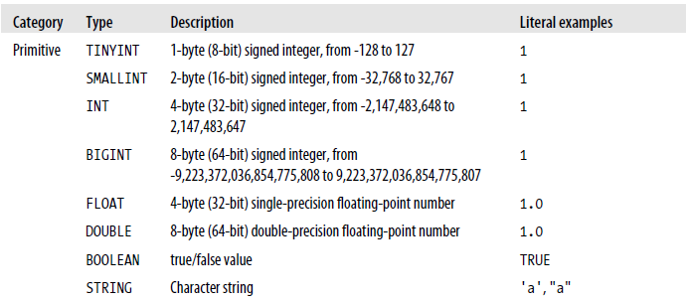
Data Types

Slide 61
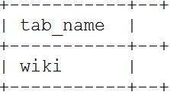
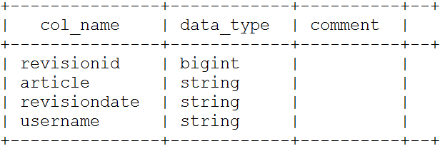
SHOW and DESCRIBE TABLES
To display list of tables available
To show the schema of a table

Slide 62
DROP and ALTER TABLE
Use drop table to delete the data and metadata for a table
Drop table <tablename>
If you want to delete the data but keep the table definition, simply remove the files in HDFS (without removing the directory)
Use Alter table to modify the table’s schema
ALTER TABLE abc RENAME TO xyz
ALTER TABLE abc ADD COLUMNS (newcol STRING)

Slide 63
Retrieval Queries
SELECT [ALL | DISTINCT] select_expr, ...
FROM table_reference
[WHERE where_condition]
[GROUP BY col_list]
[ORDER BY col_list]
[CLUSTER BY col_list
| [DISTRIBUTE BY col_list] [SORT BY col_list]]
[LIMIT number]
For complete reference, go to https://cwiki.apache.org/confluence/display/Hive/LanguageManual

Slide 64


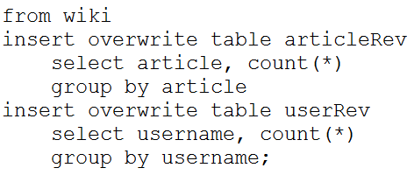
Multi-Table Inserts
In HiveQL, the query can start with FROM clause to perform multiple insert queries

Slide 65
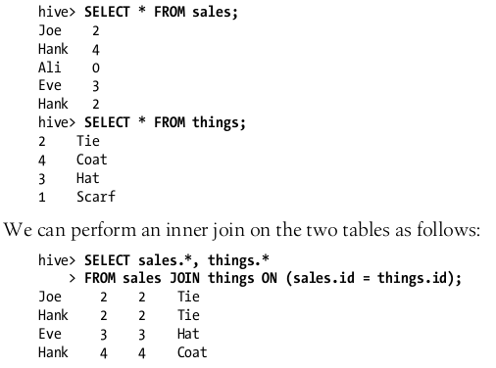
Join Query
HiveQL supports inner and outer joins

Slide 66
Partitions
Relational databases use indexes on columns to speed up executing queries in such columns
Hive organizes tables into partitions, a way of dividing a table into coarse-grained parts based on the value of a partition column
For example, a state column will partition the table into 50 partitions (one per state)
Hive physically store different partitions in different directories
Using partitions can make it faster to answer queries on slices of the data

Slide 67
Mappers and Reducers in Hive
Steps
Write the mapper script
Write the reducer script
Write the HiveQL script that does the following:
Create an input data table
Create a table for storing the reducer output
Import the mapper and reducer scripts into Hive
Load the output of reducer into the reducer output table

Slide 68
CSE 491/891
Lecture 25 (Mahout)

Slide 69
What is Mahout?
An open source data analysis software that has implementations for
Clustering
Classification
Collaborative filtering
Written in Java; built to take advantage of Hadoop for large-scale analysis problems
Available on AWS EMR, but you’ll need to wait for about 10 minutes for it to be launched

Slide 70
Mahout Classification
There are several implementations available on Mahout
Logistic regression: a linear classifier
mahout trainlogistic - to build model from training data
mahout runlogistic - to apply model to test data
Naïve Bayes classifier: a probabilistic classifier implemented for text classification
mahout trainclassifier - to build model from training data
mahout testclassifier - to apply model to test data

Slide 71
Mahout Collaborative Filtering
Collaborative filtering methods are used to rank the preference of users on various items
Mahout provides various ways to implement collaborative filtering approaches (see lecture 15)
Nearest-neighbor similarity
Matrix factorization
 | Mission Impossible | Over the Hedge | Back to the Future | Harry Potter
John | 5 | 3 | 4 | ?
Mary | 5 | 4 | 5 | 5
Lee | 2 | 2 | 4 | 5
Joe | 3 | 1 | 1 | 2

Slide 72
Clustering Algorithms in Mahout
Several clustering algorithms available
K-means
Other algorithms
Fuzzy clustering
Spectral clustering
Latent Dirichlet allocation (a probabilistic clustering)

Slide 73
Clustering Algorithms in Mahout
To use the clustering algorithms, you must first prepare your input data:
Data must be stored in HDFS
Data must be stored as vectors in sequence file format
Mahout defines a Vector interface in the package org.apache.mahout.math.Vector
For applications such as document clustering, each document should be stored as a separate file in HDFS (the name of the file will be used to identify the cluster assignment after clustering step has ended)

Slide 74
Mahout Clustering
In order to cluster other types of data, we need to make sure the input data is stored on HDFS in sequence file format
Key is identifier of the data instance
Value is a VectorWritable object
Example: suppose you have a CSV file, how do we cluster them?
You’ll need to write a program to convert the file into a sequence file with
key = record identifier
value = VectorWritable object

