Slide 1
Electric Field Computation
Scope of this section
- Electric field theory: retarded potentials and far-field radiation.
- Electric field computation: vectorised MATLAB implementation.
- Far-field THz angular emission validation.
- Custom model results and bipolar pulse waveform.
Yaoqi Dong: turning the team's simulated current density J(r,t) into the radiated far-field THz signal
Supervisor: Professor Oleg Mitrofanov
Department of Electronic & Electrical Engineering
Deck refocused to Yaoqi Dong's electric-field sections only.
01
Notes:
Open by clarifying this is not the whole team project; it is Yaoqi's electric-field contribution.

Slide 2
Far-field THz emission is driven by the retarded time derivative of current density
t_ret = t - R/c, R = |r - r′|
E(r,t) ≈ μ₀/(4π) ∬_S [ R̂ × (R̂ × J̇(r′,t_ret)) ] / R dS′
retarded time: finite propagation delay from source to observer
radiation term of Jefimenko's equation used in the model
- Only the radiation term is kept because the observation point is in the far field.
- The double cross product extracts the transverse component that can propagate.
Physical read
Radial Photo-Dember currents cancel on-axis by symmetry, but off-axis observation leaves a net transverse THz field.
Report section: Electric Field Theory; equation implemented in compute_THz_E_from_Jx.m.
02
Notes:
The message is causality plus transverse projection: current acceleration at retarded time is the source of the far field. Also note: a steady current does not radiate, so the emitted field follows dJ/dt.

Slide 3
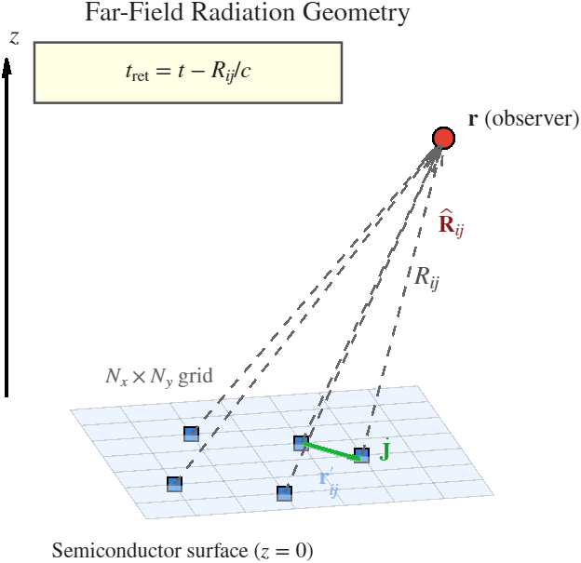
The MATLAB field solver discretises the surface into retarded Hertzian-dipole contributions
E(r,tₖ) ≈ μ₀/(4π) ∑ᵢ ∑ⱼ [ R̂ᵢⱼ × (R̂ᵢⱼ × J̇(r′ᵢⱼ,t_ret,ᵢⱼ)) ] / Rᵢⱼ Δx Δy
discrete surface sum over Nx by Ny source cells
J̇_x(xᵢ,yⱼ,tₖ) = [J_x(xᵢ,yⱼ,tₖ+1) - J_x(xᵢ,yⱼ,tₖ-1)] / (2Δ )
central finite difference used for dJ/dt
Far-field radiation geometry
- Input arrays match the code: Jx, Jy, Jz are Ny x Nx x Nt histories.
- R, Rhat and retarded indices are computed as matrices for all source cells.
Code match: dJx(:,:,2:Nt-1) central difference, meshgrid geometry, and dx dy summation.
03
Notes:
Use this slide to connect every mathematical symbol to an actual array operation in the MATLAB code. Mention that complexity is O(Nx Ny Nt) per observation point.

Slide 4
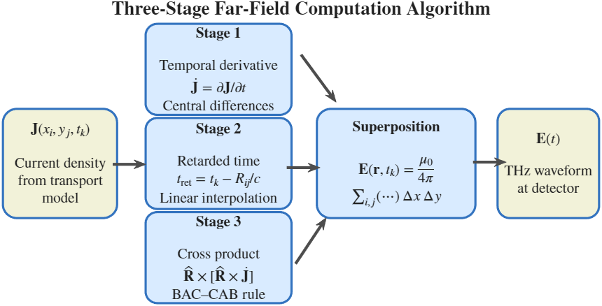
Vectorisation makes retarded-time interpolation practical without nested spatial loops
J̇_ret = (1-α)J̇(r′,t_floor(τ)) + α J̇(r′,t_floor(τ)+1), α = τ - floor(τ)
linear interpolation at the retarded time for each source cell
- The code builds linear indices with grid_y, grid_x and k1_safe.
- Invalid retarded times are masked to zero after safe index clamping.
- BAC-CAB identity evaluates Rhat x (Rhat x dJ) as (Rhat dot dJ)Rhat - dJ.
Three-stage far-field computation algorithm
Code match: idx1/idx2 interpolation and validity mask in compute_THz_E_from_Jx.m.
04
Notes:
The strongest engineering point here is that each source cell has a different retarded time, but the implementation avoids a spatial double loop. Set up the interpolation by noting the retarded time generally falls between stored time samples.

Slide 5
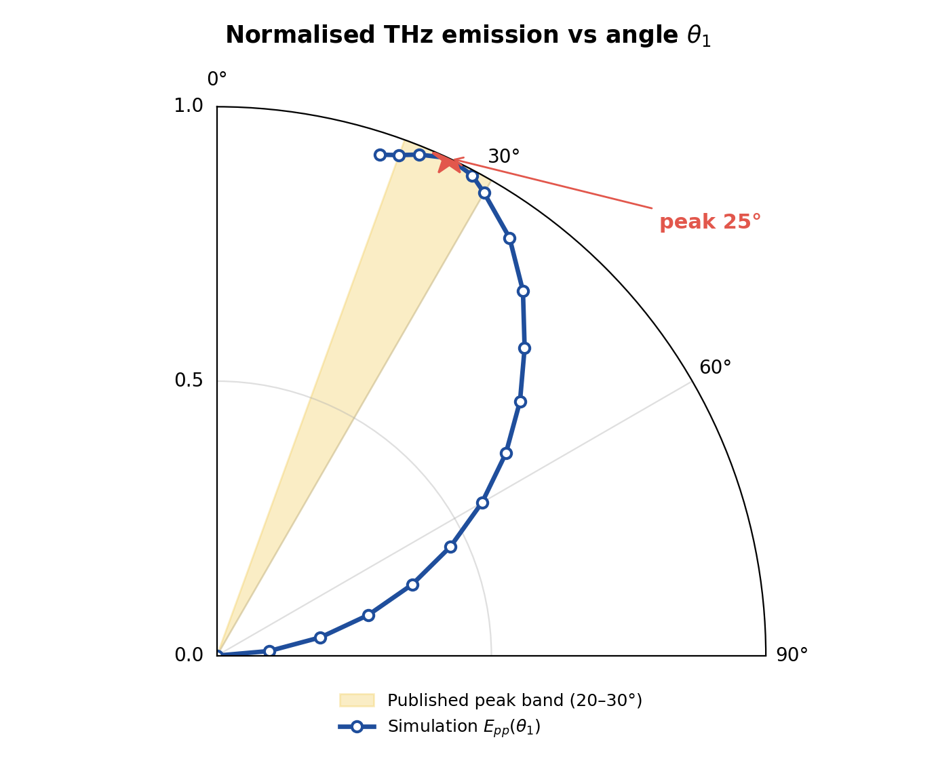
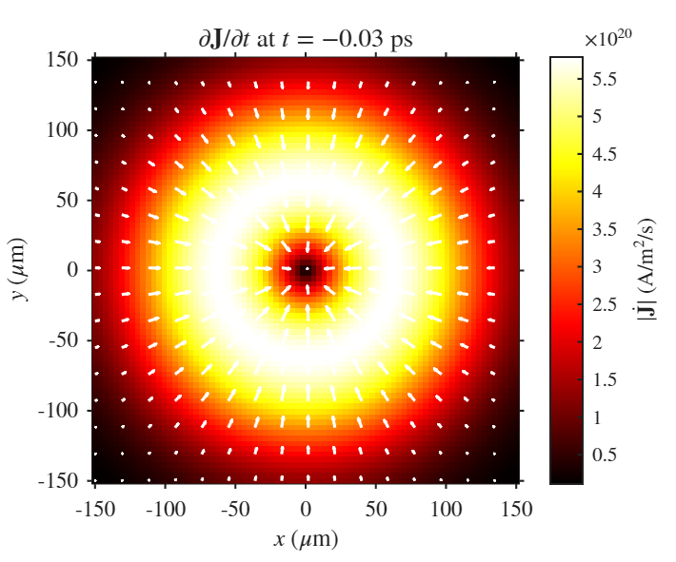
Photo-Dember source currents create a ring-shaped dJ/dt distribution and an off-axis emission lobe
J_x = qD_eff n_surf(t) ∂G/∂x, J_y = qD_eff n_surf(t) ∂G/∂y
standard Photo-Dember current used in simulateTHzFromDiffusion.m
|dJ/dt| snapshot near t = -0.03 ps
Angular validation: Epp(theta1)
- The peak Epp occurs at 25 degrees in result.m.
- The simulated lobe lies in the 20-30 degree experimental range.
- Epp falls to 0.0001 at 90 degrees after normalisation.
Report sections: Far-field THz Angular Emission Validation; result.m data.
05
Notes:
Point out that the ring is the source-side explanation for the angular lobe.

Slide 6
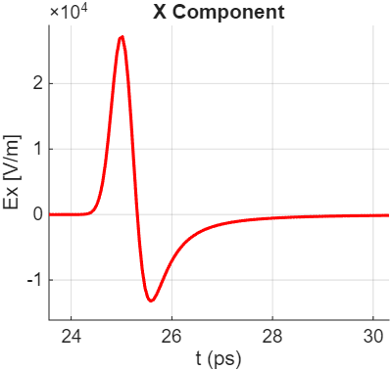
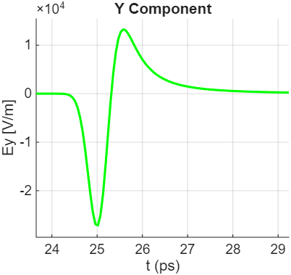
The built-in-field current gives the expected asymmetric bipolar THz pulse
- The rising current gives the leading lobe; recombination decay gives the opposite trailing lobe.
- Ex and Ey have opposite leading signs because the observer is off-axis in x and y.
- Both components return to zero within the 45 ps simulation window.
J_z(x,y,t) = q μₑ E_z(z) n(x,y,t)
vertical drift current in the depletion field
Built-in mode: Ex(t)
Built-in mode: Ey(t)
Report section: Bipolar Pulse Waveform; figures Ex.png and Ey.png.
06
Notes:
This slide is about waveform physics: the current derivative changes sign, producing a bipolar THz pulse.

Slide 7
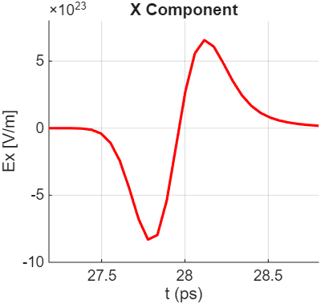
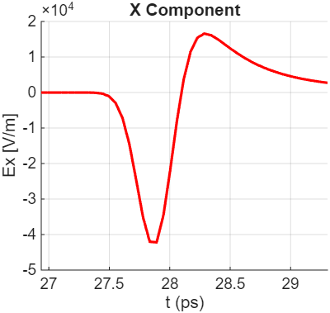
Custom built-in-field mode validates the parser and far-field integration path
Readout
Custom validation: J_x = 0, J_y = 0, J_z = -n
custom expression entered through the GUI parser
- The bipolar shape and zero crossing match.
- Amplitude differs because q, mobility and field prefactors are omitted.
- This confirms CustomJxHandle feeds the same far-field solver correctly.
Custom mode: Jz = -n
Standard built-in mode
Report section: Custom Model Results; built-in validation case.
07
Notes:
This is the first custom validation: same shape, different scale.

Slide 8
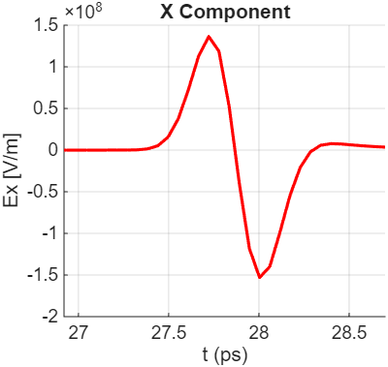
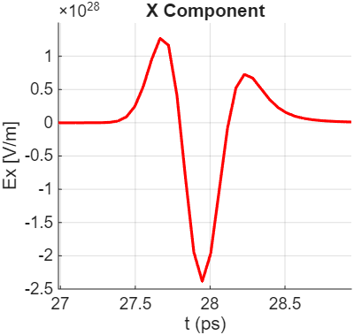
Custom Photo-Dember mode reproduces waveform shape and reveals a modelling approximation
J_PD = q(D_e - D_h) ∇ n
J_x = q(D_e - D_h) ∂ₓ n, J_y = q(D_e - D_h) ∂ᵧ n
Custom validation: J_x = dnx, J_y = dny, J_z = 0
custom mode omits the prefactor but preserves the gradient dependence
physical Photo-Dember current proportional to carrier-density gradient
- Shape agreement validates the custom parser and far-field integrator.
- Amplitude scaling is expected because custom formulas omit q(D_e - D_h).
- The stronger trailing feature appears because custom mode uses evolving n(x,y,t), while standard mode uses n_surf(t) times a fixed Gaussian gradient.
Standard Photo-Dember mode
Custom: Jx = dnx, Jy = dny
Report section: Custom Model Results; code path uses CustomJxHandle in simulateTHzFromDiffusion.m.
08
Notes:
End with the precise contribution: a validated electric-field engine plus a custom-current pathway.

Slide 9
The model is validated for angular shape rather than absolute THz power
Strengths
- Causal propagation is preserved through retarded-time interpolation.
- Vector field output makes polarisation and viewing angle part of the result.
- Physical mechanisms are separated for controlled comparison of source currents.
Limitations
- Carrier transport is simplified versus full Monte Carlo modelling.
- The far-field approximation drops near-field and detector-response effects.
- Validation uses normalised angular amplitude, not calibrated absolute power.
What this means: the pipeline is a credible computational framework; the next step is quantitative calibration against measured waveforms and a systematic sensitivity analysis.
Mark-scheme alignment: critical analysis of results, not only description of generated plots.
09

Slide 10
Contribution: an end-to-end pipeline from carrier dynamics to validated THz field patterns
Conclusions
- Implemented a retarded-potential far-field calculation for full Jx, Jy, Jz histories.
- Coupled carrier diffusion and built-in-field dynamics to time-domain THz waveforms.
- Reproduced the angular emission lobe (peak near 25 degrees) reported in the literature.
Future work
- Calibrate waveform amplitudes using detector response and collection geometry.
- Run sensitivity studies for beam waist, carrier lifetime, mobility and depletion field.
- Extend to structured metasurfaces and spatially resolved THz field maps.
Takeaway for Q&A: the key assumption is that normalised angular shape is a valid first validation target for the far-field model.
Summary of contributions prepared against the ELEC0118 final project presentation rubric.
10

