Slide 1

Electric Field Computation for THz Emission
KEY MESSAGE
A retarded-potential model can turn simulated photocurrent dynamics into measurable THz waveforms and reproduce the observed angular emission pattern.
from ultrafast semiconductor photocurrents
Yaoqi Dong
Supervisor: Professor Oleg Mitrofanov
Department of Electronic & Electrical Engineering
Faculty of Engineering Sciences
4th Year MEng Final Project Presentation
Notes:
Open with the single thesis: this project links carrier transport to far-field THz radiation, then validates the model against a published angular pattern.

Slide 2
The modelling gap is the link between local photocurrent and far-field THz radiation
ultrafast optical pulse
J(r,t)
E(r,t)
excites carriers at semiconductor surface
transient Photo-Dember and drift currents
observable THz waveform and angular pattern
- Build a MATLAB model that computes THz electric fields from simulated current density histories.
- Retain retarded time, transverse projection and 1/R radiation scaling.
- Validate against the published off-axis emission lobe for Fe:InGaAs.
100 x 100
~800
18-90 deg
seconds
typical source grid
time samples
validation sweep
single waveform runtime
Requirement alignment: clear problem, objectives and engineering-science motivation.
02
Notes:
Explain that the engineering task is the computational bridge from a source current distribution to a detector field.

Slide 3
Only accelerating, transverse current contributes to the radiated THz field
dn/dt = D grad2(n) + G(r,t) - n/tau_r
carrier diffusion and recombination produces n(x,y,t)
E(r,t) ~= mu0/4pi int int [Rhat x (Rhat x Jdot(r',tret))] / R dS'
Jx = -qD dn/dx, Jy = -qD dn/dy
Photo-Dember current from carrier-density gradients
- Jdot, not steady current, drives radiation.
- The double cross-product removes field components parallel to the line of sight.
- Retardation lets source geometry shape pulse arrival time and angular dependence.
tret = t - R/c
each source cell contributes at a delayed time
Theory basis: Jefimenko / retarded-potential far-field approximation.
03
Notes:
Keep this slide at audience level: three equations, three physical meanings. Emphasise why symmetry causes the on-axis null later.

Slide 4
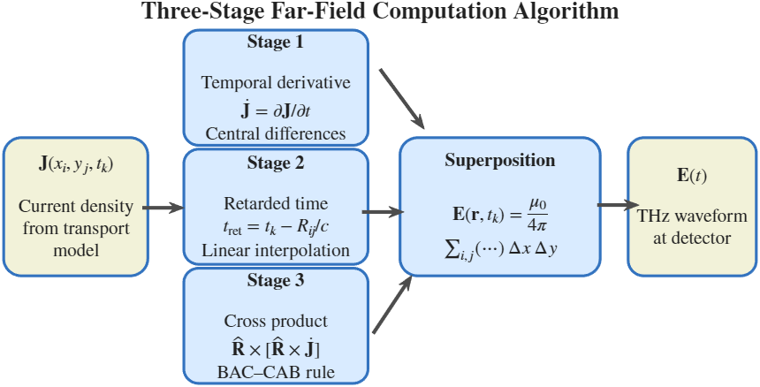
The implementation separates carrier transport, retarded projection and field accumulation
Method decisions that matter
- Central finite difference estimates dJ/dt while leaving end points zero.
- Retarded time is mapped to fractional array indices and linearly interpolated.
- BAC-CAB identity evaluates transverse projection without nested cross-products.
- Spatial operations are vectorised; the remaining loop is over observation time.
O(Nx Ny Nt)
dx dy
Three-stage far-field computation algorithm
cost per observation point
surface integral area
Code evidence: compute_THz_E_from_Jx.m and simulateTHzFromDiffusion.m.
04
Notes:
Walk through the flowchart from left to right. Accuracy choices, indexing, and performance constraints are the engineering part.

Slide 5
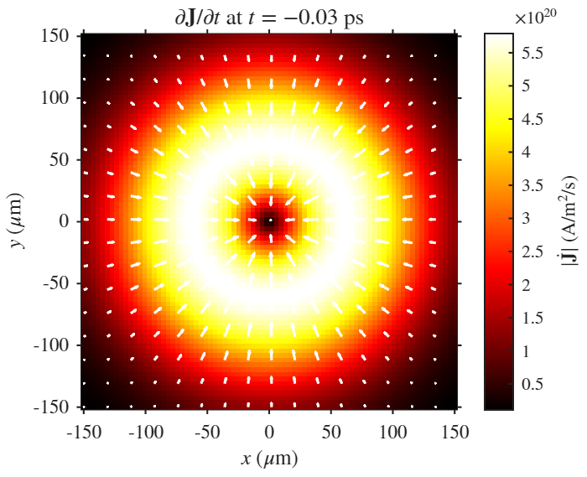
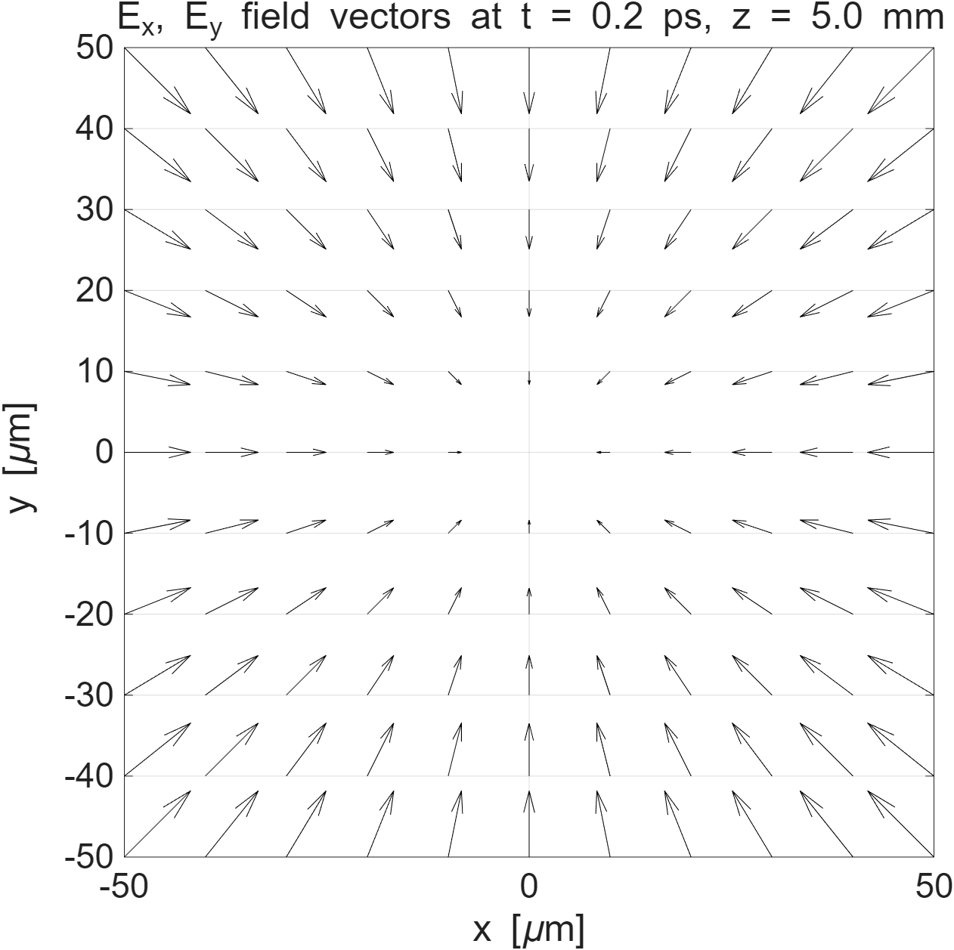
The source model captures both in-plane diffusion and normal built-in-field drift
Snapshot of |dJ/dt| with optical excitation profile
2D transverse electric-field vector map near peak response
The MATLAB model can toggle Photo-Dember and built-in-field contributions, making the physical mechanism testable rather than just descriptive.
Project implementation: simulateTHzFromDiffusion.m builds Jx, Jy and Jz histories.
05
Notes:
The left figure is the source acceleration; the right figure is the spatial field consequence.

Slide 6
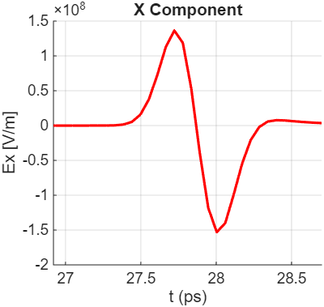
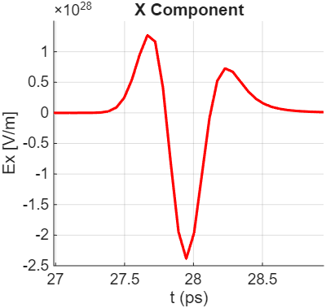
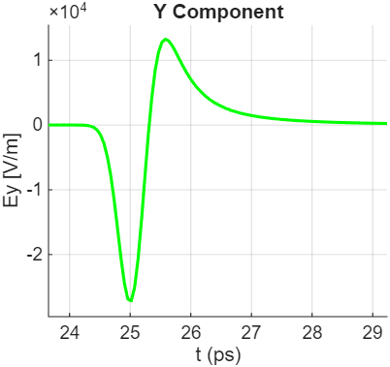
Computed waveforms are short THz pulses whose sign and amplitude depend on current mechanism
Photo-Dember-only Ex
Custom Photo-Dember Ex
Orthogonal Ey component
- The pulses are sub-picosecond scale in shape after propagation delay.
- Field polarity follows the sign of dJ/dt after transverse projection.
- Comparing Ex and Ey checks the vector nature of the radiation calculation.
Figures generated by MATLAB scripts from the project code; units shown on original axes.
06
Notes:
The useful evidence is waveform shape, polarity and vector consistency.

Slide 7
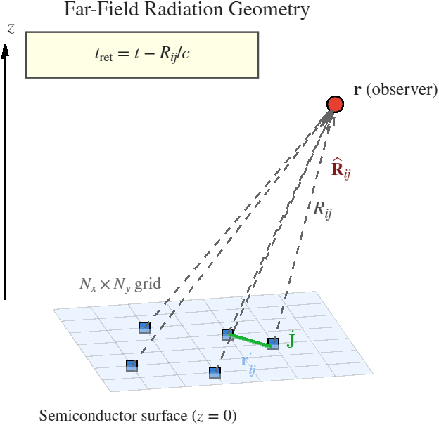
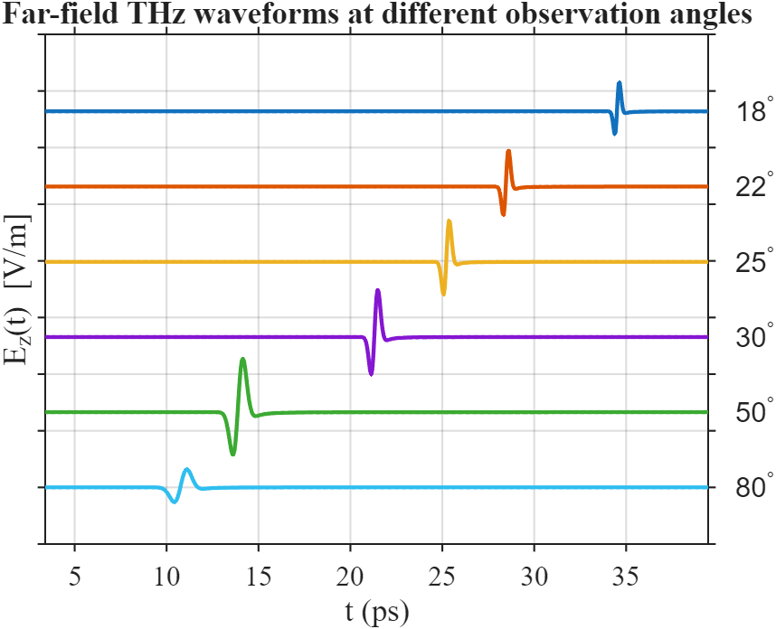
Off-axis observation breaks symmetry and creates a measurable emission lobe
Retarded source-to-observer geometry
Waveform shift and amplitude changes with angle
Physical interpretation: on-axis transverse components cancel for a radially symmetric in-plane current; off-axis viewing leaves a net transverse field.
Project report: angular sweep configured from 18 degrees to 90 degrees.
07
Notes:
Set up the validation slide: low on-axis emission, a lobe, and decay toward grazing angle are the expected signatures.

Slide 8
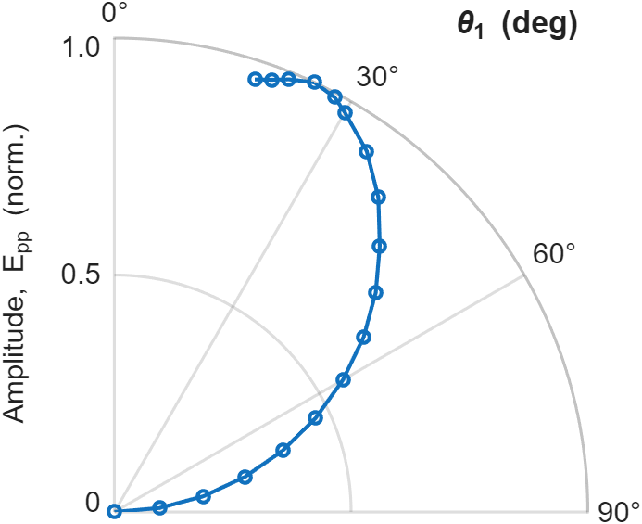
The simulation reproduces the published lobe: peak emission occurs around 25 degrees
Validation evidence
- Peak-to-peak amplitude is normalised to the maximum simulated value.
- The maximum appears near 25 degrees, consistent with the reported 20-30 degree lobe.
- Amplitude decreases toward 90 degrees, matching grazing-angle suppression.
- This validates the retarded projection and carrier-current pipeline at pattern level.
25 deg
0.0001
simulated peak angle
normalised amplitude at 90 deg
Normalised peak-to-peak amplitude versus emission angle
Validation target: Mueckstein et al. Fig. 8(b); reproduced using result.m angle sweep.
08
Notes:
Say the model reproduces key angular features, not every experimental detail.

Slide 9
The model is useful, but validation is strongest for angular shape rather than absolute power
Strengths
Limitations
- Keeps causal propagation through retarded-time interpolation.
- Uses vector fields, so polarisation and viewing angle are part of the output.
- Separates physical mechanisms for controlled comparison of source currents.
- Carrier transport is simplified versus full Monte Carlo or microscopic models.
- Far-field approximation suppresses near-field and detector-response effects.
- Validation uses normalised angular amplitude, not calibrated absolute THz power.
What this means
The project demonstrates a credible computational framework; the next engineering step is quantitative calibration against measured waveforms and systematic sensitivity analysis.
Mark-scheme alignment: critical analysis of results, not only description of generated plots.
09
Notes:
This slide shows judgement, limitations and a concrete next step based on results.

Slide 10
Main contribution: an end-to-end MATLAB pipeline from carrier dynamics to validated THz field patterns
Conclusions
Future work
- Implemented retarded-potential far-field calculation for full Jx, Jy, Jz histories.
- Coupled carrier diffusion and built-in-field dynamics to time-domain THz waveforms.
- Reproduced the key angular emission lobe reported in the literature.
- Calibrate waveform amplitudes using detector response and collection geometry.
- Run sensitivity studies for beam waist, carrier lifetime, mobility and depletion field.
- Extend the model to structured metasurfaces and spatially resolved THz maps.
Takeaway for Q&A: the key assumption is that normalised angular shape is a valid first validation target for the far-field model.
Summary of contributions prepared against the ELEC0118 final project presentation rubric.
10
Notes:
Finish by returning to the key message and be ready to discuss far-field assumptions, normalisation, and validation data.

