Slide 1
Learning to Rank – Theory and Algorithm
@夏粉_百度
合办方：超级计算大脑研究部@自动化所

Slide 2














We are Overwhelmed by Flood of Information

Slide 3

Information Explosion
2013?
Notes:
From 1898 to 1978 to 2008
Browse is impossible
Search engine – essential tool

Slide 4

Notes:
信息按一定的方式组织起来，并根据信息用户的需要找出有关的信息的过程和技术。狭义的信息检索就是信息检索过程的后半部分，即从信息集合中找出所需要的信息的过程，也就是我们常说的信息查寻

Slide 5

Ranking Plays Key Role in Many Applications

Slide 6


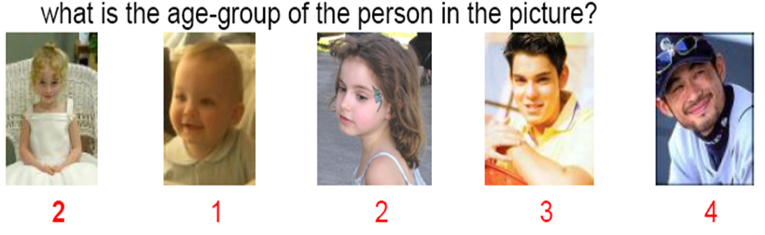
Numerous Applications
Ranking Problem
Example Applications
Information Retrieval
Collaborative Filtering
Ordinal Regression
Notes:
查询和匹配的语境和要求不同:
信息检索类： 特征描述丰富， 相对排序准确，top-k准确性；
协作过滤： 特征描述不丰富，绝对排序或等级；
序回归： 特征描述丰富，绝对排序，介于分类和回归之间；

Slide 7
Overview of my Work before 2010
Machine Learning Theory and Principle
Theory
NIPS’09
PR’09
ICML’08
Information
Retrieval
Collaborative
Filtering
Ordinal Regression
Algorithm
JCST’09
KAIS’08
IJICS’07
IJCNN’07
IEEE-IIB’06
Ranking Problems

Slide 8
Outline
Listwise Approach to Learning to Rank – Theory and Algorithm
  Related Work
  Our Work
  Future Work

Slide 9
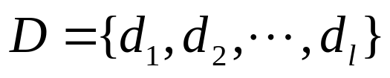
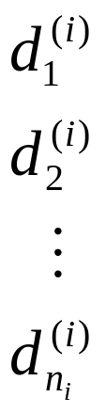
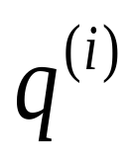
Ranking Problem
Example = Document Retrieval
Documents
ranked list of documents
query
Ranking
Systems

Slide 10
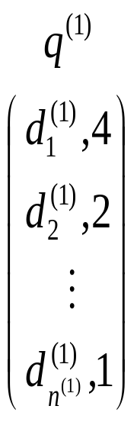
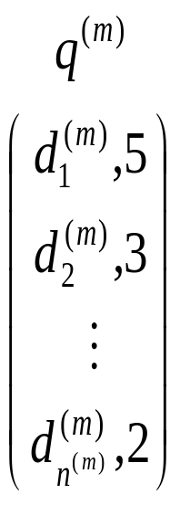



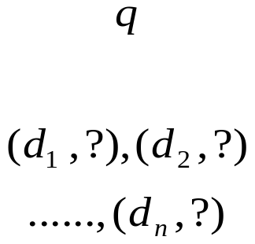
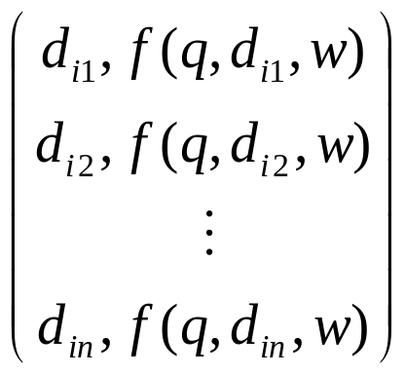

Learning to Rank for Information Retrieval
Labels:
1) binary,
2) multiple-level, discrete,
3) pairwise preference,
4) Partial order or even total order of documents
queries
documents
Learning
System
Model
min loss
Training Data
Ranking
System
Test data

Slide 11
State-of-the-art Approaches
Pointwise: (Ordinal) regression / classification
  Pranking, MCRank, etc.
Pairwise: Preference learning
  Ranking SVM, RankBoost, RankNet, etc.
Listwise: Taking the entire set of documents associated with a query as the learning instance.
  Direct optimization of IR measure
    AdaRank, SVM-MAP, SoftRank, LambdaRank, etc.
  Listwise loss minimization
    RankCosine, ListNet, etc.

Slide 12
Motivations
The listwise approach captures the ranking problem in a conceptually more natural way and performs better than other approaches on many benchmark datasets.
However, the listwise approach lacks of theoretical analysis.
  Existing work focuses more on algorithm and experiments, than theoretical analysis.
  While many existing theoretical results on regression and classification can be applied to the pointwise and pairwise approaches, the theoretical study on the listwise approach is not sufficient.

Slide 13
Our Work
Take listwise loss minimization as an example, to perform theoretical analysis on the listwise approach.
  Give a formal definition of listwise approach.
  Conduct theoretical analysis on listwise ranking algorithms in terms of their loss functions.
  Propose a novel listwise ranking method with good loss function.
  Validate the correctness of the theoretical findings through experiments.

Slide 14


Listwise Ranking
Input space: X
  Elements in X are sets of objects to be ranked
Output space: Y
  Elements in Y are permutations of objects
Joint probability distribution: P_{XY}
Hypothesis space: H
Expected loss Empirical loss

Slide 15

True Loss in Listwise Ranking
To analysis the theoretical properties of listwise loss functions, the “true” loss of ranking is to be defined.
  The true loss describes the difference between a given ranked list (permutation) and the ground truth ranked list (permutation).
Ideally, the “true” loss should be cost-sensitive, but for simplicity, we start with the investigation of the “0-1” loss.

Slide 16



Surrogate Loss in Listwise Ranking
Widely-used ranking function
Corresponding empirical loss
Challenges
  Due to the sorting function and the 0-1 loss, the empirical loss is non-differentiable.
  To tackle the problem, a surrogate loss is used.

Slide 17



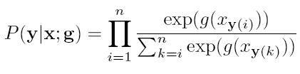
Surrogate Listwise Loss Minimization
RankCosine, ListNet can all be well fitted into the framework of surrogate loss minimization.
  Cosine Loss (RankCosine, IPM 2007)
  Cross Entropy Loss (ListNet, ICML 2007)
A new loss function
  Likelihood Loss(ListMLE, our method)
Notes:
机器学习： 目标函数+求解算法

Slide 18
Analysis on Surrogate Loss
Continuity, differentiability and convexity
Computational efficiency
Statistical consistency
Soundness
These properties have been well studied in
classification, but not sufficiently in ranking.

Slide 19
Continuity, Differentiability, Convexity, Efficiency
Loss | Continuity | Differentiability | Convexity | Efficiency
Cosine Loss (RankCosine) | √ | √ | X | O(n)
Cross-entropy loss (ListNet) | √ | √ | √ | O(n·n!)
Likelihood loss (ListMLE) | √ | √ | √ | O(n)

Slide 20
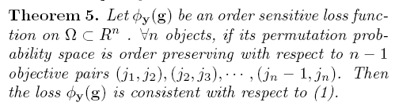
Statistical Consistency
When minimizing the surrogate loss is equivalent to minimizing the expected 0-1 loss, we say the surrogate loss function is consistent.
A theory for verifying consistency in ranking.
Starting with a ground-truth permutation, the loss will increase after exchanging the positions of two objects in it, and the speed of increase in loss is sensitive to the positions of objects.
The ranking of an object is inherently determined by its own.
Notes:
More: surrogate loss can be top-1 subgroup order sensitive to meet the consistency condition.

Slide 21
Statistical Consistency (2)
It has been proven
  Cosine Loss is statistically consistent.
  Cross entropy loss is statistically consistent.
  Likelihood loss is statistically consistent.

Slide 22
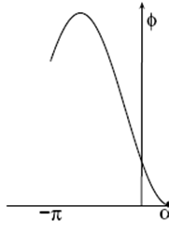
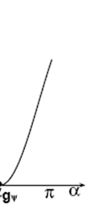
Soundness
Cosine loss is not very sound
  Suppose we have two documents D2 ⊳ D1.
g2
g1=g2
α
g1
Incorrect Ranking
Correct ranking

Slide 23
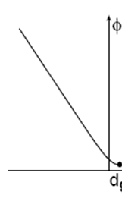
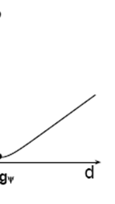
Soundness (2)
Cross entropy loss is not very sound
  Suppose we have two documents D2 ⊳ D1.
g2
g1=g2
g1
Incorrect Ranking
Correct ranking

Slide 24
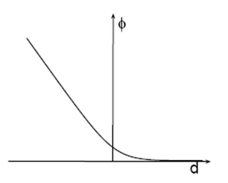
Soundness (3)
Likelihood loss is sound
  Suppose we have two documents D2 ⊳ D1.
g2
g1=g2
g1
Incorrect Ranking
Correct ranking
Notes:
As for the likelihood loss, the situation becomes much better. When the green point moves from the lower right to the upper left of the space, the likelihood loss decreases monotonously, and the minimum loss is achieved at the infinity of the upper left part of the space. This is clearly more reasonable than the aforementioned two losses.
So overall speaking, by jointly considering all the properties, the likelihood loss is better than the cosine and the cross entropy loss. This partially explains why ListMLE outperforms other ranking algorithms.

Slide 25
Discussions
All three losses can be minimized using common optimization technologies. (continuity and differentiability)
When the number of traning samples is very large, the model learning can be effective. (consistency)
The cross entropy loss and the cosine loss are both sensitive to the mapping function. (soundness)
The cost of minimizing the cross entropy loss is high. (complexity)
The cosine loss is sensitive to the initial setting of its minimization. (convexity)
The likelihood loss is the best among the three losses.

Slide 26
Experimental Verification
Synthetic data
  Different mapping function(log, sqrt, linear, quadratic, and exp)
  Different initial setting of the gradient descent algorithm (report the mean and var of 50 runs)
Real data
  OHSUMED dataset in the LETOR benchmark

Slide 27
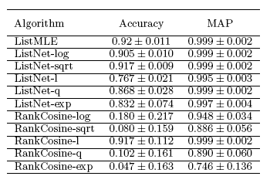
Experimental Results on Synthetic Data

Slide 28
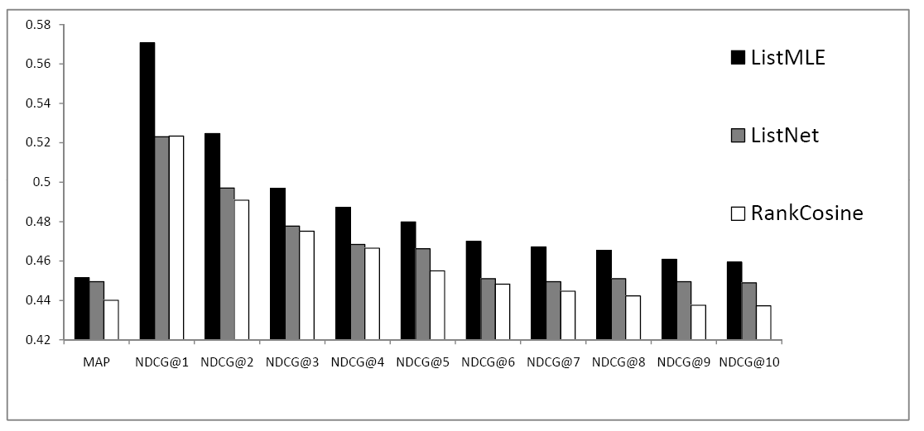
Experimental Results on OHSUMED

Slide 29
Conclusion and Future Work
Study has been made on the listwise approach to learning to rank.
  Likelihood loss seems to be the best listwise loss functions under investigation, according to both theoretical and empirical studies.
Future work
  In addition to consistency, rate of convergence and generalization ability should also be studies.
  In real ranking problems, the true loss should be cost-sensitive (e.g. NDCG in Information Retrieval).

Slide 30
References
Fen Xia, Tie-Yan Liu and Hang Li. ― Statistical Consistency of Top-k Ranking. Proceeding of the 23rd Neural Information Processing Systems, (NIPS 2009).
Huiqian Li, Fen Xia, Fei-Yue Wang, Daniel Dajun Zeng and Wenjie Mao. ―Exploring Social Annotations with The Application to Web Page Recommendation. Journal of Computer Science and Technology (JCST) (accepted).
Fen Xia, Yanwu Yang, Liang Zhou, Fuxin Li, Min Cai and Daniel Zeng. ―A Closed-Form Reduction of Multi-class Cost-Sensitive Learning to Weighted Multi-class Learning. Pattern Recognition (PR), Vol.42, No.7, 2009:1572-1581.
Fen Xia, Tieyan Liu, Jue Wang, Wensheng Zhang and Hang Li. ―Listwise Approach to Learning to Rank - Theory and Algorithm. In proceedings of the 25th International Conference on Machine Learning (ICML 2008). Helsinki, Finland, July 5-9, 2008.
Fen Xia, Wensheng Zhang, Fuxin Li and Yanwu Yang. ―Ranking with Decision Tree. Knowledge and Information Systems(KAIS). Vol.17, No.3, 2008:381–395.
Fen Xia, Liang Zhou, Yanwu Yang and Wensheng Zhang. ―Ordinal Regression as Multiclass Classification. The Internal Journal of Intelligent Control System (IJICS). Vol.12, No.3, Sep 2007:230-236.
Fen Xia, Qing Tao, Jue Wang and Wensheng Zhang. ―Recursive Feature Extraction for Ordinal Regression. In Proceeding of International Joint Conference on Neural Networks (IJCNN 2007). Orlando, Florida, USA, August 12-17, 2007.
Fen Xia, Wensheng Zhang, Wang Jue. ―An Effective Tree-Based Algorithm for Ordinal Regression. The IEEE Intelligent Informatics Bulletin (IEEE-IIB). 2006-Dec, Vol.7 No.1: 22 – 26.
Zhe Cao, Tao Qin, Tie-Yan Liu, Ming-Feng Tsai and Hang Li. ― Learning to Rank: from Pairwise Approach to Listwise Approach. In proceedings of the 24th International Conference on Machine Learning (ICML 2007).
Tao Qin, Xu-Dong Zhang, Ming-Feng Tsai, De-Sheng Wang, Tie-Yan Liu and Hang Li. ―Query-level loss Functions for Information Retrieival. Information Processing and Management. Vol. 44, 2008:838-855.

Slide 31
Thank You!
特别感谢：超级计算大脑研究部
xiafen@baidu.com
@夏粉_百度

