Slide 1

Kylo配置与使用介绍
Yao Ran
Feb 2017
Notes:
Alternate title slide – move to beginning of deck, or delete if not used.

Slide 2

目录
Kylo 架构功能介绍
Kylo 虚机环境配置
Kylo 操作过程演示
学习进阶资源
2

Slide 3

建设Hadoop数据湖所面临的挑战
技术上需要极度依赖有经验的软件工程师
Technology relies heavily on skilled software engineers
Governance, quality, and security often afterthoughts
Lack self-service and features usable by business users
Few organizations have the engineering skills or experience to build a
successful Data Lake program in-house
© 2017 Think Big, A Teradata Company

Slide 4














Kylo-based Data Lake
DTG
Ingest
Prepare
Discover
Sensors
Marketing
Marketing Executives
Mobile
Applications
Operational Systems
Streams
Wrangle
Search
Business Intelligence
Customers Partners
Machine logs
Cleansing
Access
Data Mining
Frontline Workers
Tabular Data
Batch
Business Analysts
email
Data Science
Governance
Analyze
Data Scientists
Social
Hadoop | Spark
Reporting
Engineers
Telemetry
Security, Metadata/Lineage, Operations
Analytic tools & Apps
Users
Sources

Slide 5
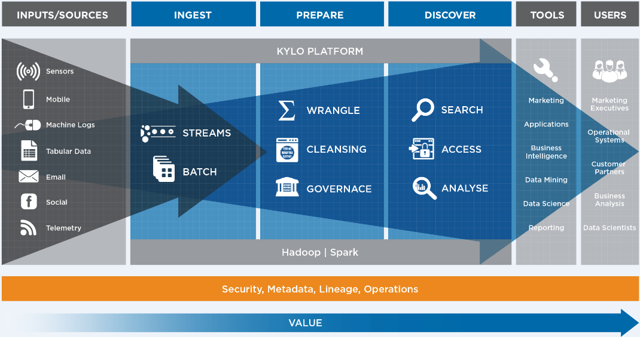
Data Lake Design Approach to Success

Slide 6
Data Lake Foundation Implementation for Success Best Practices to Delivery User Access and Business Value
Data Lake framework. Proven end-to-end framework from data source ingest to user access
Data Ingest/wrangle. Feed processing configured around a few key business data use cases
Data Preparation. Configure data cleansing and preparation
Data Confidence. Ensure completeness, freshness and data quality check processes
Governance. Configure custom validation rules and data confidence metrics
Security. Setup users, groups, and roles. Configured for Ranger/Sentry and Kerberos (if available)
Monitoring. Setup data pipeline health monitoring and service level agreements
Customization Templates. Build templates/processors for repeated & consistent use
Training. Ramp and transition to own of admin and users of this best practices framework
Documentation. Approach document, Install guide, Best Practices guide, and runbook

Slide 7
What is Kylo and How Does it Enable Data Lake Value
Kylo is an open-source Data Lake Platform Framework that is built using the latest open source capabilities such as Hadoop, Apache Spark and Apache NiFi.
Kylo is a Teradata sponsored, open-source project that is offered under the Apache 2.0 license (Kylo is not associated with the Apache Foundation).
Kylo software, documentation & tutorials are available via the Kylo website: http://kylo.io
Kylo has been innovated by Think Big Analytics over several years and from working with over 150 companies who have struggled to get value from engineering data lakes.
Kylo is helping companies overcome the number one data lake challenge that most face: the ability to provide secure and solid governance of new data sources so that they can be made directly available to the business in order to gain actionable insight and drive new business value from the company’s data.
Think Big Analytics offers optional Kylo license support, implementation and data sciences services and Academy offerings: https://www.thinkbiganalytics.com/kylo/

Slide 8
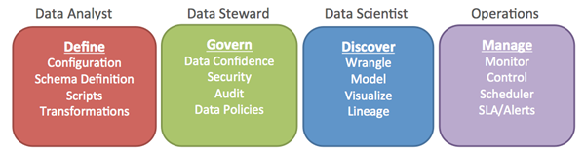
Kylo Solution Alignment & Overview (Core Governance)
Data Lake Architecture
Purpose built, well architected & managed approach that is aligned with direct business value of the data; Balance Agility & Governance.
Dev Ops Framework to consistent and continuous integration and deployment
Automate Data Pipelines
Monitor and manage data pipelines, ensure quality and SLAs, validate, profile and cleanse.
Secure
Role Based Governance - protect, encrypt, restrict data on wire and at rest.
Lineage
technical metadata and logs for every step; enable index & search
Data Prep and publish
model & prepare analytical data set optimized to meet needs of the tool or defined application needs.
Provide Data Lifecycle Management
archive with retention management for source
Notes:
What You Can Expect from Think Big’s Data Lake Foundation Pilot.
You will have a corporate repository for tracking and governing data ingest and access:
Govern what data is ingested or provisioned, by whom and when
Track usage, resolve anomalies, visualize, optimize and clarify data lineage
Offload history of operational and analytical data platforms
A discovery platform to enable data profiling, analytics, data science and business reporting

Slide 9
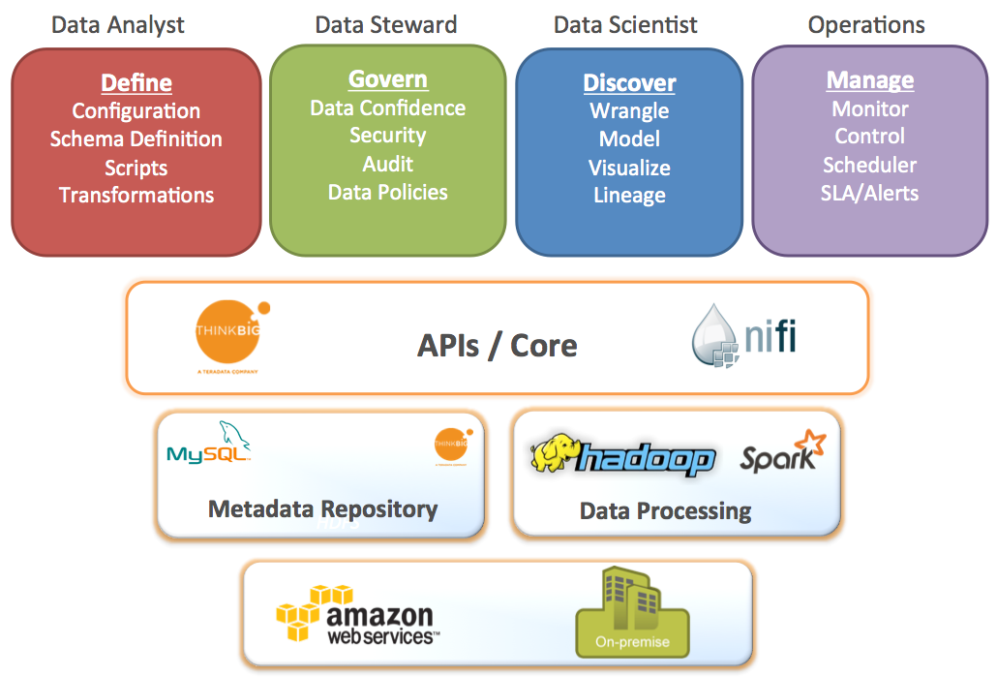
Kylo 数据湖基础框架
“Kylo” was developed as an open source offering to enable access and functionality to many user groups of the Data Lake
Features | Hadoop Alone | With Kylo
Distributed & Scalable | ✔ | ✔
Batch & Streaming support | ✔ | ✔
Real-time Analytics | ✔ | ✔
Configurable | ✔ | ✔
GUI-Driven Development |  | ✔
Data Ingest |  | ✔
Data Wrangling |  | ✔
Data Protection/Cleansing |  | ✔
Data Profiling |  | ✔
Metadata & Governance |  | ✔
Automation |  | ✔
Embedded Best Practices |  | ✔
Notes:
From the FAQ on Connections, which has a lot of other good information: https://connections.teradata.com/docs/DOC-126467
What is Kylo’s value-add over plain NiFi?
NiFi provides flow-based processing, acts as an orchestration engine and framework for data processing on the edge. It doesn’t itself provide all the tooling required for a Data Lake solution.
Key benefits of Kylo include:
· Write-once, use many times o Apache NiFi is a powerful IT tool for designing pipelines but in practice most Data Lake oriented feeds utilize just a small number of unique flows or “patterns". Think Big Kylo allows IT the flexibility to design these unique flows as a model then register the NiFi template with Kylo. This enables non-technical business users to configure dozens or hundreds of new feeds through a simple, guided stepper-UI. In other words, Kylo’s UI allows users to set up pipeline without having to code in NiFi. As long as the basic ingestion pattern is the same, there is no need for new coding. Business users will be able to bring in new data sources, perform standard transformations and publish to target systems. · Superior UI for monitoring data feeds
o Kylo’s Operations Dashboard provides centralized health monitoring of feeds and underlying data quality to provide data confidence. It can also integrate with Hadoop monitoring tools such as Ambari or Cloudera Navigator to correlate feed health to cluster service issues. Kylo can enforce Service Level Agreements, data quality metrics, and alerts
· Key Data Lake features o Metadata search, data discovery, wrangling, data browse, event-based feed execution (to chain together flows) · Accelerates NiFi development through NiFi extensions
o Includes custom NiFi custom processors for operations such as: Data Profile, Data Cleanse, Data Validate, Merge/Dedupe, Extract Table with high-water, etc.
o Includes custom Nifi processors for utilizing Hadoop for processing: Spark exec, Sqoop, Spark shell, Hive and Spark via JDBC/Thrift, and others. These processors aren't yet available with vanilla NiFi
o Pre-built NiFi templates for implementing Data Lake best practices: Data Ingest, ILM, and Data Processing
qHow Apps will put/stream data to the common staging area ?
All Kylo capabilities are exposed through REST APIs, so can be accessed from an app.

Slide 10
Kylo 数据湖基础框架
features tailored to organizational users
visual pipeline development
streaming or batch feeds
integrated best practices
scalable, open-source architecture
governance
flexible deployment
Notes:
6 years of experience distilled through 2 major development cycles (pre-NiFi and NiFi)
Governance and best practices built in
Our “ingestion” far beyond “put”: many best practices
No one likes to talk about governance, everyone likes to talk about Big Data
Our experience: the right way to do Big Data is to implement good governance early and often
End-to-end integration
Many shops cover bits and pieces with different technologies
Role separation
This can be really important, especially for CDO/CIO/CTO types
Advantages:
Efficiency
Resources spend time on what they are good at
Build once, reuse
Governance
Classic problem: IT responsible for enforcing governance (security, data protection, access control)
Business wants control of their own data
Analysts know existing data, want to explore new data
Operations supposed to keep things running
Kylo answer:
IT builds the reusable templates
Analysts/business builds the derived feeds
Analysts can explore, wrangle the data using Spark without coding
Operations uses the Operations Manager, alerts, etc.
Tooling provides right level of exposure and control for the role
Approach based on extensible, reusable templates
Build pipeline once the right way
Important point: if pipeline improved, all derived feeds are automatically changed
Big uptake from groups using/exploring NiFi, who now recognize need other pieces which we have already built
How is it more than plain NiFi?
See the FAQ on the Wiki, but high points are:
Our own NiFi processors
Our NiFi templates
Feed management over NiFi templates
Operational Dashboard
Spark-based wrangler
Security
Metadata management
Including history of data profiling

Slide 11

Kylo Framework: Speeding Time-to-Value
 | Traditional Approach
Adding a new data set | Weeks
Inserting data validation rules | Weeks
Conducting data profiling | Weeks
Enabling data discovery for business users | Months
With Kylo
Hours
Hours
Automatic
Automatic

Slide 12
Kylo 虚机环境配置

Slide 13
环境需求
Linux/Windows Host
RAM: 12G+
CPU: 4C+
HDD: 20G+（推荐使用SSD）
Oracle Virtualbox 5.1.14(Lastest)
说明：最新版本虚机是0.8.0，采用的操作系统是RHEL 7.3.1611

Slide 14
导入过程

Slide 15
安装和配置网络组件
安装Rhel 7.3的网络包：
#yum install net-tools
手动修改网络配置(/etc/sysconfig/network-scripts/ifcfg-enp0s3)
BOOTPROTO=”static”
IPADDR=153.65.129.233
NETMASK=255.255.255.0
ONBOOT=“yes”

Slide 16
虚机访问及帐户密码
应用名称 | 端口 | 帐户/密码 | 说明
SSH | 22 | root/kylo | 操作系统帐号
Kylo UI | 8400 | dladmin/thinkbig | Kylo管理帐号
Ambari | 8080 | admin/admin | Hadoop集群管理
NIFI | 8079
MYSQL | 3306 | mysql –u root
Active MQ | 8161
Web HDFS | 50070 |  | Web端方问HDFS

Slide 17
配置Dbeaver访问Hive
安装JDK
安装Dbeaver
下载&安装Hive JDBC驱动

Slide 18
Kylo 操作过程演示
Notes:
Alternate divider slide

Slide 19
学习进阶资源
www.kylo.io 官方网站
www.readthedocs.io 最佳实践
http://nifi.apache.org/ Apache NIFI
https://github.com/KyloIO/kylo 托管源代码

Slide 20

We believe…
Analytics and data unleash the potential of great companies
Notes:
We believe that analytics and data unleash the potential of great companies.
Analytics and data have become the number one assets in organizations that are driving differentiated value. When companies treat analytics and data as their number one asset, they have the now have the ability to transform organizations.
Whether your company is working to:
Reduce the time for clinical trial for new drugs;
Improve yield for farmers by better managing soil and crops
Lower carbon emissions; or
Improve communications between people
… there is unlimited potential to what data and analytics can unleash.

Slide 21
Notes:
Closing slide for all presentations

