Slide 1

Kylo配置与使用介绍
Yao Ran
Feb 2017
Notes:
Alternate title slide – move to beginning of deck, or delete if not used.

Slide 2

目录
Kylo 架构功能介绍
Kylo 虚机环境配置
Kylo 操作过程演示
学习进阶资源
2

Slide 3

建设Hadoop数据湖所面临的挑战
技术上极度依赖有经验的软件工程师
数据治理、质量和安全往往被放在事后考虑
缺少向业务用户提供自助服务和其它可用功能
Few organizations have the engineering skills or experience to build a
successful Data Lake program in-house
© 2017 Think Big, A Teradata Company

Slide 4














基于Kylo的数据湖架构
DTG
获取
处理
探索
Sensors
Marketing
Marketing Executives
Mobile
Applications
Operational Systems
流
归并
搜索
Business Intelligence
Customers Partners
Machine logs
清洗
访问
Data Mining
Frontline Workers
Tabular Data
批处理
Business Analysts
email
Data Science
治理
分析
Data Scientists
Social
Hadoop | Spark
Reporting
Engineers
Telemetry
安全、元数据/数据亲缘、 操作
Analytic tools & Apps
Users
Sources

Slide 5
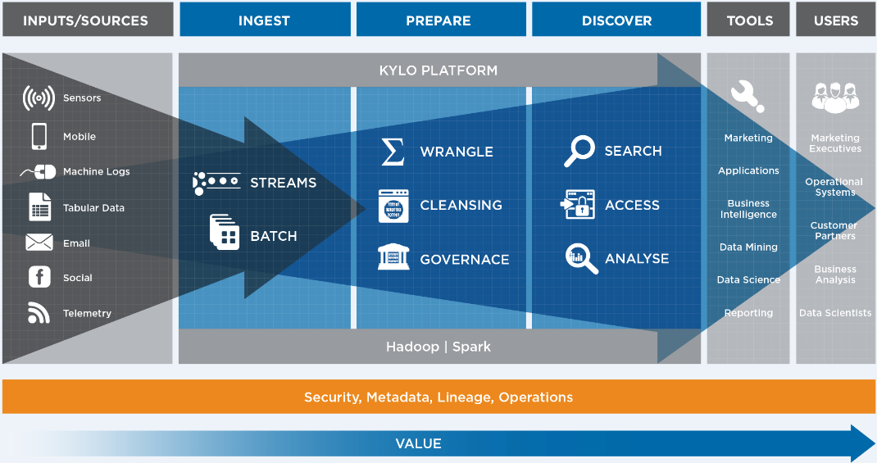
数据湖架构设计成功之道

Slide 6
数据湖基础实施成功之道 提供用户访问和产生业务价值的最佳实践
数据湖框架. Proven end-to-end framework from data source ingest to user access
数据接收与存储. Feed processing configured around a few key business data use cases
数据准备. Configure data cleansing and preparation
数据检查校验. Ensure completeness, freshness and data quality check processes
数据治理. Configure custom validation rules and data confidence metrics
数据安全. Setup users, groups, and roles. Configured for Ranger/Sentry and Kerberos (if available)
监控. Setup data pipeline health monitoring and service level agreements
自定义模版. Build templates/processors for repeated & consistent use
培训. Ramp and transition to own of admin and users of this best practices framework
文档化. Approach document, Install guide, Best Practices guide, and runbook

Slide 7
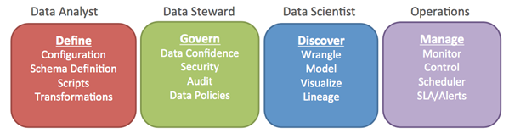
Kylo 解决方案概述(核心治理)
数据湖架构
Purpose built, well architected & managed approach that is aligned with direct business value of the data; Balance Agility & Governance.
Dev Ops Framework to consistent and continuous integration and deployment
自动化数据管道
Monitor and manage data pipelines, ensure quality and SLAs, validate, profile and cleanse.
安全
Role Based Governance - protect, encrypt, restrict data on wire and at rest.
数据血缘
technical metadata and logs for every step; enable index & search
数据准备与发布
model & prepare analytical data set optimized to meet needs of the tool or defined application needs.
数据生命周期管理
archive with retention management for source
Notes:
What You Can Expect from Think Big’s Data Lake Foundation Pilot.
You will have a corporate repository for tracking and governing data ingest and access:
Govern what data is ingested or provisioned, by whom and when
Track usage, resolve anomalies, visualize, optimize and clarify data lineage
Offload history of operational and analytical data platforms
A discovery platform to enable data profiling, analytics, data science and business reporting

Slide 8
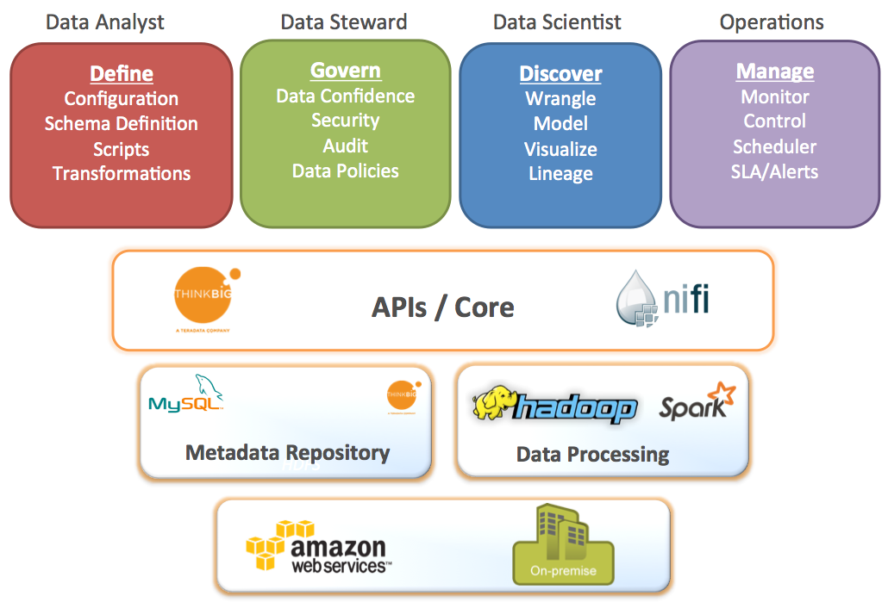
Kylo 数据湖基础框架
“Kylo” was developed as an open source offering to enable access and functionality to many user groups of the Data Lake
功能特性 | Hadoop Alone | With Kylo
分布式与可扩展 | ✔ | ✔
批处理 & 流处理支持 | ✔ | ✔
实时分析 | ✔ | ✔
可配置 | ✔ | ✔
图形化界面开发 |  | ✔
数据接收 |  | ✔
数据重组 |  | ✔
数据保护/清洗 |  | ✔
数据分析 |  | ✔
元数据 & 数据治理 |  | ✔
自动化 |  | ✔
嵌入式最佳实践 |  | ✔
Notes:
From the FAQ on Connections, which has a lot of other good information: https://connections.teradata.com/docs/DOC-126467
What is Kylo’s value-add over plain NiFi?
NiFi provides flow-based processing, acts as an orchestration engine and framework for data processing on the edge. It doesn’t itself provide all the tooling required for a Data Lake solution.
Key benefits of Kylo include:
· Write-once, use many times o Apache NiFi is a powerful IT tool for designing pipelines but in practice most Data Lake oriented feeds utilize just a small number of unique flows or “patterns". Think Big Kylo allows IT the flexibility to design these unique flows as a model then register the NiFi template with Kylo. This enables non-technical business users to configure dozens or hundreds of new feeds through a simple, guided stepper-UI. In other words, Kylo’s UI allows users to set up pipeline without having to code in NiFi. As long as the basic ingestion pattern is the same, there is no need for new coding. Business users will be able to bring in new data sources, perform standard transformations and publish to target systems. · Superior UI for monitoring data feeds
o Kylo’s Operations Dashboard provides centralized health monitoring of feeds and underlying data quality to provide data confidence. It can also integrate with Hadoop monitoring tools such as Ambari or Cloudera Navigator to correlate feed health to cluster service issues. Kylo can enforce Service Level Agreements, data quality metrics, and alerts
· Key Data Lake features o Metadata search, data discovery, wrangling, data browse, event-based feed execution (to chain together flows) · Accelerates NiFi development through NiFi extensions
o Includes custom NiFi custom processors for operations such as: Data Profile, Data Cleanse, Data Validate, Merge/Dedupe, Extract Table with high-water, etc.
o Includes custom Nifi processors for utilizing Hadoop for processing: Spark exec, Sqoop, Spark shell, Hive and Spark via JDBC/Thrift, and others. These processors aren't yet available with vanilla NiFi
o Pre-built NiFi templates for implementing Data Lake best practices: Data Ingest, ILM, and Data Processing
qHow Apps will put/stream data to the common staging area ?
All Kylo capabilities are exposed through REST APIs, so can be accessed from an app.

Slide 9
Kylo 数据湖基础框架
features tailored to organizational users
visual pipeline development
streaming or batch feeds
integrated best practices
scalable, open-source architecture
governance
flexible deployment
Notes:
6 years of experience distilled through 2 major development cycles (pre-NiFi and NiFi)
Governance and best practices built in
Our “ingestion” far beyond “put”: many best practices
No one likes to talk about governance, everyone likes to talk about Big Data
Our experience: the right way to do Big Data is to implement good governance early and often
End-to-end integration
Many shops cover bits and pieces with different technologies
Role separation
This can be really important, especially for CDO/CIO/CTO types
Advantages:
Efficiency
Resources spend time on what they are good at
Build once, reuse
Governance
Classic problem: IT responsible for enforcing governance (security, data protection, access control)
Business wants control of their own data
Analysts know existing data, want to explore new data
Operations supposed to keep things running
Kylo answer:
IT builds the reusable templates
Analysts/business builds the derived feeds
Analysts can explore, wrangle the data using Spark without coding
Operations uses the Operations Manager, alerts, etc.
Tooling provides right level of exposure and control for the role
Approach based on extensible, reusable templates
Build pipeline once the right way
Important point: if pipeline improved, all derived feeds are automatically changed
Big uptake from groups using/exploring NiFi, who now recognize need other pieces which we have already built
How is it more than plain NiFi?
See the FAQ on the Wiki, but high points are:
Our own NiFi processors
Our NiFi templates
Feed management over NiFi templates
Operational Dashboard
Spark-based wrangler
Security
Metadata management
Including history of data profiling

Slide 10

Kylo Framework: Speeding Time-to-Value
 | Traditional Approach
Adding a new data set | Weeks
Inserting data validation rules | Weeks
Conducting data profiling | Weeks
Enabling data discovery for business users | Months
With Kylo
Hours
Hours
Automatic
Automatic

Slide 11
Kylo 虚机环境配置

Slide 12
环境需求
Linux/Windows Host
RAM: 12G+
CPU: 4C+
HDD: 20G+（推荐使用SSD）
Oracle Virtualbox 5.1.14(Lastest)
说明：最新版本虚机是0.8.0，采用的操作系统是RHEL 7.3.1611

Slide 13
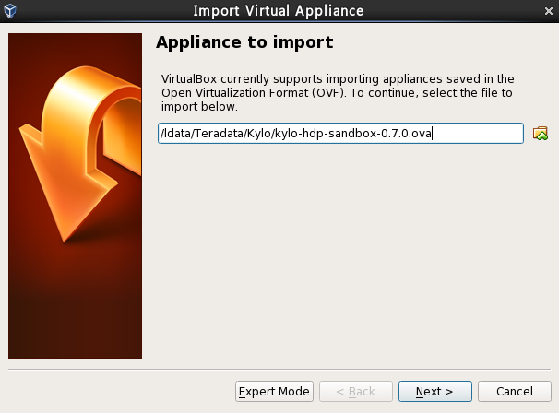
导入虚机
导入VirtualBox OVI文件

Slide 14
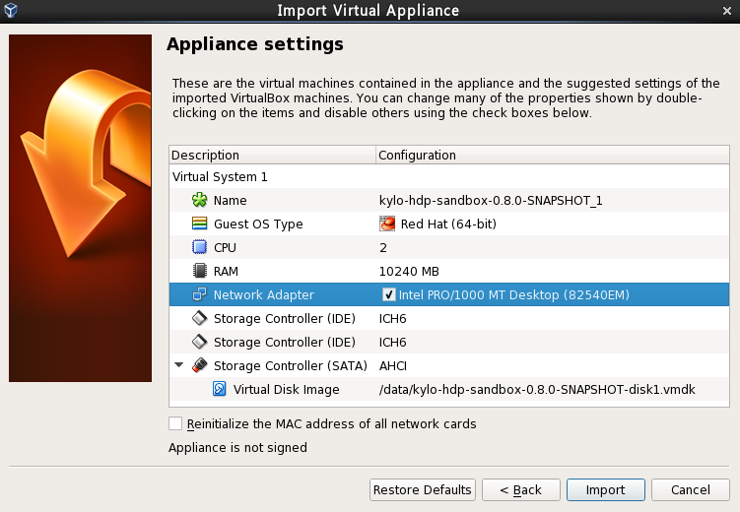
导入虚机设置
1)建议将虚机文件放在最快的磁盘上（比如SSD）
2)Storage控制器建议采用ICH6
3)虚机内存>=10G
4)不要重新初始化网卡地址

Slide 15
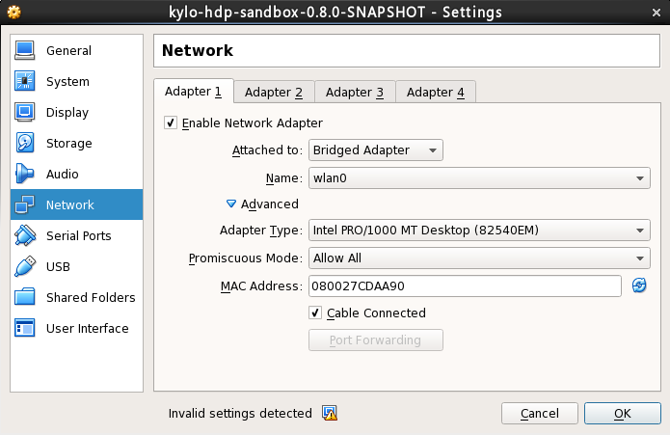
设置虚机网络
以公司网络为例，建议将主机的无线网卡Bridge到虚机，虚机与主机使用不同的IP地址

Slide 16
安装和配置网络组件
安装Rhel 7.3的网络包：
#yum install net-tools
手动修改网络配置(/etc/sysconfig/network-scripts/ifcfg-enp0s3)
BOOTPROTO=”static”
IPADDR=172.16.220.11
NETMASK=255.255.248.0
ONBOOT=“yes”
注：红色IP地址部分可以根据自己的网络设置做调整

Slide 17
虚机访问及帐户密码
应用名称 | 端口 | 帐户/密码 | 说明
SSH | 22 | root/kylo | 操作系统帐号
Kylo UI | 8400 | dladmin/thinkbig | Kylo管理帐号
Ambari | 8080 | admin/admin | Hadoop集群管理
NIFI | 8079
MYSQL | 3306 | mysql –u root
Active MQ | 8161
Web HDFS | 50070 |  | Web端方问HDFS

Slide 18
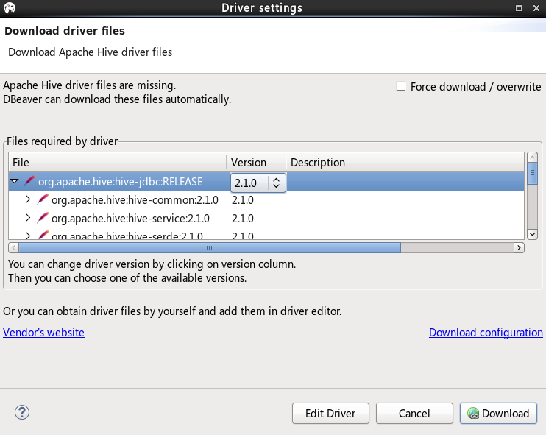
配置Dbeaver访问Hive
安装JDK
安装Dbeaver
下载&安装Hive JDBC驱动
（注：Dbeaver最新的Hive JDBC版本
是2.1.1，但是本虚机对应的版本是2.1.0，
不能弄错)

Slide 19
Kylo 操作过程演示
Notes:
Alternate divider slide

Slide 20
操作相关脚本
[root@sandbox dropzone]# beeline
Beeline version 1.2.1000.2.5.3.0-37 by Apache Hive
beeline> !connect jdbc:hive2://localhost:10000
jdbc:hive2://localhost:10000> show databases;
3 rows selected (0.041 seconds)0:
jdbc:hive2://localhost:10000> use website;
No rows affected (0.06 seconds)0:
jdbc:hive2://localhost:10000> show tables;
5 rows selected (0.056 seconds)0:
jdbc:hive2://localhost:10000> select * from mytest;
12 rows selected (0.479 seconds)
HDFS Command:[root@sandbox /]# hdfs dfs –ls /app/warehouse/website

Slide 21
学习进阶资源
www.kylo.io 官方网站
www.readthedocs.io 最佳实践
http://nifi.apache.org/ Apache NIFI
https://github.com/KyloIO/kylo 托管源代码
http://spark.apache.org/docs/latest/api/scala/index.html#org.apache.spark.sql.functions$ Spark SQL Functions

Slide 22

We believe…
Analytics and data unleash the potential of great companies
Notes:
We believe that analytics and data unleash the potential of great companies.
Analytics and data have become the number one assets in organizations that are driving differentiated value. When companies treat analytics and data as their number one asset, they have the now have the ability to transform organizations.
Whether your company is working to:
Reduce the time for clinical trial for new drugs;
Improve yield for farmers by better managing soil and crops
Lower carbon emissions; or
Improve communications between people
… there is unlimited potential to what data and analytics can unleash.

Slide 23
Notes:
Closing slide for all presentations

