Slide 1
Acree Memorial Hack Fest for Mental Health 2021
Team 13

Slide 2
Prompt:
To investigate patterns and generate insights into college students receiving mental health services and the overall mental health of those students.

Slide 3
Findings:
For each of the four questions asked about mental health, >70% of respondents experienced symptoms of mental health issues
Only ~20% of those surveyed attended therapy
So which students are most likely to seek counseling?

Slide 4
Findings:
Students demonstrating high anxiety levels and the inability to stop worrying, but not necessarily lack of pleasure or depression were most likely to have attended therapy/counseling

Slide 5
Data Preprocessing:
Of the entire dataset, only questions 32 through 38c were selected
These questions asked participants about frequency of symptoms of mental health issues and access to medical professionals for treatment
In total, there were 702 participants with 6 attributes being used in the analysis

Slide 6
Methods:
The percentages of respondents suffering from mental health problems was calculated through division
Logistic Regression was chosen for the classification algorithm
This was due to the binary nature of the target attribute

Slide 7
The Model
A third of the dataset was chosen for testing
K-Fold cross validation measured with accuracy score
Brute force algorithm used to find highest percentage to have sought therapy

Slide 8
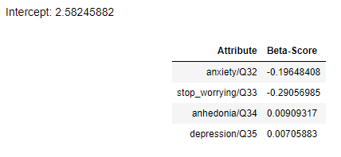
Results
Q32 and Q33 had negative Beta scores, while Q34 and 35 had small but positive Beta scores

Slide 9
Results
Students who scored highest for the ‘Anxiety’ and ‘Stop_Worry’ attributes but lowest in ‘Anhedonia’ and ‘Depression’ were more likely to seek therapy

Slide 10
Results
Even then, they were only ~34% likely to have sought counseling
Q32 and Q33 had negative Beta scores, while Q34 and 35 had small but positive Beta scores
Beta scores suggest that Anhedonic and/or depressed students less likely to seek therapy

Slide 11
What might help?
Removal of stigma surrounding depression
Recognition that anhedonia may be a symptom of depression
Encouragement of peers who exhibit symptoms to seek guidance

Slide 12
Questions?

