Slide 1

openGK 提高SNV模型方案及结果

Slide 2
原始结果源自 -9100-WES.txt 过滤后结果源自 -9100-WES-AllData.txt 共10个突变 最后三列含义： 其中called.openGK.raw列表示该突变是否存在于openGK原始结果中called.openGK.filter列表示该突变是否存在于openGK过滤后结果中 called.golden表示该突变是否存在于NA12878标准结果中
openGK 原始结果，过滤后结果和NA12878标准结果在POLG， ACADM， CFTR三个基因上的情况
No. | seqnames | start | end | ref | alt | DP | A | T | C | G | ReadBalanceMutant | AlleleFrequency | REF.FvsR | ALT.FvsR | called.openGK.raw | called.openGK.filter | called.golden
1 | 1 | 76198436 | 76198436 | T | C | 65 | 0;0 | 13;16 | 15;21 | 0;0 | 0.7143 | 55.38 | 0.448 | 0.417 | TRUE | TRUE | -
2 | 1 | 76227022 | 76227022 | A | G | - | - | - | - | - | - | - | - | - | - | - | TRUE
3 | 1 | 76229120 | 76229120 | T | C | 20 | 0;0 | 4;1 | 13;2 | 0;0 | 0.1538 | 75 | 0.8 | 0.867 | TRUE | - | TRUE
4 | 1 | 76229326 | 76229326 | T | C | 33 | 0;0 | 0;0 | 8;25 | 0;0 | 0.32 | 100 | NaN | 0.242 | TRUE | - | TRUE
5 | 7 | 117188736 | 117188736 | C | A | 111 | 33;1 | 0;0 | 62;15 | 0;0 | 0.0303 | 30.63 | 0.805 | 0.971 | TRUE | TRUE | -
6 | 7 | 117188850 | 117188850 | G | T | 132 | 0;0 | 5;25 | 0;0 | 51;51 | 0.2 | 22.73 | 0.5 | 0.167 | TRUE | TRUE | -
7 | 7 | 117351163 | 117351163 | C | T | 44 | 0;0 | 7;37 | 0;0 | 0;0 | 0.1892 | 100 | NaN | 0.159 | TRUE | - | TRUE
8 | 15 | 89860350 | 89860350 | A | C | - | - | - | - | - | - | - | - | - | - | - | TRUE
9 | 15 | 89860786 | 89860786 | A | C | 46 | 4;25 | 0;0 | 0;17 | 0;0 | 0 | 36.96 | 0.138 | 0 | TRUE | TRUE | -
10 | 15 | 89862341 | 89862341 | A | G | 71 | 14;17 | 0;0 | 0;0 | 20;20 | 1 | 56.34 | 0.452 | 0.5 | TRUE | TRUE | -

Slide 3
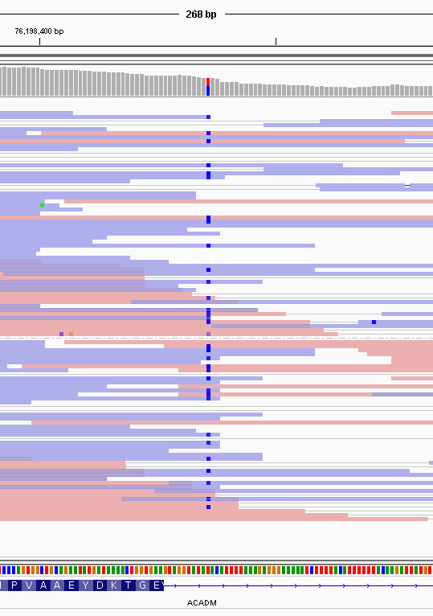
No. | seqnames | start | end | ref | alt | DP | A | T | C | G | ReadBalanceMutant | AlleleFrequency | REF.FvsR | ALT.FvsR | called.openGK.raw | called.openGK.filter | called.golden
1 | 1 | 76198436 | 76198436 | T | C | 65 | 0;0 | 13;16 | 15;21 | 0;0 | 0.7143 | 55.38 | 0.448 | 0.417 | TRUE | TRUE | -
2 | 1 | 76227022 | 76227022 | A | G | - | - | - | - | - | - | - | - | - | - | - | TRUE
3 | 1 | 76229120 | 76229120 | T | C | 20 | 0;0 | 4;1 | 13;2 | 0;0 | 0.1538 | 75 | 0.8 | 0.867 | TRUE | - | TRUE
4 | 1 | 76229326 | 76229326 | T | C | 33 | 0;0 | 0;0 | 8;25 | 0;0 | 0.32 | 100 | NaN | 0.242 | TRUE | - | TRUE
5 | 7 | 117188736 | 117188736 | C | A | 111 | 33;1 | 0;0 | 62;15 | 0;0 | 0.0303 | 30.63 | 0.805 | 0.971 | TRUE | TRUE | -
6 | 7 | 117188850 | 117188850 | G | T | 132 | 0;0 | 5;25 | 0;0 | 51;51 | 0.2 | 22.73 | 0.5 | 0.167 | TRUE | TRUE | -
7 | 7 | 117351163 | 117351163 | C | T | 44 | 0;0 | 7;37 | 0;0 | 0;0 | 0.1892 | 100 | NaN | 0.159 | TRUE | - | TRUE
8 | 15 | 89860350 | 89860350 | A | C | - | - | - | - | - | - | - | - | - | - | - | TRUE
9 | 15 | 89860786 | 89860786 | A | C | 46 | 4;25 | 0;0 | 0;17 | 0;0 | 0 | 36.96 | 0.138 | 0 | TRUE | TRUE | -
10 | 15 | 89862341 | 89862341 | A | G | 71 | 14;17 | 0;0 | 0;0 | 20;20 | 1 | 56.34 | 0.452 | 0.5 | TRUE | TRUE | -
突变1

Slide 4
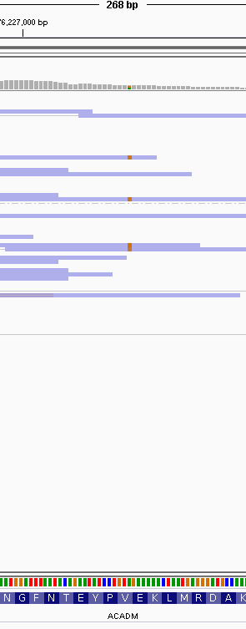
No. | seqnames | start | end | ref | alt | DP | A | T | C | G | ReadBalanceMutant | AlleleFrequency | REF.FvsR | ALT.FvsR | called.openGK.raw | called.openGK.filter | called.golden
1 | 1 | 76198436 | 76198436 | T | C | 65 | 0;0 | 13;16 | 15;21 | 0;0 | 0.7143 | 55.38 | 0.448 | 0.417 | TRUE | TRUE | -
2 | 1 | 76227022 | 76227022 | A | G | - | - | - | - | - | - | - | - | - | - | - | TRUE
3 | 1 | 76229120 | 76229120 | T | C | 20 | 0;0 | 4;1 | 13;2 | 0;0 | 0.1538 | 75 | 0.8 | 0.867 | TRUE | - | TRUE
4 | 1 | 76229326 | 76229326 | T | C | 33 | 0;0 | 0;0 | 8;25 | 0;0 | 0.32 | 100 | - | 0.242 | TRUE | - | TRUE
5 | 7 | 117188736 | 117188736 | C | A | 111 | 33;1 | 0;0 | 62;15 | 0;0 | 0.0303 | 30.63 | 0.805 | 0.971 | TRUE | TRUE | -
6 | 7 | 117188850 | 117188850 | G | T | 132 | 0;0 | 5;25 | 0;0 | 51;51 | 0.2 | 22.73 | 0.5 | 0.167 | TRUE | TRUE | -
7 | 7 | 117351163 | 117351163 | C | T | 44 | 0;0 | 7;37 | 0;0 | 0;0 | 0.1892 | 100 | NaN | 0.159 | TRUE | - | TRUE
8 | 15 | 89860350 | 89860350 | A | C | - | - | - | - | - | - | - | - | - | - | - | TRUE
9 | 15 | 89860786 | 89860786 | A | C | 46 | 4;25 | 0;0 | 0;17 | 0;0 | 0 | 36.96 | 0.138 | 0 | TRUE | TRUE | -
10 | 15 | 89862341 | 89862341 | A | G | 71 | 14;17 | 0;0 | 0;0 | 20;20 | 1 | 56.34 | 0.452 | 0.5 | TRUE | TRUE | -
突变2

Slide 5
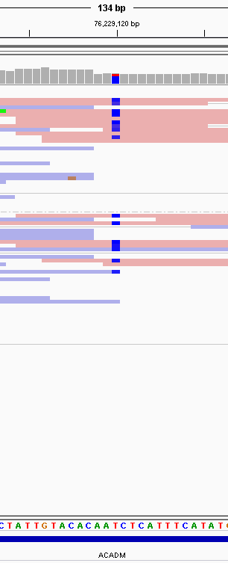
No. | seqnames | start | end | ref | alt | DP | A | T | C | G | ReadBalanceMutant | AlleleFrequency | REF.FvsR | ALT.FvsR | called.openGK.raw | called.openGK.filter | called.golden
1 | 1 | 76198436 | 76198436 | T | C | 65 | 0;0 | 13;16 | 15;21 | 0;0 | 0.7143 | 55.38 | 0.448 | 0.417 | TRUE | TRUE | -
2 | 1 | 76227022 | 76227022 | A | G | - | - | - | - | - | - | - | - | - | - | - | TRUE
3 | 1 | 76229120 | 76229120 | T | C | 20 | 0;0 | 4;1 | 13;2 | 0;0 | 0.1538 | 75 | 0.8 | 0.867 | TRUE | - | TRUE
4 | 1 | 76229326 | 76229326 | T | C | 33 | 0;0 | 0;0 | 8;25 | 0;0 | 0.32 | 100 | - | 0.242 | TRUE | - | TRUE
5 | 7 | 117188736 | 117188736 | C | A | 111 | 33;1 | 0;0 | 62;15 | 0;0 | 0.0303 | 30.63 | 0.805 | 0.971 | TRUE | TRUE | -
6 | 7 | 117188850 | 117188850 | G | T | 132 | 0;0 | 5;25 | 0;0 | 51;51 | 0.2 | 22.73 | 0.5 | 0.167 | TRUE | TRUE | -
7 | 7 | 117351163 | 117351163 | C | T | 44 | 0;0 | 7;37 | 0;0 | 0;0 | 0.1892 | 100 | NaN | 0.159 | TRUE | - | TRUE
8 | 15 | 89860350 | 89860350 | A | C | - | - | - | - | - | - | - | - | - | - | - | TRUE
9 | 15 | 89860786 | 89860786 | A | C | 46 | 4;25 | 0;0 | 0;17 | 0;0 | 0 | 36.96 | 0.138 | 0 | TRUE | TRUE | -
10 | 15 | 89862341 | 89862341 | A | G | 71 | 14;17 | 0;0 | 0;0 | 20;20 | 1 | 56.34 | 0.452 | 0.5 | TRUE | TRUE | -
突变3

Slide 6
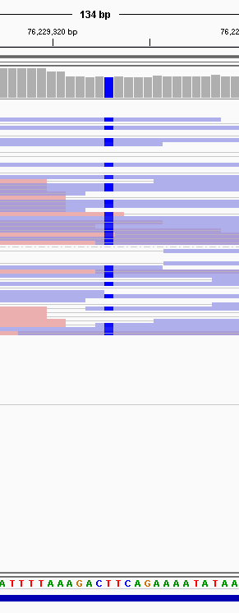
No. | seqnames | start | end | ref | alt | DP | A | T | C | G | ReadBalanceMutant | AlleleFrequency | REF.FvsR | ALT.FvsR | called.openGK.raw | called.openGK.filter | called.golden
1 | 1 | 76198436 | 76198436 | T | C | 65 | 0;0 | 13;16 | 15;21 | 0;0 | 0.7143 | 55.38 | 0.448 | 0.417 | TRUE | TRUE | -
2 | 1 | 76227022 | 76227022 | A | G | - | - | - | - | - | - | - | - | - | - | - | TRUE
3 | 1 | 76229120 | 76229120 | T | C | 20 | 0;0 | 4;1 | 13;2 | 0;0 | 0.1538 | 75 | 0.8 | 0.867 | TRUE | - | TRUE
4 | 1 | 76229326 | 76229326 | T | C | 33 | 0;0 | 0;0 | 8;25 | 0;0 | 0.32 | 100 | - | 0.242 | TRUE | - | TRUE
5 | 7 | 117188736 | 117188736 | C | A | 111 | 33;1 | 0;0 | 62;15 | 0;0 | 0.0303 | 30.63 | 0.805 | 0.971 | TRUE | TRUE | -
6 | 7 | 117188850 | 117188850 | G | T | 132 | 0;0 | 5;25 | 0;0 | 51;51 | 0.2 | 22.73 | 0.5 | 0.167 | TRUE | TRUE | -
7 | 7 | 117351163 | 117351163 | C | T | 44 | 0;0 | 7;37 | 0;0 | 0;0 | 0.1892 | 100 | NaN | 0.159 | TRUE | - | TRUE
8 | 15 | 89860350 | 89860350 | A | C | - | - | - | - | - | - | - | - | - | - | - | TRUE
9 | 15 | 89860786 | 89860786 | A | C | 46 | 4;25 | 0;0 | 0;17 | 0;0 | 0 | 36.96 | 0.138 | 0 | TRUE | TRUE | -
10 | 15 | 89862341 | 89862341 | A | G | 71 | 14;17 | 0;0 | 0;0 | 20;20 | 1 | 56.34 | 0.452 | 0.5 | TRUE | TRUE | -
突变4

Slide 7
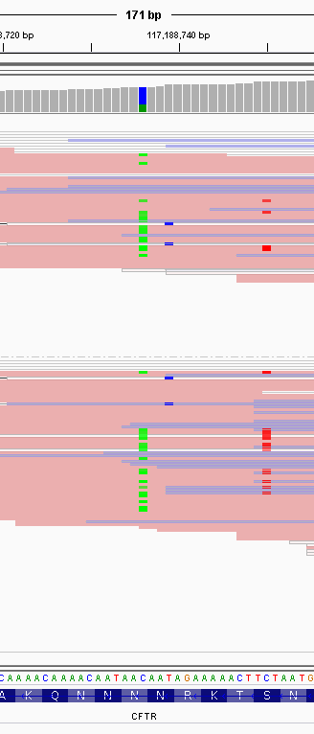
No. | seqnames | start | end | ref | alt | DP | A | T | C | G | ReadBalanceMutant | AlleleFrequency | REF.FvsR | ALT.FvsR | called.openGK.raw | called.openGK.filter | called.golden
1 | 1 | 76198436 | 76198436 | T | C | 65 | 0;0 | 13;16 | 15;21 | 0;0 | 0.7143 | 55.38 | 0.448 | 0.417 | TRUE | TRUE | -
2 | 1 | 76227022 | 76227022 | A | G | - | - | - | - | - | - | - | - | - | - | - | TRUE
3 | 1 | 76229120 | 76229120 | T | C | 20 | 0;0 | 4;1 | 13;2 | 0;0 | 0.1538 | 75 | 0.8 | 0.867 | TRUE | - | TRUE
4 | 1 | 76229326 | 76229326 | T | C | 33 | 0;0 | 0;0 | 8;25 | 0;0 | 0.32 | 100 | - | 0.242 | TRUE | - | TRUE
5 | 7 | 117188736 | 117188736 | C | A | 111 | 33;1 | 0;0 | 62;15 | 0;0 | 0.0303 | 30.63 | 0.805 | 0.971 | TRUE | TRUE | -
6 | 7 | 117188850 | 117188850 | G | T | 132 | 0;0 | 5;25 | 0;0 | 51;51 | 0.2 | 22.73 | 0.5 | 0.167 | TRUE | TRUE | -
7 | 7 | 117351163 | 117351163 | C | T | 44 | 0;0 | 7;37 | 0;0 | 0;0 | 0.1892 | 100 | NaN | 0.159 | TRUE | - | TRUE
8 | 15 | 89860350 | 89860350 | A | C | - | - | - | - | - | - | - | - | - | - | - | TRUE
9 | 15 | 89860786 | 89860786 | A | C | 46 | 4;25 | 0;0 | 0;17 | 0;0 | 0 | 36.96 | 0.138 | 0 | TRUE | TRUE | -
10 | 15 | 89862341 | 89862341 | A | G | 71 | 14;17 | 0;0 | 0;0 | 20;20 | 1 | 56.34 | 0.452 | 0.5 | TRUE | TRUE | -
突变5

Slide 8
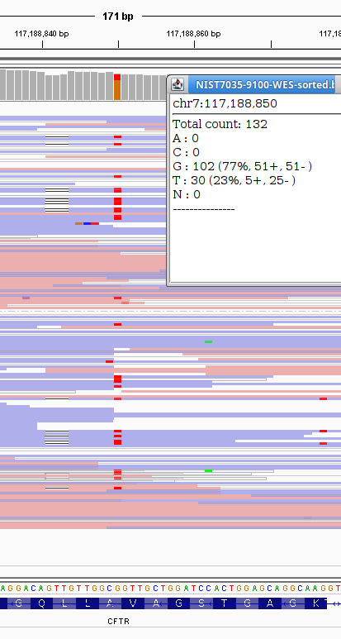
No. | seqnames | start | end | ref | alt | DP | A | T | C | G | ReadBalanceMutant | AlleleFrequency | REF.FvsR | ALT.FvsR | called.openGK.raw | called.openGK.filter | called.golden
1 | 1 | 76198436 | 76198436 | T | C | 65 | 0;0 | 13;16 | 15;21 | 0;0 | 0.7143 | 55.38 | 0.448 | 0.417 | TRUE | TRUE | -
2 | 1 | 76227022 | 76227022 | A | G | - | - | - | - | - | - | - | - | - | - | - | TRUE
3 | 1 | 76229120 | 76229120 | T | C | 20 | 0;0 | 4;1 | 13;2 | 0;0 | 0.1538 | 75 | 0.8 | 0.867 | TRUE | - | TRUE
4 | 1 | 76229326 | 76229326 | T | C | 33 | 0;0 | 0;0 | 8;25 | 0;0 | 0.32 | 100 | - | 0.242 | TRUE | - | TRUE
5 | 7 | 117188736 | 117188736 | C | A | 111 | 33;1 | 0;0 | 62;15 | 0;0 | 0.0303 | 30.63 | 0.805 | 0.971 | TRUE | TRUE | -
6 | 7 | 117188850 | 117188850 | G | T | 132 | 0;0 | 5;25 | 0;0 | 51;51 | 0.2 | 22.73 | 0.5 | 0.167 | TRUE | TRUE | -
7 | 7 | 117351163 | 117351163 | C | T | 44 | 0;0 | 7;37 | 0;0 | 0;0 | 0.1892 | 100 | NaN | 0.159 | TRUE | - | TRUE
8 | 15 | 89860350 | 89860350 | A | C | - | - | - | - | - | - | - | - | - | - | - | TRUE
9 | 15 | 89860786 | 89860786 | A | C | 46 | 4;25 | 0;0 | 0;17 | 0;0 | 0 | 36.96 | 0.138 | 0 | TRUE | TRUE | -
10 | 15 | 89862341 | 89862341 | A | G | 71 | 14;17 | 0;0 | 0;0 | 20;20 | 1 | 56.34 | 0.452 | 0.5 | TRUE | TRUE | -
突变6

Slide 9
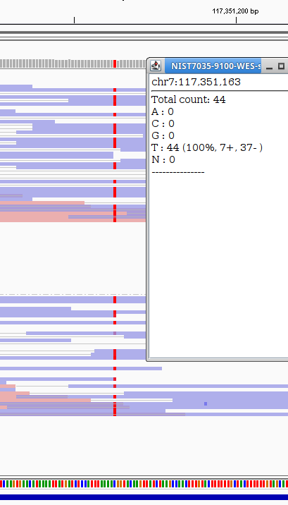
No. | seqnames | start | end | ref | alt | DP | A | T | C | G | ReadBalanceMutant | AlleleFrequency | REF.FvsR | ALT.FvsR | called.openGK.raw | called.openGK.filter | called.golden
1 | 1 | 76198436 | 76198436 | T | C | 65 | 0;0 | 13;16 | 15;21 | 0;0 | 0.7143 | 55.38 | 0.448 | 0.417 | TRUE | TRUE | -
2 | 1 | 76227022 | 76227022 | A | G | - | - | - | - | - | - | - | - | - | - | - | TRUE
3 | 1 | 76229120 | 76229120 | T | C | 20 | 0;0 | 4;1 | 13;2 | 0;0 | 0.1538 | 75 | 0.8 | 0.867 | TRUE | - | TRUE
4 | 1 | 76229326 | 76229326 | T | C | 33 | 0;0 | 0;0 | 8;25 | 0;0 | 0.32 | 100 | - | 0.242 | TRUE | - | TRUE
5 | 7 | 117188736 | 117188736 | C | A | 111 | 33;1 | 0;0 | 62;15 | 0;0 | 0.0303 | 30.63 | 0.805 | 0.971 | TRUE | TRUE | -
6 | 7 | 117188850 | 117188850 | G | T | 132 | 0;0 | 5;25 | 0;0 | 51;51 | 0.2 | 22.73 | 0.5 | 0.167 | TRUE | TRUE | -
7 | 7 | 117351163 | 117351163 | C | T | 44 | 0;0 | 7;37 | 0;0 | 0;0 | 0.1892 | 100 | - | 0.159 | TRUE | - | TRUE
8 | 15 | 89860350 | 89860350 | A | C | - | - | - | - | - | - | - | - | - | - | - | TRUE
9 | 15 | 89860786 | 89860786 | A | C | 46 | 4;25 | 0;0 | 0;17 | 0;0 | 0 | 36.96 | 0.138 | 0 | TRUE | TRUE | -
10 | 15 | 89862341 | 89862341 | A | G | 71 | 14;17 | 0;0 | 0;0 | 20;20 | 1 | 56.34 | 0.452 | 0.5 | TRUE | TRUE | -
突变7

Slide 10
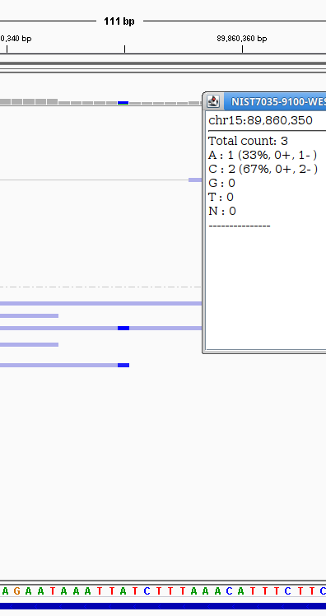
No. | seqnames | start | end | ref | alt | DP | A | T | C | G | ReadBalanceMutant | AlleleFrequency | REF.FvsR | ALT.FvsR | called.openGK.raw | called.openGK.filter | called.golden
1 | 1 | 76198436 | 76198436 | T | C | 65 | 0;0 | 13;16 | 15;21 | 0;0 | 0.7143 | 55.38 | 0.448 | 0.417 | TRUE | TRUE | -
2 | 1 | 76227022 | 76227022 | A | G | - | - | - | - | - | - | - | - | - | - | - | TRUE
3 | 1 | 76229120 | 76229120 | T | C | 20 | 0;0 | 4;1 | 13;2 | 0;0 | 0.1538 | 75 | 0.8 | 0.867 | TRUE | - | TRUE
4 | 1 | 76229326 | 76229326 | T | C | 33 | 0;0 | 0;0 | 8;25 | 0;0 | 0.32 | 100 | - | 0.242 | TRUE | - | TRUE
5 | 7 | 117188736 | 117188736 | C | A | 111 | 33;1 | 0;0 | 62;15 | 0;0 | 0.0303 | 30.63 | 0.805 | 0.971 | TRUE | TRUE | -
6 | 7 | 117188850 | 117188850 | G | T | 132 | 0;0 | 5;25 | 0;0 | 51;51 | 0.2 | 22.73 | 0.5 | 0.167 | TRUE | TRUE | -
7 | 7 | 117351163 | 117351163 | C | T | 44 | 0;0 | 7;37 | 0;0 | 0;0 | 0.1892 | 100 | - | 0.159 | TRUE | - | TRUE
8 | 15 | 89860350 | 89860350 | A | C | - | - | - | - | - | - | - | - | - | - | - | TRUE
9 | 15 | 89860786 | 89860786 | A | C | 46 | 4;25 | 0;0 | 0;17 | 0;0 | 0 | 36.96 | 0.138 | 0 | TRUE | TRUE | -
10 | 15 | 89862341 | 89862341 | A | G | 71 | 14;17 | 0;0 | 0;0 | 20;20 | 1 | 56.34 | 0.452 | 0.5 | TRUE | TRUE | -
突变8

Slide 11
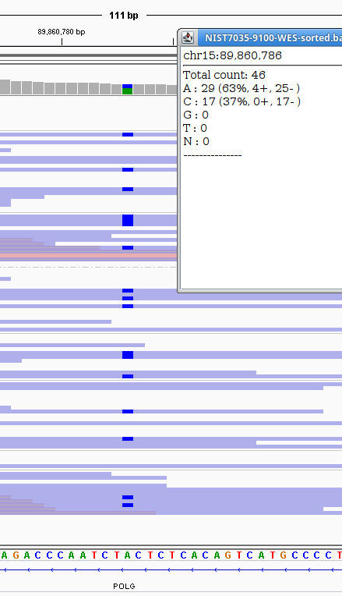
No. | seqnames | start | end | ref | alt | DP | A | T | C | G | ReadBalanceMutant | AlleleFrequency | REF.FvsR | ALT.FvsR | called.openGK.raw | called.openGK.filter | called.golden
1 | 1 | 76198436 | 76198436 | T | C | 65 | 0;0 | 13;16 | 15;21 | 0;0 | 0.7143 | 55.38 | 0.448 | 0.417 | TRUE | TRUE | -
2 | 1 | 76227022 | 76227022 | A | G | - | - | - | - | - | - | - | - | - | - | - | TRUE
3 | 1 | 76229120 | 76229120 | T | C | 20 | 0;0 | 4;1 | 13;2 | 0;0 | 0.1538 | 75 | 0.8 | 0.867 | TRUE | - | TRUE
4 | 1 | 76229326 | 76229326 | T | C | 33 | 0;0 | 0;0 | 8;25 | 0;0 | 0.32 | 100 | - | 0.242 | TRUE | - | TRUE
5 | 7 | 117188736 | 117188736 | C | A | 111 | 33;1 | 0;0 | 62;15 | 0;0 | 0.0303 | 30.63 | 0.805 | 0.971 | TRUE | TRUE | -
6 | 7 | 117188850 | 117188850 | G | T | 132 | 0;0 | 5;25 | 0;0 | 51;51 | 0.2 | 22.73 | 0.5 | 0.167 | TRUE | TRUE | -
7 | 7 | 117351163 | 117351163 | C | T | 44 | 0;0 | 7;37 | 0;0 | 0;0 | 0.1892 | 100 | - | 0.159 | TRUE | - | TRUE
8 | 15 | 89860350 | 89860350 | A | C | - | - | - | - | - | - | - | - | - | - | - | TRUE
9 | 15 | 89860786 | 89860786 | A | C | 46 | 4;25 | 0;0 | 0;17 | 0;0 | 0 | 36.96 | 0.138 | 0 | TRUE | TRUE | -
10 | 15 | 89862341 | 89862341 | A | G | 71 | 14;17 | 0;0 | 0;0 | 20;20 | 1 | 56.34 | 0.452 | 0.5 | TRUE | TRUE | -
突变9

Slide 12
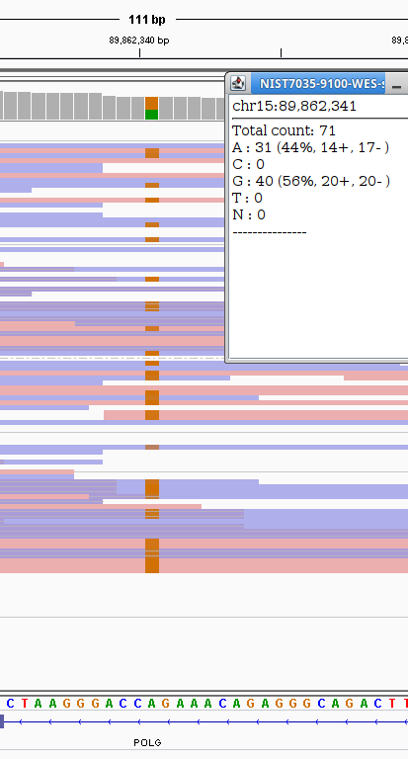
No. | seqnames | start | end | ref | alt | DP | A | T | C | G | ReadBalanceMutant | AlleleFrequency | REF.FvsR | ALT.FvsR | called.openGK.raw | called.openGK.filter | called.golden
1 | 1 | 76198436 | 76198436 | T | C | 65 | 0;0 | 13;16 | 15;21 | 0;0 | 0.7143 | 55.38 | 0.448 | 0.417 | TRUE | TRUE | -
2 | 1 | 76227022 | 76227022 | A | G | - | - | - | - | - | - | - | - | - | - | - | TRUE
3 | 1 | 76229120 | 76229120 | T | C | 20 | 0;0 | 4;1 | 13;2 | 0;0 | 0.1538 | 75 | 0.8 | 0.867 | TRUE | - | TRUE
4 | 1 | 76229326 | 76229326 | T | C | 33 | 0;0 | 0;0 | 8;25 | 0;0 | 0.32 | 100 | - | 0.242 | TRUE | - | TRUE
5 | 7 | 117188736 | 117188736 | C | A | 111 | 33;1 | 0;0 | 62;15 | 0;0 | 0.0303 | 30.63 | 0.805 | 0.971 | TRUE | TRUE | -
6 | 7 | 117188850 | 117188850 | G | T | 132 | 0;0 | 5;25 | 0;0 | 51;51 | 0.2 | 22.73 | 0.5 | 0.167 | TRUE | TRUE | -
7 | 7 | 117351163 | 117351163 | C | T | 44 | 0;0 | 7;37 | 0;0 | 0;0 | 0.1892 | 100 | - | 0.159 | TRUE | - | TRUE
8 | 15 | 89860350 | 89860350 | A | C | - | - | - | - | - | - | - | - | - | - | - | TRUE
9 | 15 | 89860786 | 89860786 | A | C | 46 | 4;25 | 0;0 | 0;17 | 0;0 | 0 | 36.96 | 0.138 | 0 | TRUE | TRUE | -
10 | 15 | 89862341 | 89862341 | A | G | 71 | 14;17 | 0;0 | 0;0 | 20;20 | 1 | 56.34 | 0.452 | 0.5 | TRUE | TRUE | -
突变10

Slide 13
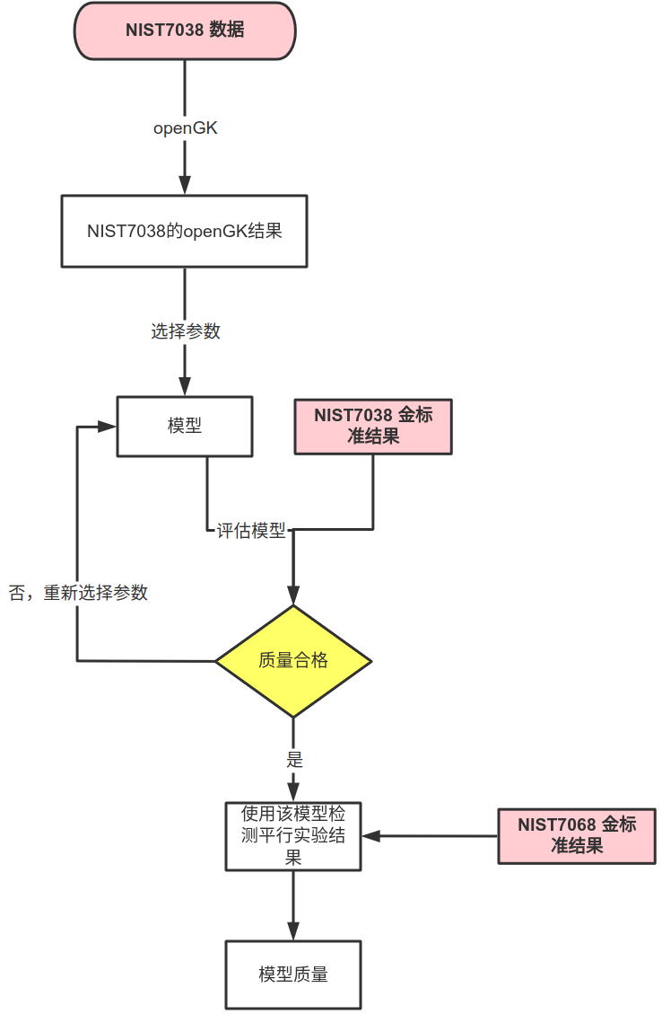
方案与思路

Slide 14
NA12878数据集 测试
GIAB金标准
扩展全外（Nextera Rapid Capture Exome and Expanded Exome），HiSeq2500
结果：HG001_GRCh37_1_22_v4.2.1_benchmark_GATK_aligned.vcf.gz
bed文件长度：62.29M（62,286,366）
SNV ：416,810个
SNV密度 ：6.69‰
===================================================
嘉检openGK
全外（AgilentV6_WES_S07604514_AllTracks_20210618-V3.1.bed
BGI2500
结果：NIST7035-9100-WES.txt
bed文件长度：62.09M （ 62,086,716）
SNV ：598, 253个
SNV密度 ：9.64‰（过滤前）

Slide 15
结果比较
GIAB和我们使用的试剂盒的探针捕获范围不同，
这里我们统一使用了GIAB的high confidence bed 和自有的bed的交集文件
捕获范围：31.6M（31,632,051）
openGK在"PLOG" "ACADM" "CFTR"三基因中有38个突变，均不在GIAB结果中
总体SNV变异数量：
GIAB金标准
嘉检openGK
raw data
5462
18280
(True positive)
24279
(False positive)

Slide 16
GIAB金标准
嘉检openGK
allData
16568
(True positive)
1589
(False positive)
7174

Slide 17
GIAB金标准
DeepVariant
18773
27452
(True positive)
3259
(False positive)
GIAB金标准
Varscan
10533
35692
(True positive)
6727
(False positive)

Slide 18
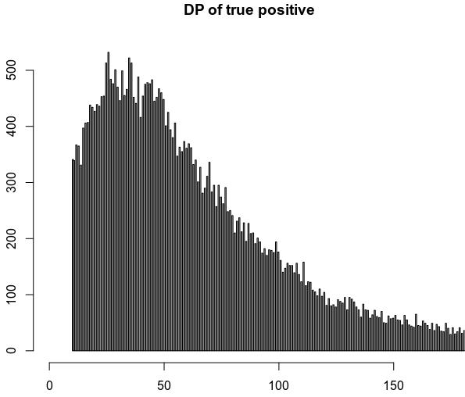
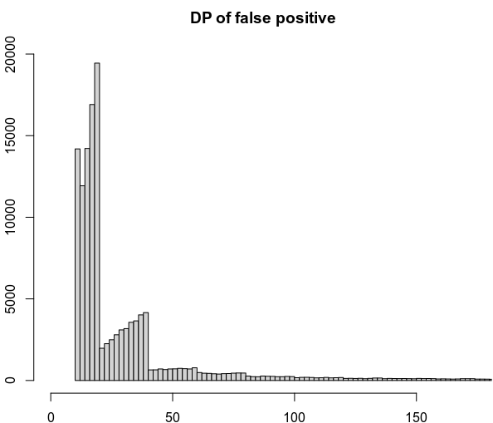
Raw数据的参数：深度
左：真阳性， 右：假阳性

Slide 19
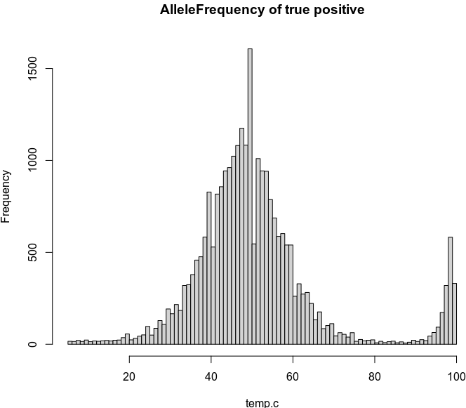
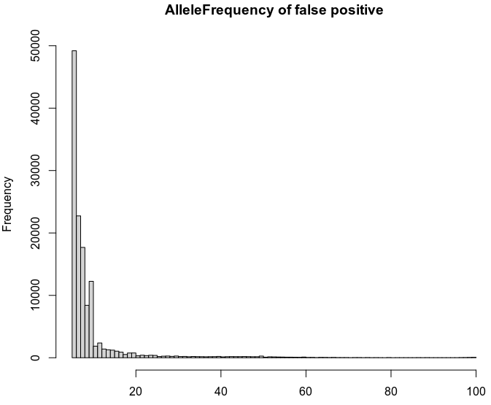
Raw数据的参数：MAF
左：真阳性， 右：假阳性

Slide 20
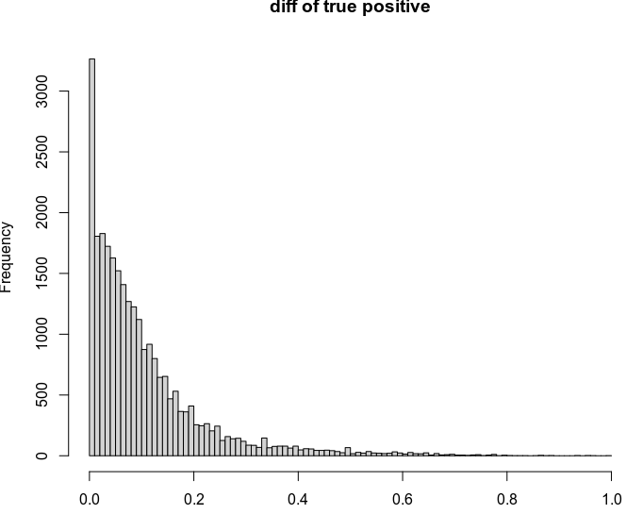
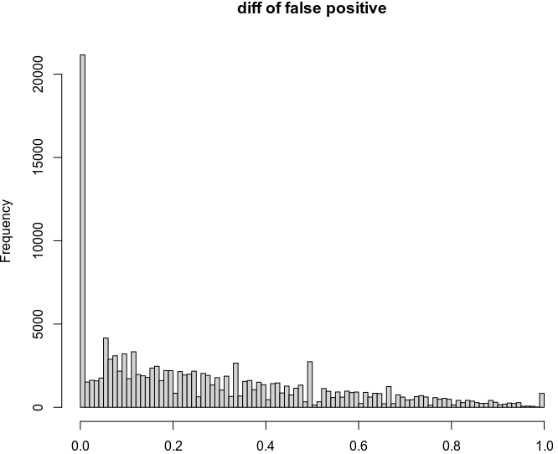
Raw滤数据的参数：Ref碱基正反比和Alt碱基正反比的差值
左：真阳性， 右：假阳性

Slide 21
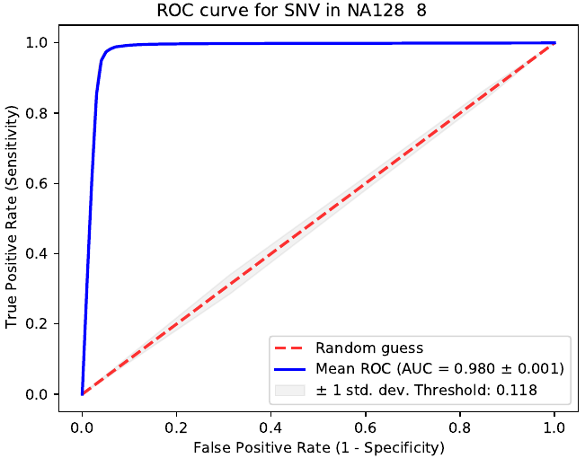
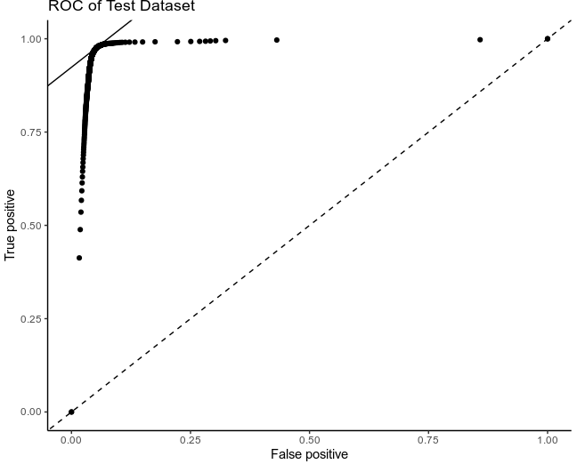
使用支持向量机对已知结果训练，预测未知结果
左：对NIST7038已知数据模型训练的结果， 右：在NIST7086上预测的结果

Slide 22
过滤后数据的参数
计算列
Final_probability
sepeProbability * mafProbability * readBalanceProbability * RB_adjust_for_location * coverageProbability
sepeProbability
DataAnno = "SePe-SePASS-PePASS"，sepeProbability = 0.99
DataAnno = "SePe_SePASS_PeFilter"，sepeProbability = 0.8
DataAnno = "SePe_SeFilter_PePASS"，sepeProbability = 0.7
DataAnno = "SePe_SeFilter_PeFilter"，sepeProbability = 0.3
DataAnno = "SeSe_SePASS"，sepeProbability = 0.4
DataAnno = "SeSe_SeFilter"，sepeProbability = 0.2
DataAnno = "PePe_PePASS"，sepeProbability = 0.4
DataAnno = "PePe_PeFilter"，sepeProbability = 0.2
mafProbability
1、maf >= 80，mafProbability = 0.99
2、maf >= 60，mafProbability = 0.75
3、maf >= 40，mafProbability = 0.9
4、maf >= 20，mafProbability = 0.75
5、maf >= 10，mafProbability = 0.4
6、mafProbability = maf / 100
readBalanceProbability
1、readBalance >= 0.05，readBalanceProbability = 0.99
2、readBalance >= 0.01，readBalanceProbability = 0.8
3、readBalance >= 0.001，readBalanceProbability = 0.6
4、readBalanceProbability = 0.2
RB_adjust_for_location
1、readBalanceProbability != 0.99 && 不在bed指定范围的偏移20内，RB_adjust_for_location = 1.2
2、RB_adjust_for_location = 1
coverageProbability
1、coverage < 20，coverageProbability = 0.6
2、coverage >= 20
1、zscore >= 2，coverageProbability = 0.75
2、zscore >= 1.5，coverageProbability = 0.85
3、zscore >= -1，coverageProbability = 0.95
4、zscore >= -3，coverageProbability = 0.5
5、coverageProbability = 0.6

Slide 23
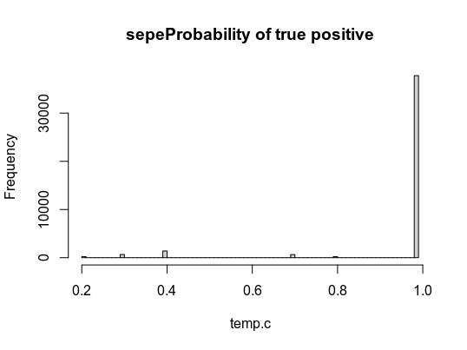
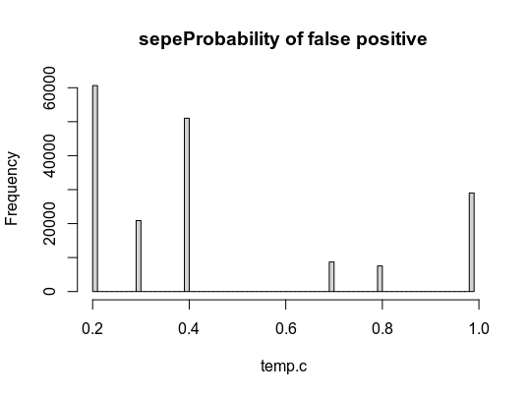
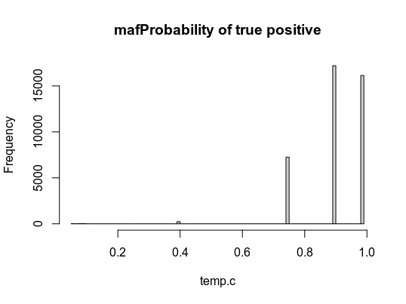
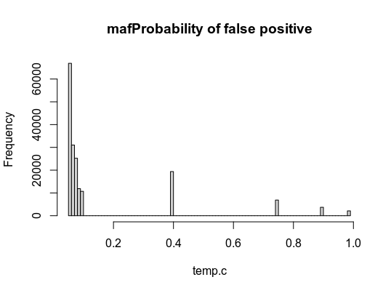
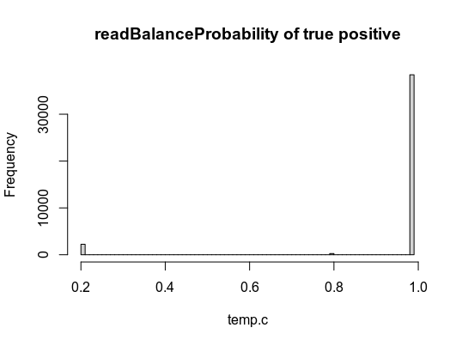
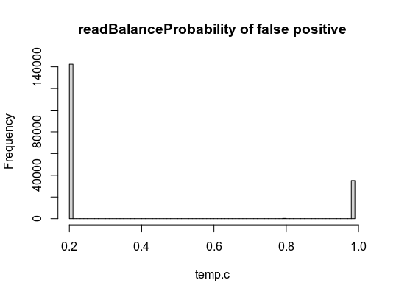
Feature selection

Slide 24
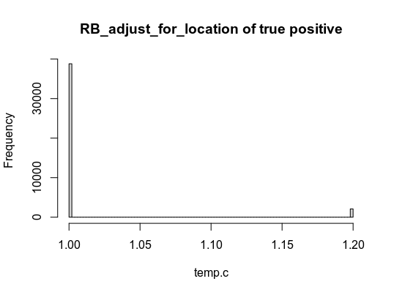
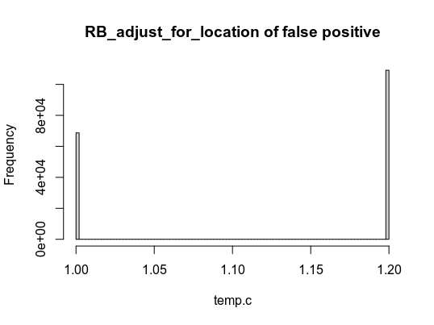
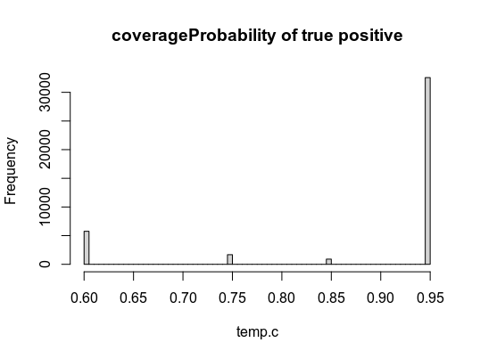
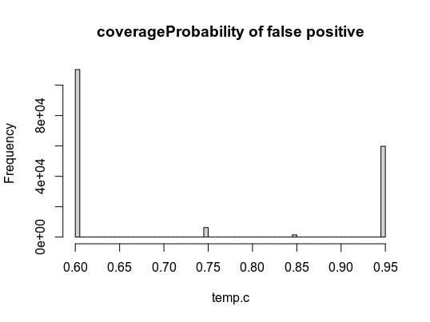
Feature selection （continue）
Feature | sd
sepeProbability | 0.1508477
mafProbability | 0.1000599
readBalanceProbability | 0.1797668
RB_adjust_for_location | 0.04406476
coverageProbability | 0.1246884

Slide 25
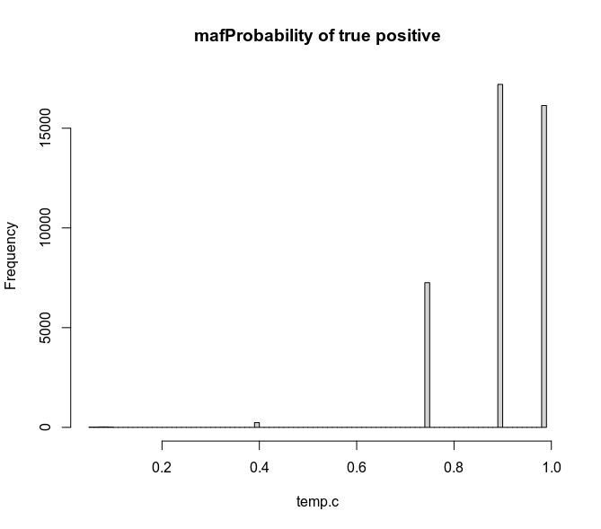
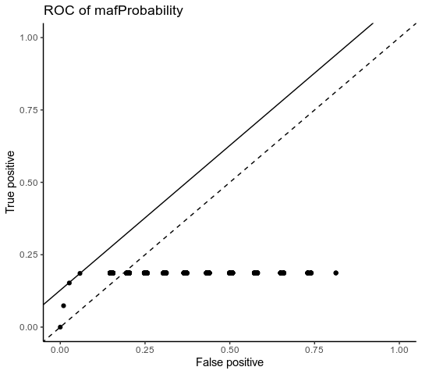
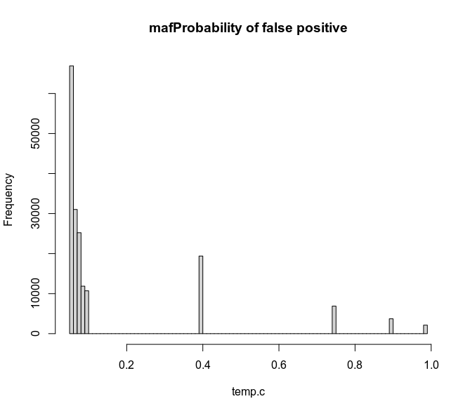
ROC
对我们的218733个结果做图， maf probabilty cutoff 0.75时，True positive与 false positive的差值最大， 分别为0.18557328和 0.058089086

Slide 26
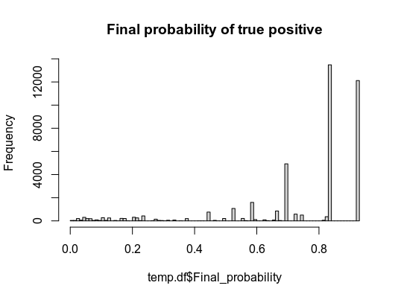
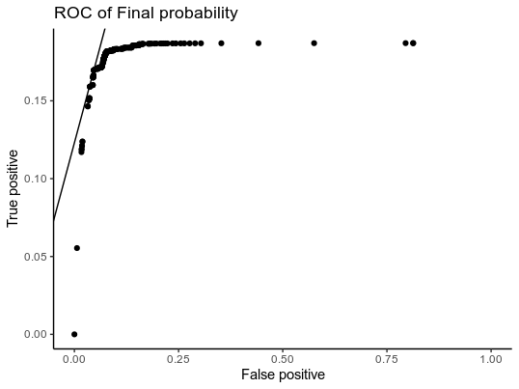
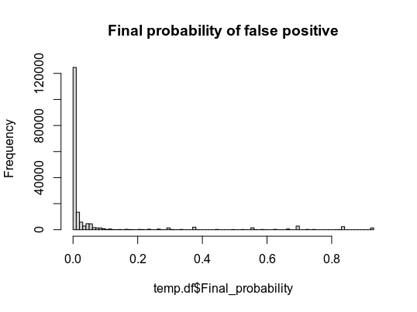
ROC
对我们的218733个结果做图， Final probabilty cutoff 0.412时，True positive与 false positive的差值最大， 分别为0.1696726和 0.04663677

Slide 27



感谢关注
专业·专注·专科

