Slide 1
ESG Compliance via Multi-Agent
Team 5 : 許耀文、陳柏安、施冠宏、李家同、江宗翰
Notes:
Hi everyone, this assignment focuses on Agents with Memory Recall via RAG, or Retrieval-Augmented Generation. The goal is to enable agents to recall relevant guidelines or historical knowledge while performing tasks. It’s not just about retrieval—it’s about helping agents reason and act with long-term memory and contextual understanding.

Slide 2
提案區
ESG報告合規性分析 企業ESG資訊揭露之法遵重點與風險分析 (以GRI為例)
input : 企業永續報告書(以台積電為例):ESG數位平台，E、S、G各篩選一章節為例 output : 輸出一份，根據GRI衡量特定準則是否有被完整揭露於報告書中，生成出一份揭露合規性分析。 使用框架: 版本: autogen (V0.5) ，Migration Guide for v0.2 to v0.4 — AutoGen，microsoft.github.io/autogen/stable/_sources/user-guide/agentchat-user-guide/migration-guide.md.txt。 yaowen225/esg_news_analyzer可做參考。

Slide 3
實作代辦事項: 如何前處理報告書? (先拆段還是不拆) (圖片是否保留) RAG實作 狀態資料庫的設定(如何確保真的能讓LLM看懂、改動) 整理agent設計 對話流編排
簡報代辦事項: 底稿(許耀文) 重新排版、改成英文(江宗翰) 模擬output修改(施冠宏) 流程圖修改(流程圖內文要 改成/加上 英文 以及依照附圖內需求修改)(家同) 上台說明(柏安)

Slide 4
Outline
Project description
Expected result
Multi-agent Structure
Notes:
This is the Outline of the report:

Slide 5
Project Description
ESG Report Compliance Analysis
Base on given sustainability report and GRI standards, produce a disclosure compliance analysis by evaluating whether specific standards have been fully addressed in the report
Input
Corporate Sustainability Report ESG Digital Platform
GRI Standards Consolidated Set of GRI Standards
Output
Disclosure compliance analysis
Framework
autogen (V0.5) autogen-0.5.7

Slide 6
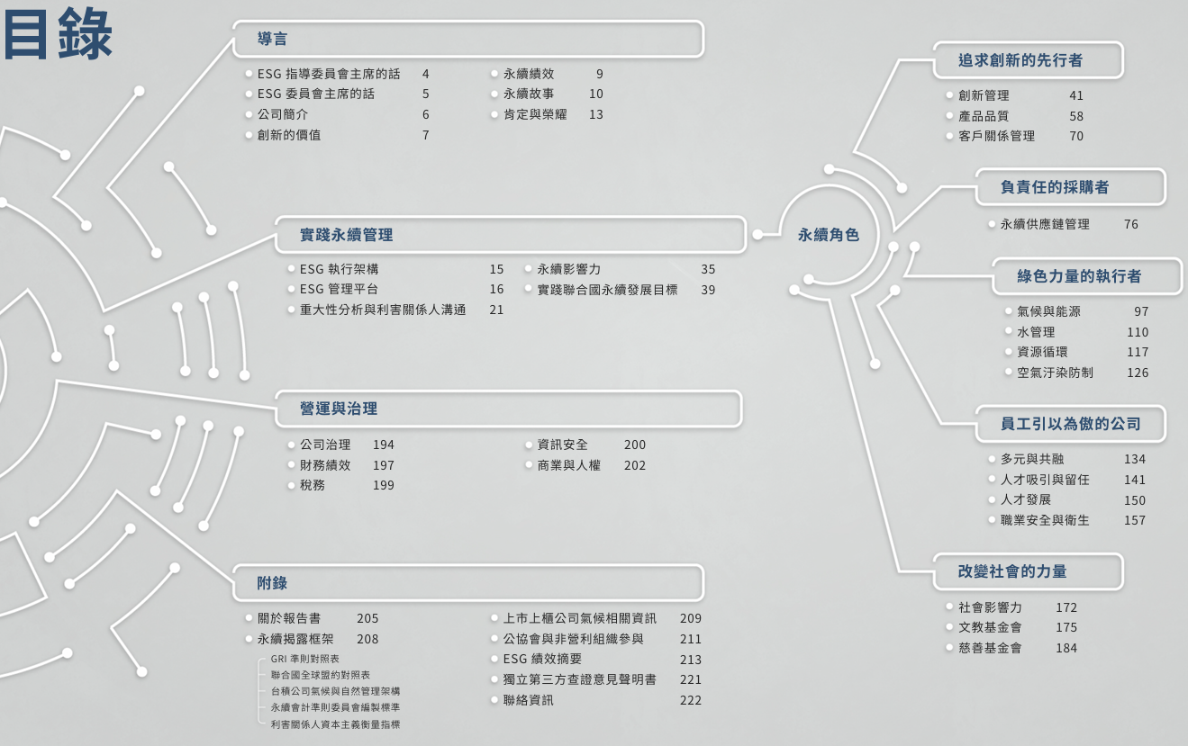
ESG Report Compliance Analysis
Input : Corporate Sustainability Report

Slide 7

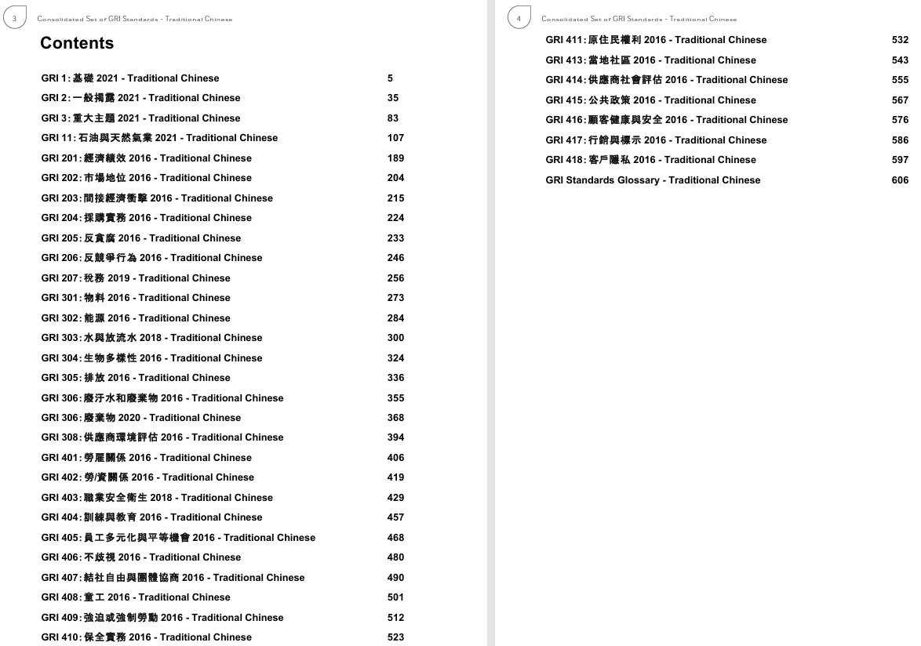
Input: GRI Standards

Slide 8
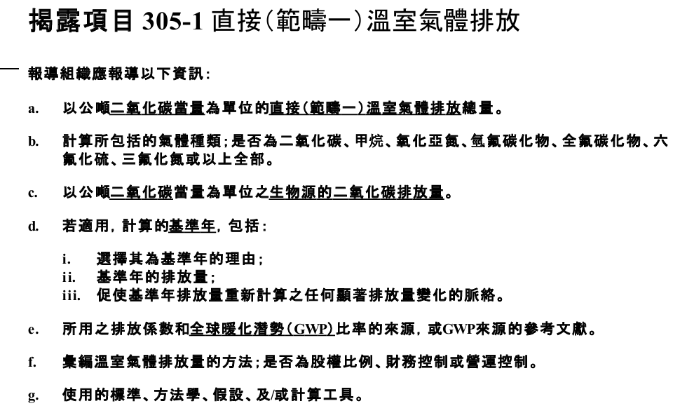
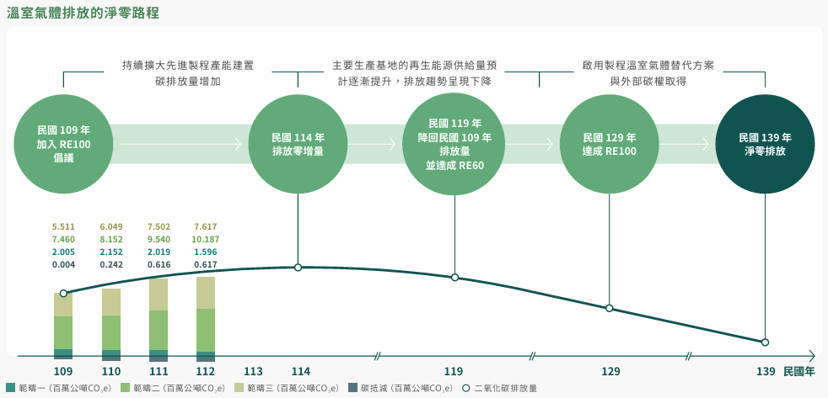
Part of GRI standards and corresponding content in the sustainability report

Slide 9
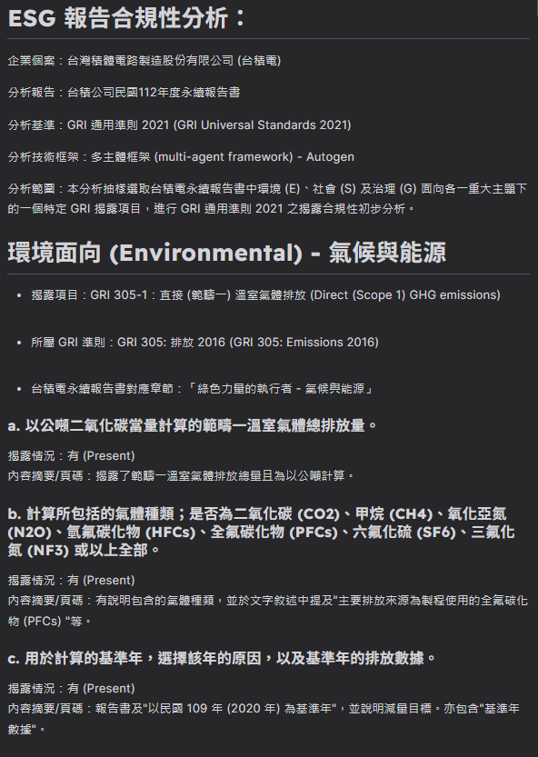
Expected Result

Slide 10
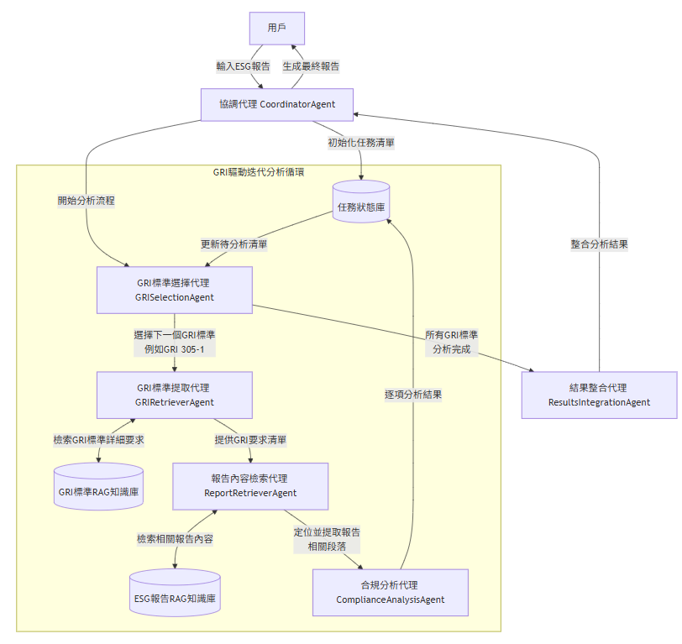
Multi-agent Structure

Slide 11
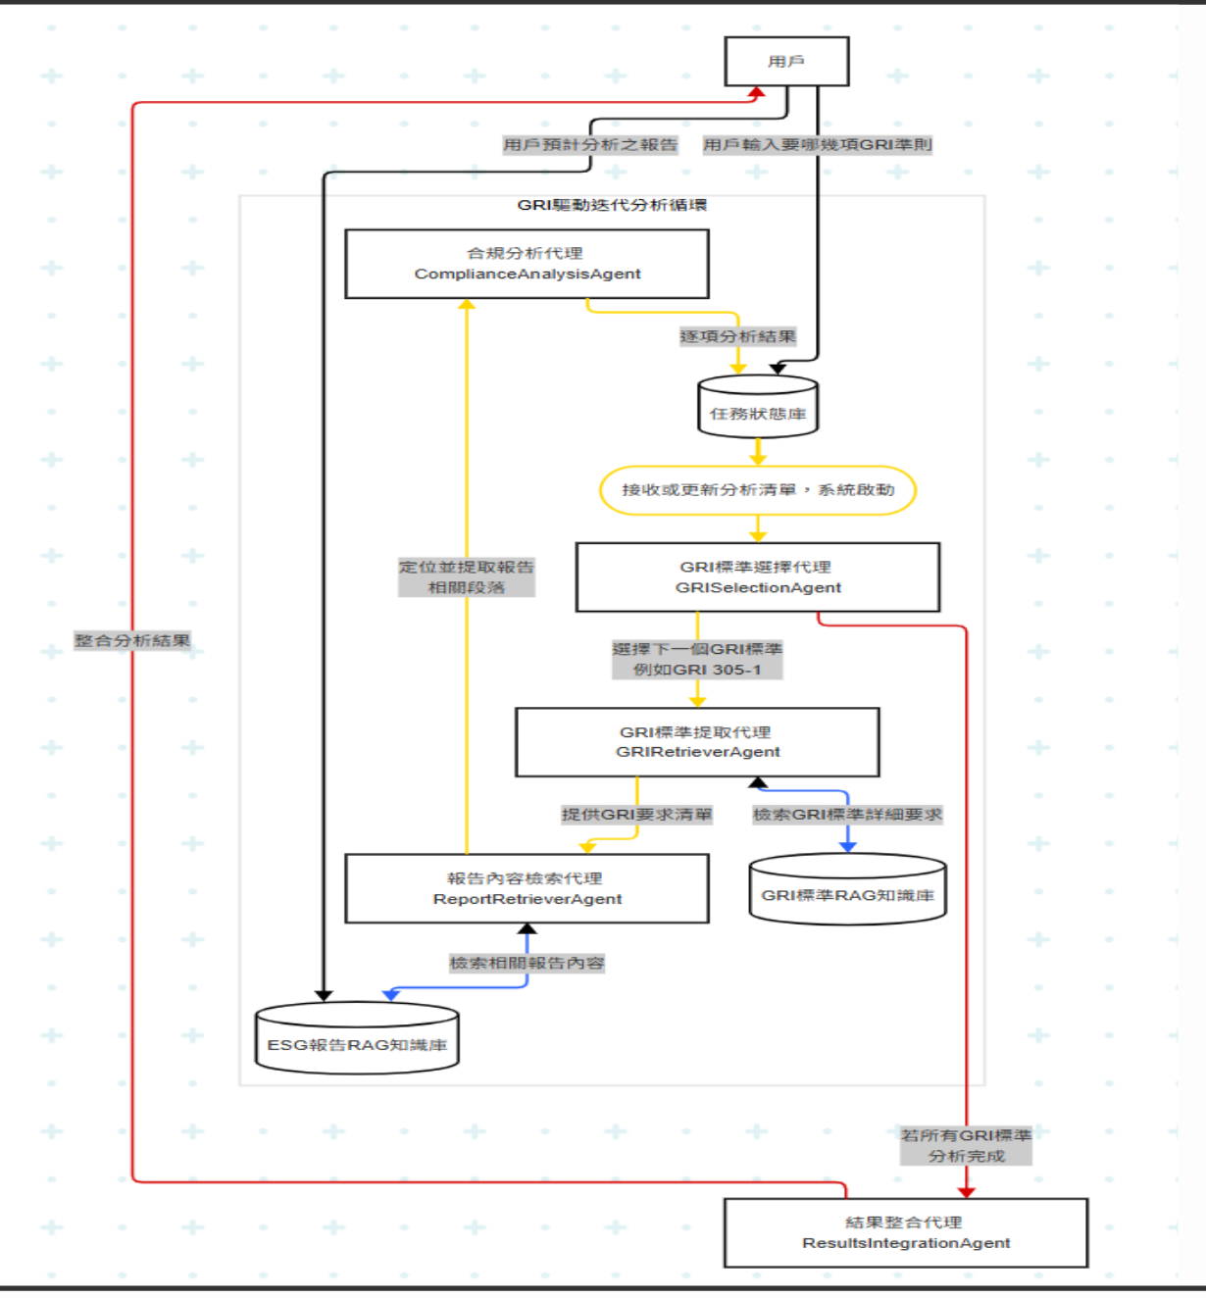
Notes:
Let me explain how our multi-agent system works, step by step.
First, the user provides ESG report, and also tells the system what kind of GRI standards they want to check.
The ESG report will go to a knowledge bases using RAG.
And the check list of GRI standards will sent to a data base for the task status
The first agent, called the GRISelectionAgent. It will chooses a specific GRI standard to analyze, like GRI 305-1.
Then, the GRIRetrieverAgent gets more details about that GRI standard from the knowledge base.
After that, the ReportRetrieverAgent looks into the company’s sustainability report and finds the related content.
The next agent is called the ComplianceAnalysisAgent. It will analysis each rule listed in GRI standard, one by one.
All the information is send to GRISelectionAgent to saved into the task status data base.
If not all GRI standards are checked yet, the agents repeat the same process for the next one.
When everything is done, the ResultsIntegrationAgent puts all the analysis together and gives the final compliance result.
This teamwork between agents makes the process smart, clear, and automatic.

Slide 12
Thanks for listening

Slide 15
Limitation(Future work)
關鍵資訊可能在於圖表中，但轉MD時會被獨立出來成圖片，不會在MD中。因此RAG時可能會有查漏。

Slide 16
Description
Notes:
The goal of this assignment is to implement an intelligent agent with memory recall capabilities, leveraging Retrieval-Augmented Generation (RAG) to enhance information retrieval and decision-making. The agent should be able to reference provided manuals, automatically retrieving relevant information to generate necessary steps and methods for task execution

Slide 17
Description - User Manual
Notes:
There are three directions for this assignment. One is doing tasks on a private system, another is using WebVoyager tasks, and the last is doing tasks related to your own goal.
For the private system tasks, we have already collected some user manuals for Portal systems.
You can also work on the tasks that WebVoyager currently supports.
For example, the arXiv task is one of them.

Slide 18
Description - User Manual
Notes:
If your target task does not have a user manual,
you can create the user manual by yourself.

Slide 19
Notes:
This workflow enhances the WebVoyager agent using RAG.
First, we process PDF manual. We convert them to Markdown, chunk the text using headers, and even use Multimodal model like GPT-4o to describe images within the PDF.
Next, all these text chunks and image descriptions are turned into vector embeddings and stored in a Chroma vector database.
When the agent gets a task, it queries this database to retrieve the most relevant manual sections.
Finally, an LLM like GPT-4 Turbo uses these retrieved results and specific prompts to generate detailed, step-by-step executable steps, guiding the agent's actions to complete its web task.

Slide 20
Notes:
For document processing, files may come in different formats.
To make them into structured data, we use tools like PDF Plumber, PyMuPDF, or PyMuPDF4LLM.
These tools help read and understand PDF files easily.

