Slide 1

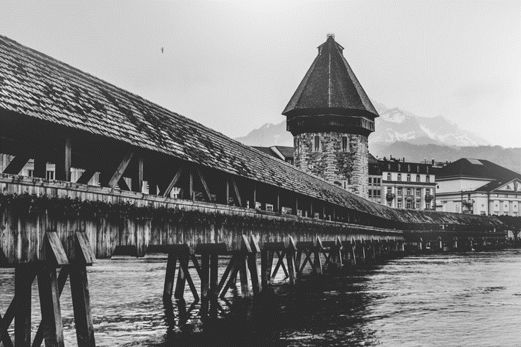
ANCIENT
DESIGN by 二三年

Slide 2

ANCIENT
1600
Through the crowd, I find the ancient buildings

Slide 3
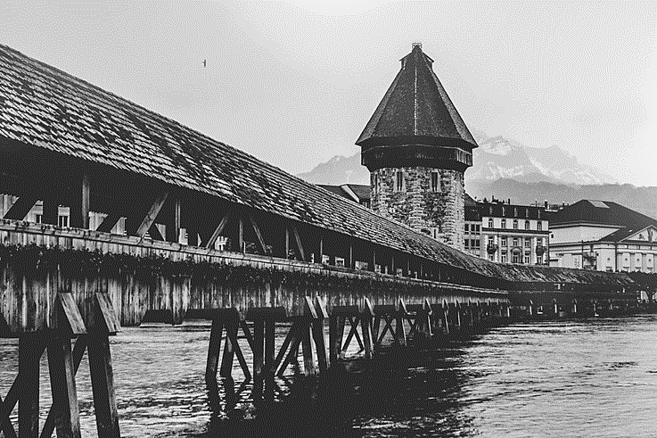
ANCIENT
Story
那是一个古老的故事、仿佛可以看见破旧的桥和海岸、看见每天往返于乡镇的小市民….
DESIGN by 二三年
That is an old story, as if to see old bridge and coast, see every day to and from the villages and towns of ordinary citizen.

Slide 4

ANCIENT
Through the crowd, I find the ancient buildings
A
B
C
When we have the chance to choose their own life .
When we have the chance to choose their own life .
When we have the chance to choose their own life .

Slide 5
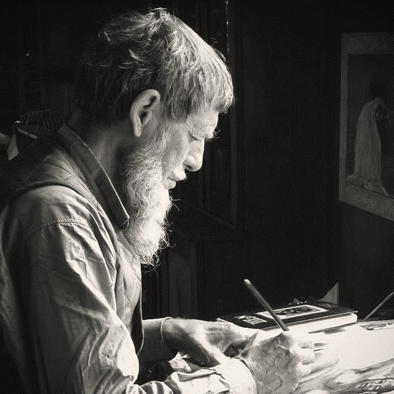
ANCIENT
1600-08-15
D I A R Y . . .
That is an old story, as if to see old bridge and coast, see every day to and from the villages and towns of ordinary citizen.
1600-08-25
That is an old story, as if to see old bridge and coast, see every day to and from the villages and towns of ordinary citizen.

Slide 6

Through the crowd, I find the ancient buildings
WHAT KEEPS
Through the crowd, I find the ancient buildings
That is an old story, as if to see old bridge and coast, see every day to and from the villages and towns of ordinary citizen.
Through the crowd, I find the ancient buildings

Slide 7
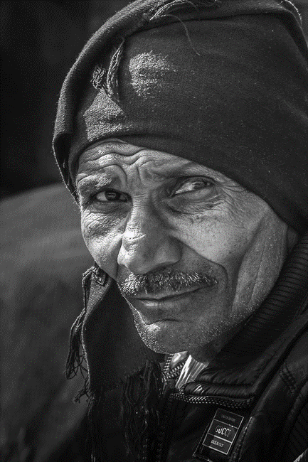
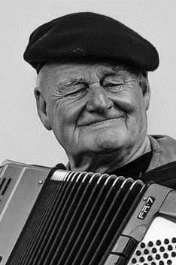
ANCIENT
D I A R Y . . .
THE OLD
That is an old story, as if to see old bridge and coast, see every day to and from the villages and towns of ordinary citizen.

Slide 8


Through the crowd, I find the ancient buildings
D
1600
G
F
Through the crowd, I find the ancient buildings
Through the crowd, I find the ancient buildings

Slide 9
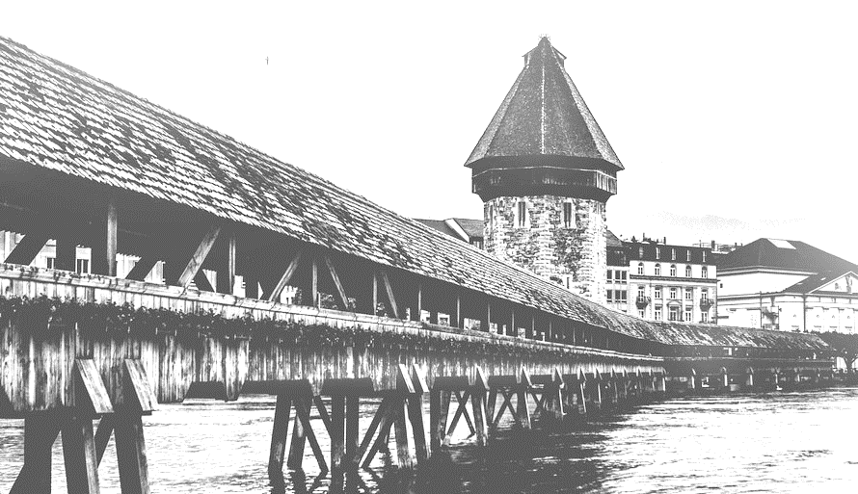
ANCIENT
ANCIENT
That is an old story, as if to see old bridge and coast, see every day to and from the villages and towns of ordinary citizen.

Slide 10
Thanks for the old people's teachings, let our young generation have more power
Thanks for the old people's teachings, let our young generation have more power
Story
Thanks for the old people's teachings, let our young generation have more power
Thanks for the old people's teachings, let our young generation have more power

Slide 11
THANK YOU
DESIGN by 二三年

Slide 12
更多精品PPT资源尽在—优品PPT！
www.ypppt.com
PPT模板下载：www.ypppt.com/moban/ 节日PPT模板：www.ypppt.com/jieri/
PPT背景图片：www.ypppt.com/beijing/ PPT图表下载：www.ypppt.com/tubiao/
PPT素材下载： www.ypppt.com/sucai/ PPT教程下载：www.ypppt.com/jiaocheng/
Notes:
模板来自于 http://www.ypppt.com

