Slide 1
Machine Learning 10601
Recitation 8
Oct 21, 2009
Oznur Tastan

Slide 2
Outline
Tree representation
Brief information theory
Learning decision trees
Bagging
Random forests

Slide 3
Decision trees
Non-linear classifier
Easy to use
Easy to interpret
Succeptible to overfitting but can be avoided.

Slide 4
Anatomy of a decision tree
Each node is a test on
one attribute
Outlook
sunny
overcast
rain
Possible attribute values
of the node
Humidity
Yes
Windy
high
normal
true
false
Leafs are the decisions
No
Yes
No
Yes

Slide 5
Anatomy of a decision tree
Sample size
Each node is a test on
one attribute
Outlook
Your data
gets smaller
sunny
overcast
rain
Possible attribute values
of the node
Humidity
Yes
Windy
high
normal
true
false
Leafs are the decisions
No
Yes
No
Yes

Slide 6
To ‘play tennis’ or not.
A new test example:
(Outlook==rain) and (not Windy==false)
Pass it on the tree
-> Decision is yes.
Outlook
sunny
overcast
rain
Humidity
Yes
Windy
high
normal
true
false
No
Yes
No
Yes

Slide 7
To ‘play tennis’ or not.
(Outlook ==overcast) -> yes
(Outlook==rain) and (not Windy==false) ->yes
(Outlook==sunny) and (Humidity=normal) ->yes
Outlook
sunny
overcast
rain
Humidity
Yes
Windy
high
normal
true
false
No
Yes
No
Yes

Slide 8
Decision trees
Decision trees represent a disjunction of
conjunctions of constraints on the attribute values of
instances.
(Outlook ==overcast)
OR
((Outlook==rain) and (not Windy==false))
OR
((Outlook==sunny) and (Humidity=normal))
=> yes play tennis

Slide 9
Representation
Y=((A and B) or ((not A) and C))
0
A
1
C
B
0
1
0
1
false
true
false
true

Slide 10
Same concept different representation
Y=((A and B) or ((not A) and C))
0
A
1
C
B
0
1
0
1
false
true
false
true
0
C
1
B
A
0
1
1
0
false
A
false
true
1
0
true
false

Slide 11
Which attribute to select for splitting?
the distribution of
each class (not attribute)
16 +
16 -
8 +
8 -
8 +
8 -
4 +
4 -
4 +
4 -
4 +
4 -
4 +
4 -
2 +
2 -
2 +
2 -
This is bad splitting…

Slide 12
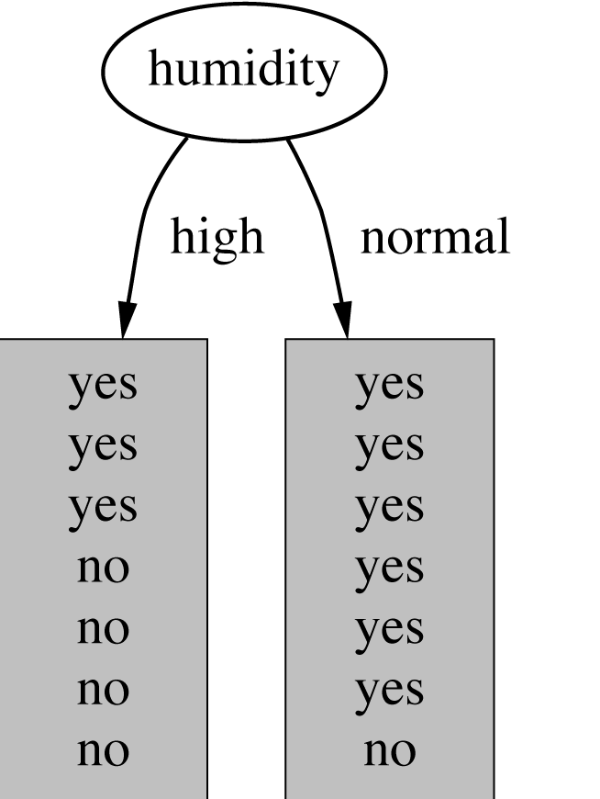
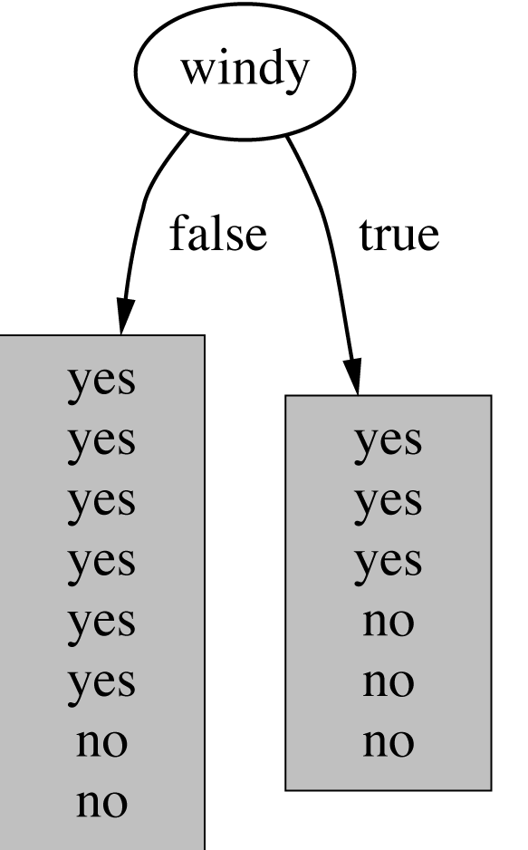
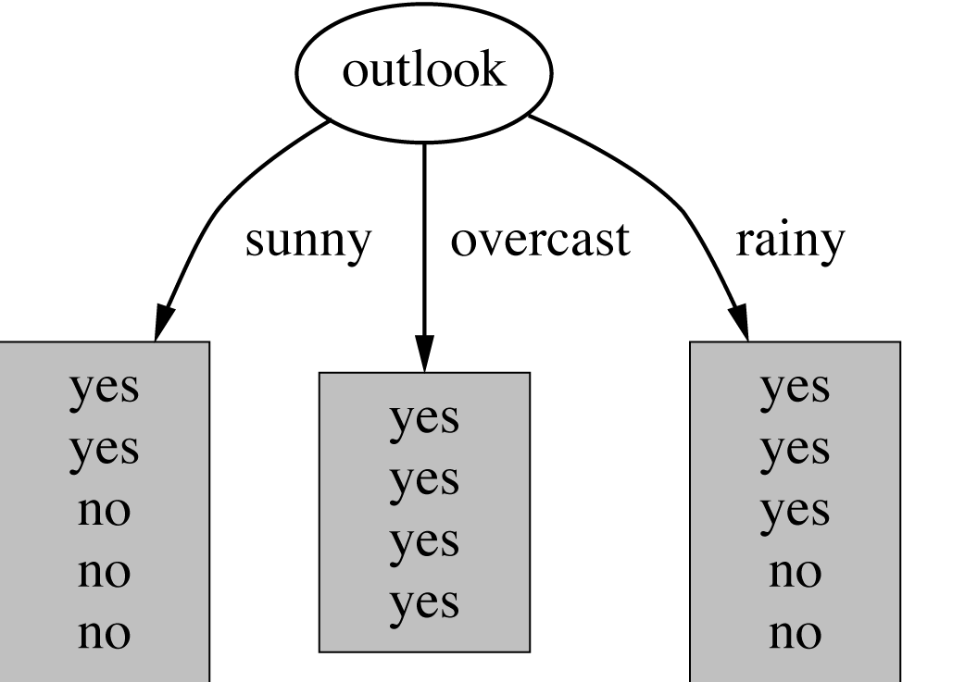
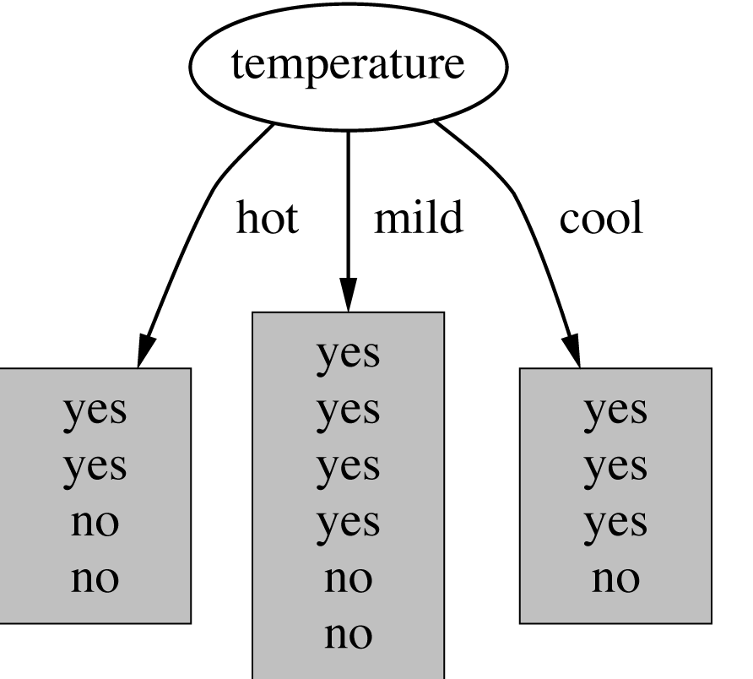
How do we choose the test ?
Which attribute should be used as the test?
Intuitively, you would prefer the
one that separates the training
examples as much as possible.

Slide 13
Information Gain
Information gain is one criteria to decide on the
attribute.

Slide 14
Information
Imagine:
1. Someone is about to tell you your own name
2. You are about to observe the outcome of a dice roll
2. You are about to observe the outcome of a coin flip
3. You are about to observe the outcome of a biased coin flip
Each situation have a different amount of uncertainty
as to what outcome you will observe.

Slide 15
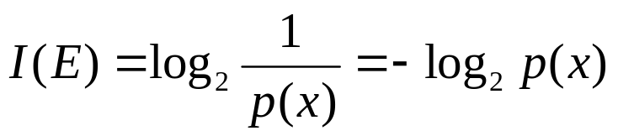


Information
Information:
reduction in uncertainty (amount of surprise in the outcome)
If the probability of this event happening is small and it happens
the information is large.
Observing the outcome of a coin flip
is head
Observe the outcome of a dice is
6
Notes:
A
C B
C
B A
A

Slide 16
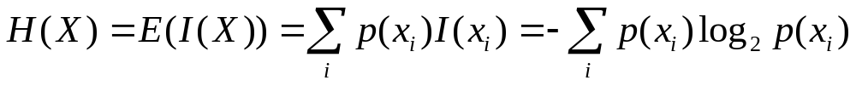
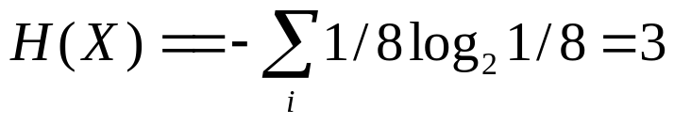
Entropy
The expected amount of information when observing the output of a random variable X
If there X can have 8 outcomes and all are equally likely
bits

Slide 17
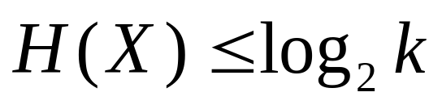
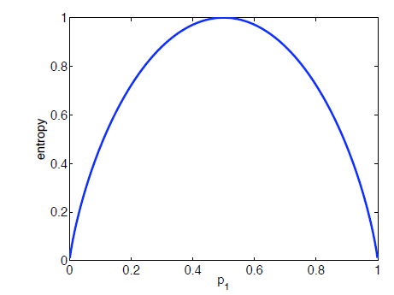
Entropy
If there are k possible outcomes
Equality holds when all outcomes are equally likely
The more the probability distribution
the deviates from
uniformity
the lower the entropy

Slide 18
Entropy, purity
Entropy measures the purity
4 +
4 -
8 +
0 -
The distribution is less uniform
Entropy is lower
The node is purer

Slide 19
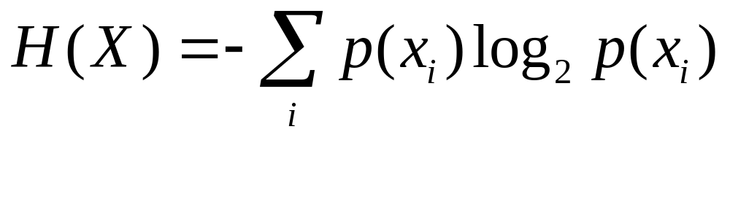
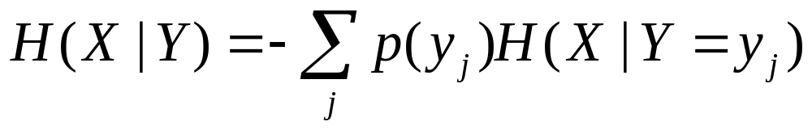
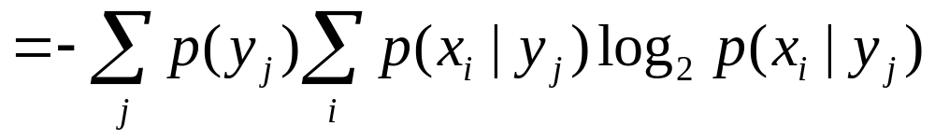
Conditional entropy

Slide 20
Information gain
IG(X,Y)=H(X)-H(X|Y)
Reduction in uncertainty by knowing Y
Information gain:
(information before split) – (information after split)

Slide 21
Information Gain
Information gain:
(information before split) – (information after split)

Slide 22
Example
Attributes
Labels
X1 | X2 | Y | Count
T | T | + | 2
T | F | + | 2
F | T | - | 5
F | F | + | 1
Which one do we choose X1 or X2?
IG(X1,Y) = H(Y) – H(Y|X1)
H(Y) = - (5/10) log(5/10) -5/10log(5/10) = 1
H(Y|X1) = P(X1=T)H(Y|X1=T) + P(X1=F) H(Y|X1=F)
= 4/10 (1log 1 + 0 log 0) +6/10 (5/6log 5/6 +1/6log1/6)
= 0.39
Information gain (X1,Y)= 1-0.39=0.61

Slide 23
Which one do we choose?
X1 | X2 | Y | Count
T | T | + | 2
T | F | + | 2
F | T | - | 5
F | F | + | 1
Information gain (X1,Y)= 0.61
Information gain (X2,Y)= 0.12
Pick the variable which provides
the most information gain about Y
Pick X1

Slide 24
Recurse on branches
X1 | X2 | Y | Count
T | T | + | 2
T | F | + | 2
F | T | - | 5
F | F | + | 1
One branch
The other branch

Slide 25
Caveats
The number of possible values influences the information gain.
The more possible values, the higher the gain (the more likely it is to form small, but pure partitions)

Slide 26
Purity (diversity) measures
Purity (Diversity) Measures:
– Gini (population diversity)
– Information Gain
– Chi-square Test

Slide 27
Overfitting
You can perfectly fit to any training data
Zero bias, high variance
Two approaches:
1. Stop growing the tree when further splitting the data does not yield an improvement
2. Grow a full tree, then prune the tree, by eliminating nodes.

Slide 28
Bagging
Bagging or bootstrap aggregation a technique for reducing the variance of an estimated prediction function.
For classification, a committee of trees each
cast a vote for the predicted class.

Slide 29
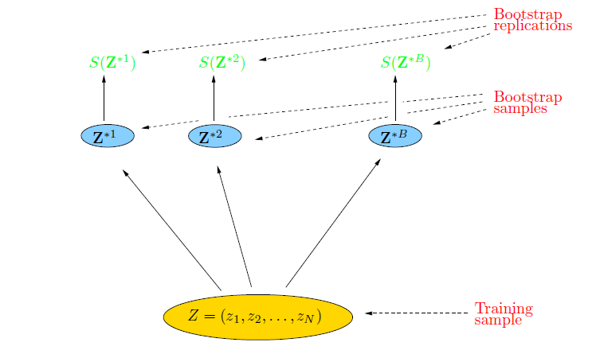
Bootstrap
The basic idea:
randomly draw datasets with replacement from the
training data, each sample the same size as the original training set

Slide 30
Bagging
Create bootstrap samples
from the training data
M features
N examples
....…

Slide 31
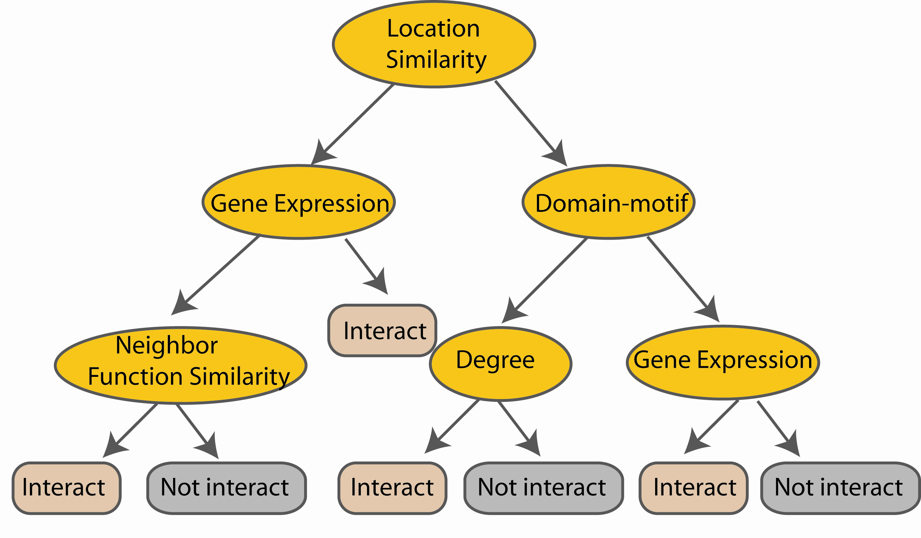
Random Forest Classifier
Construct a decision tree
M features
N examples
....…

Slide 32
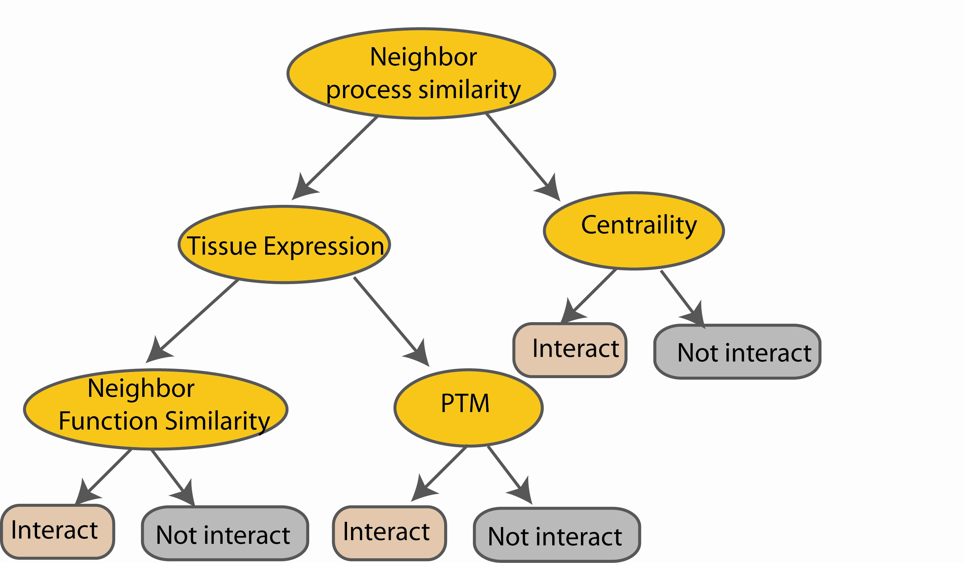
Random Forest Classifier
M features
N examples
Take the majority vote
....…
....…
Notes:
Finally the given an input data the decision is made as follows given an input data,

Slide 33
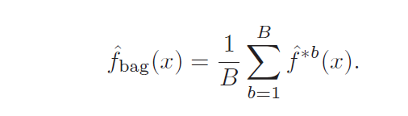
Bagging
Z = {(x₁, y₁), (x₂, y₂), . . . , (x_{N}, y_{N})}
Z^{*b} where = 1,.., B..
The prediction at input x
when bootstrap sample
b is used for training
http://www-stat.stanford.edu/~hastie/Papers/ESLII.pdf (Chapter 8.7)

Slide 34
Bagging : an simulated example
Generated a sample of size N = 30, with two
classes and p = 5 features, each having a
standard Gaussian distribution with pairwise
Correlation 0.95.
The response Y was generated according to
Pr(Y = 1|x1 ≤ 0.5) = 0.2,
Pr(Y = 0|x1 > 0.5) = 0.8.

Slide 35
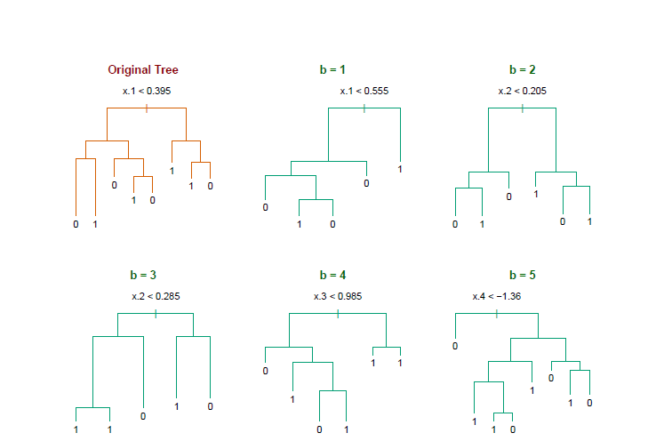
Bagging
Notice the bootstrap trees are different than the original tree

Slide 36
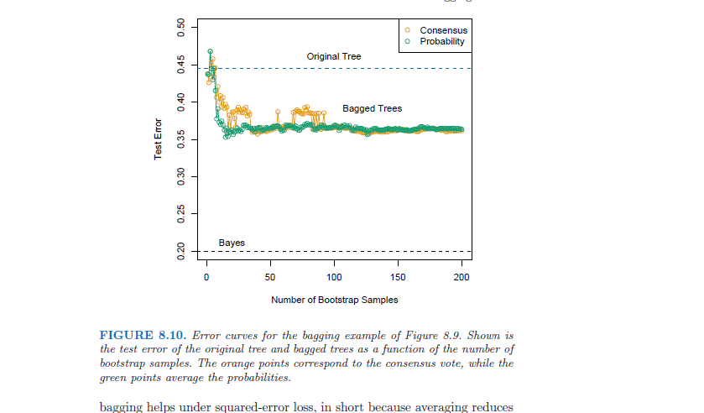
Bagging
Treat the voting
Proportions as
probabilities
Hastie
http://www-stat.stanford.edu/~hastie/Papers/ESLII.pdf Example 8.7.1

Slide 37
Random forest classifier
Random forest classifier, an extension to
bagging which uses de-correlated trees.

Slide 38
Random Forest Classifier
Training Data
M features
N examples
Notes:
As the classifier of choice we adopt Random Forest Classifier, due to its robustness to heterogenous and noisy feature.
Random Forest is an ensembe classifier. Briefly, given N data and M features, bootsrap samples are created from the traning data

Slide 39
Random Forest Classifier
Create bootstrap samples
from the training data
M features
N examples
....…

Slide 40
Random Forest Classifier
Construct a decision tree
M features
N examples
....…
Notes:
From eachd descision tree .. In spliting the nodes, the Gini Gain is employed

Slide 41
Random Forest Classifier
At each node in choosing the split feature
choose only among m<M features
M features
N examples
....…
Notes:
Different from the regular decision trees in random forest, when the splitting feature is chosen from only a subset of allf eatures.
The robostness of the classifier arises from
bootsraping of the training data and the random selection of features, the the random choose of features.

Slide 42
Random Forest Classifier
Create decision tree
from each bootstrap sample
M features
N examples
....…
....…

Slide 43
Random Forest Classifier
M features
N examples
Take he majority vote
....…
....…
Notes:
Finally the given an input data the decision is made as follows given an input data,

Slide 44
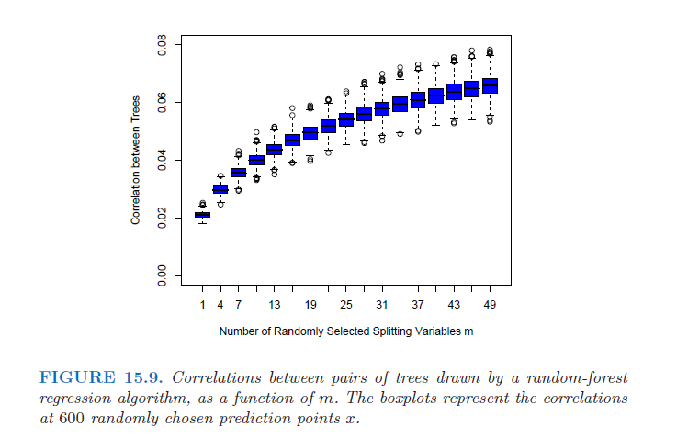

Slide 45
Random forest
Available package:
http://www.stat.berkeley.edu/~breiman/RandomForests/cc_home.htm
To read more:
http://www-stat.stanford.edu/~hastie/Papers/ESLII.pdf

