Slide 1
Introduction to genomic data science with Python
Brian Lawney, PhD
Research Scientist
Quantitative Biomedical Research Center (qBRC)
Harvard T.H. Chan School of Public Health

Slide 2
Overview and Goals
What we hope to achieve:
Introduce basic programming concepts with the Python language
Demonstrate reproducible research/workflows using Jupyter notebooks
Understand how to install and load third-party libraries
Learn to manipulate and plot data, with an emphasis on genomic applications
By the end of this course, you will:
Have some concept of how you might integrate programming into your research
(Ideally) have some orientation so you can learn to program on your own

Slide 3
Why should I learn Python (or programming in general)?
Automation
Save time, make fewer mistakes
Avoid tedium
Tasks that are repetitive
Tasks that are not feasible "by hand"
Reproducible
Analyses that are transparent
Analyses that are consistent
Ability to share

Slide 4
Why Python, specifically?
Lightweight, no compiling
Easy to write/read
Good community support
Tons of open-source packages/projects
Scientific python stack- numPy, Pandas, matplotlib
Image analysis
Web-frameworks
Deep-learning (e.g. Tensorflow, Pytorch)
Much more!

Slide 5
Getting familiar with Python
Python comes in two versions:
Python 2.x
Original version
Officially "retired"
Python 3.x
Recommended
Can be executed in at least three typical ways:
Interactive Python terminal
Scripts on the command line
Useful for automation and other cases where you do not need visuals
Notebook
Useful for interactive data exploration and "storytelling"

Slide 6
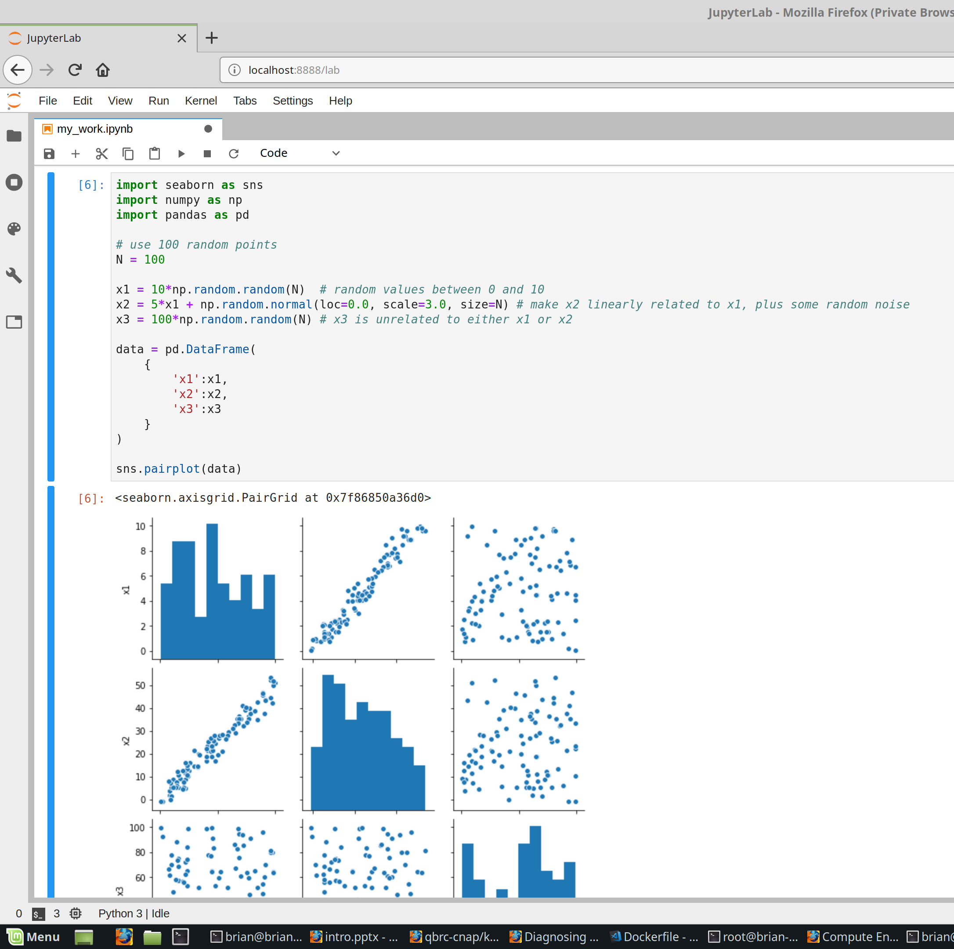
Sessions, scripts, and Jupyter notebooks
Notebook (used in web browser):
Interactive session:
>>> x = 3
>>> y = x**3
>>> y
27
my_script.py (a text file):
import numpy as np
x= np.random.random()
print(x)

Slide 7
Installing Python
Official site: https://www.python.org/downloads/
Search Google- installation guides with varying levels of detail/quality, for different platforms (Windows, Mac, Linux)

Slide 8
Installing Jupyter (on your own machine)
Easiest way is to first install Miniconda (https://docs.conda.io/en/latest/miniconda.html)
Easy installers for Windows, Mac, Linux
After miniconda install, add some data science packages and the Jupyter lab package:
conda create -–name=py37 python=3.7.6
source activate py37 (may vary by platform)
conda install numpy pandas seaborn jupyterlab

Slide 9
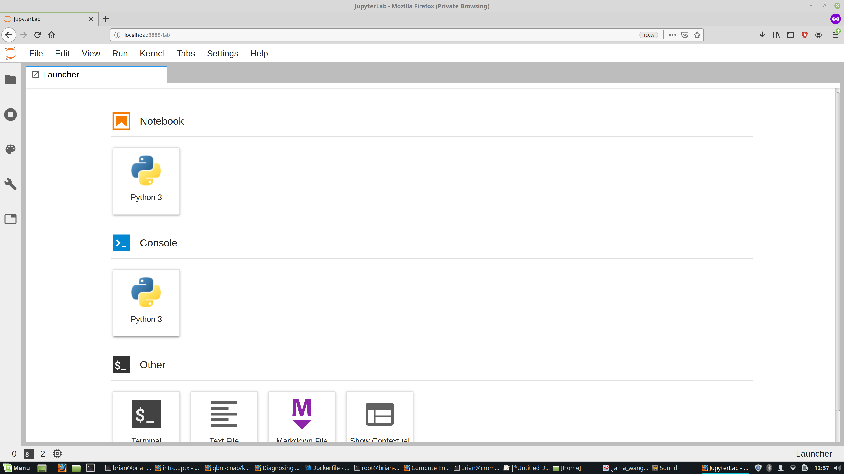

Slide 10
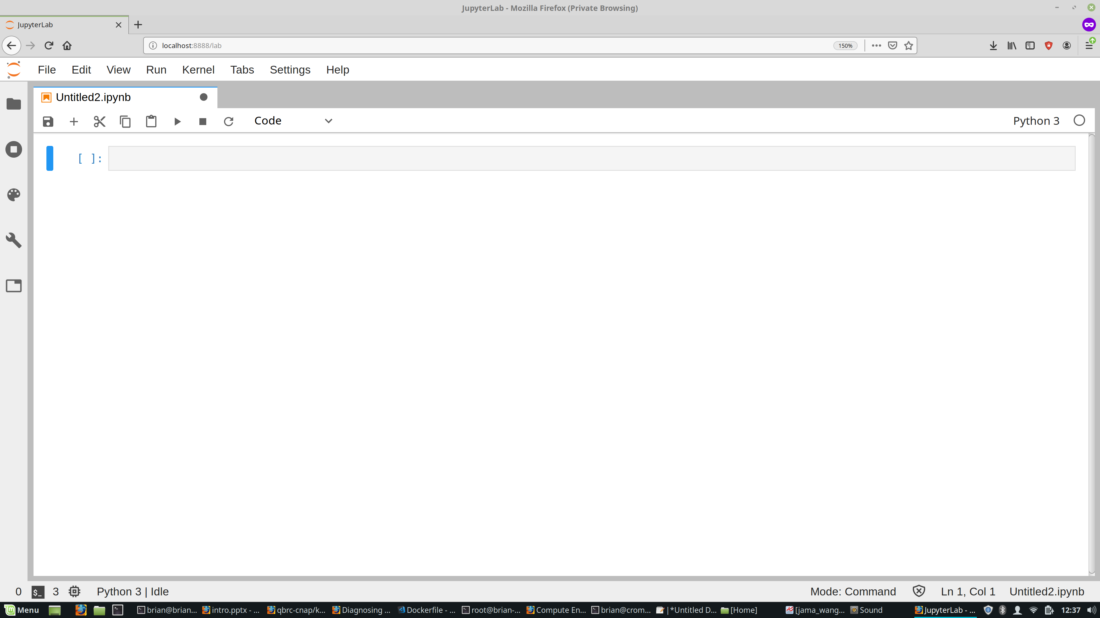

Slide 11
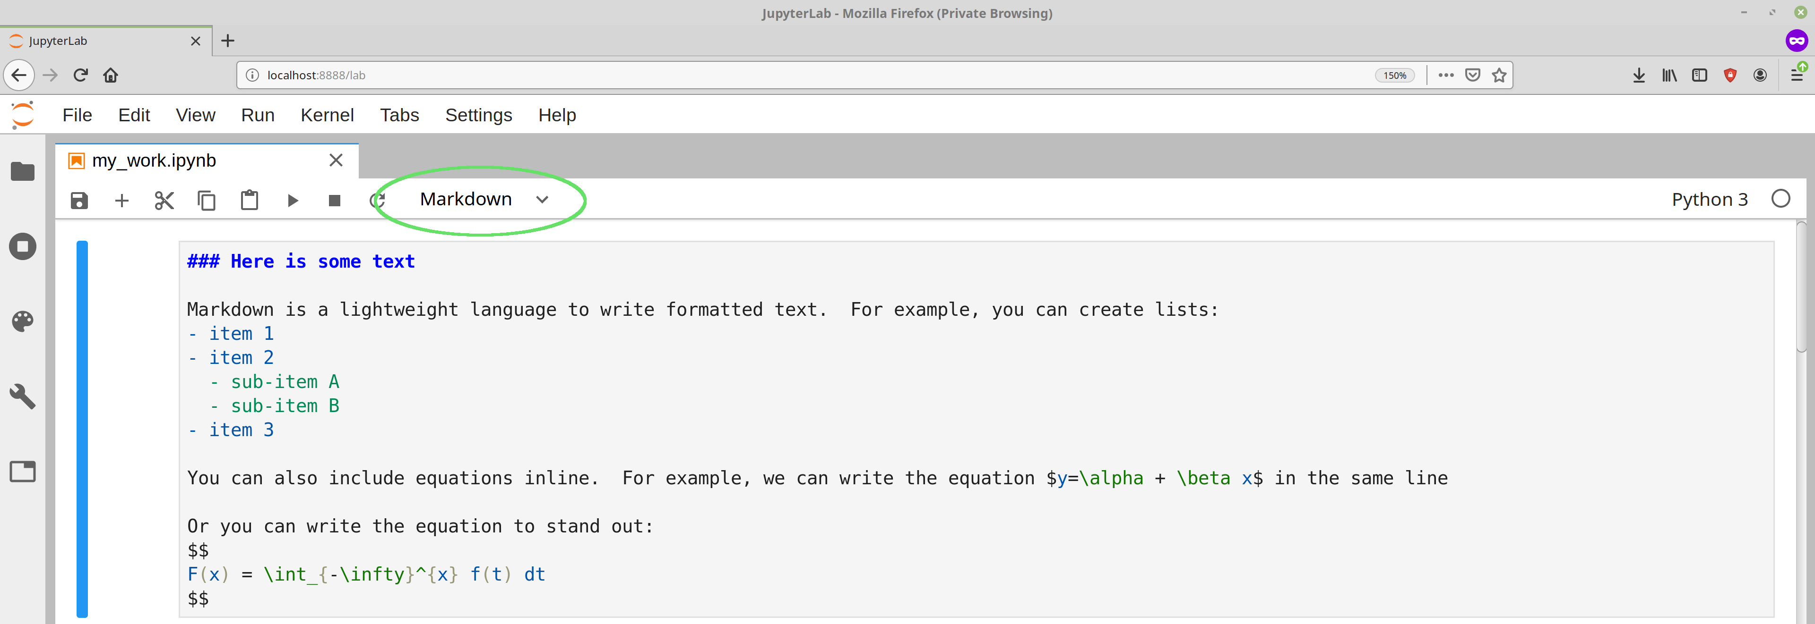
Markdown cells let you describe what you are doing and take nodes:

Slide 12
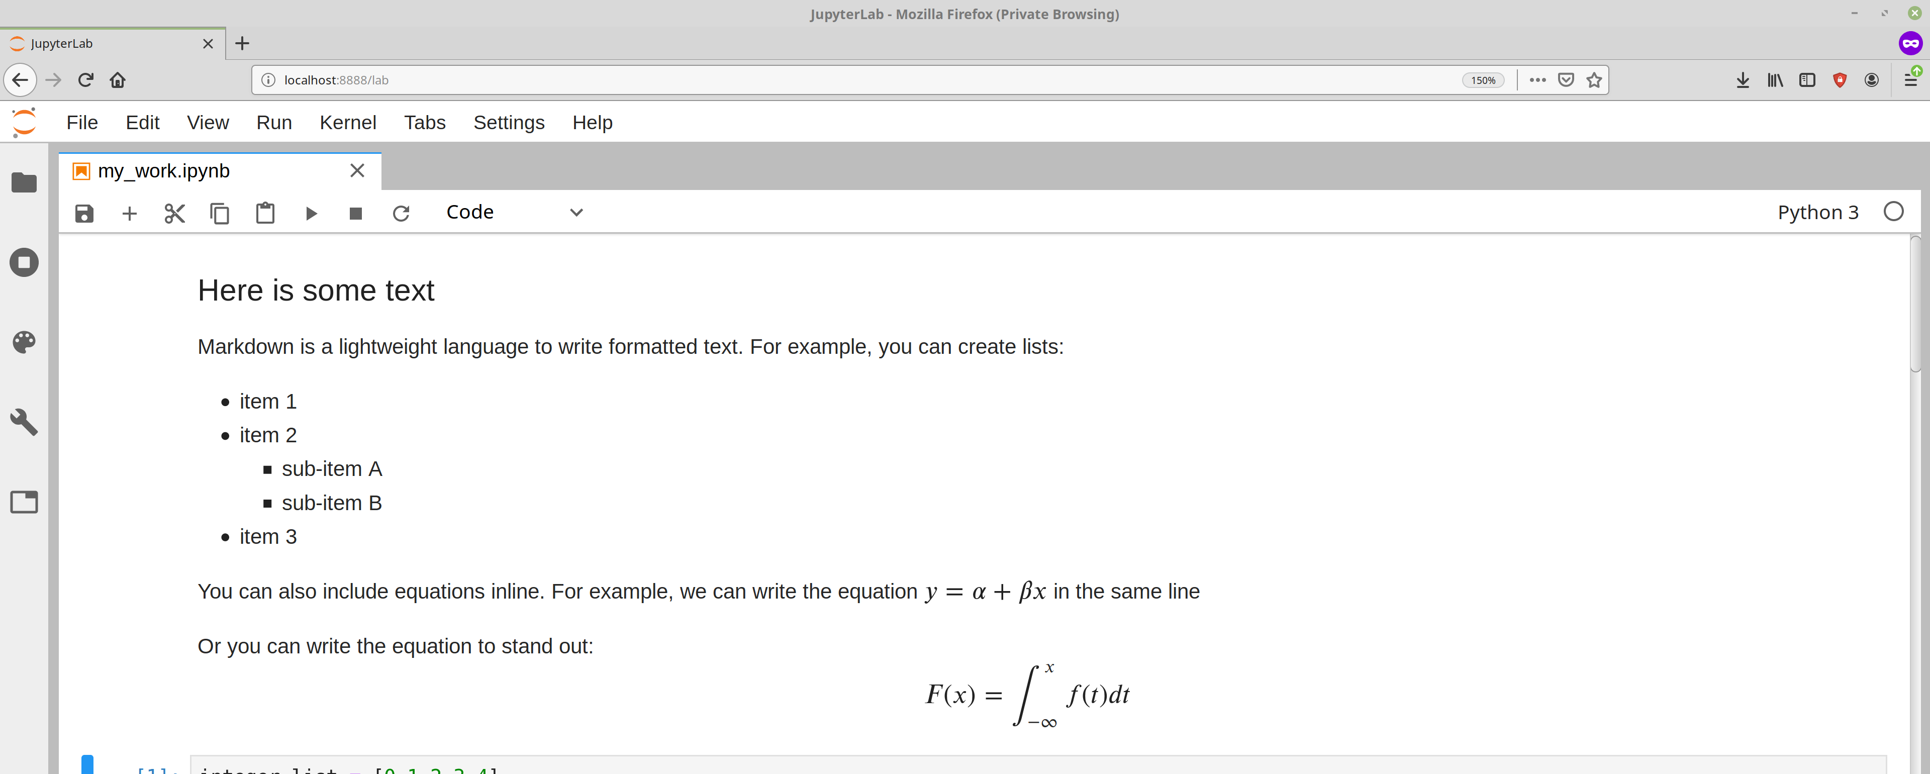
Hit Shift+Enter and the Markdown formats nicely:

Slide 13
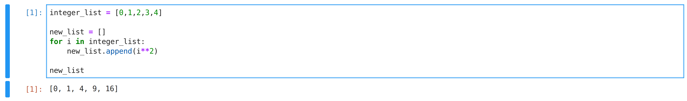
Code cells let you execute Python code:

Slide 14
Write code/analysis and plot directly in the browser

