Slide 1


Enabling Tensor Language Model to Assist in Generating
High-Performance Tensor Programs for Deep Learning
Yi Zhai¹, Sijia Yang², Keyu Pan³, Renwei Zhang², Shuo Liu¹, Chao Liu², Zichun Ye², Jianmin Ji¹, Jie Zhao⁴, Yu Zhang¹ and Yanyong Zhang¹
¹University of Science and Technology of China ²Huawei ³ByteDance ⁴Hunan University

Slide 2
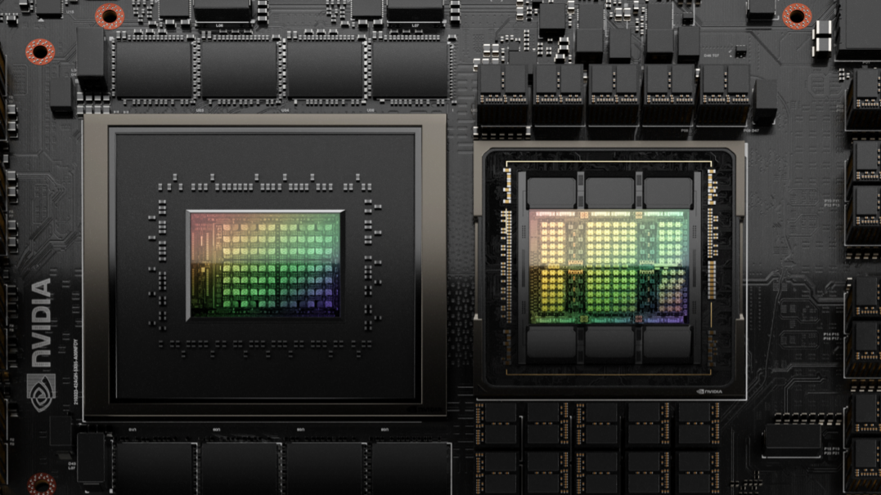
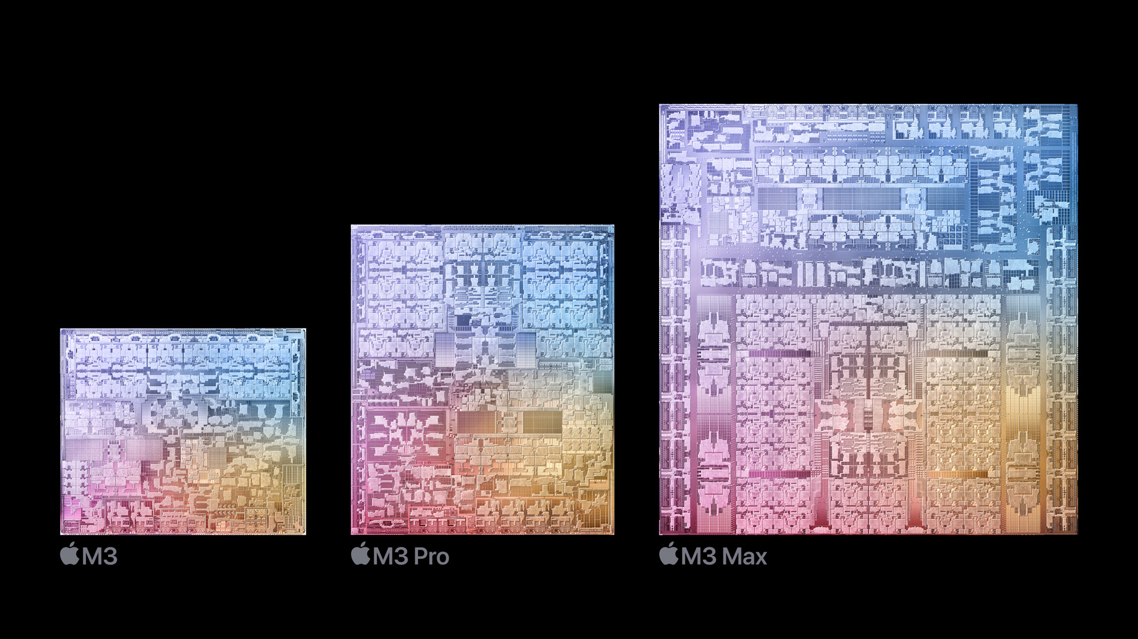
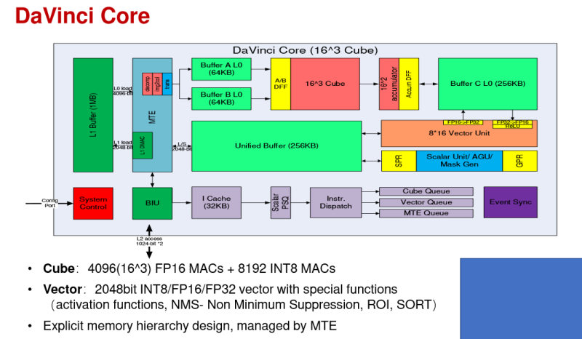
The challenge of tensor program generation
Obtaining high-performance (i.e., low-latency) tensor programs with high efficiency (i.e., short compilation time) is critically important for deep learning
Computing hardware architecture is becoming increasingly complex
To better utilize hardware performance, tensor programs need to make many “decisions”
Determining the tiling sizes of loop axes
Setting unroll steps
Choosing computation locations for operators
Strategizing on parallelization and vectorization
Deciding thread bindings
…
https://developer-blogs.nvidia.com/wp-content/uploads/2022/11/grace-hopper-superchip-1-e1670969676880.png
https://images.anandtech.com/doci/21116/Apple-M3-chip-series-architecture-231030.jpg
https://www.eetasia.com/wp-content/uploads/sites/2/2020/04/aa25369b-382d-4e5f-a0fa-1a256bccfbe2.png

Slide 3
Existing approachs
1. Pruning the decision space with heuristic constraints
hard to align perfectly
Performance indicators
(e.g., computing core utilization and/or cache reuse)
High performance
(e.g., low latency)
design
prune
Heuristic constraints
Decision space
Poor performance
Hard to choose suitable performance indicators; a better indicator value does not necessarily lead to better performance.
Sometimes, heuristic constraints prune away high-performance candidates, resulting in poor performance.

Slide 4
Existing approachs
2. Using search algorithms + performance cost models to generate tensor programs
Measuring the latency of tensor programs is time-consuming, so performance cost models are used to estimate the latency.
Performance cost models rely on sound feature engineering.
This approach is not effective in utilizing the large volume of data (i.e., tensor programs and their measured latency) for efficient tensor program generation
Traditional search algorithms were not designed to utilize big data and lacked effective data handling methods.
The performance cost models have a small number of parameters with limited learning ability

Slide 5
Motivation of TLM
Language models can improve learning capabilities and better utilize data by increasing the number of parameters.
We propose to transform the tensor program exploration task into a language model generation task.
A language model aims to generate coherent and meaningful text for a given prompt.
Our task is to generate high-performance tensor programs for given hardware and operator.

Slide 6
Overview
Wrokloads
Graph processer
Subgraphs
Tensor
compiler
Space builder
Generator
Tensor program generation framework
Tensor programs
Code generator
Executables
Space builder
Generator
Build an expansive tensor program exploration space
Develop powerful search capabilities
High performance
High efficiency

Slide 7

Overview
Wrokloads
Graph processer
Subgraphs
Tensor
compiler
Space builder
Generator
Tensor program generation framework
Tensor programs
Code generator
Executables
Space builder
Generator
Offline dataset
Subgraphs
④ Pre-training
① search space building
TLM-base
Exploration
space $S$
Supervised
fine-tuning
Demonstration data
②designingTensor language
③ Large-scale sampling
TLM
⑥ Iterative optimization
Offline dataset
⑤ Tensor program generation
Tensor program

Slide 8
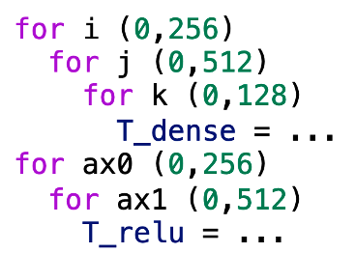
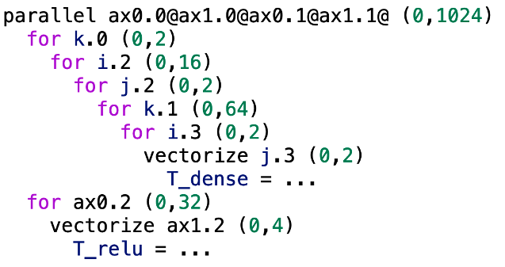
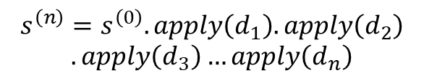

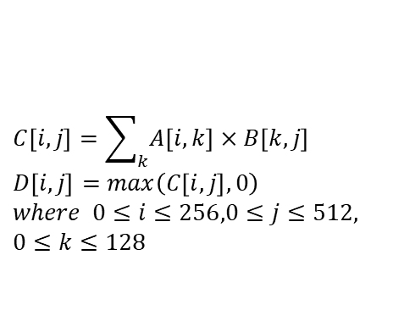



1. Search space
We formally describe the common generation process of optimized tensor programs
$$C\left[i,j\right]=\sum_{k}{A\left[i,k\right]}×B\left[k,j\right]$$
$$D\left[i,j\right]=max\left(C\left[i,j\right],0\right)$$
$$where 0≤i≤256,0≤j≤512,$$
$$0≤k≤128$$
Subgraph: $s^{\left(0\right)}$
Hardware
Decision space: $D_{i}, 1≤i≤n$
Mathematical expression
Naive tensor program
Sampling: $∀d_{i}∈D_{i}, 1≤i≤n$
Decision path: $d_{1},d_{2},d_{3}, …,d_{n}$
$$s^{\left(n\right)}=s^{\left(0\right)}.apply\left(d_{1}\right).apply\left(d_{2}\right)$$
$$.apply\left(d_{3}\right)…apply\left(d_{n}\right)$$
Tensor program:
Optimized tensor program
The performance of $s^{\left(n\right)}$ is closely related to the sampled decisions

Slide 9
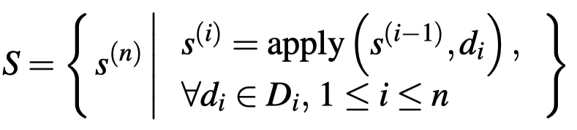



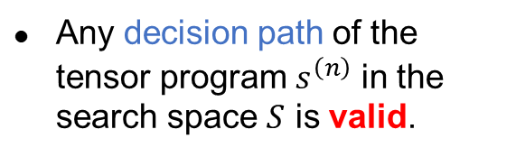
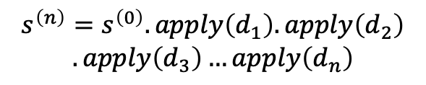



1. Search space
We next formally define the overall search space
Search space $S considers all subgraphs$
Subgraph: $s^{\left(0\right)}$
Hardware
Decision space: $D_{i}, 1≤i≤n$
$$\left|S\right|=\left|D_{1}\right| × \left|D_{2}\right| × … × \left|D_{n}\right|$$
Sample: $∀d_{i}∈D_{i}, 1≤i≤n$
Search space $S \text{is} \text{the} \text{Cartesian} \text{product} \text{of} \text{all} \text{decision} \text{spaces}$
Decision path: $d_{1},d_{2},d_{3}, …,d_{n}$
Any decision path of the tensor program $s^{\left(n\right)}$ in the search space $S$ is valid.
$$s^{\left(n\right)}=s^{\left(0\right)}.apply\left(d_{1}\right).apply\left(d_{2}\right)$$
$$.apply\left(d_{3}\right)…apply\left(d_{n}\right)$$
Tensor program:

Slide 10
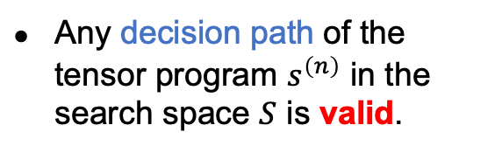
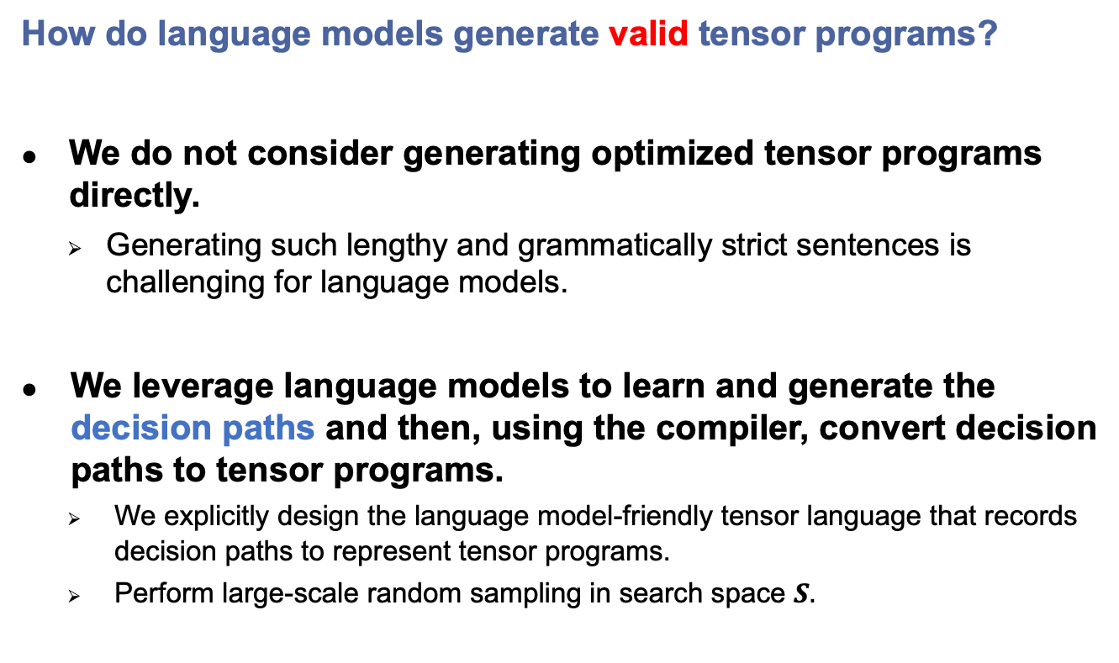
1. Search space
How do language models generate valid tensor programs?
We do not consider generating optimized tensor programs directly.
Generating such lengthy and grammatically strict sentences is challenging for language models.
We leverage language models to learn and generate the decision paths and then, using the compiler, convert decision paths to tensor programs.
We explicitly design the language model-friendly tensor language that records decision paths to represent tensor programs.
Perform large-scale random sampling in search space $S.$
Optimized tensor program
Any decision path of the tensor program $s^{\left(n\right)}$ in the search space $S$ is valid.

Slide 11
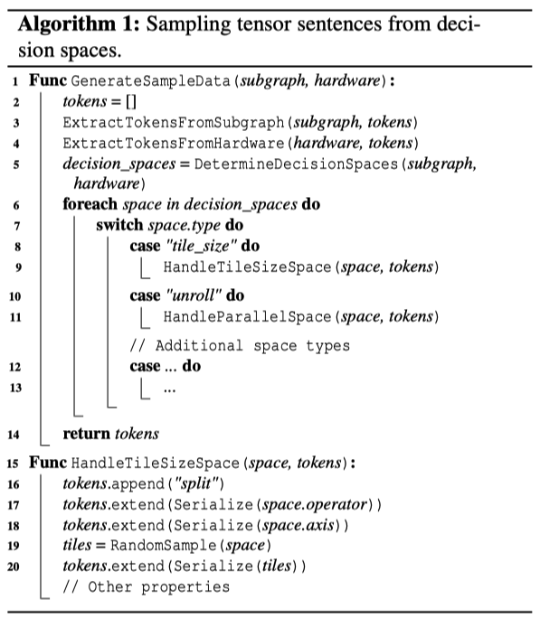
2. Tensor language
We design our natural language like tensor language. Our tensor language sentence consists of three components: (1) input subgraph, (2) hardware specifications, (3) decision paths. The token of each component of a sentence is flexible yet consistent.
$$s^{\left(n\right)}=s^{\left(0\right)}.apply\left(d_{1}\right).apply\left(d_{2}\right).apply\left(d_{3}\right)…apply\left(d_{n}\right)$$
p0 p1 T_matmul_NT p2 T_add 00a059b856ac30ac172b6252254479a6 1024 1024 512 1024 1024 512 1024 512 llvm -keys=cpu -mcpu=core-avx2 -model=i7 4 64 64 0 0 0 0 0 2 SP 2 0 1024 32 1 4 1 SP 2 4 512 8 1 4 1 SP 2 8 1024 1024 1 RE 2 0 4 1 5 8 2 6 9 3 7 FSP 4 0 0 2 FSP 4 3 1 2 RE 4 0 3 1 4 2 5 CA 2 4 3 PPT SPC 2 0 1024 32 1 4 1 SPC 2 4 512 8 1 4 1 SPC 2 8 1024 1024 1 CLS FU 4 0 1 2 3 AN 4 0 3 PRS 2 PR 2 0 auto_unroll_max_step$0 VECS
fused nn dense add fast tanh float32 4 512 float32 512 512 float32 1 512 float32 4 512 llvm -keys=cpu -mcpu=core-avx2 -model=i7 -num-cores=4 GetBlock T_matmul_NT main b0 GetBlock T_add main b1 GetBlock T_minimum main b2 GetBlock T_maximum main b3 GetBlock root main b4 ComputeInline b3 ComputeInline b2 ComputeInline b1 Annotate b0 \"SSRSRS\" meta_schedule.tiling_structure GetLoops b0 l5 l6 l7 SamplePerfectTile l5 4 64 v8 v9 v10 v11 Split l5 v8 v9 v10 v11 1 l12 l13 l14 l15 SamplePerfectTile l6 4 64 v16 v17 v18 v19 Split l6 v16 v17 v18 v19 1 l20 l21 l22 l23 SamplePerfectTile l7 2 64 v24 v25 Split l7 v24 v25 1 l26 l27 Reorder l12 l20 l13 l21 l26 l14 l22 l27 l15 l23 GetConsumers b0 b28 ReverseComputeAt b28 l20 1 -1 Annotate b4 1 meta_schedule.parallel Annotate b4 64 meta_schedule.vectorize SampleCategorical 0 16 64 512 0.25 0.25 0.25 0.25 v29 Annotate b4 v29 meta_schedule.unroll_explicit EnterPostproc 10 1 1 1 1 12 1 1 1 1 14 1 1 21 1 PPT 10 1 1 4 1 12 8 4 2 8 14 512 1 21 0 Annotate b4 2 meta_schedule.parallel

Slide 12
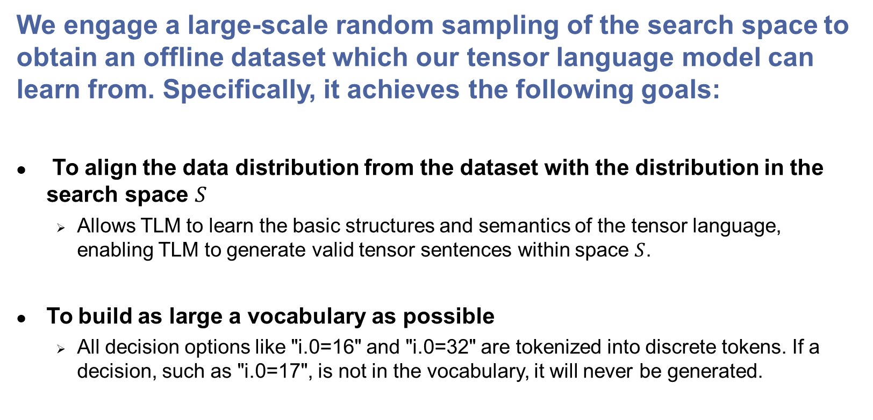
3. Large-scale random sampling
We engage a large-scale random sampling of the search space to obtain an offline dataset which our tensor language model can learn from. Specifically, it achieves the following goals:
To align the data distribution from the dataset with the distribution in the search space $S$
Allows TLM to learn the basic structures and semantics of the tensor language, enabling TLM to generate valid tensor sentences within space $S$.
To build as large a vocabulary as possible
All decision options like "i.0=16" and "i.0=32" are tokenized into discrete tokens. If a decision, such as "i.0=17", is not in the vocabulary, it will never be generated.

Slide 13

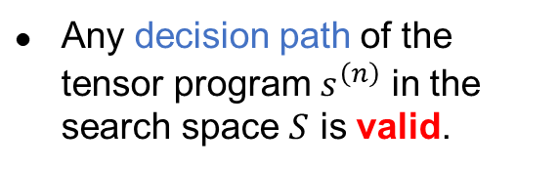
4. Pre-training
TLM adopts the architecture of GPT-2 Small
Approximately 100 million parameters. TLM is composed of 12 Transformer layers, each featuring 12 attention heads and 768 hidden units.
sampling
pre-training
Large-scale dataset
Search space $S$
TLM
Any decision path of the tensor program $s^{\left(n\right)}$ in the search space $S$ is valid.
After pre-training, TLM can generate valid tensor language sentences

Slide 14
5. Generating tensor programs
We first generate tensor language sentences, like how the language model generates sentences.
The language model probabilistically sample the next token to ensure the generated sentence is "coherent and meaningful ".
When generating the next token (i.e., the current decision), TLM combines the knowledge learned and the decisions made to probabilistically sample the current decision.
What is a language model?
①
Input
Next token
["What", "is", "a", "language", "model", "?"]
②
[…, "split", "i=1024", "to"]
TLM
"i.0=32"
①
Prompt
[…, "i=1024", "to", "i.0=32"]
②
"i.1=1"
Input
Next token
[…, "to", "i.0=32", "i.1=1"]
"i.2=4"
③
["What", "is", "a", "language", "model", "?"]
LM
"A"
③
[…, "i.2=4", "split", "j=512", "to"]
④
"j.0=8"
[..., "is", "a", "languange", "model", "?", "A"]
"language"
④
[…, "j=512", "to", "j.0=8"]
"j.1=1"
⑤
[..., "languange", "model", "?", "A", "language"]
"model"
⑤
⋮
⋮
[…, "to", "j.0=8", "j.1=1", …]
"</s>"
⑥
[..., "model", "?", "A", "language", "model" ...,]
"</s>"
⑥
[…, "split", "i=1024", "to", "i.0=32", "i.1=1", "i.2=4", "split", …, "</s>"]
⑦
["What", "is", "a", "language", "model", "?", "A", "language", "model" …, "</s>"]
⑦
... split i=1024 to i.0=32 i.1=1 i.2=4 split ...
What is a language model? A language model...
⑧
⑧
Prompt + Response
Prompt + Response

Slide 15
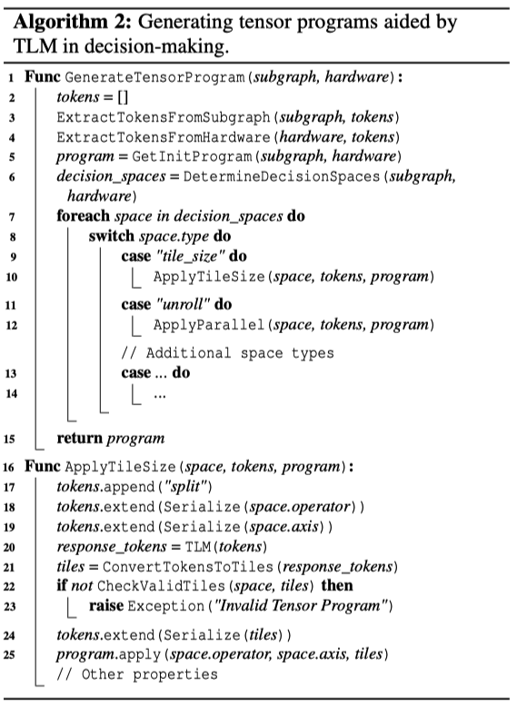
5. Generating tensor programs
We next generate tensor programs:
TLM extracts tokens from sentences, converts them to decisions, and applies them to the input subgragh to generate the tensor program.
This process has the reverse flow of the previous sentence token generation step.

Slide 16
5. Generating tensor programs
How do language models generate valid tensor programs? ✅
How do language models generate high-performance tensor programs? ❓
Using high-performance (i.e., low latency) tensor language sentences as demonstration data to perform supervised fine-tuning (SFT)!
The purpose of SFT of a language model with demonstration data is to achieve that the model’s responses to prompts align with the human intentions reflected in the demonstration data.
But, where does the demonstration data come from?

Slide 17
6. Iterative Optimization
In each iteration, we train our TLM model in a slightly different fashion compared to the language model training:
We substitute the reward model (RM) with actual tensor program measurement
A tensor sentence can be converted into a tensor program, allowing its execution latency to be directly measured on hardware
We employ iterative SFT instead of reinforcement learning (RL)
The reinforcement learning convergence process is unstable
1 × pre-training + 1 × SFT + n × (RM + RL)
Language model training
1 × pre-training + n × (measurement + SFT)
TLM training

Slide 18
6. Iterative Optimization
The core of the iterative optimization is to use the best subset of the data generated by TLM (a.k.a, the demonstration data) to fine-tune TLM.
Prompts
TLM can generate better data iteration by iteration.
The combination of inheritance and mutation may potentially generate higher quality data, aligning with the design philosophy of genetic algorithms.
The latency of the demonstration data will converge.
Mathematically speaking, a monotonic and bounded limit results in convergence.
TLM-base
TLM
SFT
Demonstration data
Sentences
To be measured
Candidates
Database
Measured
Measure in parallel
Records
How do language models generate valid tensor programs? ✅
How do language models generate high-performance tensor programs? ✅

Slide 19
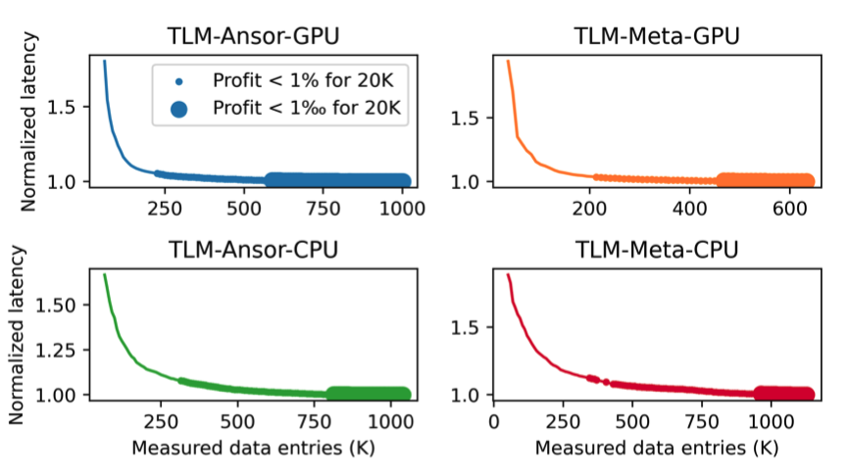
Evaluation
1. Convergence Behavior of Demonstration Data
Inducing convergence across all 126 workloads calls for approximately 200K tensor program measurements on the GPU and about 300K on the CPU.
TLM involves a data volume an order of magnitude smaller compared to TenSet and TLP, which utilize approximately 8.6M measurements.

Slide 20
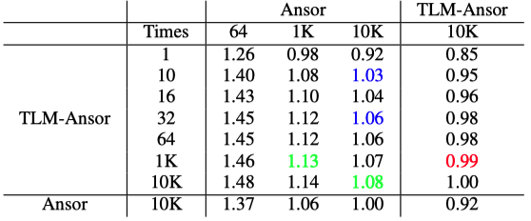
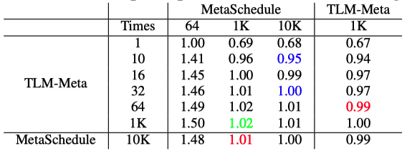
Evaluation
2. Subgraph Benchmark
With 10 measurements, TLM can achieve 103% and 95% of the performance of Ansor and MetaSchedule after 10K measurements
TLM consistently achieves acceleration relative to Ansor [osdi20] and MetaSchedule [NeurIPS23] with equal measurement times.

Slide 21
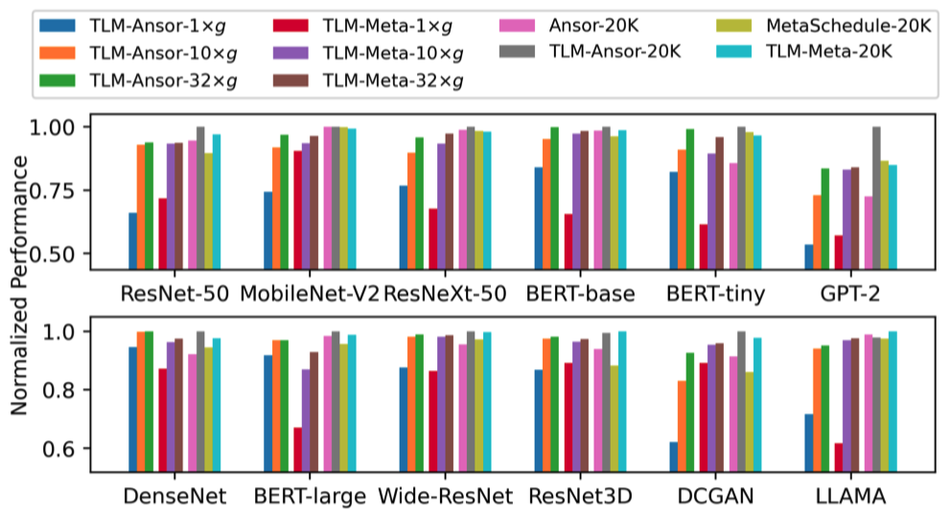
Evaluation
3. End-to-End Workload Benchmark
Under a limited budget, TLM’s performance matches that of Ansor/MetaSchedule yet compiles 61× faster -> high efficiency
In ample exploration times, TLM’s compilation duration is consistent with Ansor and MetaSchedule, delivering a performance boost of 1.08× and 1.04×, respectively.

Slide 22
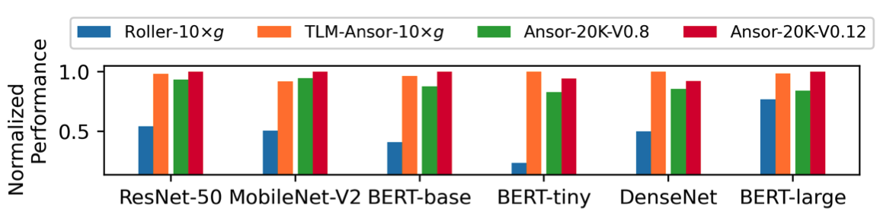
Evaluation
3. End-to-End Workload Benchmark
Performance Speedup
TLM vs. AKG 1.69X
TLM vs. AKG-TBE 1.98X
TLM has been implemented in actual systems and is now used in production.
While its compilation time aligns with Roller[osdi22], its performance is 2.25× better.

Slide 23
Summary
We design the language model-friendly tensor language to represent tensor programs, leveraging the learning capability of language models to generate high-performance tensor programs efficiently.
We develop a tensor language model that combines knowledge from offline learning and previously made decisions to probabilistically sample the best decision in the current decision space, enabling more effective space exploration.
Code available at https://github.com/zhaiyi000/tlm

