Slide 1


ARFA
An Agile Regime-Based Floating-Point Optimization Approach for Rounding Errors
Jinchen Xu ¹, Mengqi Cui ¹, Fei Li ¹, Zuoyan Zhang ²,
Hongru Yang ¹, Bei Zhou ¹, Jie Zhao ²
¹ Information Engineering University, Zhengzhou, China
² Hunan University, Changsha, China
Notes:
Good afternoon everyone. It’s a pleasure to be here with you today. My name is Zuoyan, and I’m from Hunan University in Changsha, China. Today, I would like to present our work on ARFA: an agile regime-based floating-point optimization approach for rounding errors.

Slide 2
Outline
Rounding errors
Existing approaches and difficulties
Regime-based rewriting of ARFA
Error optimization of ARFA
How ARFA works?
MOTIVATION
APPROACH
EVALUATION
CONCLUSION
Precision optimization effect
Validation interval inference
Summary
Future work
2
Notes:
To guide you through my presentation, I have divided it into four main parts: motivation, approach, evaluation, and conclusion.

Slide 3
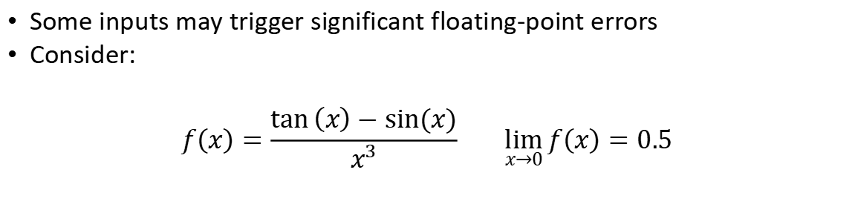
Rounding errors
Some inputs may trigger significant floating-point errors
Consider:
$$f\left(x\right)=\frac{\tan\left(x\right)−sin⁡(x)}{x^{3}} \lim_{x→0}{f\left(x\right)=0.5}$$
double f(double x) {
double num = tan(x) – sin(x);
double den = x * x * x;
return num / den;
}
>>> f(1e-7) // 64 bits result
0.5029258124322410
Accurate result //128 bits result
0.5000000000000012
3
Notes:
First, I’d like to introduce the motivation behind our research. So, what is rounding errors? For an arithmetic expression, some inputs may trigger significant floating-point errors. For example, consider the following expression: as x approaches zero, the limit value is 0.5. However, due to the existence of floating-point error, the computed result using double-precision floating-point numbers in computers deviates significantly from the real value. When we use 128 bits to represent the floating-point number, we observe that the error is significantly reduced.

Slide 4
Rounding errors
The root cause is:
Finite precision bits cannot represent all real numbers exactly
And the rounding errors can be amplified by floating-point operations
Large errors may lead to catastrophic software failures
Missile yaw [skeel’ 92]
Stock trading disorder [Quinn’ 83]
Rocket launch failure [Lions’ 96]
Precision optimization is a crucial work
4
Notes:
The fundamental reason is that computers use finite-precision floating-point numbers, which cannot exactly represent real numbers. Consequently, rounding errors are inevitable, and these errors can be amplified by floating-point operations. As we all know, floating-point errors are infamous problem in software development. And large rounding errors can lead to catastrophic software failures. Therefore, it is crucial to reduce rounding errors and optimize the precision.

Slide 5





How to solve it?
Through rewriting
Changing the order of floating-point operations can reduce errors
double a = 1.0e8, b = -1.0e8, c = 0.1;
printf(“%.10lf”, (a + b) + c); // 0.1000000000
printf(“%.10lf”, a + (b + c)); // 0.0999999940
Equivalent rewriting
double x = 0.1e-6;
printf(“%.10lf”, (1-cos(x)) / (x * x)); // 0.4996003611
printf(“%.10lf”, 1.0 / 2.0 – (x * x) / 24.0 + (x * x * x * x) / 720.0); // 0.5000000000
Approximate rewriting
Consider: for an expression $\frac{log(1−x)}{log(1+x)}$ in interval $[0.1,0.9]$
$$\frac{log1p(−x)}{log1p(x)}$$
$$\frac{log(1−x)}{log(1+x)}$$
$$\frac{log1p(x∗\left(−x\right))}{log1p(x)}−1$$
5
Notes:
We can optimize the precision by rewriting expressions because changing the order of floating-point operations can reduce errors. There are two types of rewriting methods: equivalent rewriting and approximate rewriting. For example, in equivalent rewriting, the error can be reduced by changing the calculation order. In the example on the right, calculating a plus b first can effectively avoid the catastrophic cancellation error. And in approximate rewriting, errors can be reduced by using approximations such Taylor series expansions.
For instance, consider an expression within the interval from 0.1 to 0.9; it can be rewritten into two new equivalent expressions that offer improved precision in that range.
Different rewritten expressions have varying precision performances. So, how can we design an approach to achieve the best precision optimization?

Slide 6
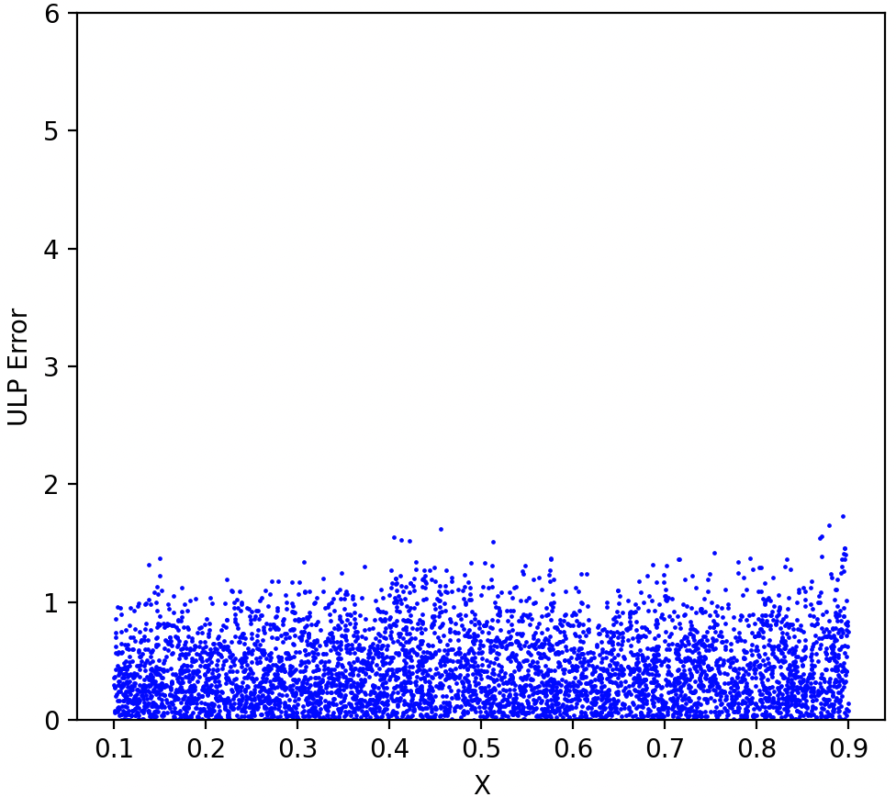
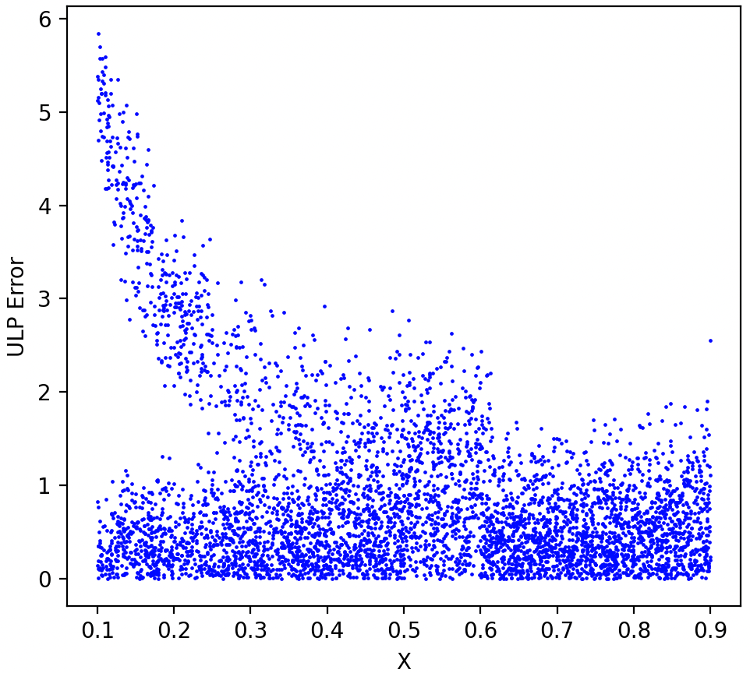
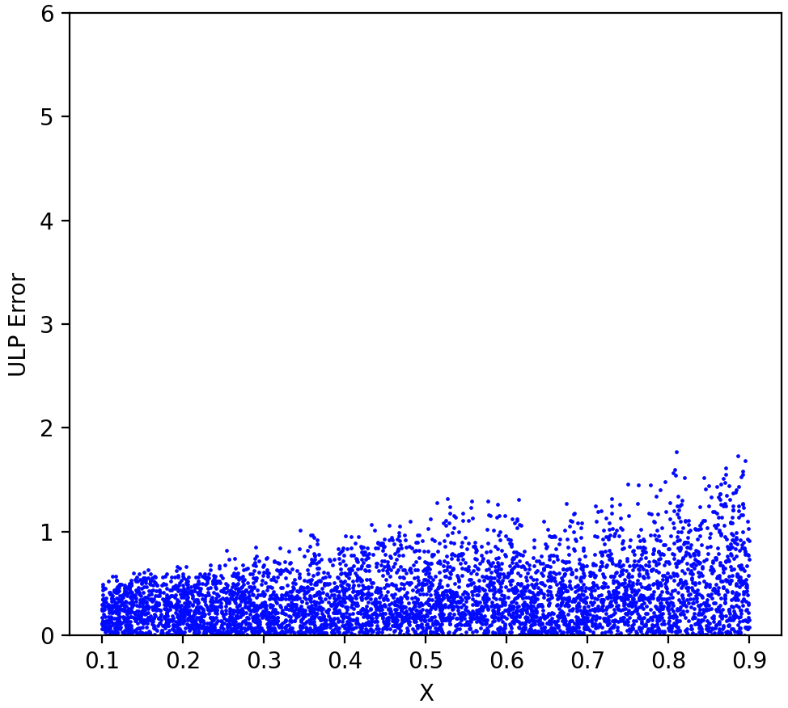



How to solve it?
$$\frac{log1p(−x)}{log1p(x)}$$
$$\frac{log(1−x)}{log(1+x)}$$
$$\frac{log1p(x∗\left(−x\right))}{log1p(x)}−1$$
What to do next?
6
Notes:
Therefore, we analyzed the error distribution of the original expression. We observed that there is a large error in the interval from 0.1 to 0.6. By comparing the error distributions of the rewritten expressions, we found that the errors in each rewritten expression are significantly reduced within this range. So, the question becomes: how do we choose the best rewritten expression to optimize precision?

Slide 7
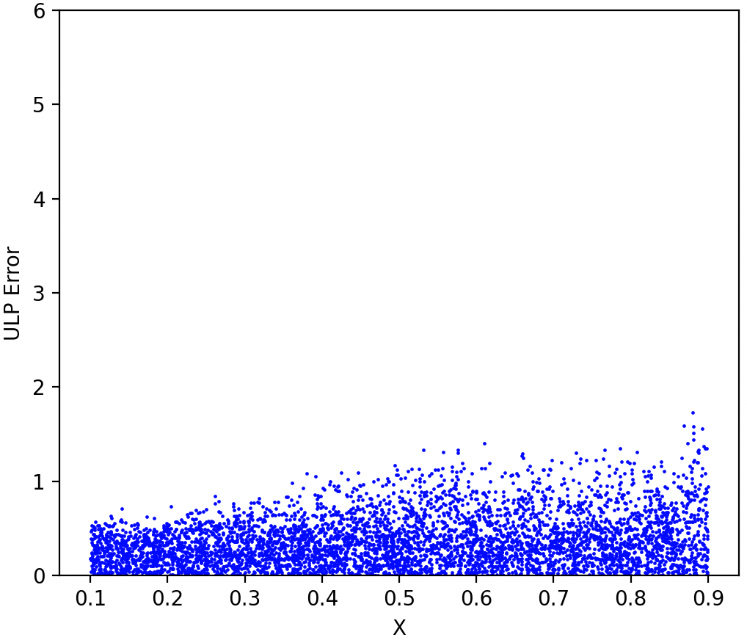



How to solve it?
We can divide the high error interval and use rewriting to optimize its precision
$$\frac{log1p(−1)}{log1p(x)}$$
Regime-based rewriting
High error interval
$$\frac{log1p(x∗\left(−x\right))}{log1p(x)}−1.0$$
$$\frac{log(1−x)}{log(1+x)}$$
Before precision optimization
After precision optimization
Two problems:
How to determine the rewriting interval?
How to rewriting?
7
Notes:
First, we observe from the error distribution plot of the original expression that the errors are not uniform. Significant errors may occur in certain intervals, while in other intervals, the errors remain within acceptable limits. Therefore, we can divide the domain into subintervals based on the characteristics of the error distribution and apply different rewritten expressions in each subinterval to optimize precision. This approach in known as regime-based rewriting. By employing this method, we find that the error distribution after precision optimization is superior to that achieved by applying a single rewriting over the entire domain.
However, there are two main challenges in implementing this method: first, how to determine the optimal rewriting intervals, and second, how to effectively perform the rewriting.

Slide 8
Existing approaches and difficulties
Regime-based rewriting is the main method of precision optimization
Herbie
Regina
Cannot find the regime in many cases
It’s difficult to search for the optimal rewriting
The number of regimes are often much larger
Low performance
A generally applicable and effective regime inference algorithm and optimal rewriting search algorithm are still missing
8
Notes:
Currently, regime-based rewriting is the primary approach for optimizing precision in floating-point computations. Herbie and Regina are among the most advanced tools employing this method. However, they still have some limitations. For example, Herbie cannot always find a valid regime for stable or specific cases. Additionally, it generates all possible rewritten expressions and selects one with smaller error based on a cost model, but this doesn’t guarantee that the chosen expression is the optimal one. On the other hand, Regina simply divides the domain into several regimes and merges regimes that use the same rewritten expressions, leading to a large number of regimes and reduced performance. Overall, a generally applicable and effective regime inference algorithm and optimal rewriting search algorithm are still missing.

Slide 9
Regime-based rewriting of ARFA
In order to solve the two problems
How to determine regimes more accurately?
Get a startup expression with the lowest possible error
Determine the high error regime based on the error distribution contour
How to generate better rewriting expressions?
Rewriting based on the order of operations
Supporting customization and extension of rewriting rules
Dynamically detect rewriting expressions instead of cost model
9
Notes:
To address these two challenges, we propose ARFA — an agile regime-based rewriting tool. First, ARFA rewrites expressions within specific intervals to obtain equivalent expressions with lower error, providing a better initial expression for subsequent interval inference and expression rewriting. Then, it determines high-error intervals by analyzing the contours of the error distribution plot.
To generate better rewritten expressions, ARFA primarily optimizes precision by reordering operations. On this basis, ARFA supports customization and extension of rewriting rules. By dynamically detecting rewritten expressions instead of relying on a cost model, ARFA is able to obtain expressions with superior precision.

Slide 10


Error optimization using ARFA
Architecture of ARFA
$$f_{e}\text{, }𝒟$$
plotting
normalization
simplification
error
analysis
preprocessing
sketching
code
optimizer
search
expansion
grain
splitting
$$\hat{f_{e}}\text{, }𝒟$$
10
Notes:
The architecture of Arfa consists of three main modules. The first module handles error analysis and preprocessing. The second module focuses on regime inference. Finally, the third module deals with expression rewriting.

Slide 11
Error optimization using ARFA
$$f_{e}\text{, }𝒟$$
Error analysis
Use MPFR to obtain dynamic errors
plotting
normalization
simplification
error
analysis
preprocessing
sketching
code
optimizer
search
expansion
Preprocessing
Choose a better start-up expression by comparing the original with Herbie and Daisy’s rewriting expression
splitting
$$\hat{f_{e}}\text{, }𝒟$$
11
Notes:
Now, let’s introduce the first module. ARFA takes as input the expression and its domain D. First, ARFA selects a set of sampling points within D to perform dynamic error detection. We use the MPFR library for this purpose to obtain more accurate error information. Then, in the preprocessing step, ARFA chooses a better initial expression by comparing the original expression with the rewritten expressions generated by Herbie and Daisy.

Slide 12
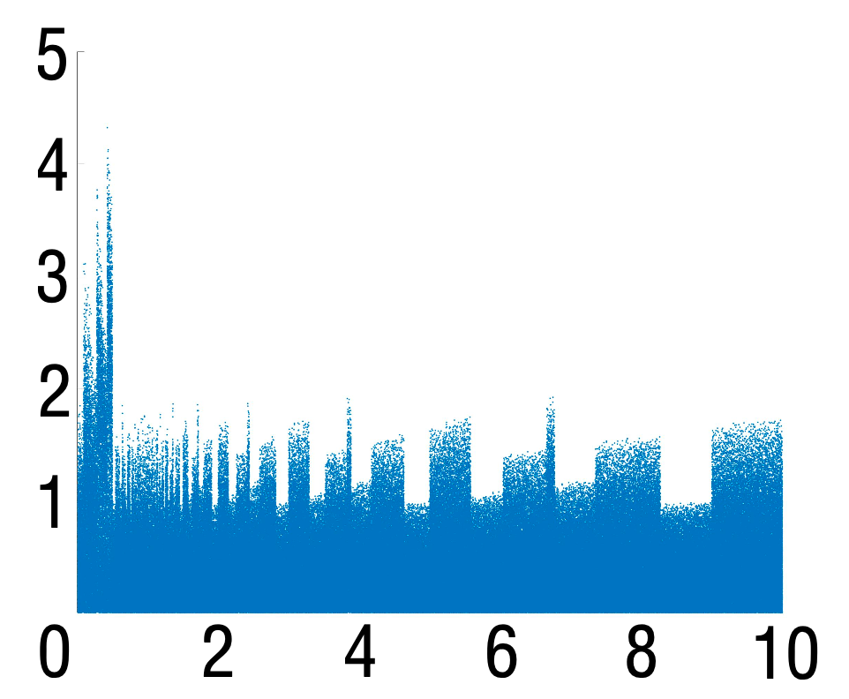
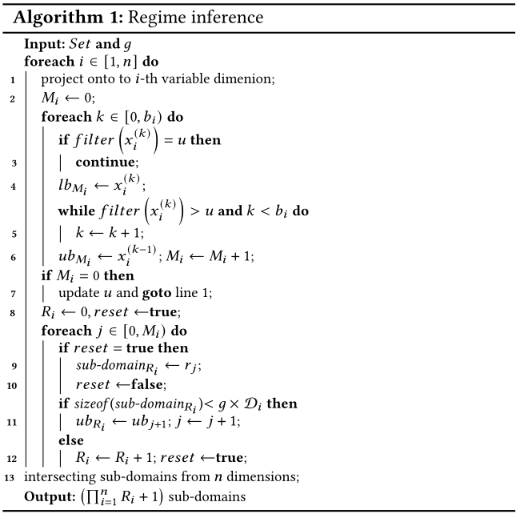
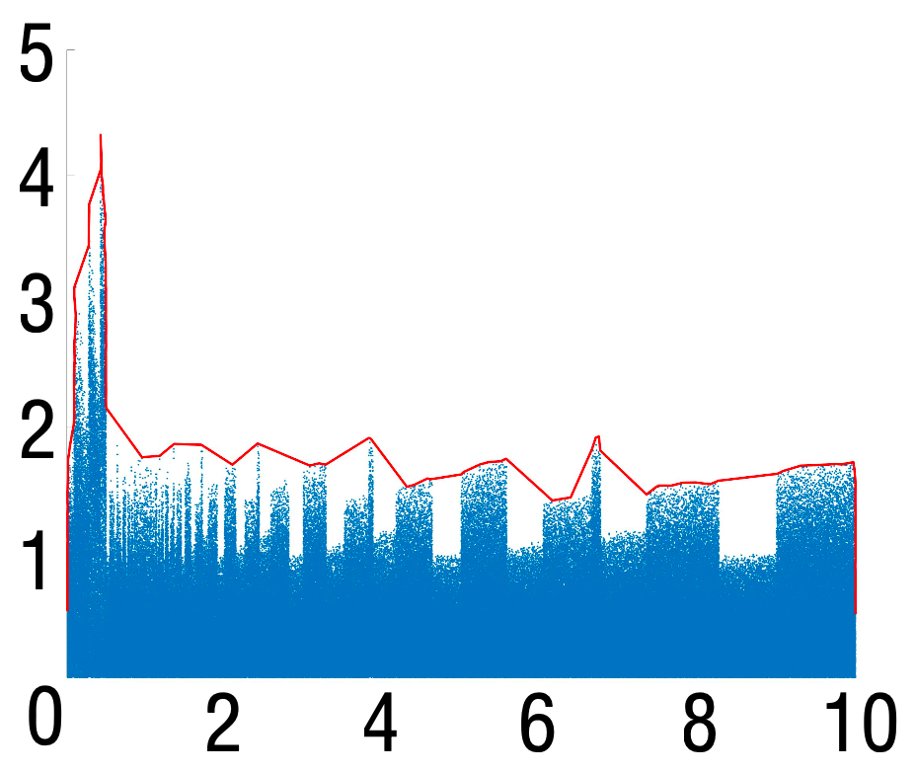
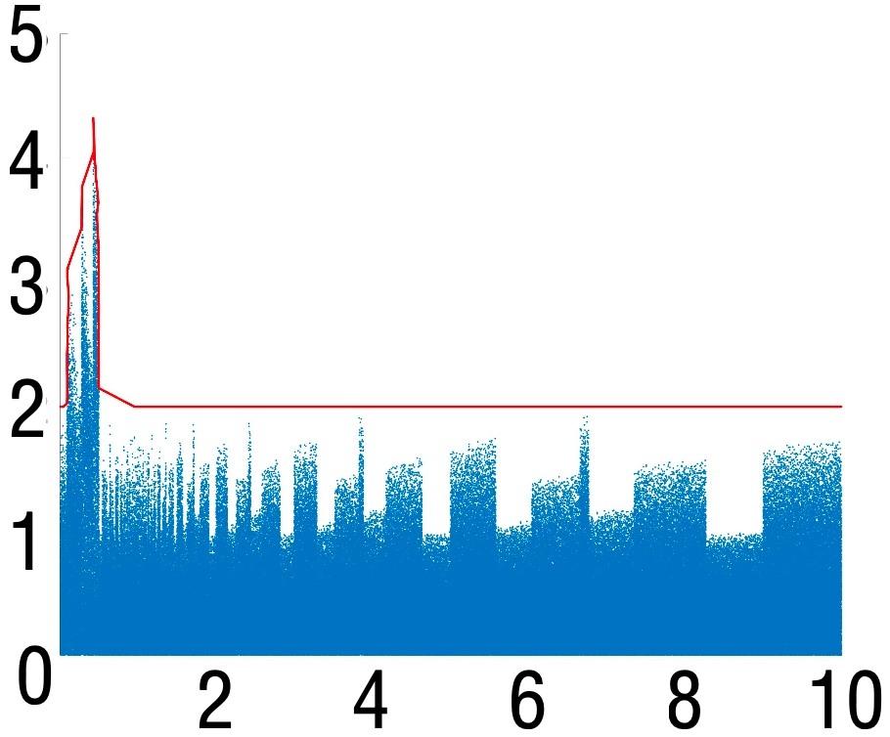
Error optimization using ARFA
Effective regime inference
plotting
sketching
splitting
Through plotting error distribution, sketching boundary lines, and dynamically set the boundary line to obtain a more accurate regime
12
Notes:
After preprocessing, we proceed to regime inference. First, by sampling within the domain D, we draw the error scatter plot, as shown in the first figure. By analyzing this error plot, Arfa can evaluate each sampling point and its corresponding error to determine whether the error should be reduced. However, this process is very time-consuming. To efficiently reflect error fluctuations, we sketch the contour of the error plot, which Arfa uses for regime inference. However, the contour lines may exhibit significant fluctuations, resulting in many regimes. Therefore, we can filter the contour line sample values by setting error boundaries to generate more accurate and manageable regimes.

Slide 13
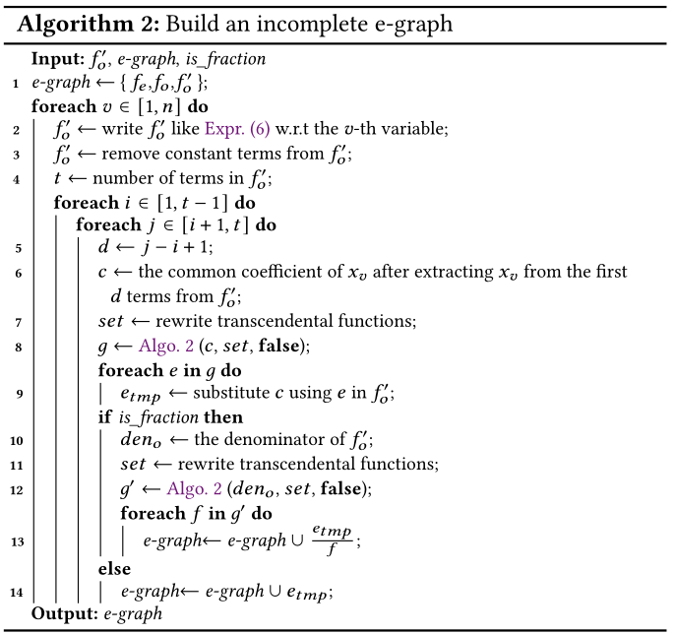




Error optimization using ARFA
Customized rewrite generation
Normalization
$$\frac{1}{x+y}+\frac{1}{x−y}+1⇒\frac{\left(x−y\right)+\left(x+y\right)+(x+y)(x−y)}{(x+y)(x−y)}$$
normalization
simplification
Simplification
$$\left(x−y\right)+\left(x+y\right)+\left(x+y\right)\left(x−y\right)⇒2x+x^{2}−y^{2}$$
code
optimizer
Reordering
$$1+3x+3x^{2}+x^{3}⇒1+(3x+\left(3x^{2}+x^{3}\right))$$
search
expansion
Extended rules
$\log\left(1+x\right)⇒log1p(x)$
$$\hat{f_{e}}\text{, }𝒟$$
ARFA supports normalization, simplification, reordering and extended rules to generate equivalent rewriting expressions
Building an incomplete e-graph to obtain a optimal rewriting expression in every regime instead of using cost model
13
Notes:
Finally, the high-error regimes identified during regime inference are addressed through rewriting and replacement. Arfa supports four rewriting rules: normalization, simplification, reordering, and extended rules. Instead of relying on a cost model, Arfa builds an incomplete e-graph to obtain an optimal rewritten expression in each regime.

Slide 14
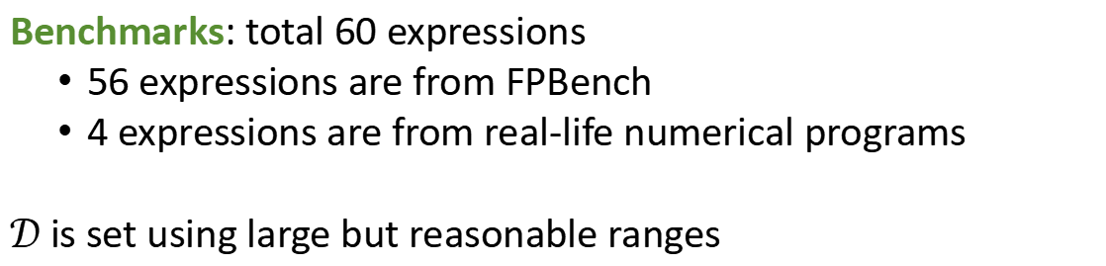
Evaluation
Benchmarks: total 60 expressions
56 expressions are from FPBench
4 expressions are from real-life numerical programs
$𝒟$ is set using large but reasonable ranges
Total Benchmarks | Single-variate | Multi-variate | Control flow | Real-life
60 | 31 | 19 | 6 | 4
14
Notes:
For our evaluation, we selected a total of 60 benchmarks. This includes 56 expressions from FPBench, comprising 31 single-parameter expressions, 19 multi-parameter expressions, and 6 test cases with conditional statements. Additionally, we included 4 test cases extracted from real-world numerical programs. Our experiments use the default domains provided by FPBench.

Slide 15
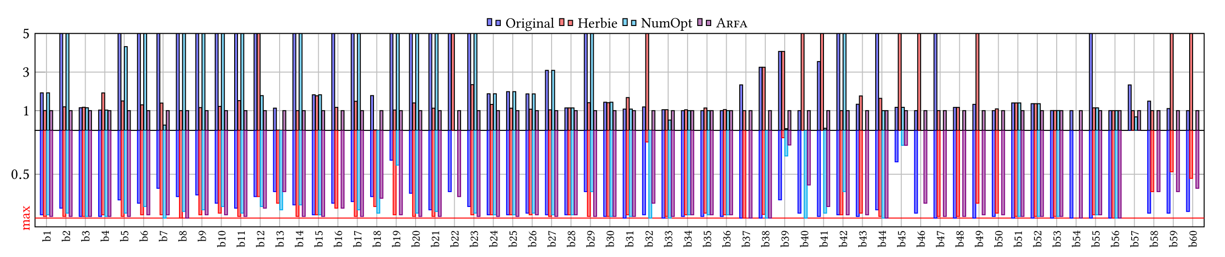
Evaluation — Precision optimization effect
ARFA performs better than Herbie and NumOpt in 60 and 52 cases respectively
15
Notes:
First, let’s compare the precision optimization results. Experiments show that across all 60 test cases, Arfa’s optimization results are consistently better than Herbie’s because Arfa can always find valid regimes and better rewritten expressions. Additionally, Arfa outperforms NumOpt in 52 out of the 60 test cases.

Slide 16
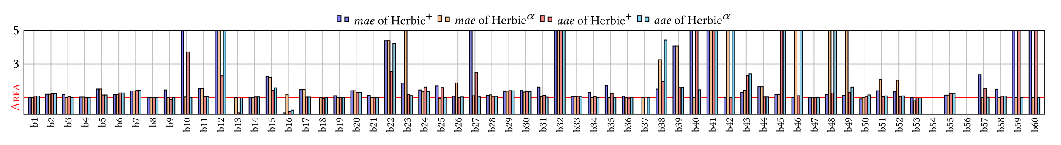

Evaluation — Quality of rewriting
Arfa allows its regime inference to work with Herbie rewrite search heuristics
ARFA’s rewriting performs better than Herbie⁺ and Herbie$α$ in 58 and 53 cases respectively in the same regime
16
Notes:
Arfa allows its regime inference to work with Herbie’s rewrite search heuristics, enabling us to directly compare the quality of the rewritten expressions. In same regimes, Arfa’s rewriting performs better than Herbie plus and Herbie alpha in 58 and 53 test cases, respectively. Therefore, compared to Herbie, Arfa can find better rewritten expressions.

Slide 17

Conclusion
ARFA
Summary
Future work
Effective regime inference
Optimal rewriting generation
Generalize Arfa
Add more rewrite rules
Integrate the RLIBM-based approaches
https://github.com/yuanyuanxia/exprAuto
17
Notes:
In conclusion, we have introduced Arfa as a tool to reduce floating-point errors in arithmetic expressions. Arfa features efficient regime inference and an optimal rewriting generation algorithm. For future work, we plan to generalize Arfa to handle more complex scenarios like control constructs and to parallelize its execution to reduce overhead. We also intend to add more rewriting rules and integrate the RLIBM-based approaches.

Slide 18
THANK YOU FOR LISTENING
ANY QUESTION?
Presenter: Zuoyan Zhang
zyanz@hnu.edu.cn
Notes:
That’s all for my presentation. Thank you all for your attention. If you have any question or would like to discuss our research further, please feel free to contact me. Once again, thank you very much.

