Slide 1


A Holistic Approach to Automatic Mixed-Precision Code Generation and Tuning for Affine Programs
Jinchen Xu Guanghui Song Bei Zhou Fei Li Jiangwei Hao Jie Zhao
1
2
1
1
1
3
Information Engineering University, Zhengzhou, China
Li Auto Inc., Shanghai, China
Hunan University, Changsha, China
ACM SIGPLAN Symposium on Principles and Practice of Parallel Programming 2024(PPoPP 2024)
March 4th, 2024, Edinburgh, UK
Notes:
Good morning ladies and gentlemen. It's a pleasure to be here with you today. I'm Guanghui Song. I work for Shanghai Lixiang Automobile Company. Li Auto Inc is a leader in China’s new energy vehicle market. The subject of my talk is 'A Holistic Approach to Automatic Mixed-Precision Code Generation and Tuning for Affine Programs'.

Slide 2
Outline
Background and Motivation
Methodology and Scope
Mixed-Precision Code Generation
Performance Prediction
Integration with Error Budgets
Experiments
Conclusion
2
Notes:
My talk will be in seven parts.

Slide 3
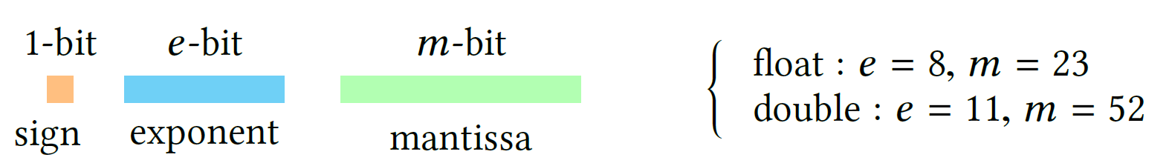
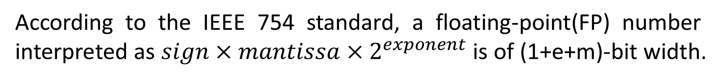
Background and Motivation
FP Representations
According to the IEEE 754 standard, a floating-point(FP) number interpreted as $sign×mantissa×2^{exponent}$ is of (1+e+m)-bit width.
Reducing FP precision is used to trade the quality degradation of a numerical program’s output for performance.
3
Notes:
To begin with, I'll be speaking about the Background and Motivation. According to the IEEE standard, a floating-point number interpreted like this of (1+e+m)-bit width. Unfortunately, the users usually choose a more precise format to guarantee the computation accuracy, which makes the performance of their programs sub-optimal. So, Reducing FP precision is used to trade the quality degradation of a numerical program’s output for performance.

Slide 4
Background and Motivation
Mixed-precision code generation and dynamic profiling can help to select the optimal precision configuration.
Existing methods:
Semi-automated and rely heavily on user expertise
The optimal performance unpredictable
Leading to sub-optimal performance
Our Method:
A Holistic Approach to Automatic Mixed-Precision Code Generation and Tuning for Affine Programs -> PrecTuner
4
Notes:
More generally, Mixed-precision code generation and dynamic profiling can help to select the optimal precision configuration.
However, this implementations have some limitations.
First, users must annotate a source program, making existing methods semi-automated and rely heavily on user expertise.
Second, decoupling the code generator and the autotuner compels the latter to search a huge space, rendering the optimal performance unpredictable.
Third, generating mixed-precision code on top of a low-level intermediate representation isolates this optimization from loop transformations, thus leading to sub-optimal performance.
And So, We proposes A Holistic Approach to Automatic Mixed-Precision Code Generation and Tuning for Affine Programs -> PrecTuner to address these challenges.

Slide 5
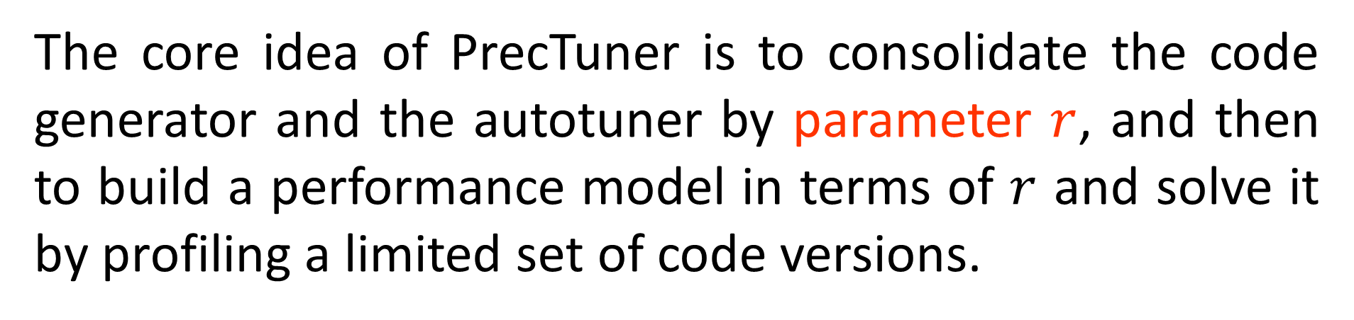
Methodology and Scope
Method Overview
Code generator
$r.c
Autotuner
Source.c
r & error budgets
r
Result.c
Performance mode
The core idea of PrecTuner is to consolidate the code generator and the autotuner by parameter $r$, and then to build a performance model in terms of $r$ and solve it by profiling a limited set of code versions.
5
Notes:
In the this section, we'll be looking at the Method Overview. The Figure shows the overall flow chart of PrecTuner. The core idea of PrecTuner is to consolidate the code generator and the autotuner by parameter $r$, and then to build a performance model in terms of $r$ and solve it by profiling a limited set of code versions.

Slide 6
Methodology and Scope
Challenges and Scope
Challenges:
Not only should no program analysis be done by users but also better performance must be guaranteed without evaluating all code variants.
Scope:
We require the input program to satisfy:
(1) loop bounds and conditionals are affine functions of program parameters and outer loop iterators, and
(2) no jump statements interrupting the static control flow of the program exist.
6
Notes:
Next, let me try to explain the challenges and scop this method addresses. The challenge we face is that not only should no program analysis be done by users but also better performance must be guaranteed without evaluating all code variants. And we require the input program to satisfy: loop bounds and conditionals are affine functions of program parameters and outer loop iterators, and no jump statements interrupting the static control flow of the program exist.

Slide 7
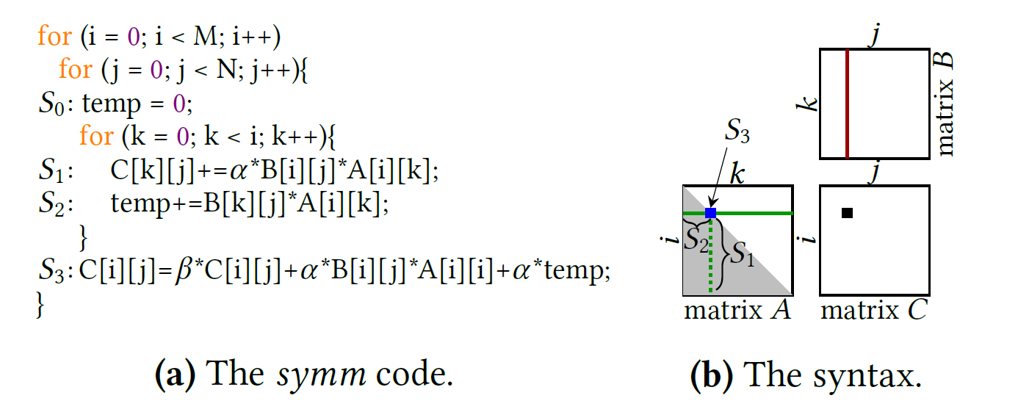
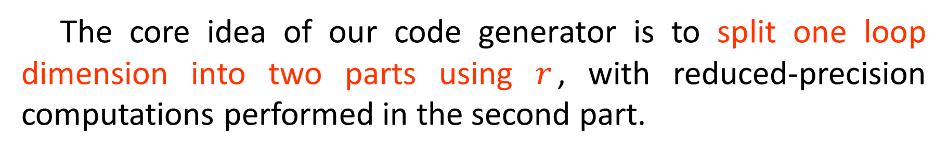
Mixed-Precision Code Generation
The core idea of our code generator is to split one loop dimension into two parts using $r$, with reduced-precision computations performed in the second part.
7
Notes:
Let’s turn to the code generator. The core idea of our code generator is to split one loop dimension into two parts using 𝑟, with reduced-precision computations performed in the second part. For illustrative purposes, we use the Figure which performs a symmetric matrix multiplication as a running example.

Slide 8
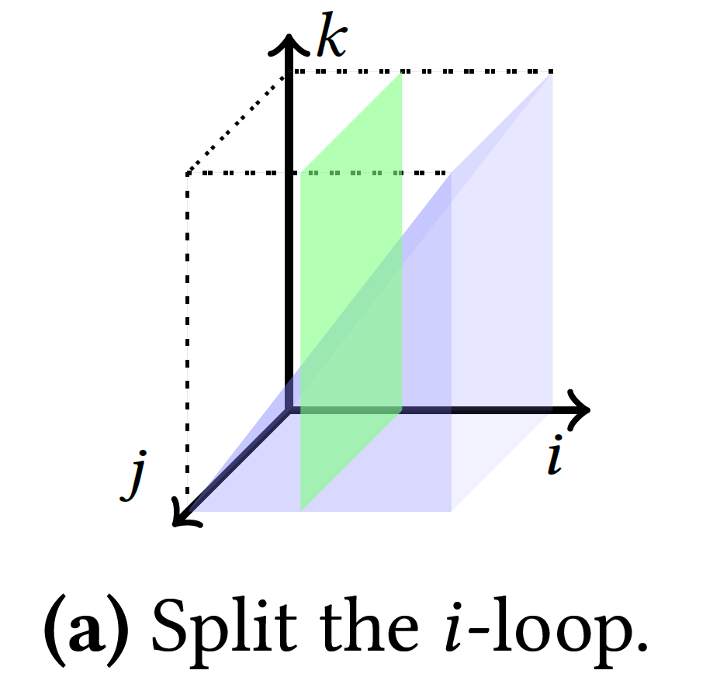
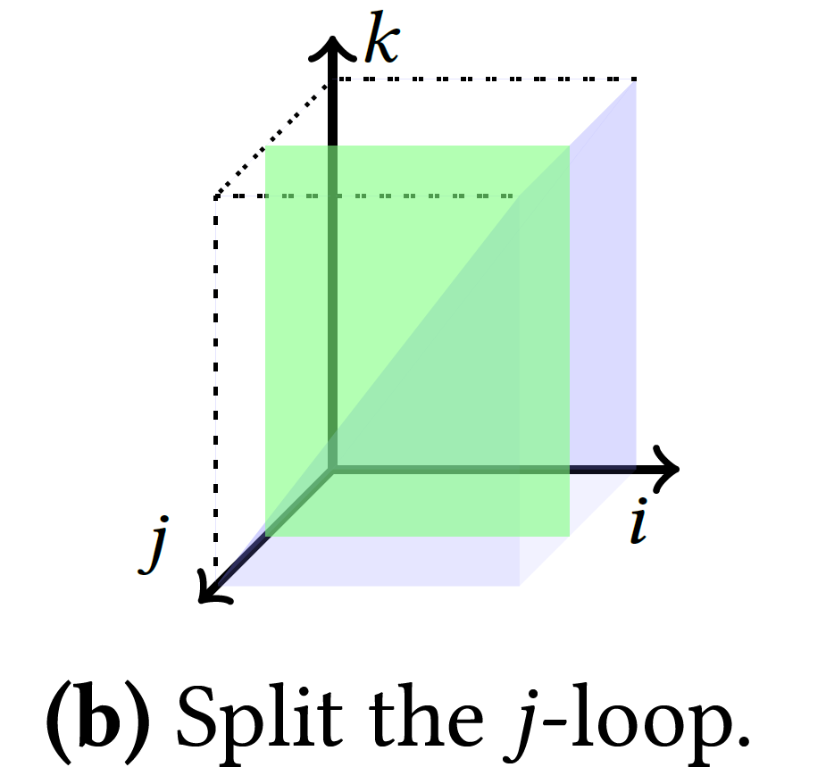
Mixed-Precision Code Generation
Basic-block-wise Iteration Space Splitting
How to determine the splittable loop dimension?
The outermost dimension should be the ideal candidate, since it minimizes the overhead of introduced type casting.
Choose the outermost dimension that
Neither appears as a program parameter in the bound expressions of its enclosing loops
Nor carries across-iteration dependences.
8
Notes:
The first challenge of our code generator is to determine the splittable loop dimension.
As you probably know the outermost dimension should be the ideal candidate, since it minimizes the overhead of introduced type casting.
For instance, It seems that it is possible to split the i-loop or j-loop.
For each basic block, we always choose the outermost dimension that neither appears as a program parameter in the bound expressions of its enclosing loops nor carries across-iteration dependences.

Slide 9
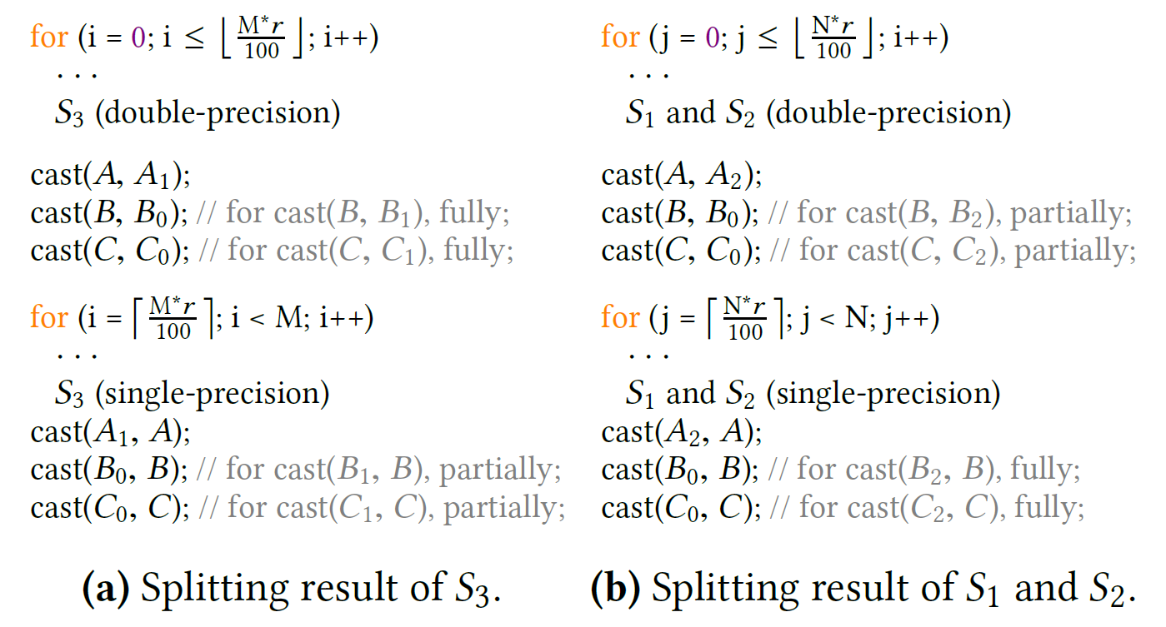
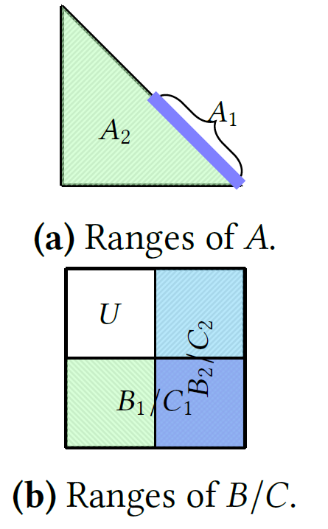
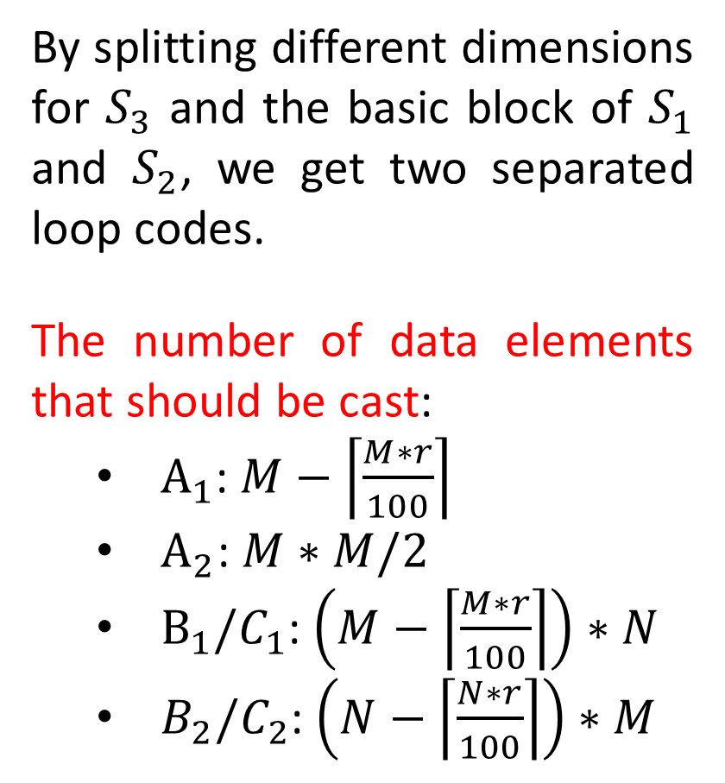
Mixed-Precision Code Generation
Range Inference for Type Casting
By splitting different dimensions for $S_{3}$ and the basic block of $S_{1}$ and $S_{2}$, we get two separated loop codes.
The number of data elements that should be cast:
$A_{1}$: $M−\left\lceil \frac{M∗r}{100}\right\rceil$
$A_{2}$: $M∗M/2$
$B_{1}/C_{1}$: $\left(M−\left\lceil \frac{M∗r}{100}\right\rceil \right)∗N$
$B_{2}/C_{2}$: $\left(N−\left\lceil \frac{N∗r}{100}\right\rceil \right)∗M$
9
Notes:
The second challenge is to infer the data ranges of type casting.
By splitting different dimensions for S3 and the basic block of S1 and S2, we get two separated loop codes, as shown in Figure above.
Because all matrices are accessed by each statement, we need to insert type casting for each matrix, as depicted in Figure below.
Finally, The number of data elements that should be cast is show in slide.

Slide 10
Mixed-Precision Code Generation
Composition with Loop Transformations
The Figure shows our compilation pipeline, with a solid box denoting a compulsory step and a dotted box optional.
10
Notes:
The third challenge is to compose the reduced-precision optimization with loop transformations.
The Figure shows our compilation pipeline, with a solid box denoting a compulsory step and a dotted box optional.

Slide 11
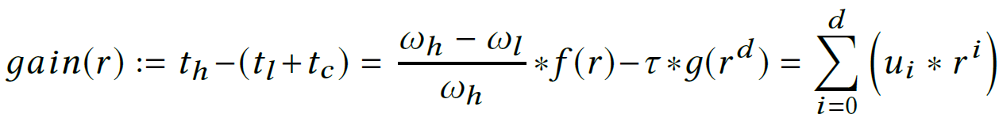
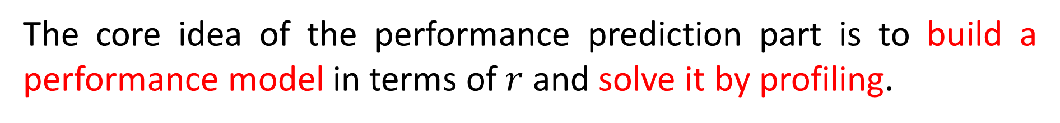
Performance Prediction
Building the Performance Model
The core idea of the performance prediction part is to build a performance model in terms of $r$ and solve it by profiling.
We can rewrite the performance model as the sum of all $\left(u_{i}∗r^{i}\right)$.
11
Notes:
The core idea of the Performance Prediction part is to build a performance model in terms of r and solve it by profiling.
We can build the performance model as shown in the slide.
In a word, We can rewrite the performance model as the sum of this multiplication, where r and ui are unknowns.

Slide 12
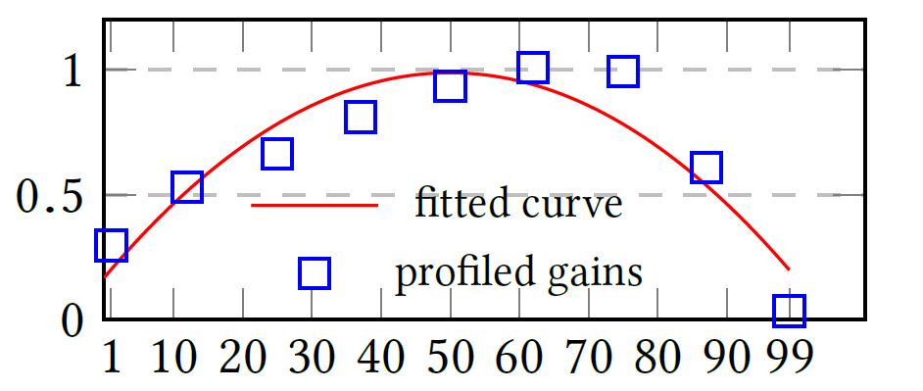
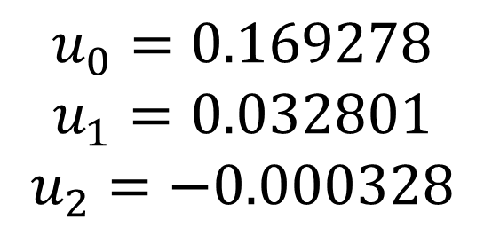
Performance Prediction
Solving the Performance Model
In practice, we select nine integers to address this curve fitting issue to obtain all the unknowns in the performance model.
$$u_{0}=0.169278$$
$$u_{1}=0.032801$$
$$u_{2}=−0.000328$$
12
Notes:
In practice, we select nine integers to address this curve fitting issue to obtain all the unknowns in the performance model.
For the running example, The Figure shows how curve fitting is approximated via performance profiling, and we can get the value of u0, u1, u2, as the slide.

Slide 13
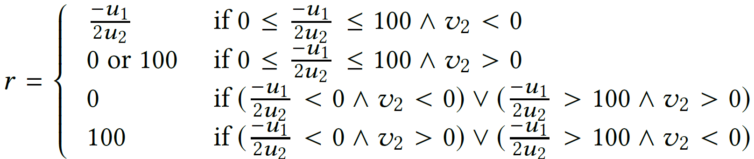
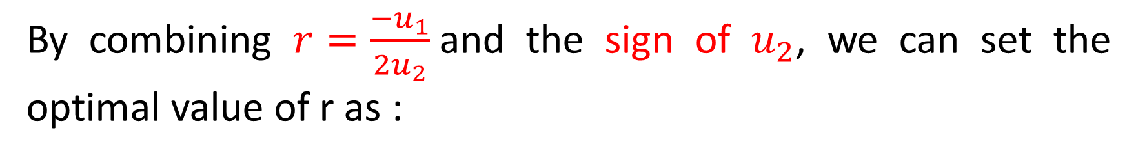
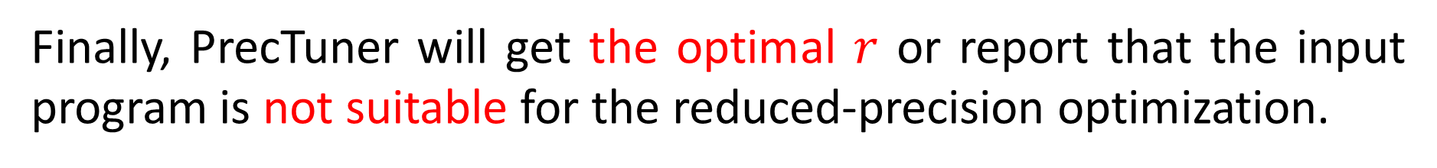
Performance Prediction
Predicting the Optimum
By combining $r=\frac{−u_{1}}{2u_{2}}$and the sign of $u_{2}$, we can set the optimal value of r as :
Finally, PrecTuner will get the optimal $r$ or report that the input program is not suitable for the reduced-precision optimization.
13
Notes:
Then, By combining 𝑟 like this and the sign of 𝑢2, we can set the optimal value of r as the figure.
Finally, PrecTuner will get the optimal r or report that the input program is not suitable for the reduced-precision optimization.

Slide 14
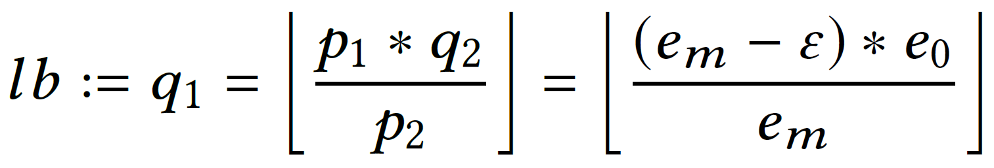
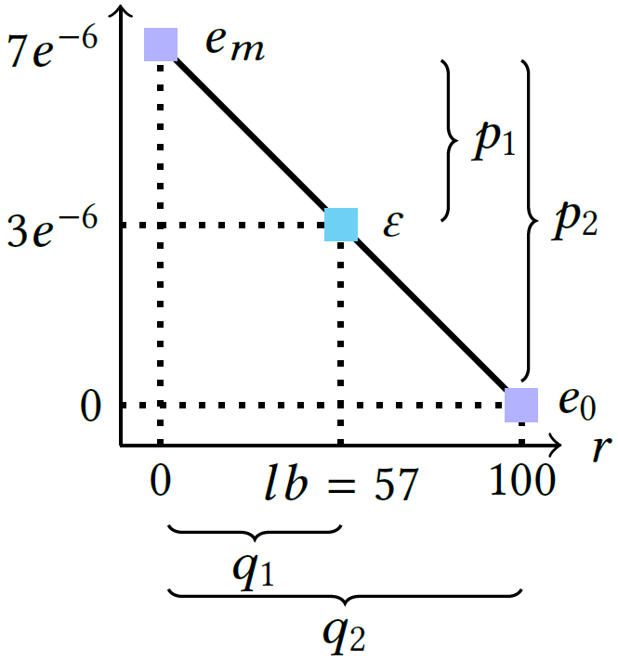
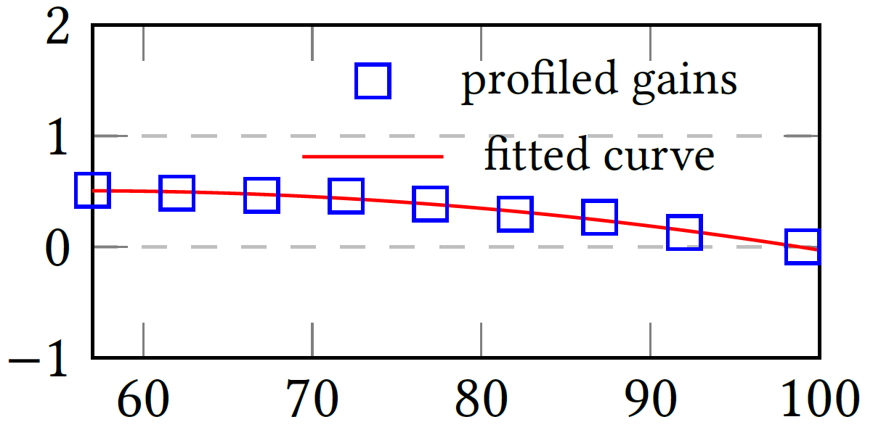
Integration with Error Budgets
You may expect PrecTuner to generate code under a predefined error budget ε.
We can use $lb$ to resdefine the feasible solution range of $r$.
14
Notes:
So far, PrecTuner can already produce the best-performing mixed-precision code. However, you may expect PrecTuner to generate code under a predefined error budget ε.
We conclude that both the errors of each output data should be zero when r equals 100, denoted as e0. Meanwhile, we compute these errors for r equals 0, denoted as em.
One can also draw a horizontal line using ε and find its cross point with the above diagonal line.
For instance, we set ε is three times ten to the power of minus six. And the cross point is shown in cyan. It is 57 for the running example represented as 𝑙𝑏.
Then, We can use 𝑙𝑏 to redefine the feasible solution range of 𝑟.
For instance, Figure on the right depicts the curve fitting result of the running example when ε is set to three times ten to the power of minus six.

Slide 15
Experiments
Experimental Setup:
3.10 GHz Intel(R) Core(TM) i5-10500 CPU
NVIDIA RTX 2070
Ubuntu 20.04.5 LTS
Clang 12.0.1 with -O3
NVCC 11.1 with -O3
PolyBench 4.2.1 (beta)
15
Notes:
Now let's turn our attention to Experiments. The Slide shows Experimental Setup.

Slide 16
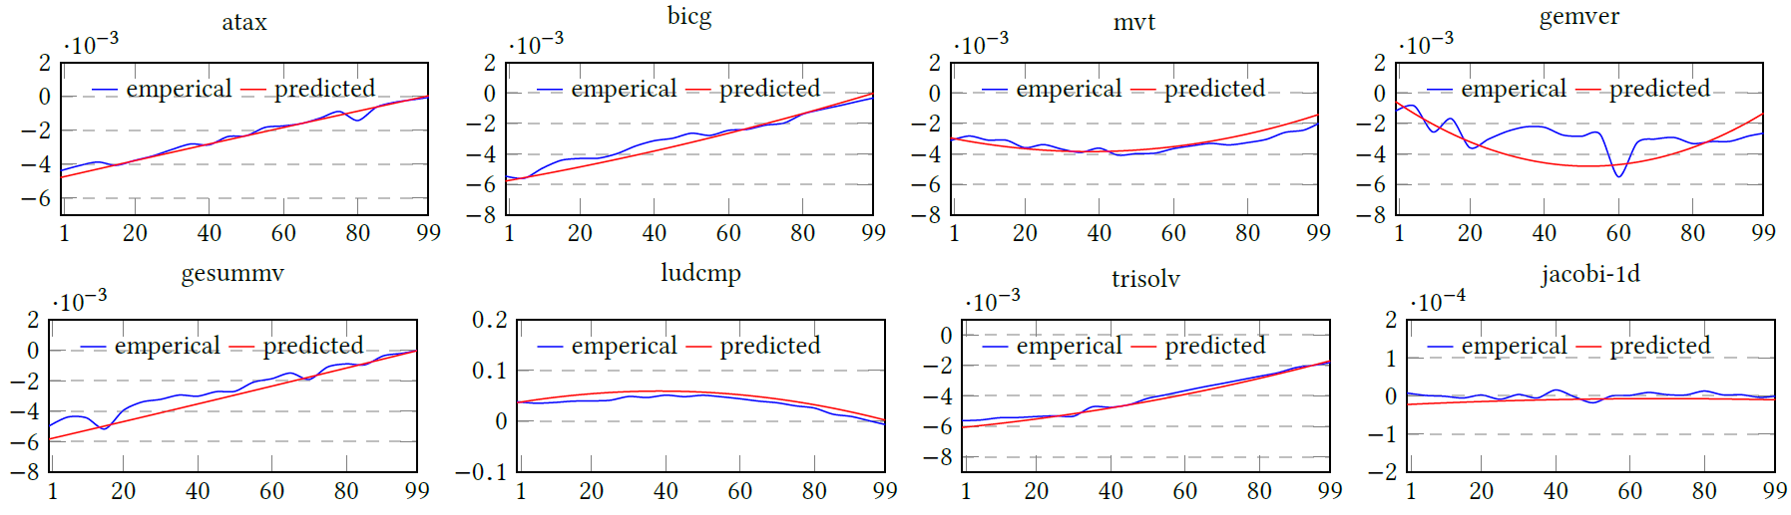
Experiments
Effects of Performance Prediction
Predicted: we let PrecTuner sample some of its generated code variants and solve the unknowns of the performance model.
Empirical: we empirically execute the mixed-precision code variants using some values of r.
Our performance model can approximate the real performance trend.
16
Notes:
Firstly, We let PrecTuner sample some of its generated code variants and solve the unknowns of the performance model. The results are then used to plot the predicted trend of performance.
Meanwhile, we empirically execute the mixed-precision code variants using some values of r. And these results are used to plot an empirical trend of performance.
As depicted in Figure, The results demonstrate that our performance model can approximate the real performance trend, even if these programs do not benefit from the reduced-precision optimization.

Slide 17
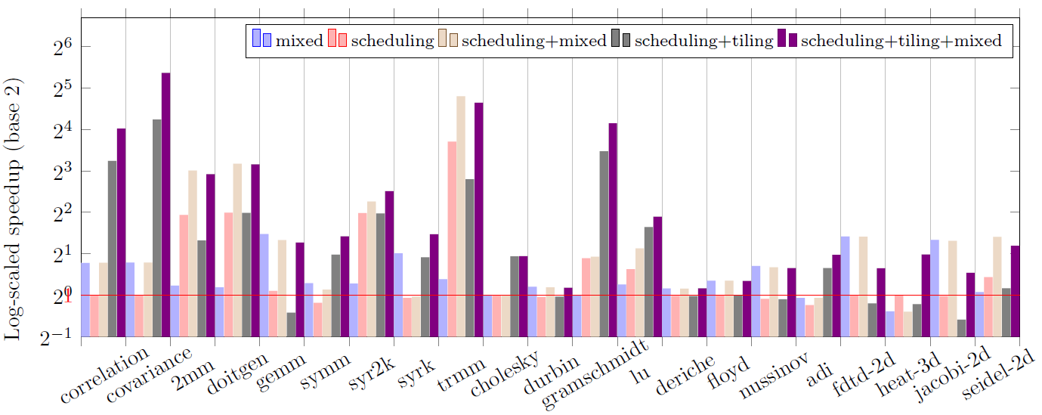
Experiments
Ablation Study of the Optimizations
The reduced-precision optimization alone enhances the performance of most programs, yielding a geometric mean speedup of 1.37×.
PrecTuner yielding a geometric mean speedup over the baseline by 2.16× and 3.68× when tiling is excluded and included, respectively.
17
Notes:
Then, we execute the 21 programs original version and record its execution time as the baseline.
Next, we use PrecTuner to transform them with only the reduced-precision optimization enabled.
The optimal value of r is predicted and then used to produce the best-performing code. This results using blue bars in the slide.
To isolate other optimizations, we transform a program by only enabling the ISL scheduler, whose results are shown in red.
Based on this version, we consider three variants, the first combining with the reduced-precision optimization, the second integrating with loop tiling, and the third considering both.
The results show that the reduced-precision optimization alone enhances the performance of most programs, yielding a geometric mean speedup of 1.37×.
PrecTuner yielding a geometric mean speedup over the baseline by 2.16× and 3.68× when tiling is excluded and included, respectively.

Slide 18
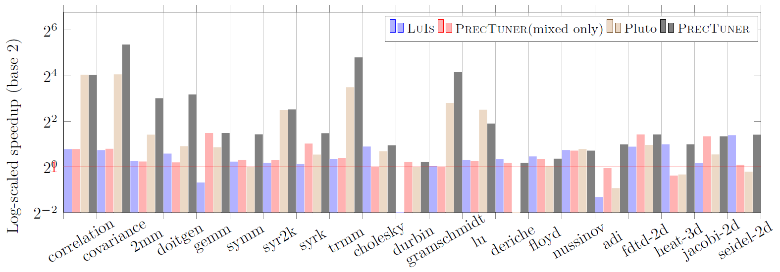
Experiments
Comparison with the State of the Art
PrecTuner obtains a mean speedup of 3.28× over LuIs. PrecTuner obtains a mean speedup of 1.81× over Pluto.
18
Notes:
Now let's turn our attention to Comparison with the State of the Art. We compares PrecTuner with LuIs, a mixed-precision autotuner that does not consider loop transformations, and pluto, which exploits parallelism and tends to perform better.
PrecTuner obtains a mean speedup of 3.28× over LuIs. Meanwhile, PrecTuner obtains a mean speedup of 1.81× over Pluto.

Slide 19
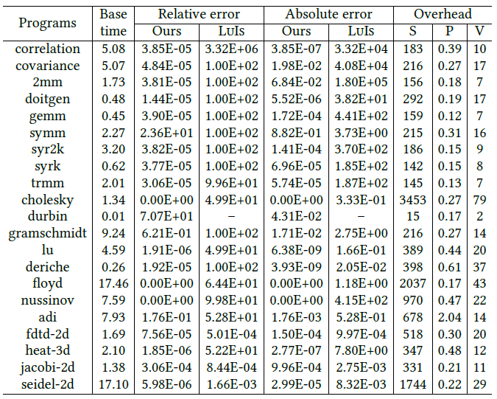
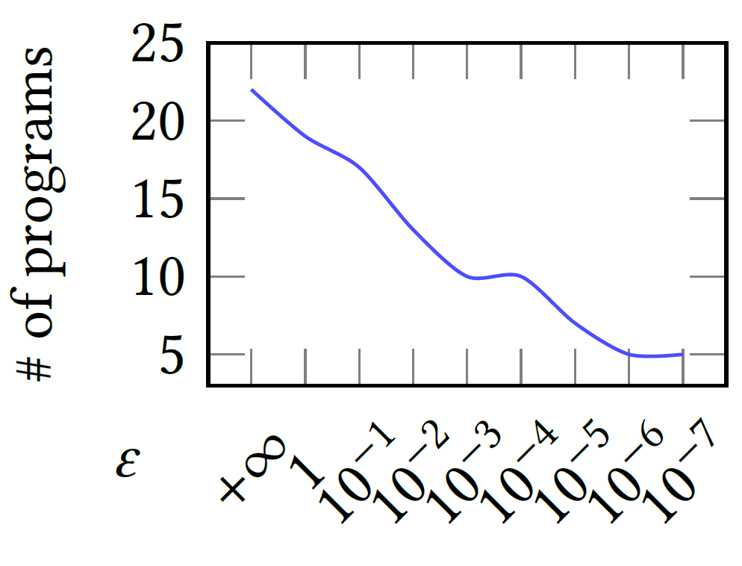
Experiments
Compatibility with Error Budgets
There always exists programs suitable for such optimization.
19
Notes:
We also report the average errors of these tools, and the tuning overhead of PrecTuner in Table on the right.
The picture on the left also depicts how the number of PolyBench programs suitable for the reduced-precision optimization varies along with the change of error budgets.
It shows that there always exists programs suitable for such an optimization.

Slide 20
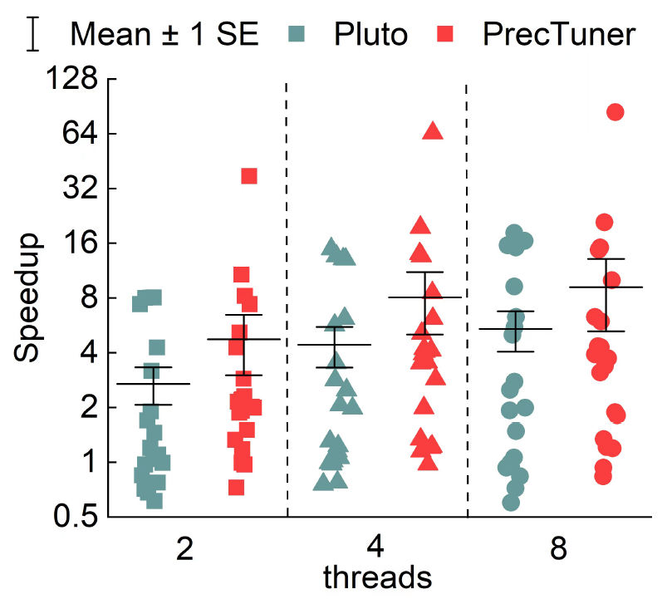
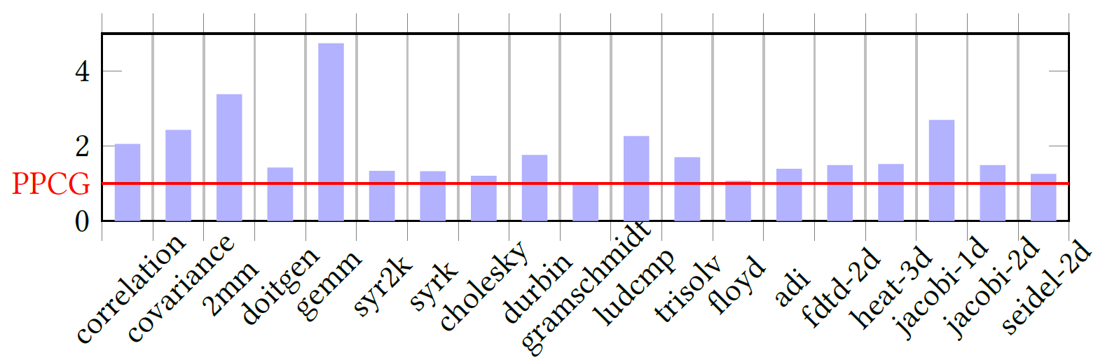
Experiments
Scalability to Parallel Execution
CPU
GPU
PrecTuner outperforms Pluto by 1.60×, 1.73×, and 1.52× under two, four, and eight threads, on average; and observes a geometric mean speedup of 1.71× over PPCG on GPU.
20
Notes:
We also evaluates the scalability of our approach to parallel execution. PrecTuner outperforms Pluto by 1.60×, 1.73×, and 1.52× under two, four, and eight threads, on average; and observes a mean geometric speedup of 1.71× over PPCG on GPU.

Slide 21
Conclusion
We present PrecTuner, a holistic, automatic approach to generate and tune mixed-precision code for affine programs.
generates mixed-precision code and predict its optimal performance, avoiding evaluate all variants.
together implements an automatic code generation and tuning framework.
integrates mixed-precision code generation with various loop transformations.
21
Notes:
In conclusion, We present PrecTuner, a holistic, automatic approach to generate and tune mixed-precision code for affine programs. It generates mixed-precision code and predict its optimal performance, avoiding evaluate all variants. It together implements an automatic code generation and tuning framework. It integrates mixed-precision code generation with various loop transformations.

Slide 22
The End
Questions? Comments?
22
Notes:
Thank you for listening. If you have any questions, I'll do my best to answer them in the time we have remaining.
- Thank you for asking that question.
- That’s a great question. Thank you for asking.
- I hope this answers your questions.
- （没听清）Sorry, I didn’t catch all of that. Could you repeat your question, please?
- （你问的应该是）If I understand you correctly, what you want to know is...
- （好问题，我不会）That’s an interesting question, but my presentation doesn’t really deal with that issue.
- （你说的是对的）Sorry, it seems that you are right. Thank you for pointing out that and I will try my best to amend it in my later work.
- （对不起，没听清楚，下面交流吧）I’m sorry. I still don’t understand your question. Could I come back to you later? I'd be glad to talk to you during the break or at the end of the session.
- （对不起，我回答不了）I'm sorry my knowledge about your question is very limited so I think I cannot give a good answer to your question.

