Slide 1
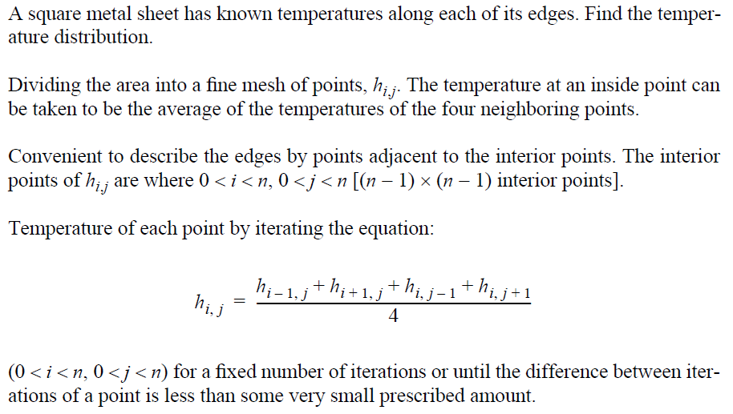
Heat Distribution (1)

Slide 2
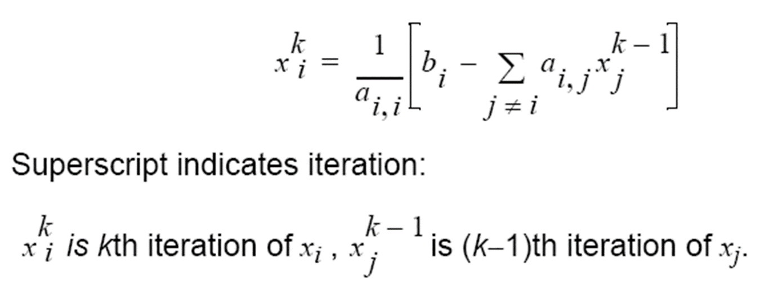
Jacobi Iteration

Slide 3
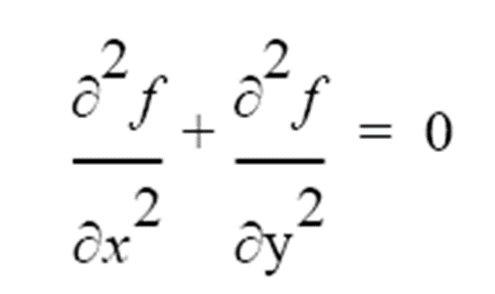
Laplace’s Equation
& Harmonic function
Solve for f over the two-dimensional x-y space.
For a computer solution, finite difference methods are appropriate
Two-dimensional solution space is “discretized” into a large number of solution points.

Slide 4
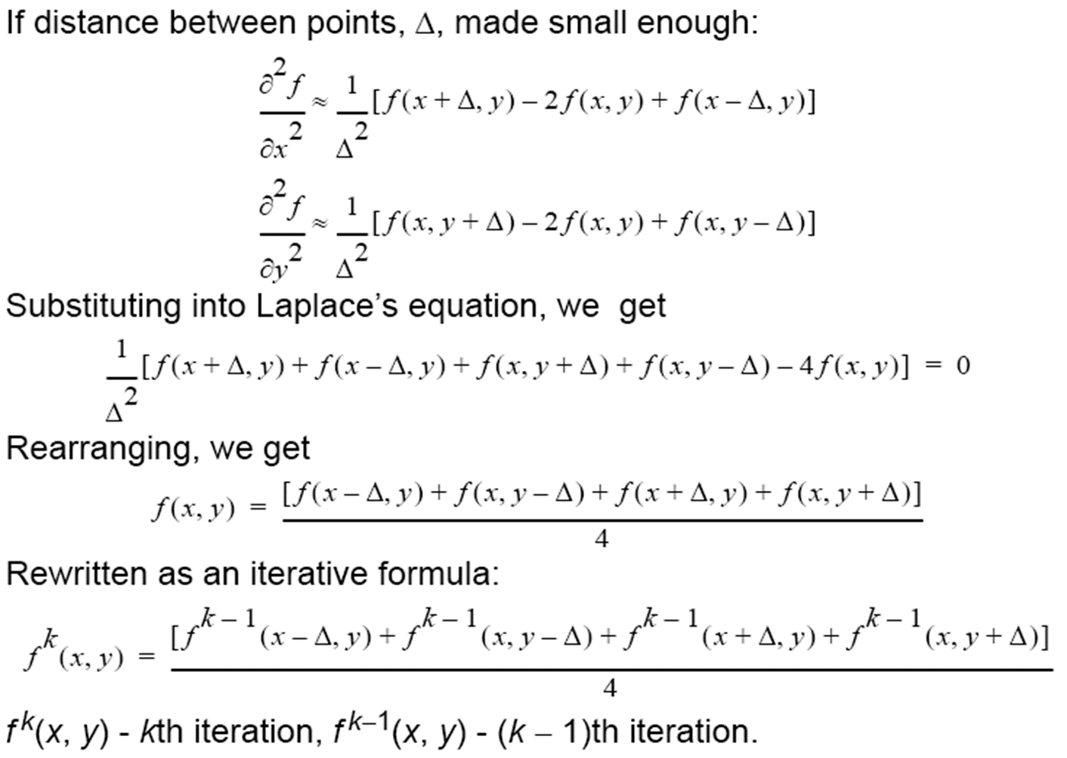
Laplace’s Equation
& Harmonic function

Slide 5
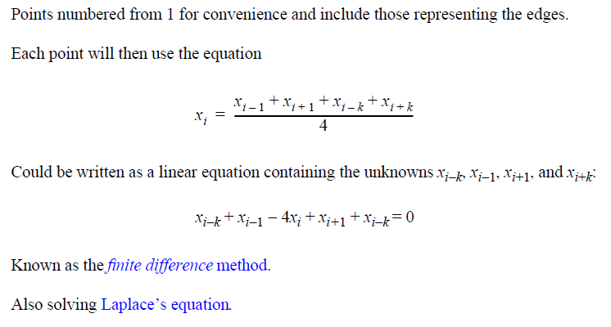
Heat Distribution (4)

Slide 6
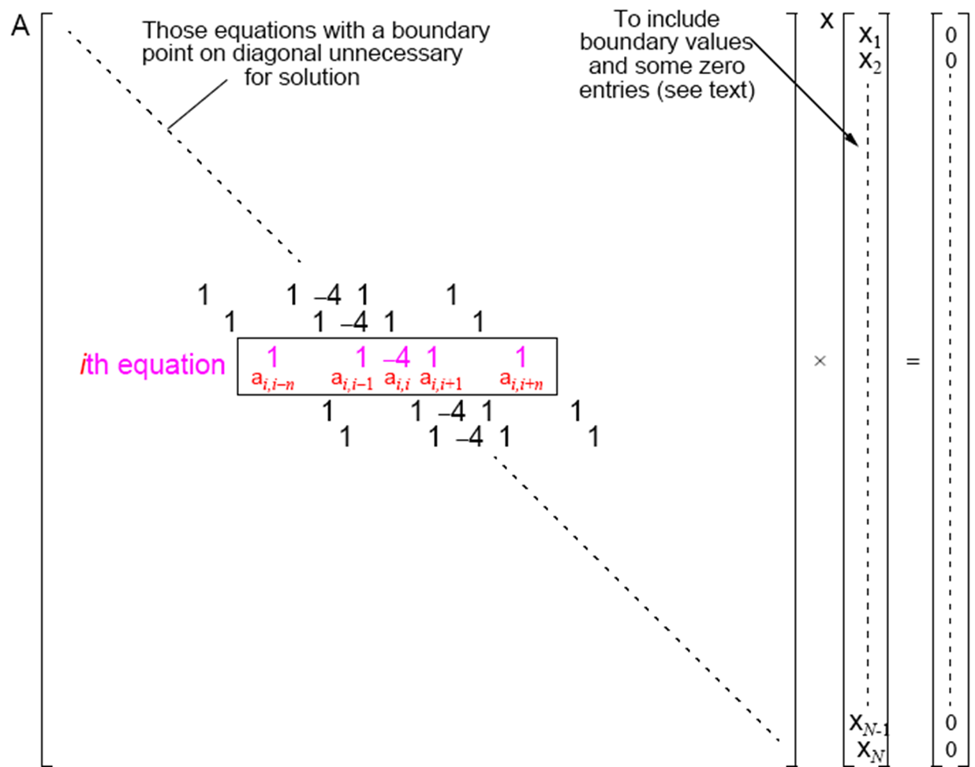
Jacobi

Slide 7
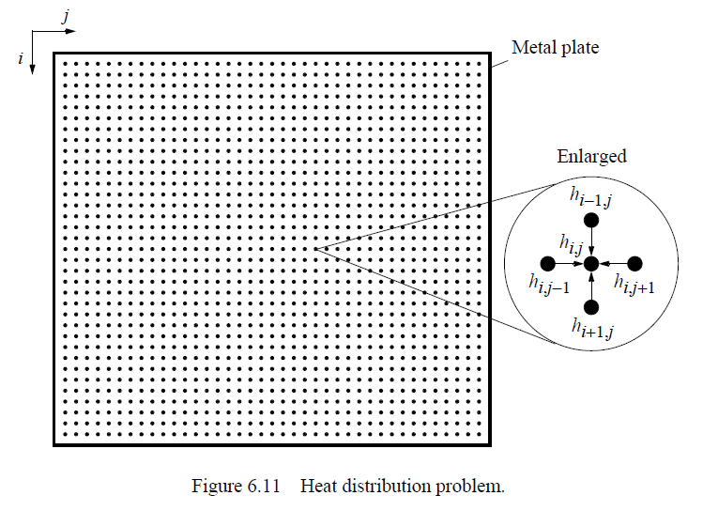
Heat Distribution (2)

Slide 8
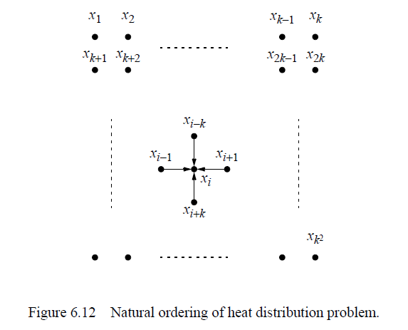
Heat Distribution (3)

Slide 9
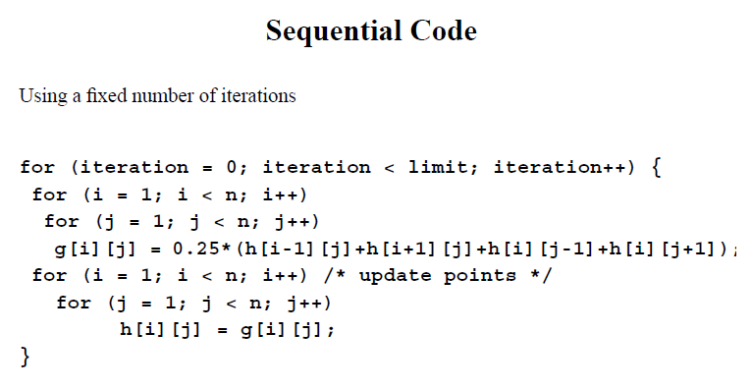
Heat Distribution (5)

Slide 10
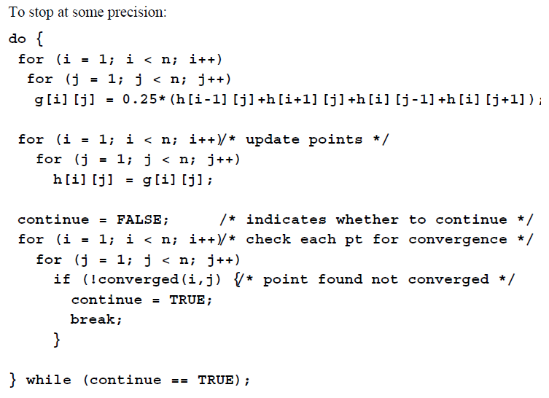
Heat Distribution (6)

Slide 11
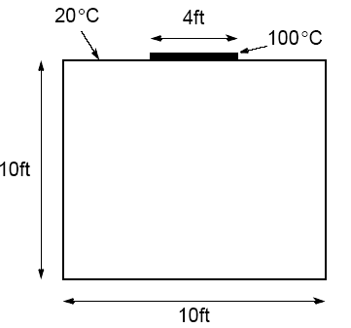
The Figure 6.19 (page 196)

Slide 12

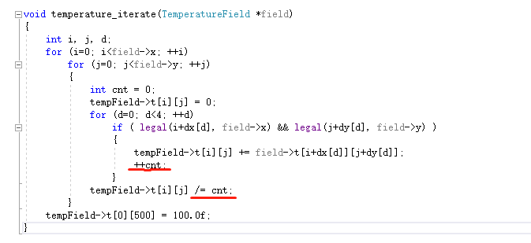
Boundary
Notes:
fireplace

Slide 13
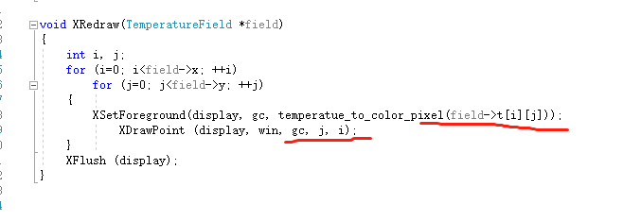
X11 Draw

Slide 14

The result

Slide 15
Suggestions
When we test our code, we should use a small figure such as “100*100”, since the big figure will cost a lot of time.

Slide 16
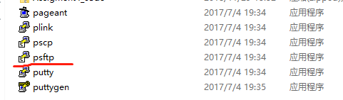
Running sequential code on cluster
Firstly, download the Assigment4_seq_code.zip from BB.
Then for windows, open “psftp”.

Slide 17
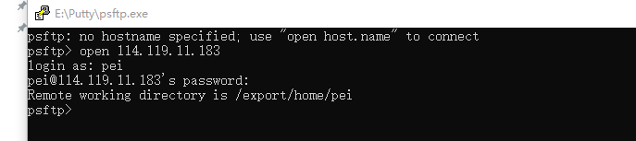
Upload files form local computer to cluster

Slide 18


Upload files form local computer to cluster

Slide 19
Upload files form local computer to cluster
For Unix or Linux

Slide 20
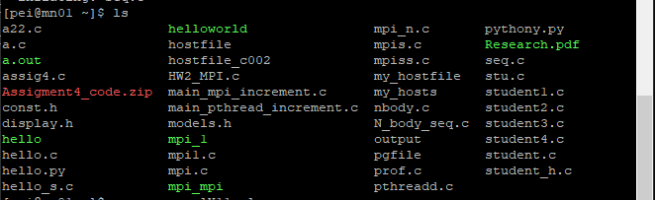
Running sequential code on cluster

Slide 21

Running sequential code on cluster

Slide 22

My result

Slide 23

Your result
For our assignment, we should modify the position of the fire source. And get the result like the following. Also, our assignment require us to plot (preferably in color) temperature contours at 5ºC intervals.

Slide 24
Your result
Because the result figure is symmetric, when we compute the temperature of one half of the figure then we also obtain the temperature of the other half part which can save a lot of time.

Slide 25

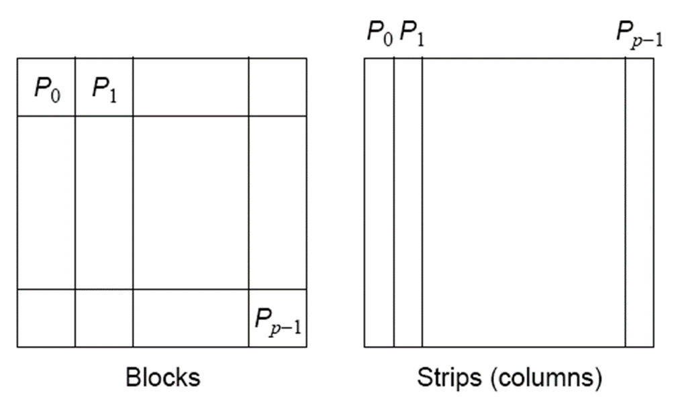
Pthread code

Slide 26
Pthread code
pthread_mutex_t *subThreadWakeUp, *subThreadFinished;
subThreadWakeUp = malloc(sizeof(pthread_mutex_t)*threads);
pthread_mutex_init();
pthread_mutex_lock();
pthread_mutex_unlock();
pthread_mutex_lock（);
pthread_mutex_unlock();

Slide 27
About cluster
Now, we can use as much as 24 cpu cores to run your MPI code.

