Slide 1
Internal Load
Out Door T
Solar

Slide 2
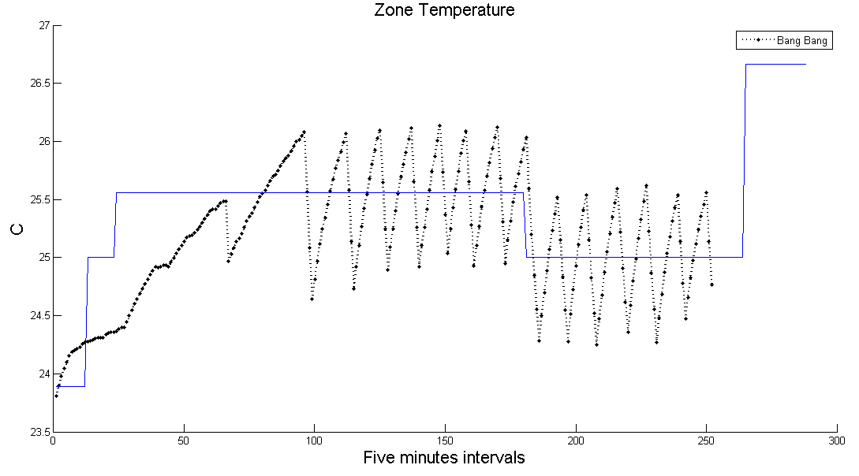
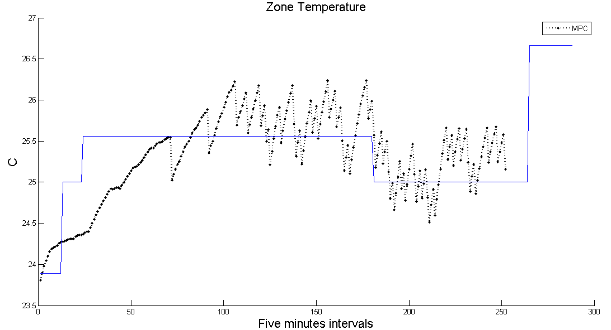

Slide 3
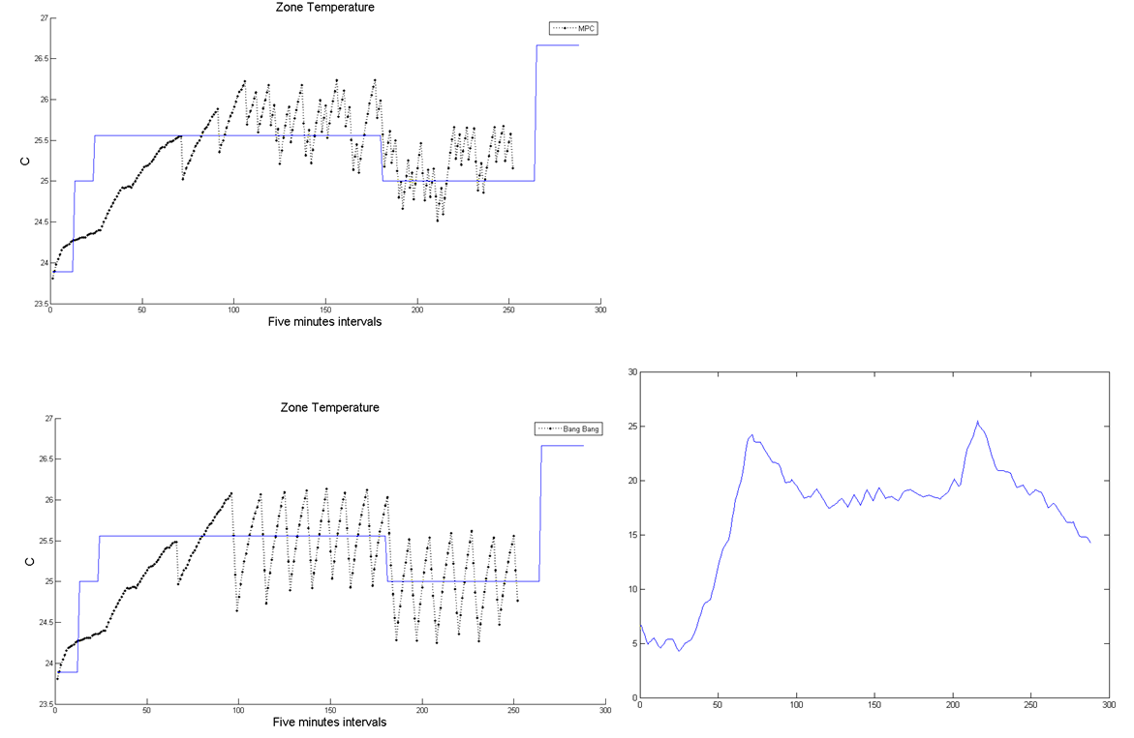
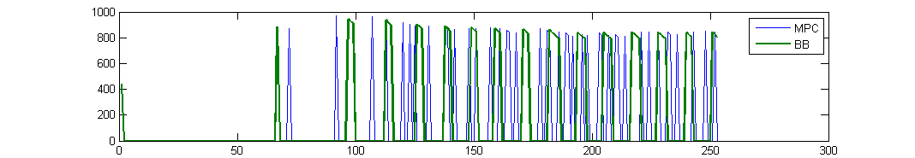
MPC Bill: 1.3838
BB Bill: 1.5443
MPC Ac Power total: 3036 w
BB Ac Power total: 3494 w

