Slide 1

Tutorial 7: Large Graph Processing I
Li, Shen
shen.li@u.nus.edu

Slide 2
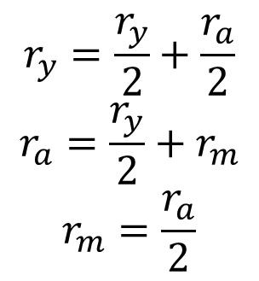
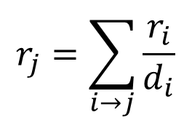
PageRank
y
a
m
A page is important if it is pointed to by other important pages
Define a rank for each page (importance score)
Can be viewed as a random walk
E.g., in page a, the user has the same possibility pick page y or page m
$$r_{y}=\frac{r_{y}}{2}+\frac{r_{a}}{2}$$
$$r_{a}=\frac{r_{y}}{2}+r_{m}$$
$$r_{m}=\frac{r_{a}}{2}$$
$$r_{j}=\sum_{i→j}{\frac{r_{i}}{d_{i}}}$$
Notes:
During the random walk, the importance is flowed from one to another.

Slide 3
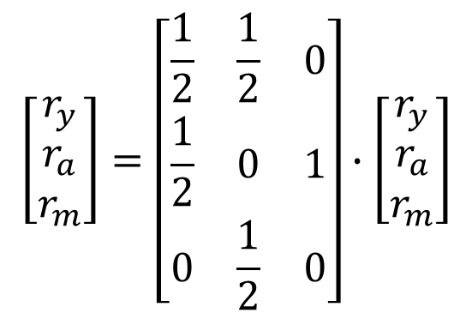
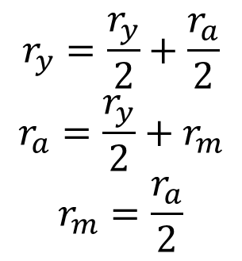
y
a
m
$$\left[\begin{aligned}r_{y} \\ r_{a} \\ r_{m}\end{aligned}\right]=\left[\begin{matrix}\frac{1}{2} & \frac{1}{2} & 0 \\ \frac{1}{2} & 0 & 1 \\ 0 & \frac{1}{2} & 0\end{matrix}\right]∙\left[\begin{aligned}r_{y} \\ r_{a} \\ r_{m}\end{aligned}\right]$$
$$r_{y}=\frac{r_{y}}{2}+\frac{r_{a}}{2}$$
$$r_{a}=\frac{r_{y}}{2}+r_{m}$$
$$r_{m}=\frac{r_{a}}{2}$$

Slide 4
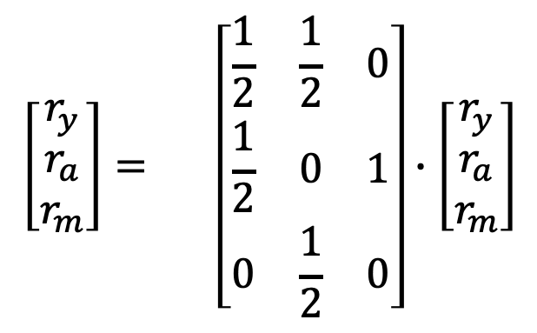
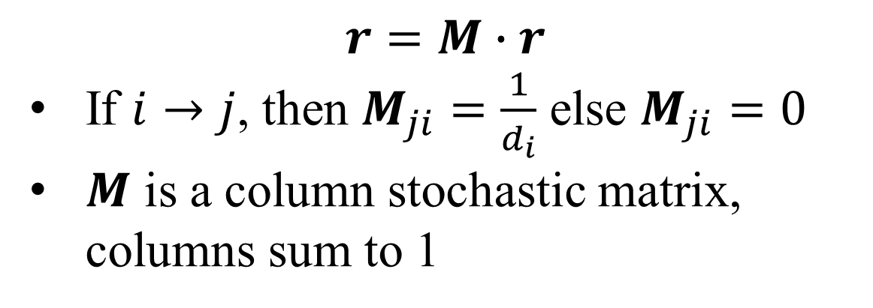
y
a
m
Starting point
End point
$$\left[\begin{aligned}r_{y} \\ r_{a} \\ r_{m}\end{aligned}\right]= \left[\begin{matrix}\frac{1}{2} & \frac{1}{2} & 0 \\ \frac{1}{2} & 0 & 1 \\ 0 & \frac{1}{2} & 0\end{matrix}\right]∙\left[\begin{aligned}r_{y} \\ r_{a} \\ r_{m}\end{aligned}\right]$$
y
y
The denominator is the out-degree of starting points.
a
a
m
m
$$r=M∙r$$
If $i→j$, then $M_{ji}=\frac{1}{d_{i}}$ else $M_{ji}=0$
$M$ is a column stochastic matrix, columns sum to 1

Slide 5
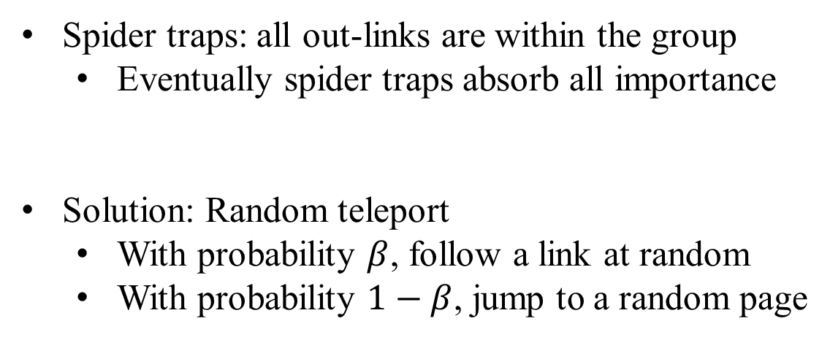
y
a
m
Spider traps: all out-links are within the group
Eventually spider traps absorb all importance
Solution: Random teleport
With probability $β$, follow a link at random
With probability $1−β$, jump to a random page

Slide 6
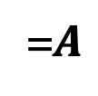
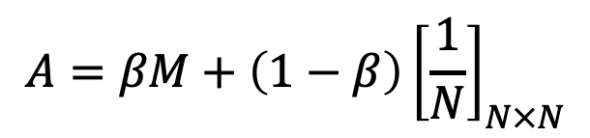


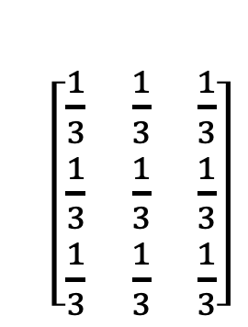
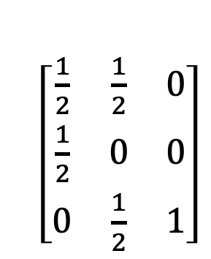

y
a
m
$$A=βM+\left(1−β\right){\left[\frac{1}{N}\right]}_{N×N}$$
y
a
m
y
a
m
$\left[\begin{matrix}\frac{1}{2} & \frac{1}{2} & 0 \\ \frac{1}{2} & 0 & 0 \\ 0 & \frac{1}{2} & 1\end{matrix}\right]$
$\left[\begin{matrix}\frac{1}{3} & \frac{1}{3} & \frac{1}{3} \\ \frac{1}{3} & \frac{1}{3} & \frac{1}{3} \\ \frac{1}{3} & \frac{1}{3} & \frac{1}{3}\end{matrix}\right]$
y
y
$$β×$$
a
$$+(1−β)×$$
a
=$A$
m
m
$$r=A∙r$$
det(A-I) = 0
Indeterminacy: (A-I)r = 0 has multiple solutions
Additional constraint: r1 + r2 + … + rn = const
Notes:
Random jump even though there is no link

Slide 7
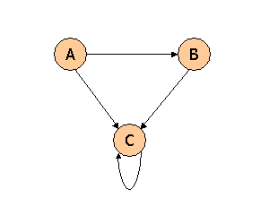
Problem 1
Consider three Web pages with the following links:
Suppose we compute PageRank with a β of 0.7, and we introduce the additional constraint that the sum of the PageRanks of the three pages must be 3, to handle the problem that otherwise any multiple of a solution will also be a solution. Compute the PageRanks a, b, and c of the three pages A, B, and C, respectively.

Slide 8
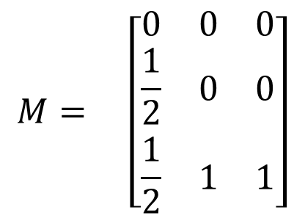
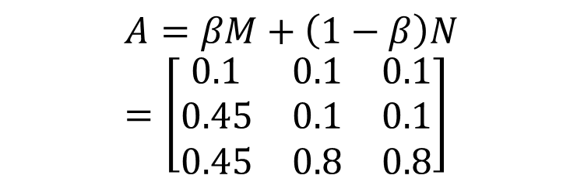
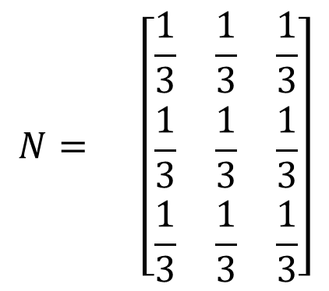
Solution 1
A
B
C
A
B
C
$$N= \left[\begin{matrix}\frac{1}{3} & \frac{1}{3} & \frac{1}{3} \\ \frac{1}{3} & \frac{1}{3} & \frac{1}{3} \\ \frac{1}{3} & \frac{1}{3} & \frac{1}{3}\end{matrix}\right]$$
A
A
$$M= \left[\begin{matrix}0 & 0 & 0 \\ \frac{1}{2} & 0 & 0 \\ \frac{1}{2} & 1 & 1\end{matrix}\right]$$
B
B
C
C
$$A=βM+\left(1−β\right)N=\left[\begin{matrix}0.1 & 0.1 & 0.1 \\ 0.45 & 0.1 & 0.1 \\ 0.45 & 0.8 & 0.8\end{matrix}\right]$$

Slide 9
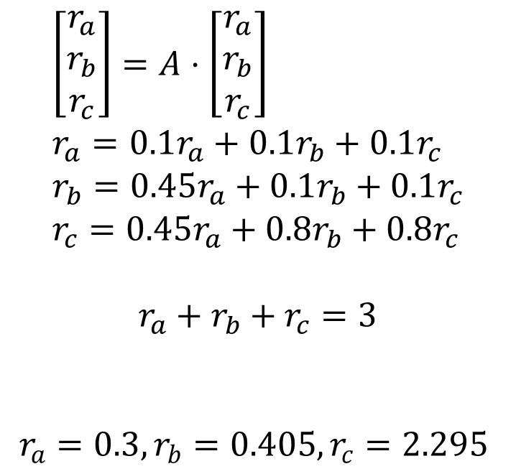
Solution 1
$$\left[\begin{matrix}r_{a} \\ r_{b} \\ r_{c}\end{matrix}\right]=A⋅\left[\begin{matrix}r_{a} \\ r_{b} \\ r_{c}\end{matrix}\right] \\ r_{a}=0.1r_{a}+0.1r_{b}+0.1r_{c} \\ r_{b}=0.45r_{a}+0.1r_{b}+0.1r_{c} \\ r_{c}=0.45r_{a}+0.8r_{b}+0.8r_{c}$$
$$r_{a}+r_{b}+r_{c}=3$$
$r_{a}=0.3, r_{b}=0.405, r_{c}=2.295$

Slide 10
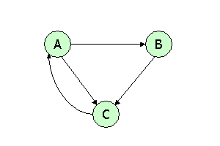
Problem 2
Consider three Web pages with the following links:
Suppose we compute PageRank with β=0.85. Write the equations for the PageRanks a, b, and c of the three pages A, B, and C, respectively.

Slide 11
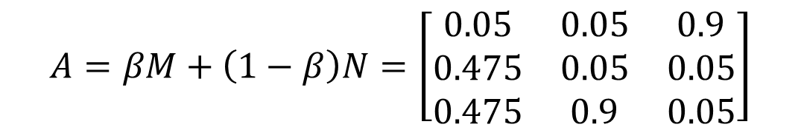
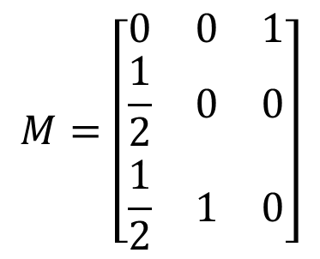
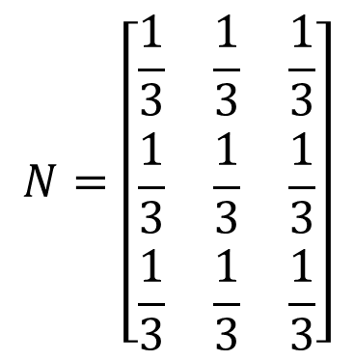
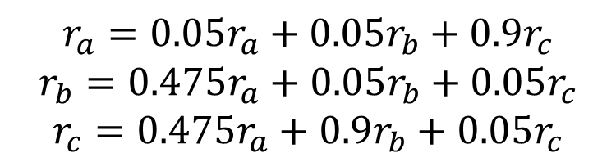
Solution 2
$$N=\left[\begin{matrix}\frac{1}{3} & \frac{1}{3} & \frac{1}{3} \\ \frac{1}{3} & \frac{1}{3} & \frac{1}{3} \\ \frac{1}{3} & \frac{1}{3} & \frac{1}{3}\end{matrix}\right]$$
$$M=\left[\begin{matrix}0 & 0 & 1 \\ \frac{1}{2} & 0 & 0 \\ \frac{1}{2} & 1 & 0\end{matrix}\right]$$
$$A=βM+\left(1−β\right)N=\left[\begin{matrix}0.05 & 0.05 & 0.9 \\ 0.475 & 0.05 & 0.05 \\ 0.475 & 0.9 & 0.05\end{matrix}\right]$$
$$r_{a}=0.05r_{a}+0.05r_{b}+0.9r_{c}$$
$$r_{b}=0.475r_{a}+0.05r_{b}+0.05r_{c}$$
$$r_{c}=0.475r_{a}+0.9r_{b}+0.05r_{c}$$

Slide 12

Topic-specific PageRank
Evaluate pages not just according to their popularity, but by how close they are to a particular topic.
Given a set S
S contains only pages that are relevant to the topic
Each page can only teleport to the page in the teleport set S
If $i∈S$, $A_{ij}=βM_{ij}+\left(1−β\right)/\left|S\right|$
Otherwise $A_{ij}=βM_{ij}$
Replace the uniform matrix with 1/|S|.

Slide 13
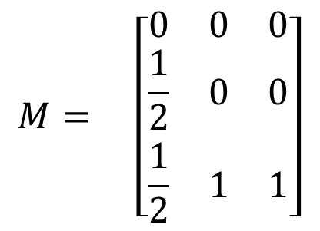

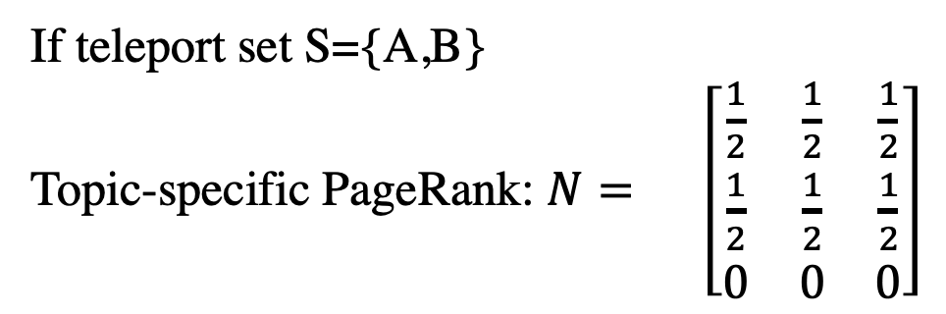

$$M= \left[\begin{matrix}0 & 0 & 0 \\ \frac{1}{2} & 0 & 0 \\ \frac{1}{2} & 1 & 1\end{matrix}\right]$$
Standard PageRank: $N= \left[\begin{matrix}\frac{1}{3} & \frac{1}{3} & \frac{1}{3} \\ \frac{1}{3} & \frac{1}{3} & \frac{1}{3} \\ \frac{1}{3} & \frac{1}{3} & \frac{1}{3}\end{matrix}\right]$
A
B
C
If teleport set S={A,B}
Topic-specific PageRank: $N= \left[\begin{matrix}\frac{1}{2} & \frac{1}{2} & \frac{1}{2} \\ \frac{1}{2} & \frac{1}{2} & \frac{1}{2} \\ 0 & 0 & 0\end{matrix}\right]$
A
B
C
$$A=βM+\left(1−β\right)N$$

Slide 14
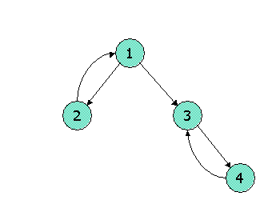
Problem 3
Consider the following link topology.
Compute the Topic-Specific PageRank for the following link topology. Assume that pages selected for the teleport set are nodes 1 and 2 and that in the teleport set, the weight assigned for node 1 is twice that of node 2. Assume further that the teleport probability, (1 - beta), is 0.3.
 | Any points
1 | 2/3
2 | 1/3

Slide 15
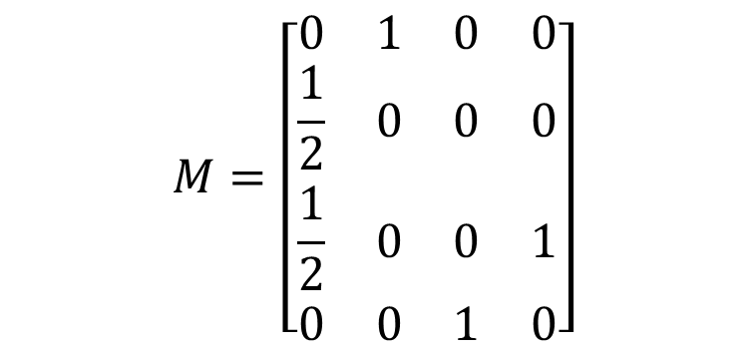
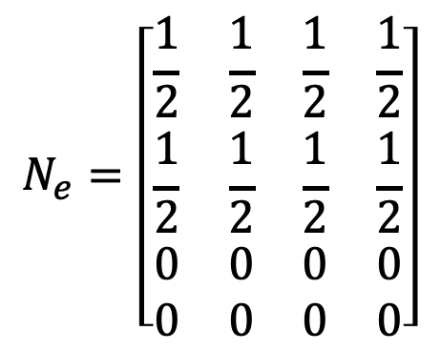
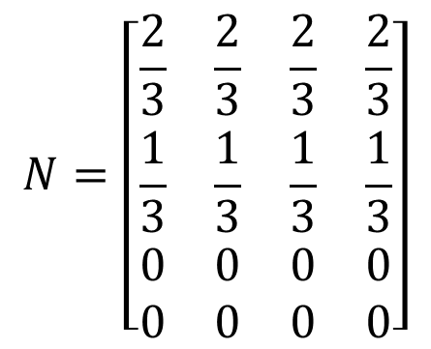
Solution 3
$$M=\left[\begin{matrix}0 & 1 & 0 & 0 \\ \frac{1}{2} & 0 & 0 & 0 \\ \frac{1}{2} & 0 & 0 & 1 \\ 0 & 0 & 1 & 0\end{matrix}\right]$$
$$N_{e}=\left[\begin{matrix}\frac{1}{2} & \frac{1}{2} & \frac{1}{2} & \frac{1}{2} \\ \frac{1}{2} & \frac{1}{2} & \frac{1}{2} & \frac{1}{2} \\ 0 & 0 & 0 & 0 \\ 0 & 0 & 0 & 0\end{matrix}\right]$$
$$N=\left[\begin{matrix}\frac{2}{3} & \frac{2}{3} & \frac{2}{3} & \frac{2}{3} \\ \frac{1}{3} & \frac{1}{3} & \frac{1}{3} & \frac{1}{3} \\ 0 & 0 & 0 & 0 \\ 0 & 0 & 0 & 0\end{matrix}\right]$$

Slide 16
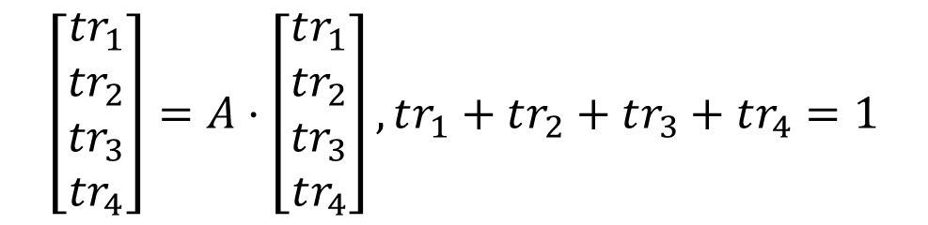
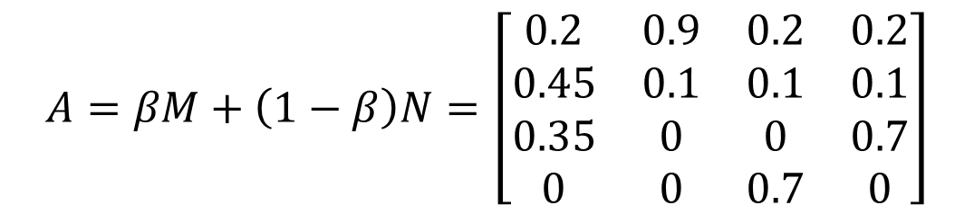
Solution 3
$$A=βM+\left(1−β\right)N=\left[\begin{matrix}0.2 & 0.9 & 0.2 & 0.2 \\ 0.45 & 0.1 & 0.1 & 0.1 \\ 0.35 & 0 & 0 & 0.7 \\ 0 & 0 & 0.7 & 0\end{matrix}\right]$$
$$\left[\begin{matrix}{tr}_{1} \\ {tr}_{2} \\ {tr}_{3} \\ {tr}_{4}\end{matrix}\right]=A⋅\left[\begin{matrix}tr_{1} \\ {tr}_{2} \\ {tr}_{3} \\ tr_{4}\end{matrix}\right], tr_{1}+tr_{2}+tr_{3}+tr_{4}=1$$
$tr_{1}=0.3576, tr_{2}=0.2252,tr_{3}=0.2454,tr_{4}=0.1718$

