Slide 1

Tutorial 8: Large Graph Processing II
Li, Shen
shen.li@u.nus.edu

Slide 2
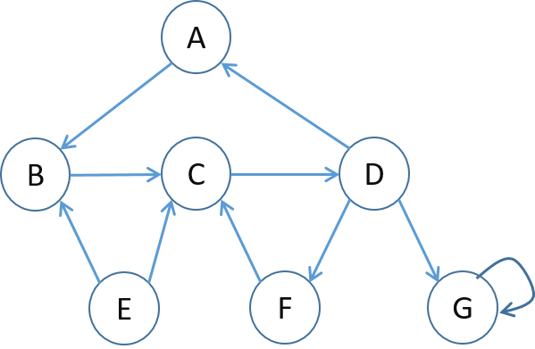
Problem 1
1. Given the following graph,
1) how many dead ends are there in the graph? For each dead end (if any), please indicate the set of vertices forming the dead end.
2) how many spider traps are there in the graph? For each spider trap (if any), please indicate the set of vertices forming the spider trap.
Notes:
Spider trap cannot be the whole graph

Slide 3
2 problems:
(1) Some pages are dead ends (have no out-links)
Random walk has “nowhere” to go to
Such pages cause importance to “leak out”
(2) Spider traps: (all out-links are within the group)
Random walked gets “stuck” in a trap
And eventually spider traps absorb all importance
Dead end
Spider trap
Notes:
What are the problems?
One phenomena is called dead end. There may be some dead ends (which do not have out-links)… → importance leak out.
The other phenomena is called spider trap. All outgoing links are within the group. Thus, eventually, spider traps absorb all importance.

Slide 4
Solution 1
No dead ends

Slide 5
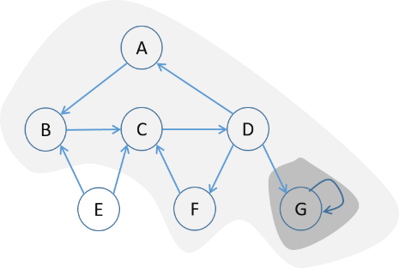
Solution 1
No dead ends
Two spider traps

Slide 6
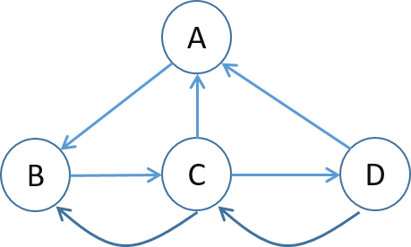
Problem 2
Set up the PageRank equations for the below graph, assuming β = 0.8 (jump probability = 1−β). Denote the PageRank of node x by r(x).

Slide 7
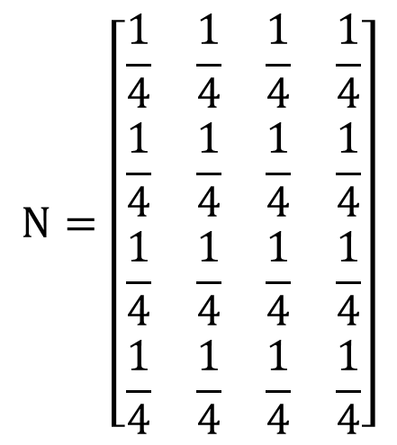
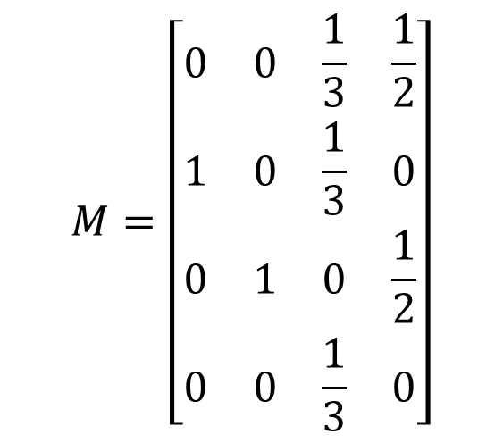
Solution 2
$$M=\left[\begin{matrix}0 & 0 & \frac{1}{3} & \frac{1}{2} \\ 1 & 0 & \frac{1}{3} & 0 \\ 0 & 1 & 0 & \frac{1}{2} \\ 0 & 0 & \frac{1}{3} & 0\end{matrix}\right]$$
$$N=\left[\begin{matrix}\frac{1}{4} & \frac{1}{4} & \frac{1}{4} & \frac{1}{4} \\ \frac{1}{4} & \frac{1}{4} & \frac{1}{4} & \frac{1}{4} \\ \frac{1}{4} & \frac{1}{4} & \frac{1}{4} & \frac{1}{4} \\ \frac{1}{4} & \frac{1}{4} & \frac{1}{4} & \frac{1}{4}\end{matrix}\right]$$

Slide 8
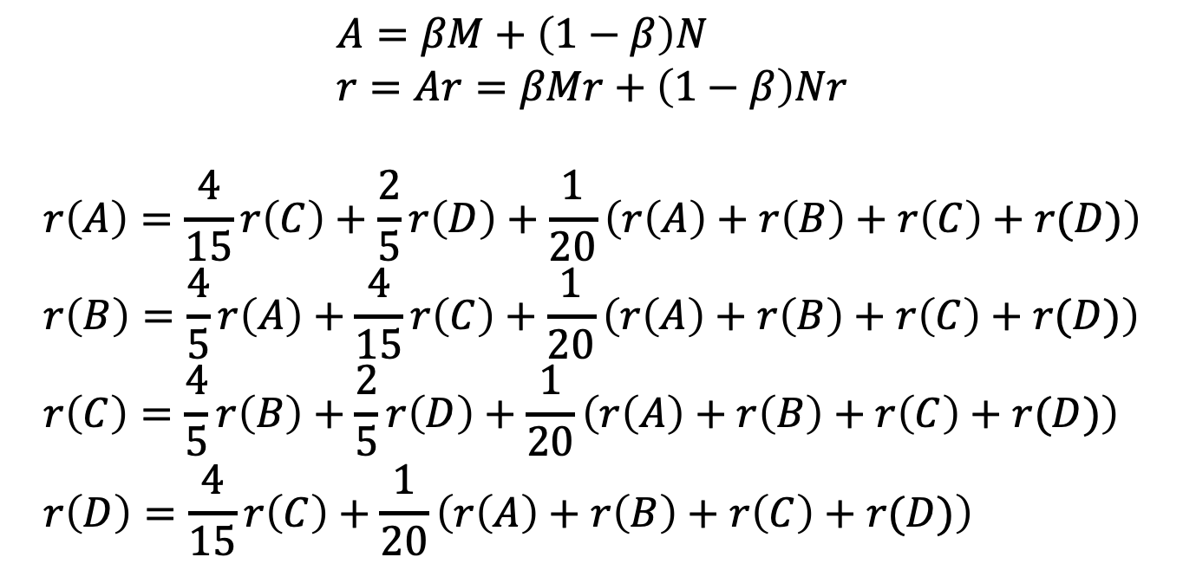
Solution 2
$$A=βM+\left(1−β\right)N \\ r=Ar=βMr+\left(1−β\right)Nr$$
$$r\left(A\right)=\frac{4}{15}r\left(C\right)+\frac{2}{5}r\left(D\right)+\frac{1}{20}\left(r\left(A\right)+r\left(B\right)+r\left(C\right)+r(D)\right) \\ r\left(B\right)=\frac{4}{5}r\left(A\right)+\frac{4}{15}r\left(C\right)+\frac{1}{20}\left(r\left(A\right)+r\left(B\right)+r\left(C\right)+r(D)\right) \\ r\left(C\right)=\frac{4}{5}r\left(B\right)+\frac{2}{5}r\left(D\right)+\frac{1}{20}\left(r\left(A\right)+r\left(B\right)+r\left(C\right)+r(D)\right) \\ r\left(D\right)=\frac{4}{15}r\left(C\right)+\frac{1}{20}\left(r\left(A\right)+r\left(B\right)+r\left(C\right)+r(D)\right)$$

Slide 9
Thanks! Q & A
Li, Shen
shen.li@u.nus.edu

