Slide 1


http://www.comp.nus.edu.sg/~cs2100/
Welcome
(AY2019/20 Semester 2)

Slide 2
Welcome to CS2100
Lecturers
Course Materials
Course Description
Assessments
Textbooks
Admin Matters

Slide 3
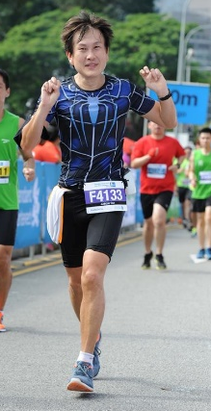
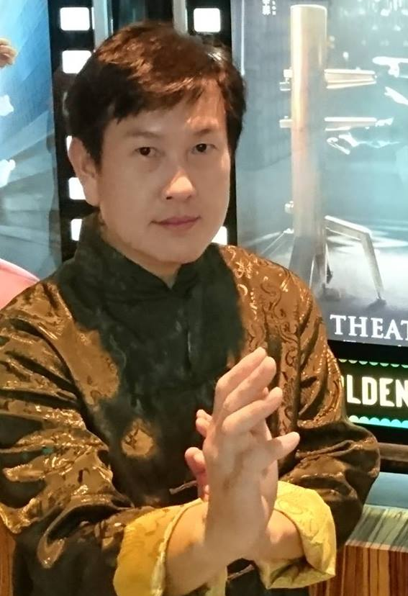
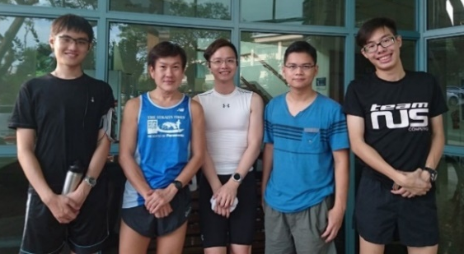
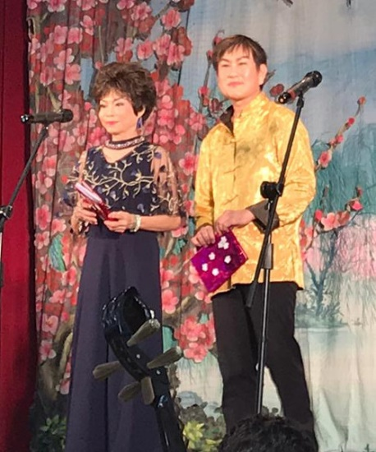
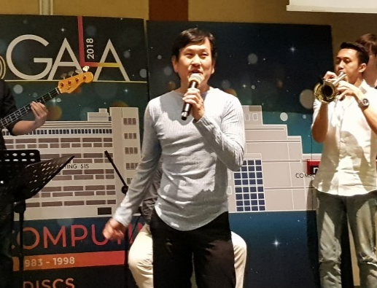
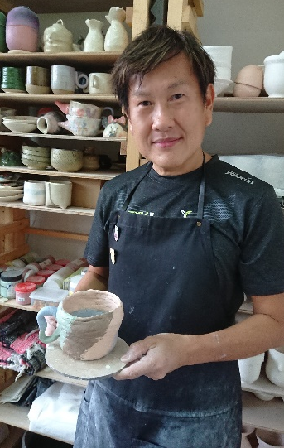
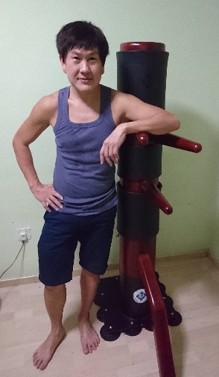
1. Lecturers
Cantonese opera
Running
Weekly group run with students. You’re welcome to join us!
Check out facebook.
A/P Tan Tuck Choy, Aaron
Office: COM1-03-12
Email: tantc@comp.nus.edu.sg
Singing
Pottery
Wing Chun
Admin appointment:
Assistant Dean (Undergraduate Studies)
SoC Gala Dinner 2018

Slide 4
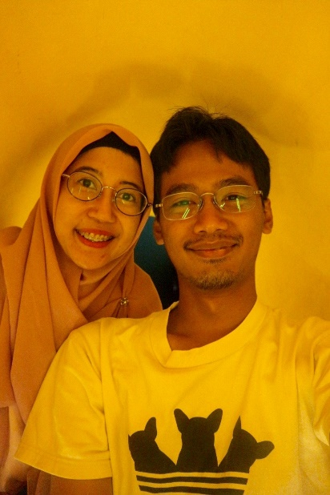
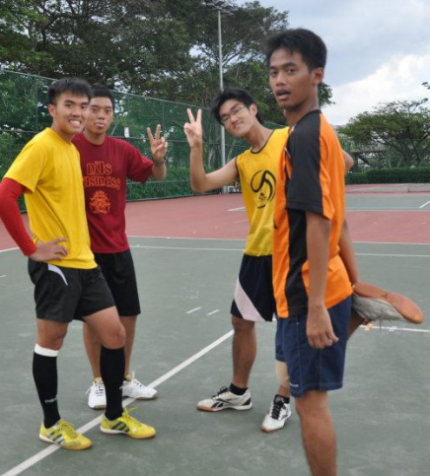
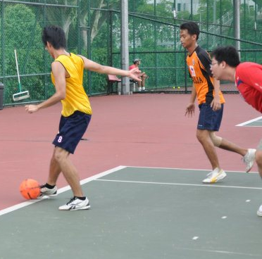
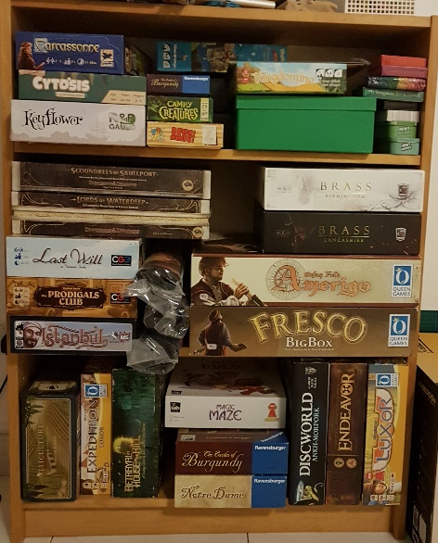
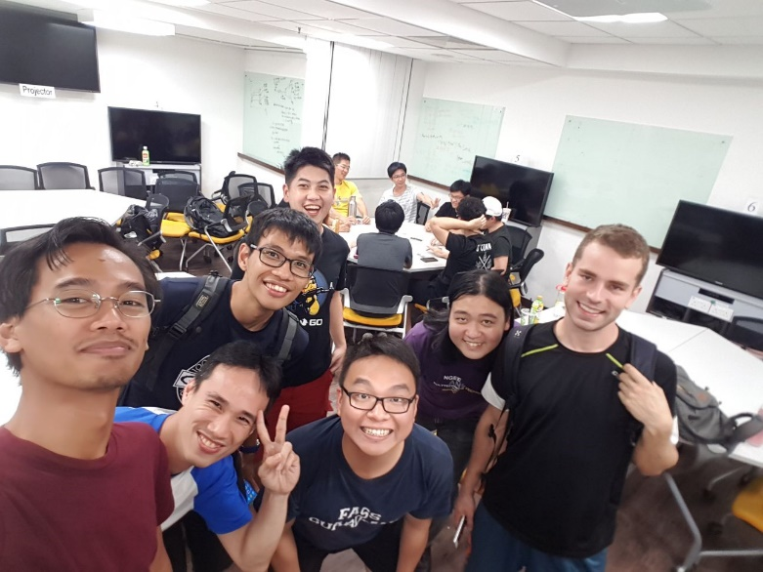
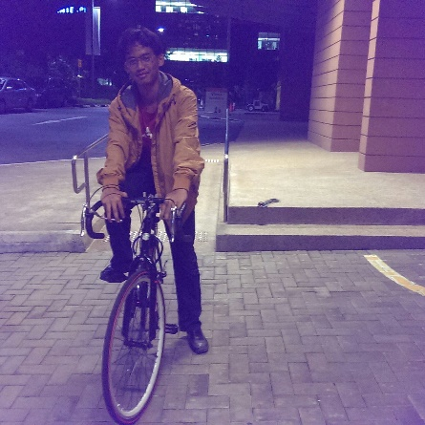
1. Lecturers
Soccer
Board Games
Adi Yoga Sidi Prabawa
Office: COM2-02-55
Email: dcsaysp@nus.edu.sg
Cycling
My shelfie showing partial collections
NUS Board Game Club (every Friday & Saturday @ YIH or E4-04-04)

Slide 5
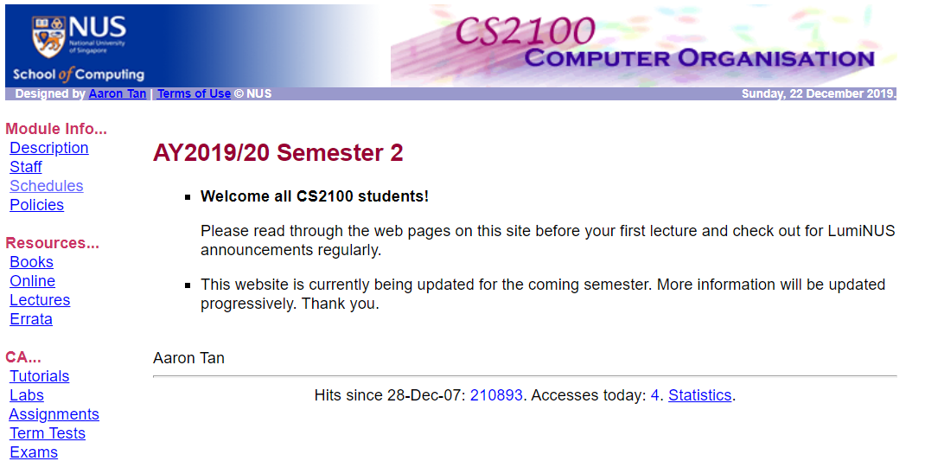
2. Course Materials
CS2100 website
https://www.comp.nus.edu.sg/~cs2100
LumiNUS
https://luminus.nus.edu.sg

Slide 6
3. Course Description (1/3)
The objective of this module is to familiarise students with the fundamentals of computing devices
The basics of data representation
How the various parts of a computer work, separately and with each other
Topics
C programming language
Data representation and number systems
Assembly language
Processor datapath and control
Pipelining
Cache
Combinational and sequential circuit design

Slide 7
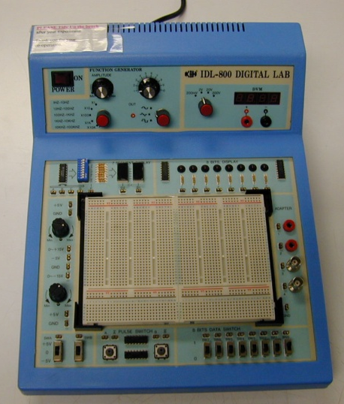
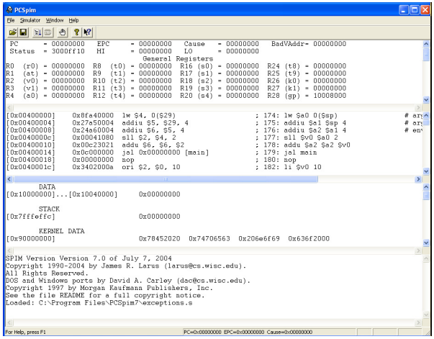
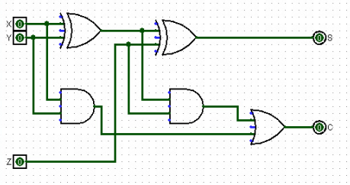
3. Course Description (2/3)
Practical aspects
C debugger
QTSpim software
Logic design experiments
Logisim software

Slide 8
3. Course Description (3/3)
Quotes
“What I hear, I forget. What I see, I remember. What I do, I understand”
– Chinese Proverb 不闻不若闻之，闻之不若见之，见之不若知之，知之不若行之；学至于行之而止矣。 – 《荀子·儒效》
“The important thing is to understand what you are doing, rather than to get the right answer” – Tom Lehrer

Slide 9
4. Assessments
CA component | Weightage
Tutorial attendance | 5%
Assignments (3 or 4) | 12%
Labs | 13%
Mid-term test * | 20%
Final exam * | 50%
* Closed book; one A4 double-sided reference sheet allowed.

Slide 10
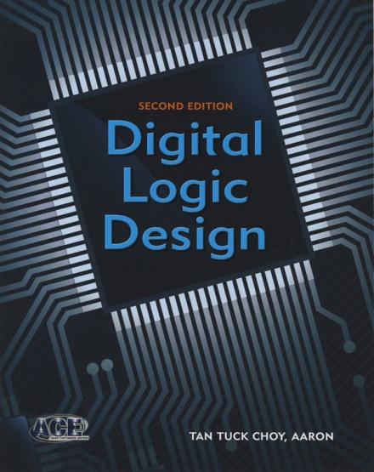
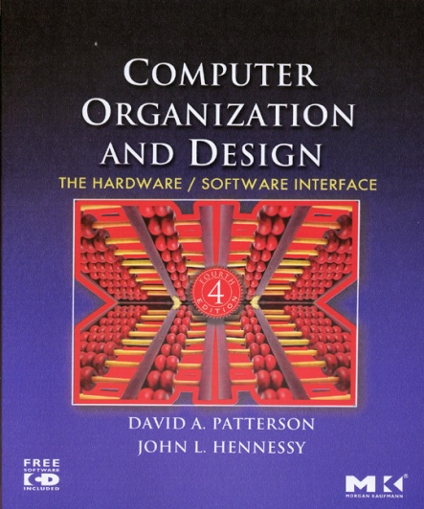
5. Textbooks
Digital Logic Design (DLD) 2nd edition by Aaron Tan McGraw-Hill
Book + ebook bundle (include errata sheet)
Please refer to CS2100 website “Errata” page for errors in the book.
Computer Organization and Design (COD), 4th edition by David A. Patterson and John L. Hennessy, 4th ed, Elsevier

Slide 11
6. Admin Matters (1/3)
Lectures are webcast
All course materials (lecture slides, tutorial questions, lab questions, etc.) will be uploaded on LumiNUS and the CS2100 website week by week
You are encouraged to use LumiNUS Forum for queries/discussion.
Everybody can help answer and everybody can read the answers
Email me at tantc @ comp.nus.edu.sg only for personal matters
Tutorial attendance
Every week, tutorial attendance for that week will be released on LumiNUS.
You are given a week from the release to inform your respective tutor of any discrepancy in that week’s records.
Thereafter, NO changes will be made to the attendance records.
You may pass your medical certificate or excuse letter to your tutor.

Slide 12
6. Admin Matters (2/3)
Week 3
No lecture on 27 January; watch webcast on Tuesday’s lecture
No labs in week 3; labs will start in week 4 (3rd Feb).
Monday tutorial groups: do make-up tutorial or join other groups.
Mid-term test
Week 8: 11 March 2019, Wednesday, 6 – 8pm
Mark this down!
Do not arrange activity on that day/time
If there is a clash with other midterm test, please inform the other module’s coordinator to make alternative arrangement
If all else fails, email me (tantc@comp.nus.edu.sg) (in advance!)

Slide 13
6. Admin Matters (3/3)
Appeals
Teaching staff are not allowed to add students into the module, add students into a tutorial/lab group, or change tutorial/lab group for students, etc.
Students have to submit appeal through the system.
Tutorial/Lab Registration
Please submit appeal through registration system – do NOT email me.
If your allocation is not settled by week 3, please attend ANY tutorial group in week 3.
Note that labs start in week 4.
Once you are assigned a group, please stick with it.
If you need to join a different group just for that week, please obtain permission from me in advance.

Slide 14
End of File

