Slide 1


http://www.comp.nus.edu.sg/~cs2100/
Lecture #6
C for Hardware Programming

Slide 2
Lecture #6: C for Hardware Programming
Overview and Motivation
Hardware Programming: Concerns
C and Hardware Programming
Code Compilation Process
Debugging – GDB

Slide 3
1. Overview and Motivation
C is a high-level language which is widely used to program microcontrollers and single board computers
Capability to address hardware memory locations
Capability to address hardware enhancements by the vendor
Another extension of the C language to support certain exclusive features required in embedded systems is Embedded C
Here, we briefly introduce C based hardware programming and not embedded C

Slide 4
2. Hardware Programming: Concerns
Code speed
Timing constraints
Slow processor compared to desktop processors
Code size
Limited memory
Programming methods
Machine code (0,1)
High difficulty
Almost no readability
Assembly language (ADD, SLL, etc.)
Low readability
Difficult in large projects
C
Fairly efficient
High readability
High speed, low size
Suitable for large projects

Slide 5
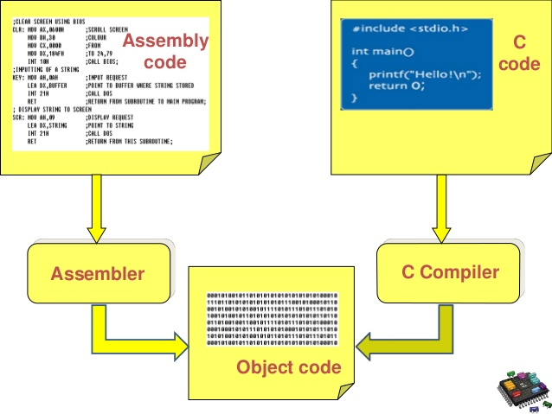
3. C and Hardware Programming
Gives symbolic names to values
Provides abstraction of underlying hardware
C Program (.c)
Code Compilation Process
Preprocessor
Preprocessed code (.i)
Compiler
Assembly code (.asm)
Assembler
Object code (.o)
Linker
External libs., etc.
Executable (.hex)
Burn program to hardware and run!

Slide 6
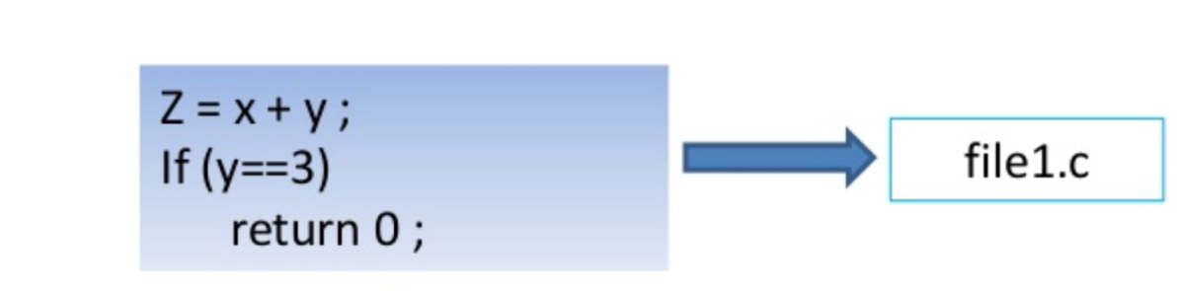
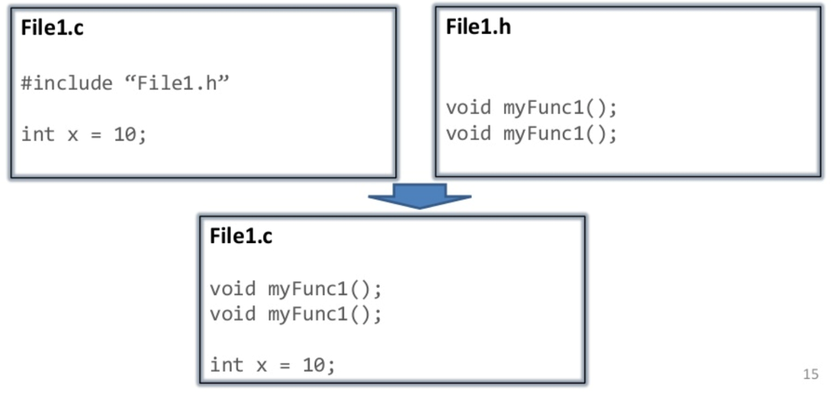
4. Code Compilation Process (1/8)
Preprocessing: It is the first stage of compilation. It processes preprocessor directives like include-files, conditional compilation instructions and macros.
C Program (.c)
Code Compilation Process
Preprocessor
Preprocessed code (.i)
Compiler
file1.i
Assembly code (.asm)
Assembler
Object code (.o)
Linker
External libs., etc.
Executable (.hex)
Burn program to hardware and run!
Notes:
https://www.slideshare.net/mohabdallah/embedded-c-lecture-1

Slide 7
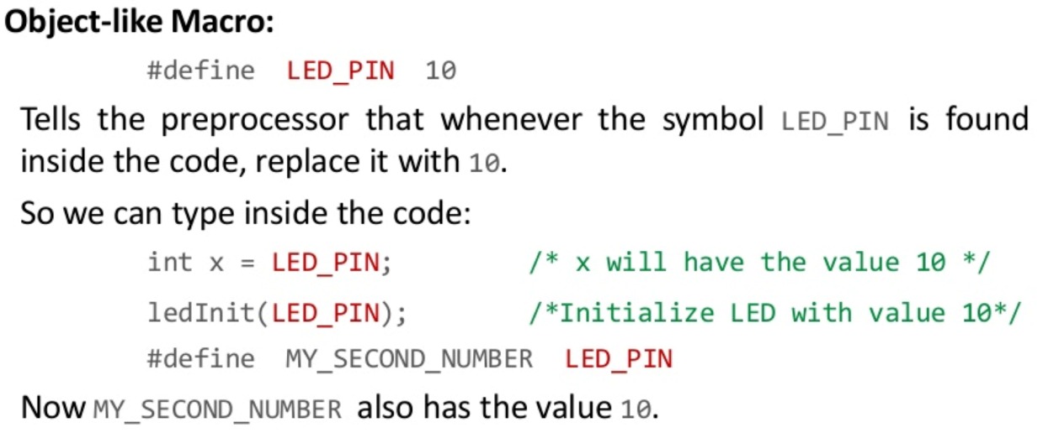
4. Code Compilation Process (2/8)
Preprocessing: It is the first stage of compilation. It processes preprocessor directives like include-files, conditional compilation instructions and macros.
C Program (.c)
Code Compilation Process
Preprocessor
Preprocessed code (.i)
Compiler
file1.i
Assembly code (.asm)
Assembler
Object code (.o)
Linker
External libs., etc.
Executable (.hex)
Burn program to hardware and run!
Notes:
https://www.slideshare.net/mohabdallah/embedded-c-lecture-1

Slide 8
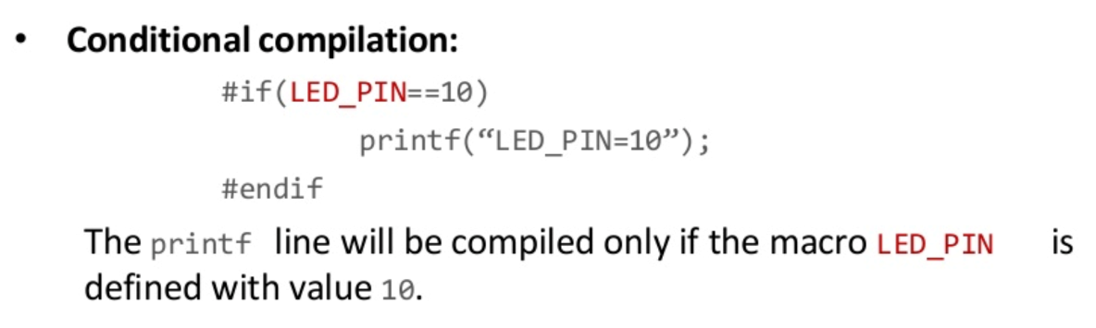
4. Code Compilation Process (3/8)
Preprocessing: It is the first stage of compilation. It processes preprocessor directives like include-files, conditional compilation instructions and macros.
C Program (.c)
Code Compilation Process
Preprocessor
Preprocessed code (.i)
Compiler
file1.i
Assembly code (.asm)
Assembler
Object code (.o)
Linker
External libs., etc.
Executable (.hex)
Burn program to hardware and run!
Notes:
https://www.slideshare.net/mohabdallah/embedded-c-lecture-1

Slide 9
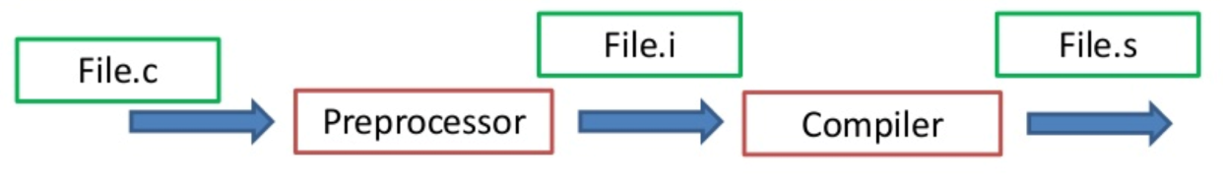
4. Code Compilation Process (4/8)
Compilation: It is the second stage. It takes the output of the preprocessor with the source code, and generates assembly source code.
C Program (.c)
Code Compilation Process
Preprocessor
Preprocessed code (.i)
Compiler
Assembly code (.asm)
Assembler
Object code (.o)
Linker
External libs., etc.
Executable (.hex)
Burn program to hardware and run!
Notes:
https://www.slideshare.net/mohabdallah/embedded-c-lecture-1

Slide 10
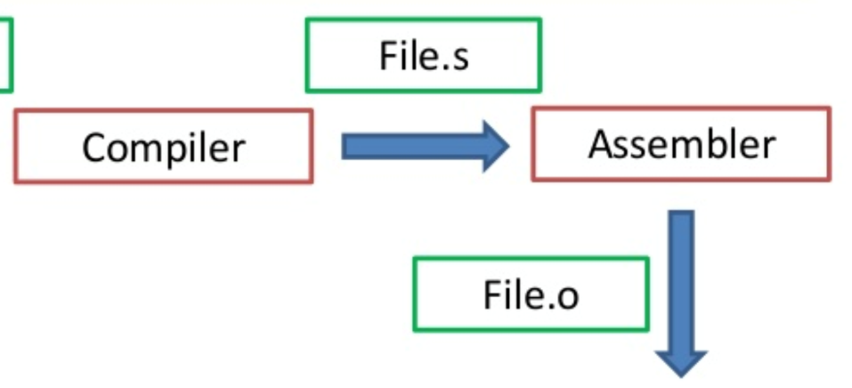
4. Code Compilation Process (5/8)
Assembler stage: It is the third stage of compilation. It takes the assembly source code and produces the corresponding object code.
C Program (.c)
Code Compilation Process
Preprocessor
Preprocessed code (.i)
Compiler
Assembly code (.asm)
Assembler
Object code (.o)
Linker
External libs., etc.
Executable (.hex)
Burn program to hardware and run!
Notes:
https://www.slideshare.net/mohabdallah/embedded-c-lecture-1

Slide 11
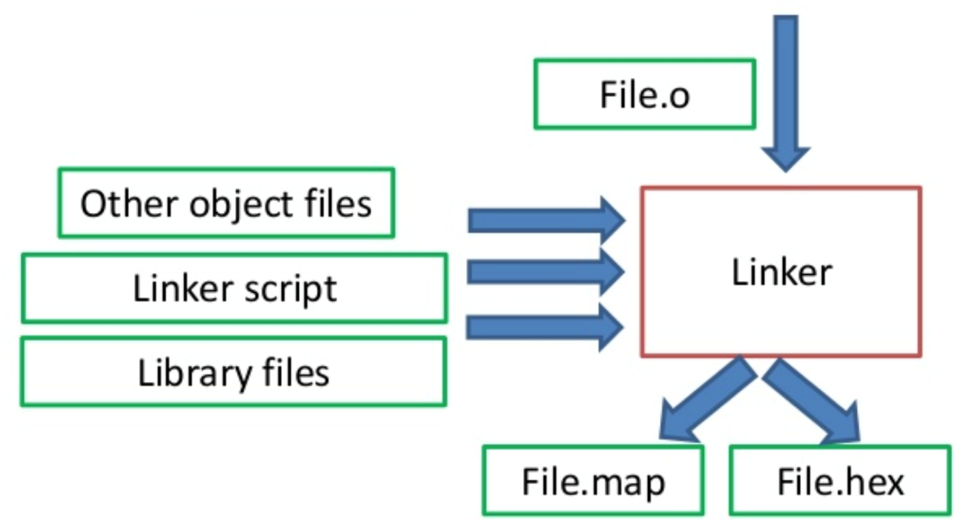
4. Code Compilation Process (6/8)
Linking: It is the final stage of compilation. It takes one or more object files or libraries and linker script as input and combines them to produce a single executable file.
C Program (.c)
Code Compilation Process
Preprocessor
Preprocessed code (.i)
Compiler
Assembly code (.asm)
Assembler
Object code (.o)
Linker
External libs., etc.
Executable (.hex)
Burn program to hardware and run!
Notes:
https://www.slideshare.net/mohabdallah/embedded-c-lecture-1

Slide 12
4. Code Compilation Process (7/8)
In doing so, it resolves references to external symbols, assigns final addresses to procedures/functions and variables, and revises code and data to reflect new addresses (a process called relocation).
C Program (.c)
Code Compilation Process
Preprocessor
Preprocessed code (.i)
Compiler
Assembly code (.asm)
Assembler
Object code (.o)
Linker
External libs., etc.
Executable (.hex)
Burn program to hardware and run!
Notes:
https://www.slideshare.net/mohabdallah/embedded-c-lecture-1

Slide 13

4. Code Compilation Process (8/8)
Notes:
https://www.slideshare.net/mohabdallah/embedded-c-lecture-1

Slide 14
5. Debugging – GDB (1/6)
GDB or GNU Debugger is used to debug C programs
It is used to inspect, step by step, the execution of a program
Commands:
Start
Step
explore
print <variable>
run
Continue
up
down
where
Notes:
- https://www.youtube.com/watch?v=xQ0ONbt-qPs
- https://www.youtube.com/watch?v=rlN3XI8kuhI

Slide 15
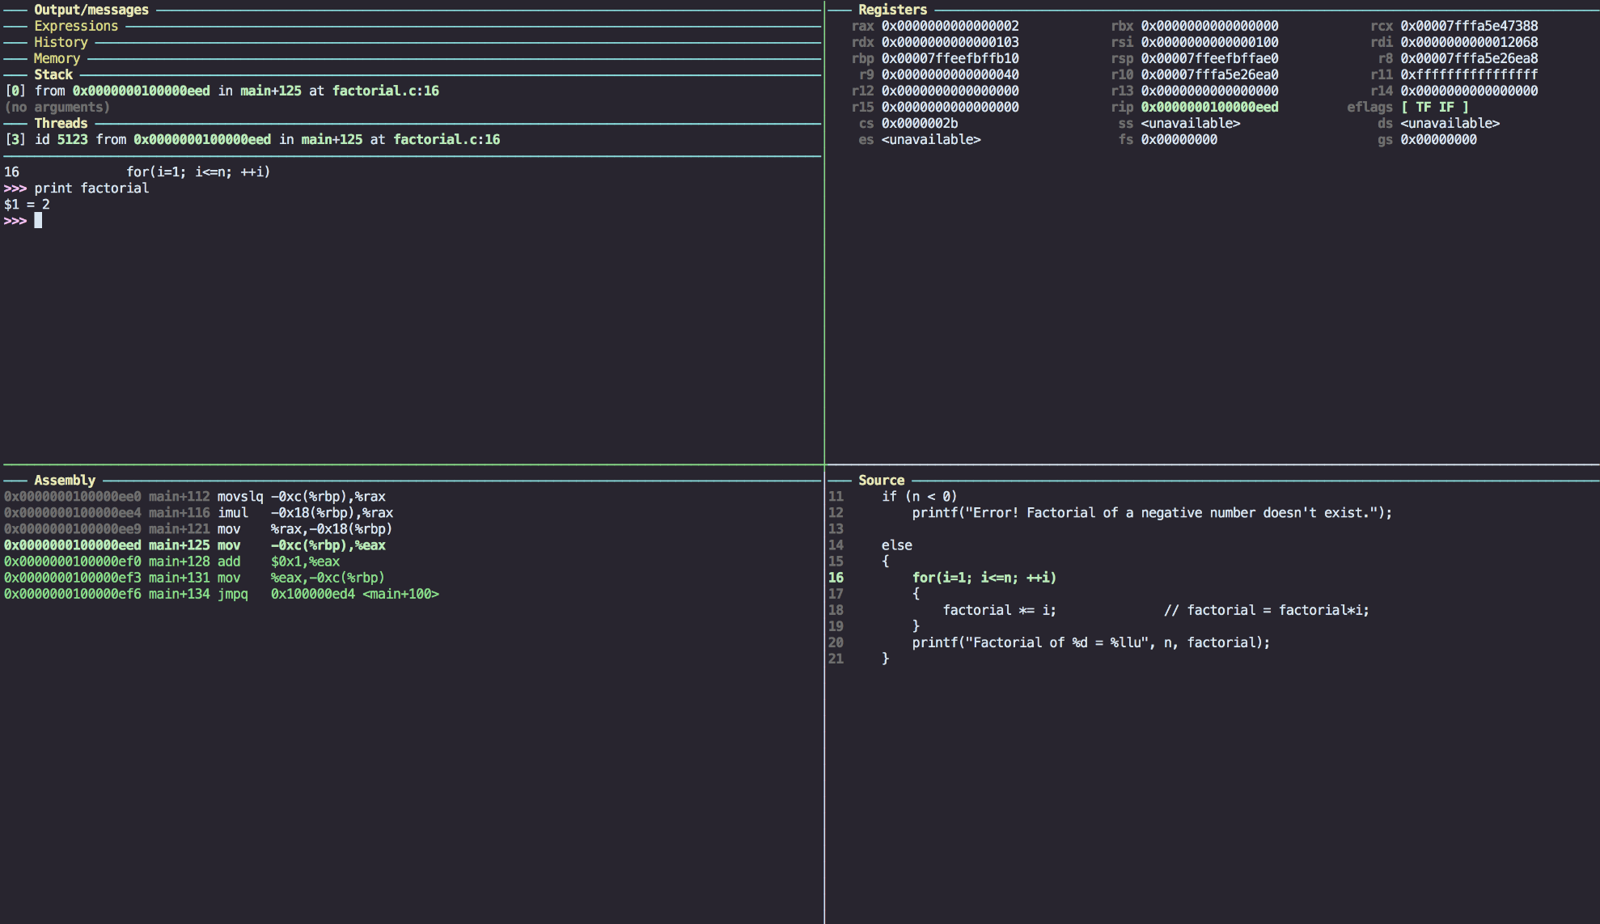
5. Debugging – GDB (2/6)
Notes:
- https://www.youtube.com/watch?v=xQ0ONbt-qPs
- https://www.youtube.com/watch?v=rlN3XI8kuhI

Slide 16
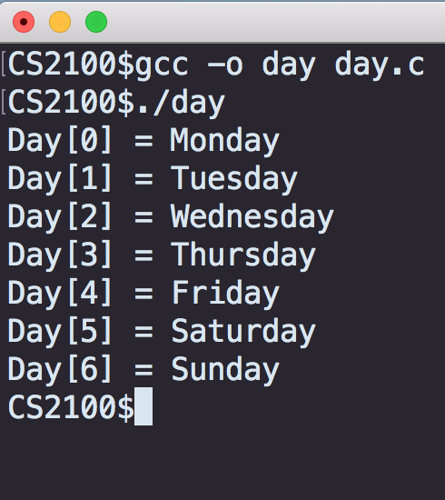
5. Debugging – Sample (3/6)
Program to print the days of the week:
#include <stdio.h>
int main(void) {
int i;
char *day[7] = {
"Monday",
"Tuesday",
"Wednesday",
"Thursday",
"Friday",
"Saturday",
"Sunday"
};
for (i = 0; i<=10; i++) {
printf("Day[%d] = %s \n", i, day[i]);
}
return 0;
}
Notes:
- https://www.youtube.com/watch?v=xQ0ONbt-qPs
- https://www.youtube.com/watch?v=rlN3XI8kuhI

Slide 17
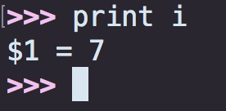
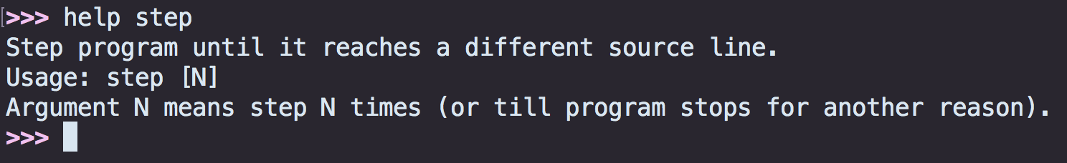
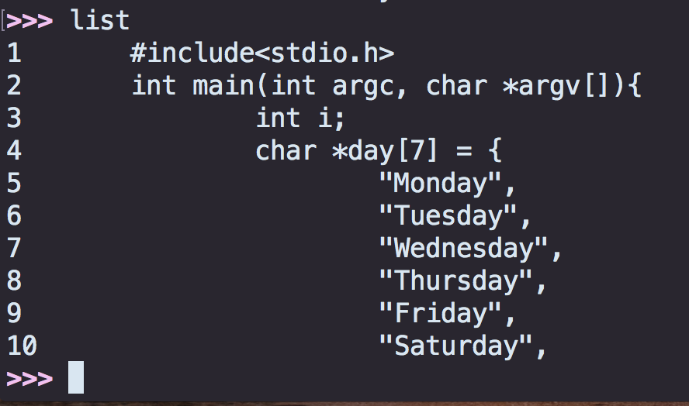
5. Debugging – Sample (4/6)
GDB
Step: helps iterating through the program step by step
Print: gives you the current value of the variable
List: lists the program
To change parameters
Notes:
- https://www.youtube.com/watch?v=xQ0ONbt-qPs
https://www.youtube.com/watch?v=rlN3XI8kuhI
https://sourceware.org/bugzilla/show_bug.cgi?id=20981

Slide 18
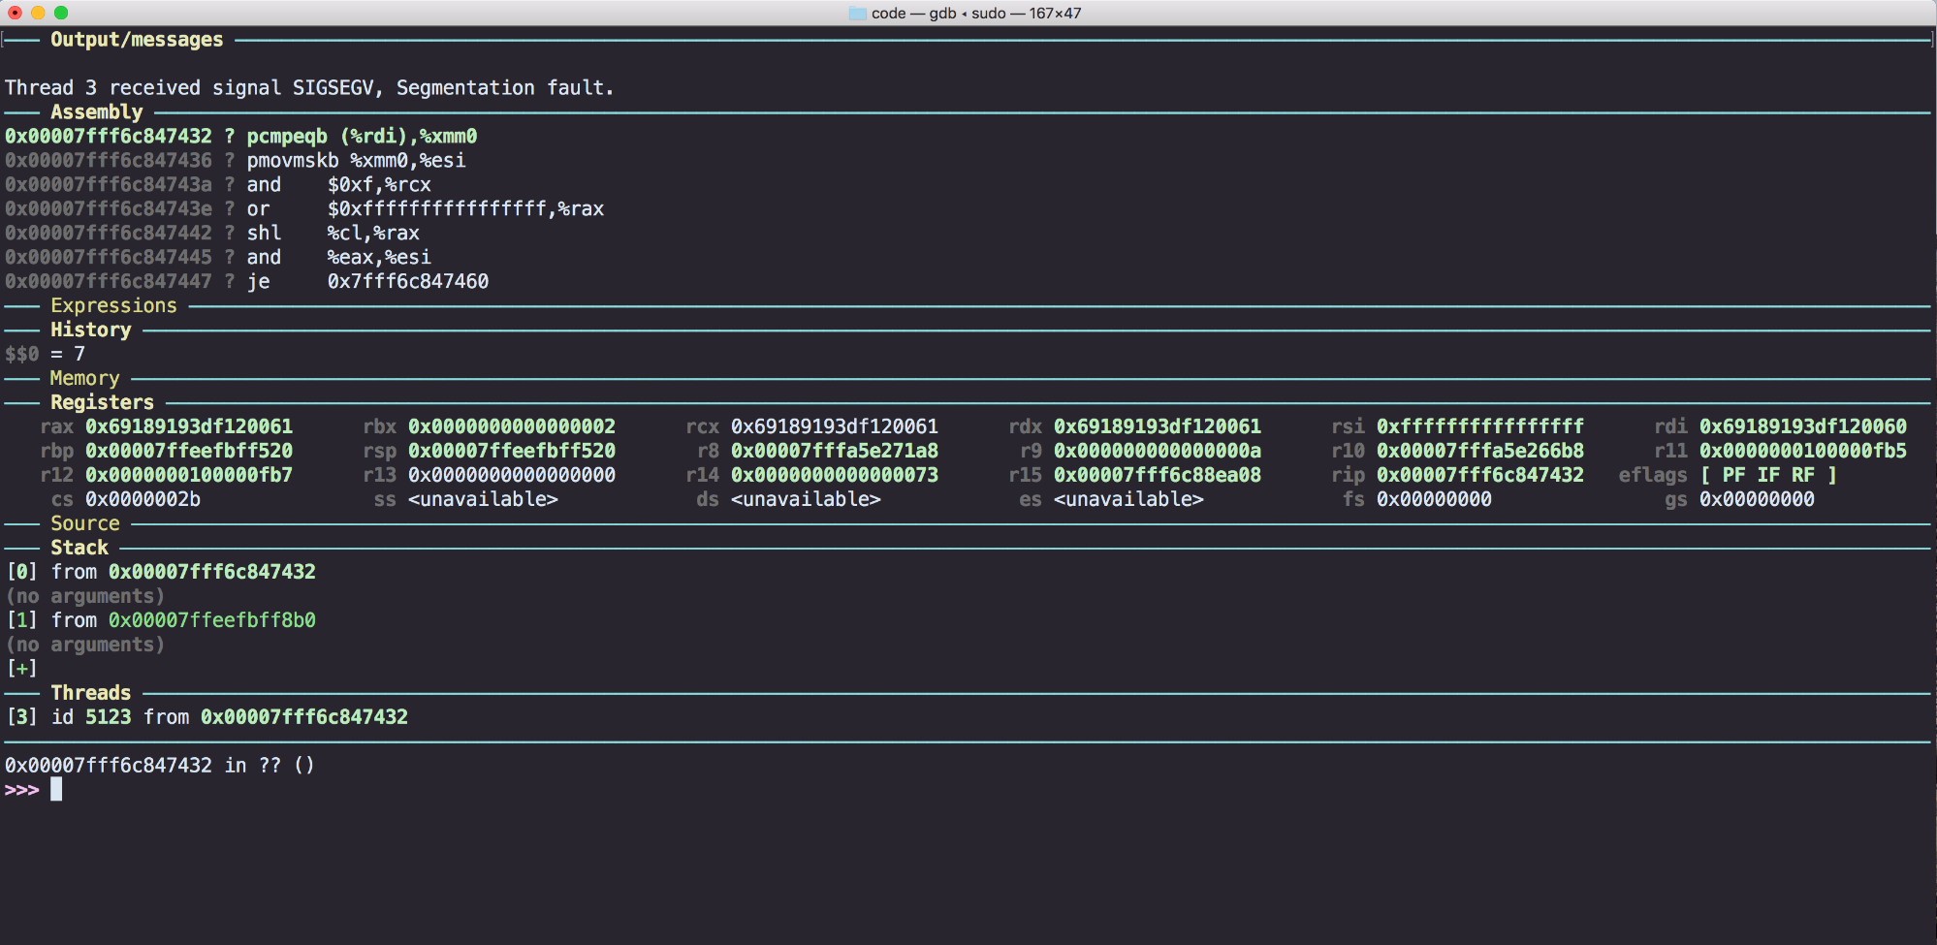
5. Debugging – Sample (5/6)
Segmentation fault
Notes:
- https://www.youtube.com/watch?v=xQ0ONbt-qPs
https://www.youtube.com/watch?v=rlN3XI8kuhI
https://sourceware.org/bugzilla/show_bug.cgi?id=20981

Slide 19
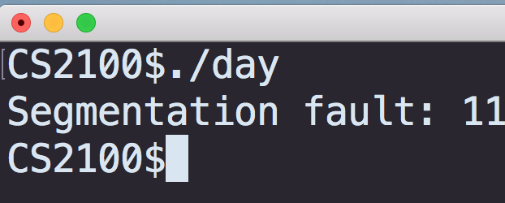
5. Debugging – Sample (6/6)
Program to print the days of the week:
#include <stdio.h>
int main(void) {
int i;
char *day[7] = {
"Monday",
"Tuesday",
"Wednesday",
"Thursday",
"Friday",
"Saturday",
"Sunday"
};
for (i = 0; i<=10; i++) {
printf("Day[%d] = %s \n", i, day[i]);
}
return 0;
}
Line 11
Notes:
- https://www.youtube.com/watch?v=xQ0ONbt-qPs
https://www.youtube.com/watch?v=rlN3XI8kuhI
https://sourceware.org/bugzilla/show_bug.cgi?id=20981

Slide 20
End of File

