Slide 1
CS2100
Tutorial #5
MIPS Processor: Datapath and Control
(Prepared by Aaron Tan)

Slide 2
Generating ALUControl Signal
Opcode | ALUop | Instruction Operation | Funct field | ALU action | ALU control
lw |  | load word |  | add
sw |  | store word |  | add
beq |  | branch equal |  | subtract
R-type |  | add |  | add
R-type |  | subtract |  | subtract
R-type |  | AND |  | AND
R-type |  | OR |  | OR
R-type |  | set on less than |  | set on less than
Instruction Type | ALUop
lw / sw | 00
beq | 01
R-type | 10
00
xxxxxx
0010
00
xxxxxx
0010
01
xxxxxx
0110
10
10 0000
0010
10
10 0010
0110
10
10 0100
0000
ALUcontrol | Function
0000 | AND
0001 | OR
0010 | add
0110 | subtract
0111 | slt
1100 | NOR
10
10 0101
0001
10
10 1010
0111
Generation of 2-bit ALUop signal will be discussed later


Slide 3
Design of ALU Control Unit (1/2)
Input: 6-bit Funct field and 2-bit ALUop
Output: 4-bit ALUcontrol
Find the simplified expressions
ALUcontrol3 = 0
ALUcontrol2 = ?
ALUop0 + ALUop1⋅ F1
 | ALUop |  | Funct Field ( F[5:0] == Inst[5:0] ) |  |  |  |  |  | ALU control
 | MSB | LSB | F5 | F4 | F3 | F2 | F1 | F0
lw
sw
beq
add
sub
and
or
slt
0
0
X
X
X
X
X
X
0 0 1 0
0
0
X
X
X
X
X
X
0 0 1 0
X
0
1
X
X
X
X
X
X
0 1 1 0
1
0
1
0
0
0
0
0
0 0 1 0
X
X
X
1
0
1
0
0
0
1
0
0 1 1 0
X
X
X
1
0
1
0
0
1
0
0
0 0 0 0
X
X
X
1
0
1
0
0
1
0
1
0 0 0 1
X
X
X
1
X
X
X
0
1
0
1
0
1
0
0 1 1 1


Slide 4
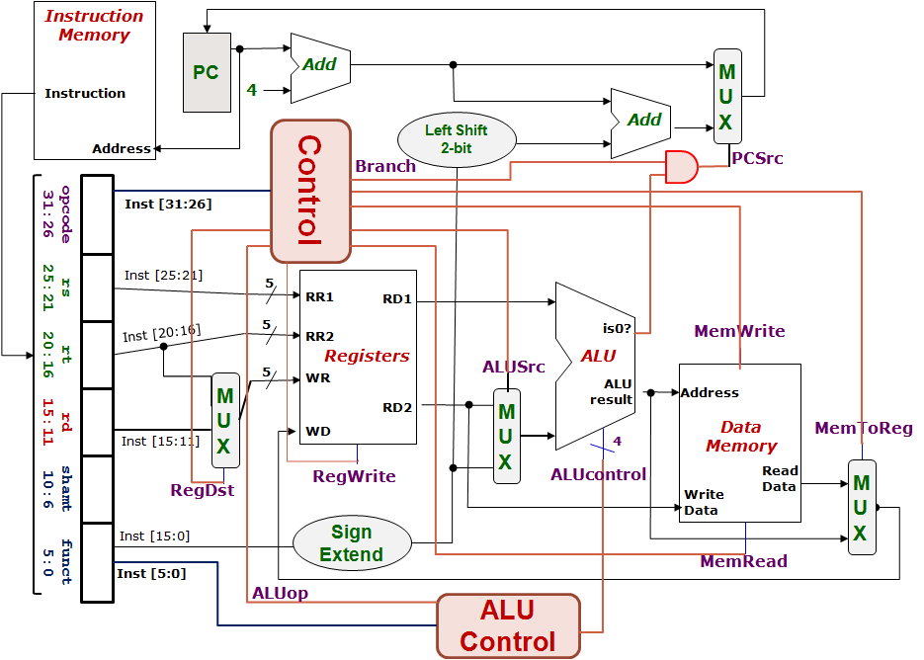
Control Design: Outputs
 | RegDst | ALUSrc | MemToReg | Reg Write | Mem Read | Mem Write | Branch | ALUop
 |  |  |  |  |  |  |  | op1 | op0
R-type
lw
sw
beq
1
0
0
1
0
0
0
1
0
0
1
1
1
1
0
0
0
0
X
1
X
0
0
1
0
0
0
X
0
X
0
0
0
1
0
1
0
1
0
1
0
1
1
0


Slide 5
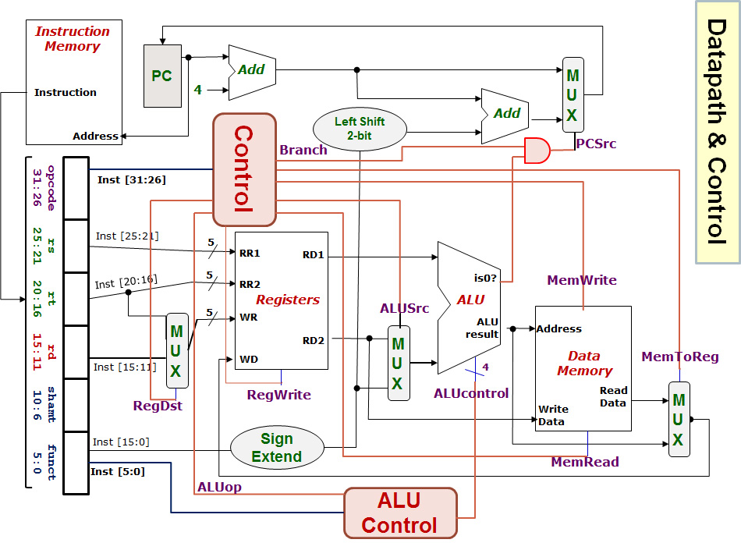
lw $24, 0($15)
R[rt] = M[R[rs]+SignExtImm]
100011 01111 11000 0000000000000000
Registers File |  |  |  | ALU |  | Data Memory
RR1 | RR2 | WR | WD | Opr1 | Opr2 | Address | Write Data
Q1(i)
Red means the data is actually used.
Blue means the data is not used.
$15
$24
$24
MEM([$15]+0)
[$15]
0
[$15]+0
[$24]
0
1
RegDest
RegWrite
ALUSrc
MemRead
MemWrite
MemToReg
Branch
ALUop
ALUcontrol
0
1
1
100011
1
01111
0
Opr1
1
11000
0
0
1
00000 00000 000000
0
1
00
Opr2
0010
1
0
Next PC value = PC + 4

Slide 6
beq $1, $3, 12
If (R[rs]==R[rt]) PC=PC+4+BrAddr
000100 00001 00011 0000000000001100
Registers File |  |  |  | ALU |  | Data Memory
RR1 | RR2 | WR | WD | Opr1 | Opr2 | Address | Write Data
Q1(ii)
$1
$3
$3 or $0
[$1]-[$3] or MEM([$1]-[$3])
[$1]
[$3]
[$1] – [$3]
[$3]
0
1
RegDest
RegWrite
ALUSrc
MemRead
MemWrite
MemToReg
Branch
ALUop
ALUcontrol
X
0
0
000100
0
00001
0
Opr1
X
00011
1
0
1
00000 00000 001100
0
1
01
Opr2
0110
1
0
Next PC value = PC + 4 or (PC+4) + (12×4)

Slide 7
sub $25, $20, $5
R[rd] = R[rs] – R[rt]
000000 10100 00101 11001 00000 100010
Registers File |  |  |  | ALU |  | Data Memory
RR1 | RR2 | WR | WD | Opr1 | Opr2 | Address | Write Data
Q1(iii)
$20
$5
$25
[$20] – [$5]
[$20]
[$5]
[$20] – [$5]
[$5]
0
1
RegDest
RegWrite
ALUSrc
MemRead
MemWrite
MemToReg
Branch
ALUop
ALUcontrol
1
1
0
000000
0
10100
0
Opr1
0
00101
0
0
1
11001
0
1
10
Opr2
0110
00000
1
0
100010
Next PC value = PC + 4

Slide 8
SUB instruction
Inst-Mem (400)
Reg.File (200)
MUX (ALUSrc)
(30)
ALU
(120)
MUX (MToR)
(30)
Reg.File
(200)
Control (100)
Q2(a)
Not critical path
400+200+30+120+30+200 = 980ps
0
1
0
1
0
1
0
1
1
0

Slide 9
LW instruction
Inst-Mem (400)
Reg.File (200)
ALU
(120)
DataMem
(350)
MUX (MToR)
(30)
Reg.File
(200)
Control (100)
Q2(b)
Not critical path
400+200+120+350+30+200 = 1300ps
0
1
0
1
0
1
1
0
Why is MUX (ALUSrc) not included this time?

Slide 10
BEQ instruction
Inst-Mem (400)
Reg.File (200)
MUX (ALUSrc)
(30)
ALU
(120)
AND
(20)
MUX (PCSrc)
(30)
Control (100)
Q2(c)
Not critical path
400+200+30+120+20+30 = 800ps
0
1
How about the green path: PC → Adder → MUX (PCSrc)?
How about the purple path: Inst.Mem → SignExt → LeftShift → Adder → MUX(PCSrc)?
0
1
0
1
1
0

Slide 11
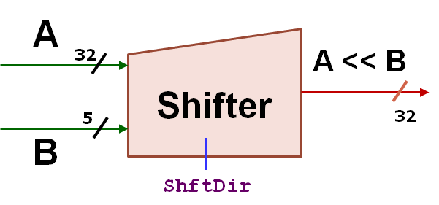
Q3
0
1
Connect:
RD2 to A,
Inst[10:6] to B.
Opr1
0
1
0
1
Opr2
1
0

Slide 12
Q3
0
1
Connect:
RD2 to A,
Inst[10:6] to B.
Opr1
Change the MemToRegcontrol to 2 bits.
0
1
0
1
Opr2
1
0
MUX
F[1] (or Inst[1])
Change this MUX to a 4:1 MUX.
sll: opcode =0; funct=0
srl: opcode=0; funct=2
So, connect F[1] to ShftDir

Slide 13
A spare diagram for your use.
0
1
Opr1
0
1
0
1
Opr2
1
0

