Slide 1
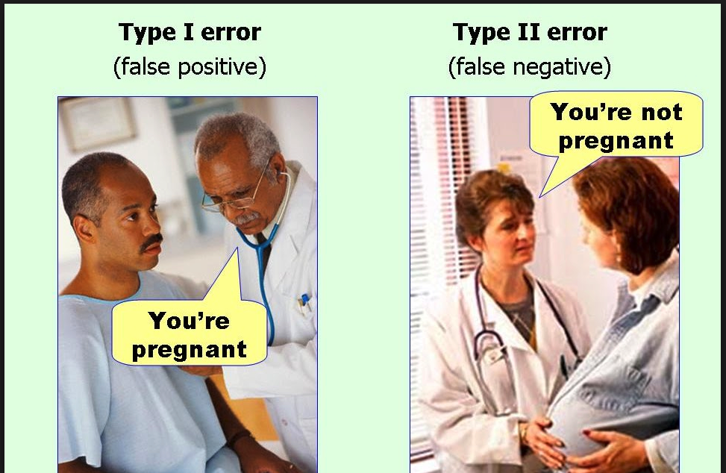
Tutorial 5: Evaluation Metrics
CS3244 Machine Learning
https://medium.com/swlh/idiots-guide-to-precision-recall-and-confusion-matrix-b32d36463556

Slide 2
Agenda
0:01 – 0:05 – Recap: Precision, Recall, F1 (5 minutes)
0:05 – 0:15 – Breakout rooms (10 minutes)
0:15 – 0:30 – Q1 (15 minutes)
0:30 – 0:45 – Q2 (15 minutes)

Slide 3
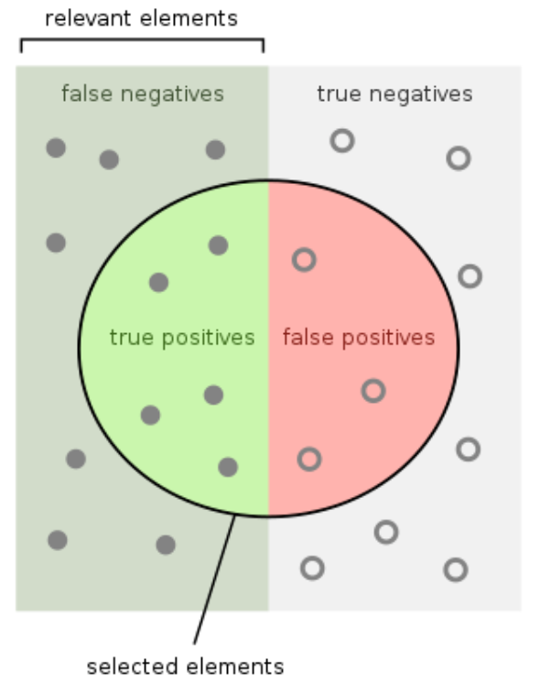
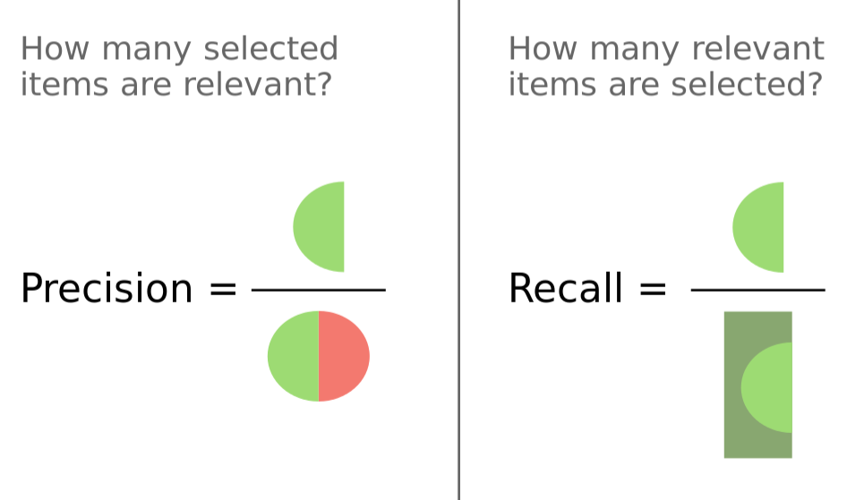
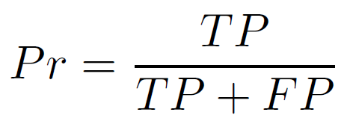
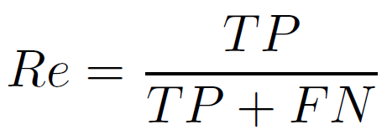
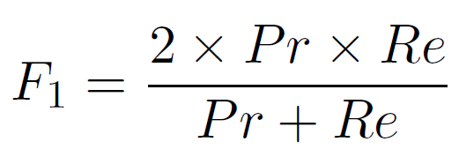
Recap: Precision, Recall, F1

Slide 4
Breakout Rooms! (10 minutes until 11:15)
Breakout Room 1 – Q1(a), (b)
Breakout Room 2 – Q1 (c)
Breakout Room 3 – Q2 (a), (b)
Breakout Room 4 – Q2 (c)
Breakout Room 5 – Q2 (d)
Assign one person to be ready to state answers and explain!

Slide 5
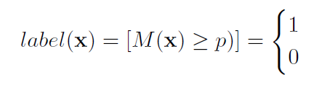
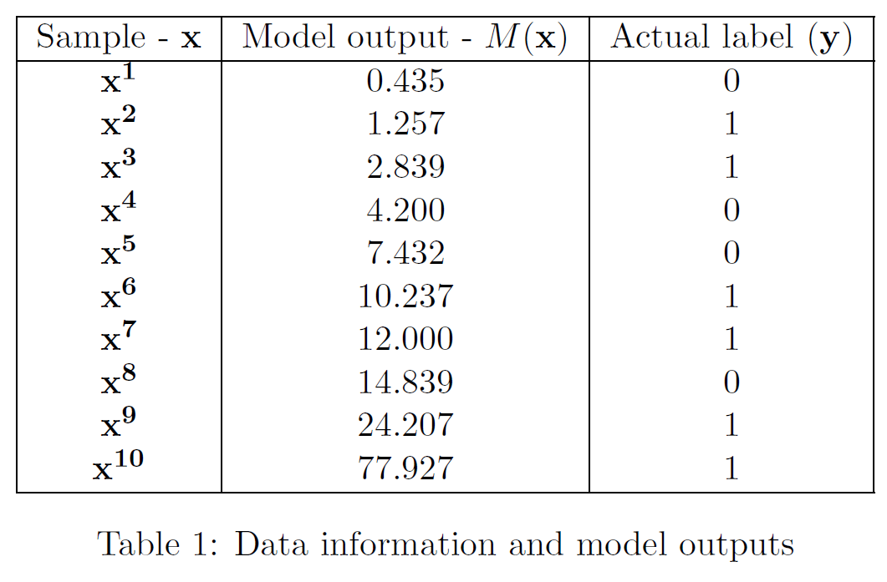
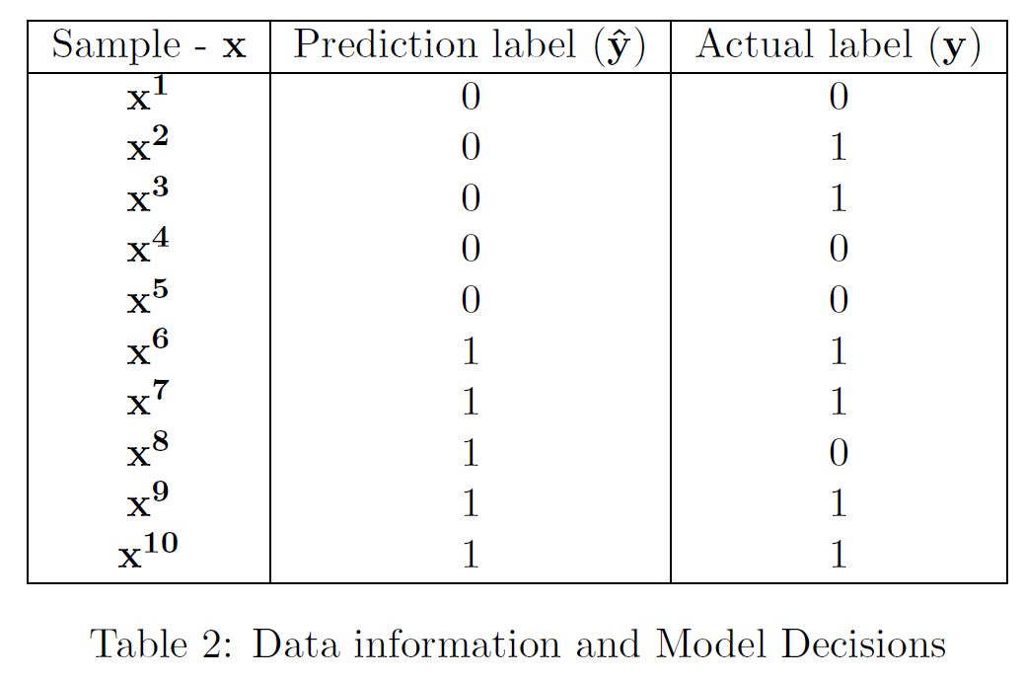
Q1: For a given binary classification problem, a machine learning model M outputs a continuous score for each input sample.
(a) For threshold p=10, find precision, recall and F1 score.

Slide 6
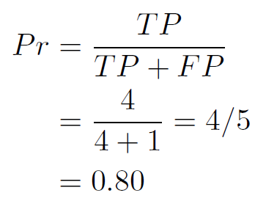
Q1: For a given binary classification problem, a machine learning model M outputs a continuous score for each input sample.
(a) For threshold p=10, find precision, recall and F1 score.

Slide 7
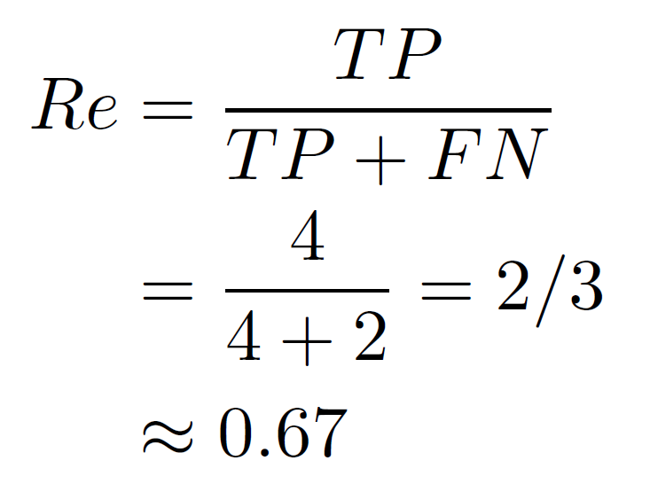
Q1: For a given binary classification problem, a machine learning model M outputs a continuous score for each input sample.
(a) For threshold p=10, find precision, recall and F1 score.

Slide 8
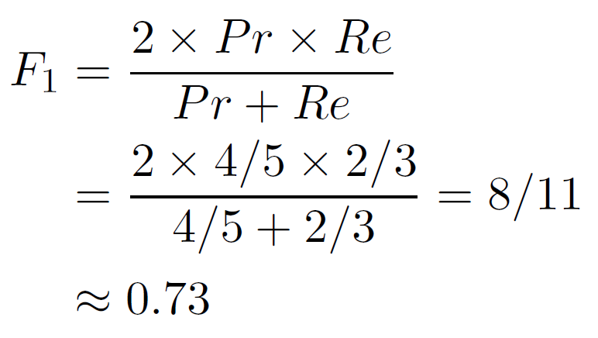
Q1: For a given binary classification problem, a machine learning model M outputs a continuous score for each input sample.
(a) For threshold p=10, find precision, recall and F₁ score.

Slide 9
Q1 (b): The number of samples is increased to m. All the model predictions M(x) are given for m samples. All model predictions are distinct. Propose an optimal way to find the best threshold p, and comment on the running time.

Slide 10
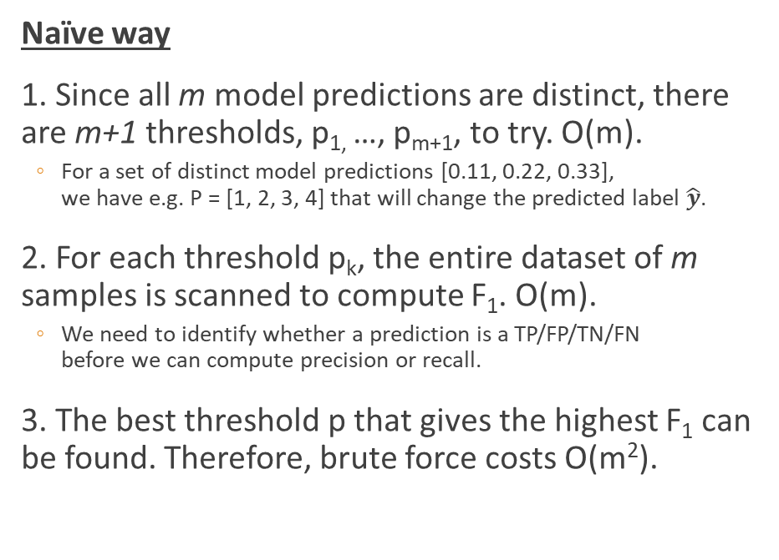
Q1 (b): The number of samples is increased to m. All the model predictions M(x) are given for m samples. All model predictions are distinct. Propose an optimal way to find the best threshold p, and comment on the running time.
Naïve way
1. Since all m model predictions are distinct, there are m+1 thresholds, p_{1,} …, p_{m+1}, to try. O(m).
For a set of distinct model predictions [0.11, 0.22, 0.33], we have e.g. P = [1, 2, 3, 4] that will change the predicted label $\hat{y}$.
2. For each threshold p_{k}, the entire dataset of m samples is scanned to compute F₁. O(m).
We need to identify whether a prediction is a TP/FP/TN/FN before we can compute precision or recall.
3. The best threshold p that gives the highest F₁ can be found. Therefore, brute force costs O(m²).

Slide 11
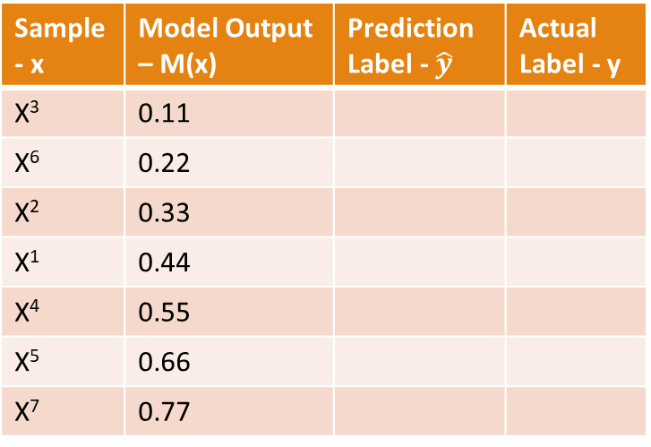
Q1 (b): The number of samples is increased to m. All the model predictions M(x) are given for m samples. All model predictions are distinct. Propose an optimal way to find the best threshold p, and comment on the running time.
Sort by model predictions first
1. Sort samples by model predictions. O(m*logm).
2. For the first threshold p₁, computing the F₁ score takes O(m).
3. For the next threshold p₂, only sample x¹’s prediction label may change, while all other samples’ prediction labels remain unchanged. Thus, computing the F₁ score takes O(1).
4. Thus, computing F₁ score for the next m-1 thresholds takes O(m).
5. Therefore, finding the best threshold p will take only O(m*logm).
Example dataset sorted by model predictions:
Sample - x | Model Output – M(x) | Prediction Label - $\hat{y}$ | Actual Label - y
X³ | 0.11
X⁶ | 0.22
X² | 0.33
X¹ | 0.44
X⁴ | 0.55
X⁵ | 0.66
X⁷ | 0.77
p₁
p₂
p₃
p₄
p₅
p₆
p₇
p₈

Slide 12
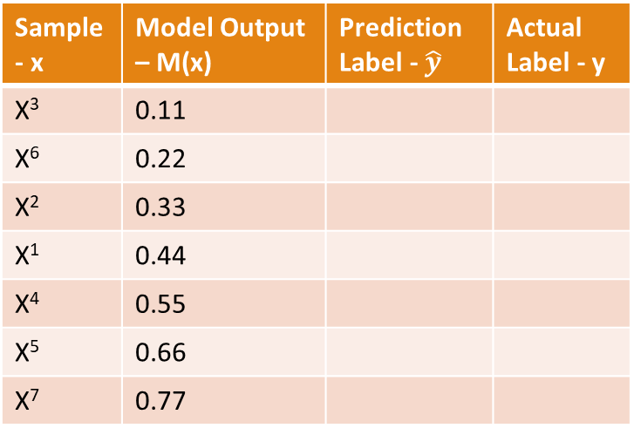
Q1 (c): Given q thresholds, find the best threshold p. (q > m samples).
Sample - x | Model Output – M(x) | Prediction Label - $\hat{y}$ | Actual Label - y
X³ | 0.11
X⁶ | 0.22
X² | 0.33
X¹ | 0.44
X⁴ | 0.55
X⁵ | 0.66
X⁷ | 0.77
p₁ = 0.37
…
p_{q} = 0.67
p₁ = 0.37

Slide 13
Q1 (c): Given q thresholds, find the best threshold p. (q > m samples).
1. The same procedure “Sort by model predictions first” can be used. O(m * log m).
2. For every threshold p₁, …, p_{q}, we need to find its correct location in the sorted order of model predictions, e.g. using binary search in O(logm).
3. Therefore, the running time is now O(q * logm).
Sample - x | Model Output – M(x) | Prediction Label - $\hat{y}$ | Actual Label - y
X³ | 0.11
X⁶ | 0.22
X² | 0.33
X¹ | 0.44
X⁴ | 0.55
X⁵ | 0.66
X⁷ | 0.77
p₁ = 0.37

Slide 14
Q2: Micro- and Macro- Averaging
(a) Create the confusion matrix for each individual class: dog, cat and pig.

Slide 15
Q2: Micro- and Macro- Averaging
(a) Create the confusion matrix for each individual class: dog, cat and pig.

Slide 16
Q2: Micro- and Macro- Averaging
(b) Calculate the micro-average confusion matrix, accuracy, precision, recall and F₁ score. What do you notice? Why?

Slide 17
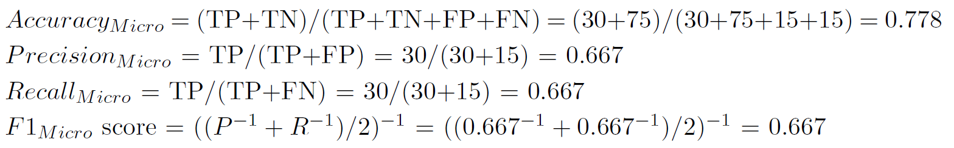
Q2: Micro- and Macro- Averaging
(b) Calculate the micro-average confusion matrix, accuracy, precision, recall and F₁ score.

Slide 18
Q2: Micro- and Macro- Averaging
(b) Calculate the micro-average confusion matrix, accuracy, precision, recall and F₁ score.
What do you notice? Why?
Precision, recall and F₁ all has the same value, because FP_{Micro} = FN_{Micro}. This is true for all other confusion matrices.
What about confusion matrices of more than 2 classes?

Slide 19
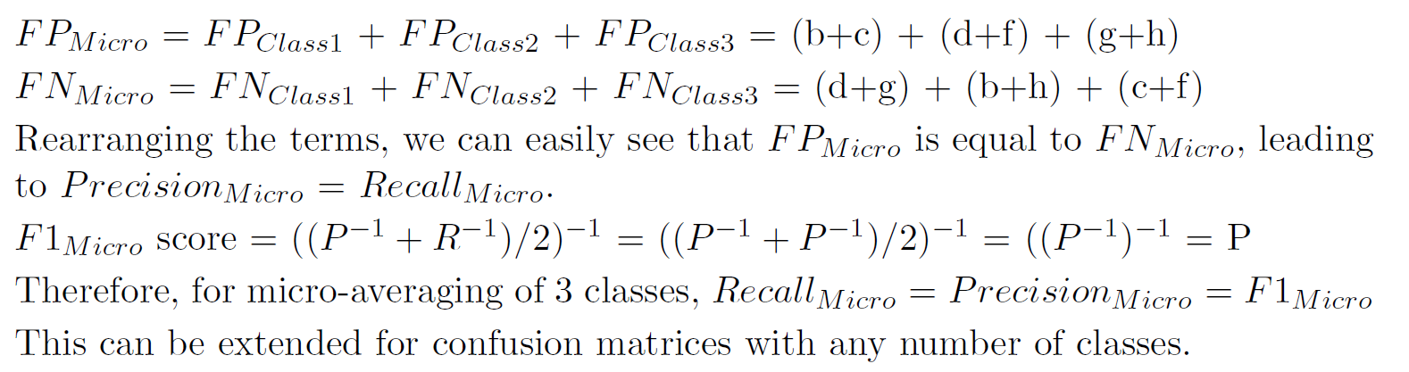
Q2: Micro- and Macro- Averaging
(b) Calculate the micro-average confusion matrix, accuracy, precision, recall and F₁ score.
Take a general 3-class confusion matrix:
Equal!
This can be extended for confusion matrices with any number of classes.

Slide 20
Q2: Micro- and Macro- Averaging
(c) Calculate the macro-average precision and recall.

Slide 21
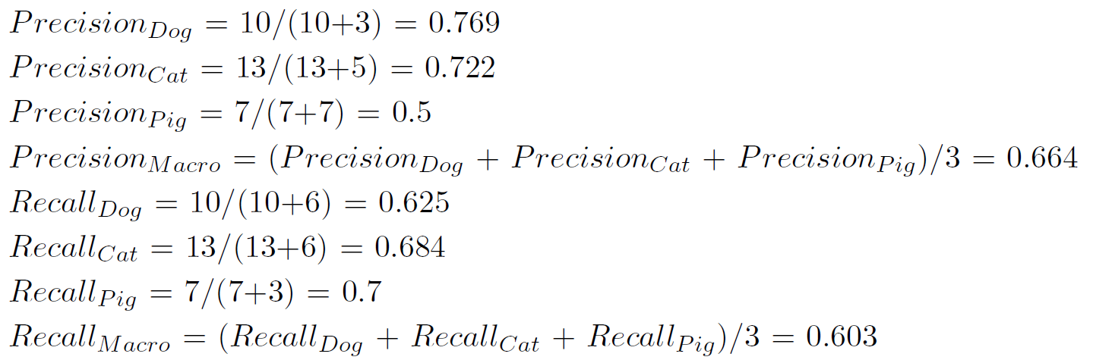
Q2: Micro- and Macro- Averaging
(c) Calculate the macro-average precision and recall.
0.670

Slide 22
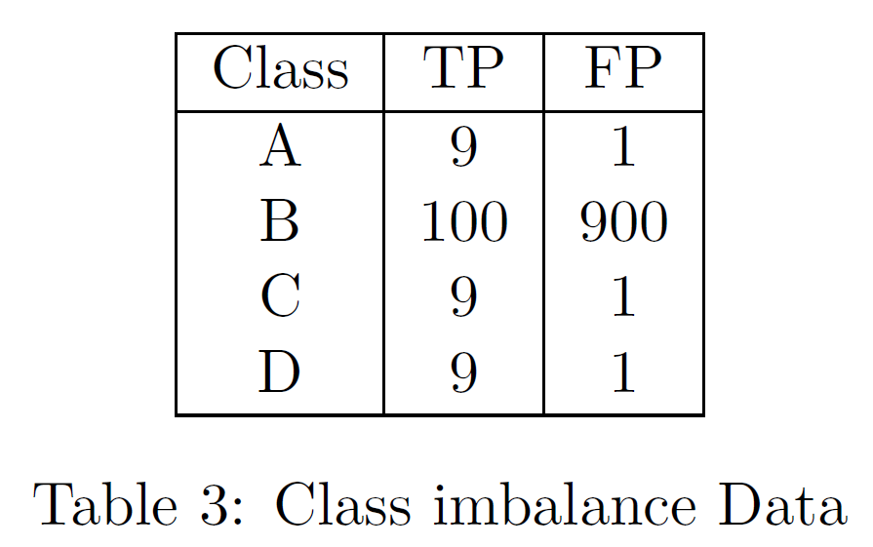
Q2: Micro- and Macro- Averaging
(d) When there is a huge class imbalance, what does Precision_{Micro} and Precision_{Macro} tell us?

Slide 23
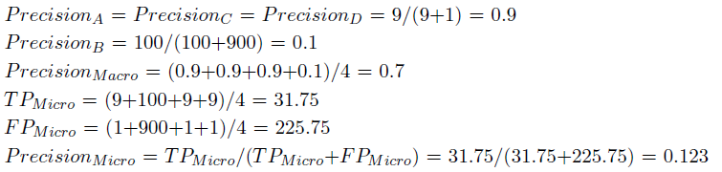
Q2: Micro- and Macro- Averaging
(d) When there is a huge class imbalance, what does Precision_{Micro} and Precision_{Macro} tell us?
Precision_{Macro} has a much higher value than Precision_{Micro}.
Because Precision_{Macro} averages the precision across classes equally, it does not take into account the large samples in class B.
In contrast, Precision_{Micro} takes into account class imbalance, resulting in a low score since Precision_{B} is low.

