Slide 1

Tutorial 6:
Regression Metrics and Data Processing
CS3244 Machine Learning

Slide 2

Agenda
0:01 – 0:05 – Quick Chat
0:05 – 0:15 – Breakout Rooms (10 minutes)
0:15 – 0:25 – Q1 (10 minutes)
0:25 – 0:35 – Q2 (10 minutes)
0:35 – 0:45 – Q3 (10 minutes)
0:45 – 0:55 – Q4 (10 minutes)

Slide 3
Breakout Rooms (10 minutes)
Breakout Room 1 – Q1
Breakout Room 2 – Q2
Breakout Room 3 – Q3
Breakout Room 4 – Q4

Slide 4
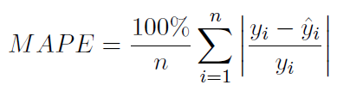
Q1: Regression evaluation metrics
The Mean Absolute Percentage Error (MAPE) is a measure for regression.

Slide 5

Q1: Regression evaluation metrics
The Mean Absolute Percentage Error (MAPE) is a measure for regression.
5.90%

Slide 6
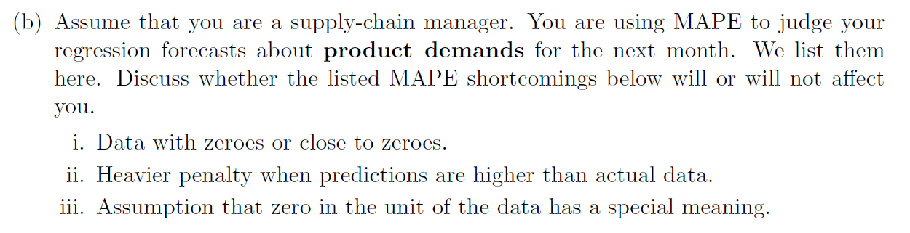
Q1: Regression evaluation metrics

Slide 7
Q1: Regression evaluation metrics

Slide 8
Q1: Regression evaluation metrics

Slide 9
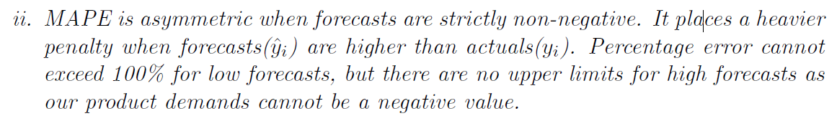
Q1: Regression evaluation metrics
Given Solution:
My Explanation:
When forecasts are much higher than the actuals, “percentage error” may exceed 100%, which no longer makes sense for the Mean Absolute Percentage Error. Since product demands are nicely lower bounded at 0, forecasts lower than actuals do not result in this problem.

Slide 10
Q1: Regression evaluation metrics

Slide 11
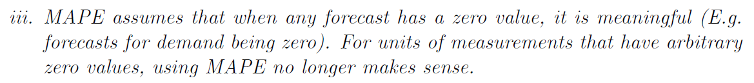
Q1: Regression evaluation metrics
Given Solution:
E.g. Unlike demand, measurements like degrees Celsius can have forecasts of negative values when actual is positive, resulting in the “percentage error” exceeding 100%, which no longer makes sense for the Mean Absolute Percentage Error.
My Explanation:

Slide 12
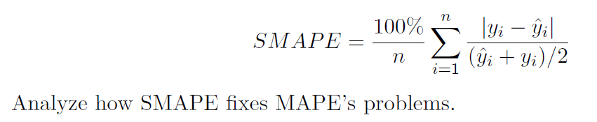
Q1: Regression evaluation metrics

Slide 13
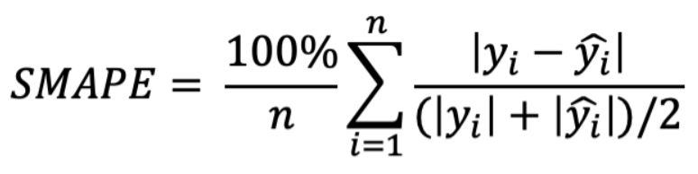
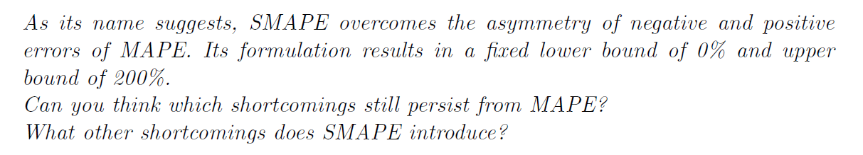
Q1: Regression evaluation metrics
Modified version avoids negative errors:
Original definition by Armstrong:

Slide 14
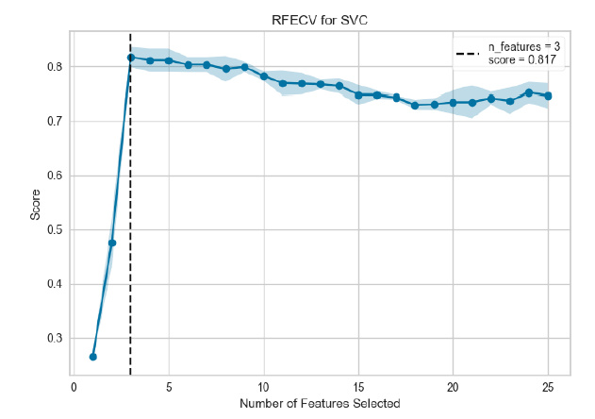
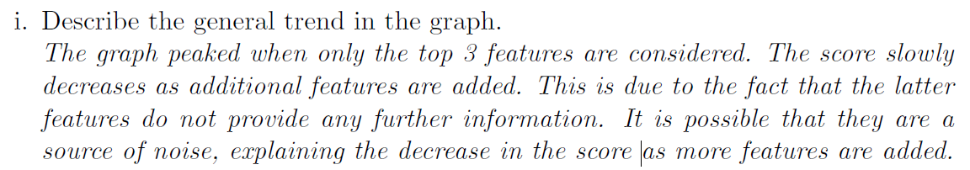
Q2. (a) Curse of Dimensionality
Recursive Feature Elimination (RFE)

Slide 15
Q2. (a) Curse of Dimensionality

Slide 16
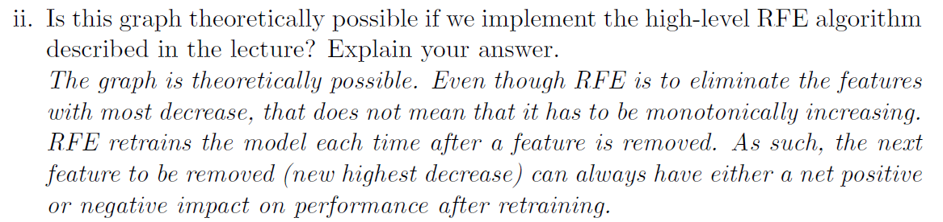
Q2. (a) Curse of Dimensionality

Slide 17
Q2. (a) Curse of Dimensionality

Slide 18
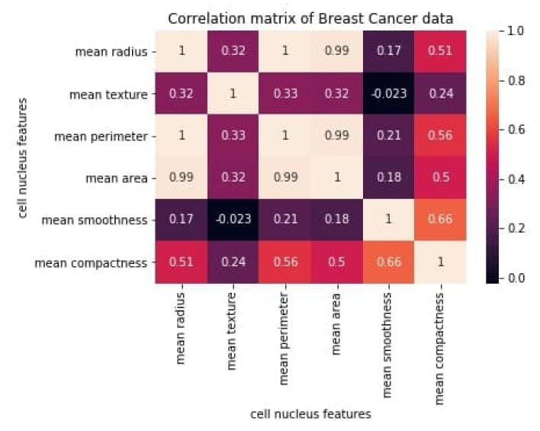
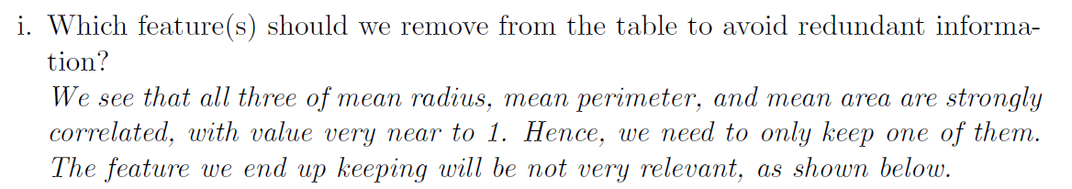
Q2. (B) Curse of Dimensionality

Slide 19
Q2. (B) Curse of Dimensionality

Slide 20
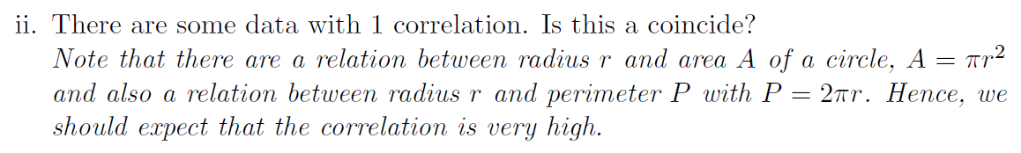
Q2. (B) Curse of Dimensionality

Slide 21
Q2. (B) Curse of Dimensionality

Slide 22
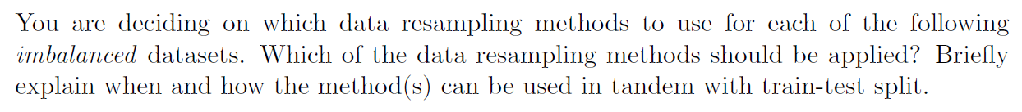
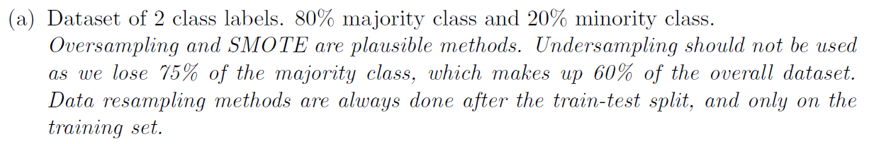
Q3. Data Resampling Techniques

Slide 23
Q3. Data Resampling Techniques
80%
20%
80%
20%
Oversampling
Undersampling
VS

Slide 24
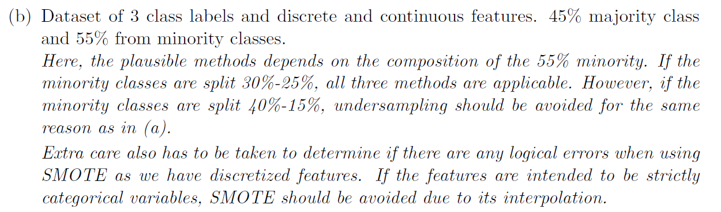
Q3. Data Resampling Techniques

Slide 25
Q3. Data Resampling Techniques

Slide 26
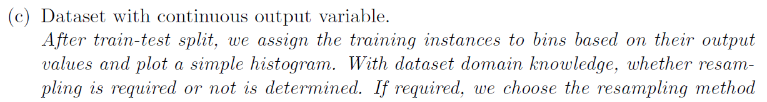
Q3. Data Resampling Techniques

Slide 27
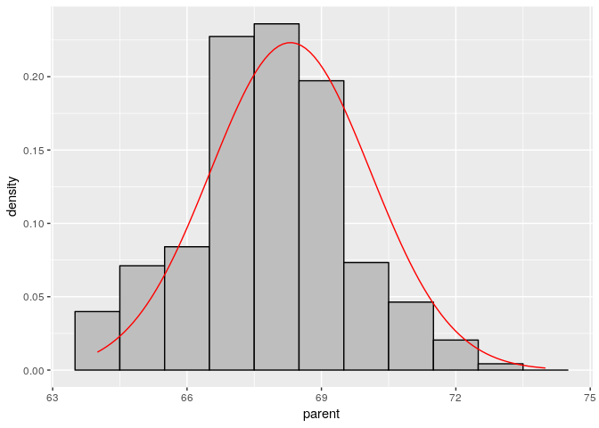
Q3. Data Resampling Techniques

Slide 28
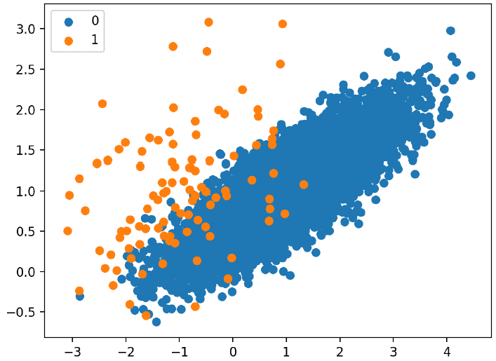
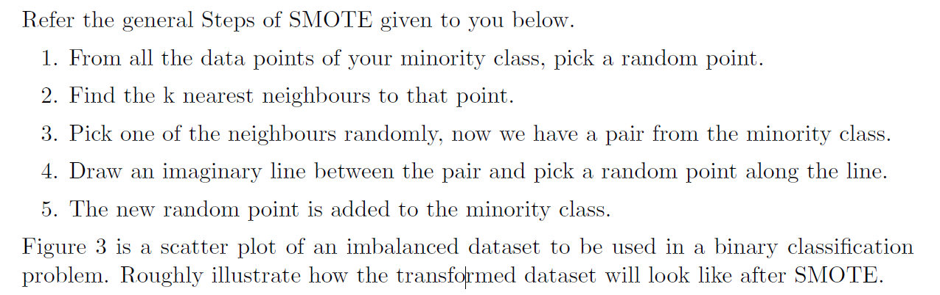
Q4. Data Resampling: SMOTE

Slide 29
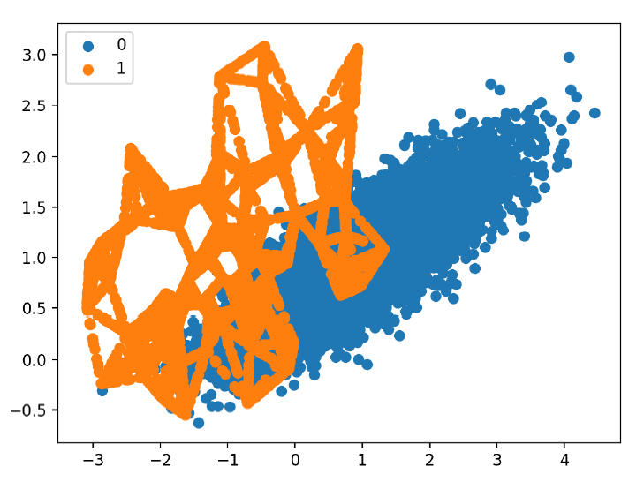
Q4. Data Resampling: SMOTE

