Slide 1
CS3244 Tutorial 7
Perceptron & Neural Networks
Will begin class at 14:01

Slide 2
AGENDA
0:01 – 0:07 – Kahoot!
0:07 – 0:17 - Recap: Perceptrons & NNs
0:17 – 0:25 - Breakout Rooms
0:25 – 0:35 –Q1
0:35 – 0:45 – Q2

Slide 3
Kahoot

Slide 4
Recap

Slide 5
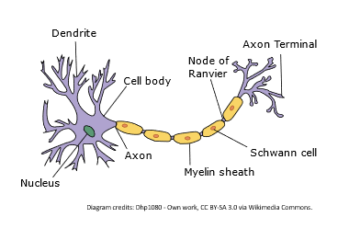
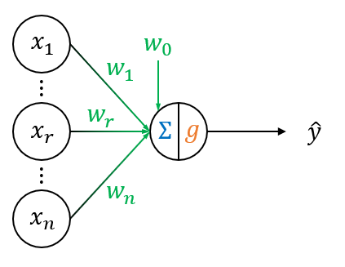
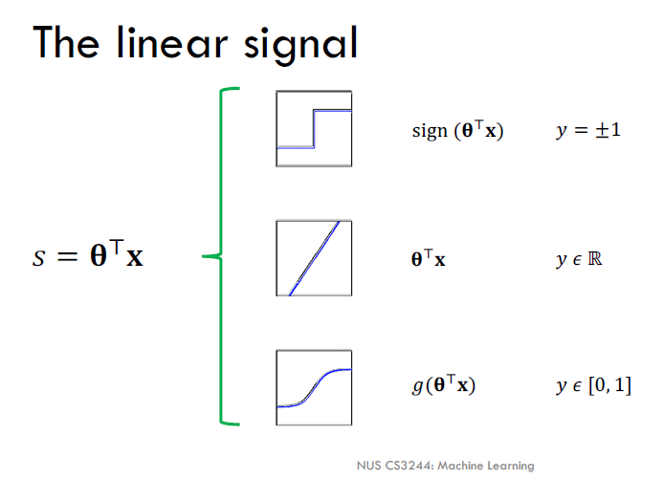

Basic Perceptron
Building block for deep neural networks
Already introduced!
Biological Inspiration
Mathematical Model
Only differ in activation function
Notes:
Let them know that understanding perceptrons is important as it builds into deep neural networks
Introduce perception as mathematical model neuron (Biologically inspired)
Let them know that it has actually already been introduced

Slide 6
Perceptron Learning Algorithm
Logistic Regression
Perceptron
W = W - η * 𝛁L
W = W + η * (y - ȳ) * x
Similarities:
Make a small change to the previous weights
Uses learning rate to control amount of change
Differences:
Logistic Regression using gradient descent to get weight update
Perceptron uses manually crafted weight update
Notes:
Briefly go through the perceptron learning algorithm and note the difference between the logistic regression learning algorithm
Mention that perceptron cannot use gradient descent because it is not differentiable

Slide 7

Extending the Perceptron
1. Use different activation functions - sigmoid, tanh, ReLU
Step and sgn activation function not used because not differentiable
2. Use gradient descent to learn the optimal parameters
For example: using the MSE loss and the sigmoid activation function:
Calculus to derive
3. Combine multiple perceptrons together to obtain Multi-Layer Perceptron / Feed-Forward Neural Network. Allows model to model nonlinear functions
Notes:
Talk about how the perceptron can be extended

Slide 8
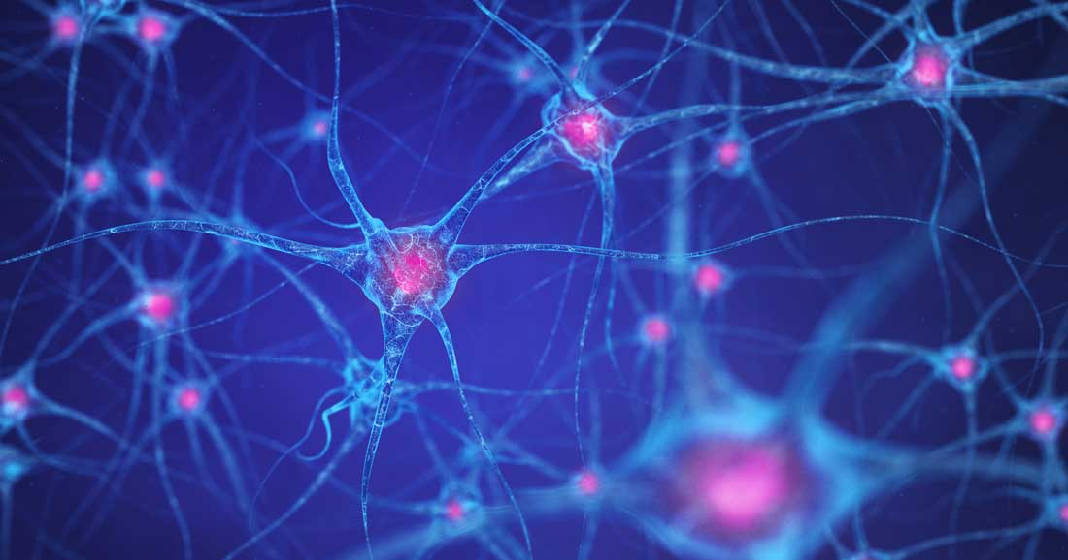
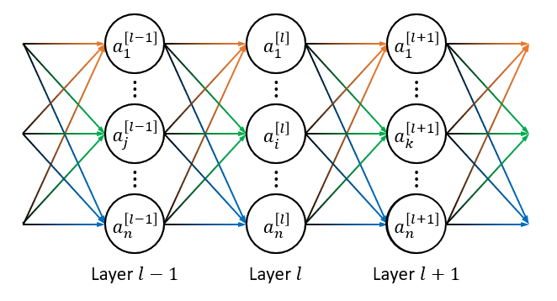
Feed Forward Neural Networks
Biological Inspiration
Mathematical Model
Still very different from how our brain works!
Notes:
Talk about how the perceptron can be extended

Slide 9
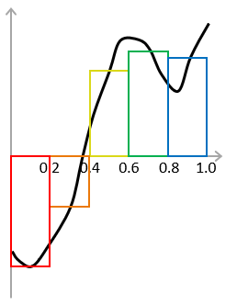
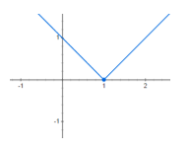
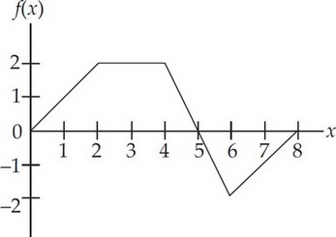
Feed Forward Neural Networks
Why do we connect multiple perceptrons together?
Allows us to model nonlinear functions
Modelled y = |x - 1|
Extend the idea to piecewise functions
2 layer network can model ANY function
Universal Approximation Theorem
Notes:
Talk about how the perceptron can be extended

Slide 10
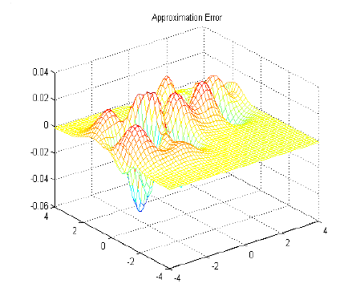
Feed Forward Neural Networks
If 2 layer networks can model ANY functions, why do we need to build deeper models
2 layer networks might be very inefficient
Deeper models allows layers to build upon features extracted from previous layers
Notes:
Talk about how the perceptron can be extended

Slide 11
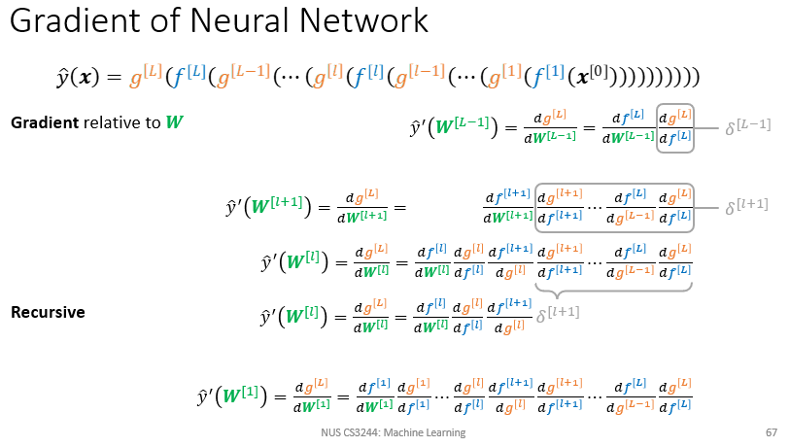
Feed Forward Neural Networks
Use gradient descent and backward propagation to calculate the gradients for weight update. Essentially just a very complicated chain rule
Notes:
Talk about how the perceptron can be extended

Slide 12
Tutorial

Slide 13
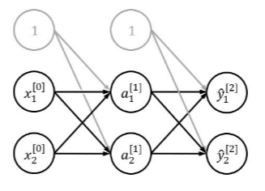

Q1 (a): Given input (2, 3)^{T}, label y=(0.1,0.9)^{T}, compute a^{[1]}, ȳ^{[2]}, L(ȳ, y) after forward propagation.
Note:
Output ReLU Function
MSE loss
Guiding Questions:
What do the rows vs columns of W^{[1]} correspond to?
What does [0] and 2 in x^{[0]}₂ refer to?
Notes:
Will need to write it out and work through it manually to illustrate

Slide 14
Q1 (a): Given input (2, 3)^{T}, label y=(0.1,0.9)^{T}, compute a^{[1]}, ȳ^{[2]}, L(ȳ, y) after forward propagation.
Note:
Output ReLU Function
MSE loss
Guiding Questions:
What do the rows vs columns of W^{[1]} correspond to?
What does [0] and 2 in x^{[0]}₂ refer to?
Columns correspond to features (2D).Rows correspond to nodes (2 weights + 1 bias).
[0] refers to layer 0. 2 refers to “node 2”.0
A common confusion / source of mistakes / time sink during exam is due to the lack of familiarity with the notation. Familiarise yourself!
Notes:
Will need to write it out and work through it manually to illustrate

Slide 15
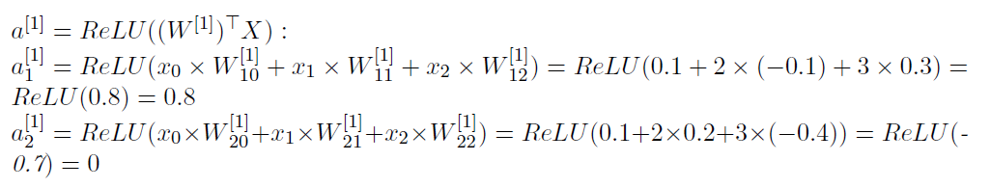
Q1 (a): Given input (2, 3)^{T}, label y=(0.1,0.9)^{T}, compute: a^{[1]}, ȳ^{[2]}, L(ȳ, y).
Note:
Output ReLU Function
MSE loss
[1] refers to layer 1.
1 refers to node 1.
Notes:
Will need to write it out and work through it manually to illustrate

Slide 16
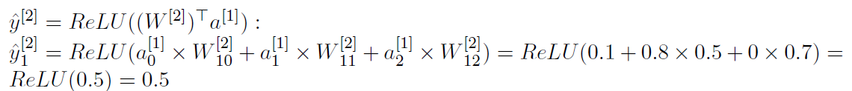
Q1 (a): Given input (2, 3)^{T}, label y=(0.1,0.9)^{T}, compute: a^{[1]}, ȳ^{[2]}, L(ȳ, y).
Note:
Output ReLU Function
MSE loss
Another common careless mistake: Forgetting to apply ReLU after computing matrix multiplication.
Notes:
Will need to write it out and work through it manually to illustrate

Slide 17
Q1 (a): Given input (2, 3)^{T}, label y=(0.1,0.9)^{T}, compute: a^{[1]}, ȳ^{[2]}, L(ȳ, y).
Note:
Output ReLU Function
MSE loss
MSE (Mean Squared Error)
Notes:
Will need to write it out and work through it manually to illustrate

Slide 18

Q1 (b): Calculate gradient/partial derivative of L(ȳ, y) with respect to W^{[2]}₂₁ and L(ȳ, y) with respect to W^{[2]}₁₂
Guiding Questions:
What does [2] and 21 in W^{[2]}₂₁ refer to?
How do you express the partial derivative in terms of the above given expressions?
Notes:
Will need to write it out and work through it manually to illustrate

Slide 19
Q1 (b): Calculate gradient/partial derivative of L(ȳ, y) with respect to W^{[2]}₂₁ and L(ȳ, y) with respect to W^{[2]}₁₂
Guiding Questions:
What does [2] and 21 in W^{[2]}₂₁ refer to?
How do you express the partial derivative in terms of the above given expressions?
[2] refers to weights going out of layer 2.
21 refers to “to node 2, from node 1”.
Notes:
Will need to write it out and work through it manually to illustrate

Slide 20
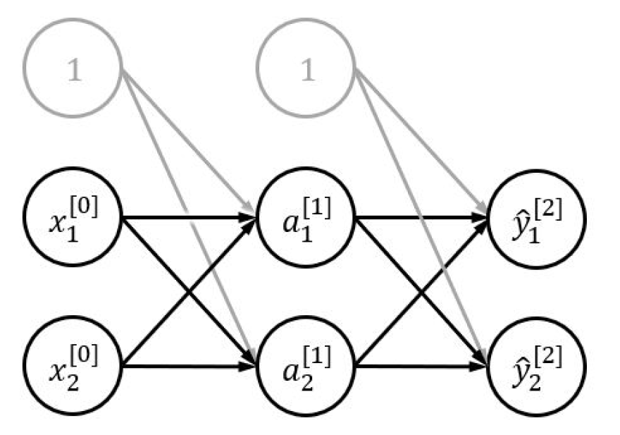
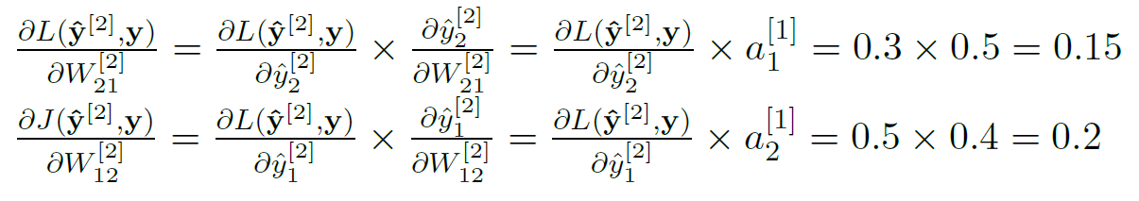
Q1 (b): Calculate gradient/partial derivative of L(ȳ, y) with respect to W^{[2]}₂₁ and L(ȳ, y) with respect to W^{[2]}₁₂
Guiding Questions:
What does [2] and 21 in W^{[2]}₂₁ refer to?
How do you express the partial derivative in terms of the above given expressions?
[2] refers to weights going out of layer 2.
21 refers to “to node 2, from node 1”.
Notes:
Will need to write it out and work through it manually to illustrate

Slide 21
Q2 (a): Model AND, OR, NOT using 1 perceptron. Assume AND and OR take 2 inputs, NOT takes 1 input.
AND
OR
NOT
AND
OR
NOT
IN | IN | OUT
0 | 0 | 0
0 | 1 | 0
1 | 0 | 0
1 | 1 | 1
IN | IN | OUT
0 | 0 | 0
0 | 1 | 1
1 | 0 | 1
1 | 1 | 1
IN | OUT
0 | 1
1 | 0
Notes:
Will need to write it out and work through it manually to illustrate

Slide 22
Q2 (a): Model AND, OR, NOT using 1 perceptron. Assume AND and OR take 2 inputs, NOT takes 1 input.
AND
OR
NOT
AND
IN | IN | OUT
0 | 0 | 0
0 | 1 | 0
1 | 0 | 0
1 | 1 | 1
sgn[0(1) + 0(1) - 1.5] = sgn[-1.5] = 0
sgn[0(1) + 1(1) - 1.5] = sgn[-0.5] = 0
sgn[1(1) + 0(1) - 1.5] = sgn[-0.5] = 0
sgn[1(1) + 1(1) - 1.5] = sgn[0.5] = 1
Notes:
Will need to write it out and work through it manually to illustrate

Slide 23
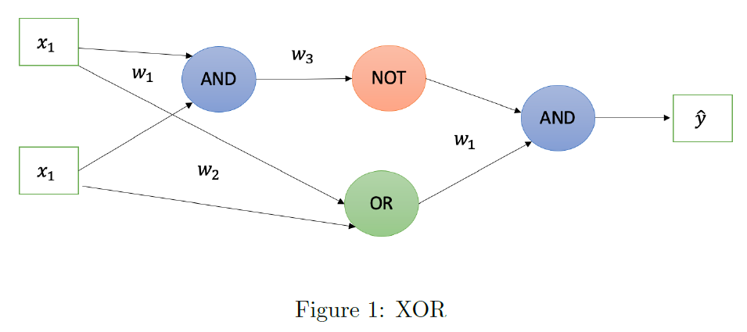
Q2 (b): Model XOR (2 inputs) using perceptrons that implement AND, OR and NOT. Show the diagram and specify weights.
AND
OR
NOT
Notes:
1. NOT(AND(x1,x2)) ensures that input (1,1) will return 0.
2. OR(x1,x2) ensures that input (0,0) will return 0.
3. When we AND the above 2 expressions, we ensure that only (1,0) and (0,1) returns 1.

Slide 24
Q2 (c): Can this function be expressed with a 3-layer perceptron?
Every positive region can expressed using hyperplanes (AND hyperplanes). Then OR of the positive regions would be the final perceptron.
TLDR: The dataset can be classified using a number of hyperplanes.
Notes:
Will need to write it out and work through it manually to illustrate

