Slide 1
CS3244 Tutorial 8
Deep Learning

Slide 2
Agenda
11:01 – 11:07 – Recap: CNNs and RNNs (6 min)
11:07 – 11:15 – Breakout Rooms! (8 min)
11:15 – 11:20 - Q1(a) (5 min)
11:20 – 11:25 - Q1(b) (5 min)
11:25 – 11:30 - Q1(c) (5 min)
11:30 – 11:35 - Q1(d) (5 min)
11:35 – 11:45 - Q2 (10 min)

Slide 3
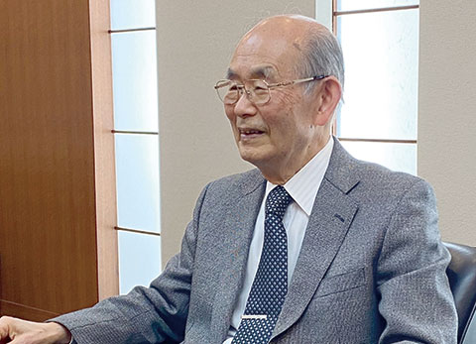
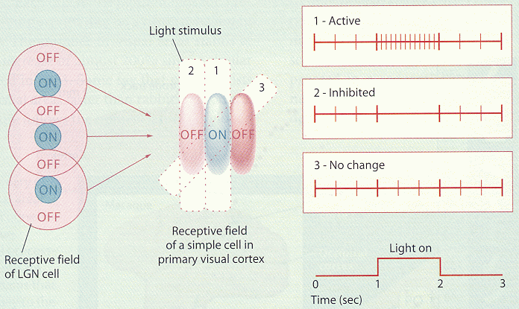

Recap: CNN
History of Convolutional Neural Networks
- Fukushima Kunihiko proposed the “Neocognitron” in 1979.
- The neocognitron was inspired by Hubel & Wiesel in 1959 from the simple and complex cells in the visual primary cortex.
- Kunihiko was awarded the 2021 Bower Award for his highly influential CNN architecture.
- Watch about his contributions, presented by Jürgen Schmidhuber: https://www.youtube.com/watch?v=ysOw6lNWx2o
Fukushima, K. (1988). Neocognitron: A hierarchical neural network capable of visual pattern recognition. Neural networks, 1(2), 119-130.

Slide 4



Recap: CNN
History of Convolutional Neural Networks
- Yann LeCun (A.M. Turing Award Laureate 2018) was the first to use backpropagation to train the CNN, not the first to invent the structure.

Slide 5
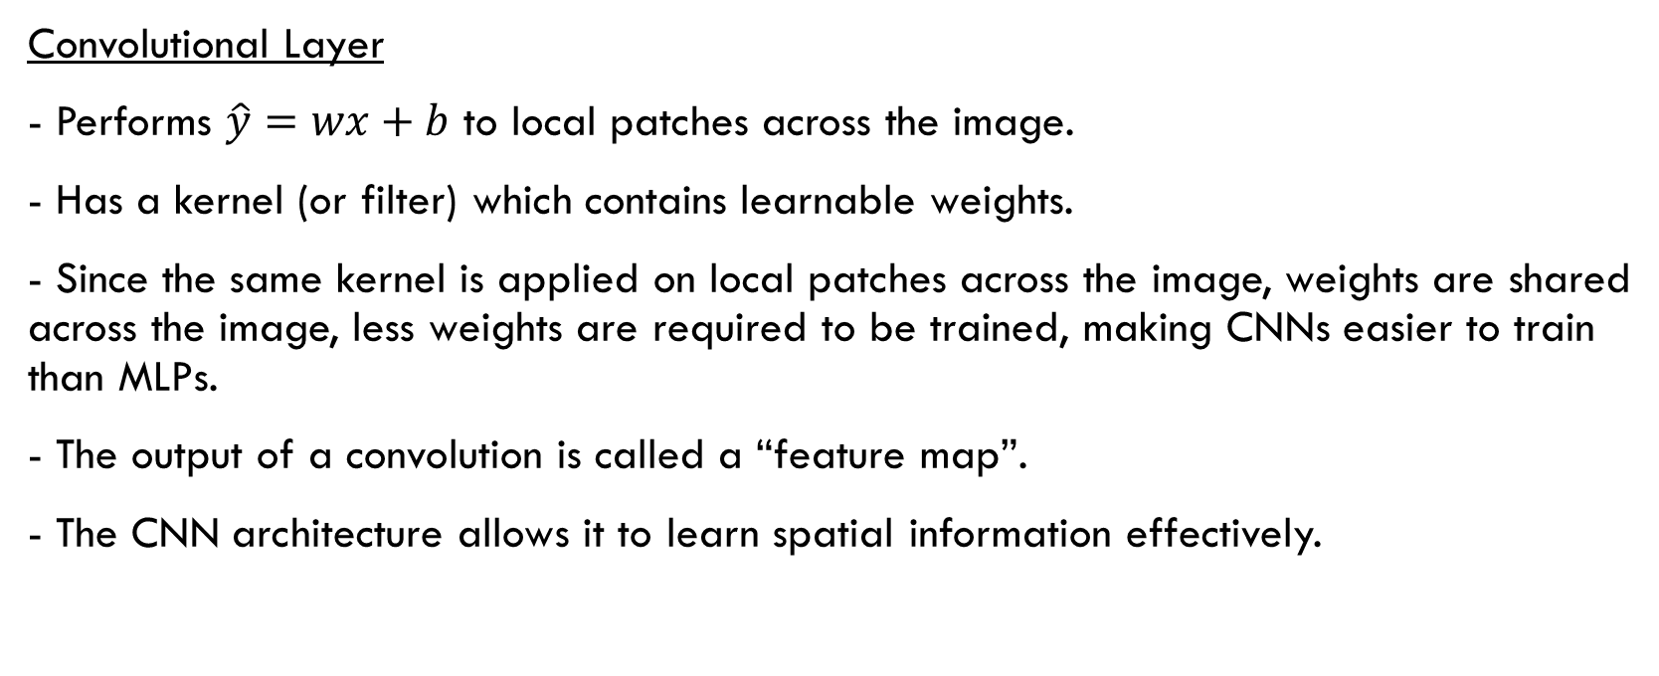
Recap: CNN
Convolutional Layer
- Performs $\hat{y}=wx+b$ to local patches across the image.
- Has a kernel (or filter) which contains learnable weights.
- Since the same kernel is applied on local patches across the image, weights are shared across the image, less weights are required to be trained, making CNNs easier to train than MLPs.
- The output of a convolution is called a “feature map”.
- The CNN architecture allows it to learn spatial information effectively.

Slide 6
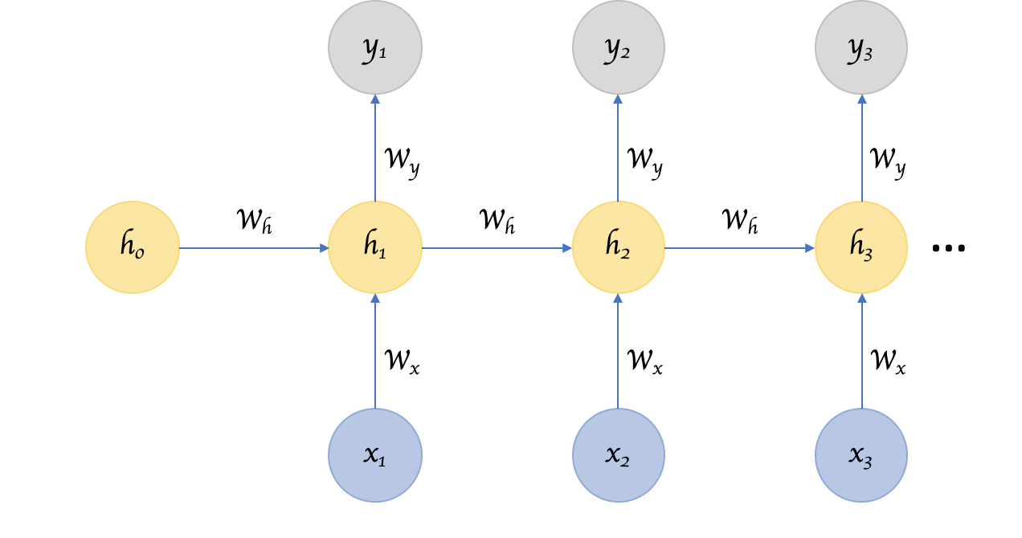
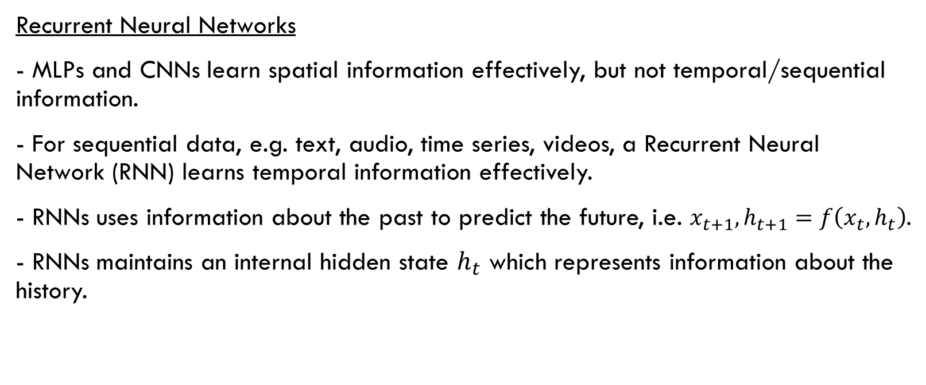
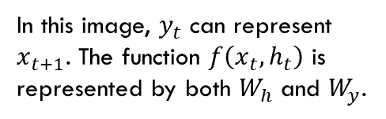
Recap: RNN
In this image, $y_{t}$ can represent $x_{t+1}$. The function $f\left(x_{t},h_{t}\right)$ is represented by both $W_{h}$ and $W_{y}$.
Recurrent Neural Networks
- MLPs and CNNs learn spatial information effectively, but not temporal/sequential information.
- For sequential data, e.g. text, audio, time series, videos, a Recurrent Neural Network (RNN) learns temporal information effectively.
- RNNs uses information about the past to predict the future, i.e. $x_{t+1},h_{t+1}=f\left(x_{t},h_{t}\right)$.
- RNNs maintains an internal hidden state $h_{t}$ which represents information about the history.

Slide 7
Breakout rooms!
Breakout Room 1 – Q1(a)
Breakout Room 2 – Q1(b)
Breakout Room 3 – Q1(c)
Breakout Room 4 – Q1(d)
If you have time, think about Q2.

Slide 8
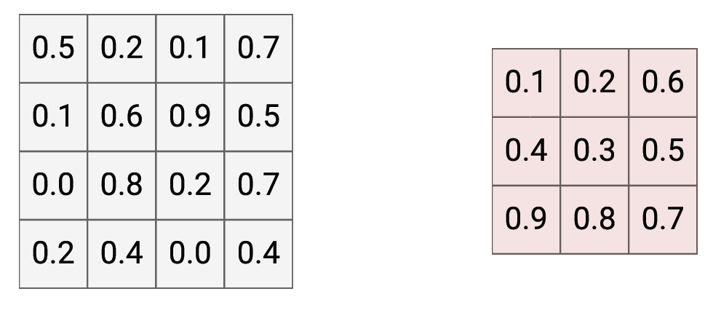
Q1. CNN
(a) Given a 4x4 image, a 3x3 kernel, no padding and 1x1 stride, 1. Get the output feature map from this convolution; 2. Specify the output dimensions.

Slide 9
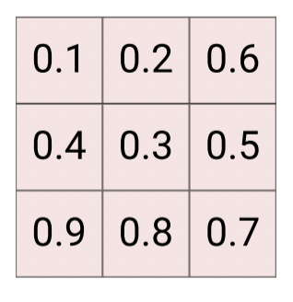
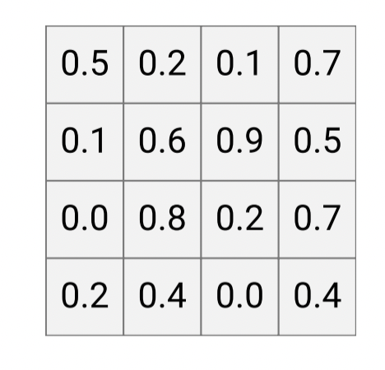
Q1. CNN
(a) Given a 4x4 image, a 3x3 kernel, no padding and 1x1 stride, 1. Get the output feature map from this convolution; 2. Specify the output dimensions.
Output dimension: 2x2
1.60
2.59
Stride = 1x1
Padding = 0x0
1.51
1.91

Slide 10
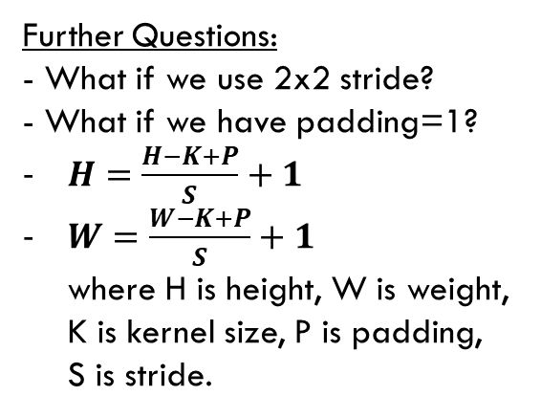
Q1. CNN
(a) Given a 4x4 image, a 3x3 kernel, no padding and 1x1 stride, 1. Get the output feature map from this convolution; 2. Specify the output dimensions.
Further Questions: - What if we use 2x2 stride?
- What if we have padding=1?
$H=\frac{H−K+P}{S}+1$
$W=\frac{W−K+P}{S}+1$ where H is height, W is weight, K is kernel size, P is padding, S is stride.
Output dimension: 2x2
1.60
2.59
Stride = 1x1
Padding = 0x0
1.51
1.91

Slide 11
Q1. CNN
(b) Given a single (224x224x3) image, a convolutional layer with 96 (11x11) kernels, and each kernel with 3 channels, (4x4) stride and no padding, calculate the output size after forward propagation through the first convolutional layer.

Slide 12
Q1b
3D Input
1 x 3D Kernel
3
3
11
11
224
224

Slide 13
Q1b
3D Input
1 x 3D Kernel
3
3
11
11
224
224

Slide 14
Q1b
3D Input
1 x 3D Kernel
3
3
11
11
224
224

Slide 15
Q1b
3D Input
1 x 3D Kernel
3
3
11
11
224
224

Slide 16
Q1b
3D Input
1 x 3D Kernel
3
3
11
…
11
224
224

Slide 17
Q1b
3D Input
1 x 3D Kernel
3
3
11
…
11
224
224

Slide 18
Q1b
3D Input
1 x 3D Kernel
3
3
11
…
11
224
224

Slide 19
Q1b
3D Input
1 x 3D Kernel
3
3
11
…
11
224
224

Slide 20
Q1b
3D Input
1 x 3D Kernel
1 x 2D Feature Map
3
3
11
…
11
224
224

Slide 21


1b
$H=\frac{H−K+P}{S}+1$
$W=\frac{W−K+P}{S}+1$ where H is height, W is weight, K is kernel size, P is padding, S is stride.
Calculate the size of a 2D feature map:
= {(224 + 0 – 11)/4 + 1 x (224 + 0 – 11)/4 + 1}
= {54 x 54} (round down to the nearest integer)

Slide 22
Q1b
3D Input
1 x 3D Kernel
1 x 2D Feature Map
3
3
11
11
224
54
54
224

Slide 23
Q1b
3D Input
96 x 3D Kernels
96 x 2D Feature Maps
3
…
96
224
54
54
224
Size of 96 x 2D feature maps: {96 x54 x 54}

Slide 24
Q1. CNN
(c) Specify the output shape if we use a batch of images instead of a single image. What are the advantages of using a batch of images?

Slide 25
Q1. CNN
(c) Specify the output shape if we use a batch of images instead of a single image. What are the advantages of using a batch of images?
Output shape: B x 96 x 54 x 54.
Batch training is computationally more efficient due to parallelisation with GPUs and more stable in gradient descent convergent (Recall: stochastic vs batch gradient descent).
Optional: Batch training tricks also become available, e.g. Batch Normalization. Read: https://gauthamkumaran.com/batchnormalization/

Slide 26
Q1. CNN
(d) Why is it a good design choice to stack 2 convolutional layers, each with 3x3 kernels, one after the other on an image, instead of a single convolutional layer with a 5x5 kernel? Assume 1x1 stride.
3x3
3x3
5x5
Image
vs
Image

Slide 27
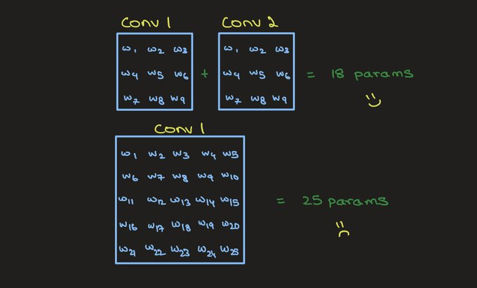
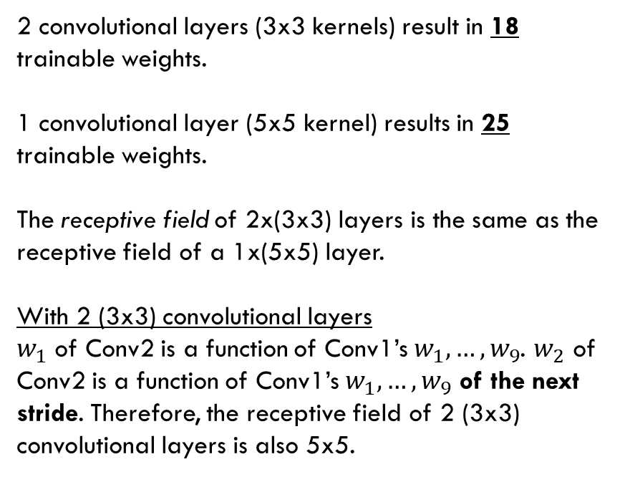
Q1. CNN
(d) Why is it a good design choice to stack 2 convolutional layers, each with 3x3 kernels, one after the other on an image, instead of a single convolutional layer with a 5x5 kernel?
2 convolutional layers (3x3 kernels) result in 18 trainable weights.
1 convolutional layer (5x5 kernel) results in 25 trainable weights.
The receptive field of 2x(3x3) layers is the same as the receptive field of a 1x(5x5) layer.
With 2 (3x3) convolutional layers
$w_{1}$ of Conv2 is a function of Conv1’s $w_{1},…,w_{9}$. $w_{2}$ of Conv2 is a function of Conv1’s $w_{1},…,w_{9}$ of the next stride. Therefore, the receptive field of 2 (3x3) convolutional layers is also 5x5.

Slide 28
Q2. Discussion questions
What model do you use to model the sentiment of sentences?
- RNN or CNN both works. Since sentences are a sequence of words, RNNs are a natural model for sentences. Nonetheless, a 1D CNN is also capable of modelling sequences.
- In fact, in the past when computational resources were limited, first transforming a long sequence through a CNN before applying into a RNN was a feasible method of modelling time series data. (Chollet, Francois. Deep learning with Python. Simon and Schuster, 2017.) [Book, Code]
What model do you use for translation between 2 languages?
- RNN. This is a case of “many-to-many” architecture (e.g. autoencoder), where the output comes strictly after encoding all of the input sentences’ tokens. The encoded representation is then decoded into the output language.

