Slide 1
CS3244 tutorial 9
Rnns and explainable ai (xai)

Slide 2
agenda
11:01 – 11:07 – Kahoot!
11:07 – 11:15 – Breakout Rooms
11:15 – 11:25 – Q1
11:25 – 11:35 – Q2
11:35 – 11:45 – Q3
11:45+ - Advice on ML from here onwards…

Slide 3
Breakout rooms!
Breakout Room 1 – Q1
Breakout Room 2 – Q2
Breakout Room 3 – Q3

Slide 4
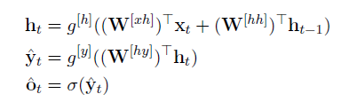

1(a) Backpropagation through time (bptt)

Slide 5
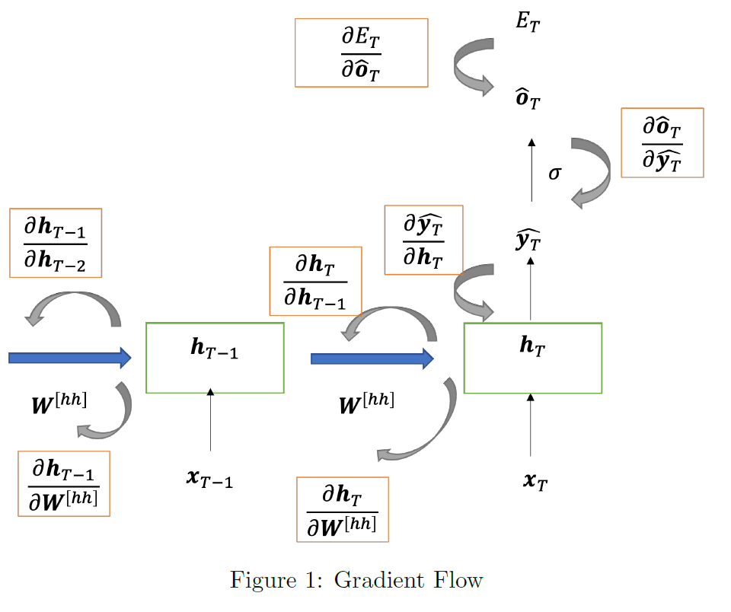
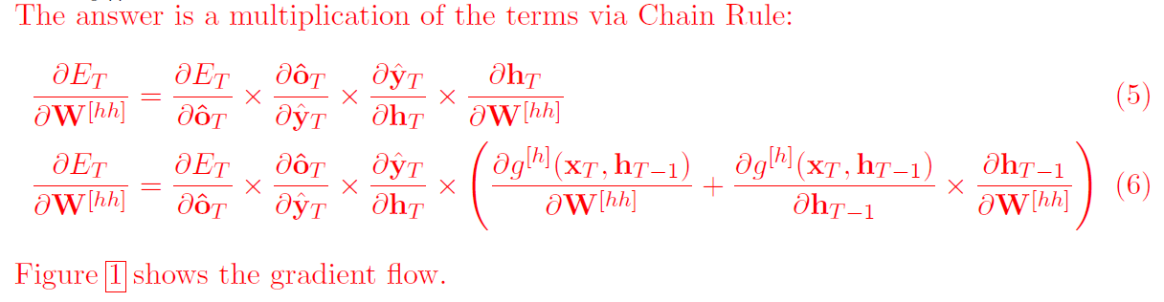
1(a) BPTT

Slide 6
1(b) which term is responsible for vanishing gradients?

Slide 7
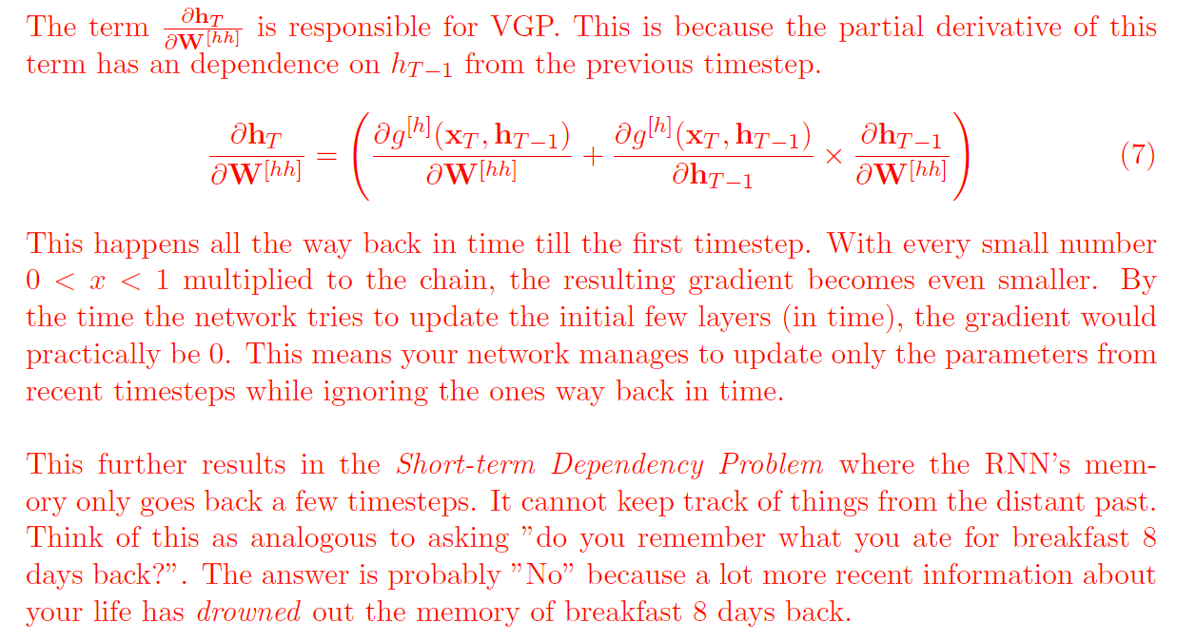
1(b) which term is responsible for vanishing gradients?

Slide 8
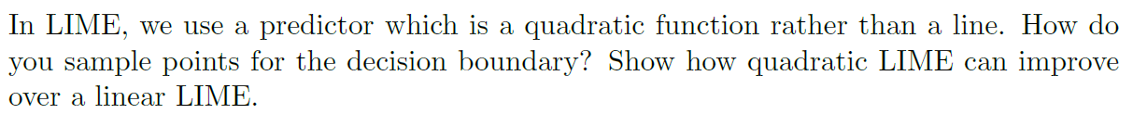
2(a) lime

Slide 9
2(a) lime

Slide 10
2(b) What are the disadvantages of lime for explanation?

Slide 11
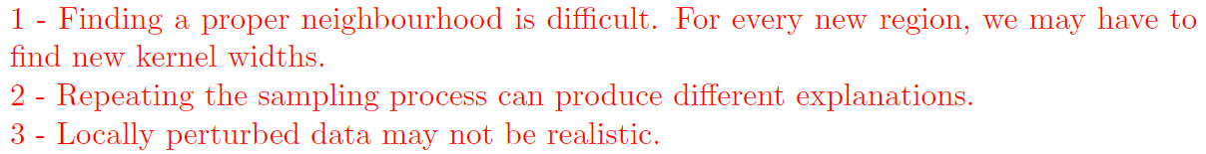
2(b) What are the disadvantages of lime for explanation?

Slide 12
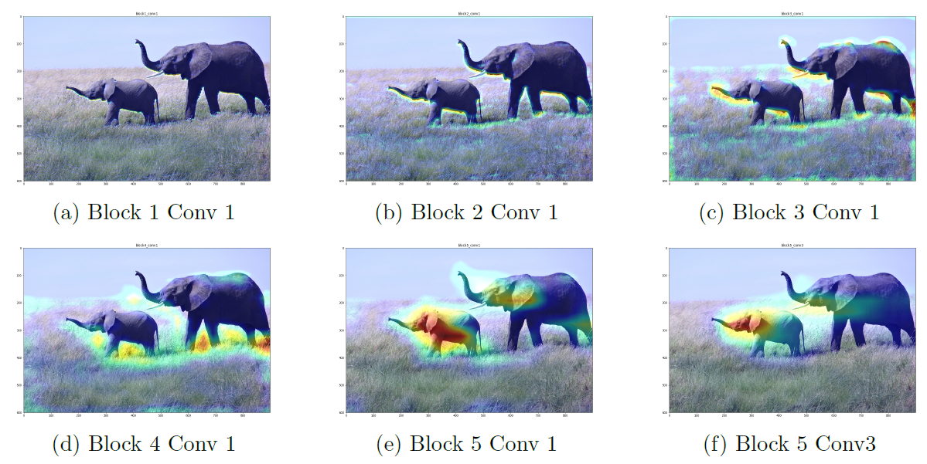
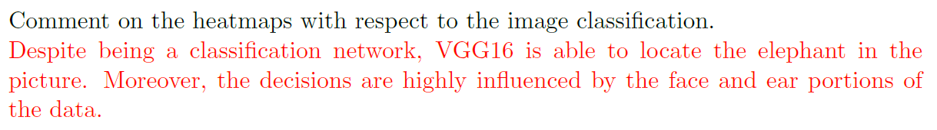
3(a) xai: class activation mapping

Slide 13
3(a) xai: class activation mapping

Slide 14
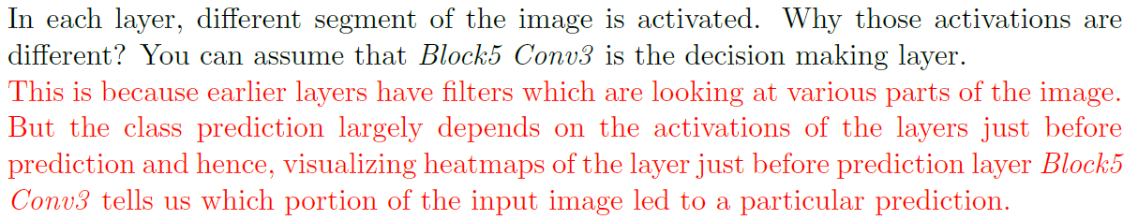
3(b)

Slide 15
3(b)

Slide 16
3(b)

Slide 17
Machine learning: from here onwards…
On Exams
At least understand everything that has been gone through in the module.
If possible, familiarise yourself with everything.
On Understanding
ML is wide, deep and still advancing, so it is difficult.
In the end, understanding still depends on foundations.
On Learning
Online courses – deeplearning.ai, CS294 Deep Unsupervised Learning, and many more.
NUS Modules – CS3243, CS4243, CS4246, CS4248, CS5242, CS5260, CS5339, CS5340.
On Interest - @jetnew

