Slide 1
CS3244 Tutorial 10
Unsupervised Learning

Slide 2
Agenda
11:03 – 11:10 – Kahoot!
11:10 – 11:20 – Breakout Rooms
11:20 – 11:30 – Q1
11:30 – 11:40 – Q2

Slide 3
Breakout Rooms! (10 minutes)
Breakout Room 1 – Q1
Breakout Room 2 – Q2

Slide 4
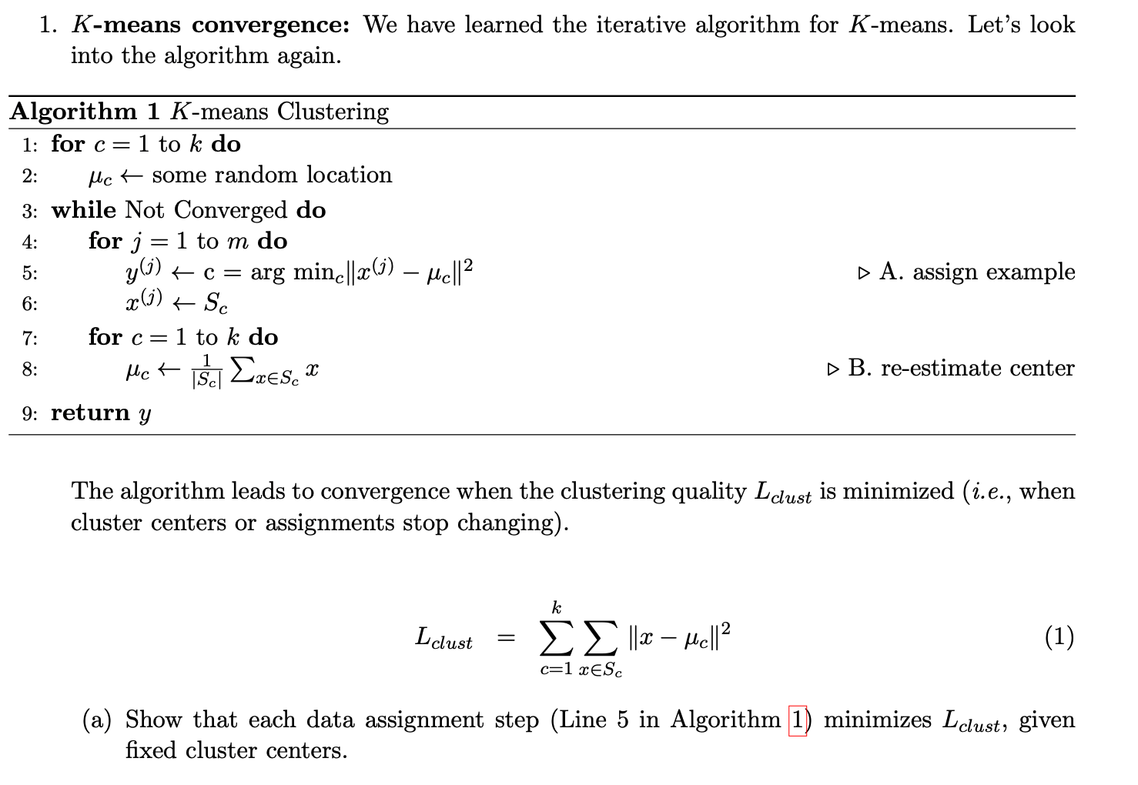

Slide 5
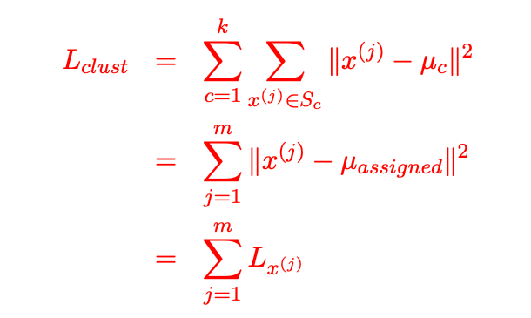
Rewrite $L_{clust}$ into the sum of distances between individual data point and their assigned centers
Sum of distances between each data point and its assigned cluster.
Minimizing $L_{clust}$ is thus equivalent to separately minimizing $L_{x^{\left(j\right)}}$ for all $j∈[0,m]$, which can be achieved by assigning every data point to its nearest center.

Slide 7
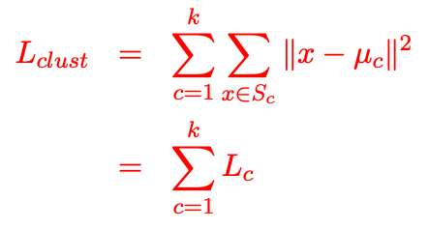
Rewrite $L_{clust}$ into the sum of errors for each cluster.
To minimize $L_{clust}$, it suffices to individually minimize $L_{c}$ for all $c∈[1,k]$ because the assignment is fixed.

Slide 8
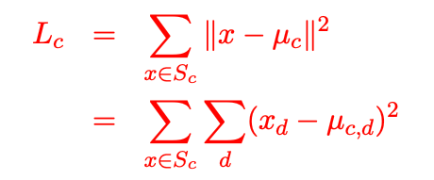

We now look at $L_{c}$ for arbitrary $c∈[1,k]$.
d represents dimension.
To minimize $L_{c}$, the derivative of $L_{c}$ with respect to $μ_{c}$ should be 0.
Recall $μ_{c}∈R^{n}$, we have
$$\frac{∂L_{c}}{∂μ_{c}}=\left(\begin{matrix}\begin{aligned}\frac{∂L_{c}}{∂μ_{c,1}} \\ \frac{∂L_{c}}{∂μ_{c,2}}\end{aligned} \\ \begin{aligned}⋮ \\ ⋮\end{aligned} \\ \frac{∂L_{c}}{∂μ_{c,n}}\end{matrix}\right)$$

Slide 9
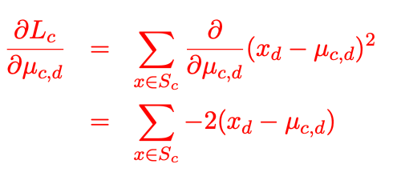
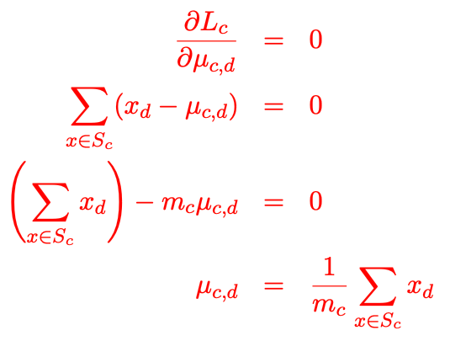


We look at a single dimension of $\frac{∂L_{c}}{∂μ_{c}}$ once at a time. For arbitrary $d∈[1,n]$, we have
Looks familiar? This is similar to computing the gradient of MSE for linear regression
Set the derivative to $0$.
Drop the ‘-2’ since it still equates 0.
Take the $μ$ out of the $∑$.
For an arbitrary dimension of $μ_{c}$, the value that minimizes $L_{c}$ is the mean value of data points in cluster $S_{c}$.

Slide 11
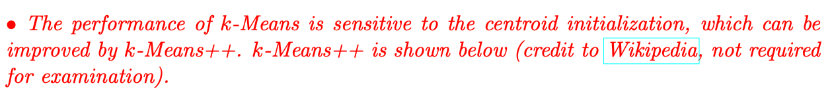

Slide 12
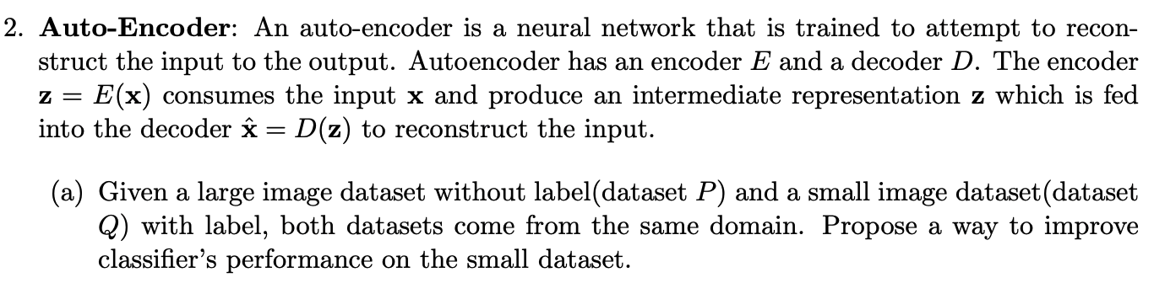

Slide 13
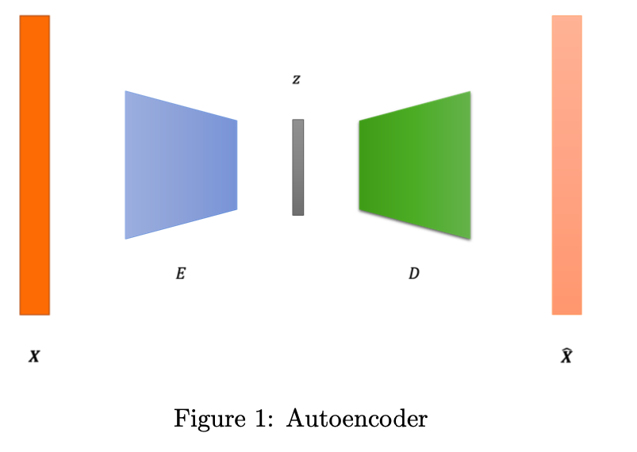
Step1: Pre-train a deep convolutional autoencoder on the dataset $P$

Slide 14
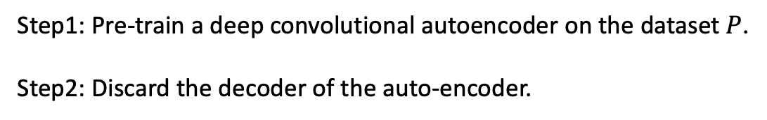
Step1: Pre-train a deep convolutional autoencoder on the dataset $P$.
Step2: Discard the decoder of the auto-encoder.

Slide 15
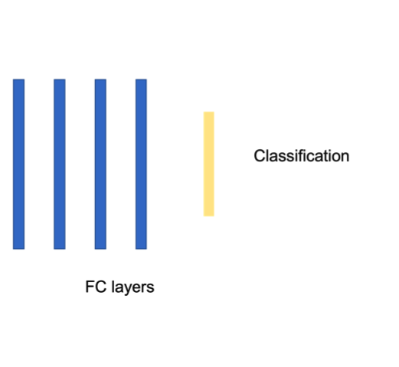
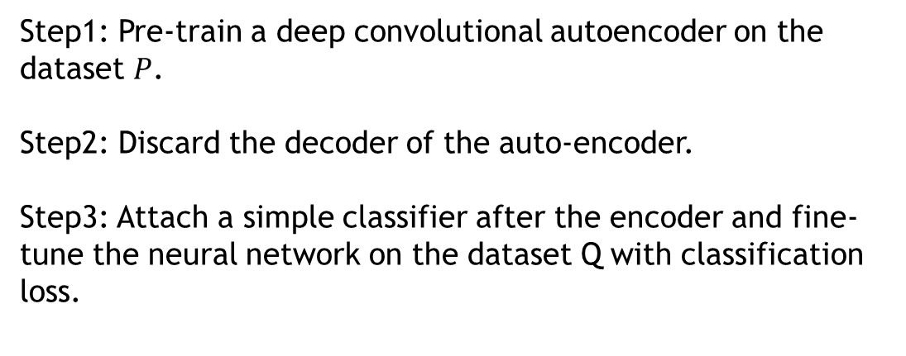
Step1: Pre-train a deep convolutional autoencoder on the dataset $P$.
Step2: Discard the decoder of the auto-encoder.
Step3: Attach a simple classifier after the encoder and fine-tune the neural network on the dataset Q with classification loss.

Slide 16
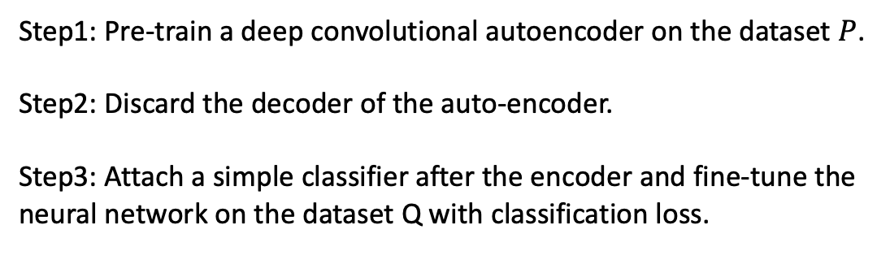
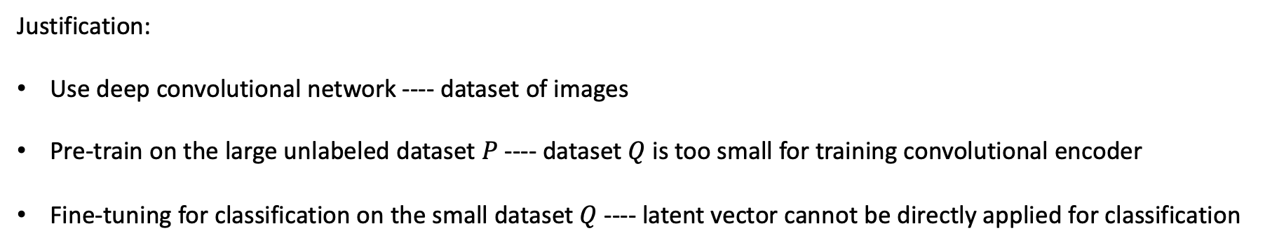
Step1: Pre-train a deep convolutional autoencoder on the dataset $P$.
Step2: Discard the decoder of the auto-encoder.
Step3: Attach a simple classifier after the encoder and fine-tune the neural network on the dataset Q with classification loss.
Justification:
Use deep convolutional network ---- dataset of images
Pre-train on the large unlabeled dataset $P$ ---- dataset $Q$ is too small for training convolutional encoder
Fine-tuning for classification on the small dataset $Q$ ---- latent vector cannot be directly applied for classification

Slide 17
Step1: Pre-train a deep convolutional autoencoder on the dataset $P$.
Step2: Discard the decoder of the auto-encoder.
Step3: Attach a simple classifier after the encoder and fine-tune the neural network on the dataset Q with classification loss.
Note: There are 2 ways of fine-tuning a pre-trained model.
Continue to train the weights of the pre-trained model along with the classifier.
Pros: Able to tune the entire architecture more effectively to the dataset-of-interest Q.
Cons: May cause catastrophic forgetting of the pre-trained model.
Freeze the weights of the pre-trained model, and use its outputs as extracted features and train the classifier.
Pros: Avoids catastrophic forgetting of the pre-trained model.
Cons: May not be as performant as method 1 on the dataset-of-interest Q.
In practice, method 2 is generally preferred, since performance usually does not differ greatly.

Slide 18
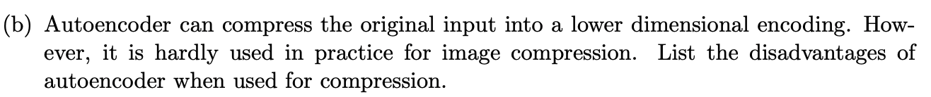

Slide 19
Lossy. Autoencoder loses pixel information because it aims to discard the unimportant features and retain only important features. On the contrary, modern image format like PNG can achieve lossless compression.
Data Dependent. Autoencoder works well only if the input comes from the same distribution of the training set. If the input is out of distribution, the recovered image quality will be very poor.

Slide 20
Questions?

Slide 21

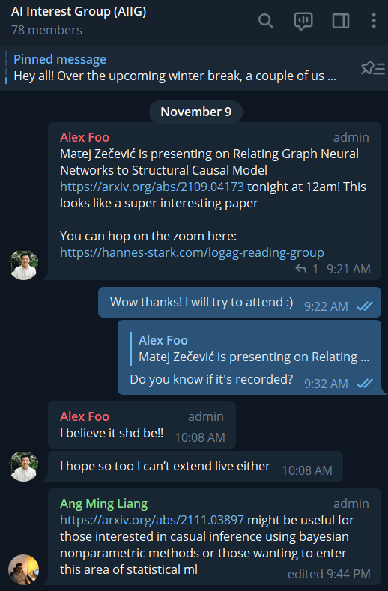
Thank you for a great teaching experience!
NUS Statistics & Data Science Society – Website, Telegram
AI/DS/ML Workshops, Career Talks & Sharings, Data Science Competition
AI Interest Group – PM @jetnew
Telegram group among friends who are interested in AI. PM me @jetnew and I’ll add you!
Research Interests – Reinforcement learning, multi-agent systems, causality.
Socials - LinkedIn, GitHub, Portfolio
Any further advice: PM me @jetnew on Telegram.

