Slide 1

Predict Car Accident Severity

Slide 2
Predicting Car Accident Severity is valuable for city government and management.
In order to reduce the frequency of car collisions in the community, an optimal model must be developed to predict the severity of the accident under the current weather, road and visibility conditions. When the conditions are bad, the model can warn the driver to remind them to be more careful.

Slide 3
Data acquisition and cleaning
The car accident severity report in Seattle can be found online. There are 194673 cases accidents with 38 kinds of different features.
We will use the WEATHER, ROADCOND, COLLISIONTYPE, LIGHTCOND and VEHCOUNT to predict the SEVERITYCODE.
After data preparation, there are 189316 cases accidents with 5 kinds of different features and 1 predict label.

Slide 4
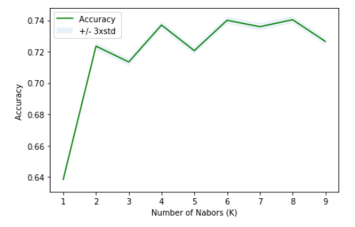
Classification Model
Method | Accuracy | Jaccard Score | F1-Score | Log Loss
KNN | 0.74 | 0.74 | 0.70 | \
Decision Tree | 0.75 | 0.75 | 0.71 | \
SVM | 0.75 | 0.75 | 0.71 | \
Logistics Regression | 0.72 | 0.72 | 0.66 | 0.58

Slide 5
Conclusion
From the figure we can see that this model can perform best when the k=8. Also, from the accuracy table, we know that for this classification case, both Decision Tree and Support Vector Machine can perform well and give us an accuracy of 75%.
In this study, I analyzed the relationship between car accident features and the severity. I identified weather, road condition , collision type, light condition and vehicle count that affect the accident severity. I built classification models to predict the accident severity. These models can be very useful in helping road management in several ways. For example, drivers should reduce driving when the weather condition is bad, pay more attention to the road with less light, etc.

