Slide 1
Introduction to Cloud Computing

Slide 2
Opening speech (chitchat)…
Introduction of myself
What this course is about
  Fundamental cloud knowledges and how they are deployed in the real world
  Essential cloud services and how they are used in business
  Design, implement and maintain a cloud hosted system
  Basic hands-on operation using cloud resources
What this course is NOT about
  Coding technique in cloud
  Techniques to build a data center
  Detail parameter tweaks in cloud
Knowledge level after this course (compare to a cloud company junior employee)
  Theoretical – 70% Practical – 30%
Requirement
  Attend classes…do assignment yourself…contribute to project…use online resources

Slide 3
Outline of the course
Introduction of Cloud Computing
Compute Services in Cloud
Storage and Database Services in Cloud
Networking in Cloud
IAM and Security in Cloud
Reliability and Incident Management
Development Cycle and Business Process in Cloud Management
Project Proposal Presentation
Hybrid Infrastructure and Migration
Industry-specific modules in Cloud
Core features in Cloud
Business related topics

Slide 4
Objective of the course
Understand the basic and key concept of Cloud
Able to differentiate and pick the correct services offered by CSPs
Understand the pillars of making and managing a good Cloud Solution
Have preliminary hands on experience on Cloud platform
Learn to handle the ambiguity and uncertainty in Cloud environment.
Learn to design and operate a single purpose cloud system
Understand the modernization techniques and trend of Cloud Computing
Important Notice:
  This course is NOT difficult to understand
  But it’s heavy in terms of concepts, services, and CSP document reading

Slide 5
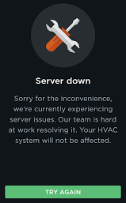
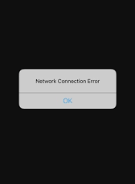
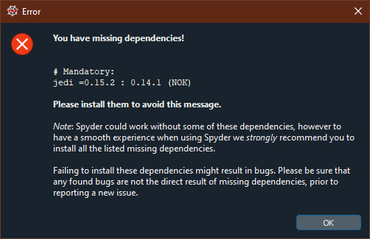
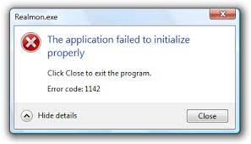
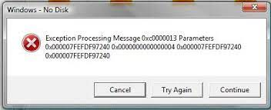
Why need cloud?
4 Scenarios in our daily life
  Computer crash when you’re playing a game or writing your thesis
  You installed a new software but can’t use because of lacking dependencies
  You want to write a simple “Hello World” code, but spent several days to set up the coding environment
  You bought an expensive GPU and only use it several hours a week…
  4 Scenarios in corporate
    Large number of IT engineer to maintain system and Database
    Long admin process to buy/discard hardware/software
    Crazy during disaster: no engineer can go back office during Covid-19 lockdown
    To guarantee service availability, many servers are deployed just as redundancy
Notes:
Spend a lot of time doing infrastructure/environment set up → Time consuming
Companies don’t have to worry about managing the infrastructures

Slide 6
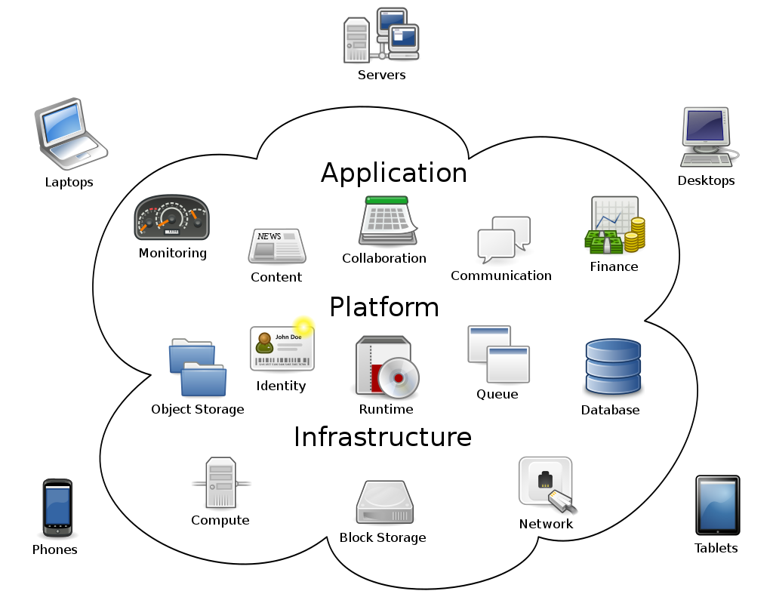
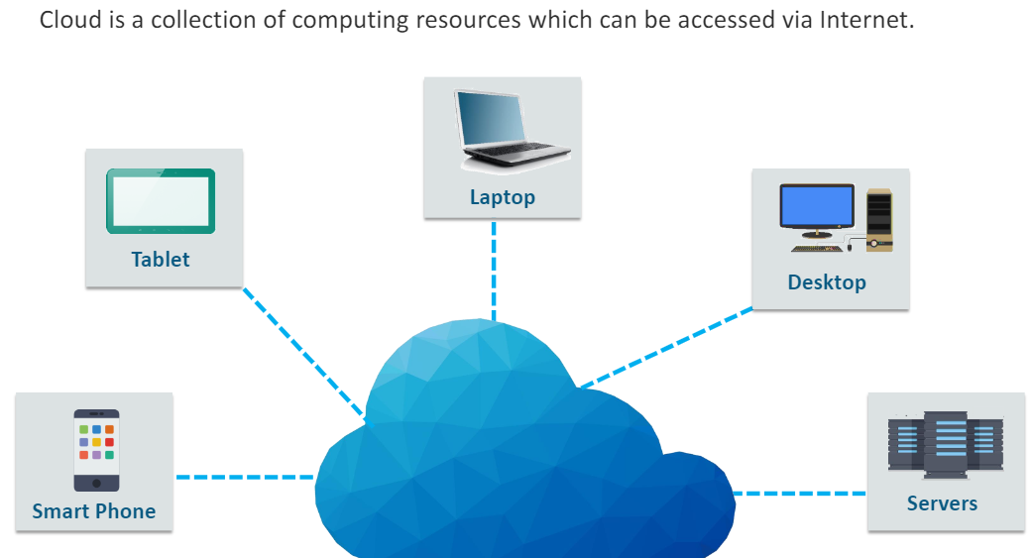
Introduction-cloud
What is Cloud Computing?
  [From wiki] Cloud computing is the on-demand availability of computer system resources, especially data storage (cloud storage) and computing power, without direct active management by the user.
  Key problems solved by Cloud
  Who manages the infrastructure
  How to maximize the utilization of infrastructure (resource sharing, reduce cost)
  Flexibly add/remove resources to keep up the pace of IT system evolvement
Notes:
On demand – you pay for what you need

Slide 7
Introduction-history
Time-sharing technology was popular in 1960s
The term cloud was used to refer to platforms for distributed computing as early as 1993
"cloud computing" appeared as early as 1996 in a Compaq internal document
Meanwhile, virtual private network service is introduced by telecom companies in 1990s
In July 2002, Amazon created subsidiary Amazon Web Services
In March 2006 Amazon introduced its Simple Storage Service (S3), followed by Elastic Compute Cloud (EC2) in August of the same year.
In April 2008, Google released the beta version of Google App Engine
2008~2009, NASA and US government start to deploy projects using cloud
In February 2010, Microsoft released Microsoft Azure
Since then, cloud computing changes to fast lane……

Slide 8
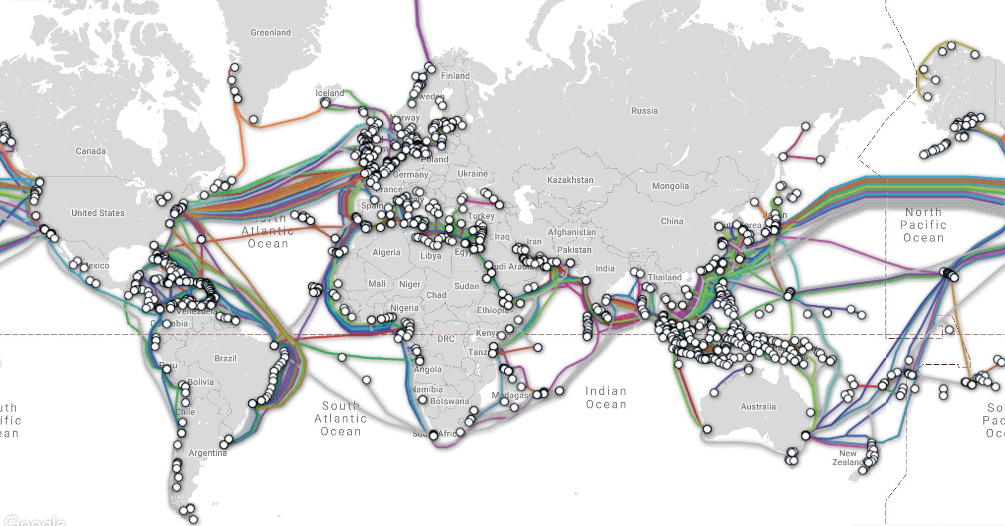
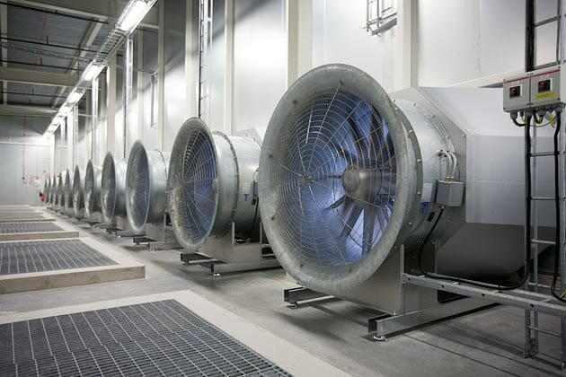
Introduction-enablement
Cloud enabling technologies – hardware
  Powerful computers
  High-speed Fibre network
  Global Submarine communication cables
  Efficient power supply systems
  Advanced environmental control (humidity, light, temperature, etc)
  Low-voltage cable routing
  Aisle containment & fire protection
  Standardization (e.g. EN50600 and ISO22237)
There are more than 70 operational data centers in Singapore , accounted for about 7% of the country’s total yearly electricity consumption (from Ministry of Trade and Industry)
Notes:
Standardization: all data centers have a standard to follow (e.g cooling temp, network bandwidth)

Slide 9
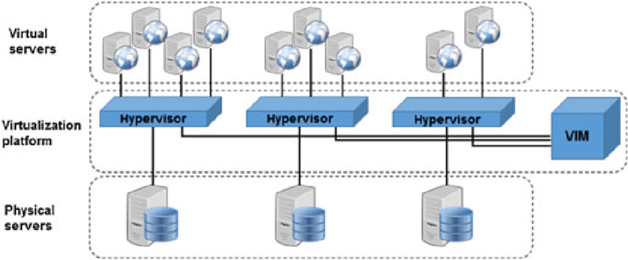
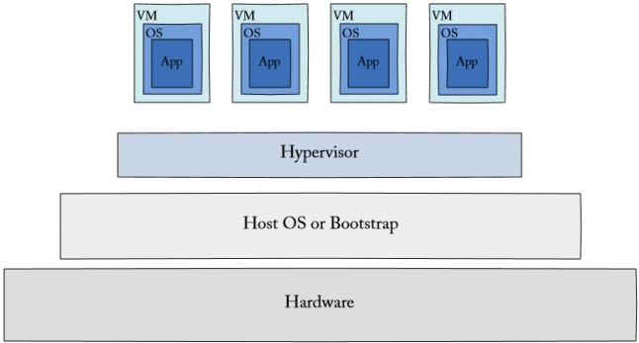
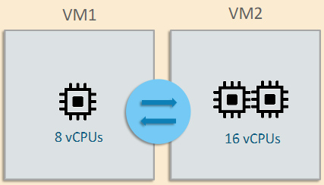
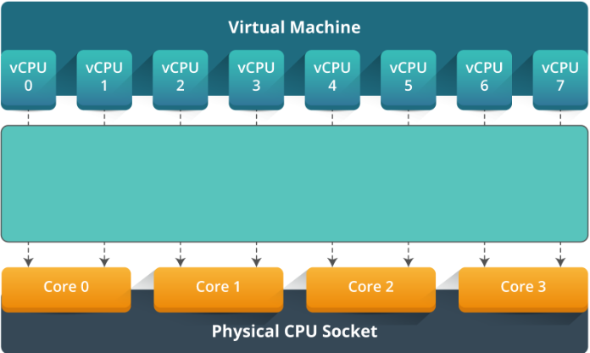
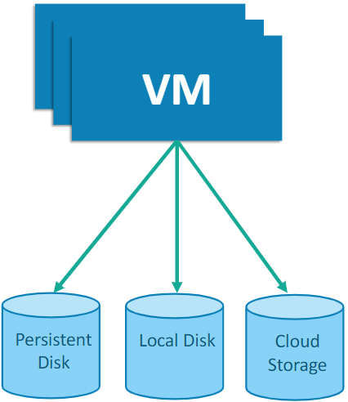
Cloud enabling technologies - software
VMWare
Microsoft (Hyper-V)
Citrix (Xen)
RedHat (KVM, SPICE)
Oracle (Solaris Zones, Ldoms, xVM)
Notes:
VM Ware – virtualize your one physical machine into virtual VMS ( Hypervisor isolate hardware layer and OS layer) → different VMs install their own OS system and they communicate with hypervisor. Hypervisor communicate with underlying hardware.
Hypervisor – allow us to divide one physical machine into different VMs

Slide 10
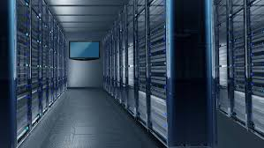
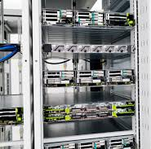
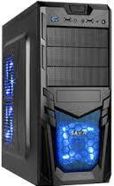

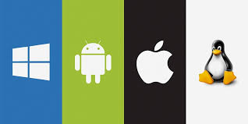
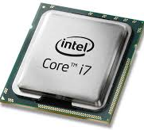
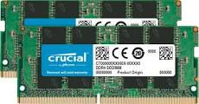
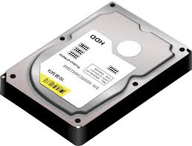
Introduction-terminology
DC, Rack, Images
Hypervisor
  A hypervisor or virtual machine monitor (VMM) is a piece of software that allows physical devices to share their resources among virtual machines (VMs) running on top of that physical hardware. The hypervisor creates, runs and manages VMs.
Co-location (co-lo)
  A data center that provides rental space, network connections, power, cooling, and security for servers that you manage and maintain.
API – Application Programming Interface
CLI – Command Line Interface
CSP – Cloud Service Provider (AWS, Azure, GCP, Alibaba, etc)
Notes:
DC: Data center
Inside Rack – different layers where each layer is one physical machine . Inside the physical machine we have memory, OS, storage, RAM etc.
Different way to access cloud : One way is using CLI , you can give it a batch file to create many servers.

Slide 11
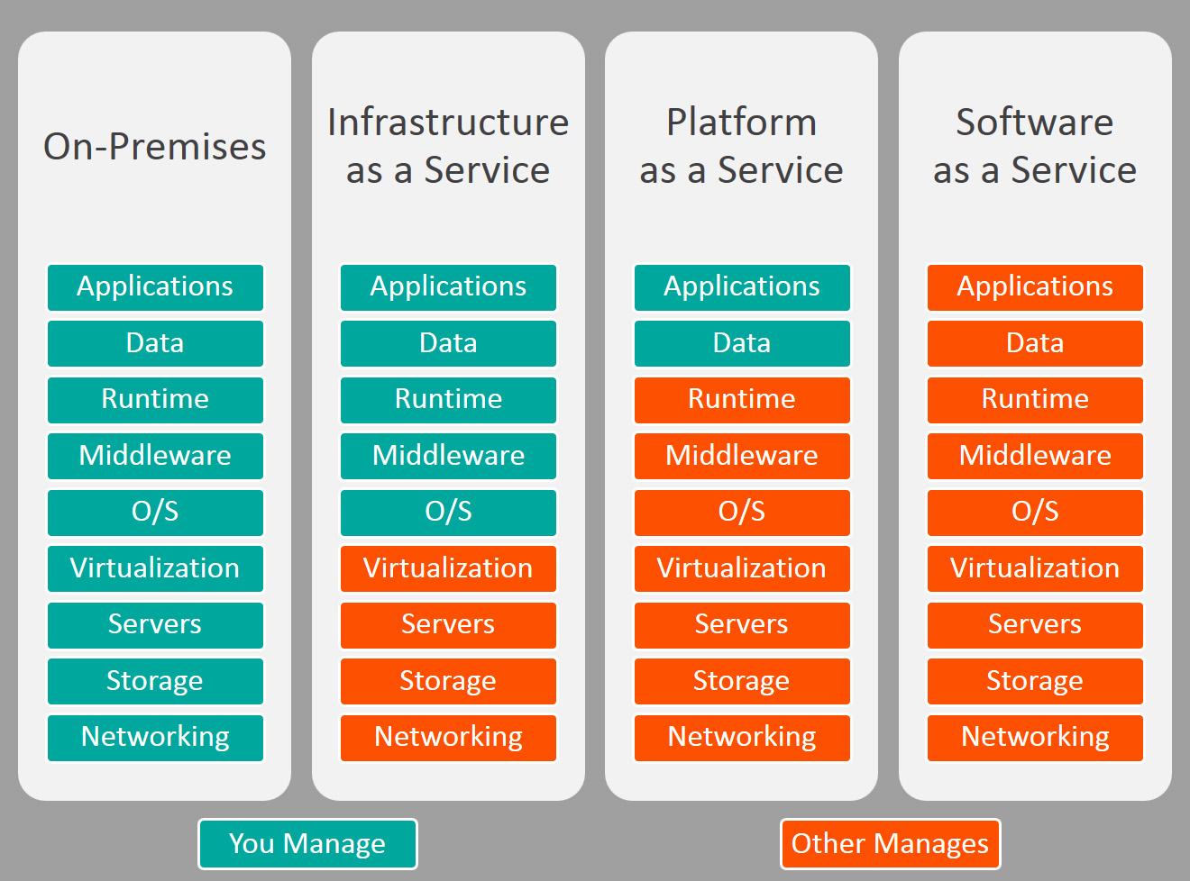
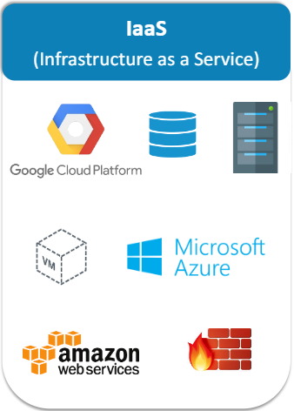
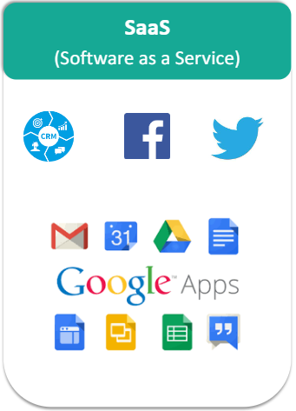
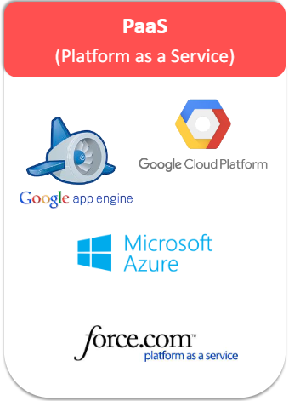
Service Models: Haas, Iaas, Paas, Saas
Notes:
Haas: Hardware as a service, just renting a physical server from CSP
Other manages : CSP manages
All has Virtualization, cloud svc are base on VM technology so that it can be split and scaled to different people. (all deployed on VMs)

Slide 12
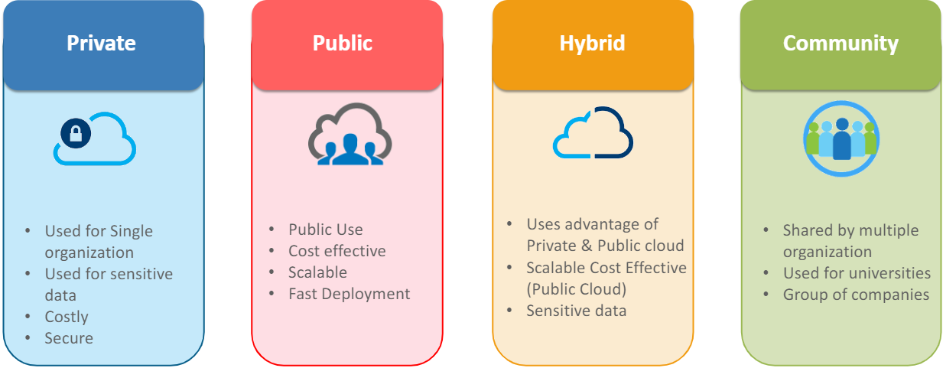
Private cloud, public cloud, hybrid cloud
Notes:
Public, everyone can use: AWS, Azure , GCP !
Private: on prem cloud
Hybrid-cloud: Must have at least one data center on prem != Multi cloud
Multi-cloud: using two or more public cloud providers, not necessarily to be connected.
Community: GCC – all government agencies must use GCC

Slide 13
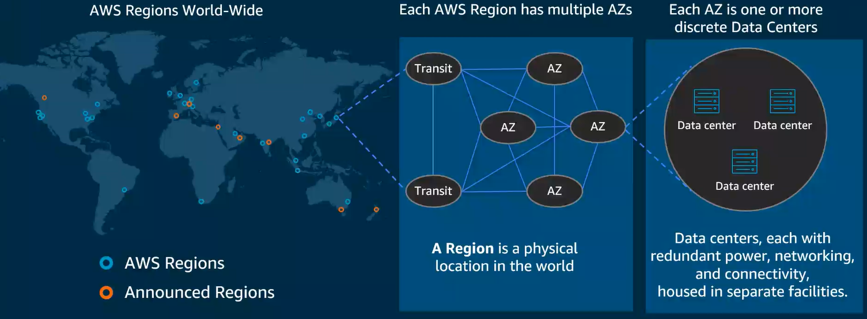
Global, regional, zonal resources
  Regional – a cluster of data centers within nearby cities
  Zonal – a cluster of buildings within a data center
Note: It is important to pay attention on the geographical availability of resources
  VPC is a global resource for GCP but Regional Resource for AWS
  Subnets are regional resources for GCP but Zonal Resource for AWS
  Persistent disks are only accessible by other instances within the same Availability Zone(AZ)
Notes:
Global: you can view created resource from any continent globally
Zonal: SG is one region we have different zones (e.g one in Changi with 3 buildings == 1 Zone) AWS calls these AZ (Availability Zone)
AWS EC2 == Azure VM
AZ1 In SG region→ u cannot see this resource, use image in AZ1 from AZ2.
SDD Storage – you can only connect to the same zone machine ( if create in AZ1 u cannot attach in AZ2, won’t be able to see it) → good security, not expose to global network
Reigional → As long as within region, can attach any resources across AZ
VPC: Virtual Private Cloud ( Private network) . In GCP can create one in US, SG, Philipines and connect it together. But in AWS you can only create VPC within one region inbetween you have to use transit gateway/vpn/ internet to communicate with each other
Transit : Diverts traffic to different regions
Within each zone is a cluster of data centers.

Slide 14
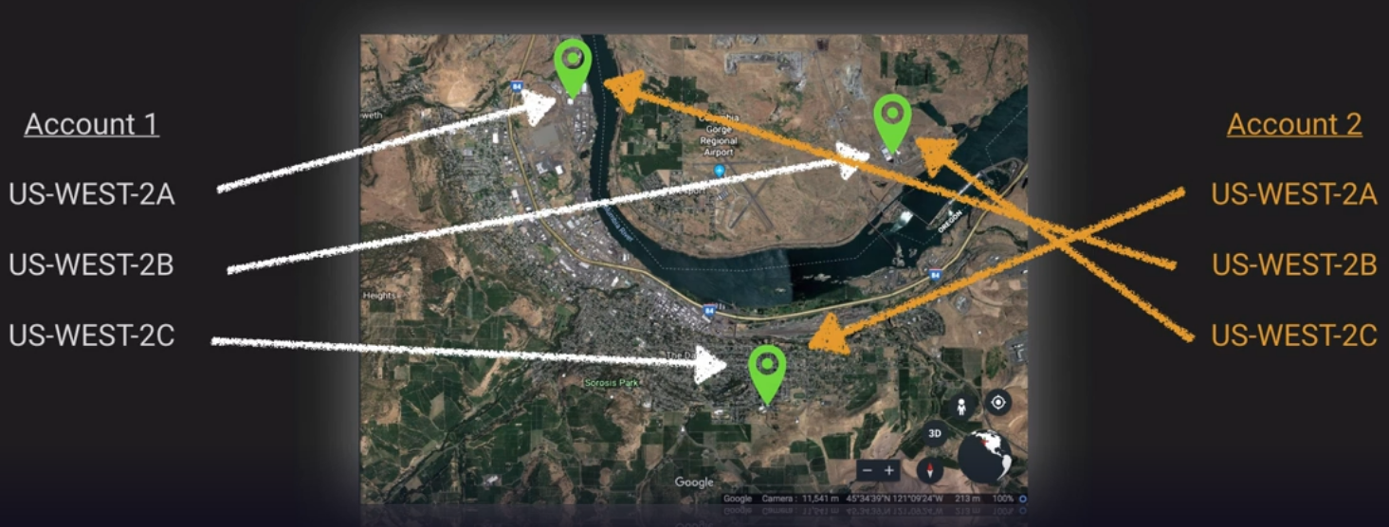
Availability zones
Physical to logical AZ assignment is done at the Account Level

Slide 15
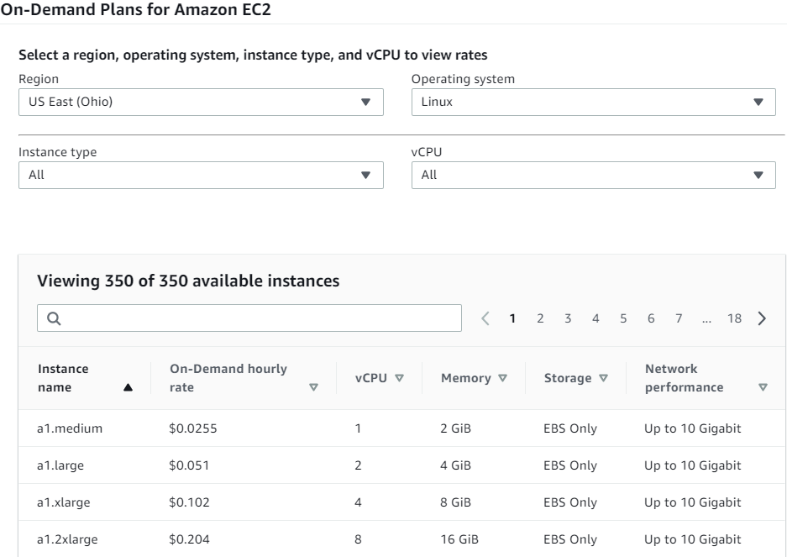
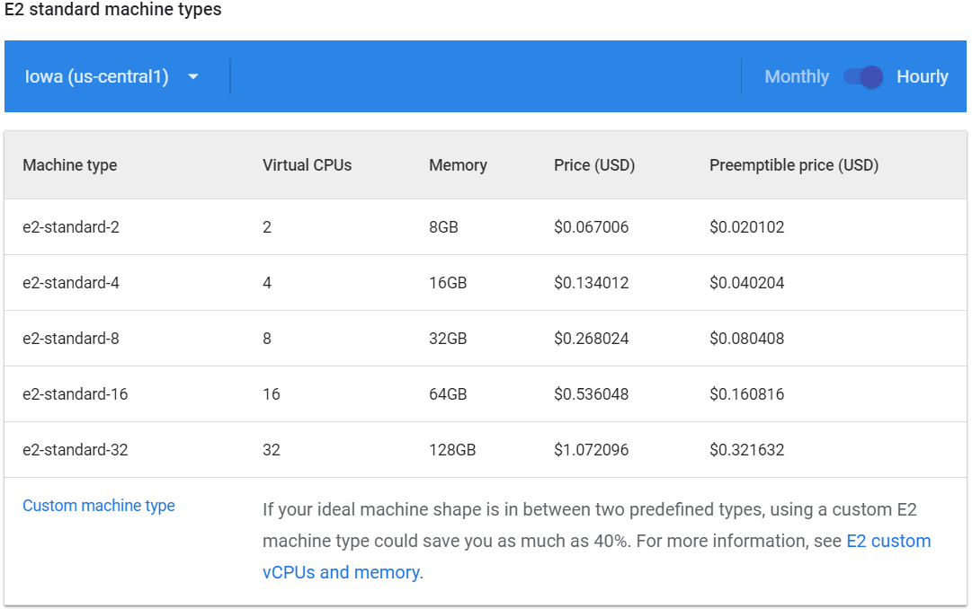
Charging models
  On-demand mode (pay per use) vs. Prevision mode (resource reservation)
  Committed usage (~xx% discount)
  Free tier trial user (some credit, 1 year, limited resources)
Per second basis billing for Linux VM instance and Storages
Notes:
On-demand mode : From point instance is available to point it is terminated, charge by seconds usually. [Pay as you go == On demand]

Slide 16
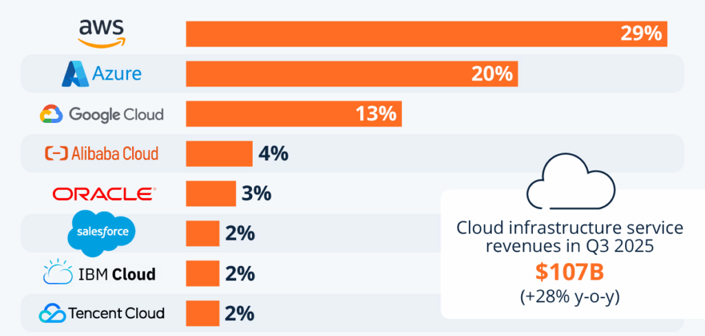
Introduction-CSP market share

Slide 17
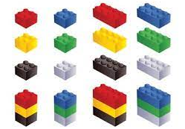
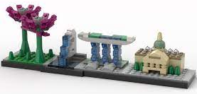

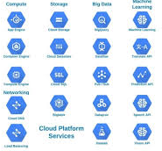
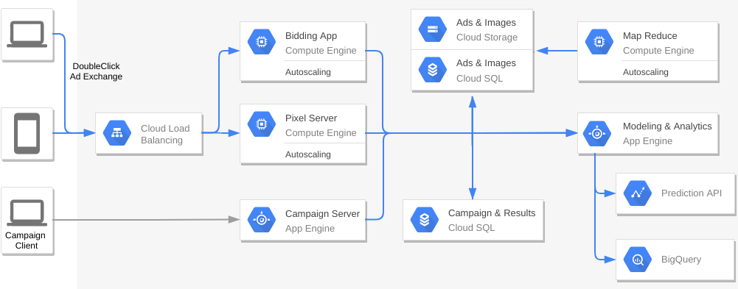

Cloud modules vs lego
Mindstorms
Managed Services
Notes:
Create one instance, one service connect with IP address etc. and it will flow

Slide 18
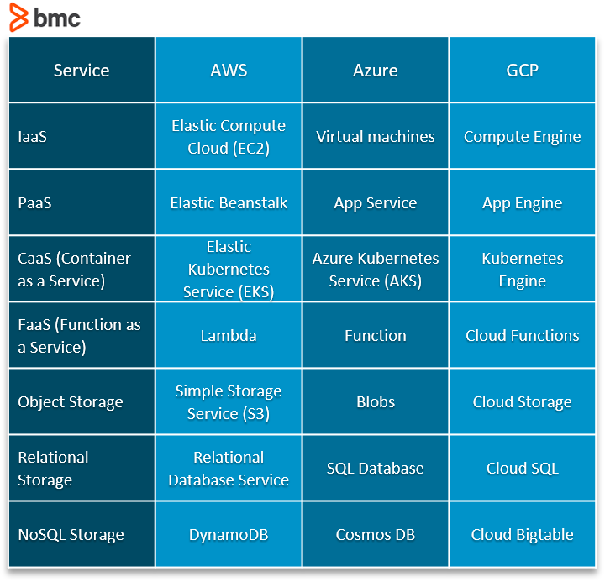
Major cloud functions in 3 biggest Cloud Platforms

Slide 19
benefit of cloud
Cost-effectiveness. Reduced upfront costs of investing in facilities, utilities, hardware and licensing. Pay-as-you-go model allows an organization to pay for only the computing resources it uses.
Scalability. Complete control over infrastructure and the ability to scale IT resources up and down depending on business demands.
Speed of innovation. The agility to respond swiftly to market needs by rolling out new products or services.
Accessibility. Access to cloud-based applications and data from virtually any device by connecting to the internet.
High availability. Most cloud providers provide highly reliable services, with up to 99.99% uptime.
Abundant supportive tools. Cloud offers many off-the-shelf tools, software, models for various industries

Slide 20


Ready to jump into the cloud?

Slide 21
Lab session – access the cloud

Slide 22
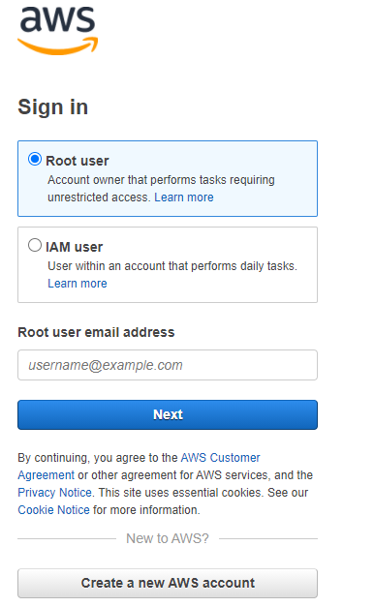
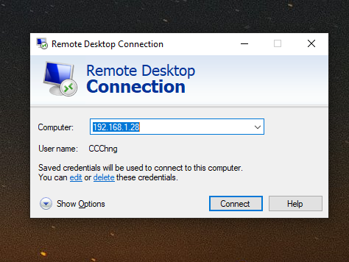
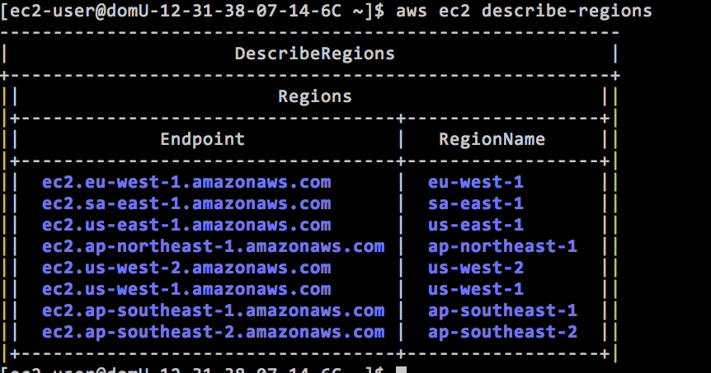
3 Ways to access cloud
Web Portal
Remote Desktop (RDP)
Command Line Interface (CLI)

Slide 23
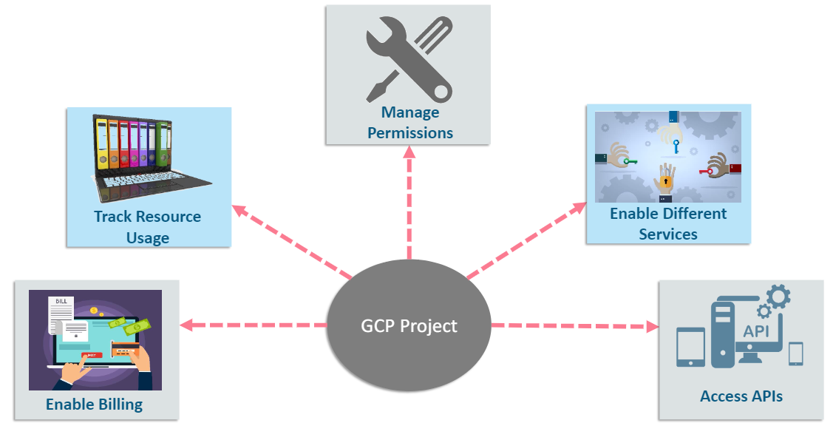
Web Portal
https://console.aws.amazon.com
https://cloud.google.com/gcp
Enter your user account and password
Let’s create our first AWS/GCP project together (it’ll be used for the course project)
Project

Slide 24
Command Line Interface
Install CLI tool on local computer
  https://docs.aws.amazon.com/cli/latest/userguide/install-cliv2.html
  https://cloud.google.com/sdk/docs/install
Open command prompt (Windows) or open a terminal (Linux)
Type
  aws configure
  gcloud init
  gcloud config set project myProject
  gcloud config set compute/zone us-central1-a
Prepare below information
  Project name
  Region (us-east-1)
  Access key
  Output file format (usually JSON)

Slide 25


Slide 26

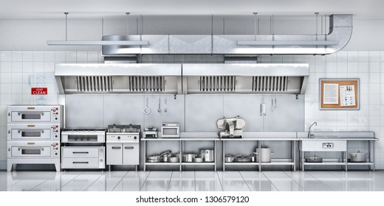
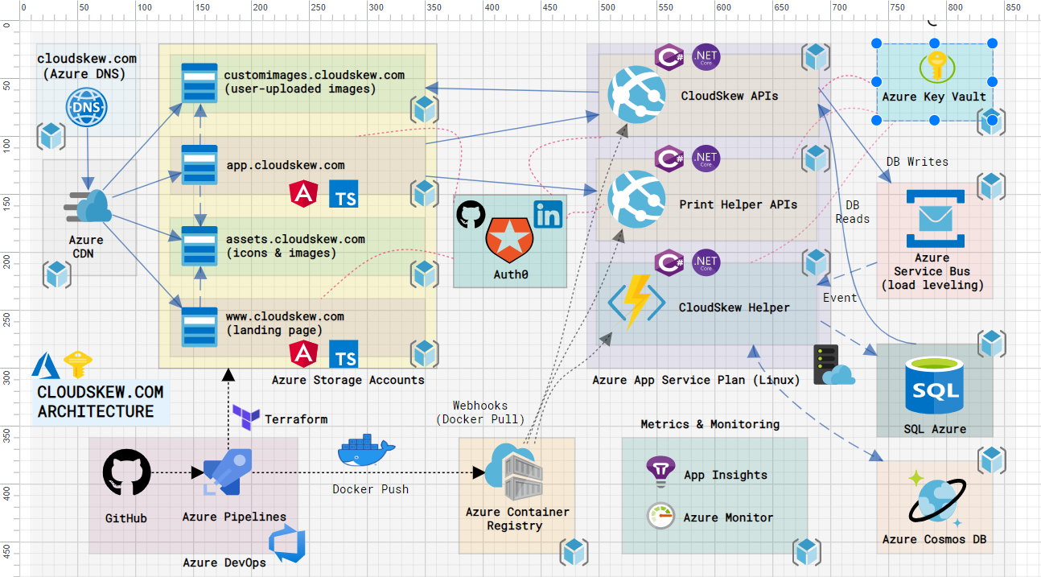
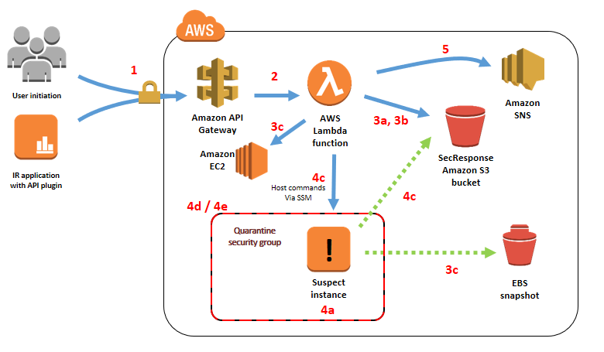
Good or bad architecture?
VS

Slide 27
design & manage a good solution in cloud
Impact factors
  Business requirement
  Technical requirement
  Cost consideration
Questions to ask…
  What are the business goals it supports
  What are the data and activities flow through it
  What will be the pattern of data and activities
  What kind of interactions users will need (UI)
  What if an abnormal situation or disaster happens - do you need high availability? Deploy in one region and backup in another region?
Notes:
What are the data and activities flow through it : minimal data can just use a smaller instance, if a streaming like data then we will need a streaming pipeline infront. Queue system is not good for streaming data. For stateful data distribute to different backend svc if not can just use Kubernettes to instantly spin up nodes and shut it down to save cost.

Slide 28
Business requirement
Common business targets ( common business requirements that make uw to use cloud)
Business use cases
Product strategy
Cost considerations
Regulation and compliance
Security
SLA and KPIs
Reduce Cost
Improve performance
Gain customer satisfaction
Speed-up Innovation
Reduce Incident
Extend to global market
Notes:
Want to do business in SG or globally?
Product strategy: only target woman due to higher purchasing power?

Slide 29
Technical requirement
Compute power
Network speed
Access control
Backup frequency
Admin/dev/end-user Interface
Observability ( do I know what is really happening in my system, !=monitoring, more than monitoring , it is how your application performs in cloud)
Heterogeneous System Support ( if u have hybrid cloud and on prem servers)
Security
…
Notes:
No need remember, fyi

Slide 30
Cost considerations
Upgrading/development cost
  Software license
  Managed services on cloud
  Storage
  Data ingress & egress
  Dedicated/private network
  DevOps manpower
  3rd party integration
  Laws and regulations
  Hot standby and redundancy
Maintenance cost
  Monitoring and incident management manpower
  RPO and RTO
  Total Cost of Ownership (TCO) –total all cost considerations ( e.g infrastructure, traffic, manpower)--> to compare whether on prem or cloud is cheaper
  On prem need more manpower compared to cloud (higher manpower cost)
Notes:
Dedicated : give you physical hardware whole machine theirs, but higher cost → to gurantee performance and avoid problem of neighbours using a lot of bandwidth
RPO: how much storage lost you can tolerate (e.g max lost 1 hour of data) → backup interval must be less than 1 hour

Slide 31
Cloud solution design metrics
Business Metrics
  CAPEX/OPEX/ROI
  SLA
  TCO (Software license, managed services on cloud, storage, data ingress & egress, DevOps personnel, 3rd party integration, Hot standby and redundancy, etc)
  Laws and Regulations
  KPIs (project/operation) – objective, what uw to achieve, must be measurable with specific numbers)
  RPO/RTO (Recovery Point Objective, Recovery Time Objective)
Technical Metrics
  Computational power and speed
  Data lifecycle (collection, version, volume, speed, retrieve pattern, retention, etc)
  Network (VPC, VPN, interconnect, firewall, request pool, etc)
  Availability (HA)
  Scalability
  Reliability
  Durability
Notes:
Need to know meaning in exam
CAPEX: fix deposit cost
OPEX: Operation Cost (e.g maintaining conditions , db upgrading)
ROI: Return Of Investment ( how much spent vs get back)

Slide 32
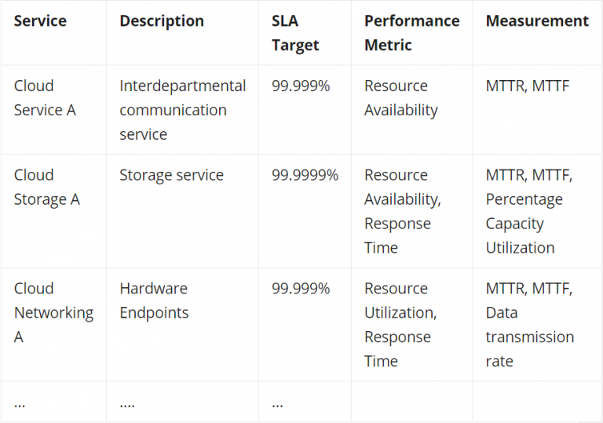
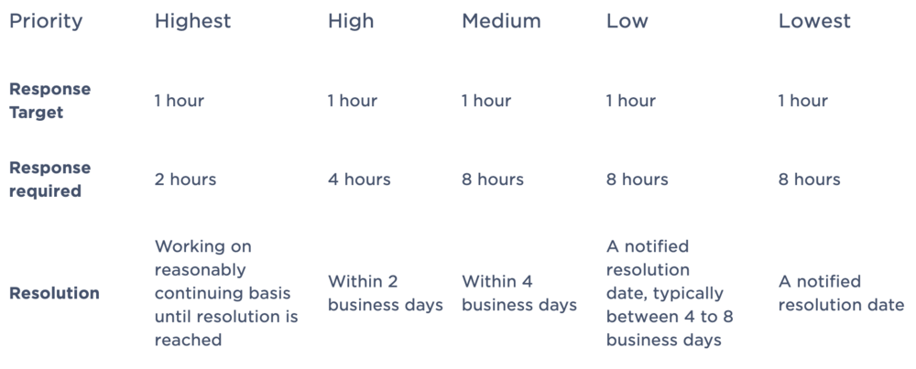
SLA
A service-level agreement (SLA) defines the level of service expected by a customer from a supplier, in terms of key performance indicators like latency, successful response rate, downtime, error recovery time, etc.
Notes:
Bind to law, if break the other party can sue you
EC2 svc SLA != Individual EC2 instances! → EC2 svc is on, just your instance down

Slide 33
KPI
A Key Performance Indicator is a measurable value that demonstrates how effectively a company is achieving key business objectives.
Organizations use KPIs at multiple levels to evaluate their success at reaching targets.
  High-level KPIs may focus on the overall performance of the business
  Low-level KPIs may focus on processes in departments such as sales, marketing, HR, support and others
Typical KPIs for cloud solutions
  Resource utilization
  Optimization rate
  Service availability (%)
  Customer complain (#/quarter)
  Incident rate and incident restoration time
  Mean time to detect incidents
  Cost per customer

Slide 34
regulation and Compliance
PDPA/GDPR (Personal Data Protection Act/General Data Protection Regulation)
  Personal data protection
PCI DSS (Payment Card Industry Data Security Standard)
  Industry security standards for businesses accept payment cards
SOX (Sarbanes–Oxley)
  Data integrity on financial data (tamper prevention)
COPPA (Children's Online Privacy Protection Act)
  US law to protect personal information of children under 13
HIPAA (Health Insurance Portability and Accountability Act)
  US law to protect the security of medical information
ISO
  International standard on various aspect of a business (e.g. ISO9001 Quality Control, ISO27001 Information Security)

Slide 35
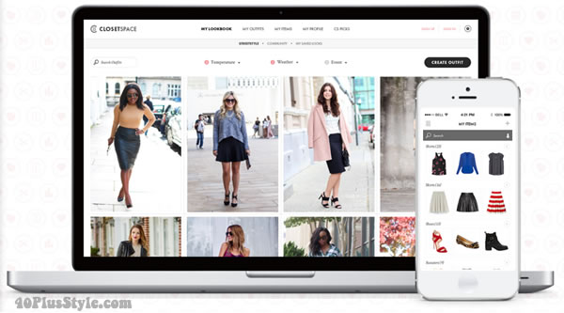
Case Study – a brief intro
Dress4Win online wardrobe management system
  It is a web-based company that helps their users organize and manage their personal wardrobe using a web app and mobile application.
  The company also cultivates an active social network that connects their users with designers and retailers.
  They monetize their services through advertising, e-commerce, referrals, and a freemium app model.
  The application has grown from a few servers in the founder’s garage to several hundred servers and appliances in a co-located data center. However, the capacity of their infrastructure is now insufficient for the application’s rapid growth.

Slide 36
Dress4win: Business requirement
The capacity of their infrastructure is now insufficient for the applications’ rapid growth. (need to use scalability of the cloud service)
Company desire to innovate faster (deploy system with cloud native features, cloud native solutions adopt native solutions faster e.g Kubernettes can spin up pods)
Company want to make a full migration to a public cloud, including test and production environment. ( 2 environment need 2 account, how to connect cross accounts need to set IAM control policies, cicd pipelines)
They want to improve the reliability of service by adding a disaster recovery site
no downtime for system → in cloud solution needs a mirror system, if any system down the other continue to serve → 2 system must be of different regions

Slide 37
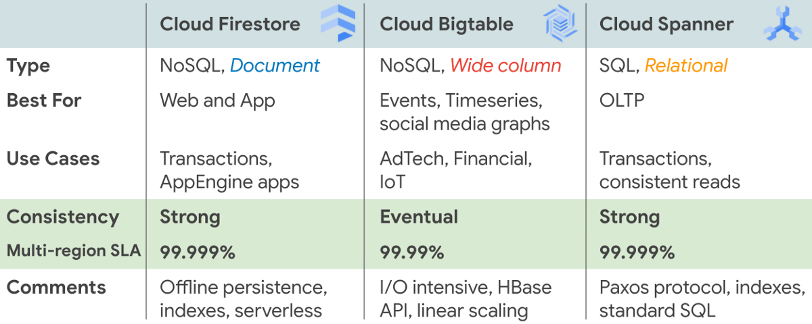
Availability
A measure of the time that services are functioning correctly and accessible to users
Downtime:
864ms/day or 6.05s/week or 26.3s/month
Downtime:
8.64s/day or 1.01min/week or 4.38min/month
Notes:
Availability here refer to entire service, not a single instance (VM)

Slide 38
Reliability
Availability under certain level of abnormal situation for some time
  Heavy load
  User misbehaviour
  Cyber attack
How to improve Reliability?
  Redundancy
  Fault tolerance
  Load balance
  Human error prevention
How to verify reliability?
  PTVA (Penetration Test and Vulnerability Assessment)
  Stress test – INCREASE LOAD UNTIL IT CRASHES, see how system crashes when overload
  Load test
Notes:
We’ll explain reliability in detail in Lesson 6.

Slide 39
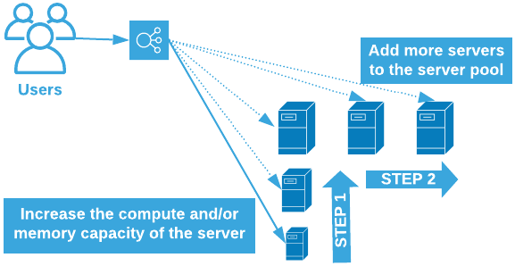
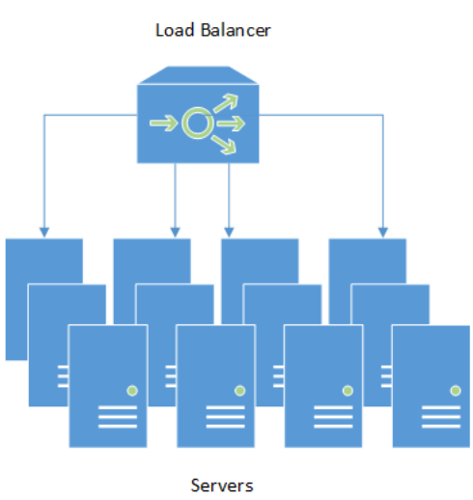
Scalability
Ability of a service to adapt its infrastructure to the load on the system
  Vertical scalability – scale up storage only
  Horizontal scalability – creating cluster of machines
How to achieve scalability in cloud?
  Auto re-provision of resources (e.g. Terraform)
  Auto-scaler of container cluster or VM groups (e.g. Kubernetes)
  Load Balancer
Notes:
If workload/customer load increases , how will system behave? Can it create more machines ?

Slide 40

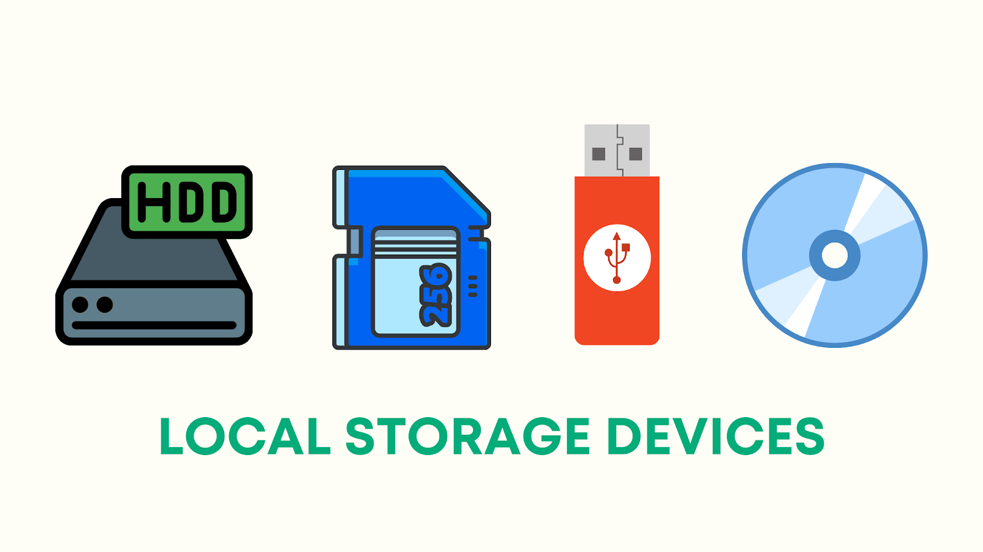


Durability
A measurement for storage
Durability is used to measure the likelihood of data loss (corruption)
Example:
  S3 Standard Tier is designed for 99.999999999% durability.
  This means that if you store 100 billion objects in S3, you will lose one object at most.
VM
Persistent Disks (NAS)
Bucket
Notes:
S3 is global service! No need to choose region.

Slide 41
Summary
Why we need cloud
Cloud enablement technologies (HW & SW)
Big CSPs
Cloud terminologies
Business metrics (SLA/KPI/Cost/Security/etc)
Technical metrics (key cloud resources, four indicators)
Notes:
Availability, Reliability, Scalability, Durability

Slide 42
Assignment
Prepare your cloud account and familiar yourself with the cloud menu
Think about the business and technical requirement for below systems
  Online shopping system
  Logistic tracking system
  Health monitoring system
  Online digital bank

