Slide 1
network services in cloud

Slide 2
Outline
Introduction of CSP global network infrastructure
Virtual Private Cloud (VPC)
IP addressing
Subnets
  Private subnet and public subnet
  NAT GW
  Bastion Host
Routing tables
Security in Network
  Firewall
  Security Group
  Network Access Control List (NACL)
VPC sharing and peering
Load balancer
Cloud CDN

Slide 3
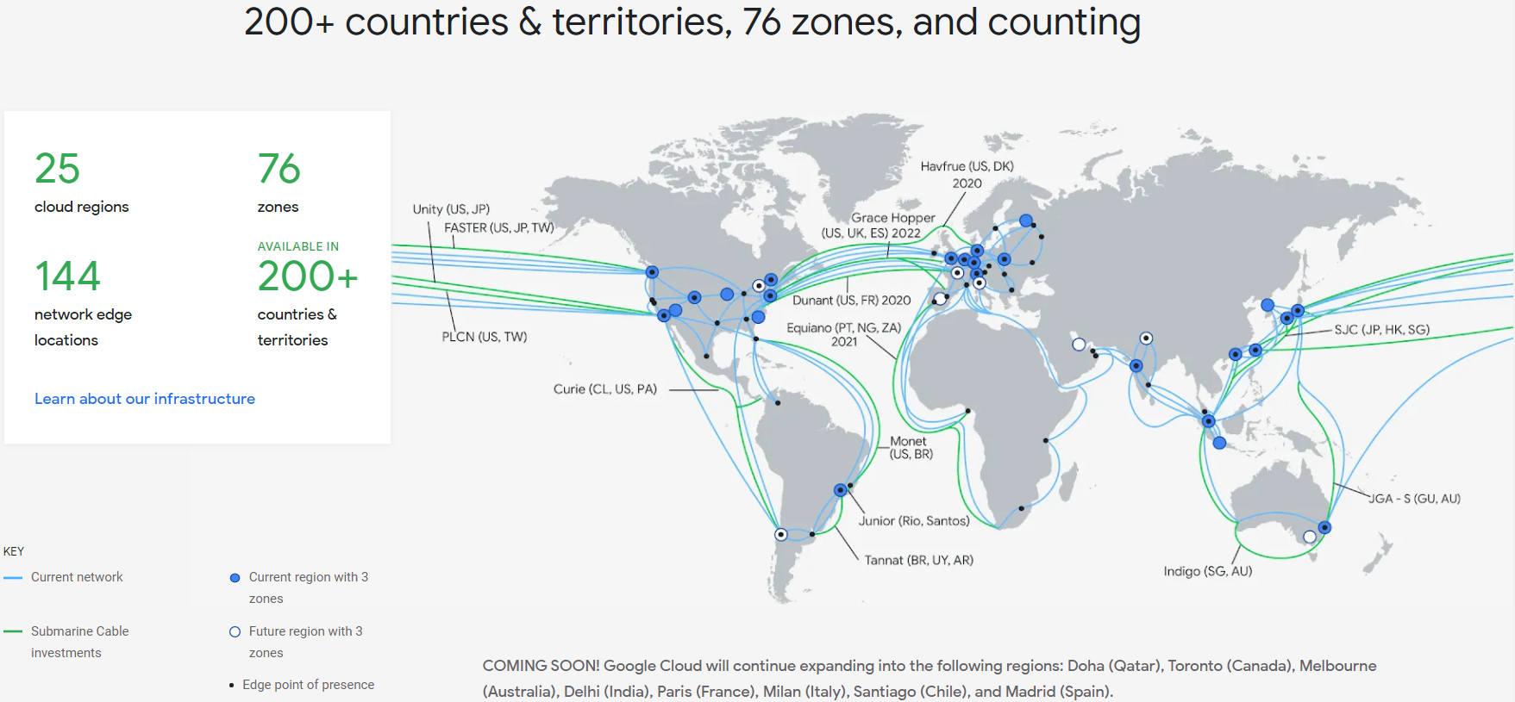
Within EU and Japan: 12ms
Within North America: 30~40ms
Trans-Atlantic (US-EU): 70ms
Trans-Pacific (US-Asia): 100ms
EU/EMEA-Asia: 120ms
EU-India: 350ms

Slide 4
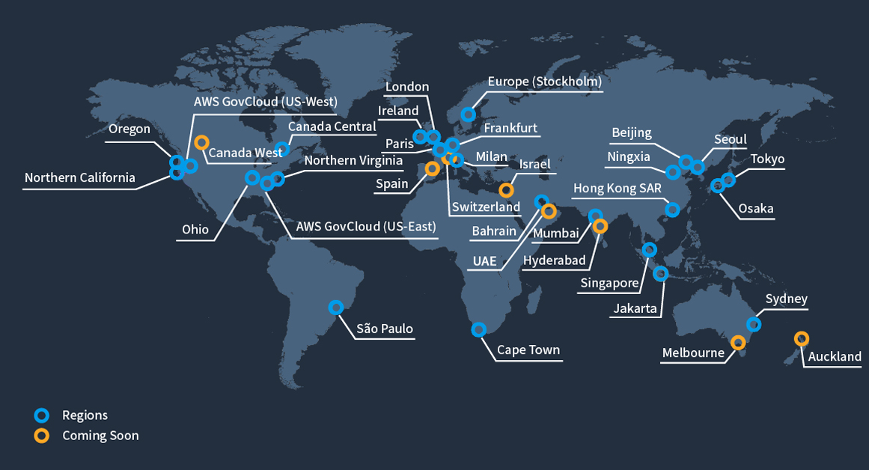
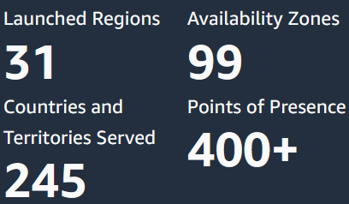

Slide 5
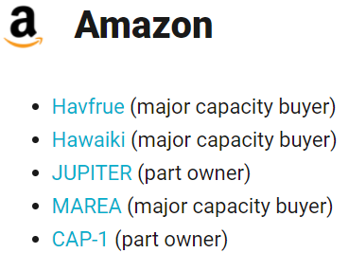
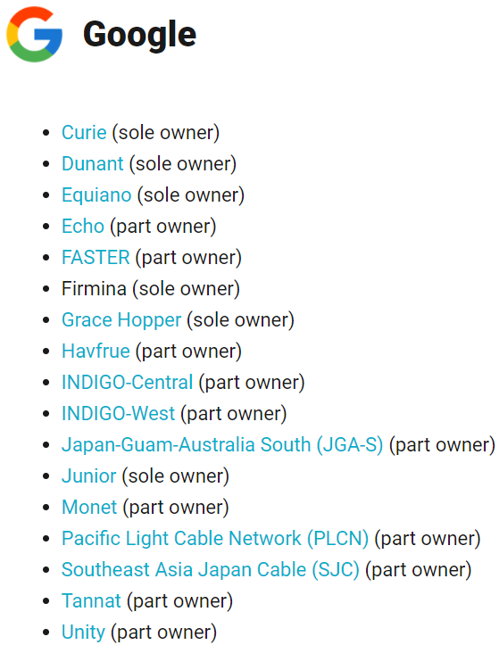
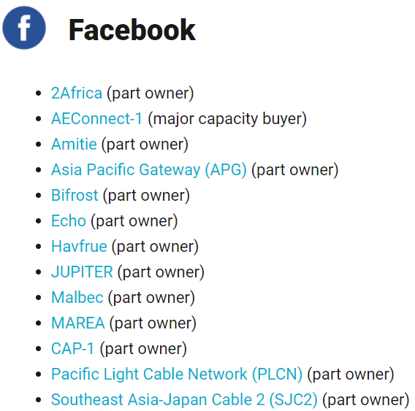
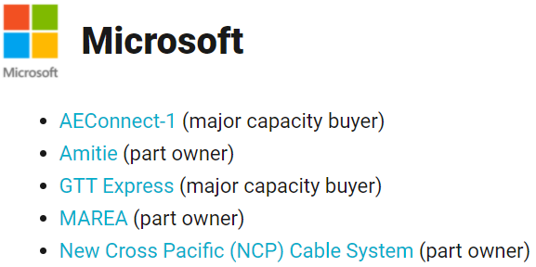
CSP owned Submarine cable

Slide 6
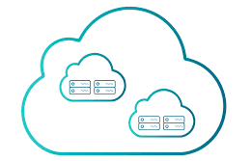
Virtual private cloud

Slide 7
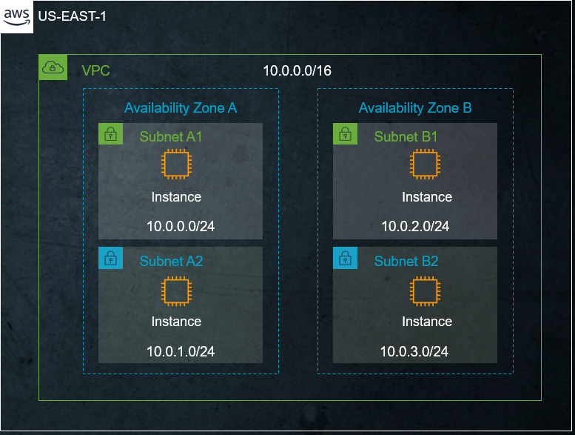
Virtual private cloud
A virtual private cloud (VPC) is a secure, isolated private cloud hosted within a public cloud
  There’s a limit of Max.# of VPC a project can have
  https://docs.aws.amazon.com/vpc/latest/userguide/amazon-vpc-limits.html
  Key factors in VPC
  IP address
  Subnet
  Router
  Firewall
  Sharing
VPC: we deploy instances in private cloud, how to ensure nobody can access it.

Slide 8
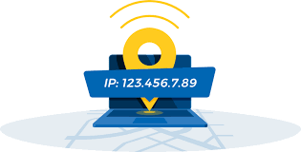
Ip services

Slide 9
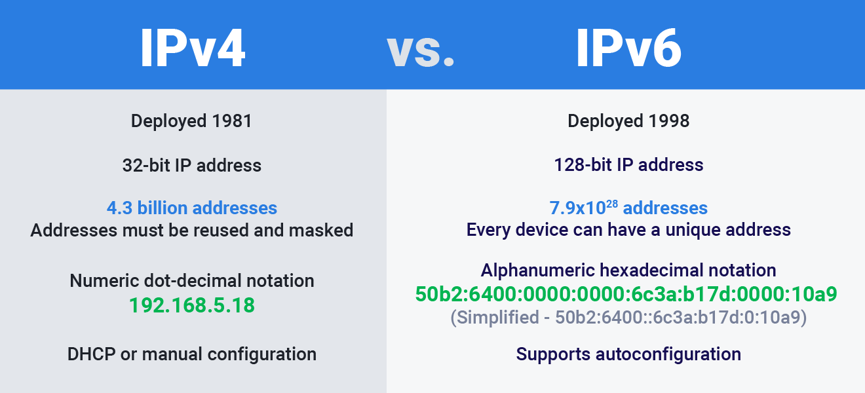
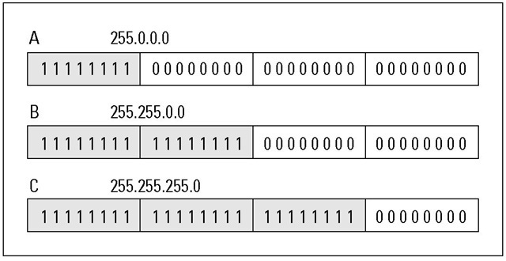
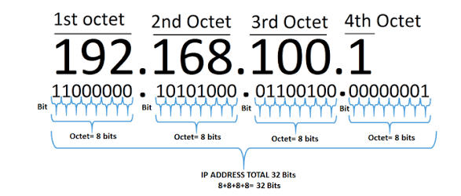
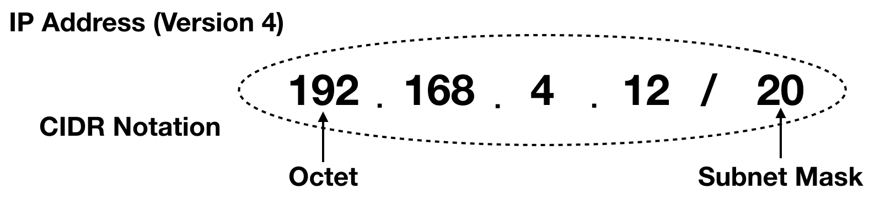
IP and cidr blocks
Do a logical AND operation with the IP address to check if the IP belong to its subnet
The bigger subnet mask== smaller address range
e.G 28 fits 28 bits, I have 32 bits in total, means I only have 4 bits I can change. 2**4 is the number of address I can use

Slide 10
ip services in cloud
Server with fix address, so won’t change
 | Private IP | Public IP | Static IP | Dynamic IP
Explanation | Local address used in private network | Global address that can be accessed by routers from Internet | An address that doesn’t change unless the machine is decommissioned or network architecture is changed | Dynamic addresses are assigned, as needed, by Dynamic Host Configuration Protocol (DHCP) servers
Example/ remark | 10.0.0.0 – 10.255.255.255 172.16.0.0 – 172.31.255.255 192.168.0.0 – 192.168.255.255 | google.com — 172.217. 22.14 Yahoo.com --- 22.87. 47.67 | Static IP is used for servers that need a fixed address for customers to access the services | Dynamic IP is used for clients that just need an address to send request and get response
Cannot be access by internet
Elastic IP: Reserved public IP in AWS
Can attached to any of the instance, even when instance terminate, can detach and attach to another instance

Slide 11
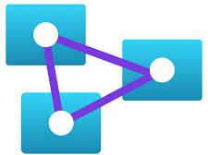
Subnet

Slide 12
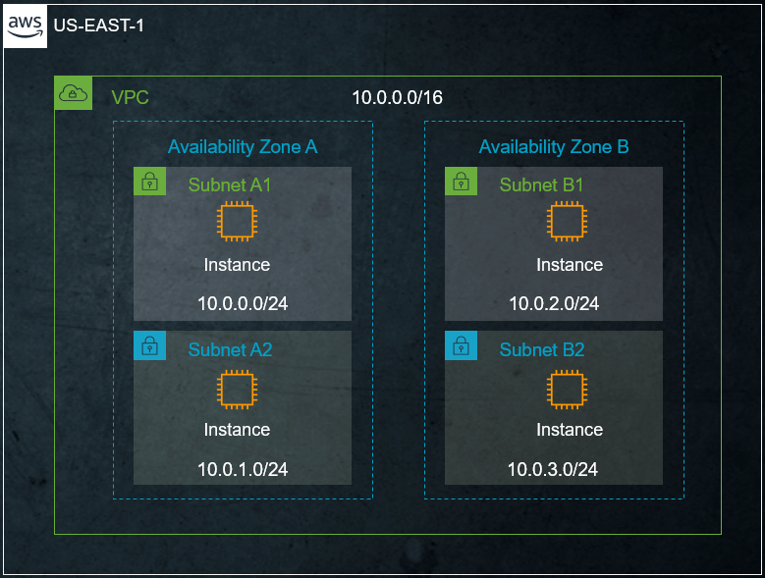
subnet
Subnet is smaller subset of the vpc address
VPCs span a region
Subnet span a AZ
Subnets are allocated as a subset of the VPC CIDR range
You can have multiple subnets in each VPC and each AZ

Slide 13
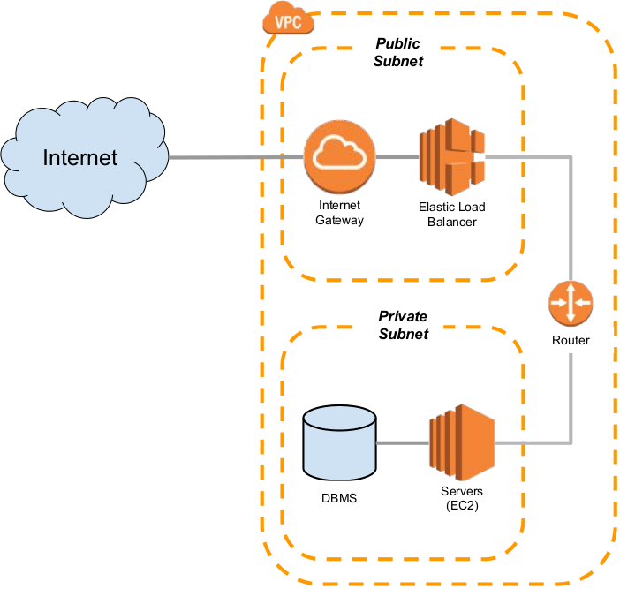
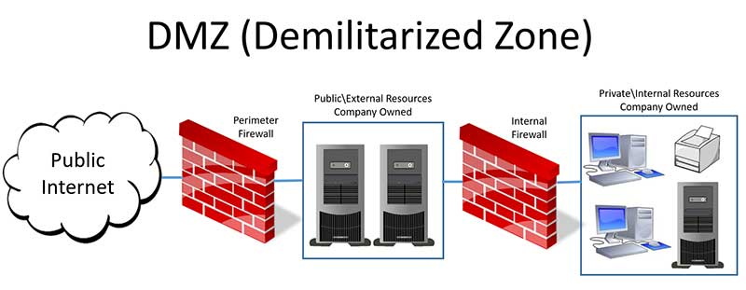
Public & Private subnet
If there is internet gateway associated with subnet then this is a public subnet
Public Subnet
  can be accessed from Internet
  Inside resources should have public IP
Private Subnet
  no access from Internet
  Inside resources only have private IP
Private subnet

Slide 14
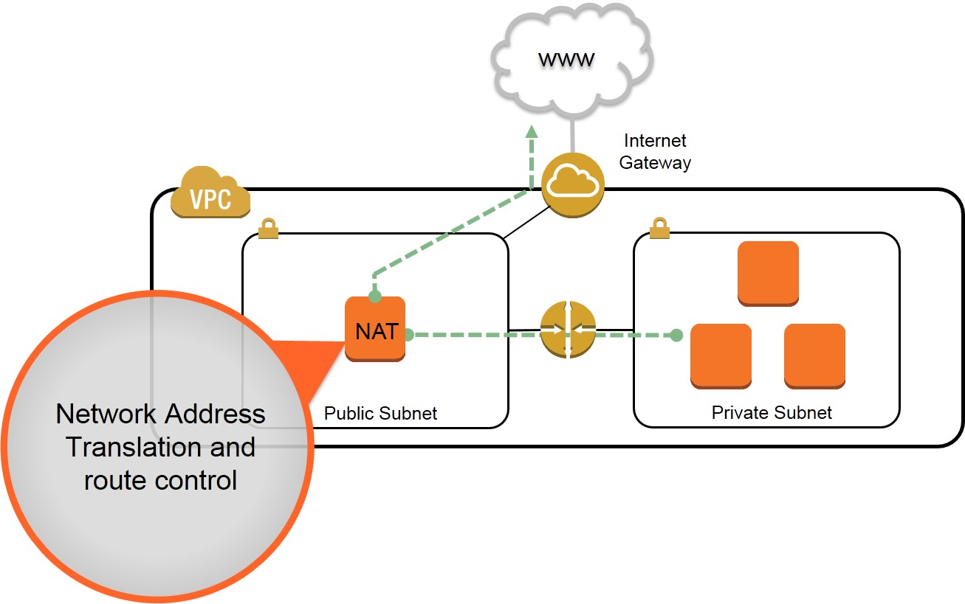
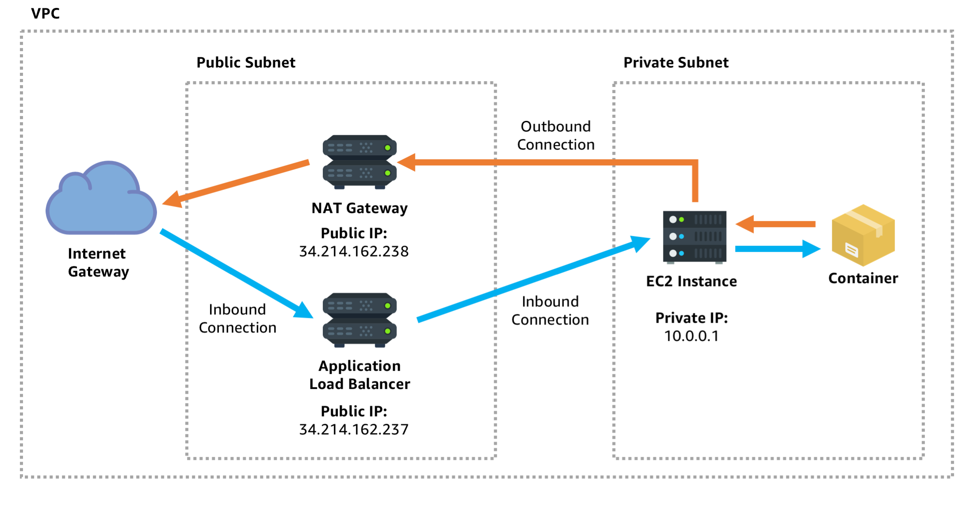
Nat gateway
NAT
1. Do private to public IP translation (for when internal instance) want to acesss internet
2. Gateway isolated private gateway and outside world. NAT gateway will never receive any internet initiated traffic ( NOT INTERNET RETURN- return package is allowed)
Concept:
Example:
Network address translater
NAT allows responses from Internet to reach the Private Subnet (NOT INTERNET INITIATED!!)
Request iniatiated from internet will be directed from application loadbalancer and distribute to ec2 instance
Notes:
TESTED IN FE

Slide 15
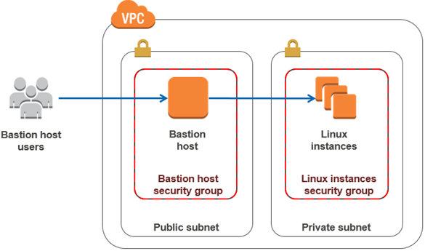
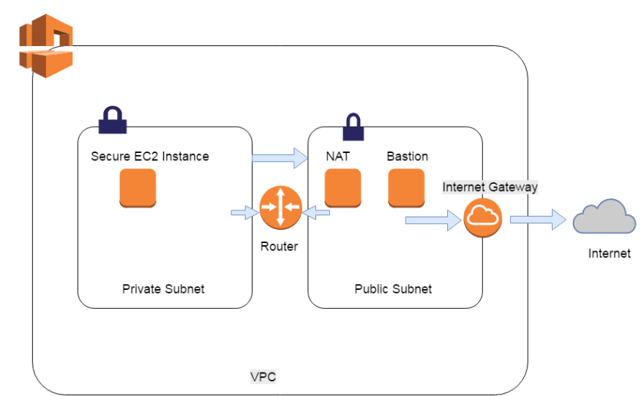
Bastion host
To cater for legal request coming from outside to acess private resources
Concept:
Example:
Bastion host allows SSH/RDP request coming from Internet
Notes:
TESTED IN FE

Slide 16
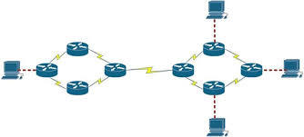
Routing tables

Slide 17
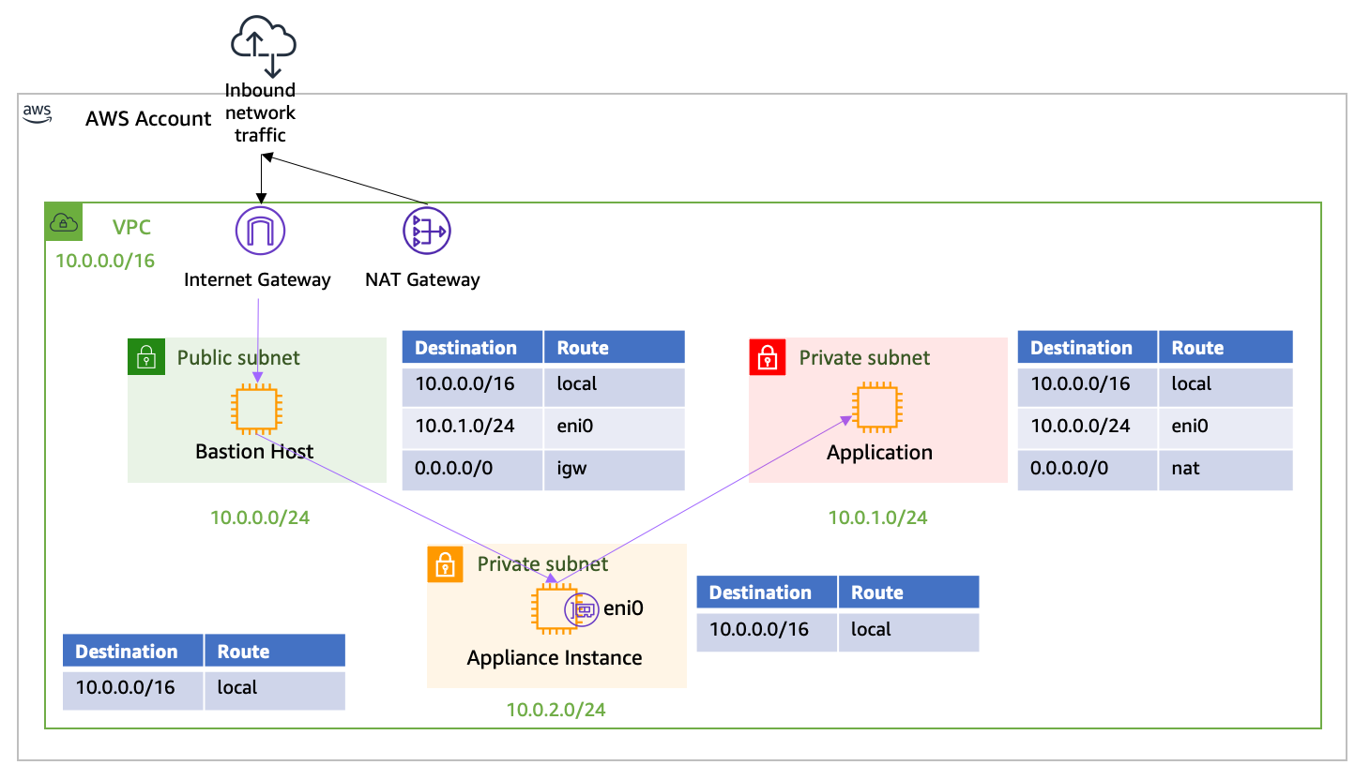
Routing tables
2 Types of Route Tables
  Main Route Table (default)
  Custom Route Table
Each subnet has associated routing table
Routing tables can be associated with multiple subnets
Local – within VPC
For all the rest go to the internet

Slide 18
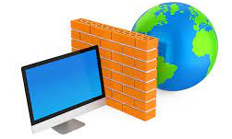
Vpc Security

Slide 19
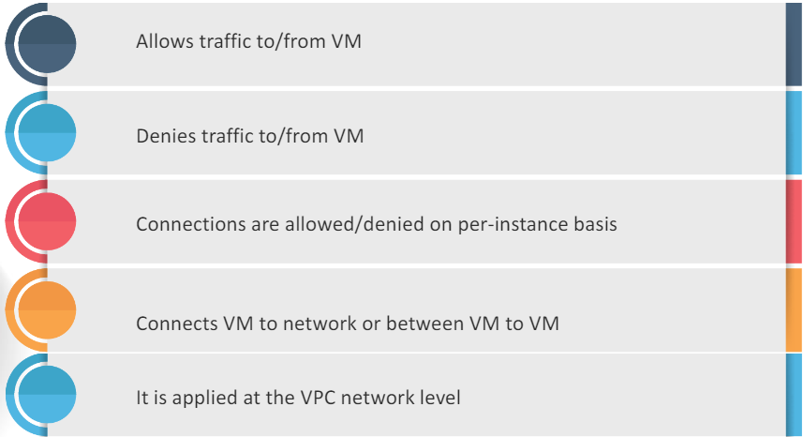
firewall

Slide 20
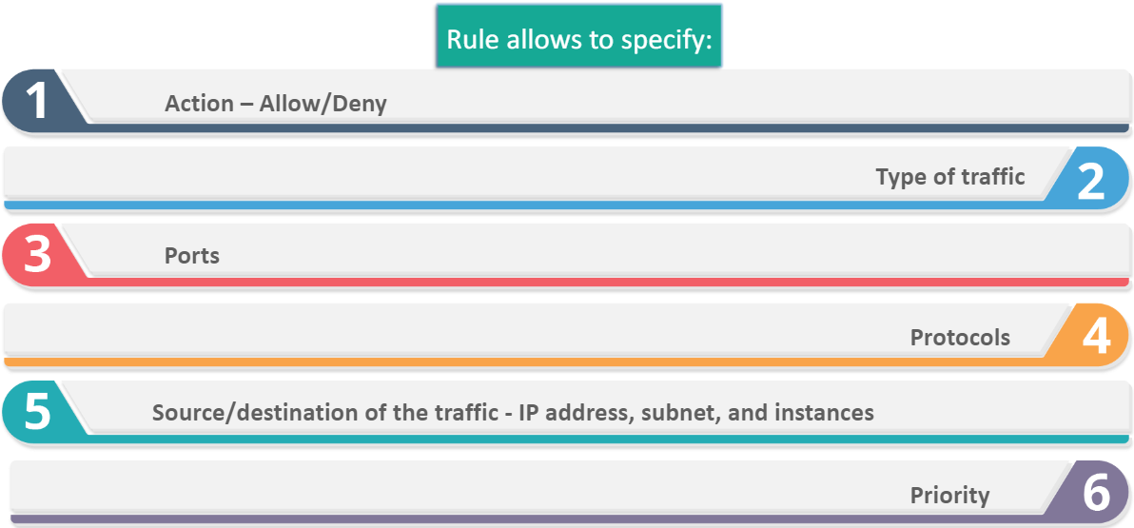
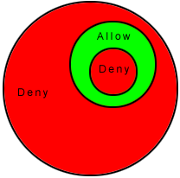
Firewall rules
Firewall apply to whole VPC – filter traffic coming from internet to vpc as a whole
Incoming, outgoing
80(HTTP), 443(HTTPS), 21(FTP), 22(FTPS/SSH), 995(POP3 SSL)
HTTP, HTTPS, TCP, TDP, SSH, ICMP, FTP, FTPS
0 (highest) ~ 65535 (lowest)

Slide 21
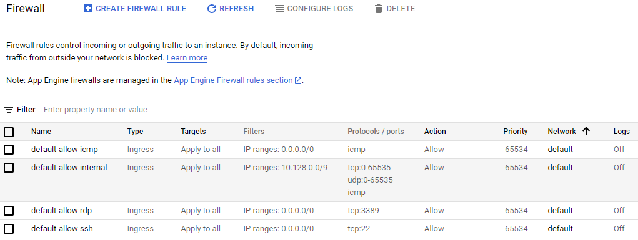
Firewall in gcp and aws
Firewall Policy 1
Firewall Policy 2
Firewall Rules
Firewall Rule Groups
Firewall Rule Groups

Slide 22
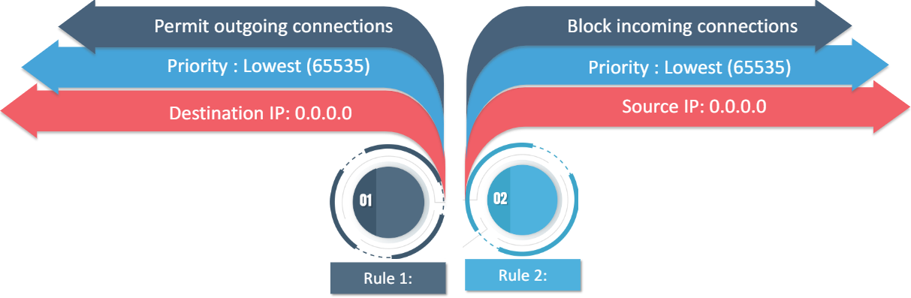
Implied/default firewall rules
Every VPC network has two permanent firewall rules which are implicitly defined
Low priority, every other rule u add will
Overwrite this
Default rules-Deny all incoming connections (ingress) & Allow all outgoing connections (egress)
Default rules are not shown on console and can NOT be removed
Ingress traffic from Internet is free, egress traffic to Internet is chargeable

Slide 23
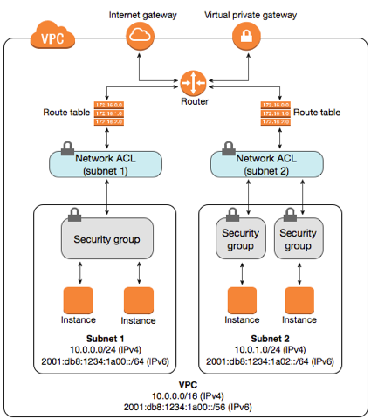
Security groups (aws)
Firewall apply to whole VPC – filter traffic coming from internet to vpc as a whole
A security group acts as a virtual firewall for instances to control inbound and outbound traffic
When you launch an instance in a VPC, you can assign up to 5 security groups to the instance
Security groups act at the instance level, not the subnet level. Therefore, each instance in a subnet in your VPC can be assigned to a different set of security groups
For each security group
  One set of rules for inbound traffic
  One set of rules for outbound traffic
It filters traffic based on protocols and port numbers
It is stateful – the incoming response traffic to the request sent out from an instance is automatically allowed regardless of rules, and vice versa
No inbound rules upon creation
Default with allow-all outbound rules
Instances associated with a security group can't talk to each other unless you add rules allowing the traffic
A security group can only be used in the VPC that you specify when you create the security group
Within subnet each instance can have different security group.
Only a certain kind of ip range can go into this subnet instance. Security group is attach to instance level

Slide 24
Network Access control list (NACL)
It is an optional layer of security for the VPC that acts as a firewall for controlling traffic in and out of one or more subnets.
Network ACLs use rules similar to security groups
Security Group | Network ACL
Operates at the instance level | Operates at the subnet level
Supports allow rules only | Supports allow rules and deny rules
Is stateful: Return traffic is automatically allowed, regardless of any rules | Is stateless: Return traffic must be explicitly allowed by rules
AWS evaluate all rules before deciding whether to allow traffic | AWS process rules in order, starting with the lowest numbered rule, when deciding whether to allow traffic
Applies to an instance only if someone specifies the security group when launching the instance, or associates the security group with the instance later on | Automatically applies to all instances in the subnets that it's associated with (therefore, it provides an additional layer of defence if the security group rules are too permissive)

Slide 25
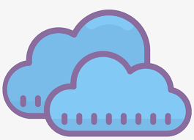


Vpc sharing & peering

Slide 26
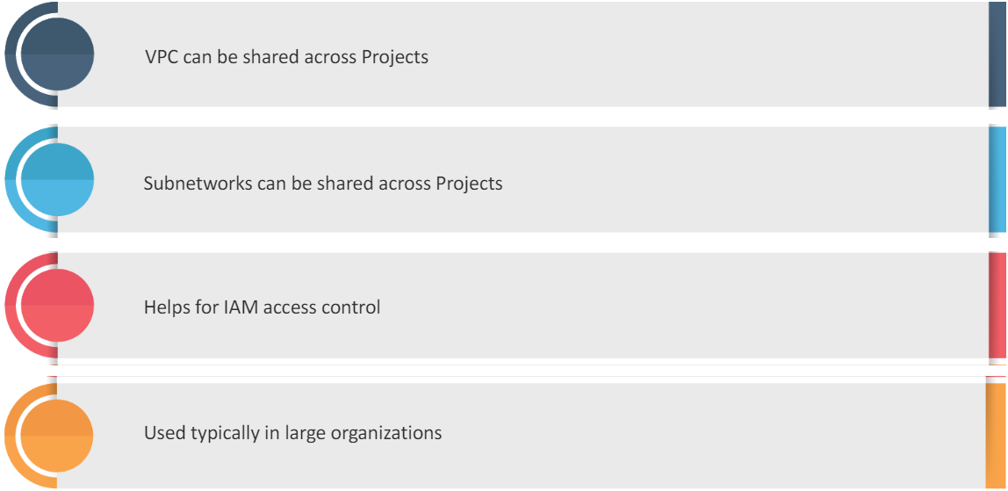
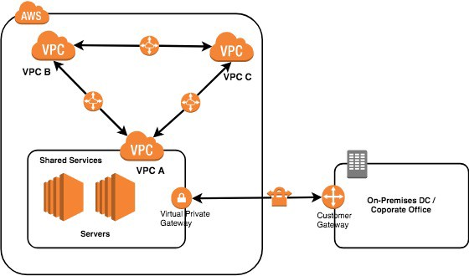
Vpc sharing
VPC sharing is only within the organisation
VPC sharing is more a permissions process. Allowing two or more corporate divisions to have service in the same VPC → all the resources in VPC are shared
It is used for different projects to share resources
  E.g. A service from marketing accesses the customer database managed by IT
In GCP, a shared VPCs are comprised of a host (administrator) project and one or more service projects
In AWS, Owner account acts as the administrator
Most CSPs allow select subnets to be shared – selecting subnet within VPC
NOT across organizations

Slide 27
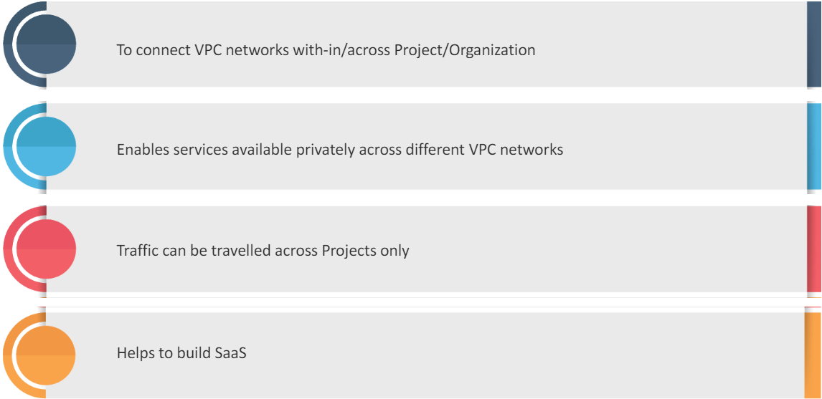
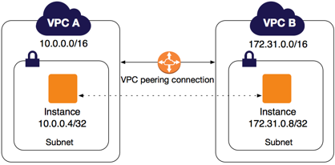
Vpc peering
VPC Peering is basically a networking process. In old school it is like telling your networking team to create connections and routes between data centres.
It enables different VPCs to communicate using private IP address in RFC1918 (via CSP’s backbone)
VPC peering is used as an alternative to using external IP addresses or using VPNs to link networks
There is a limit of Max.# of peering connections from a single VPC (for GCP is 25)
Peering works among different organizations
Advantages:
Lower latency as the traffic stay on the CSP’s network
Services in the VPC are inaccessible from public Internet
No egress charges associated with the traffic

Slide 28
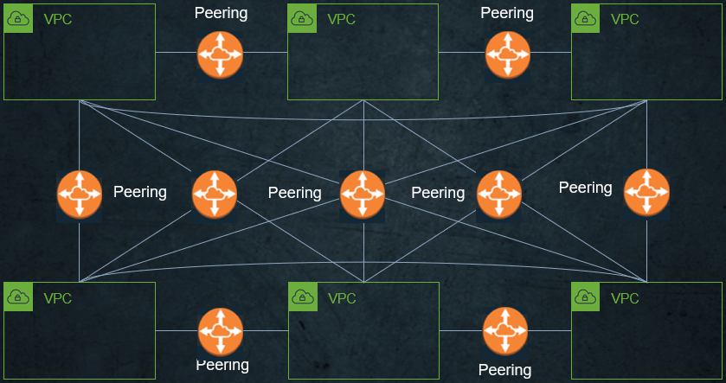
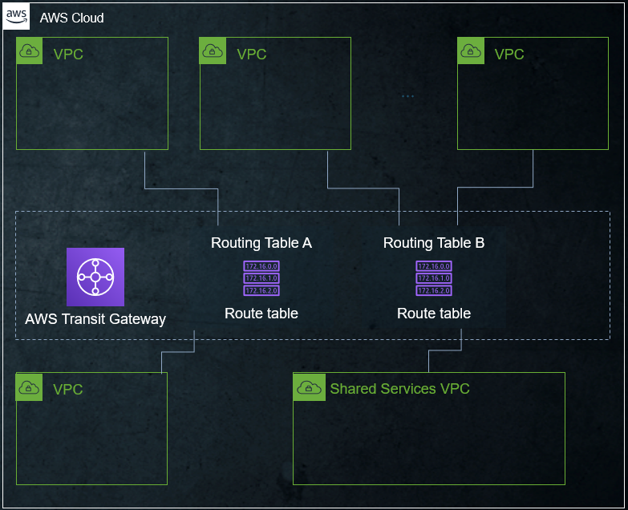
Transit gateway
Everybody attach their VPC to this transit gateway. Can cross az cross region. Good solution when u got multiple vpc uw to peer w each other from multiple org.
√
?

Slide 29


Slide 30

Load balancing

Slide 31
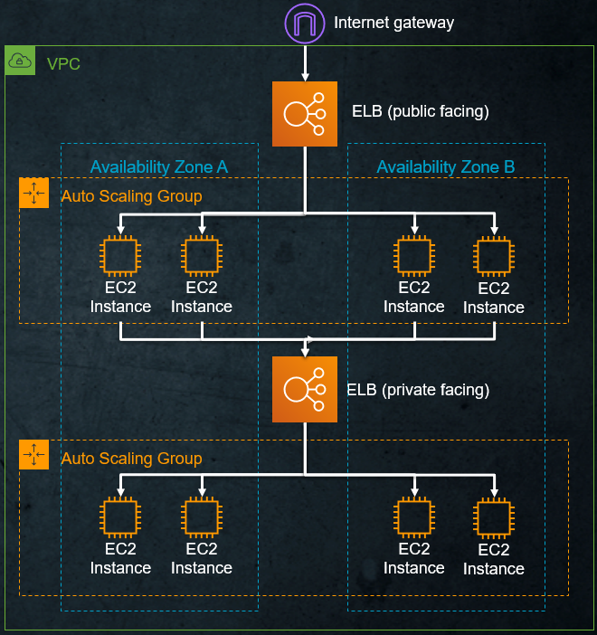
Elastic Load balancer
Distribute traffic to multiple targets
Multiple Availability Zones
ELB Scales automatically
Support Auto Scaling Groups
  Automatically (de)register instances to the ELB
There are 2 types of ELB:
  Network Load Balancer (L4)
  Application Load Balancer (L7)
Notes:
Load balancer not just facing outside

Slide 32
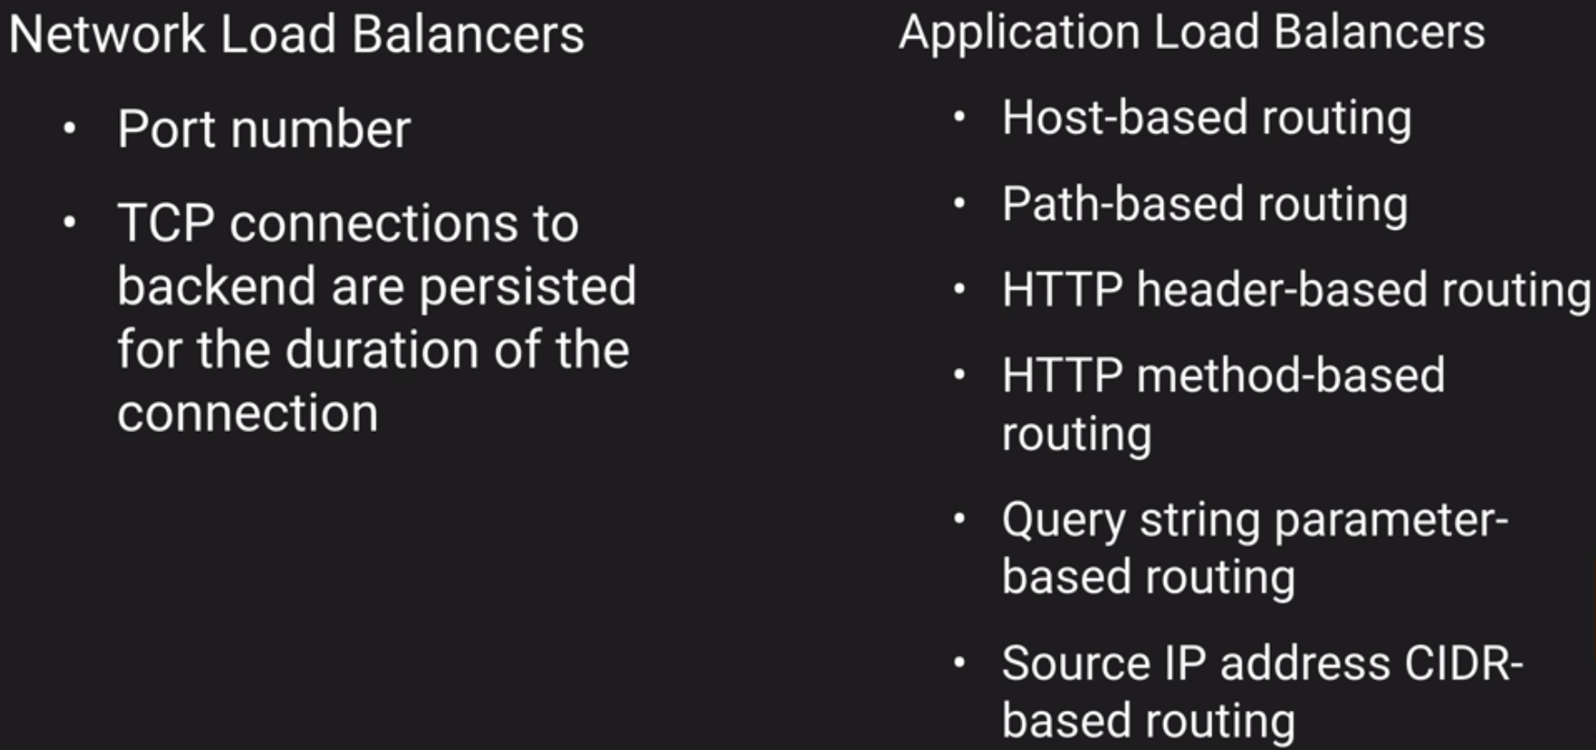
ELB – routing options
Configure NLB if you need:
Ultra-high performance
Static IP address
https://login.sgonlineshop.com/buyer
https://login.sgonlineshop.com/seller
Direct to different backend servers using path-based routing

Slide 33
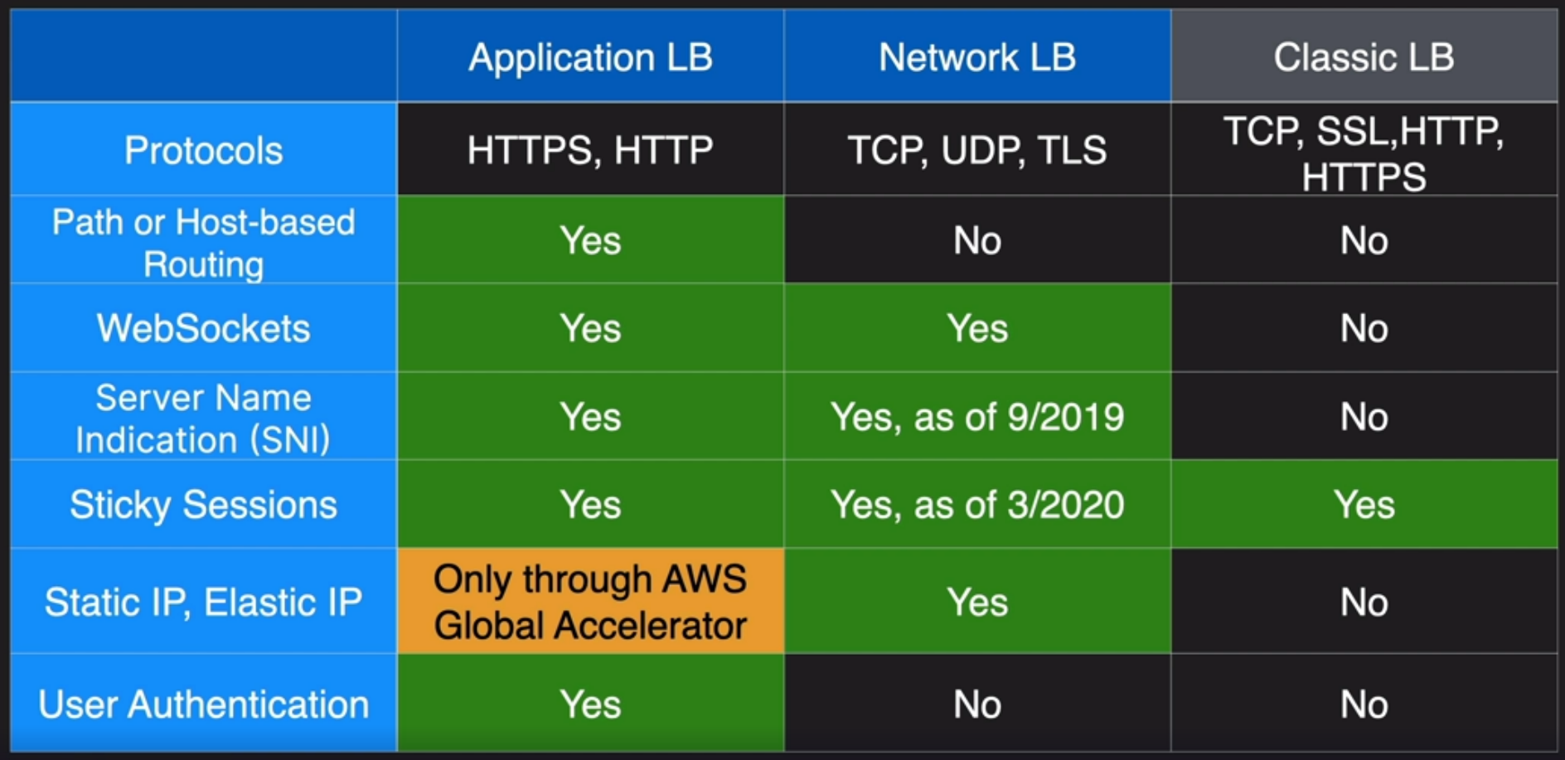
Comparison of ELB
Remember:
If high throughput or Static IP is needed, choose NLB
If HTTP-header based distribution is needed, choose ALB

Slide 34

Content distribution network

Slide 35
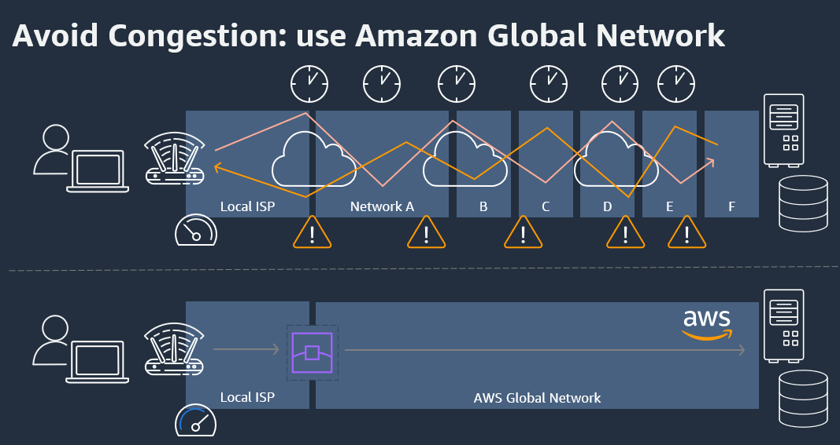
Why need CDN?

Slide 36
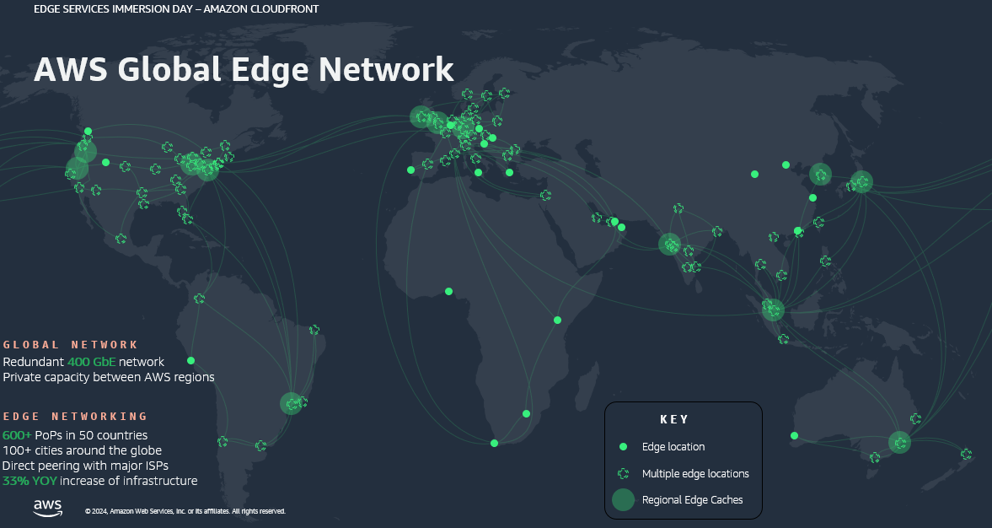
600+ Points of Presence in 100+ cities

Slide 37
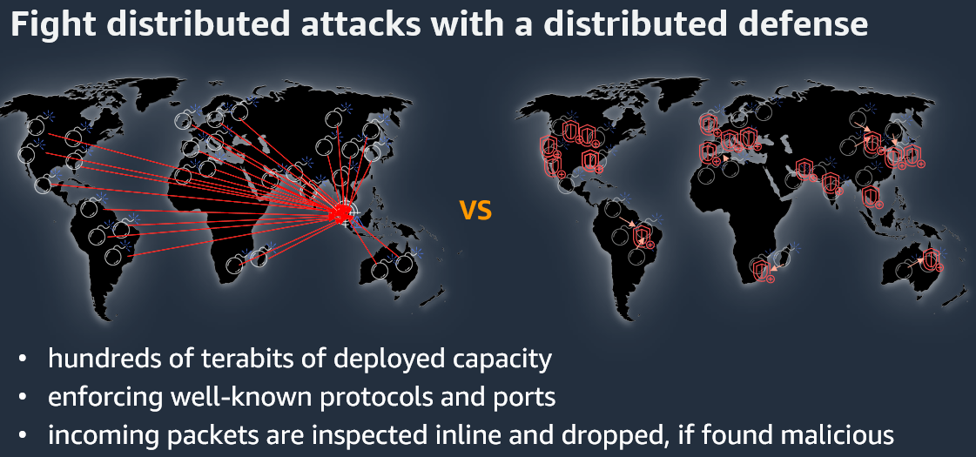

Slide 38



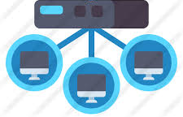
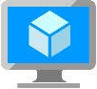

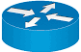
summary
Load Balancer
(Internal/Global)
CDN
Organization 1
Internet
VPC1
(sales)
VPC5
(on-prem)
10.0.0.1/20
VPN Dynamic Routing
192.168.1.0/24
VPC Sharing
VPC Peering
VPC2
(product)
VPC3
(Procurement)
VPC4
(partner sales)
10.1.0.1/24
192.168.0.0/24
10.10.0.1/20
Organization 2

Slide 39
Lab – Network
https://catalog.workshops.aws/general-immersionday/en-US/basic-modules/20-vpc/vpc
Note: The IP ranges in the above steps are examples, you can choose your own IP range

Slide 40
Assignment
Create a subnet and attach a NACL
Create an instance and a database(or another instance) within this subnet
Create two security groups (SG1 & SG2), add your instance and database(or another instance) into different security groups
Test 2 scenarios see how ACL and security group will affect your traffic
  NACL allows a traffic, SG1 denies it, SG2 allows it
  NACL denies a traffic, SG1 and SG2 allow it
Submit your homework via eLearn
Design the network components for your project

Slide 41
Reference – dress4win
40 web application servers providing micro-services based APIs and static content
  Tomcat-Java
  Nginx
  4-core CPUs
  32 GB RAM
20 Apache Hadoop/Spark servers
  Data analysis and real-time trending calculations
  8-core CPUs
  128GB RAM
  4*5TB HDD (RAID 1)
3 RabbitMQ servers for messaging, social notifications and events
  8-core CPUs
  32GB RAM
Miscellaneous servers
  Jenkins, monitoring, bastion hosts, security scanners
  32GB RAM
Private subnet 2 for analytics
Private subnet 1 for request response
Public subnet for Internet Requests

