Slide 1
devops & business continuity

Slide 2
outline
Software development lifecycle
DevOps
  Release management
  Development methodology
  Test framework
Business continuity
  Business continuity plan
  Disaster recovery
  Cost management

Slide 3
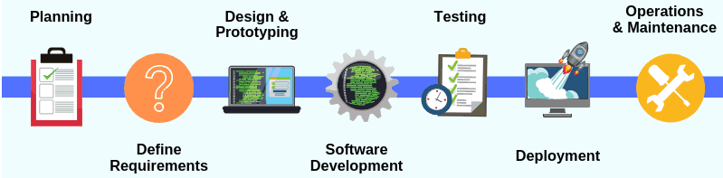
Software development lifecycle
SDLC is a standard business practice to build software applications
Cloud environment modernize the traditional SDLC process
DevOps
Business owners
Head of relevant dept.
Leader:
Project manager
Solution architect
Participant:
System users
Developers
Process owners
Developer
Tester
Deployment engineer
Operation engineer

Slide 4
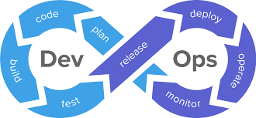
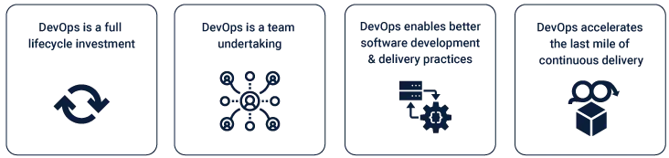
What is devops
Questions in old school software development
  Developers and operators work in silos and they don’t understand each other
DevOps
  Combined role for development and operation
  Demanding role in IT area, especially with cloud knowledge
Start from 2009
Over 70% of SMBs adopting DevOps Services

Slide 5
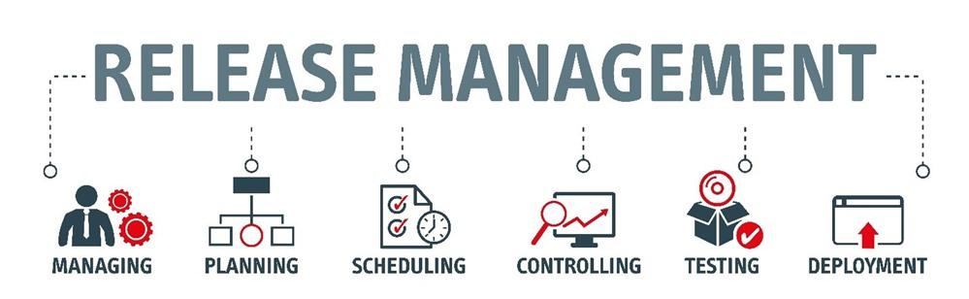

Slide 6
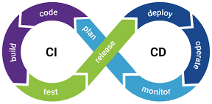
Release management
Release management is the practice of deploying code and configuration changes to environments (e.g. test, production)
It is an integral part of DevOps, which combines software engineering and system administration efforts
Traditionally, developers and system administrators are different group of people. It is less efficient in modern software development environment
  Developers have the best knowledge resolve problem on operation
  With proper tools, deployment of code will not consume much of developers’ time
  Contribute to System Reliability
  It enables developers to deploy corrected code quickly
  It enables small patches instead of large set of changes
  It helps to roll back the bad deployments
  Two core functions of release management
  Continuous Integration
  Continuous Deployment

Slide 7
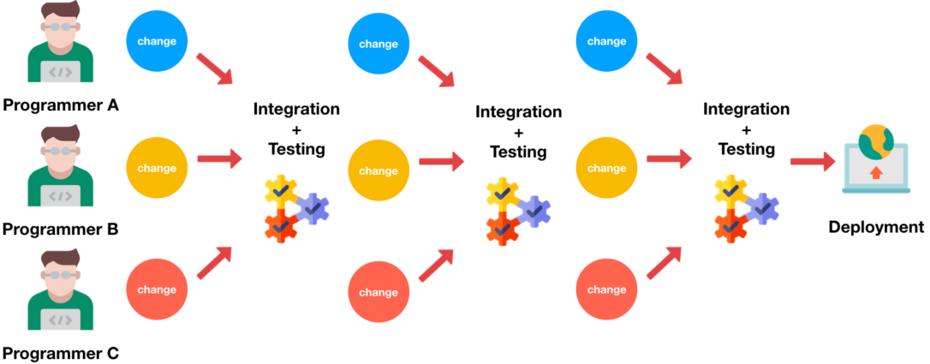
Continuous integration (CI)
Continuous integration (CI) is the practice of automating the integration of code changes from multiple contributors into a single software project
It's a primary DevOps best practice, allowing developers to frequently merge code changes into a central repository where builds and tests are conducted
Component of CI
  Local/central repository, version control system, branching folder, code check and auto-build
Why need CI?
  Divide the project into small teams to speed up the code development process
  Different piece of code may need different platforms and tools
import sys
num1 = input('Enter first number:')
num2 = input('Enter second number:')
#Add two number by programmer1
sum = int(num1) + int(num2)
print('The sum of '+ num1 +' + '+ num2 + ' is ' + str(sum))
#Find the square root of first number by programmer2
num_sqrt = int(num1) ** 0.5
print('The square root of ' + num1 + ' is ' + str(num_sqrt))
# Check if the 2nd number is even or odd by programmer3
if (int(num2) % 2) == 0:
print(num2 + ' is an Even number.')
else:
print(num2 + ' is an Odd number.' )

Slide 8
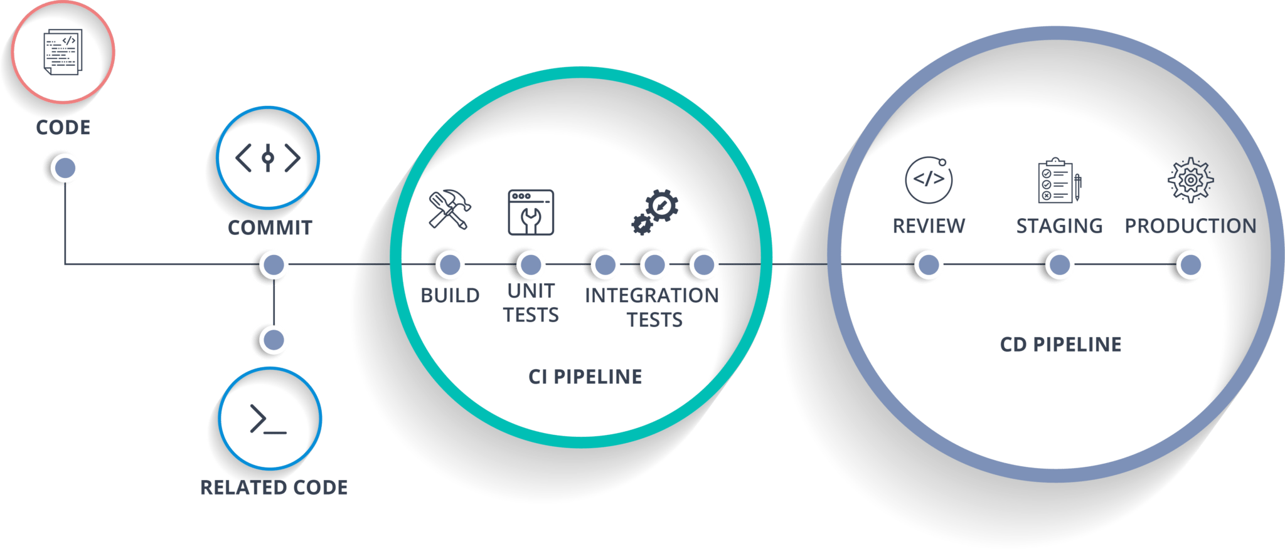
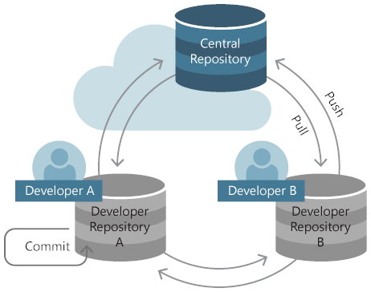
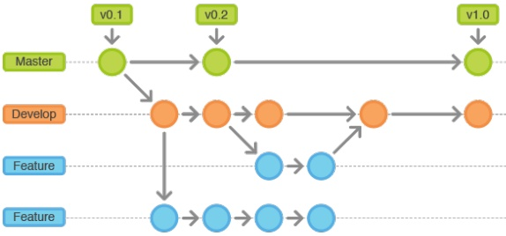
CI architecture & workflow
Branches
merge
Version Control: Development Branches
Distributed Version Control System (GIT)

Slide 9
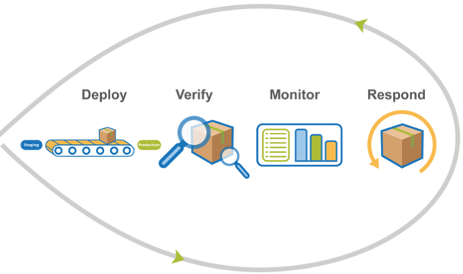
Continuous deployment (CD)
Continuous deployment is a software release process that uses automated testing to validate if changes to a codebase are correct and stable for immediate autonomous deployment to a production environment
It support both preview or no human intervention on the code deployment
It is a pipeline that automate the code deployment for big server clusters
It has the ability to monitor and roll back to previous stable version if any incident happens for the current version

Slide 10
CD strategies
Complete Deployment
  Updates all instances of the modified code at once
Rolling Deployment
  Incremental update all servers over a period of time
  Server1→stabilization(e.g. 2hrs)→server2→stabilization→server3
Canary Deployment
  Releases an application or service incrementally to a subset of users (e.g.5~20%)
Blu/Green Deployment
  Utilizes two identical environments, a “blue” (staging) and a “green” (production) environment with different versions of an application or service

Slide 11
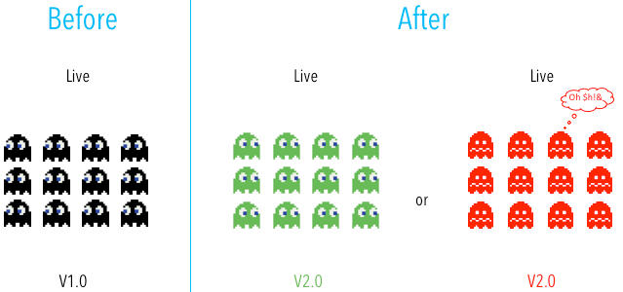

Complete deployment
For single server running a monolithic application
  Downtime is required
  Risky, not suitable for commercial system
Usually used in R&D type small project

Slide 12
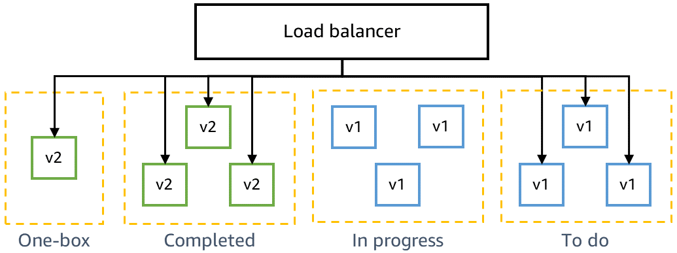
Rolling deployment
Advantage
  No service downtime
  Expose only a subset of users to the risk of disruptive code
  Relatively simple to roll back
  Less risky than complete deployment
  Implementation is simple
Disadvantage
  Server needs to support both old and new version during stabilization period
  Stabilization period for each server drags the whole deployment slow

Slide 13
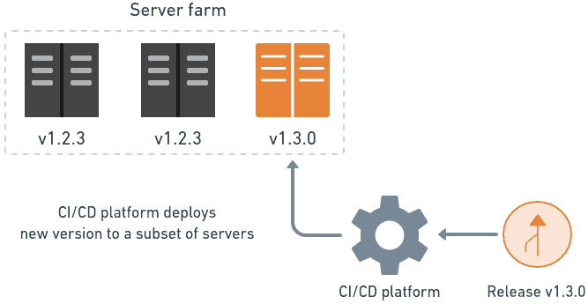
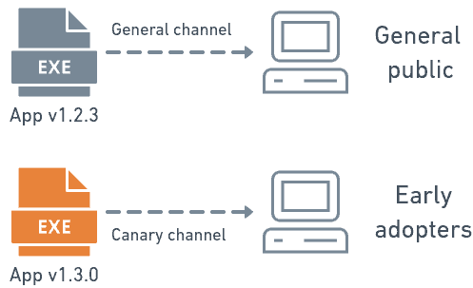
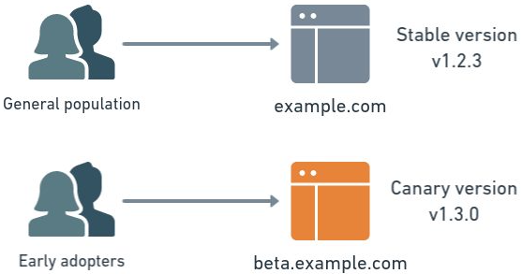
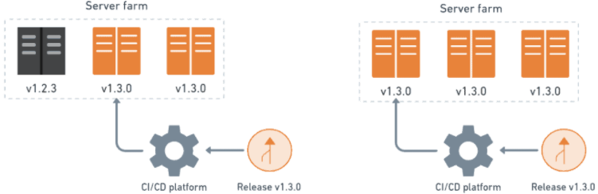
Canary deployment
Pros
  It allows organizations to test in production with real users
  It allows comparison of different versions side by side
  It’s cheap as it does not need two production environments
  It’s easy to rollback as both version on the same production server
Cons
  Usually, the customer base direct to the new version need to be carefully chosen
  Scripting a canary release can be complex
  Manual verification and testing is needed

Slide 14
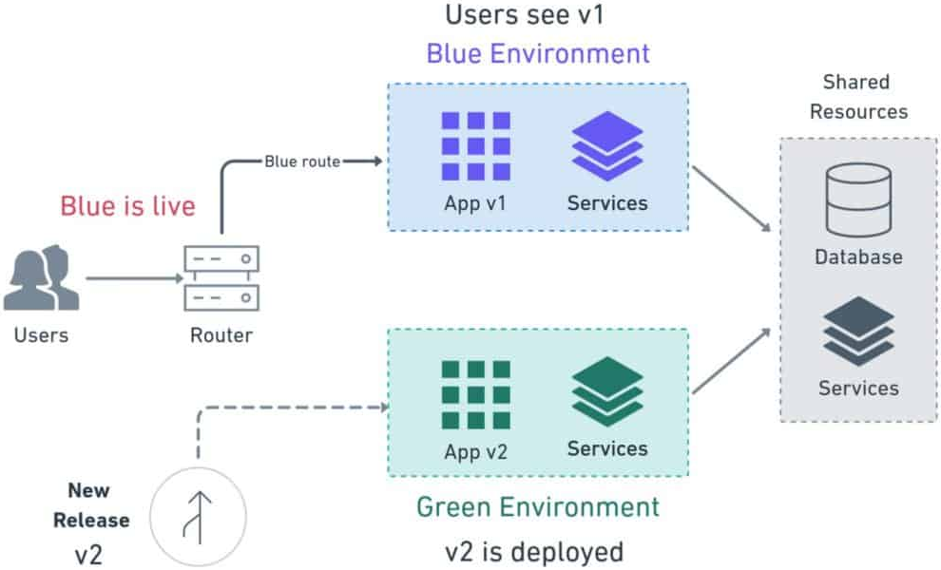
Blue/green deployment
Pros
  Simple, fast, well-understood, easy to implement
  Rollback is straight forward, just direct the traffic back to Green environment
Green Environment
Green route
Green is live
App v1
Services
Cons
  High cost as it need 2 systems
  Replicating a production environment can be complex and expensive
  Shift all user traffic at once is risky
  In-flight user transactions may be lost during the shift of traffic
App v2
Services
Blue Environment

Slide 15
CD test
Unit test
  For smallest unit testable code (function, API endpoint, entry point of a program)
  Target to find bugs within the smallest unit
Integration test
  For a combination of units
  Usually to test if the whole process is conducted correctly in sequence
  May include different levels, depends on business logic
Acceptance test
  For business owners
  To ensure the code meets the business requirement of the system
  A system can pass rigorous unit & integration test but still fail acceptance test
Load test
  To understand how system performs under a set of conditions
  Simulated workload is generated for the test (API calls, HTTP requests, etc)
  Usually the load is heavier than expected
  It is crucial for systems subject to spiking workloads

Slide 16
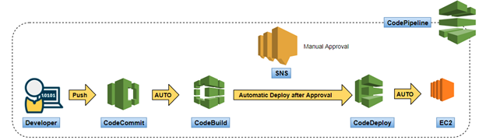
AWS CI/CD pipeline
CodeCommit
  Private code repository
CodeBuild
  Build source code
CodeDeploy
  Fully managed CD service for EC2/on-prem server/Fargate/Lambda
  Blue/green deployment → Linear & Canary in 2020→…
  CodePipeline

Slide 17
Every container setup has two parts:
Control plane: the "brain" that decides where containers run, restarts failed ones, and handles scaling.
Worker nodes: the actual servers (EC2 instances) where containers run.
EKS (Kubernetes)
AWS manages the brain for you. The worker nodes are still your problem: you create EC2 instances, join them to the cluster, and patch and scale them. That's what she meant by "make EC2 urself n put the nodes."
ECS (AWS's own container service)
The brain is fully AWS's and basically invisible. If you use the Fargate launch type, you don't touch any servers at all. You just say "run this container with 1 vCPU and 2GB RAM" and AWS finds somewhere to run it. That's the "no need" part.

Slide 18
Development Methodology

Slide 19
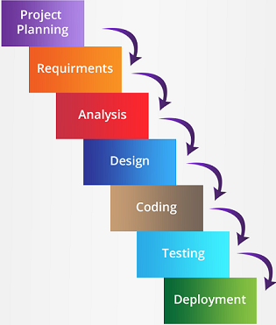
Development methodology
Waterfall Methodology
Once a phase is completed, no going back
Suitable for project which
  all functional requirements are known at initial stage
  Business processes change slowly
  Complex requirement
  Safety critical software (e.g. medical/aviation app)
Pros
  Minimum time spend on requirement gathering & design phase
  All requirement can be taken into consideration in design phase
  Low risk of developing useless code
Cons
  Users may not really know what they want at initial stage
  Business requirement may change over the course of a project
  Go to market waiting time is long

Slide 20
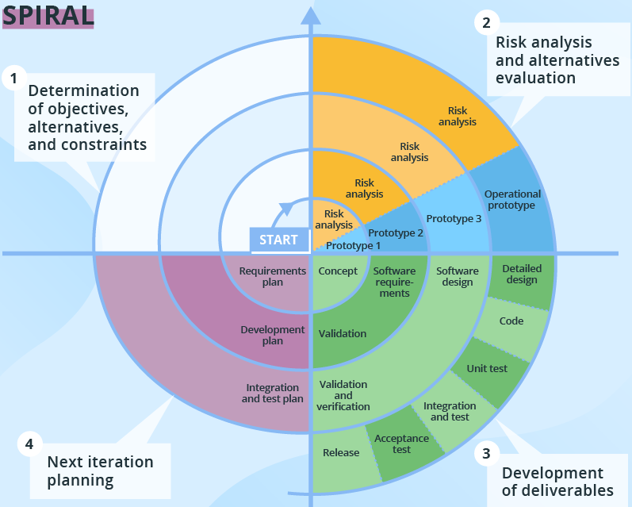
Development methodology
Spiral Methodology
Works on similar phases as waterfall methodology
Work on only a limited set of functionalities at a time
After all stages are completed for one set of functionalities, stakeholders determine what to work on next
Each cycle consist of
  Understanding stakeholders’ objective
  Reviewing product and process alternatives
  Identifying risks and how to mitigate them
  Securing stakeholder commitment to the next iteration
Pros:
  Development can start when full requirement is unclear
  Knowledge from each iteration can be applied in later iterations
  Adaptable to progressing business requirements
Cons:
  New requirements need to wait for the next iteration to add
  Go to market waiting time is not minimum

Slide 21
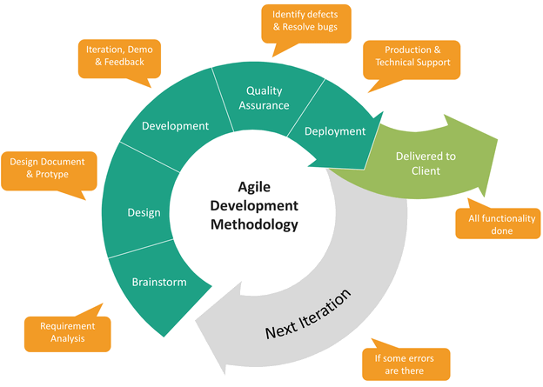
Development methodology
Agile Methodology
It is interactive with shorter cycles and focus on small deliverables
Each iteration includes planning, design, development, testing, and deployment
It needs close collaboration between developers and stakeholders and with frequent code deployment
Suitable for projects that
  need to adapt to changing business and technical requirements
  Simple/straight-forward requirement
  Need the fastest GTM speed (e.g. online shopping system, web design, public positioning app)

Slide 22
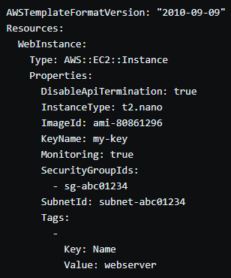
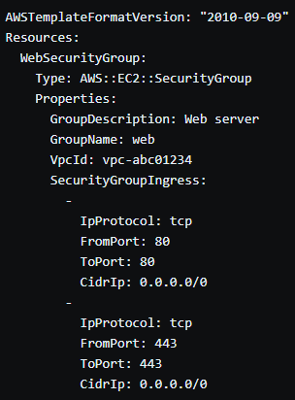
Infrastructure as code
IaC means automatic deploy & configure IT infrastructure using configuration files
Reason for IaC: cost + time
Managing IT infrastructure was a manual process.
Professionals need long time to set up the infra.
Scalability and availability is the issue.
Monitoring and health maintenance is a big problem.
https://aws.amazon.com/cloudformation/resources/templates/

Slide 23
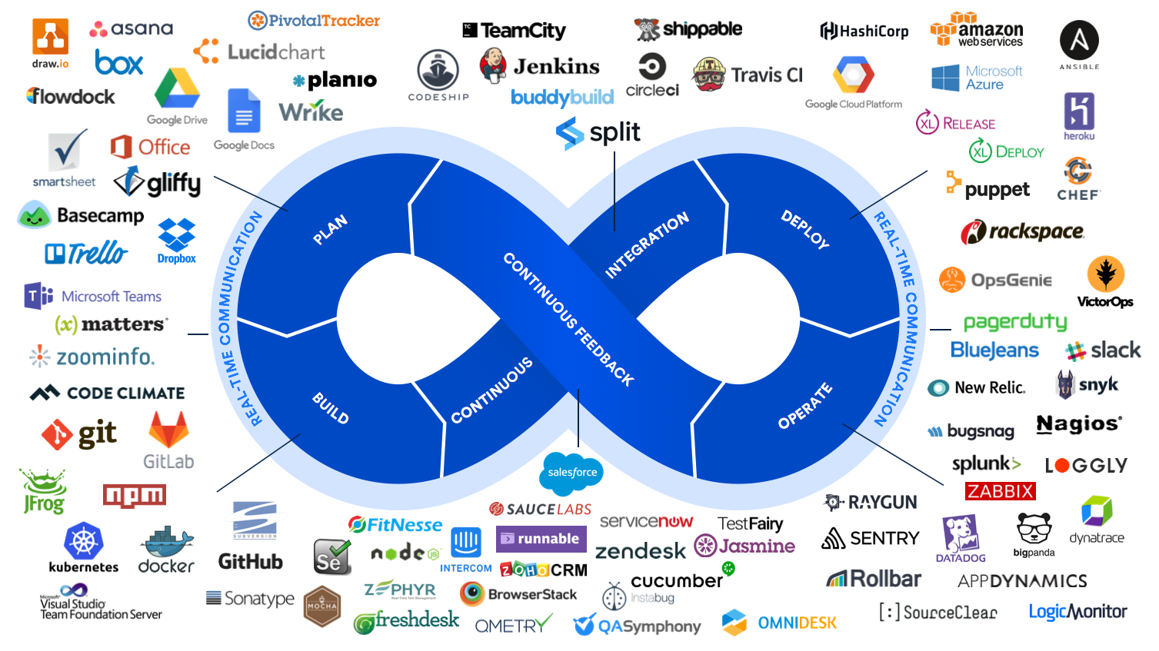
Tools for devops

Slide 24
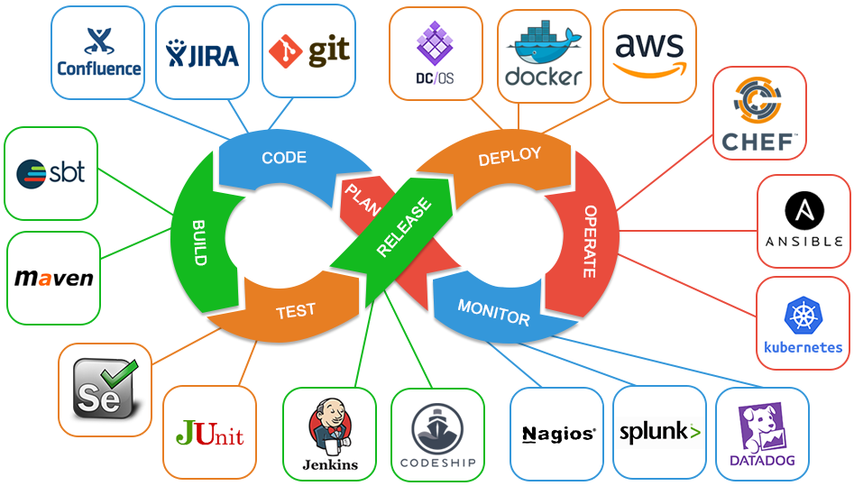
Most commonly used devops tools

Slide 25
Commercial trend of SDLC & Devops
  Towards micro-services
  Towards distributed services
  Towards agile development
  Towards managed services (serverless)
  Managed instance groups
  Serverless environment
  Managed database
  Managed data pipeline
  Towards AI-assisted DevOps
  Towards Agent-based

Slide 26
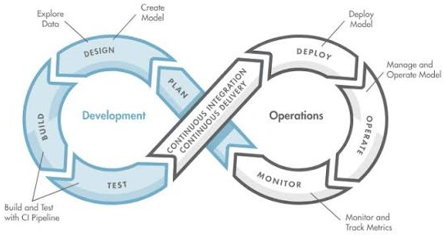
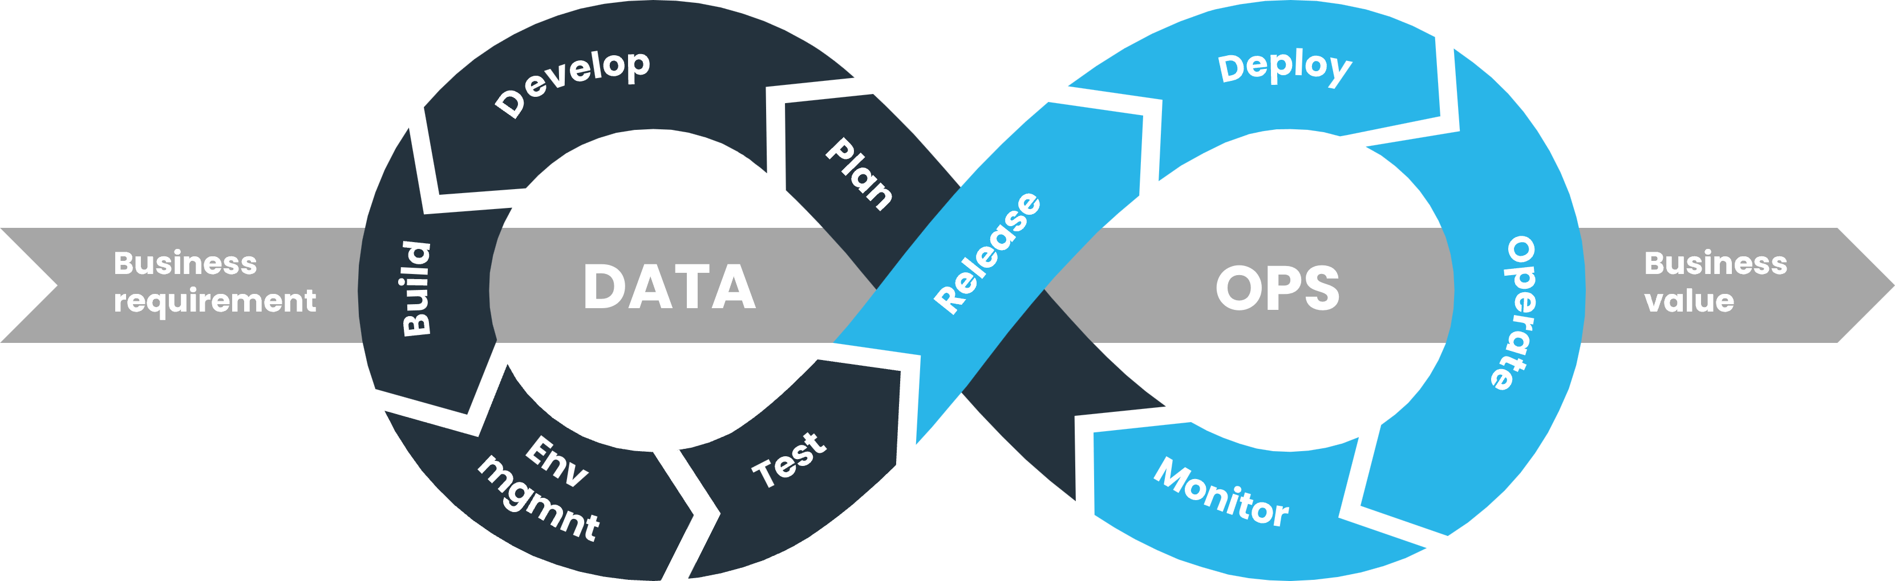
Devops, Aiops, Mlops, dataops
DevOps: code pipeline
AIOps: monitoring automation
MLOps: ML model deployment pipeline
DataOps: data pipeline (ingest->pre-processing(transform)->transfer->consume)

Slide 27
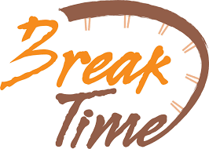

Slide 28


Slide 29
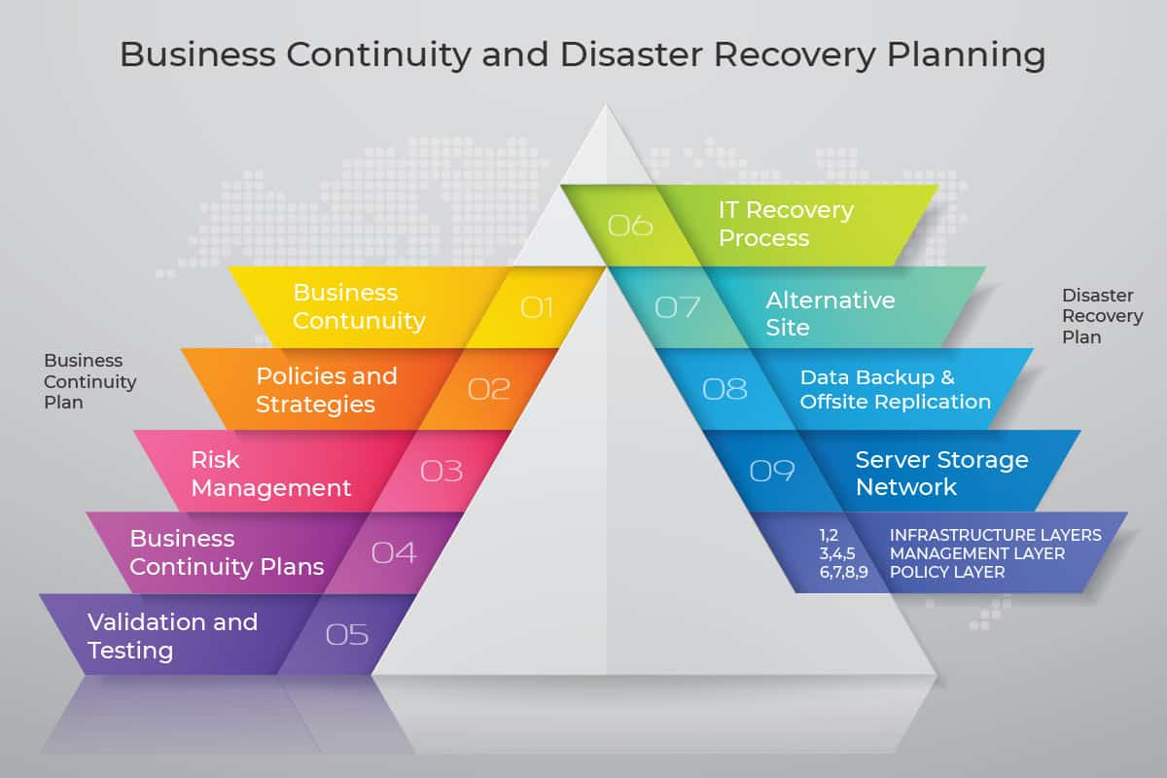
Business continuity planning (BCP)
This is an enterprise-scale process to keep business operations functioning in the event of a large-scale natural or human-made disaster
Component of Business Continuity
  Disaster plan – how to respond to a disaster. It includes information as where operations will be established, which services are critical, what personnel are vital to recovery, plans to deal with insurance/customers/suppliers
  Business impact analysis – describes possible outcomes of different levels of disaster
  Recovery plan – how services will be restored to normal operations
  Recovery time objectives – which services should be restored first and the time expected to restore them
Disaster recovery (DR)
  A subset of BCP
  Focus on IT operations
  Basic supported features for Cloud Computing

Slide 30
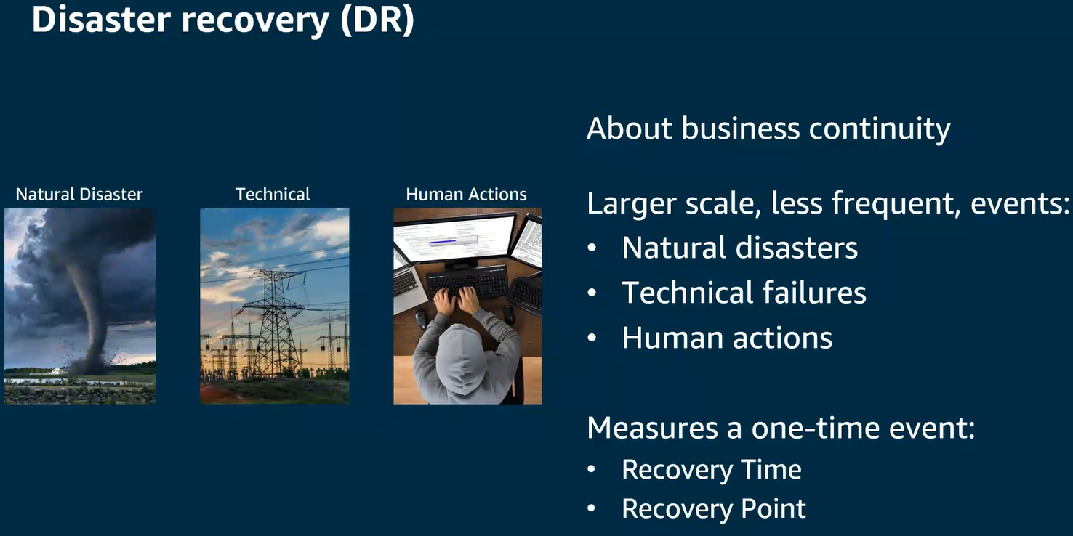
Disaster recovery (DR)
Plan for the continuous IT service
  Backup site – hot/cold standby
  Scripts and processes
  Manpower to establishing service in DR site
  Criteria to switch
Requirement of DR
  Must be operatable
  Must be included in system design phase
  Must be tested regularly
Challenges
  Restoring a service in DR to a state as close as possible to the last state of the system in production
  Realtime synchronization of database may be needed
  Memory data is lost during disaster
  DR strategy
  Backup & restore
  Pilot Light (core system has running standby, manual failover)
  Warm standby (active-passive) – just switchover
  Multi-site (active-active) – 0 down time

Slide 31
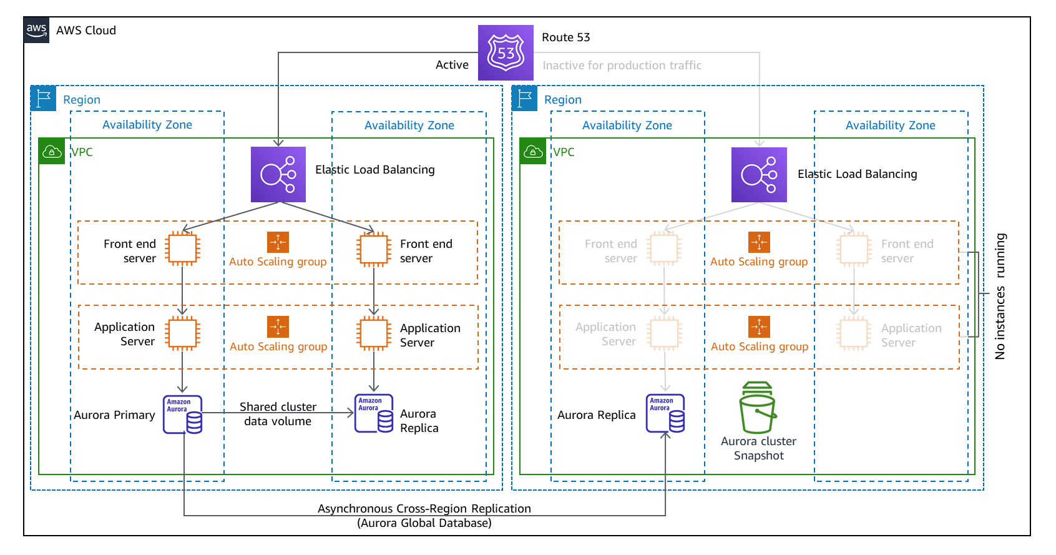
Notes:
Pilot Light -> Core system: data in auroura primary database, we create replica to do the synchronous to save some time , rest of server just server spin up time. Reduce DR time from creating everything from scratch , only create intermediate servers using the template.

Slide 32
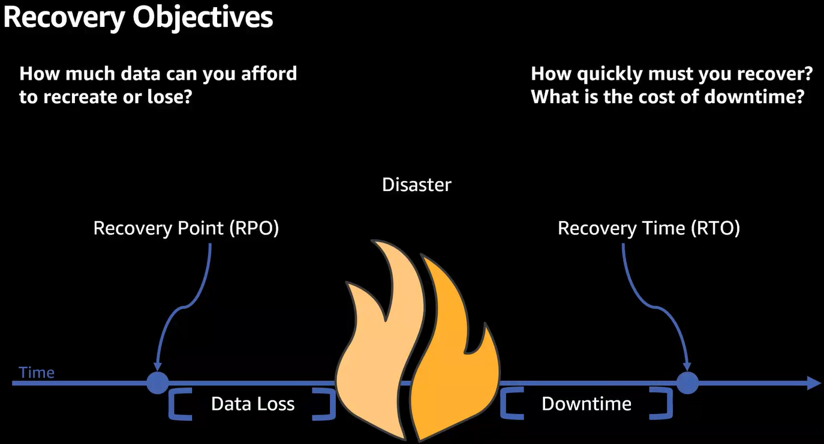

Slide 33
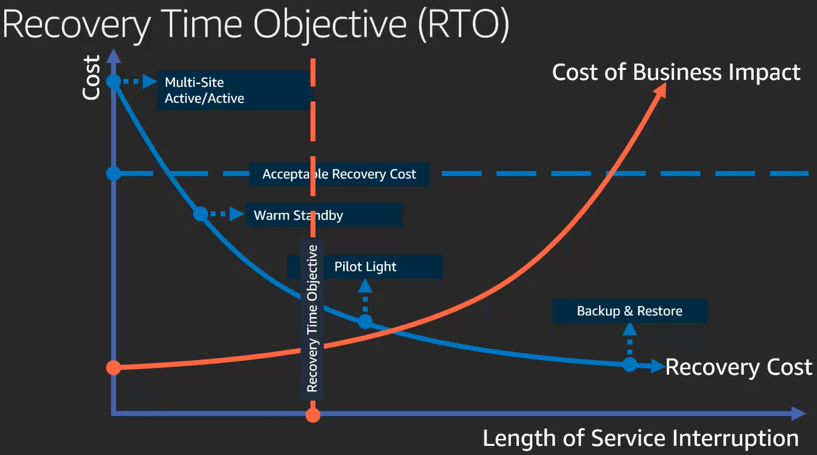

Slide 34
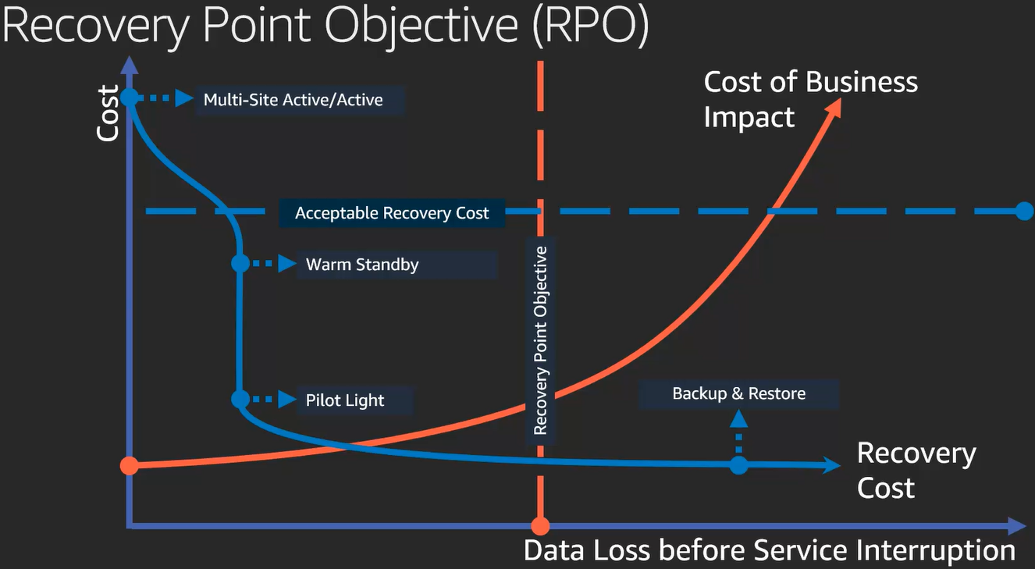

Slide 35
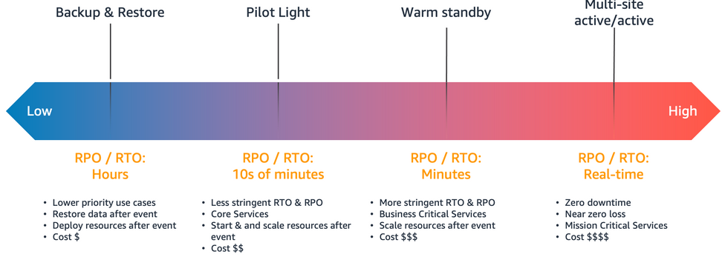
Quiz
If your company set RTO and RPO to be 24 hours for a 5GB SQL database. What is your recommendation on the DR deployment to fulfill the requirement in a cost-effective way?
  Backup & restore
  Pilot Light
  Warm Standby
  Multi-site HA
Notes:
Backup & Restore → you have 24 hours no need to spend money for pilot light or so

Slide 36
Cost Management
Cost Explorer
Budget

Slide 37
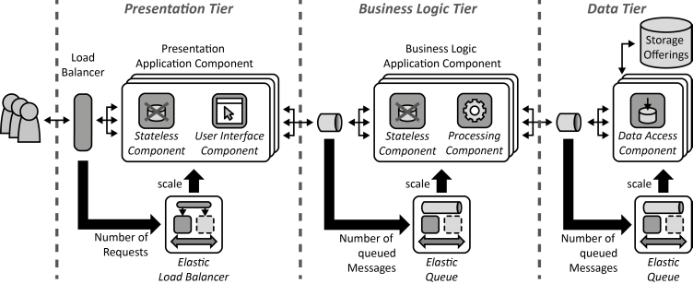
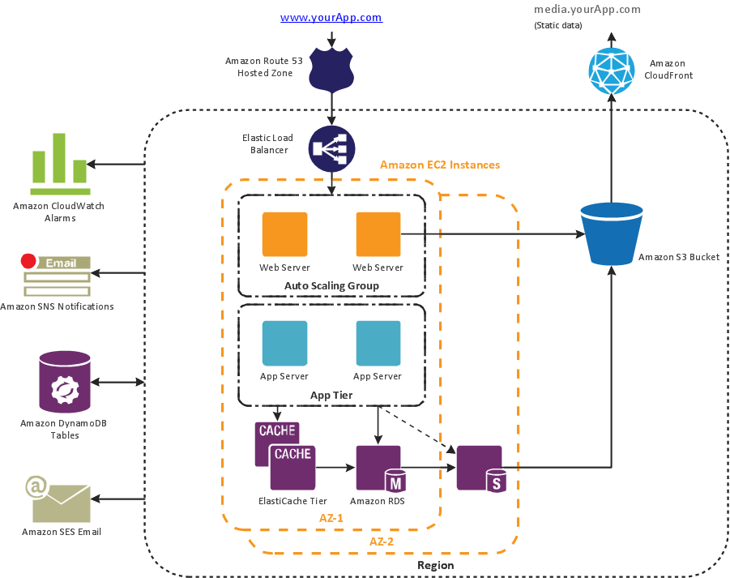
3-tier solution architecture in cloud

Slide 38
Assignment
Discuss within the team on how you plan to design the chosen project
Draw system architecture
Define each modules and how they communicate
Prepare a presentation within 15min
You can start to write/modify the code from now on, fully deployment into cloud may wait until proposal confirmed
Please submit your presentation slides via eLearn, with the following information:
  Context setting and business goal
  Use cases and key functions
  Solution design with cloud resources
  Implementation plan (which part will be implemented and which part will not)

Slide 39
Lab - cloudformation
https://catalog.us-east-1.prod.workshops.aws/workshops/df7f72cf-4f10-4664-acb6-b30dc8d4bcf0/en-US#introduction

