Slide 1
Compute services in cloud

Slide 2
Outline
Type of compute services
Virtual Machine
  Types and variations
  (Service account)
  Instance Groups
  Use cases
Micro-service engine
  Standard
  Flexible
  Use cases
Serverless engine
  Event, triggers, functions
Managed container clusters (Kubernetes)
  Concept, structure and abstractions
  Use cases
  Lab

Slide 3
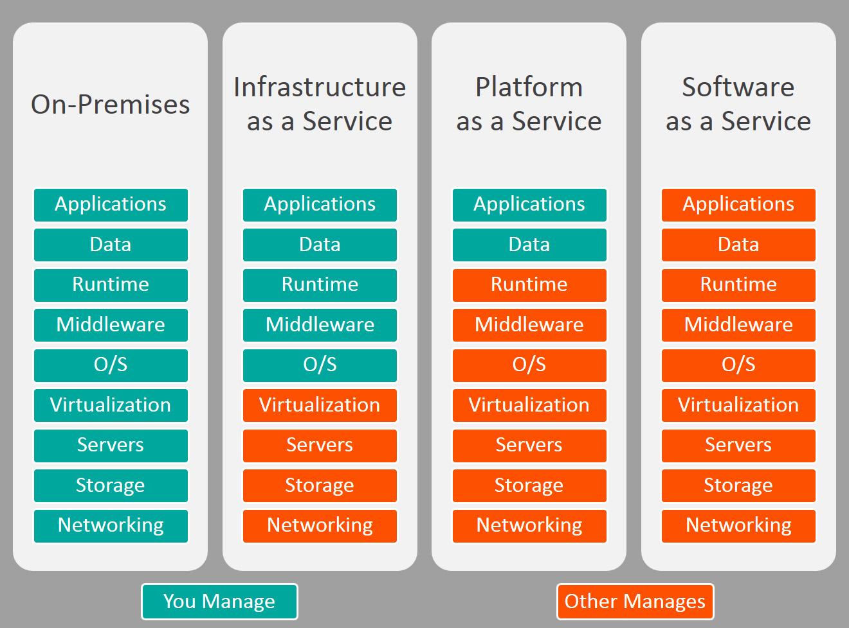
Type of compute services
1.Virtual Machine (E2/EC2)
2. Micro-service Engine
(Elastic Beanstalk/ AppEngine)
3. Managed container clusters (Kubernetes)
4. Serverless Engine
(Lambda/Cloud Functions)
Notes:
All uses VM, difference is just how much cloud service provider manages.

Slide 4
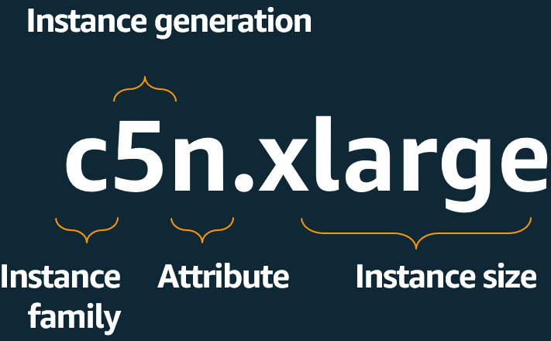
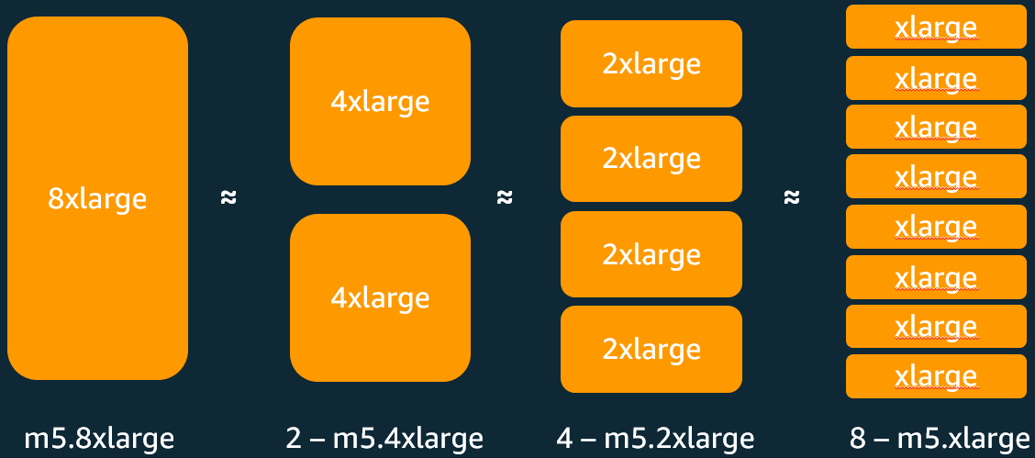
Virtual machine (Instance)
All components of a traditional computer are virtualized for customization
  CPU
  Memory
  Hard-disk
These virtual machines run in CSP’s data centers worldwide through fiber network
Support different operating systems
  Windows
  Linux (Ubuntu, Redhat, etc)
Pre-defined machine types
  Micro (0.2 vCPU) to Super (96vCPUs) compute power
  Compute-optimized or memory-optimized
  N1, E2, Mac, T4g, T3, A1,......
Notes:
Whether or not compute-optimized or memory optimized is the ratio of vcpu:memory.
Compute-optimized instances (e.g. AWS C-series) have a high vCPU-to-memory ratio — more processing power per GB of RAM. These suit CPU-bound workloads like batch processing, video encoding, or scientific modeling, where you need lots of computation but not much memory.
Memory-optimized instances (e.g. AWS R-series, X-series) have a high memory-to-vCPU ratio — lots of RAM relative to compute. These suit workloads that need to hold large datasets in memory, like in-memory databases, caching layers, or real-time big data analytics.

Slide 5
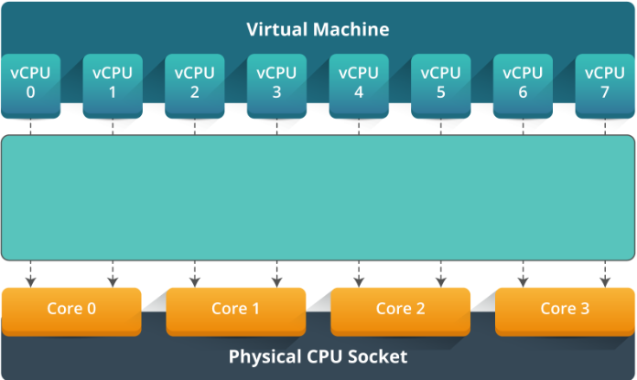
Provision an instance
Choose vCPU and memory
  Each vCPU is treated as a single physical CPU
  1 or more vCPUs are assigned to a VM (even number)
  Total number of available vCPUs depends on the zone
  Standard pre-defined machine types have balanced CPU and memory ratio
  HighCPU or Highmem machine type are for special computational purpose
Customization on creation *
  When pre-defined machine type does not match the desired capacity
  Incurred cost will be adjusted accordingly on-the-spot
  Basic rules for provision memory
  Memory should be between 0.9GB/vCPU to 6.5GB/vCPU
  Total memory should be a multiple of 256MB
Pre-defined machine types
Standard
High Memory
High CPU
Shared-core
Mega Memory
*: change the machine type or adjust resources after provision may require shutdown or terminate the machine

Slide 6
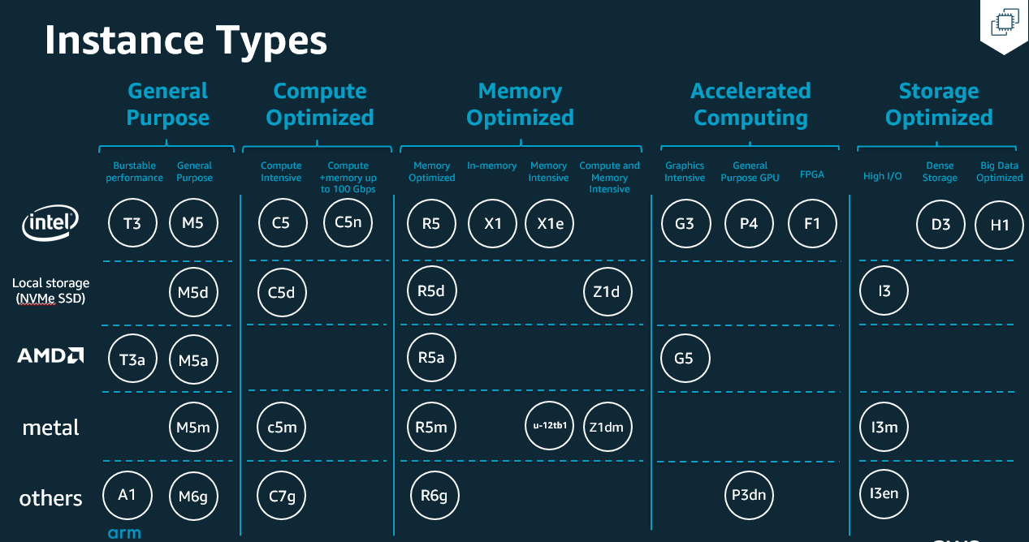
https://aws.amazon.com/ec2/instance-types/

Slide 7
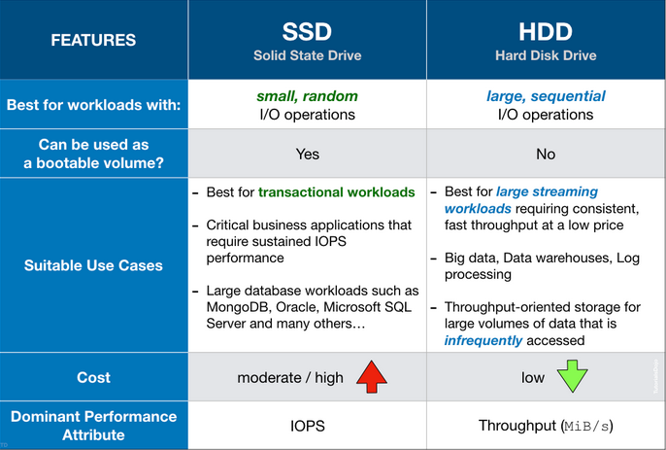
Provision an instance
VM
Local SSD (NOT PERSISTENT)
  Physically attached to the host machine (VM)
  High IOPS (2.4mil/1.2mil for read/write, throughput up to 9.3Gbps)
  Very low latency compare to other block storage options
  For temporary storage such as cache or scratching processing space
  Attach up to 24 local SSD partitions for 9TB of total space
Persistent Disk
  SSD or HDD
  Attach to VM(s) or Kubernetes Engine
  Transparently resize
  Support simultaneous readers (data sharing among VMs)
  Snapshots are geo-replicated for restore in all regions by default
  Exist even after the VM is deleted
Local SSD
Persistent Disk
Persistent Disk
Notes:
Storage

Slide 8
Provision an instance (cont.d)
Choose network interface
Choose VPC (or use custom VPC)
Choose Firewall Rules (e.g. allowed protocols, IPs)
Meta Data and User Data
  Meta Data describes the instance (e.g. IP, hostname, image-ID)
    Curl http://169.254.169.254/latest/meta-data/
  User Data is customer script run in the instance
    #!/bin/bash
    yum update -y
    yum install -y httpd
    systemctl start httpd
    systemctl enable httpd
    echo "<h1>Hello World from $(hostname -f)</h1>" > /var/www/html/index.html

Slide 9
Pre-emptible VM and shielded VM
Pre-emptible VM
  Run 24 hours before shut down by CSP
  Can be shut down anytime while running
  Running processes have 30s to shut down gracefully before VM shutdown
  Up to 80% cheaper than standard VM
  Pre-emptible VM can be used for most compute services (e.g. EC2, Fargate, RDS, EMR)
Shielded VM
  VM with enhanced security controls
  Secure boot
  vTPM (virtual Trusted Platform Module)
  Integrity monitoring – compares the boot measurements with a trusted baseline and return true if the results match and false otherwise

Slide 10
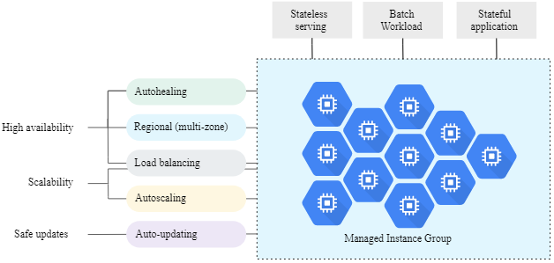
Instance group
Clusters of VMs managed as a single unit
Managed instance group
  Must be identical VMs created by the same instance template
  Auto-scaling, load balancing, auto-healing, auto-update
Unmanaged instance groups
  VMs may not be identical
  Used to support preexisting cluster configurations for load balancing tasks

Slide 11
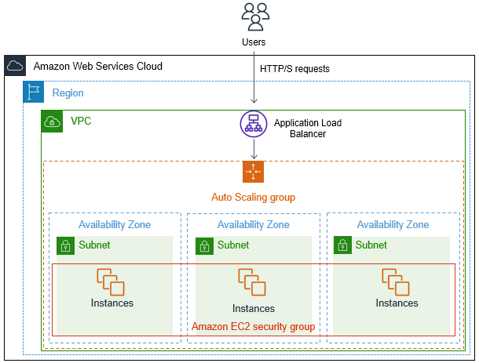
Example: Instance group with ELB

Slide 12
VM instance Use cases
Suitable for users who need control over all aspects of a VM
It is compatible for docker/container
Easy to attach/detach storage spaces
Good option to run stateful applications, like databases
Sole tenancy is available for high security required cases
More flexible for tech-savvy to custom the system
First choice for lift-and-shift migration
Cheaper compared to fully managed services

Slide 13
Elastic Compute engine (EC2) demo

Slide 14
Micro-service engine
Paas service for micro services
Regional service
Fully managed
  Provides health checks and automatically patches underlying OS
  VMs are restarted once a week
  Some platform allows user to customize their runtime environment by using Docker files (e.g AppEngine flexible)
Resource auto-scale according to workload
Load balancer is implemented by default
Usage based charging (free daily quota)
SDK for development and testing
Run on sandbox environment
Deployment
  $ gcloud app deploy (for GCP)
  $ eb create dev-env (for AWS)

Slide 15
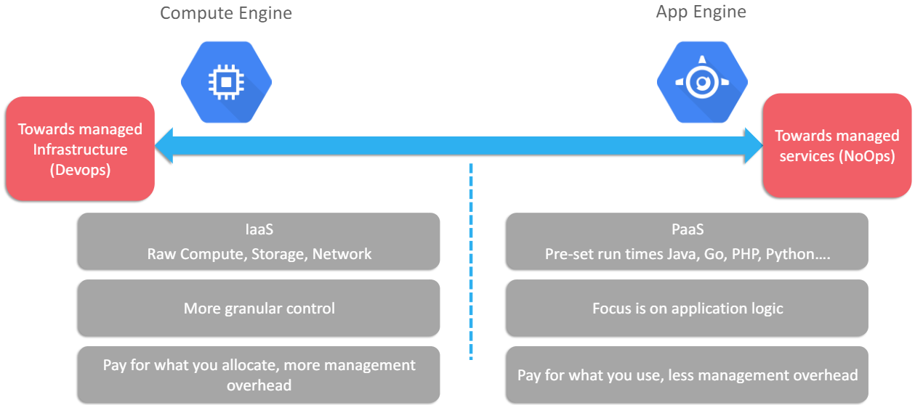
Difference to VM
By default, SSH is disabled.
Limited access to storage
Regional resource

Slide 16

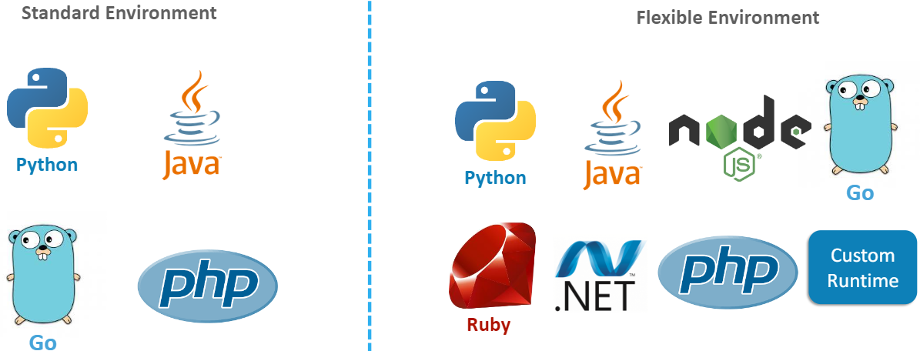



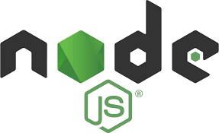


Micro service engine environment
AWS Beanstalk
GCP AppEngine

Slide 17
Use cases
Web and mobile backends
Suitable for applications need to scale rapidly up or down
Release different versions of the APP quickly
APP should be stateless
  If state really need to be maintained, store outside in a cache or database
Task queues are integrated
  To schedule asynchronous tasks
  To distributing workload
Startup time for micro-service engine is on the order of minutes, not seconds

Slide 18
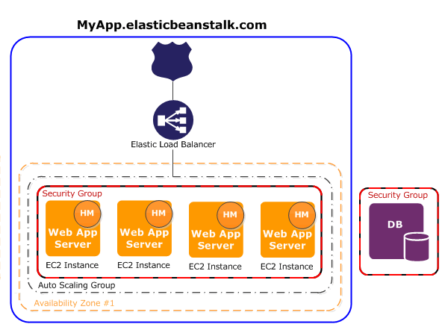
Micro service engine usage example

Slide 19


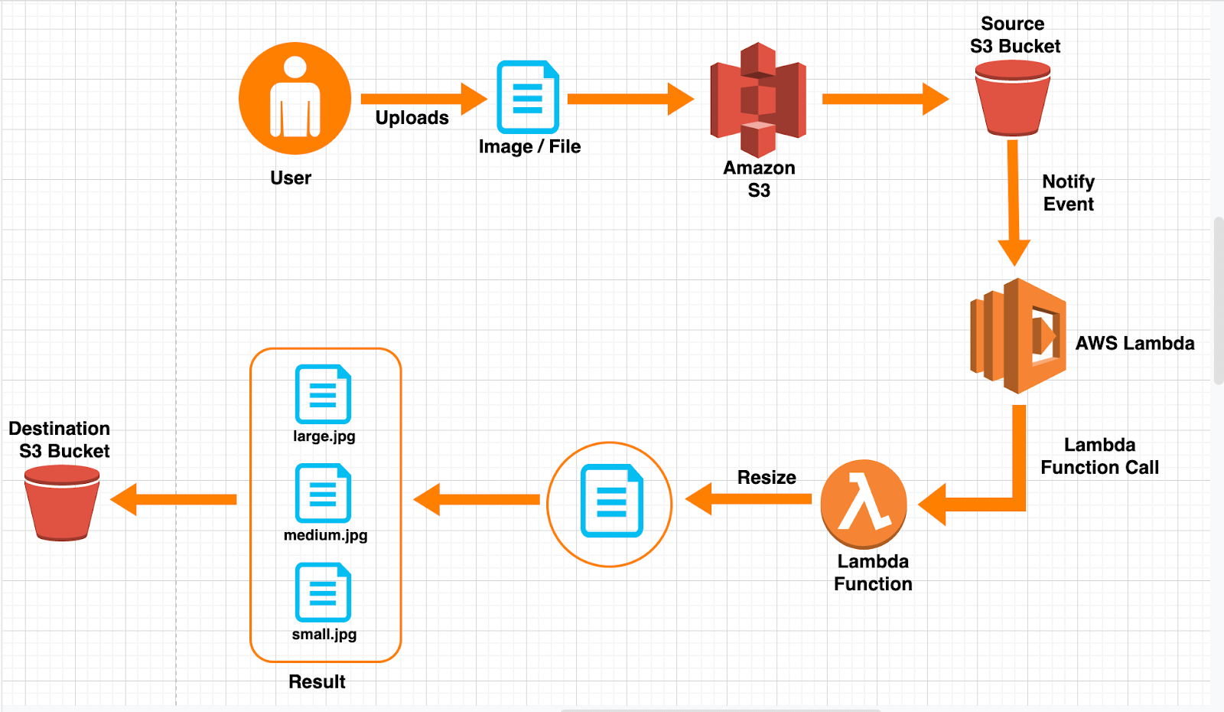
Serverless engine
A piece of code to be triggered to complete some short operations
Triggers
  S3 events
  SNS
  SES
  CloudFormation
  CloudWatch Logs
  CloudWatch Events
  CodeCommit
  Config
  ……
Support languages
  Node.js, Python, Go, Java
There’s a limitation of serverless engine execution time.
  AWS Lambda functions can run up to 15min per execution.
  GCP Cloud Functions are timed out after 1min, but user can extend this period up to 9 minutes.
Notes:
a trigger to do a short operation

Slide 20
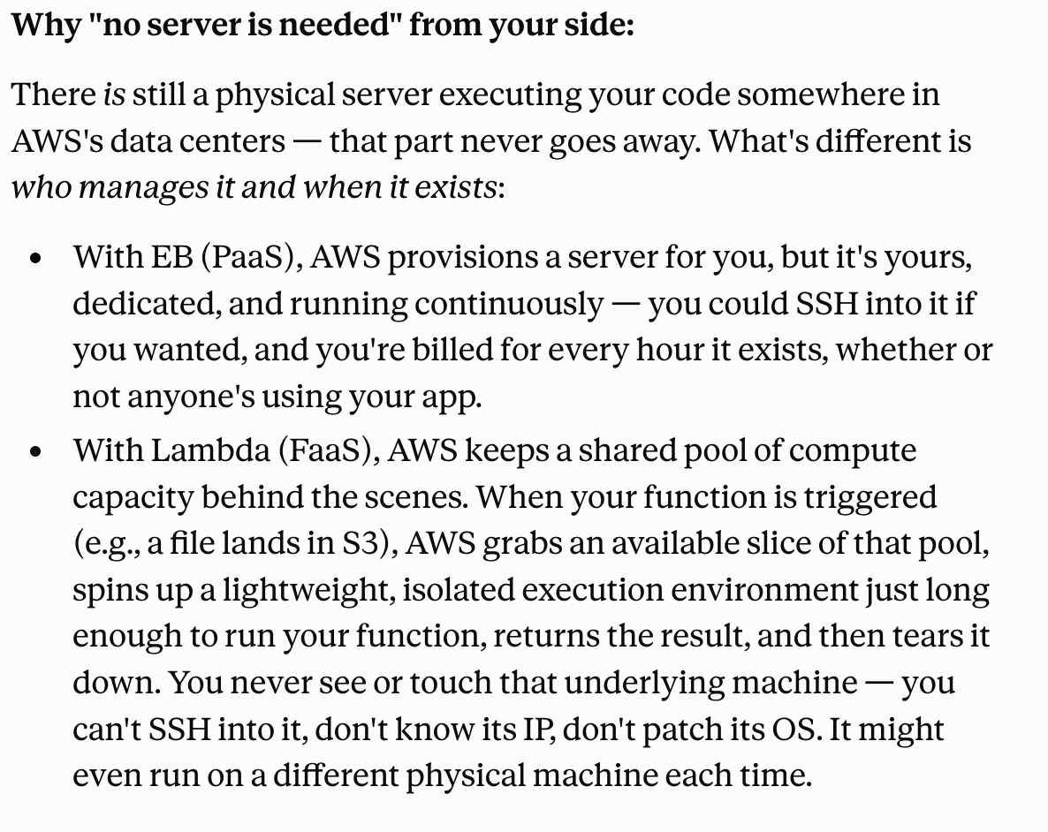

Slide 21
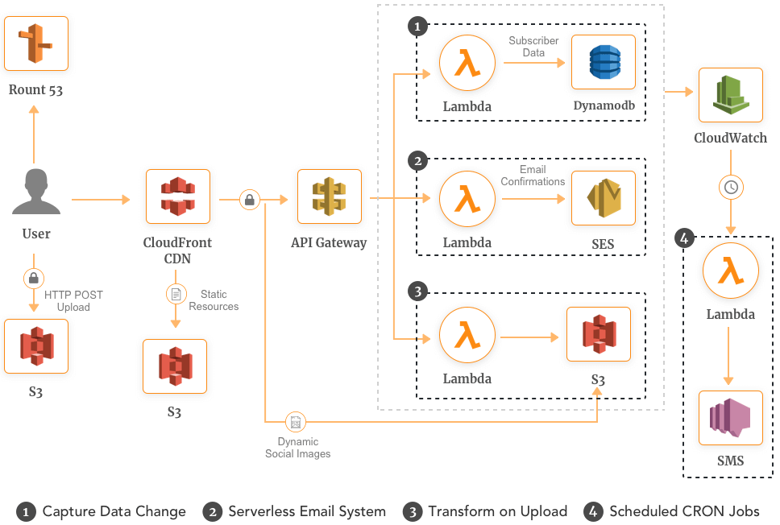
Lambda usage example

Slide 22


Slide 23
Container & kubernetes

Slide 24
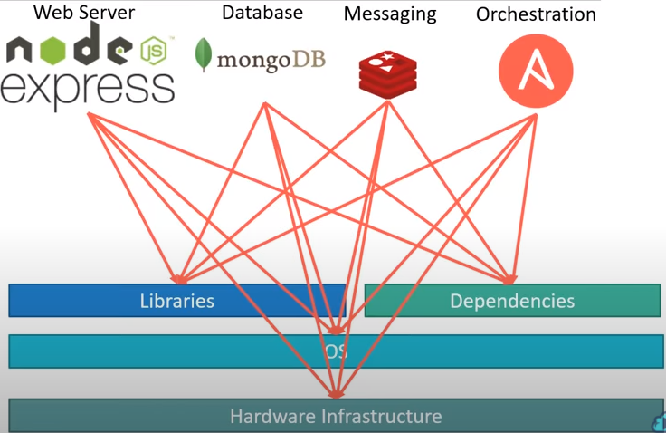
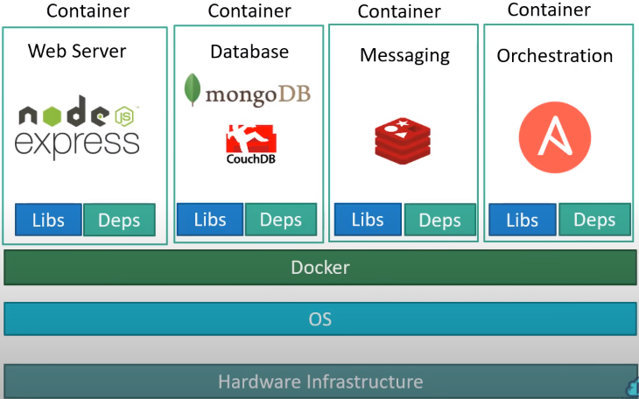
What is a container?
Problem
  Each application may need different OS type and version, dependencies, and libraries
  The adjust of underlying OS/dependencies/libraries may result the existing app fail to function
  Different Dev/Test/Prod environments
Docker
  De-couple the Linux Kernel and User Space
  Share Kernel and pack User Space to containers
  Not a hypervisor, can’t virtualize across OS kernels
Container
  An isolated virtual environment
  Light (~MB) and portable
  Docker hub (https://hub.docker.com/ )

Slide 25
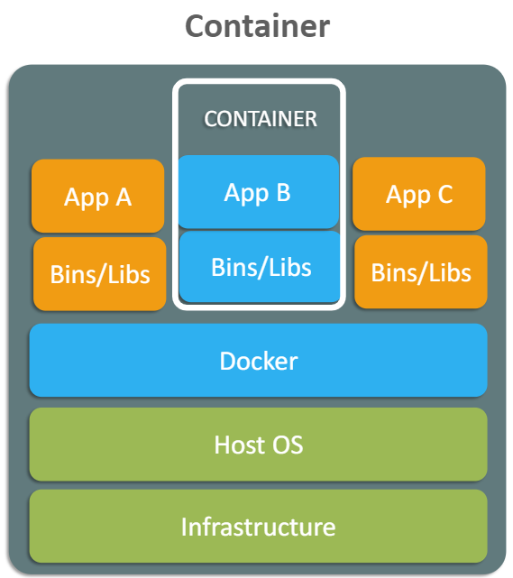
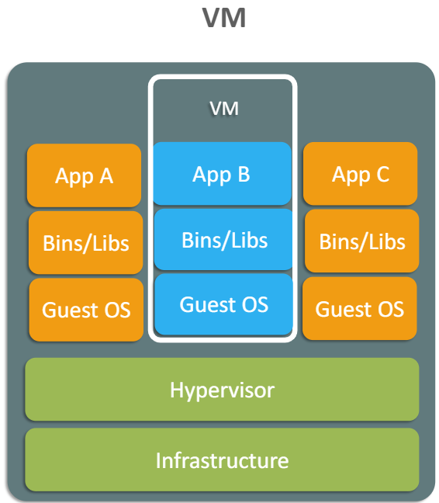
Container vs vm
App layer abstraction
Shared OS resources
Lightweight
Faster boot time
Hardware layer abstraction
Each VM has its own OS
Not lightweight: each VM has full OS, binary, libraries, etc
Slow to boot

Slide 26
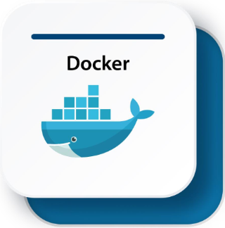
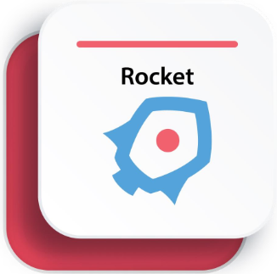
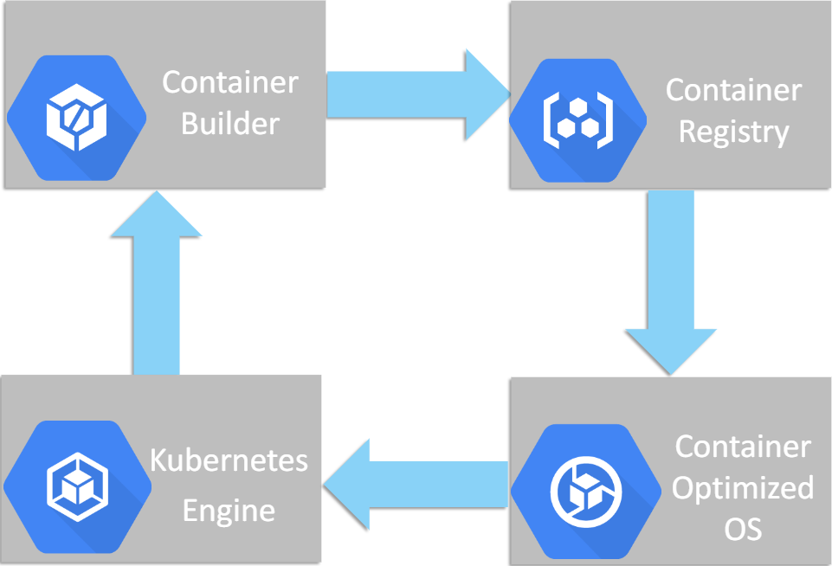
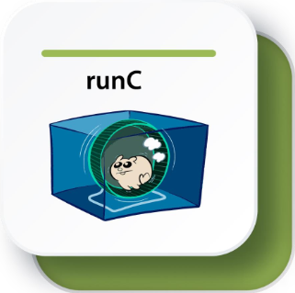
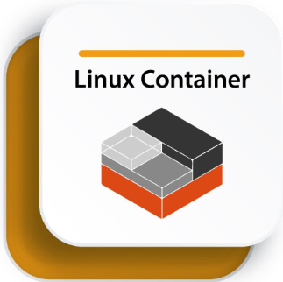
Containers deployment
Container packager
Storage of docker images
Open source containerization platform
No daemon. Run in bash process.
Container service orchestration
OS image for container services
Standard low-level container runtime. Written in Go.
A set of 1 or more processes that are isolated from the rest of the system

Slide 27


Why need Kubernetes?
Questions
  How many containers should be load to a ship?
  Which container goes to which ship?
  How terminal talks to ships? And ships talk to each other?
  How business owners access their containers?

Slide 28




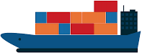




Components of kubernetes
Out of cluster
Node 1
Control plane (@Master Node)
kubelet
Pod 1
Kube-proxy
Pod 2
Kube-apiserver
scheduler
kubelet
Node 2
Kube-proxy
ectd key-value store
kubelet
Node 3
Node 4
kubelet
Kube-proxy
controller manager
Kube-proxy

Slide 29
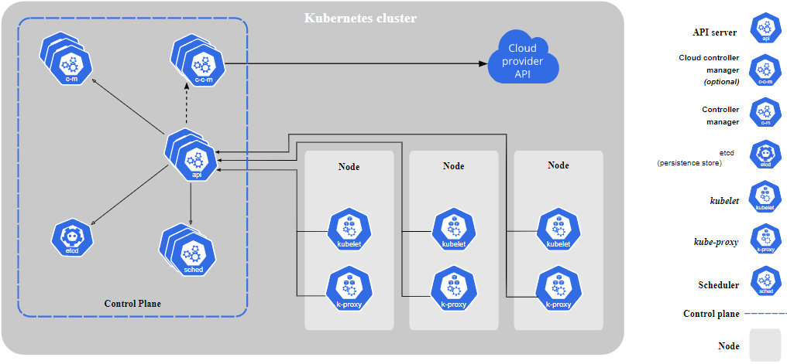
Managed Container clusters (Kubernetes)
Kubernetes, also known as K8s, is an open-source system for automating deployment, scaling, and management of containerized applications.
The 1st version of Kubernetes published in July, 2015
https://kubernetes.io

Slide 30
Components of kubernetes
kube-apiserver
  Front-end of Kubernetes control plane
  Scale horizontally
etcd
  Key-value pair information database
kube-scheduler
  Select a node to assign newly created Pods
kube-controller-manager
  Node controller, job controller, endpoints controller, service account & token controller
  Usually complied in a single process
Kubelet
  Make sure containers are running and healthy in a Pod
kube-proxy
  Maintain network rules on nodes
  Allow network communication to the Pods from inside and outside of the cluster
Control Plane
Node

Slide 31
Important terms for kubernetes
Pods
  Smallest computation unit managed by Kubernetes
  Multiple containers should be in the same pod only if they are functionally related, and have similar scaling and lifecycle characteristics
  Deployed in groups or replicas to nodes by the scheduler
  Ephemeral, may be terminated if not functioning properly
Services
  An abstraction with a stable API endpoint and stable IP address
  For other services to interact with
  Keep track of its associated pods to route calls to a functioning pod
Deployment
  A desired number of pods running the same version of an application
  Kubernetes maintain the healthy Pods within a deployment

Slide 32
Important terms for kubernetes
ReplicaSets
  A controller that manages the number of pods running for a deployment
  Remove unhealthy pod and add new pod based on pod specification
StatefulSets
  Designate pods as stateful and assign a unique identifier to them
  Kubernetes use the identifier to track which clients are using which pods and keep them paired
Persistent volumes
  Decouple from ephemeral pod to store data
Ingress
  An object that controls external access to services running in a Kubernetes cluster
  Ingress controller must run in a cluster

Slide 33
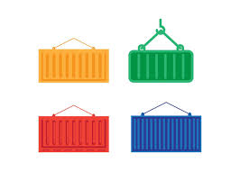
Work chart of kubernetes
Service
(API, IP)
Clients
Other services
Deployment
(Desired # of node)
ReplicaSet/StatefulSet
(kill and add pod, pair traffic)
ingress
(traffic control)
Control Plane
Node
Node
Node
kubelet
kubelet
Kube-apiserver
(communication)
Kube-control-manager
kubelet
Kube-proxy
Kube-proxy
Kube-proxy
pod
pod
Kube-scheduler
(decide which node to host the new pod)
etcd
(DB)
pod
pod

Slide 34
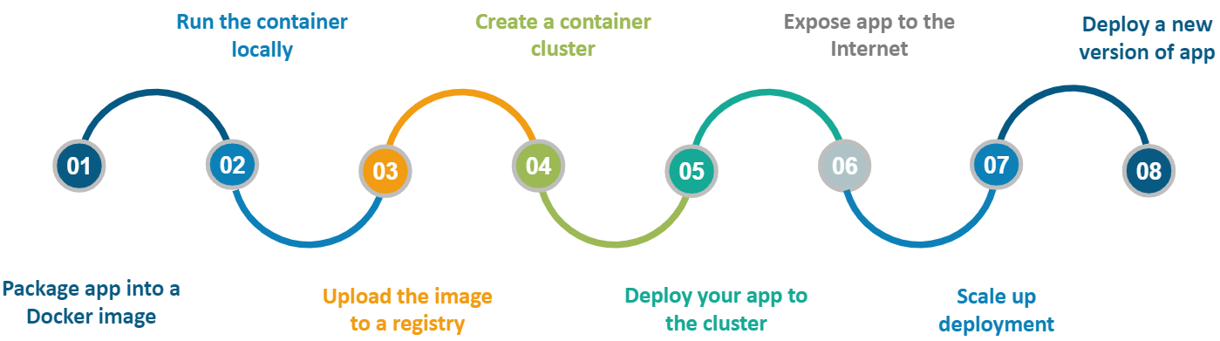
Deploy a containerized web app

Slide 35
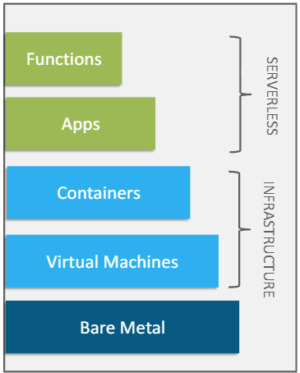
Summary
Saas
4. Serverless Engine
(Lambda/Cloud Functions)
Paas
2. Micro-service Engine
(Elastic Beanstalk/ AppEngine)
Iaas~Paas
3. Managed Container clusters (Kubernetes)
Iaas
1.Virtual Machine (EC2/E2)

Slide 36
Case study – Dress4win
40 web application servers providing micro-services based APIs and static content
  Tomcat-Java
  Nginx
  4-core CPUs
  32 GB RAM
20 Apache Hadoop/Spark servers
  Data analysis and real-time trending calculations
  8-core CPUs
  128GB RAM
  4*5TB HDD (RAID 1)
3 RabbitMQ servers for messaging, social notifications and events
  8-core CPUs
  32GB RAM
Miscellaneous servers
  Jenkins, monitoring, bastion hosts, security scanners
  32GB RAM

Slide 38
Lab 1: VM creation
https://catalog.workshops.aws/general-immersionday/en-US/basic-modules/10-ec2/ec2-linux

Slide 39
Lab 2: Deploy an app
Open the Elastic Beanstalk console, and in the Regions list, select your AWS Region.
In the right top of navigation pane, click “Create Application”.
Use AWS sample code or upload your .html code in zip/war format
  For this lab just choose TomCat & using AWS sample code
Click “Create application”
Click on the URL to test the webpage
View logs and configuration tags
Deploy a new version of the app
  https://docs.amazonaws.cn/en_us/elasticbeanstalk/latest/dg/GettingStarted.DeployApp.html
CLI
  aws elasticbeanstalk create-application-version --application-name my-application --version-label v1 --source-bundle S3Bucket=DOC-EXAMPLE-BUCKET,S3Key=php-proxy-sample.zip
  https://docs.aws.amazon.com/cli/latest/reference/elasticbeanstalk/index.html
Notes:
Lab 2 Notes: Deploy an App with Elastic Beanstalk
What Elastic Beanstalk (EB) Is
A PaaS (Platform-as-a-Service) — automates provisioning of EC2 instances, load balancer, security groups, and app deployment.
Not specific to microservices — it hosts any web app/service. For true microservice architectures, AWS's more purpose-built tools are ECS/EKS (containers) or Lambda (serverless).
Key Concepts Learned
Server = a computer/program that listens for requests and responds. Client = the one making the request.
Web server = a server that specifically handles HTTP requests and returns web content.
Tomcat = a Java web server / servlet container — not a file, but the software EB installs on your EC2 instance to run Java web apps (packaged as .war files).
AWS CLI ≠ SSH. The CLI runs on your local machine and calls AWS's APIs over HTTPS (like the browser console, but via terminal). It does not log you into any remote server. Auth comes from credentials stored via aws configure.
Steps Completed
1. Create app + environment (Console)
EB Console → select Region → Create Application.
Chose platform: Tomcat, source: AWS sample code.
Clicked Create application → EB provisions EC2, load balancer, etc.
Tested the live app via the generated environment URL.
Reviewed Logs and Configuration/Tags.
2. Deploy a new version (CLI)
Full sequence, in order:
bash
# 1. Create S3 bucket (one-time)
aws s3 mb s3://yanting-eb-lab --region us-east-1
# 2. Upload new app package to S3
aws s3 cp my-application-v2.war s3://yanting-eb-lab/my-application-v2.war
# 3. Register the S3 file as a new application version
aws elasticbeanstalk create-application-version \
--application-name yanting-application \
--version-label v4 \
--source-bundle S3Bucket=yanting-eb-lab,S3Key=my-application-v2.war
# 4. Deploy that version to the live environment
aws elasticbeanstalk update-environment \
--environment-name <your-environment-name> \
--version-label v4
Registering a version (create-application-version) ≠ deploying it. Deployment only happens on update-environment.
describe-applications — lists apps + their exact ApplicationName (auto-generated from what you typed, e.g. yanting-application, not literally my-application).
describe-environments — lists EnvironmentName and EnvironmentId (either works interchangeably as the deploy target).
describe-application-versions — checks a version's processing Status (UNPROCESSED → PROCESSED, not an error).
New app version deployed to a live EB environment entirely via CLI, tied to a manually created S3 bucket — demonstrating the full deploy pipeline (build → upload to S3 → register version → deploy to environment).

Slide 40
Lab 3: familiar with lambda
Create a bucket and upload a image into it
To create a Lambda function from a blueprint in the console
Open the Functions page on the Lambda console.
Choose Create function.
On the Create function page, choose Use a blueprint.
Under Blueprints, enter s3 in the search box.
In the search results, do one of the following:
  For a Node.js function, choose s3-get-object.
  For a Python function, choose s3-get-object-python.
Choose Configure.
Under Basic information, do the following:
  For Function name, enter my-s3-function.
  For Execution role, choose Create a new role from AWS policy templates.
  For Role name, enter my-s3-function-role.
Under S3 trigger, choose the S3 bucket that you created previously.
  When you configure an S3 trigger using the Lambda console, the console modifies your function's resource-based policy to allow Amazon S3 to invoke the function.
Choose Create function.
Create mys3testevent test function to test the lambda function
https://docs.aws.amazon.com/lambda/latest/dg/with-s3-example.html

Slide 41
Lab 4 (optional): Kubernetes primary
Prerequisite
  Create an IAM role, give AmazonEKSClusterPolicy and AmazonEKSServicePolicy
  Create an IAM role, give AmazonEKS_CNI_policy and AmazonEKSWorkerNodePolicy
  Install kubectl https://docs.aws.amazon.com/eks/latest/userguide/install-kubectl.html
  (Add kubectl.exe into the environment path)
  Create VPCs for the cluster
aws eks update-kubeconfig --name mynginxcluster //update local config file
Create work nodes on EC2
Add work nodes to cluster
Create deployment yaml file and deploy it
Create service yaml file and deploy it
kubectl describe svc nginx
Copy the public IP and view the web application deployed
https://docs.aws.amazon.com/eks/latest/userguide/getting-started-eksctl.html

Slide 42
Assignment
Create an Auto Scaling VM group using launch template
Attach a load balancer to the Auto Scaling group (e.g. Application LB)
Violate the scaling policy (terminate VM/stress CPU) to see how ASG scale out and scale in
Write a simple report with key steps and the screenshot of each step
Submit your homework via eLearn
Choose one project topic and list down the compute resources for it (no need to submit)

