Slide 1
Hybrid cloud and migration

Slide 2
outline
Kubernetes lab (by Guest Lecturer from Dell Technology)
Hybrid cloud
  Concept
  Use cases
  Networking
  Hybrid cloud data sync
  Hybrid service management
Migration
  Concept
  Types
  Steps
  CSP services and tools

Slide 3
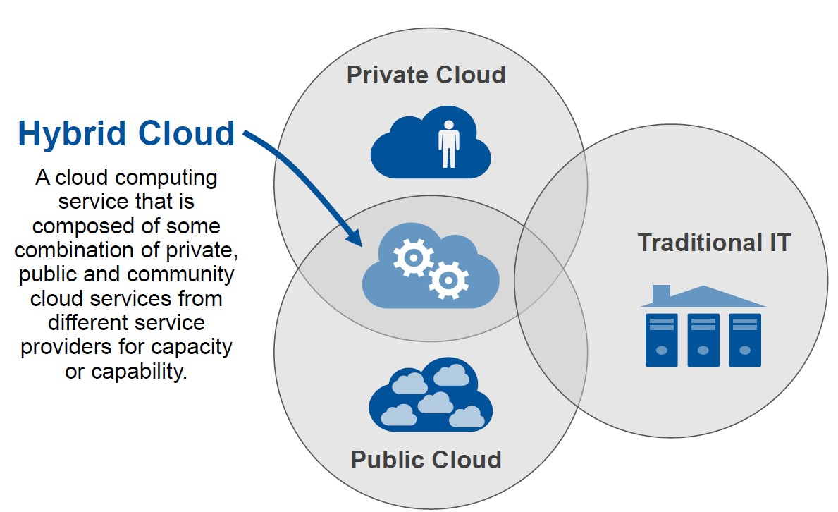
Hybrid cloud
Must have at least on-prem machines
Hybrid cloud combines a private cloud with one or more public cloud services, with proprietary software enabling communication between each distinct service
Hybrid cloud is NOT multi-cloud
Advantages of hybrid cloud
  Gives businesses greater control over their private data with reduced exposure to public cloud
  Reduce cost by keeping some backend operations on premise
  A hybrid model requires much less space on-premises compared to pure private model
  Overhead of hybrid cloud
  Complex management of two systems
  Duplicated database may needed
  Synchronization of systems ( between public & on –prem)

Slide 4
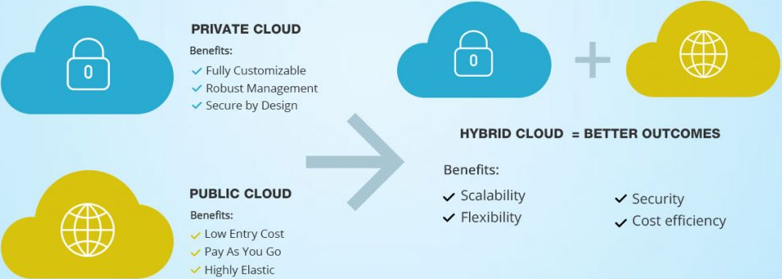
Use cases
New application
  For startups who want to test their new product or service
  Offset some initial investment
Regulatory compliance
  Certain industries (e.g. finance, healthcare) are regulated to protect sensitive data
Workload anomalies
  Different workload requires different systems → cloud may not provide environment u need
  Hybrid offers more variety for business need

Slide 5
CSP hybrid networking service
VPN – server client model
Interconnect(GCP)/Direct Connect (AWS)
  Direct connection
  Partner interconnect
Peering
  Direct peering
  Carrier peering
How to connect public & on prem cloud together – (e.g data sync)

Slide 6
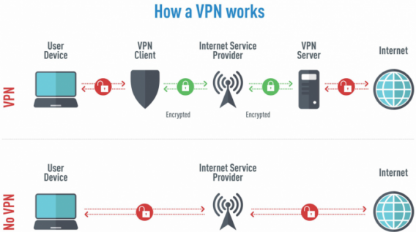
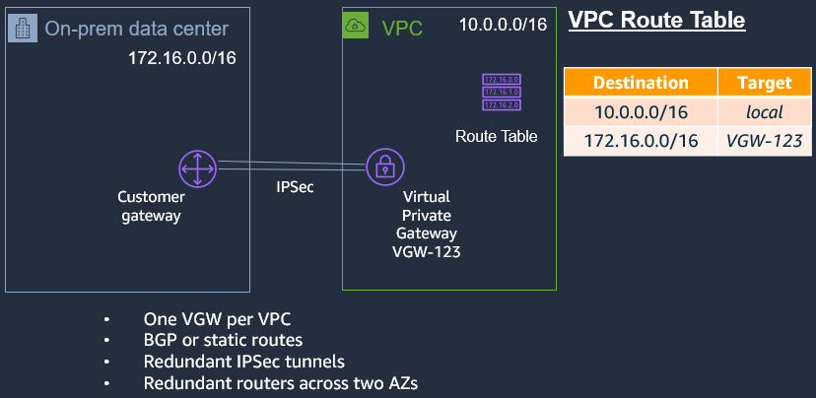
Cloud vpn
My data not allow to travel via internet → SHOULD NOT CONSIDER VPN , VPN tunnel is still set up on top of internet
Create a secure tunnel on Internet use IPSec Tunnel
Support of static and dynamic routes
One-to-many connection
Support IKEv1 and IKEv2
High available VPN service include hot standby VPN
  Limitations
    Need to install VPN terminal software
    Bandwidth is limited (for GCP is 3Gbps) →if huge data volume b/n on prem n public don’t consider VPN
    Data is still transmitted via public Internet
A simpler way without VPN: https://aws.amazon.com/verified-access/

Slide 7
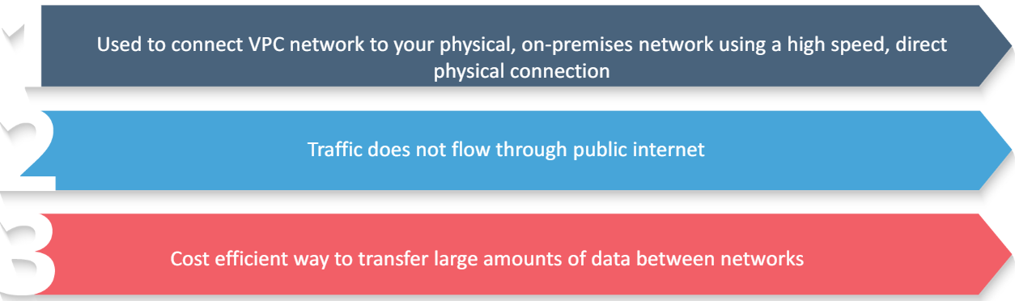
Interconnect (Direct connect)
Physical connection between public and private environment
High throughput (up to 200Gbps)
High security (dedicated line)
Private IP in VPCs are directly addressable from on-premise devices
Expensive with all the hardware setup and hosting
Direct interconnect use CSP network, offer multiple of 10/100Gbps connections
Partner interconnect use 3rd party network provider, offer multiple of 50mbps~10Gbps connections

Slide 8
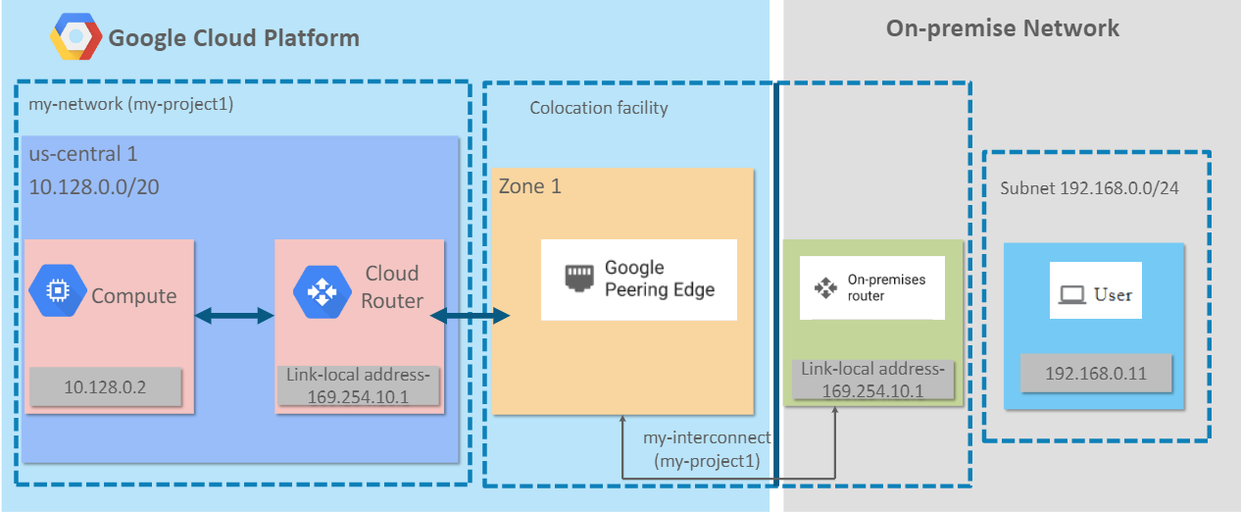
Example of direct interconnect
This peering edge can locate in CSP or 3rd party network provider
Notes:
Consider Direct Connect if they highlight huge bandwidth and privacy
Direct connect does not ensure DR → even within Direct connect, sg gov still create a lot of VPN tunnels for different agencies.
Doesn’t mean got list line means don’t use VPN→ VPN is just a virtual tunnel on top of any lines ( NOT ALL VPN must be created on top of internet , internet is not requirement of VPN)

Slide 9
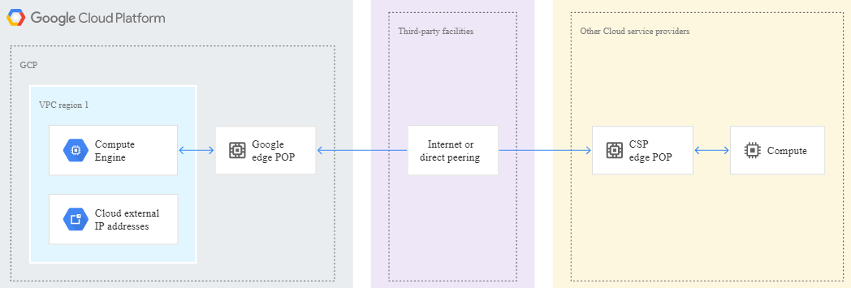
peering
It is a network configuration, not a CSP service
It does NOT have an SLA
It allows customer network connect to CSP edge POP (point of presence) or via carrier’s POP
It works by exchanging Border Gateway Protocol routes, forms a private network between both parties
For direct peering, candidate network needs to meet CSP’s technical requirements, submit request to CSP, get approval before peering
If candidate cannot satisfy Google’s peering requirements, use carrier peering (find ISP service in between)- your server peer with ISP first then ISP peer with google cloud
ISP services
Notes:
VPC peering between different organisations but Peering of hybrid cloud needs application to the CSP so they provide peering config for ur router to peer w csp routers
Peer with CSP directly ( if router meets requirements ) if not find ISP service in between to peer with the CSP
Peering also by internet

Slide 10
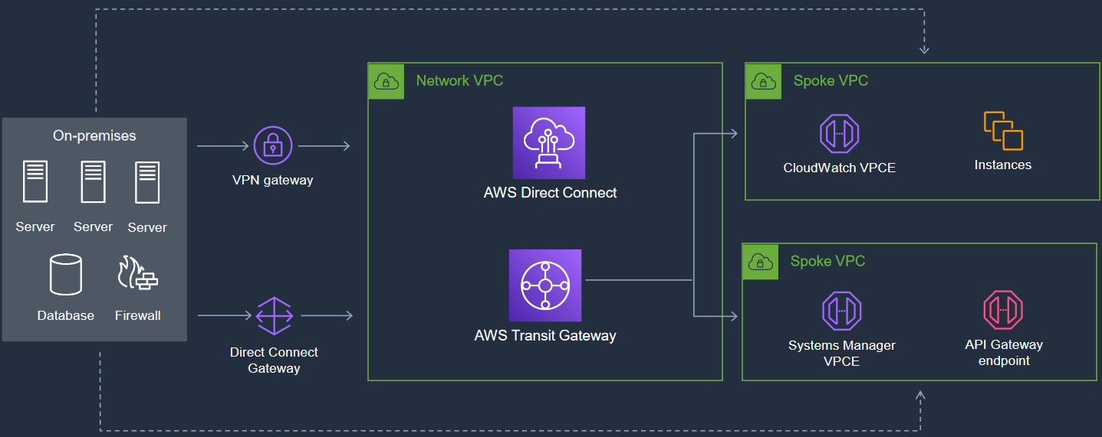
Hybrid cloud architecture
Notes:
Transit Gateway – if you have multiple VPC
All vpc connect to transit gateway, transit gateway connect to direct connect and direct connect connet to on premise

Slide 11
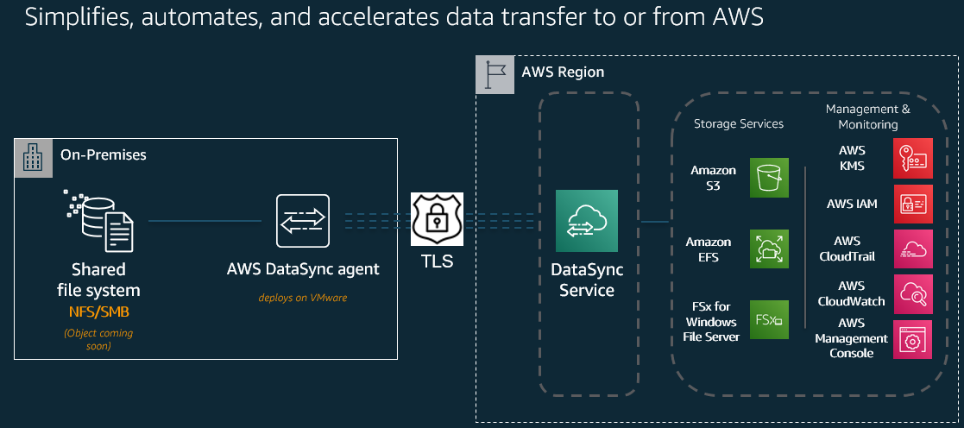
Hybrid cloud data sync - AWS DataSync
Notes:
Inside connection how to exchange data?
Data Sync service distribute the data to AWS storages
Data Sync Service : minimal interval for scheduling is one hr ( NOT A REAL TIME SYNCRHONISATION SERVICE)

Slide 12
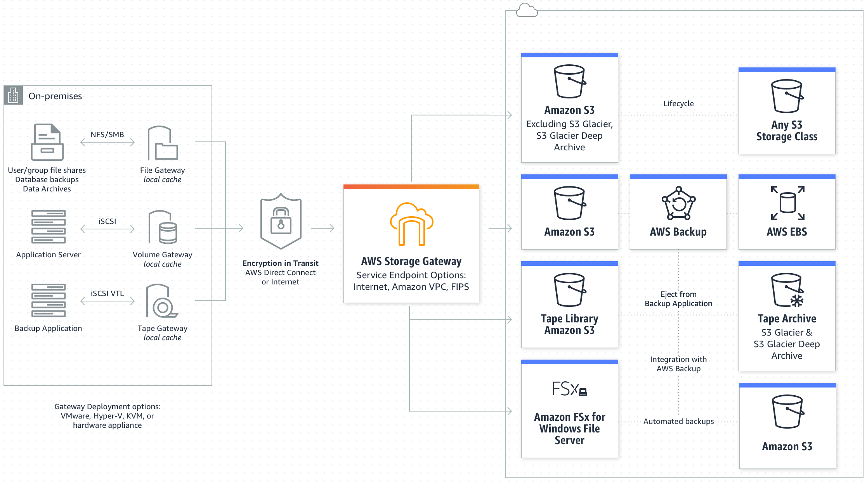
Hybrid cloud data sync - AWS Storage Gateway
https://docs.aws.amazon.com/storagegateway/latest/userguide/WhatIsStorageGateway.html
Notes:
Storage gateway distribute data for each respective storage
Near real time data synchronization: File Gateway, Volume Gateway, Tape Gateway→ we need different due to different file systems
Local cache – storage gateway itself has local cache → u can schedule data transfer and delete in on prem system or u can also have a copy at the gateway cache such as critical data that is already transferred to the cloud ( if on prem svc need to use it just go straight to local cache)

Slide 13
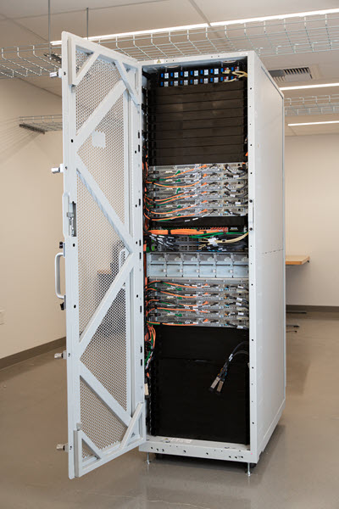
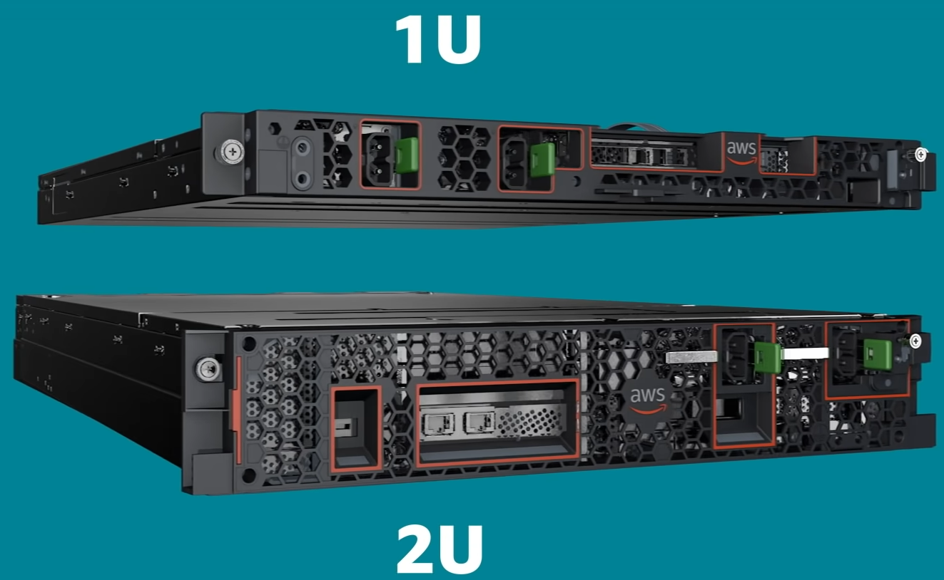
AWS outpost
Outpost Rack
It provides local compute and networking services for sites with space and capacity constraints
With Outposts servers, you can run native AWS services locally, like EC2 and ECS, managed by AWS
Offers
  Full rack, 1U server (64vCPU, 128G mem, 4TB HD), 2U server (128vCPU, 256G mem, 8TB HD)
Outpost Server
Notes:
On prem Data svc but if u using outpost→ aws deliver their hardware

Slide 14
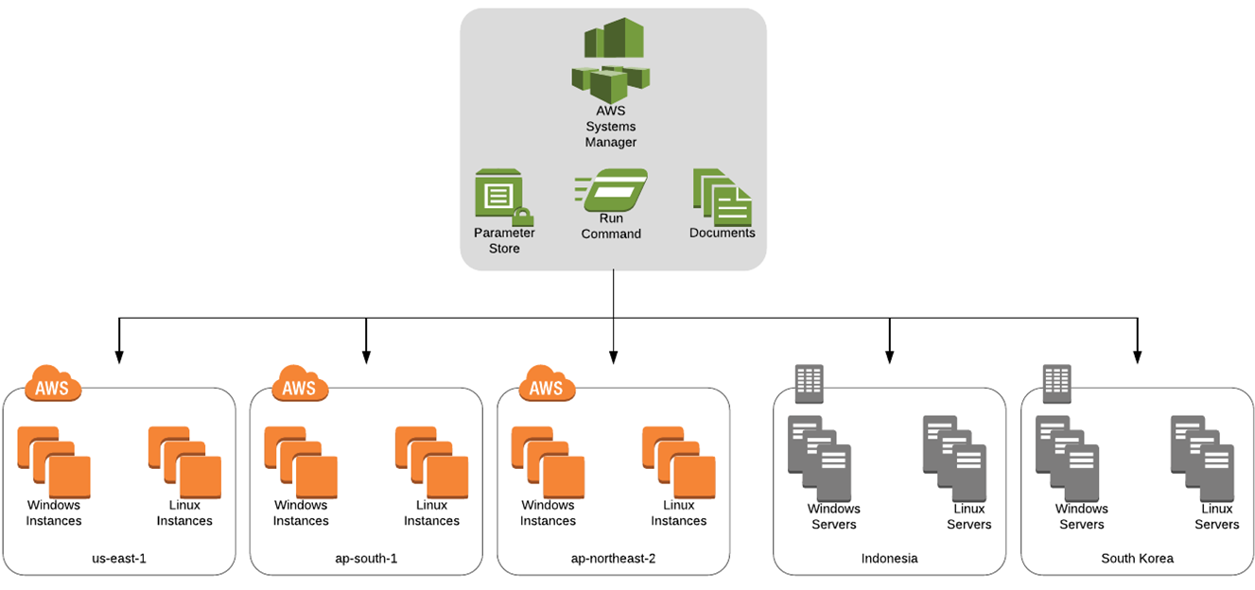
AWS systems manager
Centralized operation hub

Slide 15
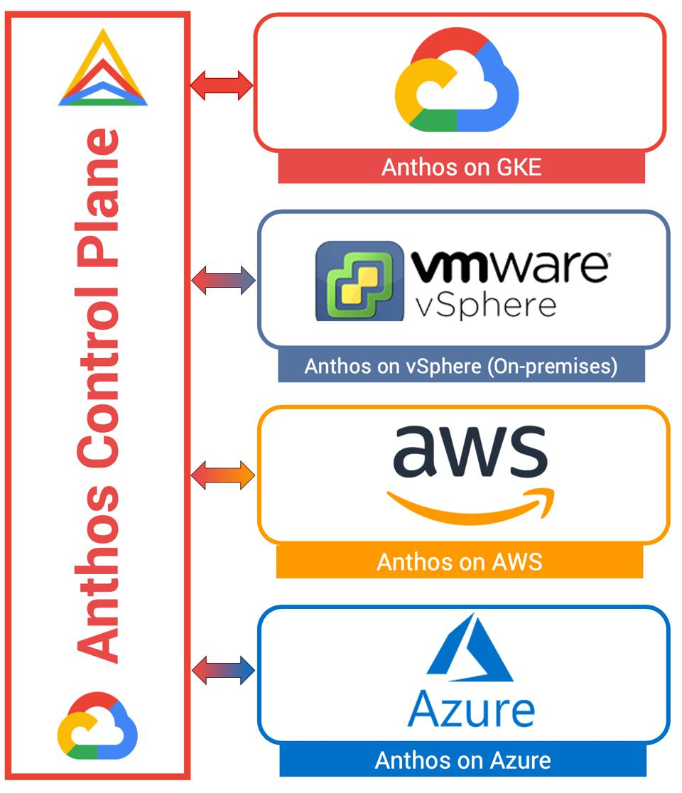
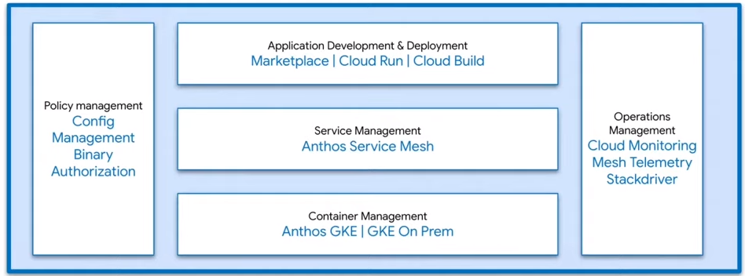
Hybrid container - Anthos
Anthos is a modern application management platform that provides a consistent development and operations experience for cloud and on-premises environments
It offers config-as-code for resource configuration and application deployment
It extends GCP services and engineering practices to on-premise environments

Slide 16
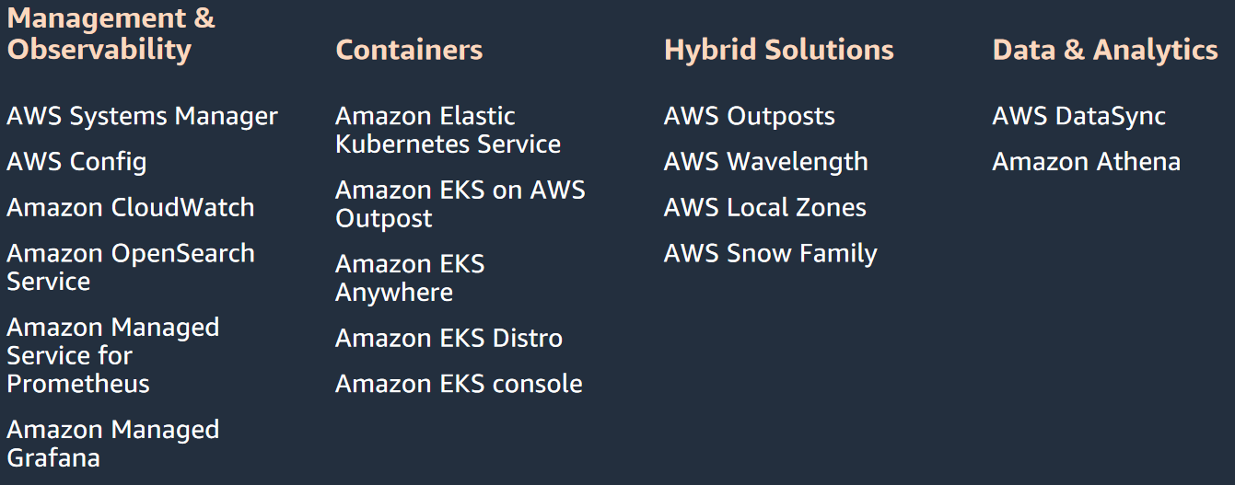
AWS solutions for hybrid/multicloud

Slide 17


Slide 18
Migration

Slide 19
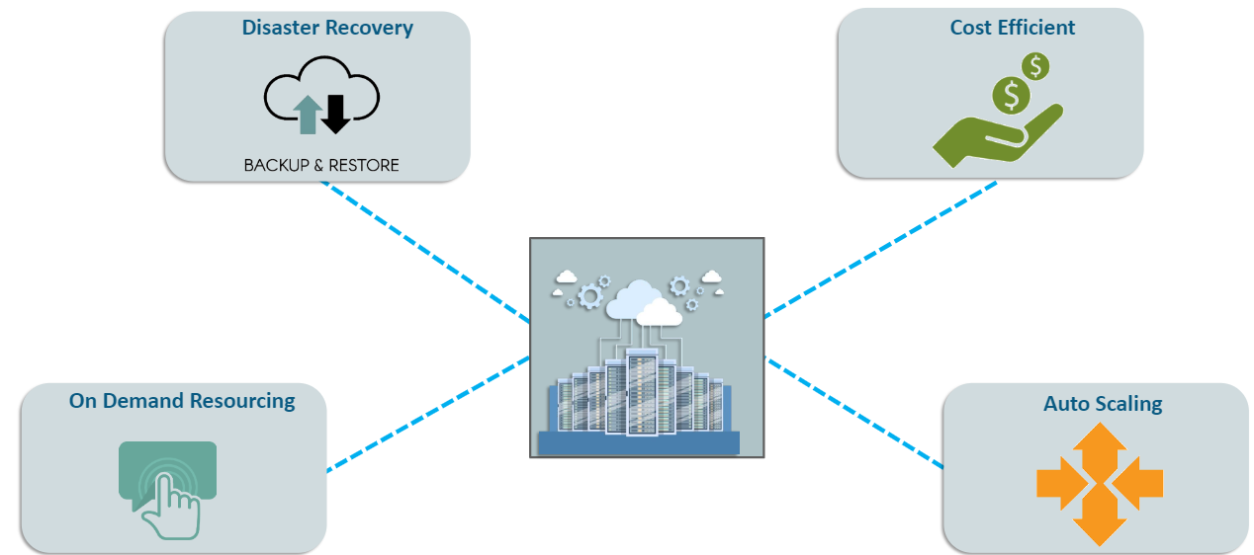
Why migrate to cloud?
Pay-per-use
Pre-emptible resources
Easy to add/reduce resources
Cope with traffic spike

Slide 20
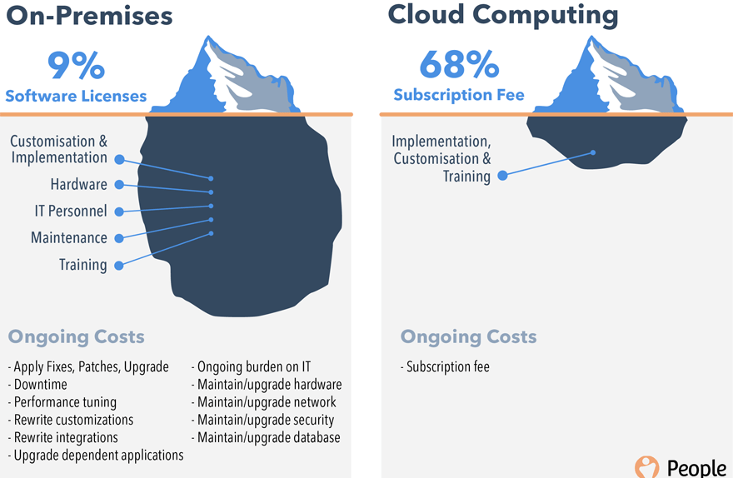
Cost comparison
But usually, the cost alone is not a strong business case for migration decision (especially when you use lots of managed services)
The real benefit for cloud migration is Agility and Flexibility.

Slide 21
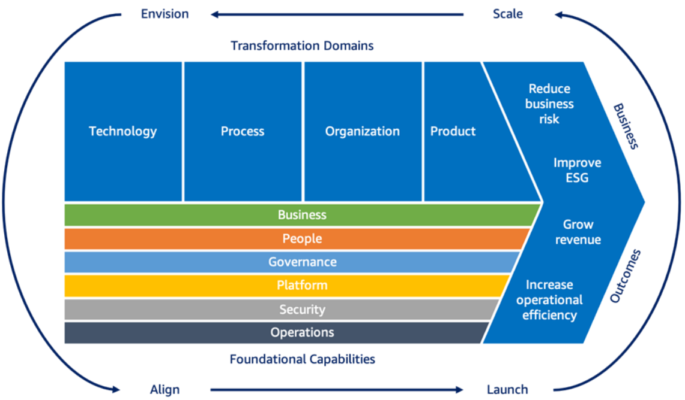
Cloud adoption framework 3.0
It provides a comprehensive list of recommendations for implementing, adapting, configuring, and maintaining workflows associated with already deployed software.
Launched in Nov, 2021

Slide 22
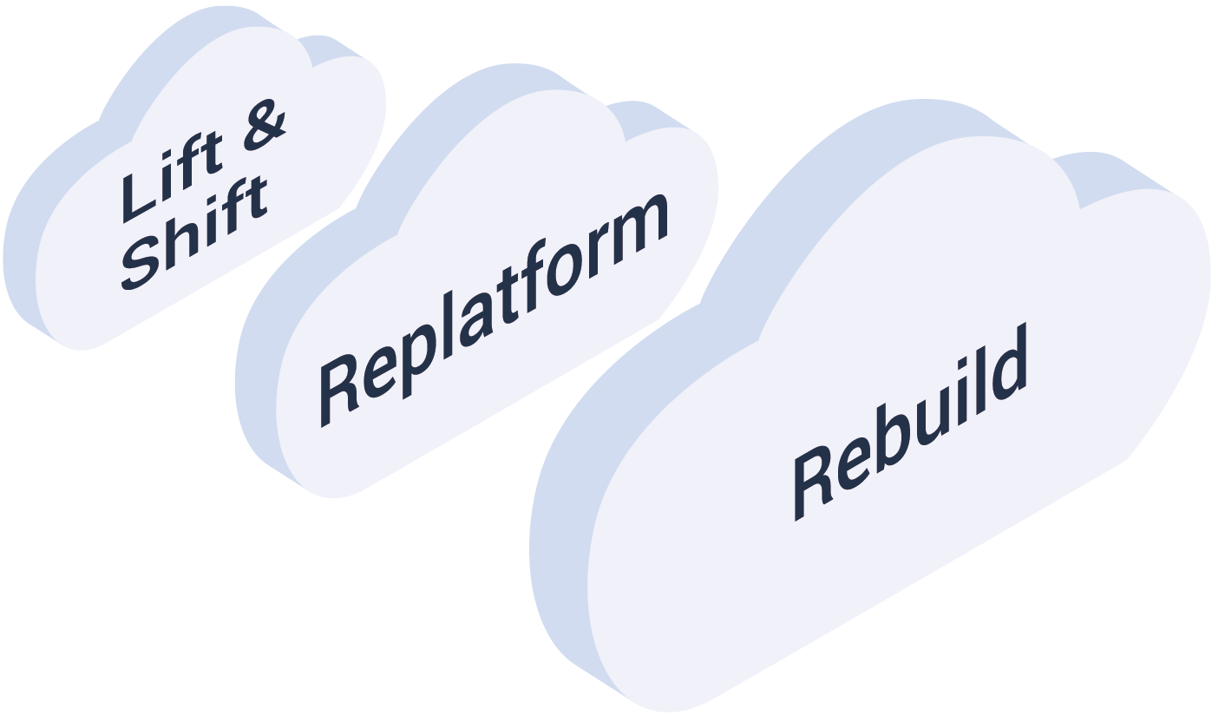
Type of migration
Lift and shift
  Infrastructure and data are moved with minimal changes
  Only necessary changes are made
  Simplest, but easy to fail if requirements are not accurately mapped to cloud configuration
Re-platform (move and improve)
  Infrastructure and architecture are modified to take advantage of cloud
  Example: move on-premise monolithic web service app to Kubernetes Engine
  Work scope may grow into a full-blown refactoring project
Rebuild
  A legacy application is replaced by a new, native cloud application
  Most time-consuming approach
  May provide the highest return on investment
  Repurchasing
  Move to a different product
  Usually used when move to a SaaS platform, like moving a CRM to Salesforce.com

Slide 23
Steps for migration
Assessment
  Inventory of applications and infrastructure (resources & networks)
  Compliance, licensing, dependencies
  IAM hierarchy, customer managed private keys
Pilot
  Migrate 1~2 application to get a sense of level of effort required
Data migration
  Move data sources which are depended by core applications to cloud
  Select the right method according to data volume, network speed, and security level
  Synchronization may be needed for live migration
Application migration
  Live migration without disconnecting the client or application
  Migrate with planned downtime
Optimization
  Leverage on cloud resources to optimize the processes
  E.g. add load balancer, cloud monitoring, or data streaming tools

Slide 24


Resource to be moved
Compute resources
  VMs/Containers/production/test/staging
  Applications, configurations, libraries, dependencies, licenses
Storages
  File system, object storage, database
Networks
  Subnet, communications, firewalls, load balancer
  Inter connections of resources, public facing endpoint
  connection with 3rd party and on-premise resources
IAM architecture
  Rules and policies for the whole organization towards the system
Security keys
  Customer managed keys for each resources and functions
Development tools
  CI/CD, testing, service mesh management, hybrid cloud management
Backups and Redundancies
  HA site setup
Only move at midnight!
Within 2 days!

Slide 25
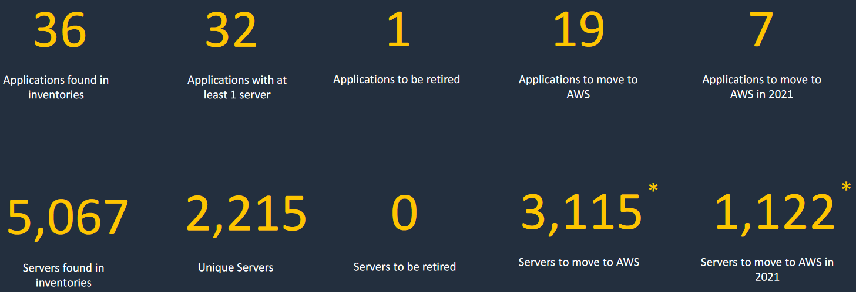
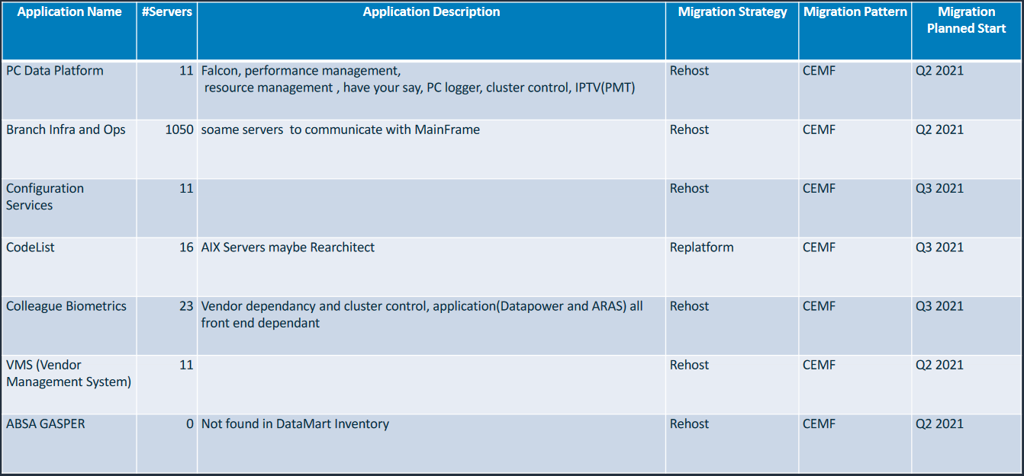
Assessment result

Slide 26
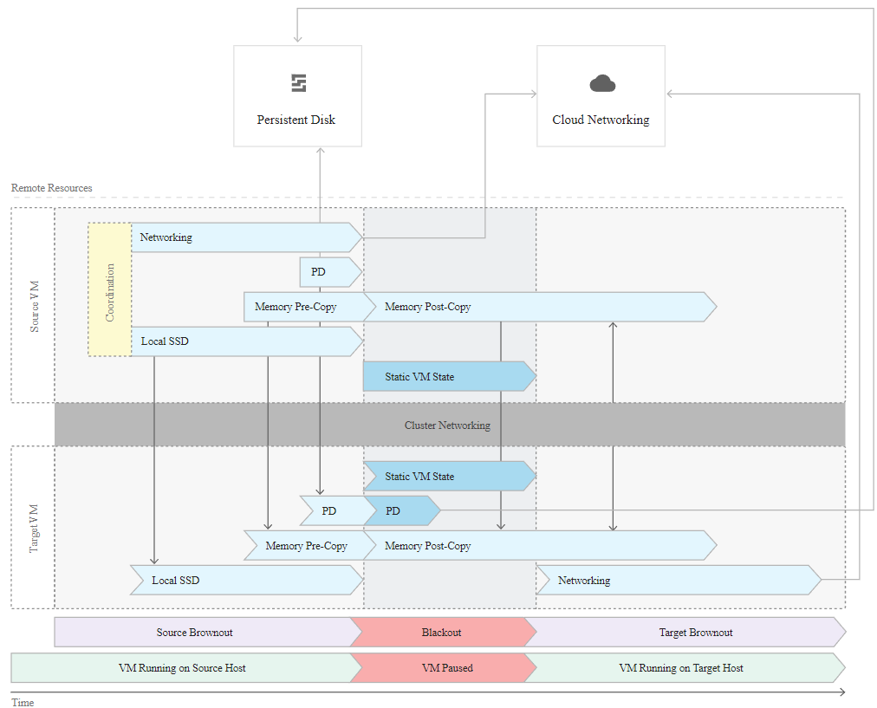
Live migration

Slide 27
Csp migration services

Slide 28
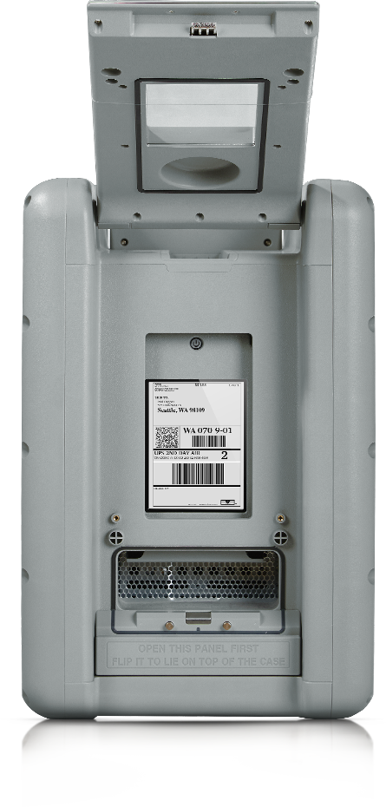
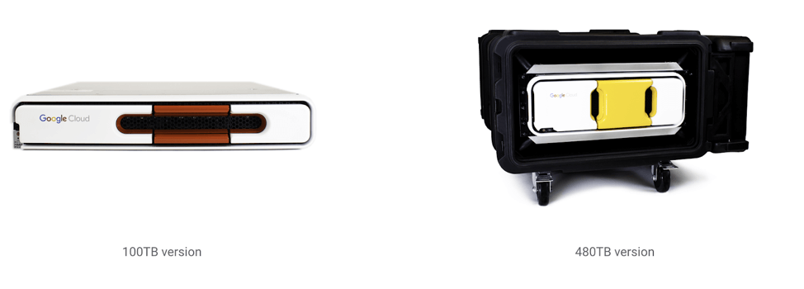
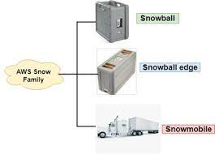
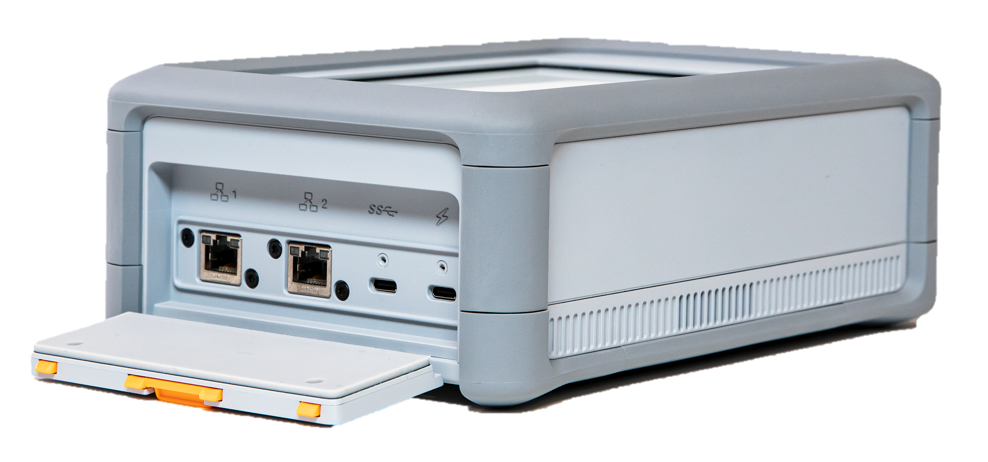
CSP Data migration equipment
100TB version
Command line copy
  For small amount of data or files (<1TB) with reasonable network speed
Storage transfer service
  Free/charged service offered by CSP
  For medium size of data (1~10TB)
Offline media
  Customer request for transfer appliance service
  Prepare destination resources (bucket, keys, configuration)
  CSP send an offline data storage to customer
  Customer install the hardware and copy data to the HW appliance
  Customer ship the appliance back to Google
  Google Transfer Appliance Team transfer data to target cloud resources
  Customer validate the data
Import via 3rd party
480TB version
Up to 120TB
Up to 80TB
SnowCorn: 8TB
Up to 100PB
28
Notes:
Snowball edge- has a computing power integrate with it
Snowball – no computing services

Slide 29
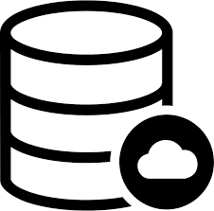
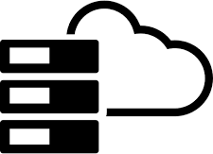
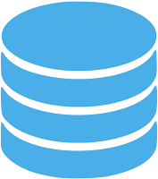
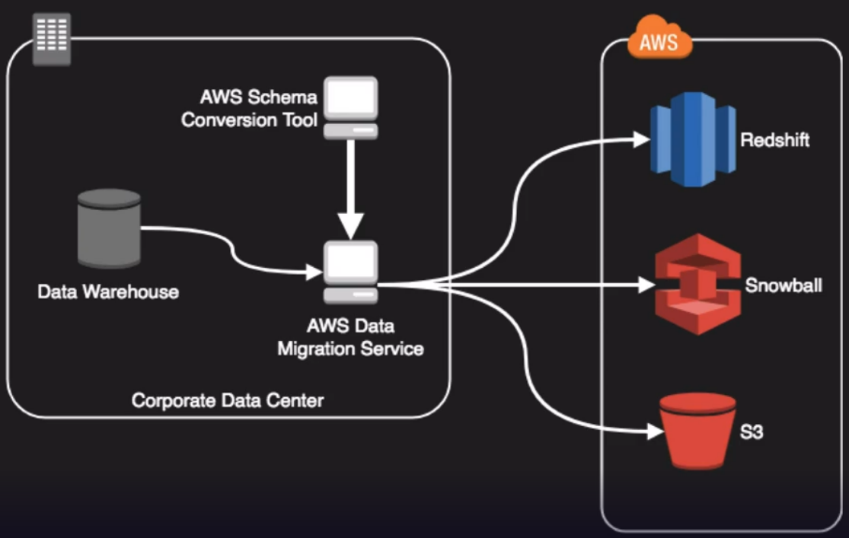
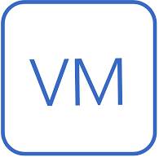
Migration of Database
Export-based migration
  Local database → cloud storage → cloud database
  Local database is locked for writes during export operation
  Suitable for small database with loose constraint SLA
Primary/replica migration
  Create a replica database in cloud
  Synchronize cloud database with local database
  Application is configured to point to the cloud database
  For large database or tight constraint SLA
2
1
Cloud DB
Cloud Storage
Local DB
2
1
Local DB
Cloud DB
Notes:
Order physical device and do offline
Or do online service

Slide 30
CSP Licensing mapping
BYOL model
  Bring your own license
Pay-as-you-go model (metered license)
  Charged by software provider or CSP
  For example, Windows server OS is included in the hourly charge
Verification of license mapping
  For both models, license mapping needs to be verified before migration
  A single site license may not be appropriate for multiple region cloud application
  A single user license may not be appropriate for container clusters
  Some license is charged on features, need to verify if cloud have this feature

Slide 31
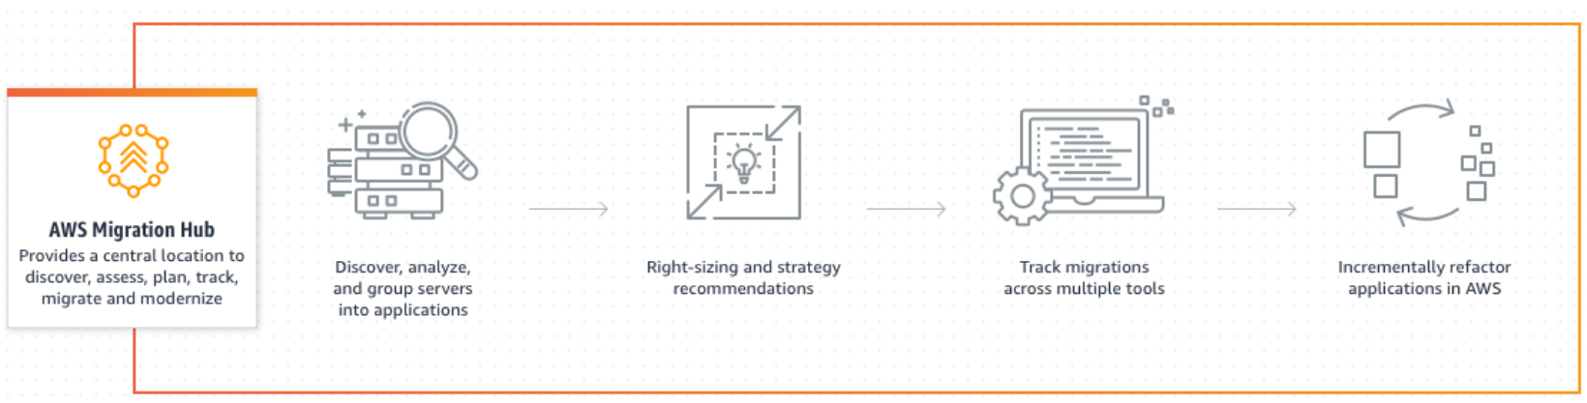
AWS migration hub
Storage migration – storage gateway & snowball
Server migration service (SMS)
  VMware vSphere / Microsoft Hyper-V
  using Server Migration Connector (download to on-prem servers)
Database migration service (DMS) – Schema Conversion Tool (SCT)
Application discovery service
  Gather information from on-prem DC to help with the inventory list
  Collect config, usage, behavior data to estimate TCO if migrate to AWS

Slide 32
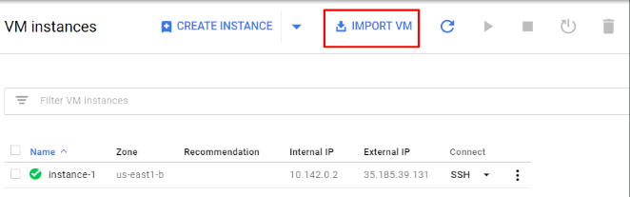
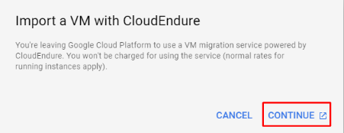
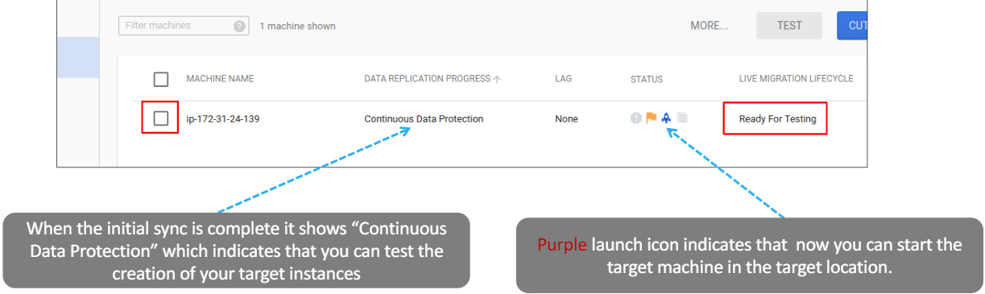
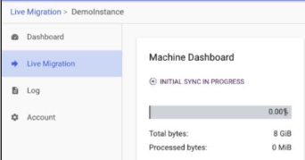
GCP integrated migration tool
CloudEndure

Slide 33
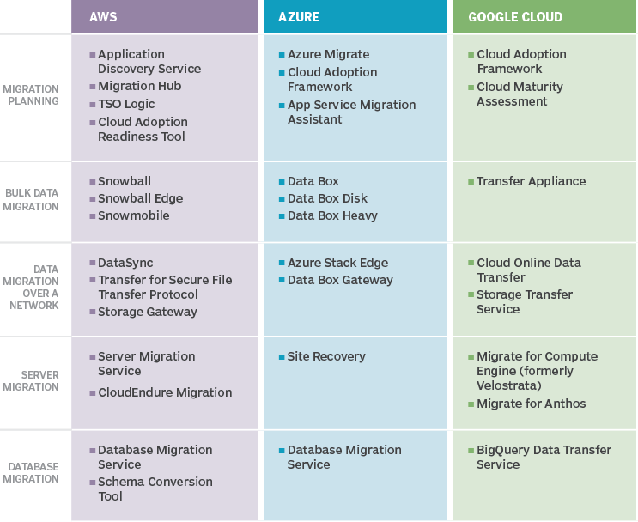
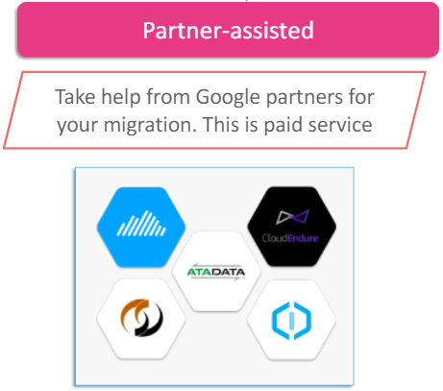
CSP tools for migration
https://aws.amazon.com/partners/featured/migration/

Slide 35
Cloud governance

Slide 36
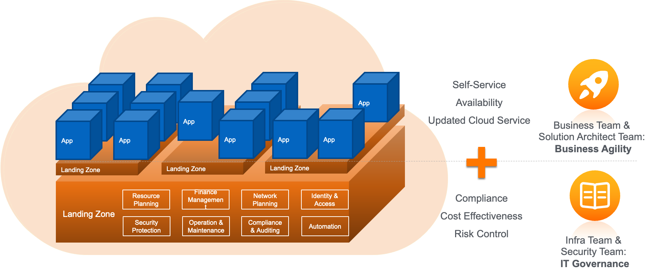
Pillars of cloud governance
Resource Governance – Standardized Provisioning
Security Governance – IAM, SCPs, Security Hub
Compliance & Risk – Audit Manager, AWS Config, CloudTrail
Operational Governance – Monitoring, Incident Response, Backup
Data Governance – Classification, Retention, Encryption
Cost Governance – Budgets, Cost Explorer, Tagging

Slide 37
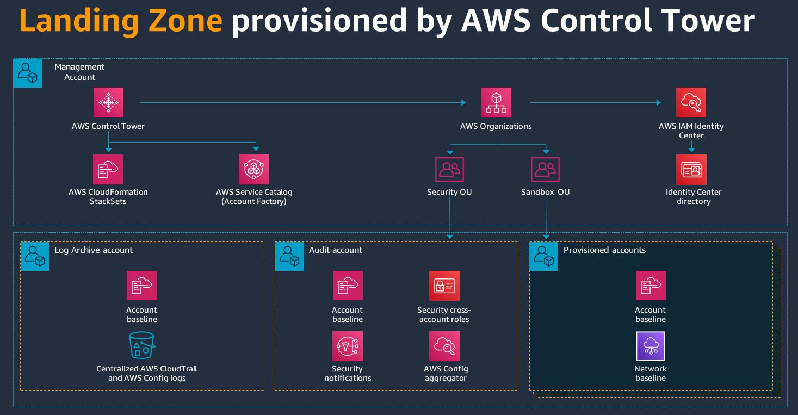
Landing zone
A landing zone is a well-architected, multi-account Cloud environment that is scalable and secure.

Slide 38
Ai assisted cloud governance
Stage | Status in 2026 | Adoption
Dashboard governance | Mature | Nearly universal
Policy-as-Code | Mature | Common
AI copilots for governance | Early mainstream | Growing rapidly
AI-generated governance recommendations | Emerging | Pilots
Autonomous governance agents | Experimental | Very few
Fully self-governing cloud | Mostly hype | Almost none
AI is assisting in:
FinOps
Governance policy generation
Drift detection with explanation
Natural language governance queries
Compliance evidence generation
Predictive governance
AI is not good at yet:
Autonomous remediation
Cross-domain reasoning
Cloud Governance Engineer may use skills to supervise a fleet of AI copilots and governance agents that continuously monitor, explain, recommend, and enforce cloud standards.
Notes:
AI detects:
This S3 bucket is public.
Should it:
block it?
encrypt it?
notify?
ignore because it's a public website?

