Slide 1
GENERATIVE AND AGENTIC AI · TOPIC 8
Agentic Retrieval-Augmented Generation
From Classic RAG to Advanced RAG to Retrieval the Agent Drives
Laura Wynter, PhD
SMU School of Computing and Information Sciences
MITB CS614 · AY2026–27

Slide 2
ROADMAP
What we'll cover
01
What RAG is, and why it helps
07
Re-ranking: the two-phase approach
02
The simpler alternative: long context
08
Contextual RAG, BM25 & rank fusion
03
The RAG pipeline: chunk → embed → retrieve → generate
09
Advanced RAG & the frontier
04
Embedding models & vector stores
10
Agentic RAG: retrieval as a tool the agent drives
05
Why RAG fails (SAGE)
11
Agentic retrieval patterns & when to use them
06
Evaluating a RAG pipeline
12
Evaluating and securing agentic RAG
Topic 8, Agentic RAG
MITB CS614

Slide 3
FRAMING
Learning outcomes
▸ Understand Retrieval-Augmented Generation (RAG) and how it works end-to-end
▸ Be aware of its benefits and its limitations
▸ Understand how those limitations can be addressed and reduced
▸ Situate RAG in the 2026 stack: modern embeddings, vector DBs, RAGAS, advanced retrieval
▸ Turn a fixed retrieve-then-generate pipeline into agentic RAG, where the agent (Topic 7) decides what to retrieve
Topic 8, Agentic RAG
MITB CS614

Slide 4
FRAMING
Where we are
▸ T1–T4: representation, transformers, training and customising the model itself
▸ T5–T6: serving it, and measuring whether the output is any good
▸ T7: the agent, an LLM in a loop with tools, memory and guardrails
▸ Today: the single most useful tool you can give that agent, retrieval over your own data
▸ We build it in order: what RAG is (§1–§4) → making it accurate (§5–§7) → handing the controls to the agent (§8)
Topic 8, Agentic RAG
MITB CS614

Slide 5
01
What RAG Is, and Why It Helps
Let the model read your data at answer time instead of only its training data.

Slide 6
§1 · DEFINITION
What is RAG?
▸ RAG lets an LLM use user-designated external data sources as context to answer a query
▸ It combines a "retriever" of information with a "generator" of output
▸ The retriever fetches data, from the Internet or (usually) a vector database, and hands it, with the original query, to the generator
▸ The generator uses the retrieved data to produce its response
▸ Helps mitigate, though not eliminate, hallucination and bias, reducing many LLM ethical issues
Topic 8, Agentic RAG
MITB CS614

Slide 7
§1 · CONTRAST
Bare LLM vs. RAG
Bare LLM call
RAG
• Answers only from frozen training knowledge
• No access to your private / recent data
• Hallucinates confidently when it doesn't know
• No citation or provenance for claims
• Retrieves relevant passages at query time
• Grounds answers in your own corpus
• Fewer hallucinations, answer tied to sources
• Can cite the chunks it used
Topic 8, Agentic RAG
MITB CS614

Slide 8
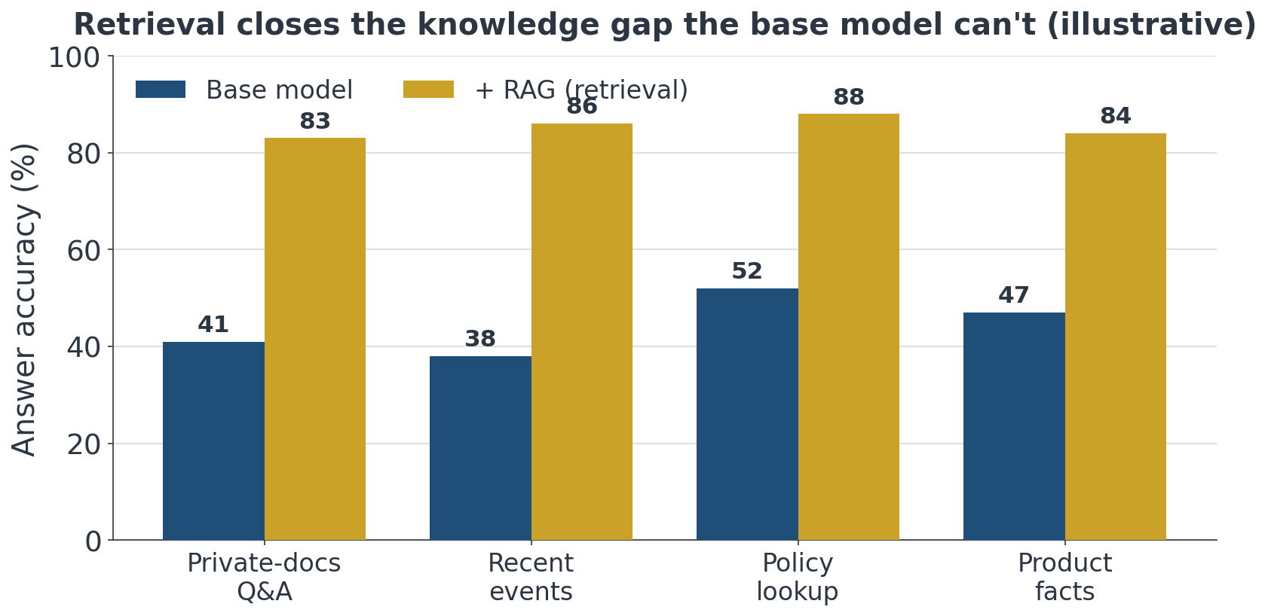
§1 · WHY IT HELPS
Retrieval closes the knowledge gap
Illustrative: on tasks needing private, recent or policy knowledge the base model lacks, grounding lifts answer accuracy sharply.
Topic 8, Agentic RAG
MITB CS614

Slide 9
02
First, the Simpler Alternative
Before building a pipeline, ask whether you even need one.

Slide 10
§2 · LONG CONTEXT
Just put the text in the prompt?
▸ For long-context models (128K+ tokens ≈ 200 pages) you can include the full text directly
▸ Adding the full text to the prompt can be more effective than RAG, no retrieval to get wrong
▸ But with a paid API, large input prompts get costly on every call
▸ Prompt caching lets providers reuse a frequently-sent long prompt without re-charging full tokens
▸ 2026 reality: context windows now reach ~1M tokens, long-context is a real baseline, not a toy
Topic 8, Agentic RAG
MITB CS614

Slide 11
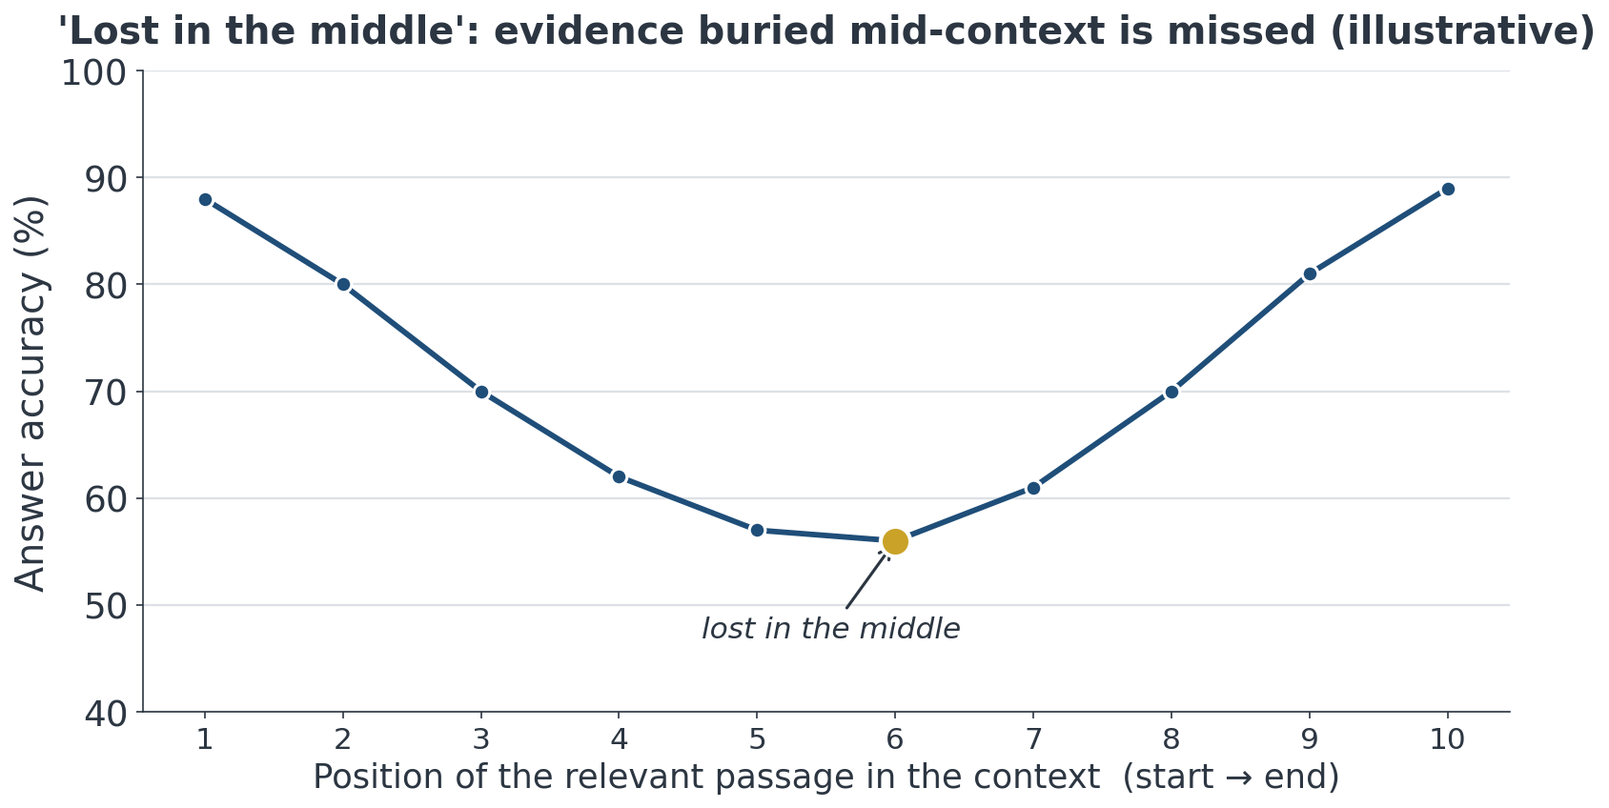
§2 · LONG CONTEXT
Long context isn't free: 'lost in the middle'
Illustrative: accuracy is highest when the key passage sits near the start or end of the context and sags in the middle, a reason to retrieve and surface the right passage rather than bury it in a huge prompt.
Topic 8, Agentic RAG
MITB CS614

Slide 12
§2 · WHEN RAG WINS
For longer material, back to RAG
▸ Corpora bigger than any window, changing constantly, or needing per-user scoping still favour RAG
▸ RAG retrieves only what's relevant, cheaper per query than stuffing everything every time
▸ Rule of thumb: small/static context → long-context prompt; large/dynamic corpus → RAG
Topic 8, Agentic RAG
MITB CS614

Slide 13
§2 · PIPELINE
The RAG pipeline, end to end
Chunk docs
few hundred tokens
Embed
one vector per chunk
Vector store
index the vectors
Retrieve top-k
cosine similarity
LLM generates
answer from chunks
Index once (chunk → embed → store); then retrieve + generate per query. The same embedding model must encode both the chunks and the query.
Topic 8, Agentic RAG
MITB CS614

Slide 14
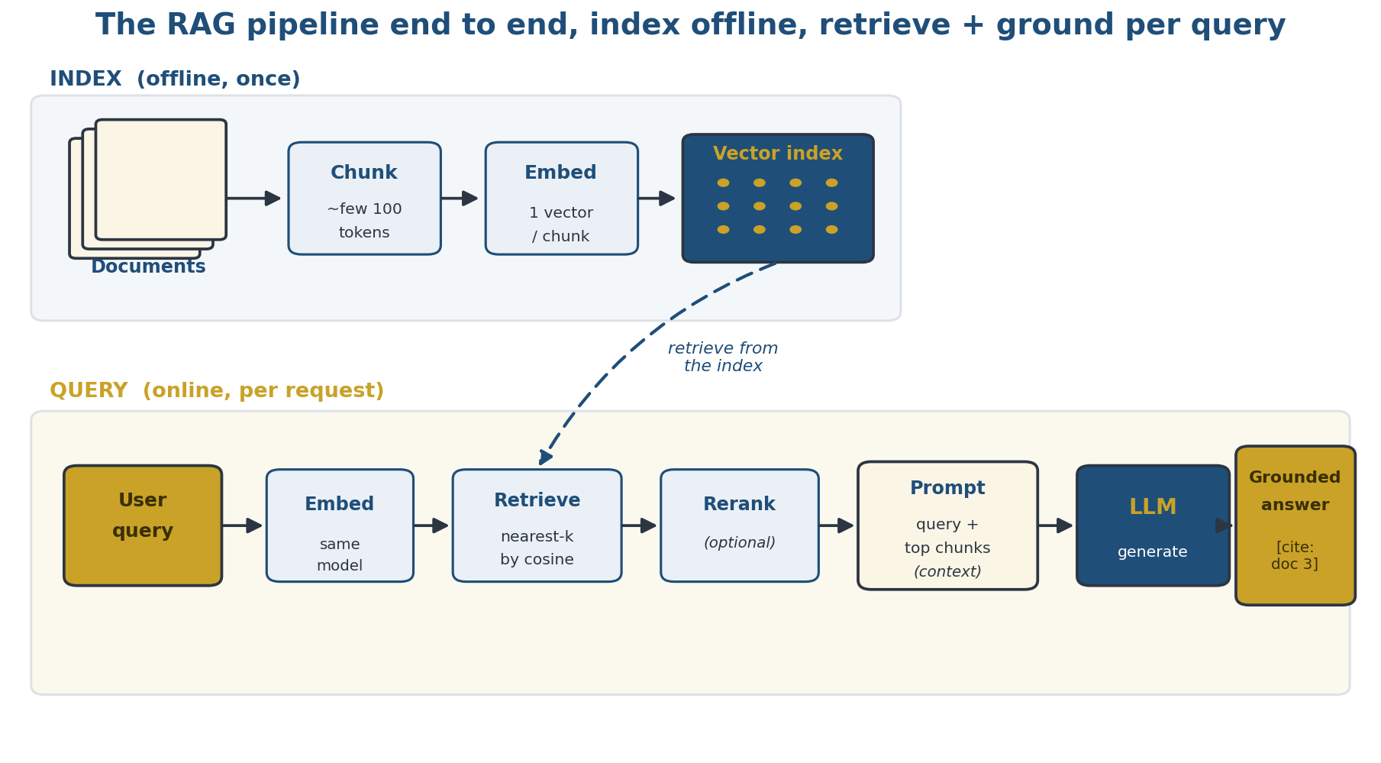
§2 · PIPELINE DRAWN OUT
RAG end to end, an offline index lane and an online query lane
Illustrative: index once (chunk → embed → vector index); per query, embed → nearest-neighbour retrieve → optional re-rank → prompt+context → LLM → a grounded, cited answer.
Topic 8, Agentic RAG
MITB CS614

Slide 15
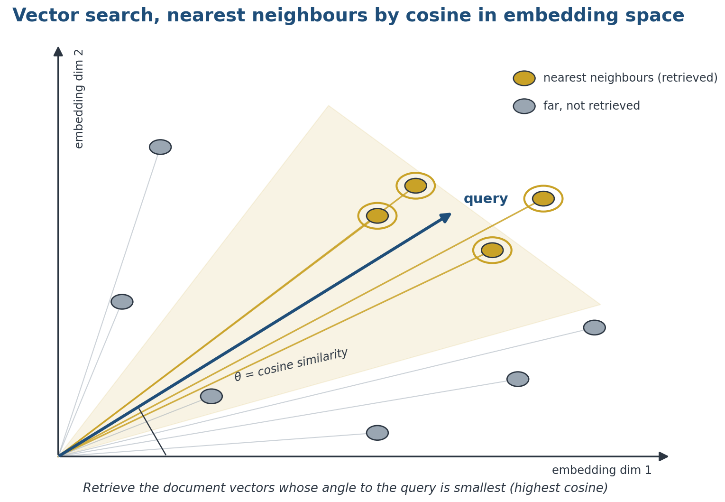
§2 · VECTOR SEARCH
What 'retrieve top-k by cosine' actually means
Illustrative: query and document chunks are points in embedding space; retrieval returns the vectors whose angle to the query is smallest (highest cosine similarity).
Topic 8, Agentic RAG
MITB CS614

Slide 16
§2 · EMBEDDINGS
Embedding models: beyond all-MiniLM
Model | Where it runs | Note
all-MiniLM | Local (ST) | Small, fast, our labs
Gemini Embedding | API (Google) | Current MTEB leader
Qwen3-Embedding | Open weights | Current MTEB leader, self-hostable
BGE-M3 (BAAI) | Open weights | Multilingual, multi-granularity, hybrid-friendly
Cohere embed-v4 | API | Multimodal, long-doc, strong retrieval
voyage-3.5 (Voyage) | API | High hosted quality
text-embedding-3 | API (OpenAI) | Strong, no local GPU
Pick by retrieval quality (MTEB leaderboard, leaders shift often), embedding dimension / cost, and local vs. API constraints.
Topic 8, Agentic RAG
MITB CS614

Slide 17
§2 · VECTOR STORES
Storing & searching the vectors
▸ Our labs use brute-force cosine over all chunks, perfectly fine at teaching scale
▸ In production, a vector index gives approximate-nearest-neighbour search that scales to millions
▸ FAISS (in-process library), Chroma (lightweight local DB), pgvector (Postgres extension)
▸ Managed options (Pinecone, Weaviate, Qdrant) add hosting, filtering and hybrid search
Topic 8, Agentic RAG
MITB CS614

Slide 18
03
Why RAG Fails
RAG works most of the time, engineering is mostly about the times it doesn't.

Slide 19
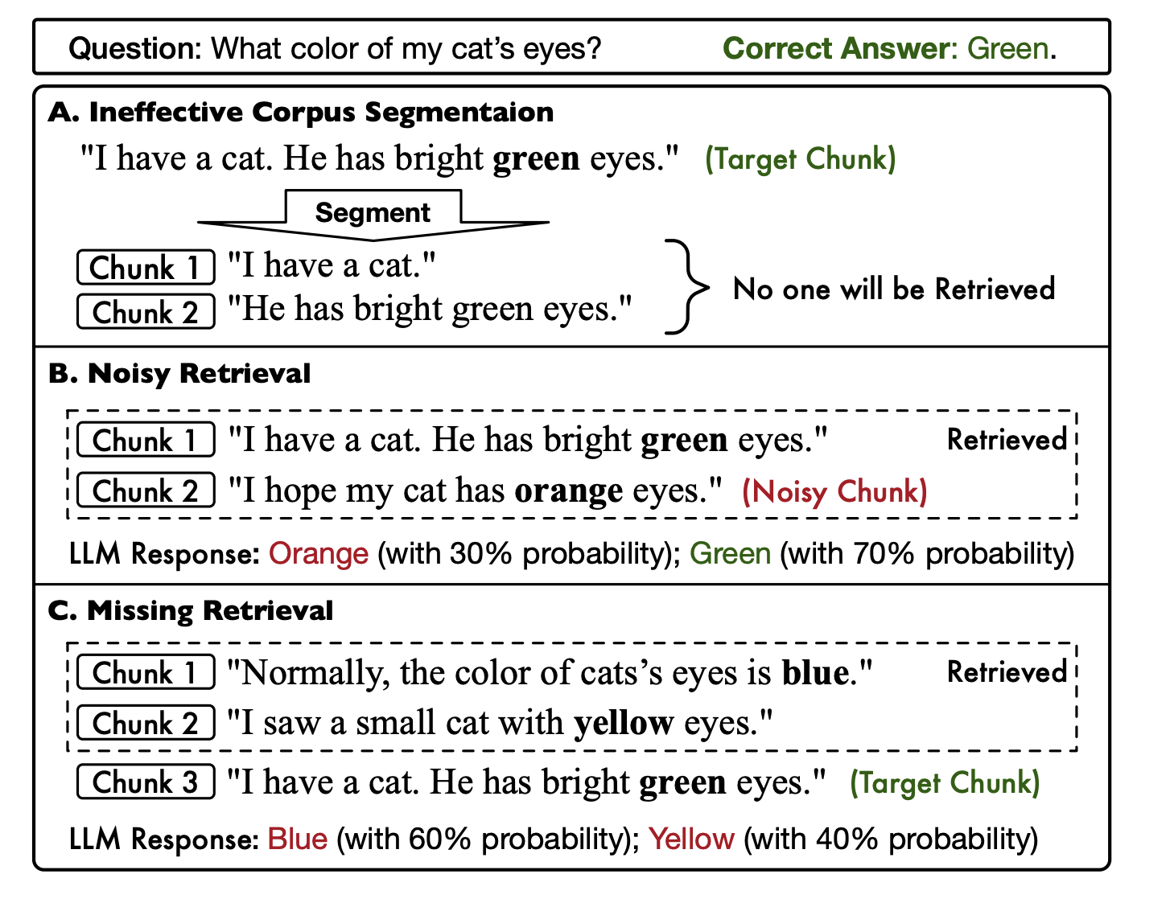
§3 · THE PROBLEM
How RAG goes wrong, one question, three failures
Question: what colour are my cat's eyes? (A) chunking splits the answer so neither piece is retrieved; (B) a noisy chunk competes with the right one; (C) the target chunk is never retrieved at all. Source: SAGE, Zhang et al., arXiv 2025.
Topic 8, Agentic RAG
MITB CS614

Slide 20
§3 · FAILURE MODES
Three ways RAG breaks
Failure mode | Symptom | Fix
Bad chunking | No chunk carries the full answer | LLM / learned chunker (SAGE)
Noisy retrieval | Irrelevant chunks in the top-N | Re-rank; tighten k
Missing retrieval | Target chunk falls outside top-N | Raise N, then hybrid + re-rank
Chunking remedy: ask an LLM to chunk; SAGE trains a dedicated chunking model (next slide).
Topic 8, Agentic RAG
MITB CS614

Slide 21
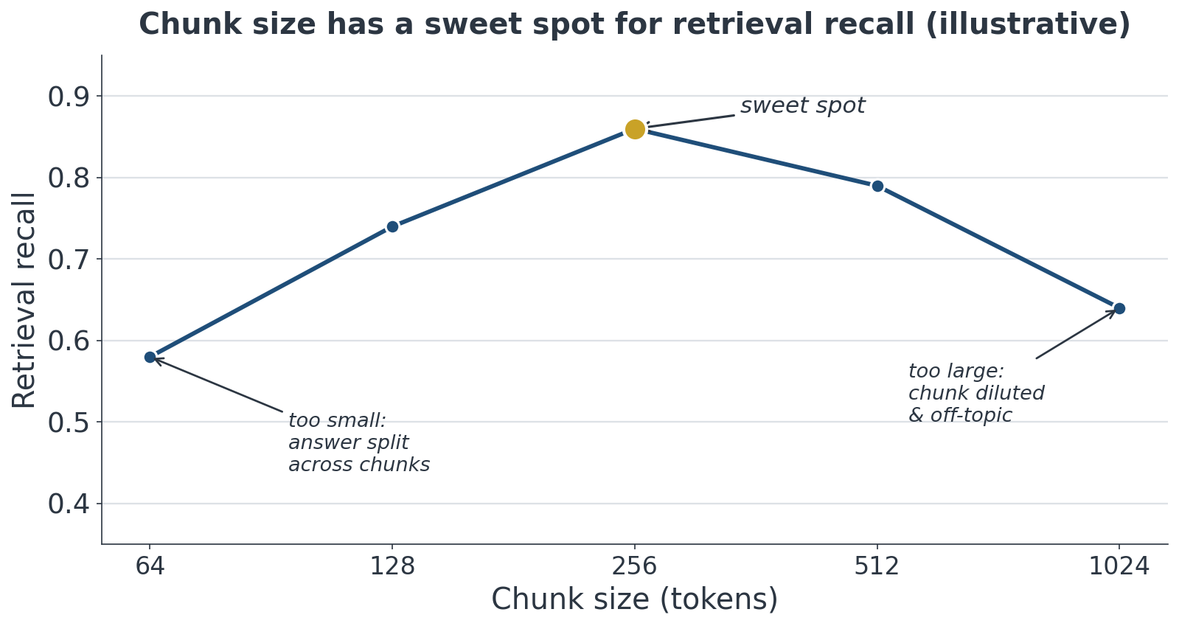
§3 · CHUNKING
Chunk size is a trade-off with a sweet spot
Illustrative: tiny chunks split the answer across many pieces; huge chunks dilute each vector with off-topic text. Recall peaks at a mid size, tune it, don't guess.
Topic 8, Agentic RAG
MITB CS614

Slide 22
§3 · SAGE
SAGE: precise retrieval for RAG
"Precise retrieval, a learned chunker plus semantic segmentation, sharply reduces the noisy- and missing-retrieval failures of naive top-N RAG."
SAGE: A Framework of Precise Retrieval for RAG · Zhang et al., arXiv 2025
Topic 8, Agentic RAG
MITB CS614

Slide 23
04
Evaluating a RAG Pipeline
To fix ineffective RAG, first measure it, quantitatively.

Slide 24
§4 · THE PROBLEM
Why the top-N prompt can go wrong
▸ The basic paradigm sends the top-N chunks plus the query straight to the LLM, three things can break it:
· Chunks add irrelevant info that then leaks into the answer
· The embedding distance doesn't produce an accurate ranking
· The N chunks miss the relevant information entirely
▸ So: quantitatively evaluate the pipeline before trying to improve it
Topic 8, Agentic RAG
MITB CS614

Slide 25
§4 · CLASSIC METRICS
Retrieval metrics with ground truth
▸ First gather test data with ground-truth answers (and the passages that should be retrieved)
▸ Score retrieval as a classic IR problem: Precision, Recall, F1 over the retrieved chunks
▸ Generation overlap can be checked with BLEU and ROUGE against reference answers
▸ Limitation: BLEU/ROUGE reward surface word overlap, not whether the answer is faithful or correct
Topic 8, Agentic RAG
MITB CS614

Slide 26
§4 · RAGAS
ADVANCED
Modern RAG evaluation: RAGAS
Metric | What it checks
Faithfulness | Every claim in the answer is supported by the retrieved context
Answer relevance | The answer actually addresses the user's question
Context precision | The retrieved chunks were relevant, not noise
Context recall | The retrieved chunks covered the full answer
LLM-graded, RAG-specific metrics, prefer over BLEU/ROUGE. See also TruLens, LangSmith eval.
Topic 8, Agentic RAG
MITB CS614

Slide 27
05
Re-Ranking: The Two-Phase Approach
Recall more, then re-order with a model that actually reads the query.

Slide 28
§5 · THE IDEA
Two-phase RAG with a re-ranker
▸ If accuracy is poor, re-ranking is the first lever to pull
▸ Phase 1, recall widely: increase N → N′ so more candidate chunks are retrieved
▸ Phase 2, re-order: pass the N′ chunks to a "re-ranker" that re-scores and re-orders them
▸ The re-ranker uses an LLM or specially-trained encoder to score each document with the query as context
▸ Other backends (e.g. Elasticsearch, which also indexes CSV-like data) can replace the vector DB
Topic 8, Agentic RAG
MITB CS614

Slide 29
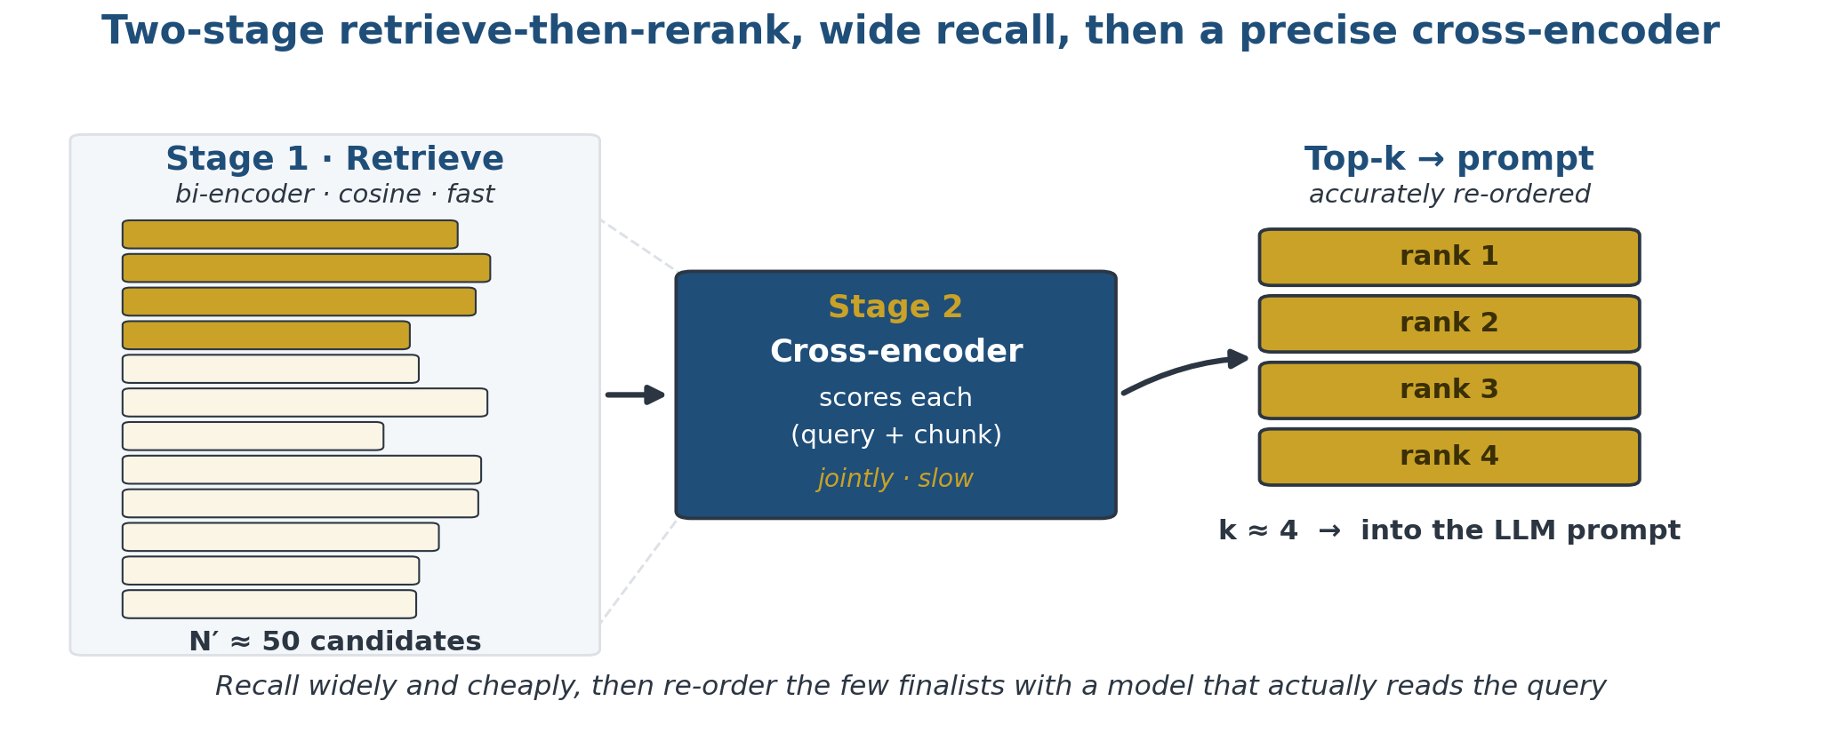
§5 · THE FUNNEL
Retrieve wide, then narrow with a cross-encoder
Illustrative: a large, cheap candidate set from the bi-encoder is re-scored by a cross-encoder that reads the query with each chunk, leaving a small, accurately-ordered top-k for the prompt.
Topic 8, Agentic RAG
MITB CS614

Slide 30
§5 · TWO-PHASE
Two-phase retrieval with a re-ranker
Retrieve N′
recall widely
Cross-encoder
scores query + chunk
Re-order
joint relevance
Top-k → LLM
best chunks in prompt
Recap of the funnel above: phase 1 recalls many candidates cheaply, phase 2 re-orders them with a model that reads the query.
Topic 8, Agentic RAG
MITB CS614

Slide 31
§5 · WHY IT HELPS
Why re-ranking beats plain cosine
▸ The vector DB embedded each chunk when it was loaded, before any query existed
▸ Those chunk embeddings do not take the user query into account, no Attention over the pair
▸ A re-ranker feeds the chunk AND the query to a transformer together
▸ It computes a joint, context-dependent similarity score, a far more relevant ranking
Topic 8, Agentic RAG
MITB CS614

Slide 32
§5 · ENCODERS
ADVANCED
Bi-encoder vs. cross-encoder
Bi-encoder (the vector DB)
Cross-encoder (the re-ranker)
• Chunk and query embedded separately
• Embeddings precomputed, query-independent
• Similarity = cosine of two fixed vectors
• Very fast; scales to millions of chunks
• Chunk + query fed in together (Sent A + Sent B)
• Joint attention over the pair at query time
• Outputs one context-dependent relevance score
• Much slower, score every candidate at query time
Topic 8, Agentic RAG
MITB CS614

Slide 33
§5 · IN PRACTICE
ADVANCED
Re-rankers in practice
▸ BERT-type cross-encoders do the re-ranking, also sold as APIs
▸ Cohere Rerank 4: rerank-v4.0-fast and rerank-v4.0-pro
▸ Rerank v3.5 is deprecated; since Aug 2026 calls go to rerank-4
▸ Rerank 4 scores differ from 3.5, re-tune any hard cut-offs
▸ Advantage: more relevant chunks, better ordering into the prompt
▸ Disadvantage: far slower than cosine, so re-rank few, not many
Topic 8, Agentic RAG
MITB CS614

Slide 34
06
Contextual RAG, BM25 & Rank Fusion
Anthropic's 2024 recipe: fix lost context and bring back keyword search.

Slide 35
§6 · BM25
Keyword search is not dead: BM25
▸ Contextual RAG (Anthropic, 2024) resurrected BM25 alongside it
▸ BM25 extends TF-IDF by also accounting for document length
▸ A query like "Error code TS-999": embeddings miss the exact string, BM25 nails it
▸ Lesson: semantic and lexical retrieval fail differently, combine them
▸ Combine with Reciprocal Rank Fusion (RRF): sum 1/(k+rank) across both lists
Topic 8, Agentic RAG
MITB CS614

Slide 36
§6 · CONTEXTUAL
Contextual RAG: prepend context to chunks
▸ Problem: a chunk pulled out of its document loses the context needed to interpret it
▸ Fix: prepend a short context blurb to each chunk before embedding it
▸ Give the full text (or main component) plus one chunk to an LLM; get 50–100 tokens of chunk context
▸ Repeat per chunk, prepend the context, then embed, retrieval now sees each chunk in situ
Topic 8, Agentic RAG
MITB CS614

Slide 37
§6 · PIPELINE
Contextual + BM25 + rank-fusion pipeline
Prepend context
LLM blurb per chunk
Index both
embeddings + BM25
Retrieve both
semantic AND exact
Rank fusion (RRF)
merge & de-dupe
Top-K → LLM
+ optional re-rank
Anthropic (2024): semantic and lexical retrieval fail differently, fuse the two ranked lists with Reciprocal Rank Fusion (RRF), then optionally re-rank.
Topic 8, Agentic RAG
MITB CS614

Slide 38
07
Advanced RAG & the Frontier
Where retrieval research has gone since the basic pipeline.

Slide 39
§7 · SURVEY
Advanced retrieval techniques
▸ Hybrid search: run semantic + BM25 together and fuse, now the default strong baseline
▸ Query rewriting: expand or clarify the user's query before retrieval (multi-query, step-back)
▸ HyDE: have the LLM draft a hypothetical answer, embed that, and retrieve against it
▸ GraphRAG: build a knowledge graph over the corpus so retrieval can traverse entities and relations
▸ Each targets a specific failure: vocabulary mismatch, under-specified queries, multi-hop questions
Topic 8, Agentic RAG
MITB CS614

Slide 40
§7 · VISUAL RAG
ADVANCED
ColPali: visual document RAG
▸ Problem: chunk-and-embed pipelines run on extracted text, they lose figures, tables and chart layout
▸ ColPali retrieves over rendered PAGE IMAGES directly, no OCR, no brittle text-extraction step
▸ It uses late-interaction MULTI-VECTOR retrieval (ColBERT-style): many vectors per page, matched token-to-patch
▸ Strong on figure-, table- and chart-heavy PDFs, exactly the material in the PDF RAG lab (Lab B)
▸ Cost: multi-vector indexes blow up storage; MUVERA compresses them into single fixed-size vectors to fix that
Topic 8, Agentic RAG
MITB CS614

Slide 41
§7 · CHOOSING
What to reach for, when
Technique | Reach for it when
Chunking + embeddings + top-k cosine | Always, the strong default baseline
Hybrid (BM25 + semantic) | Exact terms, codes or names matter
Re-ranking | Recall is fine but ordering is noisy
HyDE / query rewrite / GraphRAG | Evaluation shows a specific gap
Each technique targets a specific failure, add them in response to evaluation, not by default.
Topic 8, Agentic RAG
MITB CS614

Slide 42
§7 · OUR LABS
Adding the "G": generation, and what it needs
▸ Everything so far produced a ranked list of chunks; the "G" turns the top ones into an answer
▸ Generation is one LLM call: system prompt with a grounding rule + the retrieved chunks + the question
▸ Grounding rule: answer only from the chunks, cite them by number, say "not in the documents" otherwise
▸ Both labs end with this step, and you change two dials: the grounding rule, and how many chunks go in
▸ Watch for the two failures: a wrong chunk answered confidently, and the LLM ignoring the rule and answering from memory
Topic 8, Agentic RAG
MITB CS614

Slide 43
08
Agentic RAG: Retrieval the Agent Drives
Stop hard-coding the retrieval; make it a tool the agent decides how to use.

Slide 44
§8 · THE SHIFT
What changes when the agent owns retrieval
▸ Everything so far is a FIXED pipeline: one query → one retrieval → one generation, decided by your code
▸ Agentic RAG makes retrieval a TOOL (Topic 7): the agent decides whether to retrieve, what to ask for, and when to stop
▸ The loop can search several times, rewrite the query between attempts, and check the evidence it got back
▸ Nothing from §1–§7 is thrown away: chunking, embeddings, hybrid search and re-ranking are the tools it calls
▸ What moves is the control flow, out of your script and into the agent’s loop
Topic 8, Agentic RAG
MITB CS614

Slide 45
§8 · MEMORY
Retrieval as the agent's long-term memory
▸ Topic 7: short-term memory only, the message history and a one-task scratchpad
▸ Long-term memory: embed the agent's own notes, store them, retrieve by similarity
▸ Each step: embed the question, pull the top-k memories, put them in the prompt
▸ Same index, embedding model and cosine ranking; only the corpus author changed
▸ Same failure: similarity is not relevance, a look-alike memory can outrank the right one
▸ Same fixes: re-rank the hits, ground the answer in them, expire stale memories
Topic 8, Agentic RAG
MITB CS614

Slide 46
§8 · CONTRAST
Classic RAG vs. agentic RAG
Classic RAG (fixed pipeline)
Agentic RAG (agent-driven)
• Always retrieves, exactly once
• Query is used as the user typed it
• Top-k is whatever the index returned
• No recovery if the right chunk is missed
• Cheap, fast, predictable, easy to debug
• Retrieves only when the question needs it
• Rewrites and decomposes the query first
• Judges the chunks, and can search again
• Recovers: widen, re-query, or switch source
• Slower and dearer, better on hard questions
Topic 8, Agentic RAG
MITB CS614

Slide 47
§8 · THE LOOP
The agentic retrieval loop
Plan
what do I
need to know?
Search
call the
retrieval tool
Judge
is this evidence
enough?
Re-query
or switch
source
Answer
grounded,
with citations
The same retrieve-and-generate parts as §2, but the arrows are decided at run time by the agent, and “Judge” can send it back to “Search” several times before it answers.
Topic 8, Agentic RAG
MITB CS614

Slide 48
§8 · PATTERNS
Agentic retrieval patterns
▸ Query rewriting: turn a vague question into a good search query before retrieving (§7, now done by the agent)
▸ Decomposition: split a multi-part question into sub-queries and retrieve for each
▸ Iterative / multi-hop: use the answer to sub-question 1 to form the query for sub-question 2
▸ Self-correction (CRAG, Self-RAG): grade the retrieved chunks; if weak, re-query, widen k, or fall back to web search
▸ Routing: pick the right source per question, vector store, BM25, SQL table, or the live web
Topic 8, Agentic RAG
MITB CS614

Slide 49
§8 · CHOOSING
Which agentic pattern fixes which failure
Failure (from §3) | Agentic remedy
Target chunk falls outside top-N | Re-query and iterate until the evidence covers the question
Noisy chunks compete with the right one | Grade the chunks, drop the weak ones, retrieve again
Question spans several documents | Decompose into sub-queries, retrieve each, then synthesise
Right answer lives in another system | Route to the tool that holds it (SQL, web, another index)
Question needs no retrieval at all | Let the agent skip retrieval instead of forcing it
Add an agentic step for a failure your evaluation actually shows, the same discipline as the advanced-RAG table in §7.
Topic 8, Agentic RAG
MITB CS614

Slide 50
§8 · DEEP RESEARCH
ADVANCED
Deep research: agentic RAG at long horizon
▸ “Deep research” products are agentic RAG run for minutes, not seconds
▸ The agent plans a set of questions, searches repeatedly, keeps notes in memory (Topic 7), then writes a cited report
▸ Sub-agents can each own one sub-question and report back to a lead agent
▸ The hard parts are not retrieval: budget control, avoiding loops with no progress, and honest citation
Topic 8, Agentic RAG
MITB CS614

Slide 51
§8 · EVALUATION
Evaluating agentic RAG
▸ Everything from §4 still applies to the FINAL answer: faithfulness, answer relevance, context precision/recall (RAGAS)
▸ Add the trajectory metrics from Topic 7: how many retrieval calls, did each one add new evidence, tool-call success rate
▸ Watch for the characteristic failure: the agent loops, searching over and over without making progress
▸ Always keep the fixed pipeline as a baseline, agentic RAG has to earn its extra cost and latency
Topic 8, Agentic RAG
MITB CS614

Slide 52
§8 · COST & RISK
What agentic RAG costs you
▸ Every extra turn of the loop is another retrieval plus another LLM call, slower and dearer per answer
▸ Cap it: a maximum number of retrieval calls, a token or time budget, and a clear stop condition
▸ Retrieved text is UNTRUSTED input: an injected instruction can ride in on a chunk and hijack a tool-using agent
▸ So the guardrails from Topic 7 apply here: scoped tools, no privileged action taken on retrieved instructions, log the trajectory
▸ Rule of thumb: start with the fixed pipeline, go agentic when evaluation shows single-shot retrieval is what’s failing
Topic 8, Agentic RAG
MITB CS614

Slide 53
Key takeaways
01
RAG = retriever + generator
Ground the LLM in your data at query time, chunk, embed, retrieve top-k by cosine, then generate.
02
Know the simpler baseline
Long-context prompting (with caching) can beat RAG for small, static corpora, measure before building.
03
Measure, then improve
Evaluate with Precision/Recall/F1 and prefer RAGAS (faithfulness, relevance) over BLEU/ROUGE.
04
The upgrade path
Re-ranking, hybrid BM25 + contextual RAG, then advanced retrieval, each fixes a specific failure.
05
Agentic RAG
Make retrieval a tool the agent drives, rewrite, retrieve, judge, retrieve again, and pay for it only when the questions are hard.

Slide 54
LAB
Hands-on lab & what's expected
▸ Lab A, Topic8-RAG-Simple: cosine retrieval over a few sentences, cross-encoder re-ranking, generation, then vector memory
▸ Lab B, Topic8-RAG-with-Reranking-and-PDFs: chunk real PDFs, retrieve by cosine, re-rank the top-N′, generate a cited answer
▸ No vector DB: brute-force cosine is fine at this scale, and it keeps every step visible
▸ The code is complete; you change the embedding model, the chunking, the question, N′, the grounding rule and k
▸ Stretch: swap in a stronger embedding model or a vector store; wrap the retriever as a tool for your Topic 7 agent
Topic 8, Agentic RAG
MITB CS614

