Slide 1
Storage and database in cloud

Slide 2
outline
Type of Storage
  Block Storage
  Shared File Systems
  Object Store
Database
  Relational Database
  Non-relational database
Memory/Cache

Slide 3
Type of Storage
Block Storage
  Raw Storage
  Data organized as an array of unrelated blocks
  Host File System places data on disk
  Ex: Hard Disks, Storage Area Network (SAN) Storage Arrays
File Storage
  Unrelated data blocks managed by a file (serving) system
  Native file system places data on disk
  Ex: Network Attached Storage (NAS) Appliances, Windows File Servers, EFS
Object Storage
  Stores Virtual containers that encapsulate the data, data attributes, metadata and Object IDs
  API Access to data
  Metadata Driven, Policy-based, etc.
  Ex: S3, Cloud Storage
  Throw anything inside, don’t organize by blocks !

Slide 4
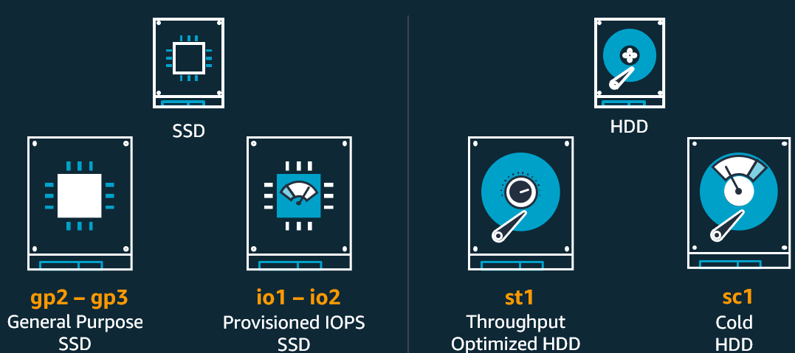
Block Storage
Instance storage
Amazon EBS
Snapshots
Temporary block-level storage attached to host hardware that is ideal for storage of information that frequently changes or is replicated across multiple instances
Easy to use, high performance block storage service designed for use with Amazon Elastic Compute Cloud (EC2) for both throughput and transaction intensive workloads
Incremental, point-in-time copies
of your EBS data that can be used
to restore new volumes, expand the size of a volume, or move volumes across Availability Zones
Using VM as a DB → needs high IOPS → quick search for the data (need fast read & write) , use provisioned iops instead of general
Usually for analytical workload
For data not frequently accessed, need long to search it but can fetch a few batch after that
Notes:
Iops: how fast you can locate the data
bandwidth: once you locate data, now fast can you fetch the whole bunch of data

Slide 5
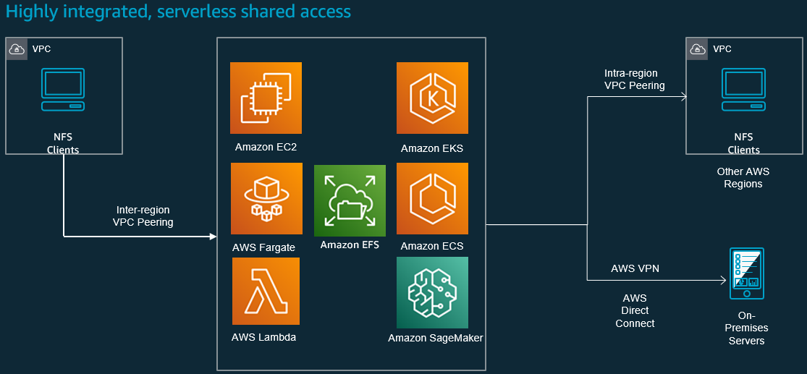
File system
Network attach to file system
Use only when you need file sharing , because this is more expensive than EBS
Network Attached Storage
  Google Filestore
  AWS Elastic File System
  It is accessible from compute engines and Kubernetes engine
  It provides low latency and high IOPS, so it can be used for databases and other performance sensitive services

Slide 6
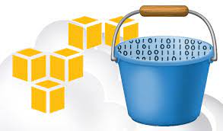
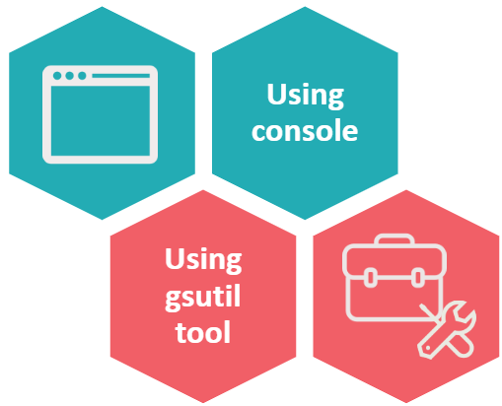
Object storage
Global service
Web accessible object store (through API or HTTPS)
Highly durable (99.999999999% design)
Limitlessly scalable
Multiple Tiers to match your workload
Data Lifecycle Rules
Static Website Hosting
Security, Compliance, and Audit capabilities
Standard Storage Pricing (us-east-1) - $0.023 per GB
Only can have one name globally
Low chance data is corrupted

Slide 7
Characteristics(S3)
It is an object storage system
It is designed for persisting unstructured data, like files, images, videos.
The files stored in Cloud Storage are treated as atomic
No seeking and reading specific blocks in the file
It uses a global namespace for bucket names
A bucket is named when it is created and CANNOT be renamed
Individual objects within buckets can have their own access controls as well
The naming convention makes it looks similar to a hierarchical structure
No limit for Minimum object size
Unlimited space world-wide
Support re-transmission from the break point
OBJECT STORAGE
Atomic: Cannot modify it, not like a file system where you can rename etc. If you want to change it you must change on local machine and upload again
FOR AWS: Whole S3 has ACL (public private etc.) → Buckets itself has ACL but each individual objects too

Slide 8
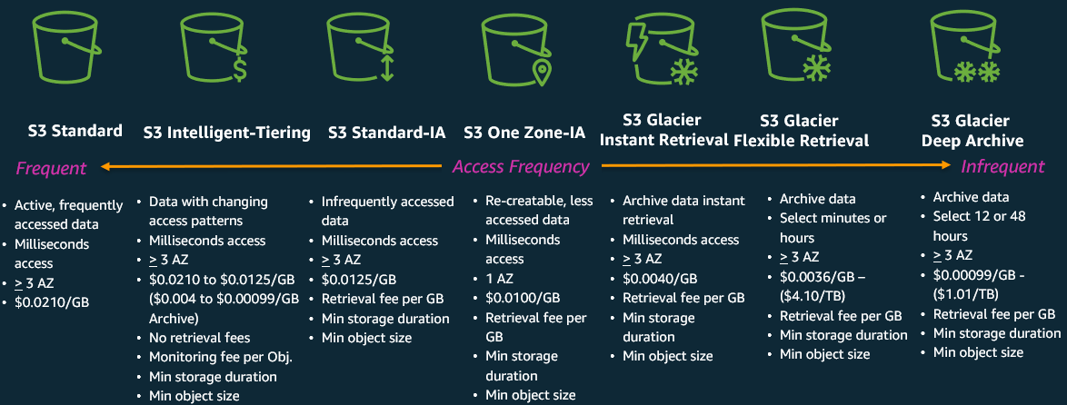
Storage classes (EXAM!)
CSP help to deploy into minimal 3 AZ
Only put in 1AZ, cheaper

Slide 9
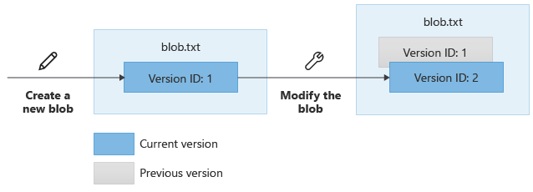
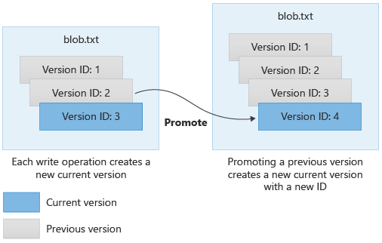
Object versioning
It’s the pre-requisite of below services
  Object lock (only apply to a specific version of the object) can read but cannot modify, to enable object lock must enable versioning
  S3 replication – Cross Region Replication (CRR) / Same Region Replication (SRR)
Cloud Storage retains a noncurrent object version each time you replace or delete a live object version (using a metageneration number)
  Noncurrent versions retain the name of the object, but are uniquely identified by their generation number
  Noncurrent versions only appear in requests that explicitly call for object versions to be included
  A noncurrent version retains its ACLs and does not necessarily have the same permissions as the live version
Object lifecycle management can be done with/without versioning
Any upload will generate a new version, will not overwrite previous one

Slide 10
Object Lock
Before object lock must enable versioning, u can only lock a specific version of the object not the whole object
S3 Object Lock can help prevent Amazon S3 objects from being deleted or overwritten for a fixed amount of time or indefinitely.
Object Lock uses a write-once-read-many (WORM) model to store objects.
Object Lock only applied to a specific version of Object (thus object versioning must be enabled)
Types of Object Lock
  Retention period – A retention period specifies a fixed period of time during which an object version remains locked.
  Legal hold – A legal hold provides the same protection as a retention period, but it has no expiration date.
Retention modes
  Compliance mode - a protected object version can't be overwritten or deleted by ANY user, including the root user
  Governance mode - users can't overwrite or delete an object version or alter its lock settings unless they have special permissions.

Slide 11
SRR and CRR
Provide automatic, asynchronous data replication for your S3 buckets
SRR: Same-Region Replication
  Aggregate logs into a single bucket
  Live replication between accounts
  Abide by data sovereignty laws
CRR: Cross-Region Replication
  Meet compliance requirements
  Minimize latency
  Increase operational efficiency
S3 RTC replicates 99.99 percent of new objects stored in Amazon S3 within 15 minutes (backed by a service-level agreement, or SLA)

Slide 12





Data retention and lifecycle management
Data retention
  How long to keep the data in different tiers of storages, database, and cache
  The retention policies are crafted based on business requirements
Data lifecycle
  Creation, active use, infrequent access but online, archived, deleted
  Where to store the data in different lifecycle period
Utility Bills – 1 year
Purchase Order – 3 years
Bank Statement – 5 years
Frequently access but not so frequently as cache --> put in SQL DB
Safety Record– 7 years
Patents – permanent
Infrequent access
Became historical data
Bulk access only
Backup only
cache
SQL DB
Data Warehouse
Storage Bucket
Coldline Bucket
Archive
Smaller but support real time production retrieve of data
Datawarehouse : historical data for analytical purposes

Slide 13
Typical S3 use case
Mass object storage
Infrequent data storage (archive warehouse)
Static reporting service (public facing)
Static website service (S3 + Cloudfront)
Cheap replacement of Database for non-frequent usage (together with Athena)
Data lake
Data analytics intermediate conversion pool
Centralized logging
Directors/managers/3rd party→we generate report put in S3 and use ACL to allow specific person to retrieve within period (WONT SEE DATA)
If need read and write → better to use DB than s3
Put in s3 bucket → use to process it → put it back into db

Slide 14
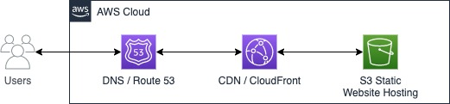
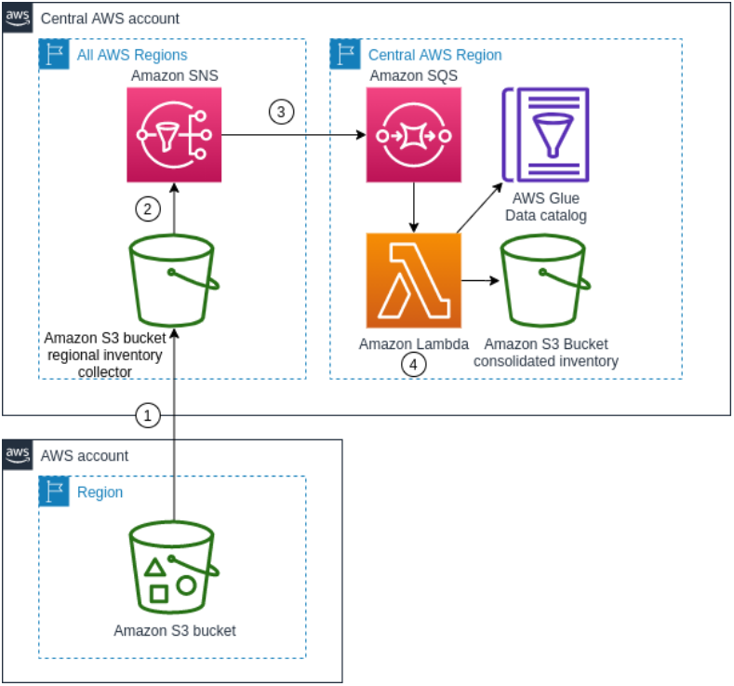
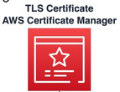
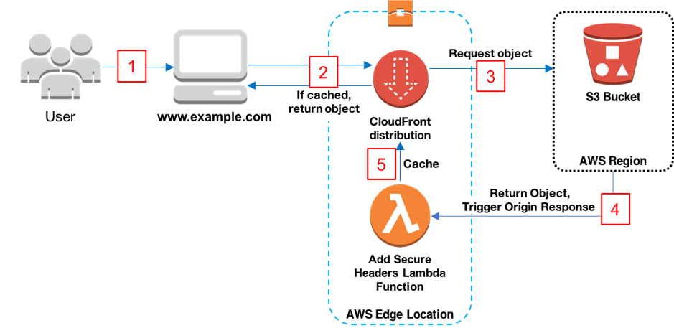
Typical S3 architecture
Static website : HTML static file, but still need create server for backend → waste of resource → use cloudfront + s3 for cheapest way
Need interaction display something (not static) → then use backend server
Cloudfront: content distribution network, fetch file from s3 and show to end user
Simple version
See static website → Put in s3, save cost
Cache it so won’t need to acess S3 again
Each bucket correspond to specific account to set policy easily. Different buckets from diff account that can coordinate with each other
Authentication
Offload TLS
Modify HTTP header for internal resources
Improved version
Lambda do some modification of the content and send back to cloudfront
Case 1: Cloudfront + S3 for static website hosting
Case 2: centralized reporting

Slide 15
Lab: S3
https://catalog.workshops.aws/general-immersionday/en-US/basic-modules/60-s3/s3
Notes:
gsutil acl ch -u AllUsers:R gs://my-test-bucket-0903/Cloud-Solutions.png
gsutil acl set private gs://my-test-bucket-0903/
gsutil acl set private gs://my-test-bucket-0903/Cloud-Solutions.png

Slide 16


Slide 17
database

Slide 18
Concept of database
Design for fast retreivesl
A database is a collection of information that is organized so that it can be easily accessed, managed and updated.
A database usually provides query language to access the data it stored
Thus, a database actually consists of two parts: a storage pool and a management system
…and thus, it has two tiers of charges: storage and query
Different type of information
Different type of database
Non relational
Structured Information with relations
Relational Database
SQL/mySQL/PostgreSQL
Key-value pair information
Key-value Database
Document information
Document Database
Wide column information
Wide column Database

Slide 19
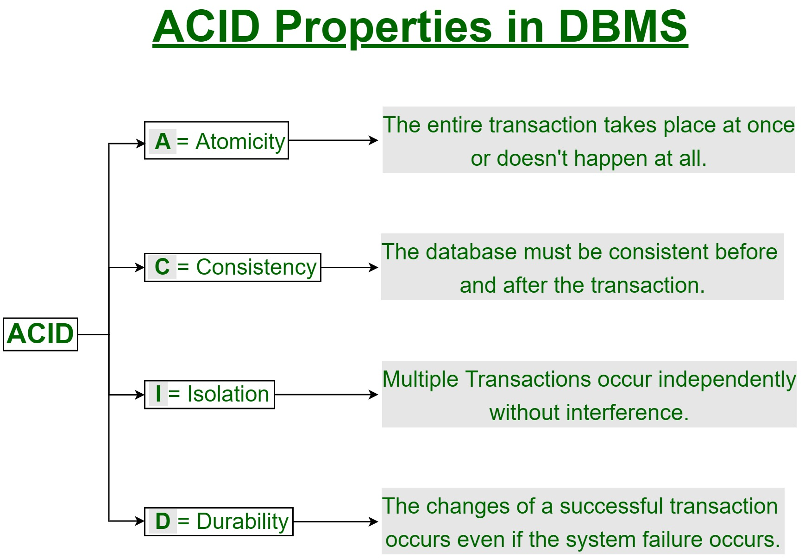
ACID
A commonly used term to describe the characteristics of the transaction.
This is not the requirement of a database. Not all database support ACID.
Transactional db must be strong consistency . Put data in sg, if someone read from Europe immediately get the updated
Distributed DB, whoever write anything then do a read --> data is the updated one
Strong consistency
Eventual consistency
Some latency exists, gap for data to be updated between write and read
Instantaneous persistent disk write from memory

Slide 20
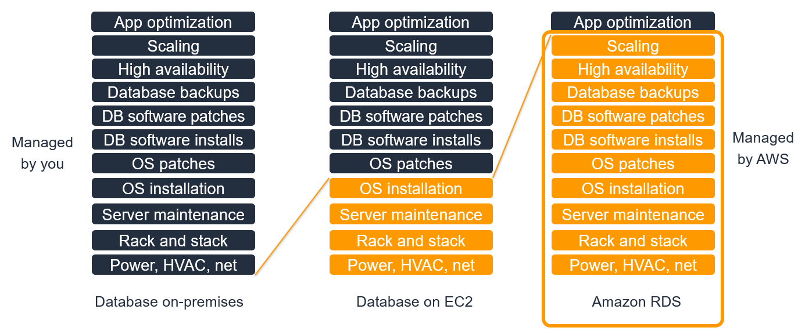
DB@EC2 vs DB services
Proce of RDS higher than EC2. and have no visibility of how they do software patches etc.

Slide 21


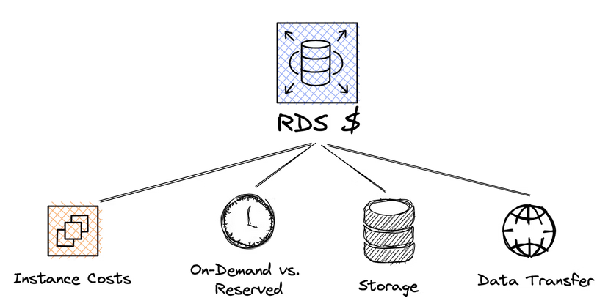




Relational database
Relational databases are highly structured data stores
They are designed to store data with minimal risk of anomalies
They offer comprehensive query language to manipulate the stored data
They support ACID transactions
Cloud managed SQL (Saas)
Use pre-configured VMs
Auto-backup
REST APIs
Highly scalable (CPU & Memory)
Connect with CSP Compute Services and external systems

Slide 22
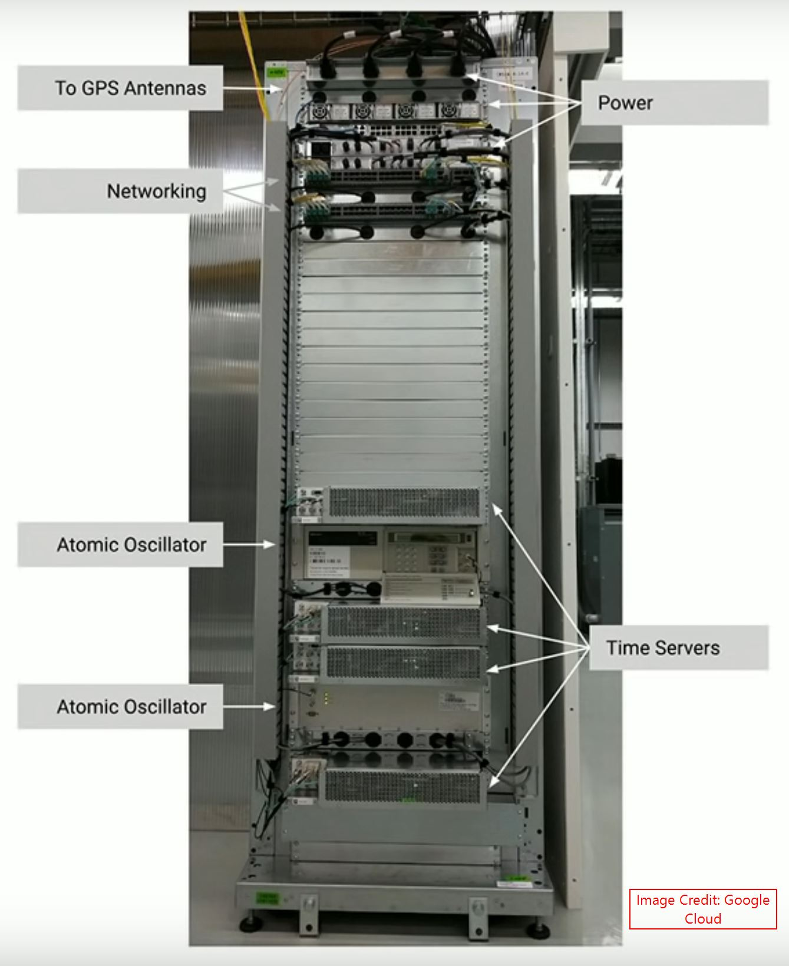
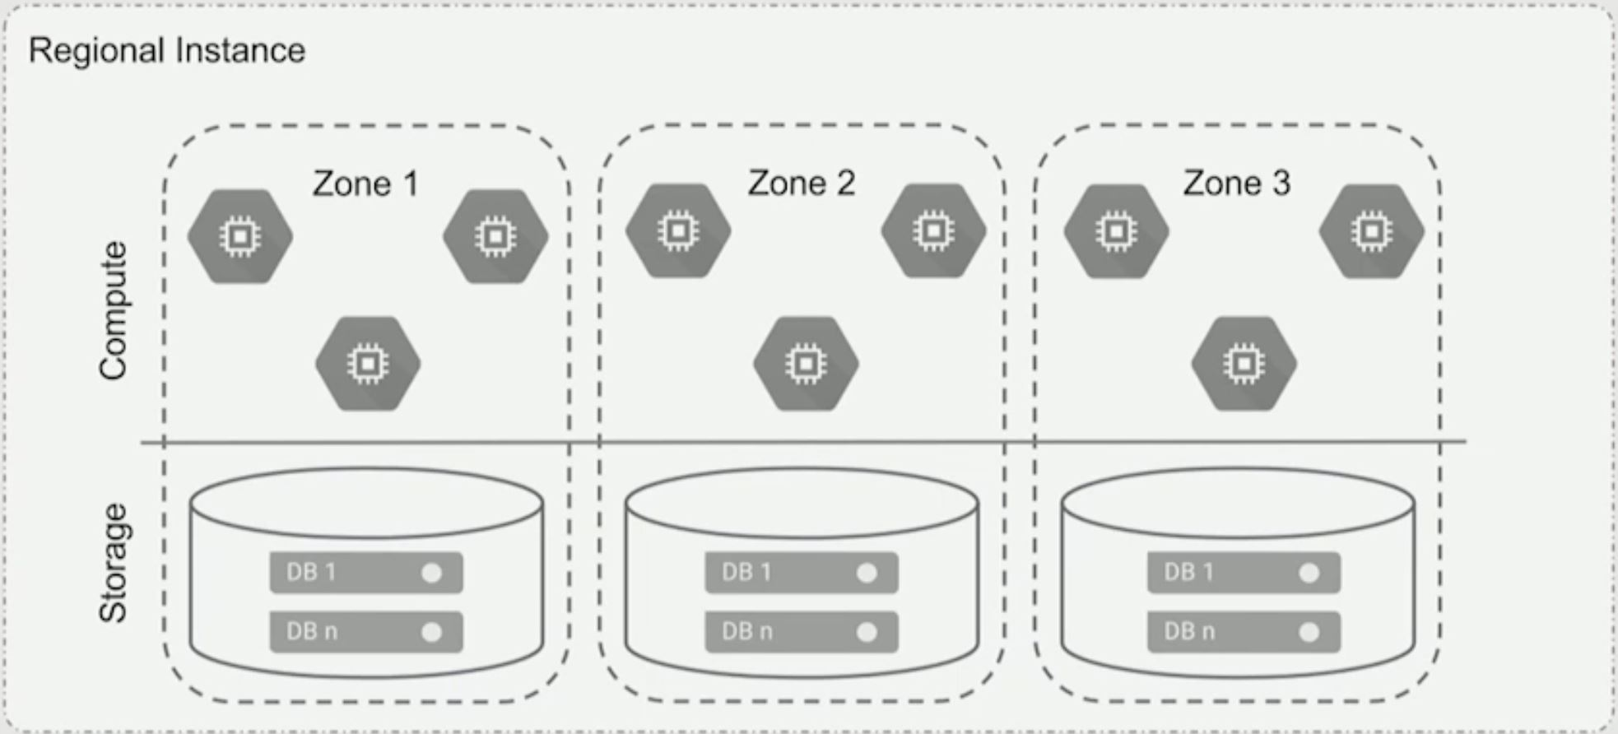
Global transactional database
It is a fully managed RDMS database
It supports horizontal scalability across regions
It support strong consistency and 99.999% availability (<5min/year)
It is used for application require strong consistency on a global scale:
  Financial trading systems
  Logistics application
  Global inventory tracking
Data is encrypted at rest and in transit
GCP Cloud Spanner/AWS DynamoDB
Distributed relational db
Physical implementation of TrueTime
The most difficult part for strong consistency:
Synchronize the time globally!

Slide 23
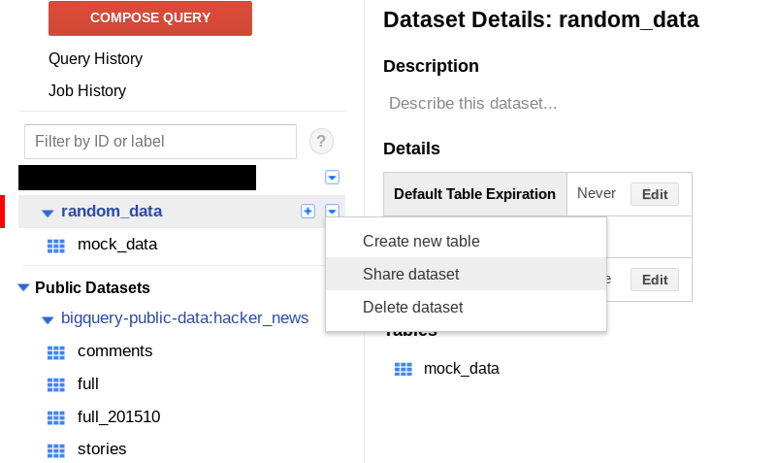
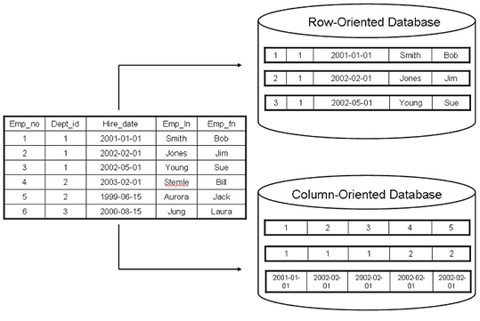
Data warehouse
Distributed relational db
Analytics & non transactional
Transactional --> use relation database
Relational database to store huge amount of data
Support fast queries with large volumes of return data
Support batch and streaming jobs, but not for transactional applications
Google Cloud BigQuery(serverless, bq command), AWS RedShift (cluster-based, sql command)

Slide 24
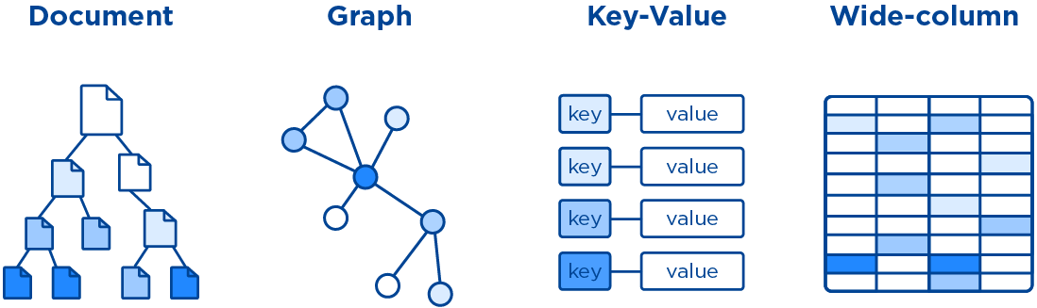
Non-relational database
A non-relational database does not use the tabular schema of rows and columns found in most traditional database systems.
Instead, non-relational databases use a storage model that is optimized for the specific requirements of the type of data being stored.
No fixed schema
Various formats
Various storage model
Various query format

Slide 25
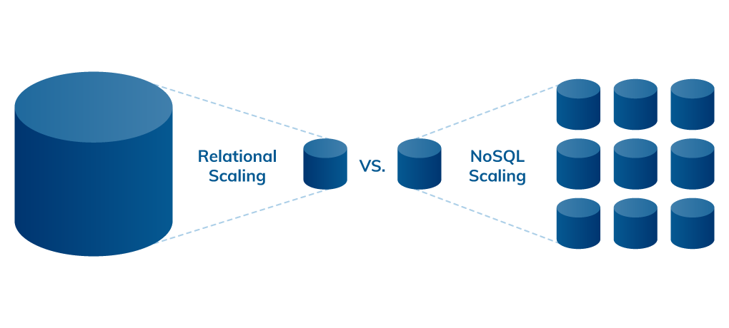
scalability
Relational DB: only support vertical stealing, cannot randomly add nodes ( no horizontal scaling)
noSQL: do horizontal scaling
* AWS DSQL (introduced on Dec.3, 2024): serverless distributed SQL database with virtually unlimited scale

Slide 26
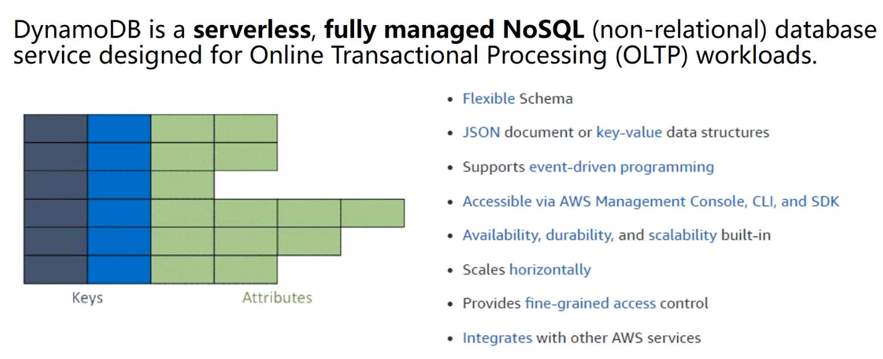
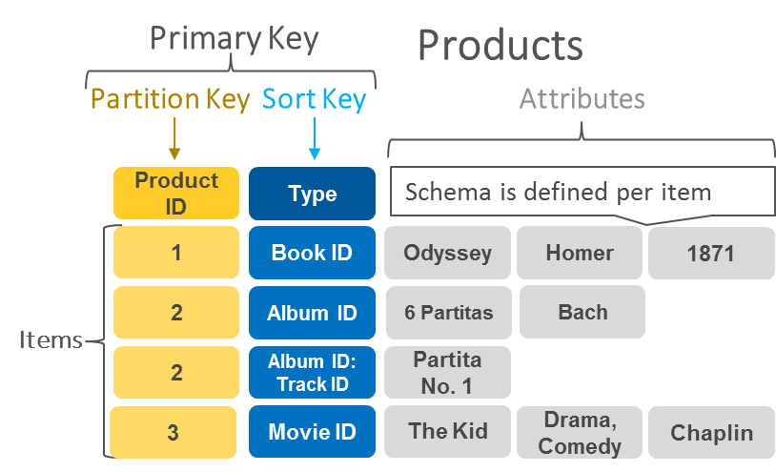
Key-value database
It stores data as a collection of key-value pairs in which a key serves as a unique identifier.
Both keys and values can be anything, ranging from simple objects to complex compound objects.
Key-value databases are highly partitionable and allow horizontal scaling at scales that other types of databases cannot achieve.
Suitable for simple record data like session store and shopping carts

Slide 27
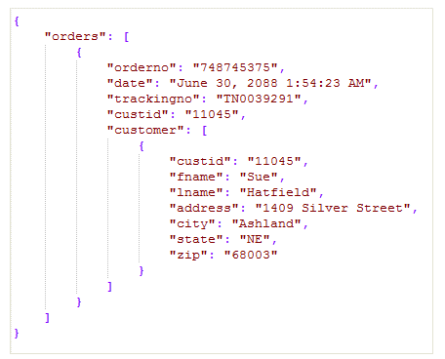
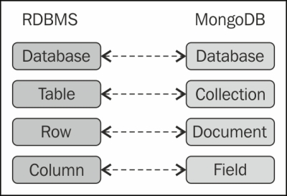
Document database
It is flexible and semi-structured
Documents are identified with a unique key. This key is a simple ID, typically a string, a URI, or a path
It allows to retrieve documents based on content (or metadata)
It allows edit the content of a document
Used cases
  Content management systems (blogs and videos)
  E-commerce platforms (catalogs or user profiles)

Slide 28
CSP document database
Amazon DocumentDB
  all CRUD statements (Create, Read, Update, Delete) guarantee atomicity and consistency, even for operations that modify multiple documents
  Per second pricing
  Support up to 15 replicas
  Scales from 10GB to 64TB
Google Firestore
  Upgraded version of Datastore
  ACID transactions are supported
  Support strong consistency
  Provide SQL-like query language called GQL
  Supports real-time updates
  Provides mobile and web client libraries
  It can scale to zero
RDBMS
Datastore
Database
Database
Table
Kind
Row
Entity
Column
Property

Slide 29
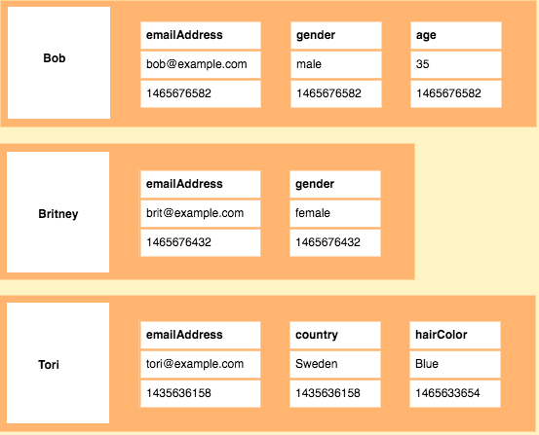
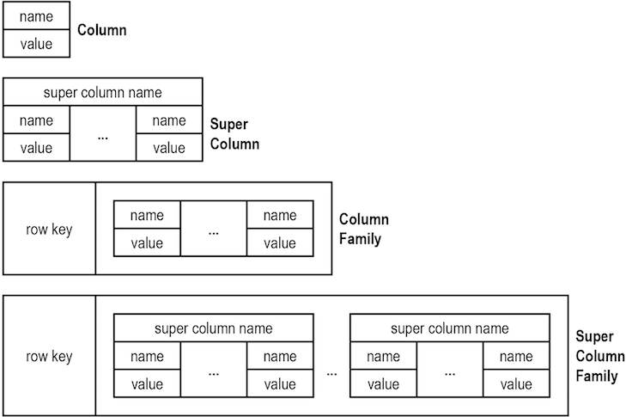
Wide-column database
It is a table with rows and columns
The names and format of the columns can vary from row to row in the same table
It can be interpreted as a two-dimensional key–value store
Use cases
  Finance and write heavy applications
  Senor logs (IoT), geographic records, and reporting systems
  Time series data

Slide 30
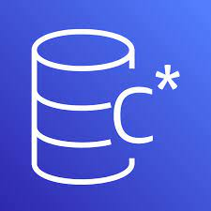
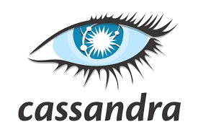

CSP wide column database
AWS Keyspaces (for Apache Cassandra)
  Data is stored on disks in partitions based on partition key
  Use Cassandra Query Language (CQL)
  No JOINs in CQL (you should design each table specifically for a particular access pattern)
Google Bigtable
  Store petabyte-scale data
  Sub 10ms latency
  Run on a cluster of servers
  Use regional replication
  Supports Hadoop HBase interface
  Use Bigtable-specific command cbt

Slide 31
A special database: memory/cache

Slide 32
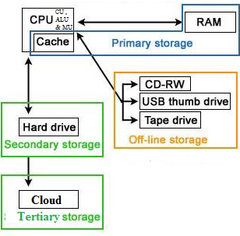
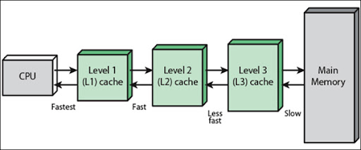
Benefit of cache
Cache speed up CPU calculation
Cache put infront of DB
The primary purpose of an in-memory data store is to provide ultrafast and inexpensive access to copies of data
Improve performance on the same hardware
  No need search on secondary storage
Improve responsiveness
  Data on hand
Decrease network cost
  No need to access network
Available during network interruptions
Typical Use cases
  In-memory data lookup
  RDBMS speedup
  Session status record
  Buffer traffic spike
  API token caching
High availability: multi-az, create another DB ( distributing db into different regions). One db crash then workload will shift into another db. Use for disaster recovery!!!
Read replica: db small amount of write but huge amt of read, read occupy iods then write happen slowly → db overloaded → create different read replica by copying form main db. Those read replica only servers read request & never accept write operation. [ cater for heavy read applications]

Slide 33
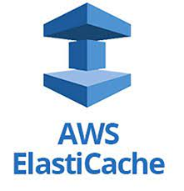
CSP memory/cache services
AWS ElastiCache
  Managed Redis service and Memcached
  Sub-millisecond data access
  Different capacity tiers to choose
  Up to 419GB instance and 25Gbps network throughput
  Price from $0.017/hour to $7.28/hour
Google Cloud Memorystore
  Managed Redis service and Memcached
  Sub-millisecond data access
  Different capacity tiers to choose
  Support up to 300GB instance and 12 Gbps network throughput
  Basic tier provides a simple Redis cache on a single server
  Standard tier provides cross zone replication with 99.9% availability
  Price from $0.016/GB/hour to $0.064/GB/hour
https://redis.io/

Slide 34
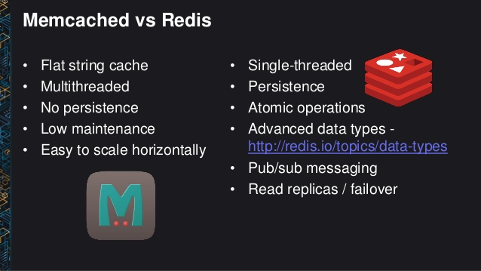
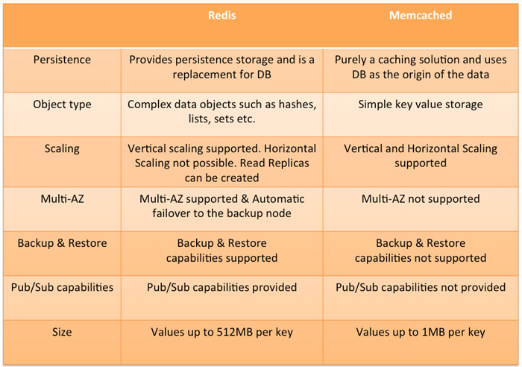
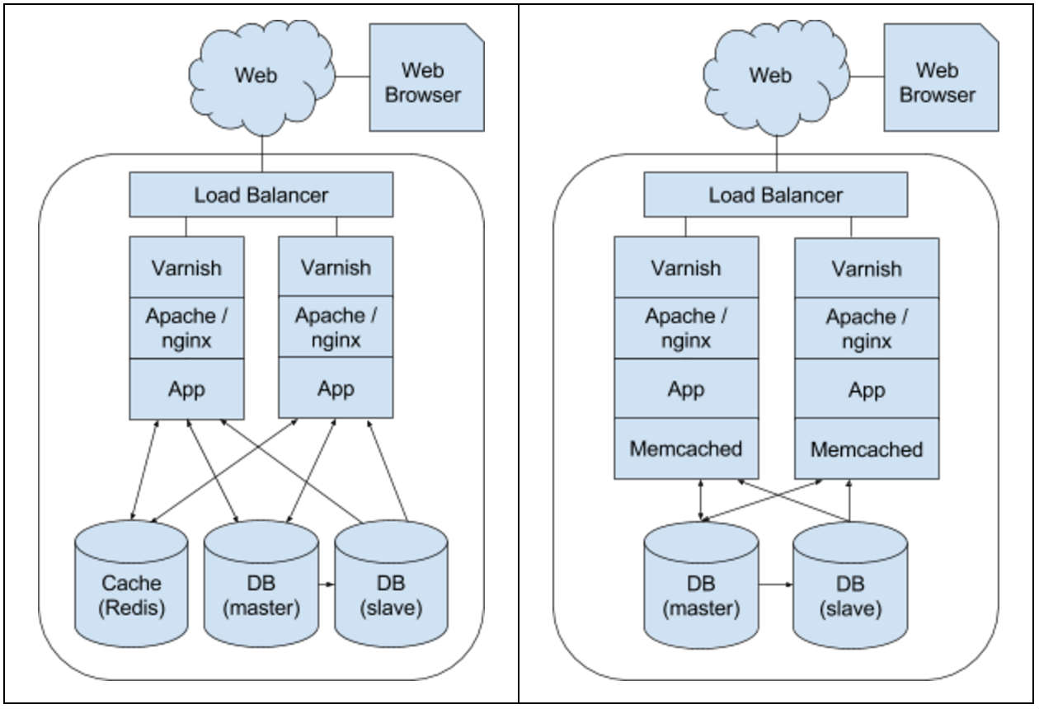
Redis vs memcached
REDIS: for enterprise grade

Slide 35

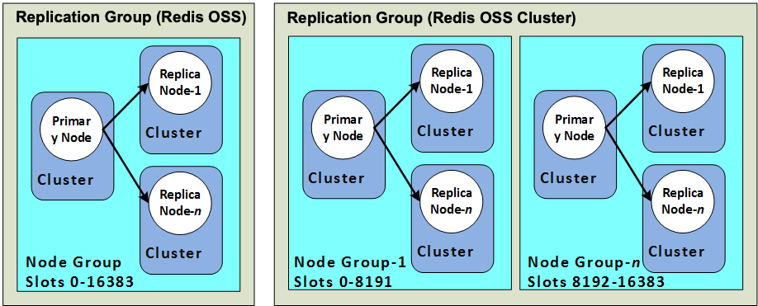
Valkey
In March 2024, Redis Inc. announced that future versions of Redis would no longer be open source
Mar.28, 2025, the Linux Foundation, Redis OSS developers, and contributors united to fork version 7.2 of Redis OSS and create the Valkey project.
AWS ElastiCache, MemoryDB are Valkey-compatible, with free-tier trial
Valkey use a similar client-server model with a distributed clusters as Redis OSS
https://docs.aws.amazon.com/AmazonElastiCache/latest/dg/CacheNodes.NodeGroups.html

Slide 36
Database summary

Slide 37
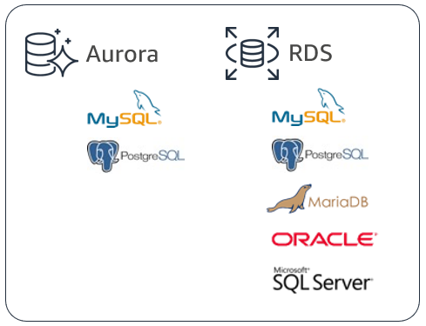
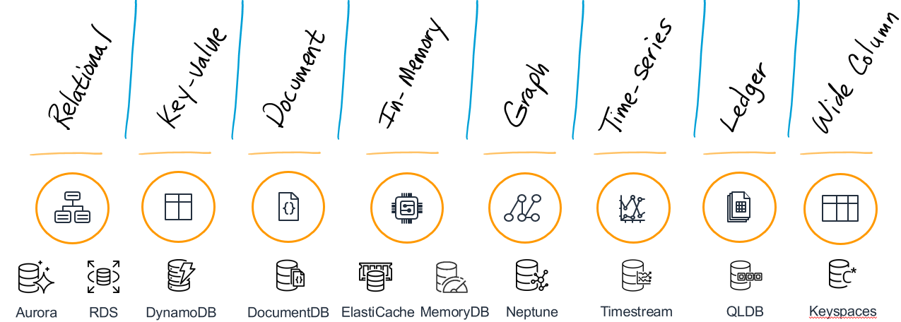
Database services in AWS

Slide 38
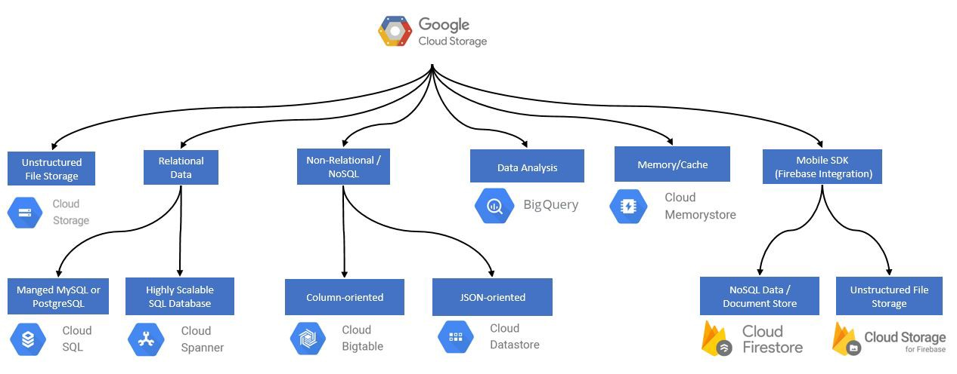
GCP storage offerings (FYI)

Slide 39
lab – RDS Database
option1
https://catalog.workshops.aws/general-immersionday/en-US/basic-modules/50-rds/rds-mysql
Use MySQL
https://docs.aws.amazon.com/AmazonRDS/latest/UserGuide/USER_ConnectToInstance.html
Use PostgreSQL
https://docs.aws.amazon.com/AmazonRDS/latest/UserGuide/USER_ConnectToPostgreSQLInstance.html
option2

Slide 40
Assignment
Choose one of the non-relational DB that you familiar with. Create one instance and test some simple operations on it (put, modify, get, etc)
List down 3 unique points you find interesting for the DB selected.
Submit your homework via eLearn
Design the storage and database system for the 4 projects
Notes:
Dymono db etc.

