Slide 1
IAM and Security

Slide 2
outline
IAM
  Element of IAM
  Identities, Permissions, Roles, Resources, Policy
  IAM Inheritance
  IAM best practice
Security in cloud
  Shared responsibility model
  Data security – encryption
  Key management
  CSP security services
  Security evaluation

Slide 3
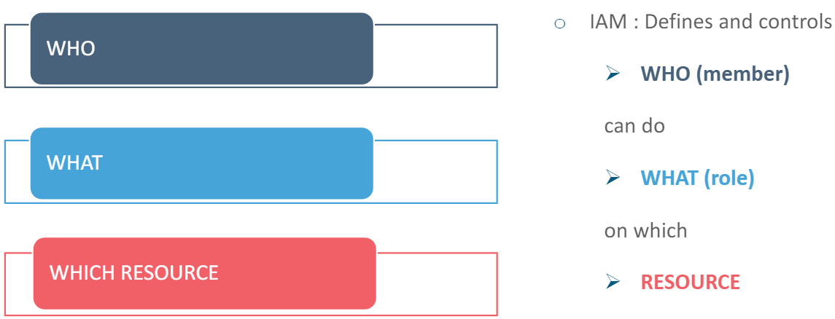
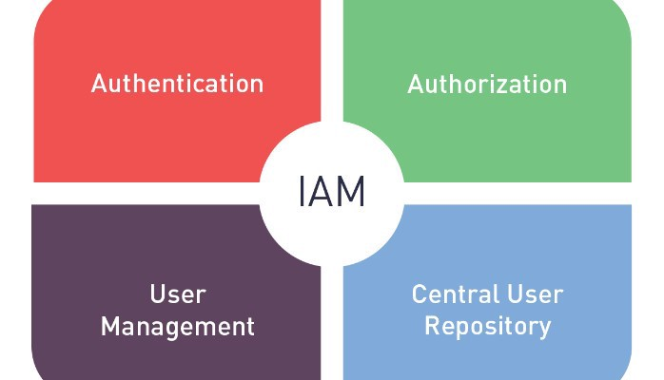
Identity and Access management (IAM)
Identity and access management is primarily about defining and managing the roles and access privileges of users.
An IAM system can provide assurances and help keep track of employee activity.
Components of an IAM system
  a user repository
  role definition and authorization engine
  authentication system with single sign-on capabilities
  password management
  account provisioning/de-provisioning
  Auditable record

Slide 4
elements of IAM
Identities and groups
Permissions
Roles
Resources
Policies
who
what
a group of permissions
resource
a group of access assignments

Slide 5
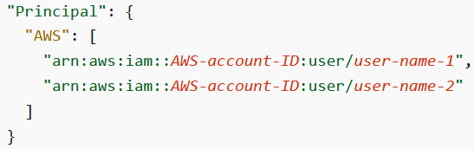
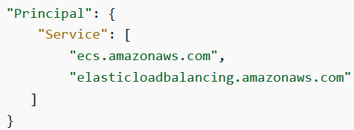
identities in AWS
IAM user!=Root user (email)
IAM user
Service
Account ID
Root of an account
IAM Role (temporary user)
Users from federated services
https://docs.aws.amazon.com/IAM/latest/UserGuide/reference_policies_elements_principal.html

Slide 6
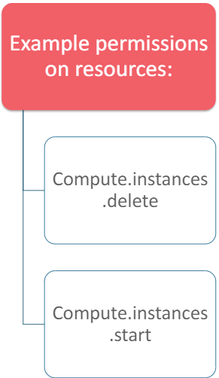
permissions
Permissions are specific access right to a cloud resource
It is also called permitted actions
Users are not allowed to modify permissions, they are managed by CSP
Permissions are granted to policy or roles, then to IAM entities
  By default these entities start with no permissions
  In GCP, permissions must be assigned to roles first then to a user. GCP manages default roles for customers to choose. Policies are created by customers.
  In AWS, permissions are assigned to policies then to a user/role. AWS manages default policies for customers to choose. Roles are created by customers.

Slide 7
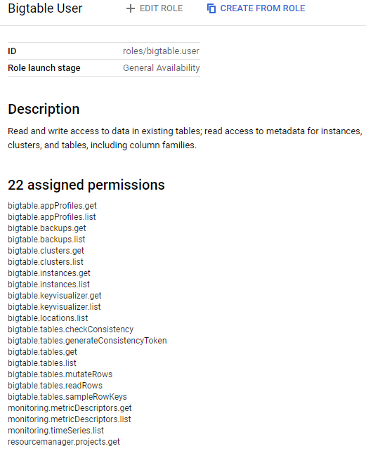
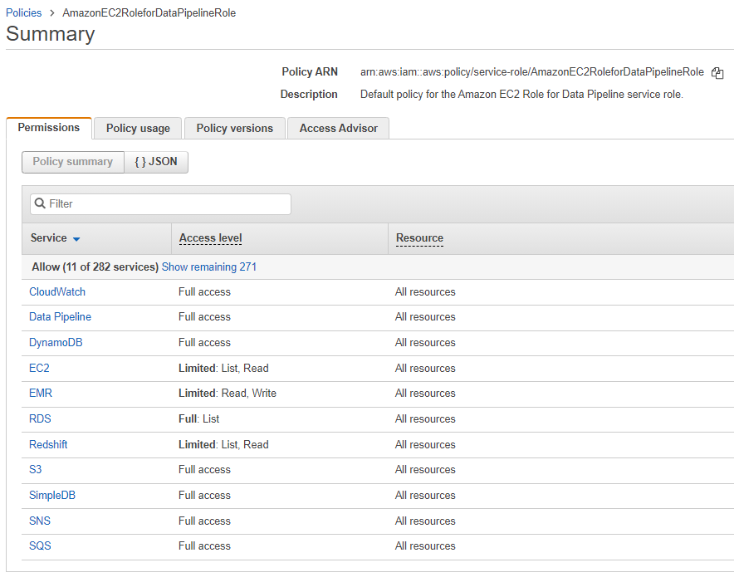
assignment of permissions
GCP
AWS

Slide 8

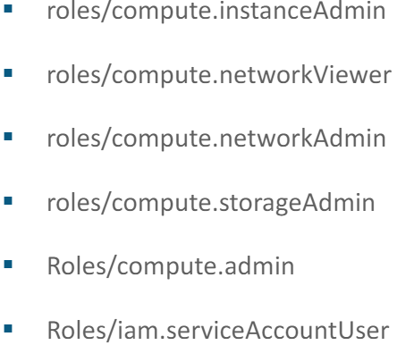
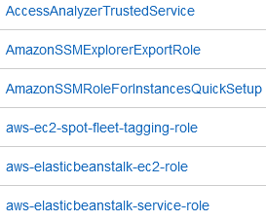
role
Role is a temporary user in AWS
  It only been assigned a key pair when it is invoked
  Its key pair will expire after a certain hours
Secure, nobody can hack
Shift your mask depending on which svc u access
identity
identity
How it works?
Temporarily
Assume roles
Attached roles
Benefit:
No need hardcode identity credentials within programs/commands
No need flood the permanent credentials among services
Each time a role is assumed, a temporary set of credentials are generated and used to the target service.

Slide 9
resources
Resources are entities that exist in the cloud platform and can be accessed by users
Typical resources with access control:
  Projects
  Instances
  S3 buckets
  Databases
  Message pipelines
  Cloudformation template
  …

Slide 10
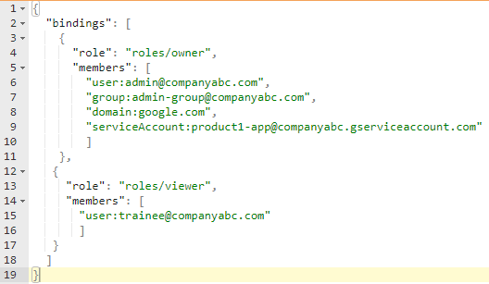
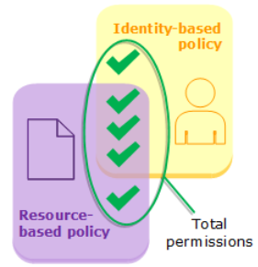
Iam policy
TESTED. Will be given policy and explain what
This policy is - is it deny scv? Is it for specific identity can or cannot acess
IAM Policy in GCP (user defined)
  It is a collection of statements contains set of roles and a set of role members
  Defined with a JSON file
  It groups a set of members who have the same type of access on the same set of resources
  It provides an easier way to maintain the access control list for large companies with fast employee churn rate
  IAM Policy in AWS (CSP/user defined)
  Stand alone object
  Identity-based policy: assigned to an identity, give individual access
  Resource-based policy: assign to a resource, limit the access towards the resource (e.g. S3 bucket policy)
GCP
{
"Version": "2012-10-17",
"Statement": [
{
"Action": "ec2:*",
"Resource": "*",
"Effect": "Allow",
"Condition": {
"StringEquals": {
"ec2:Region": "us-east-1"
}
}
}
]
}
A must have identity base policy and B must have resource base policy
AWS

Slide 11
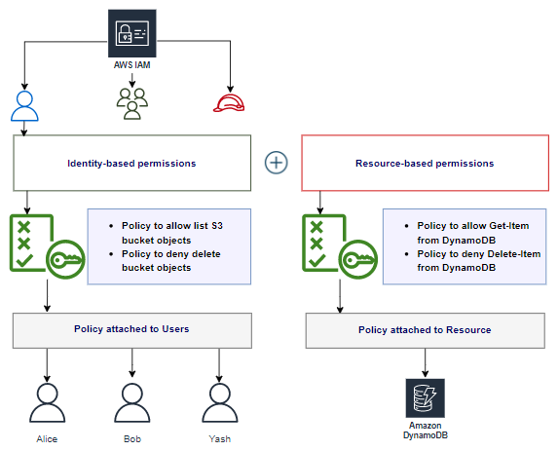
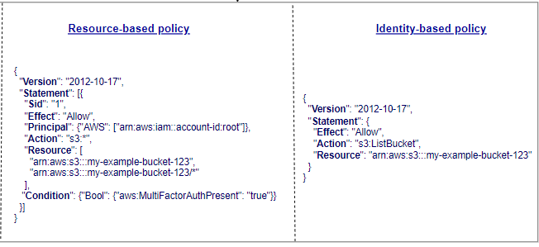
Resource vs identity based policy
Identity based policy is associated to an identity (user)
  It defines what this specific identity can/can’t do
  The policy won’t contains a principle field because it’ll be associated to a principle
Resource based policy is associated to a resource
  It defines the criteria that allow/deny to access this resource
  It have a principle field as this policy will be associated to a resource, not a principle
Inside policy, no statement about the identity. Identity base policy gna attach to a specific identity
# have principal -> means resource based

Slide 12
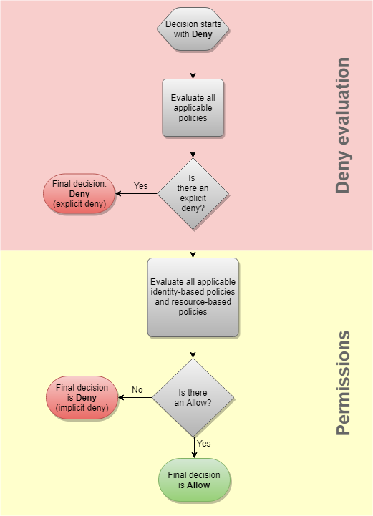
IAM evaluation process
Default is all denied
As long as deny, allow will never take effect
If role base allow and resource disallow – final outcome is deny. As long as any of them is deny then is deny
All applicable policies are evaluated together
Explicit Deny -> Deny
Explicit Allow ONLY -> Allow
No Explicit Deny or Allow -> Deny
Q: If there’re two policies attached to the role Bob.
One is allow EC2:creation, another is deny EC2:creation.
Is Bob allowed to create an EC2 instance?

Slide 13
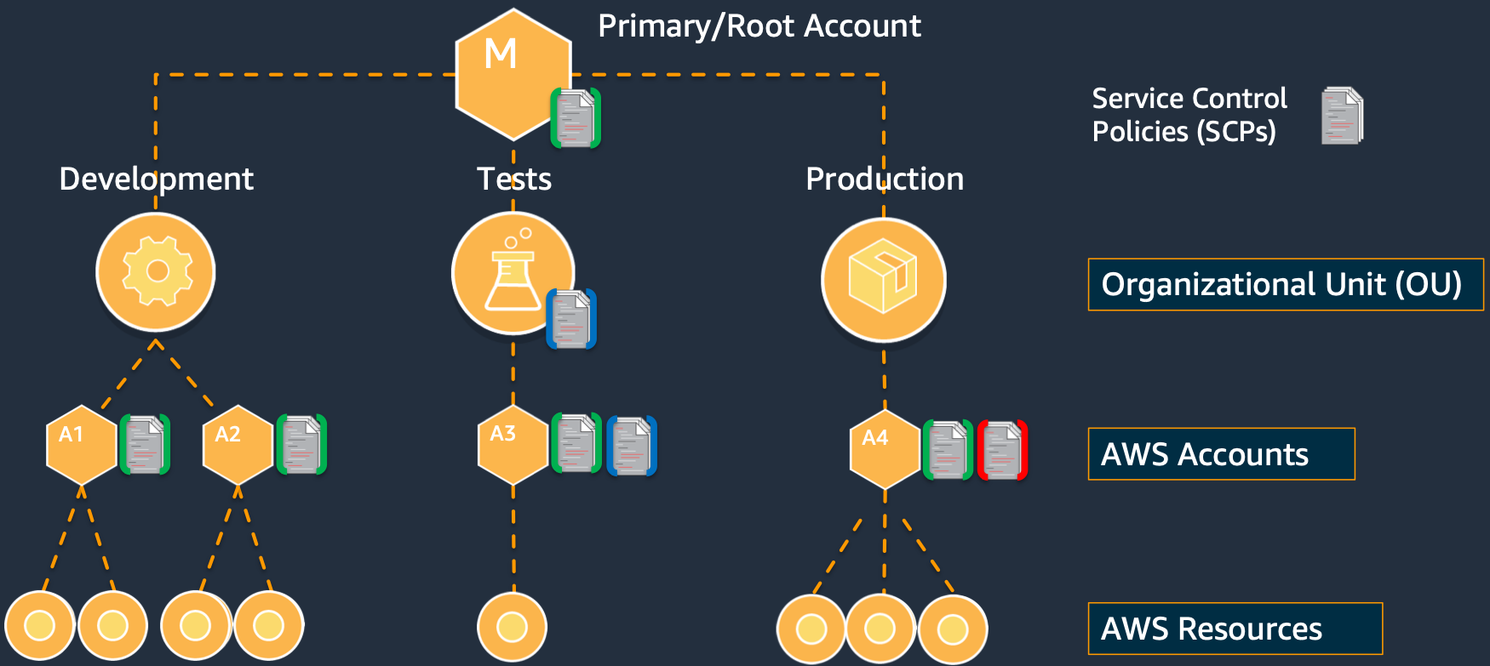
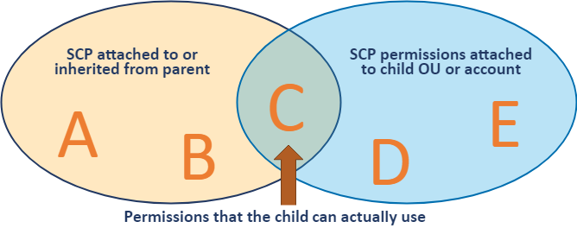
AWS account structure
AWS flat organization structure:
Resources are directly under the account in AWS.
Payer – Multiple Linked Account (each Linked Account serves one project)
Permission of a resource is the Intersection of the parents Service Control Policy (SCP) and its own policy
E.g. if organization SCP defines all S3 buckets in this organization is private. Even you define a public S3 bucket in a sub-account, it can’t be accessed from Internet.

Slide 14
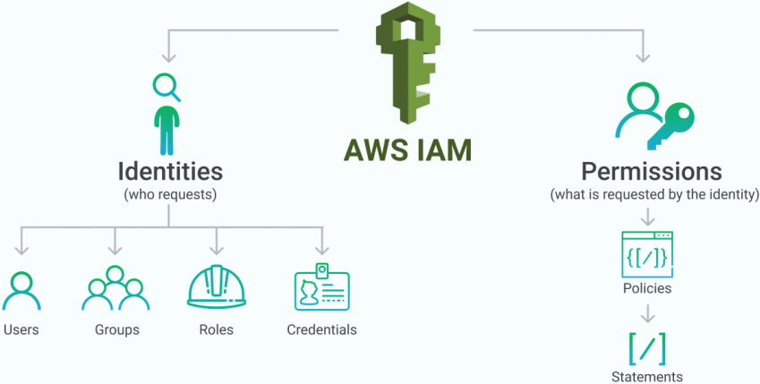

Iam snapshot
Default deny
Explicit allow without explicit deny: Allow
Explicit deny: Deny

Slide 15
Best practice of iam
Lock away your AWS account root user access keys
Use roles to delegate permissions
Grant least privilege (only necessary permissions are granted)
Validate your policies
Configure a strong password policy for your users
Enable MFA
Use roles for applications that run on Amazon EC2 instances
Rotate credentials regularly
Remove unnecessary credentials
Use policy conditions for extra security
Monitor IAM activity and log it

Slide 16
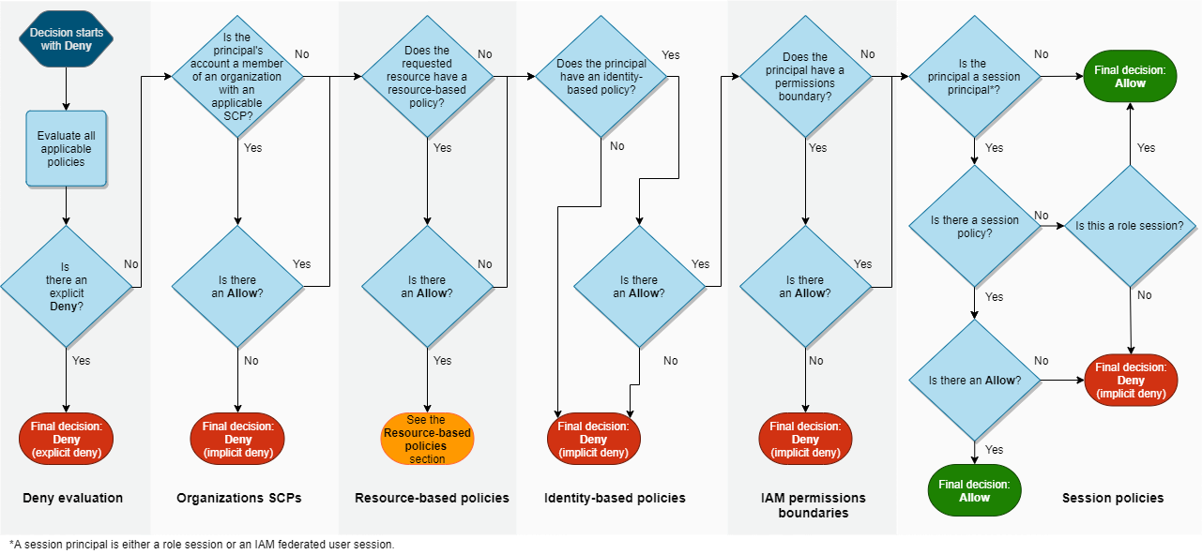
Policy evaluation logic (reference only)
https://docs.aws.amazon.com/IAM/latest/UserGuide/reference_policies_evaluation-logic.html

Slide 17


Slide 18
security in cloud

Slide 19
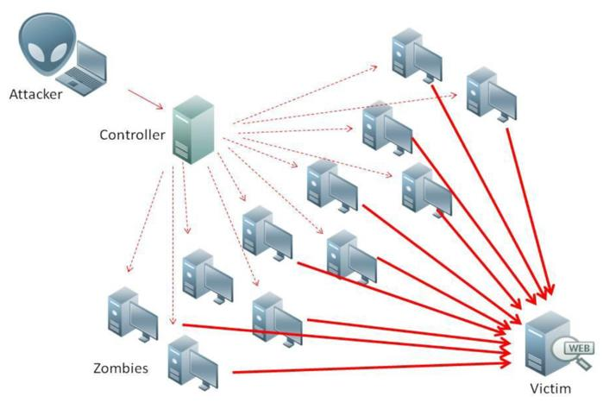
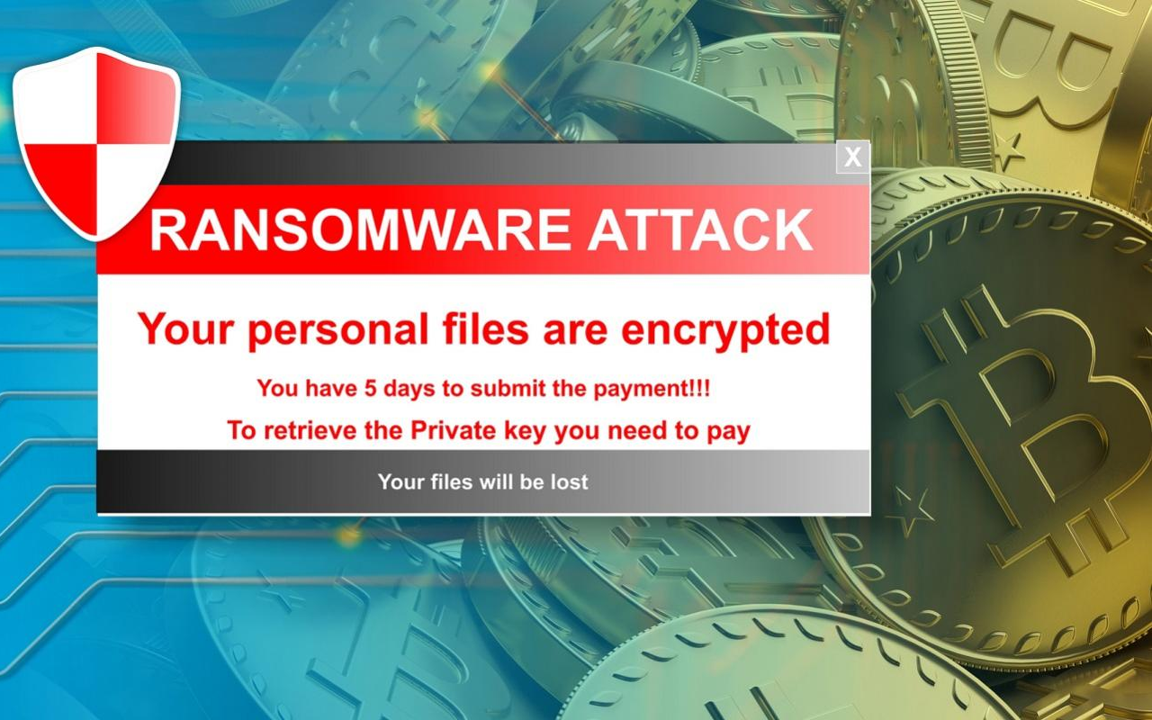
Attacks for cloud services
Malware
  Open back-hole to manipulating or stealing data or eavesdropping
Man-in-the-middle
  Act as proxy server to hack exchanged messages
Account hijacking
  Gain access to a user’s credentials by phishing or spyware or cookie poisoning
DDoS – overload a system and make services unavailable to users
Ransomware – lock system/important files and ask for money
And more …

Slide 20
Shared responsibility model
Customer
Customer content
Customers are responsible for their security and compliance IN the Cloud
Platform, Applications, Identity & Access Management
Operating System, Network & Firewall Configuration
Client-side Data Encryption
Server-side Data Encryption
Network Traffic Protection
AWS
AWS Foundation Services
AWS is responsible for the security OF
the Cloud
Compute
Storage
Database
Networking
AWS Global Infrastructure
Availability Zones
Edge Locations
Regions

Slide 21

Data security - encryption
TESTED IN EXAM
Types of encryptions
  Encryption at rest: for data in various kinds of cloud storages (e.g. S3, EFS, DynamoDB)
  Encryption in transit: for data on network transmission
  Encryption at rest
  GCP encrypt data at rest by default, AWS provide free tools to enable encryption at rest
  It happens at platform & infrastructure & hardware levels
  Data are encrypted in chunks. Each chunk has its own data encryption key.
  Data encryption keys are also encrypted at rest
  Commonly used algorithms: AES128 (for older devices) & AES256
  Encryption in transit
  Authentication of sources
  Application Layer Transport Security (ALTS) – a Google customized version of TLS
Encryption In-Transit
Encryption At-Rest
HTTPS
Object
SSL/TLS
Database
VPN / IPSEC
Filesystem
SSH
Disk

Slide 22
Key Management Service (KMS)

Slide 23
KMs
Generate, use, store, rotate, and destroy cryptographic keys
Supported encryption algorithms
  AES256, RSA 2048, RSA 3072, RSA 4096, EC P256, and EC P384
Types
  AWS owned key – created and used by AWS in multiple AWS accounts, usually hidden
  AWS managed key – created by AWS, can be used by AWS and user. E.g. aws/s3 or aws/rds
  Customer managed key(CMK) – created and used by customer. E.g. myKey
Key deletion
  You can only schedule the deletion of a customer managed key. You cannot delete AWS managed keys or AWS owned keys.
  Before deleting a CMK, you need to know how many ciphertexts were encrypted under that CMK (method: disable it to surface affected services before schedule a deletion).
  Schedule a CMK deletion need 7~30 waiting days.

Slide 24
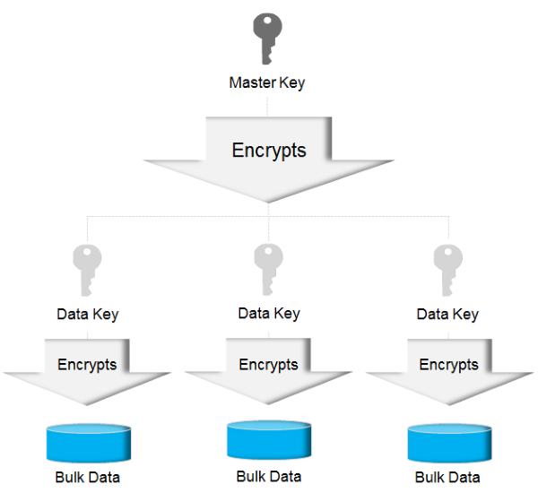
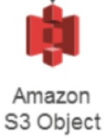


envelope encryption – why?
KMS
Problem:
A large amount of data will be encrypted by one Master Key
A large amount of plain data need to be transmitted via Internet to KMS to get encrypted
CMK is limited to encrypting up to 4k data.

Slide 25
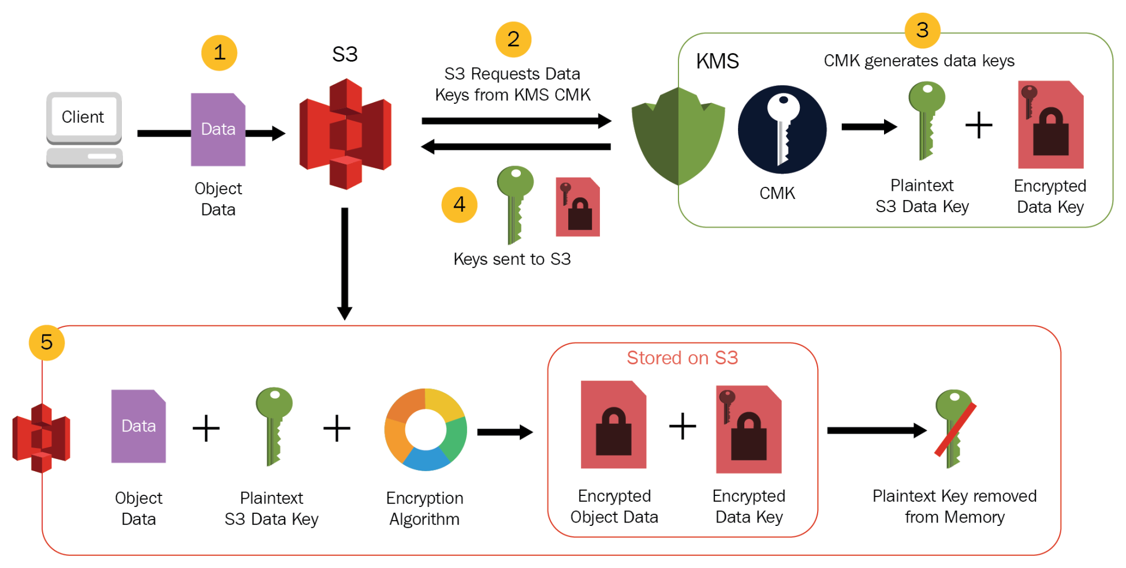
Envelop encryption – how?
KMS uses CMK generate a data key and encrypts it using CMK
KMS send the plain data key and encrypted data key back to S3
S3 uses plain data key encrypts the data, discard it, store only the encrypted data key
S3 send encrypted data key back to KMS
KMS authenticate the request and decrypt the data key using CMK
KMS send plain text data key back to S3
S3 use it decrypt the file and discard it

Slide 26
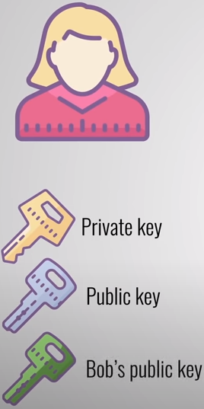
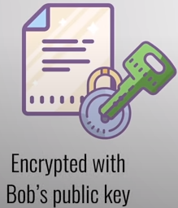
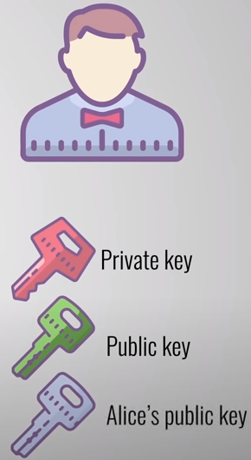
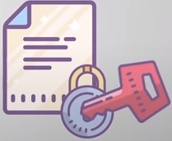
Symmetric vs asymmetric keys
Symmetric key means the same key will be used for encryption and decryption
Asymmetric keys has key pairs. One is for encryption, the other is for authentication.
Data key pairs are asymmetric data keys that consist of a mathematically-related public key and private key. They are designed to be used for client-side encryption and decryption, or signing and verification outside of AWS KMS.
AWS KMS protects the private key in each data key pair under a symmetric CMK in AWS KMS that you specify.
AWS KMS can generate asymmetric keys but can’t manage or perform cryptographic operations with asymmetric key pairs. You can download and use it outside of KMS.
RSA asymmetric encryption example
Step3: Bob uses his private keys to decrypt message
Step2: Alice use Bob’s public keys to encrypt message and send
Step1: Alice and Bob exchange their public keys via public network

Slide 27


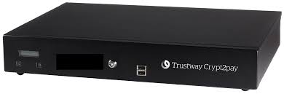
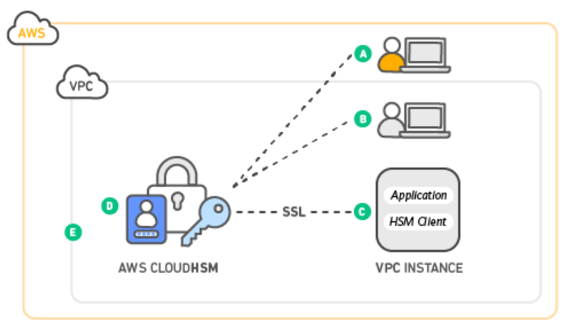
Hsm-hardware security module
A physical computing device that safeguards and manages digital keys
It is in the form of a plug-in card or an external device that attaches directly to a computer
A vast majority of existing HSMs are designed mainly to manage secret keys
HSMs are used for real time authorisation and authentication in critical infrastructure
HSM can offload some encryption work from central CPUs (SSL Acceleration HSM)
Specialized HSMs are used in the payment card industry

Slide 28
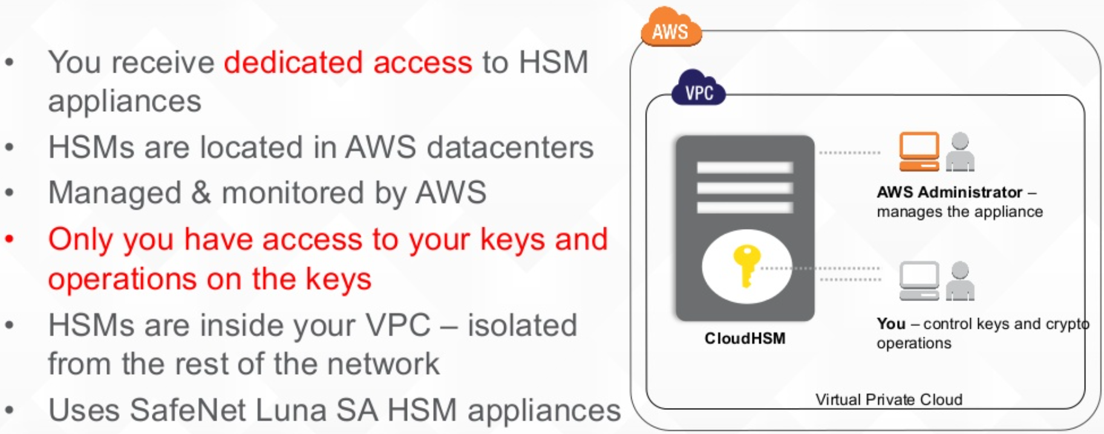
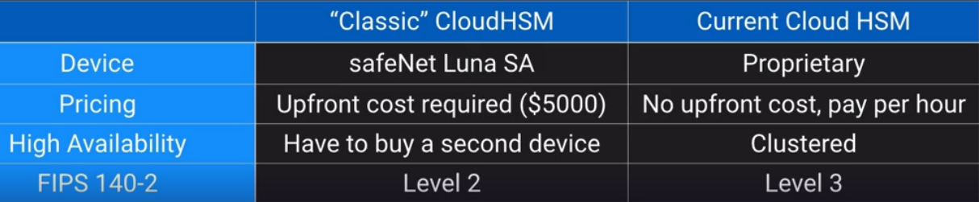
AWS cloud hsm
https://aws.amazon.com/cloudhsm/

Slide 29
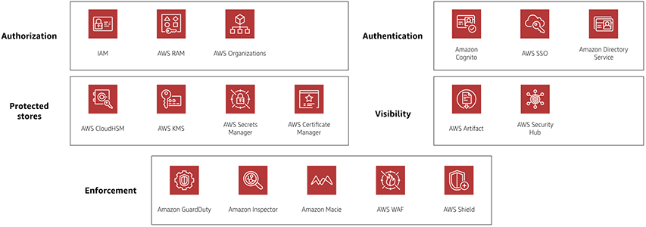
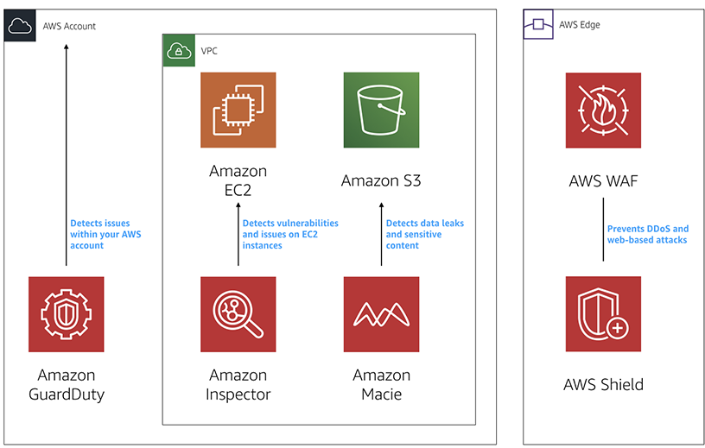
Other security services in cloud
https://docs.aws.amazon.com/prescriptive-guidance/latest/security-reference-architecture/architecture.html
Notes:
Iam cloudhsm awskms waf and shield : tested

Slide 30

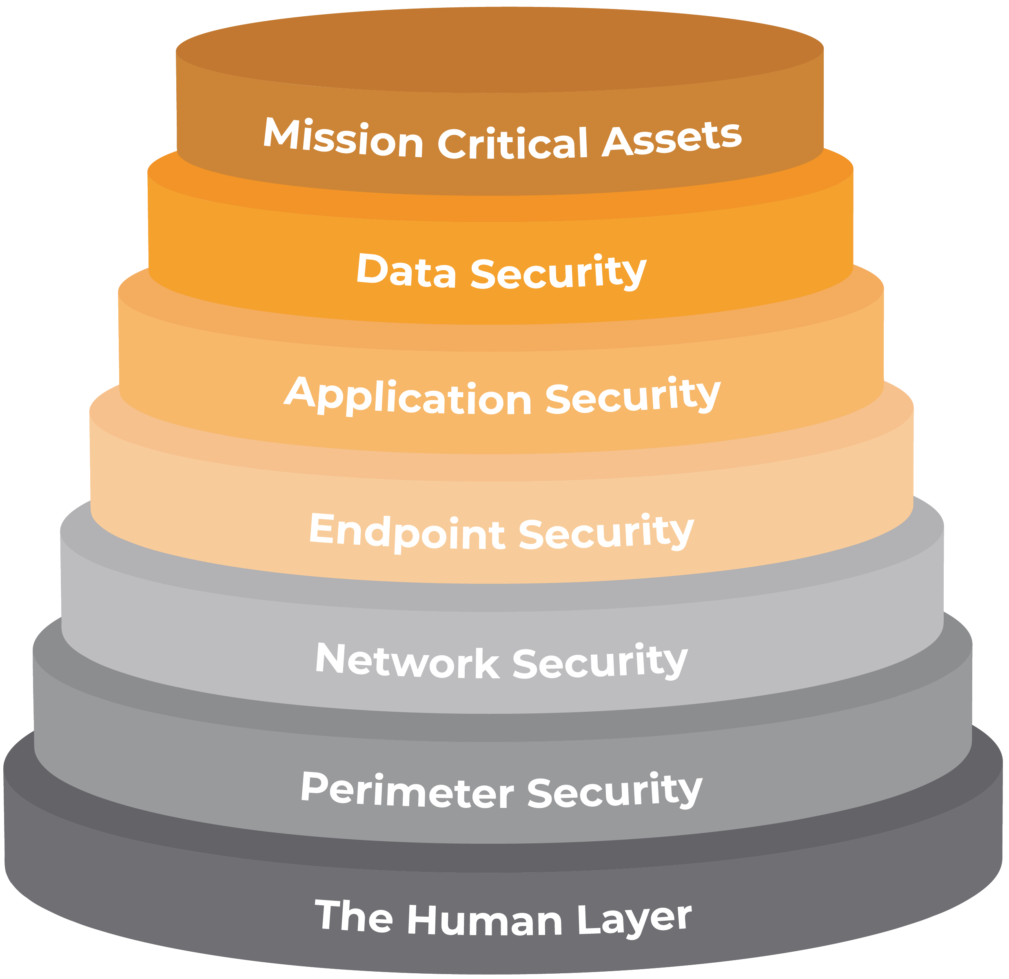
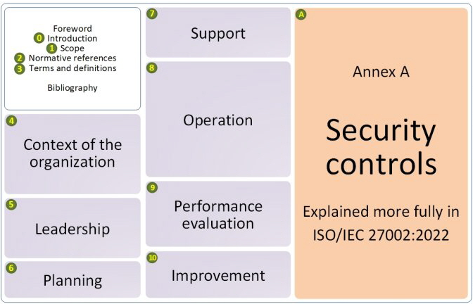
Layered security
ISMS Manual Book
Company Policy Documents
Company Template for Activities
Evidences and Reports
……

Slide 31
Security evaluation
Penetration Test (Vulnerability Assessment)
  It is the practice of testing a computer system, network or web application to find security vulnerabilities that an attacker could exploit
  Penetration testing can be automated with software applications or performed manually
  Penetration Test in Public Cloud Platform (AWS)
  Allowed services: EC2, RDS, CloudFront, Aurora, etc.
  Prohibited Activities: DNS hijacking via Route53, DDoS, Protocol flooding, etc.
  Approval-required activities: Network Stress Testing, simulated Phishing, iPerf testing, etc.
  https://aws.amazon.com/security/penetration-testing/
Auditing
  A process to review what has happened in the system
  Usually by checking system logs for administrative actions and data operations
  Beside cloud-related operations, application should generate logs that identify significant events
  Logs are saved for a limited period of time
  Logs can be exported for external report by JSON file to Cloud Storage/BigQuery Datasets/JSON messages to Pub/Sub

Slide 33
Lab – IAM
https://catalog.workshops.aws/general-immersionday/en-US/basic-modules/30-iam/iam

Slide 34
assignment
Define the IAM and data security features for the selected project

