Slide 1
observability and reliability

Slide 2
outline
Observability in cloud
Cloud monitoring tools
Reliability and Incident
Incident Management
Reliability Engineering
  Overload
  Cascading failures
Test for Reliability
Post-Mortem Analysis

Slide 3
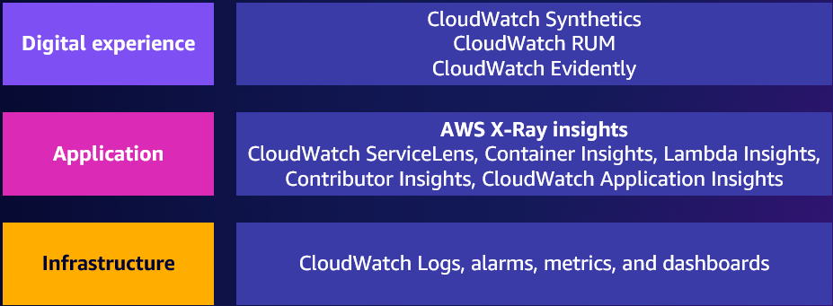
Observability describes how well you can understand what is happening in a system, often by instrumenting it to collect metrics, logs, and traces.
To achieve operational excellence and meet business objectives, you need to understand how your systems are performing, from IT/Operator/End User point of view
3 layers Important for exam

Slide 4
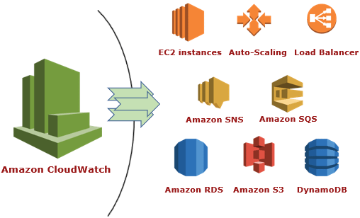
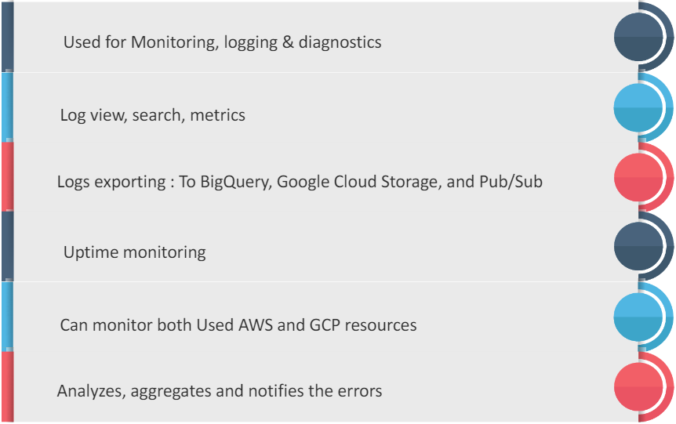
CSP monitoring tools
Monitoring tools is the infrastructure layer
AWS CloudWatch
GCP Operations Suite (formerly Stackdriver)
Suitable for the monitoring of all 3 layers

Slide 5
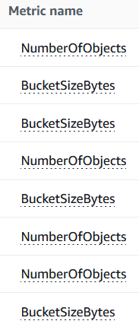
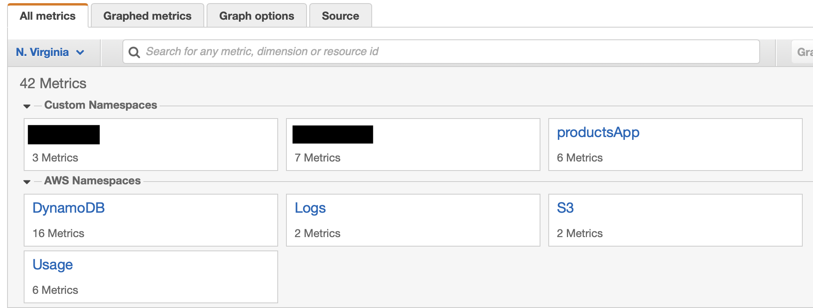
metrics
DEFAULT CLOUD WATCH MONITORING: Cloud watch sample data on a hypervisor level – cloud watch have some build in models on hypervisor level → only visible at hypervisor level & whatever happen on top of ec2 – there is no memory usage → must install agent
Metric is a variable that describe a certain aspect of the system
Namespace (a container for CloudWatch metrics)
  AWS namespace
  Custom namespace
External metrics
  From other CSP platforms or 3rd party monitoring tools

Slide 6
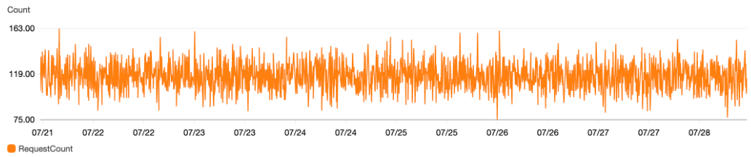
Time series
1. Monitor EC2 disk & memory -> must install cloudwatch agent in VM
2. By default cloudwatch only sample data every 5 min
A time series is a set of metrics recorded with a time stamp
Metrics are collected at a specific interval, like second or minute
The time is recorded in epochs, which is the number of seconds elapsed since midnight of Jan.1, 1970, in the UTC time zone
  E.g. 1583938967 (Wednesday, March 11, 2020 3:02:47 PM
  By default, Cloudwatch collect a data point every 5min
    If you need 1min collection interval, extra charge will be applied

Slide 7
Dashboard
Dynamic, self-updating AWS infrastructure dashboards

Slide 8
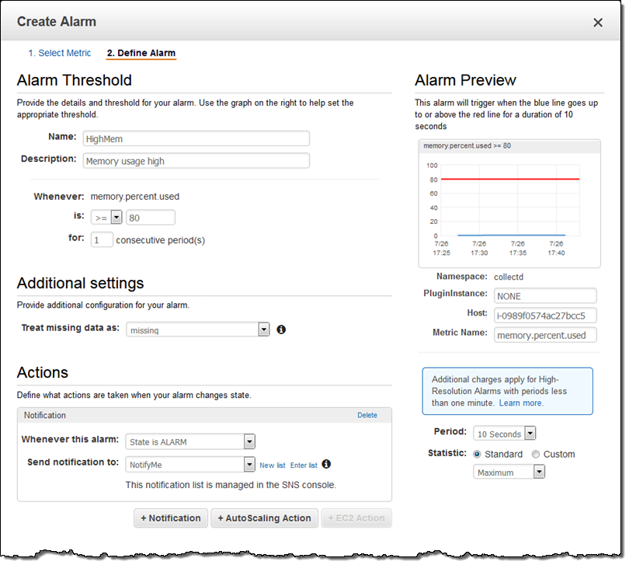
alert
Amazon CloudWatch alarms allow you to set a threshold on metrics and trigger an action
  Auto Scaling action
  EC2 Action (Stop, Terminate, Reboot or Recover)

Slide 9
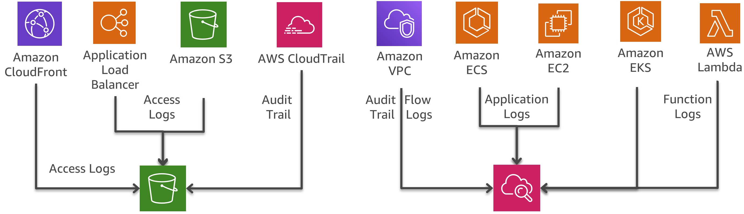
logging
Log is a time series record of the system events and operational activities, like
  Instant memory occupancy
  Incoming request for the past 5min
  IAM policy modification performed by administrator
Logs can be generated by Cloud platform or customer applications
Logs can feed into other systems for analysis and trigger some operations
Logging is a basic function for system monitoring and problem tracing
CSP offers fully managed logging service
  securely store, search, analyze, alert on log data and events
Useful for internal/external audit

Slide 10
Cloudwatch events
Provides a near real-time stream of system events that describe changes to your AWS resources.
Write rules to indicate which events are of interest to your application and what automated actions to take when a rule matches an event.

Slide 11
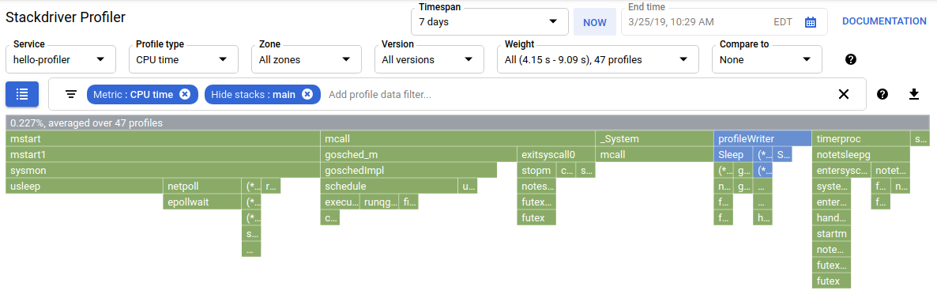
Profiler (GCP)
It continuously analyzing the performance of CPU or memory-intensive functions executed across an application
It presents the call hierarchy and resource consumption of the relevant function in an interactive flame graph
Used for developers to understand how their functions are actually called, and which paths consume the most resources

Slide 12
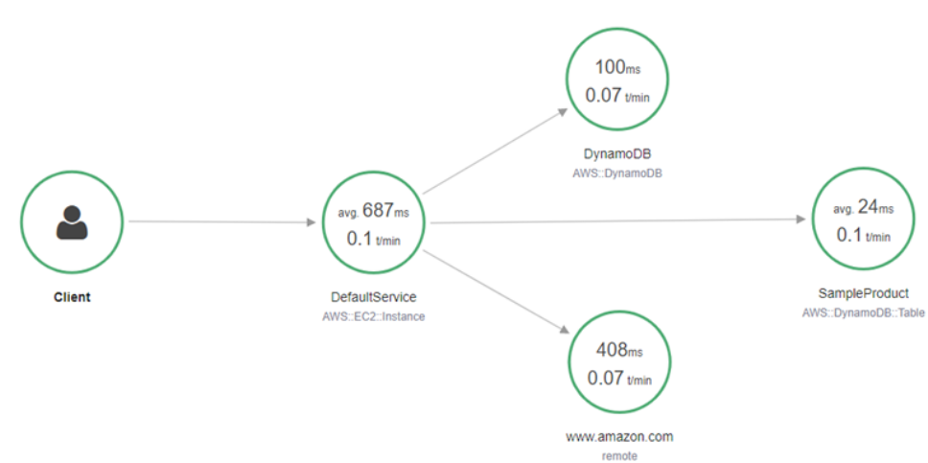
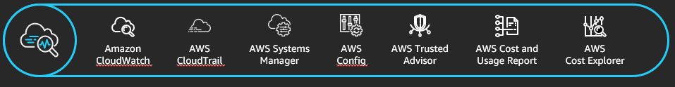
AWS X-Ray
Help developers monitor and analyze application traces, including the performance of calls to other downstream components or services from cloud & on prem
Extension: operation services in AWS

Slide 13
Synthetics
Run tests on your endpoints every minute, 24x7, and alerts you as soon as your application endpoints don’t behave as expected.
View of your customers’ experiences
Configurable scripts
Run once
Run on a schedule
Check availability and latency
Store load time data
Store screenshots

Slide 14
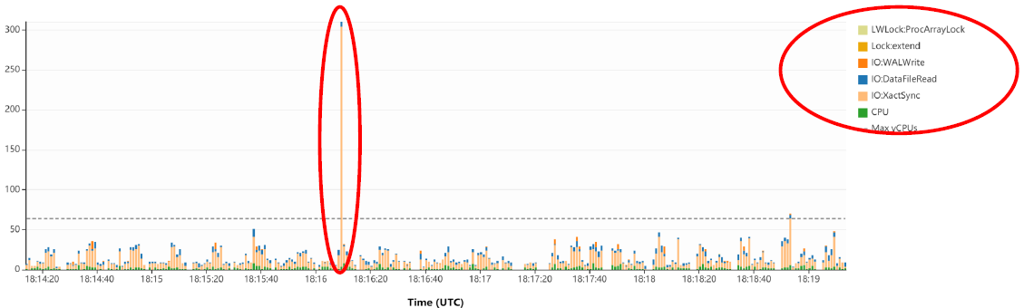
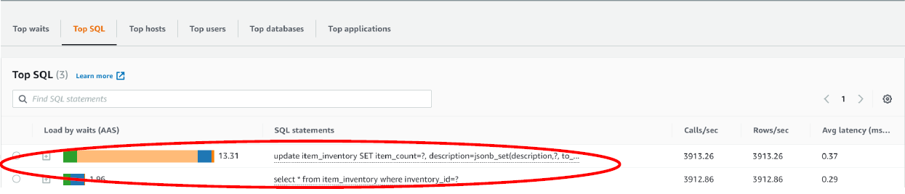
Performance insight (RDS)
Install agent in VM to see performance of the SQL request

Slide 15
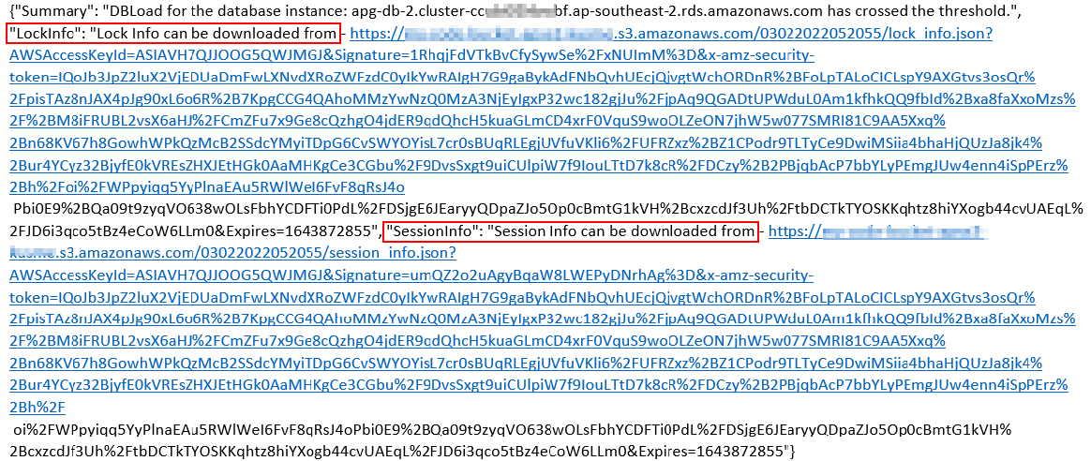
Enrich cloudwarch alarms using lambda
It is suitable for short lasting ad-hoc error
Write Lambda functions to query SQL immediately when anomalies detected
Cloudwatch event triggers Lambda to perform the probe query
Results will be emailed to the person-in-charge, together with Cloudwatch alerts
It’ll give instantaneous diagnose information for the short lasting error
When something happens -> lambda run sql statement & capture current situation of RDS instance --> get the reults & send to customer.

Slide 16
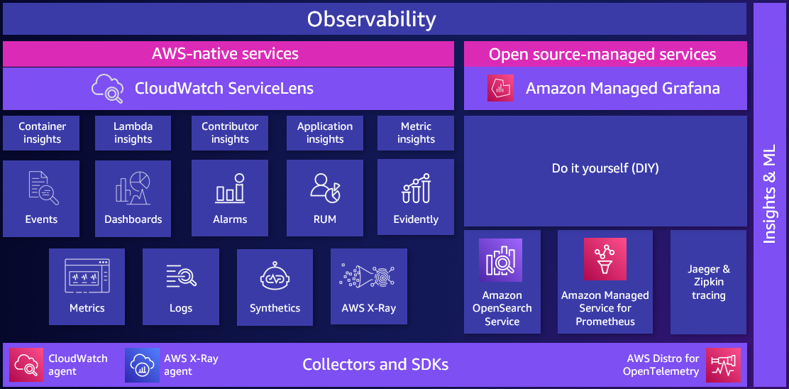

Slide 17
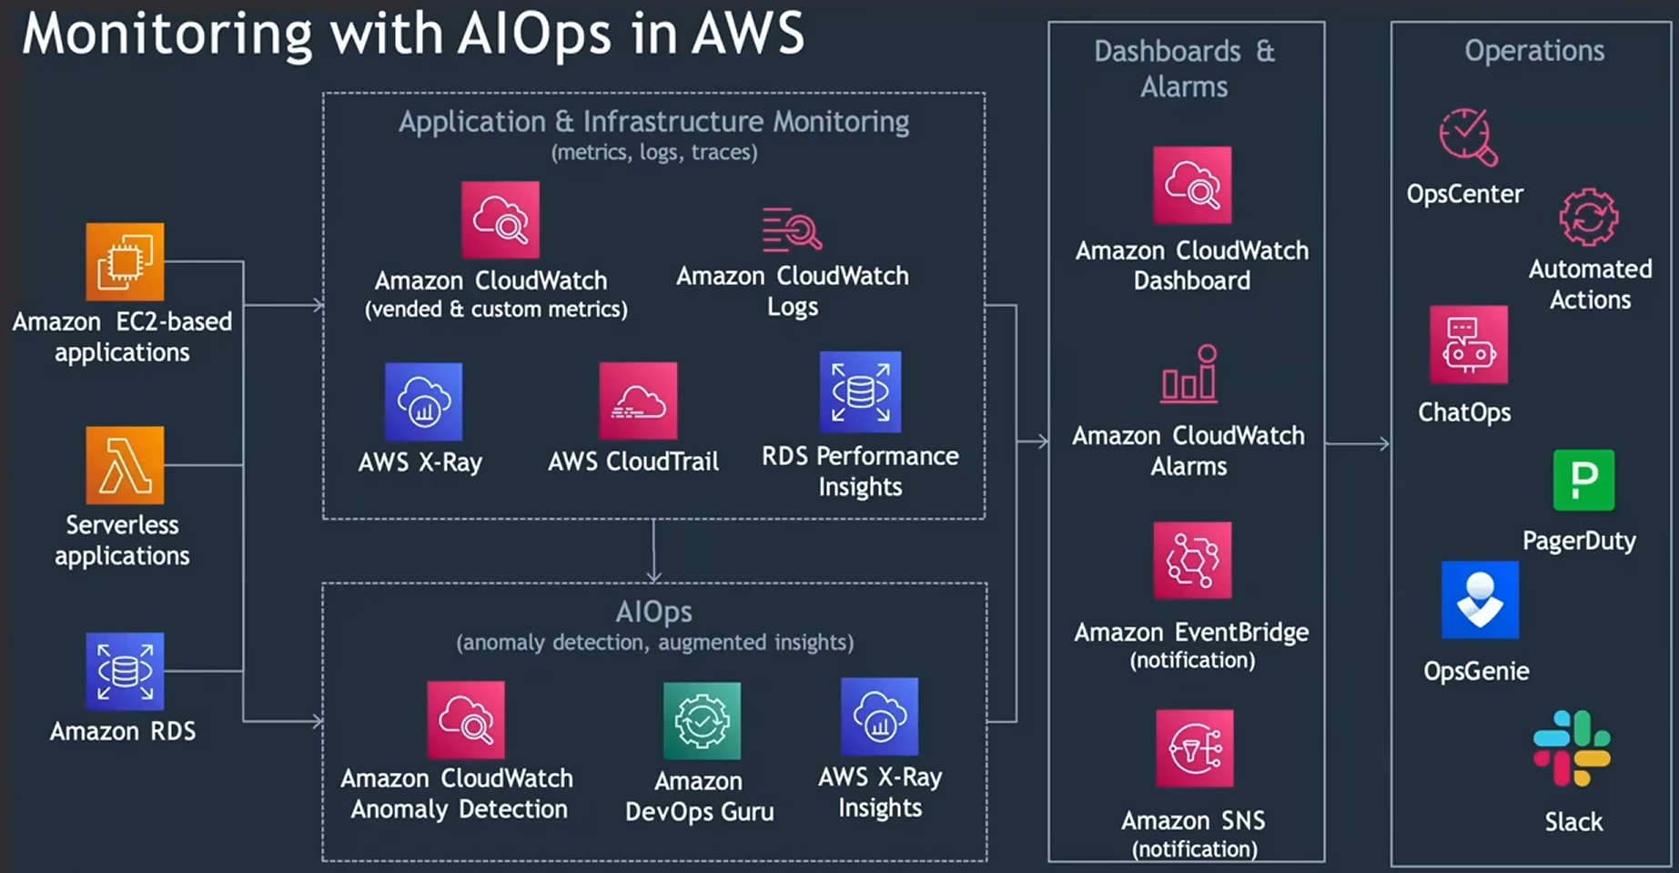

Slide 18
Cloudwatch demo

Slide 19


Slide 20
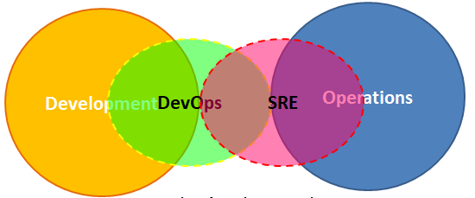
Reliability engineering

Slide 21
Let’s start with Real cases
In July 2024, Microsoft Azure experienced a significant global outage that lasted for nearly 8 hours. The outage, which began on July 30th, impacted various Azure services, including the Azure portal, some Microsoft 365 services, and Microsoft Purview. Microsoft attributed the outage to a distributed denial-of-service (DDoS) cyberattack.
Later the same day, AWS also faced a significant outage, impacting services across its global network. Users reported issues accessing critical AWS services, including EC2 instances, S3 storage, and RDS databases. (Forbes)
In 2024, Google Cloud Platform (GCP) experienced several significant outages, impacting various services and regions.
  October 23, 2024: A power failure in a single data center in the europe-west3 region caused a partial shutdown of the europe-west3-c zone.
  August 3, 2024: Multiple GCP products, including Networking and Virtual Private Cloud, were affected in the europe-west9-a region for nearly 2 hours.
  Jan.10, May.16, Aug.12, …

Slide 22
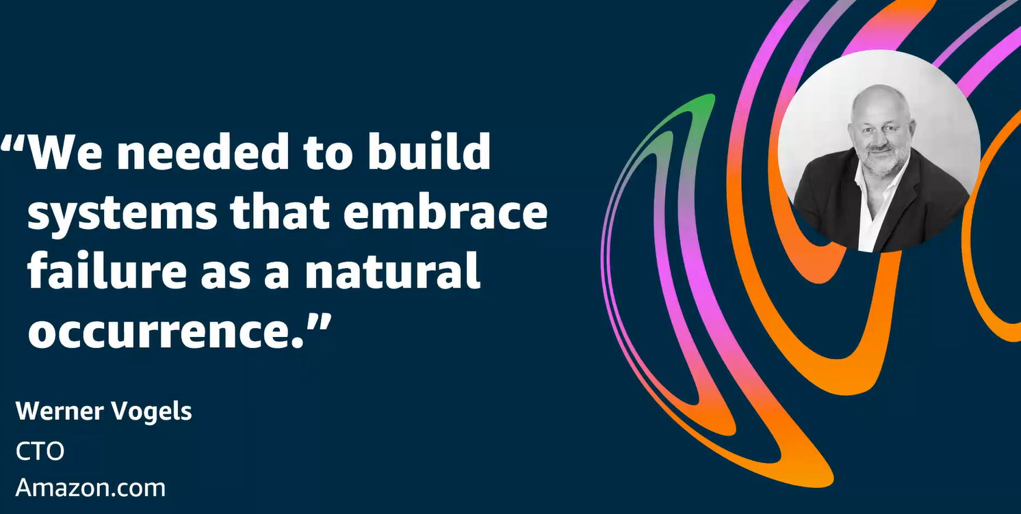

Slide 23
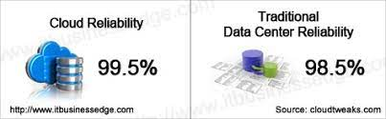
reliability
In an information system, reliability shows the probability of a system/component for performing the required functions in a period of time without failure
It does not contain any repair process but accounts for the period of time that the system/component failed during its operating time
It is usually measured by the amount of downtime the target system has in a year
  Both planned downtime and unplanned downtime
Reliability is used on
  Infrastructure – high at initial state and gradually reduces with device depreciation
  Application – low at initial stage and gradually increase as bugs fixed
  Service – link to Infra and App reliability but not a simple addition of failures
Service down
Service ok
Service ok with workaround
Repair process is going-on

Slide 24
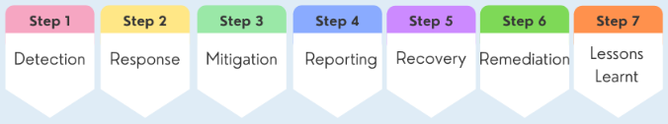
incident
ITIL* defines an incident as an unplanned interruption to or quality reduction of an IT service.
Incident can be trivial or serious, it is categorized by levels
Incident management is not expected to perform root cause analysis to identify why an incident occurred.
Rather, the focus is on doing whatever is necessary to restore the service.
This often requires the use of a temporary fix, or a workaround.
SLA
Critical - Incidents that cause significant impact
E.g. system down or service unavailable
Major – Incidents that have high impact
E.g. some core services are unavailable
Minor – Incidents that have low impact
E.g. noticeable performance degradation
Response time …resolution time(RTO)… penalty if failed to meet the RTO
*ITIL: Information Technology Infrastructure Library. It defines a set of practices for IT to aligning with the need of business

Slide 25
Reliability engineering
It solves the question of
  How to response when reliability is under threat?
  How to prevent violation of reliability?
  How to learn the most from incidents?
Overload
  Shedding load
  Degrading QoS
  Upstream throttling
Cascading failures
  Identify resource exhaustion
  Circuit breaker design
Test for reliability
  Reliability stress test (increase workload until system breaks)
Post-Mortem analysis

Slide 26
overload
SRE not solving root cause of overload, they alleviate the overload first asap
Software engineers and site reliability engineers(SREs) can’t prevent overload, they can only decide how to respond to it
Important decisions to make
  Threshold for overloading (that need manual intervention)
  Which function has higher priority to be attended (like doctors decide who can have the oxygen support in overloaded hospital)
  To what degree should the traffic need to be released
Shedding load
  According to criticality
  According to SLA with various users
  According to past statistics
Degrading QoS
  Provide partial or approximate results
  Respond with sampled data
  This requires some planning on software engineers to accommodate degraded results
Upstream throttling
  Identify the source of overloading
  Make the source of overloading reduce request rate or buffer requests for a later time
  Upstream wait for a random time before resume request

Slide 27
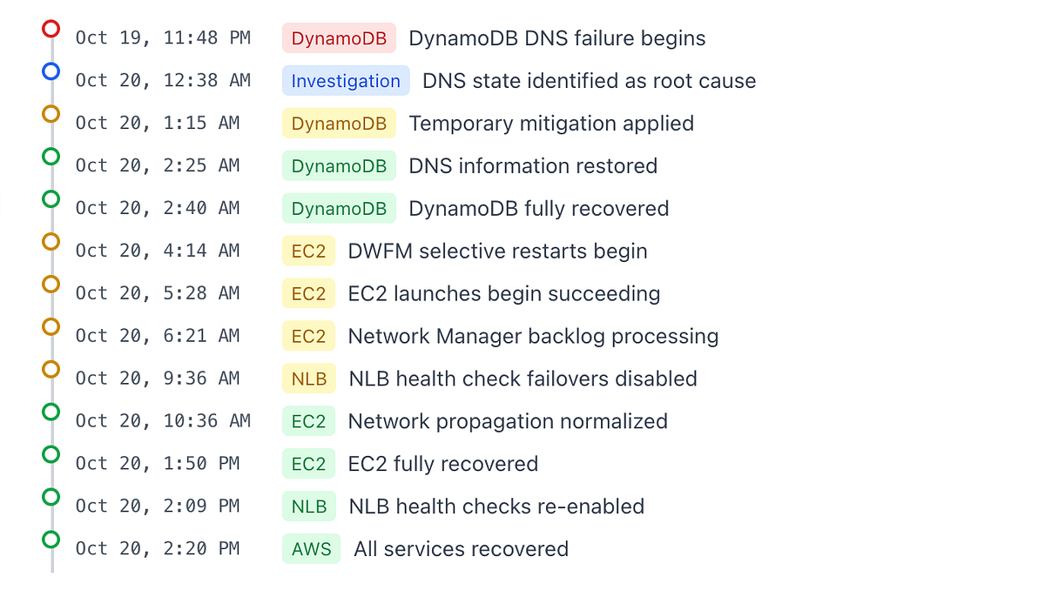
Cascading failures
AWS Oct.20 Cascaded Failure
(Total 14.5+ hours outage)
https://aws.amazon.com/message/101925/
A failure in one part of a distributed system may cause a failure in another part of the system, which in turn causes another failure in some other services
  DynamoDB service (us-east-1) Planner and Enactors incurred data race-> DNS resolution failure-> DWFM(Droplet Workflow Manager) overloaded after DynamoDB recovered 3 hours later-> EC2 Network Manager overloaded after 6+ hours recovery of both DynamoDB and DWFM-> NLB unstable with indeterministic healthcheck result ->ECS/EKS recovery.
Identify resource exhaustion
  This is the common reason for cascading failures
Circuit breaker design
  Apply overload response on node with resource exhaustion (usually just limit the load)
Best to expect
  Customers receive some errors while services under stress recover
  Prevention
  Reliability stress test
  Auto-scale resources (avoid thrashing)

Slide 28
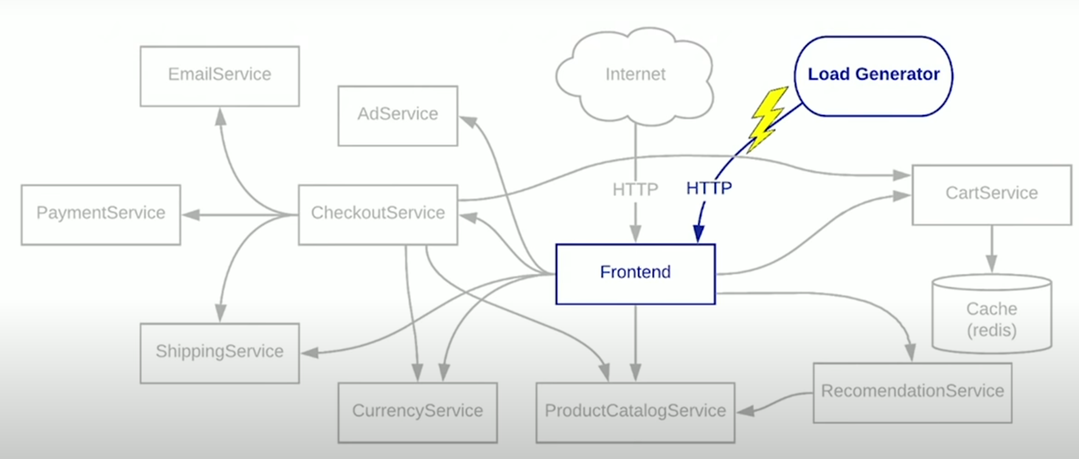
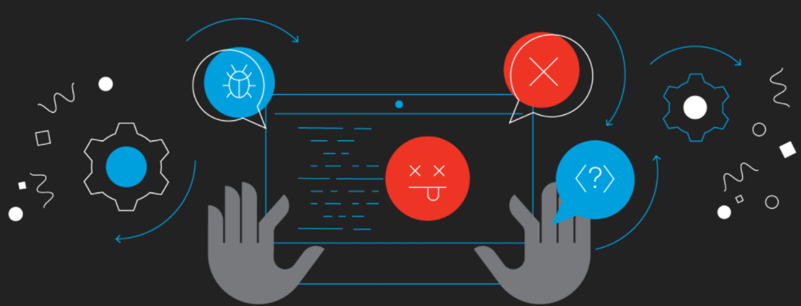
Test for reliability
Reliability stress test
  It increase the workload until the system crash
  It is used to understand when a system will fail and how it will fail
  It is able to detect cascade failures
Chaos Engineering (FIS)
  Experimenting on a production system with real-world turbulent conditions
  To understand how a system will perform under chaos
  Tools such as Simian Army, developed by Netflix. It introduces failures randomly into functioning systems to study the impact

Slide 29
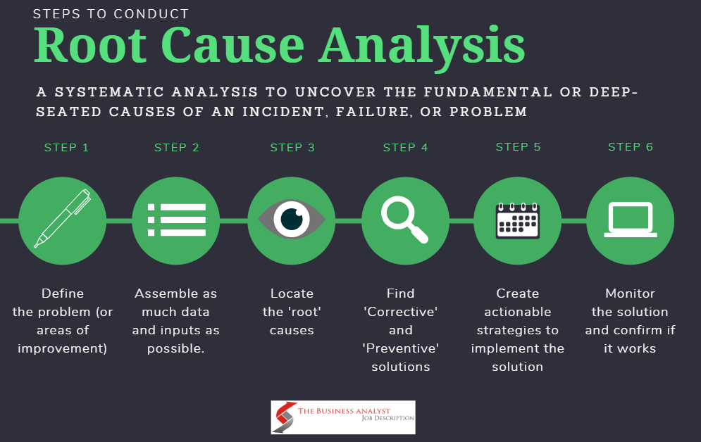
Post-Mortem Analysis
Recap about Incident Management
  It is not purely a technical process, but more of a organizational process
  It need an incident commander to coordinate a response
  It should have a well-defined operation team to analyze the problem and make changes to the system to remediate the problem
  The target is to restore service as soon as possible
  The event chain and actions taken should be documented
Post-Mortem Analysis
  Root cause analysis of the incident
  Learn from incident to prevent it happen again
  Document conclusions and decisions for future preference

Slide 30
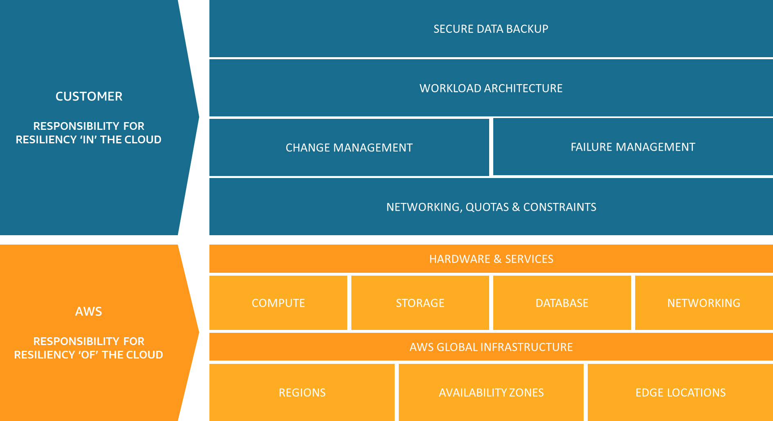
Shared responsibility model for resiliency

Slide 32
Lab - cloudwatch
https://catalog.workshops.aws/general-immersionday/en-US/basic-modules/40-monitoring/monitoring

Slide 33
Requirement for our project
General requirement
  Business and context settings are required (e.g. customer base, use case, business goal)
  Architectural and functional design are required
  Functional implementation keeps to the basic (for demonstration only)
  Source code can be written in any language or downloaded from public code repository
  Focus on how to leverage on various cloud services to support the functions
Online shopping system
  Customers base should be defined
  Payment module can leave blank (no need implementation, but need to design it)
Logistic tracking system
  It can be city delivery service or fleet tracking system
  GPS/WiFi signal can use faked numbers (but must be reasonable)
  Analysis should be included
Health monitoring system
  Patient database and medical history are pre-defined
  Sensor signals can use simulator to generate or manual input
  Alert should be included
  Banking
  Security is the key feature in design and maintenance

Slide 34
Project grading guide
The project occupies 30% of the total score
  Project Proposal Presentation: 4% (15 mins)
  Final Project Presentation: 8% (20 mins)
  Final report: 15% (5 to 30 pages)
  Overall peer evaluation: 3%
Evaluation points
  Feasibility of business and technical requirement within the context settings
  Main resources allocated with justification (including compute, storage, network, security)
  Linkage of resources (e.g. message flow, cron scheduler)
  Overall design and implementation
  Monitoring and alert settings
  Scalability and reliability of the system
  Grading criteria (full mark – 10)
  Solution is not functionable based on business requirement or lack of critical features – 5/below
  Solution is functionable based on business requirement and use cases – 6/7
  Solution is functionable with well architected pillars of security, reliability, sustainability – 8/9
  Solution is optimized to deliver the result with all 5 well-architected pillars - 10

Slide 35
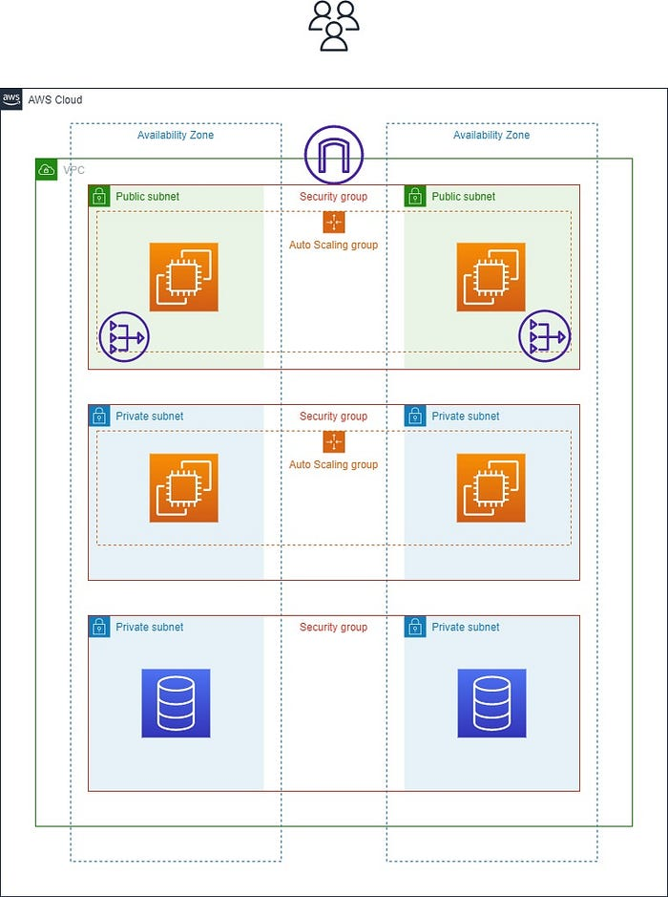
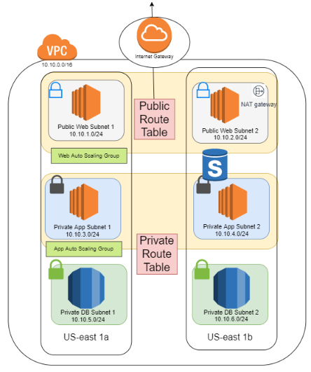
Typical 3 Layer Cloud Architecture Design:

Slide 36
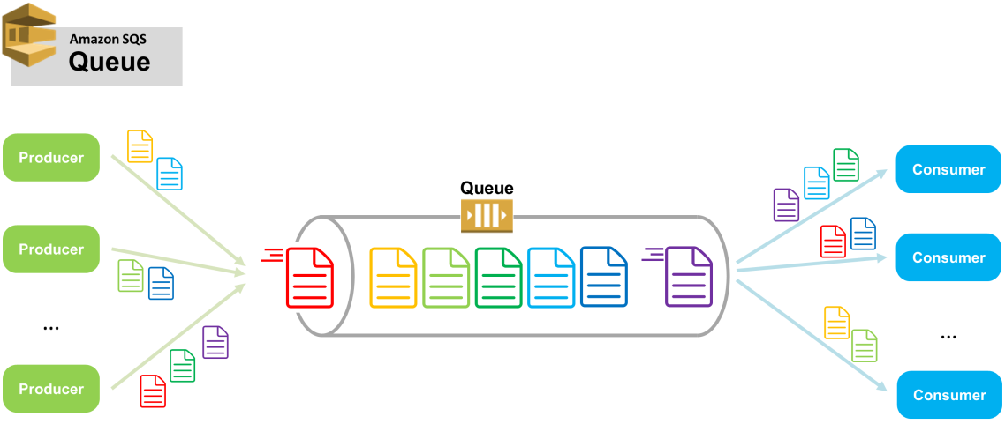
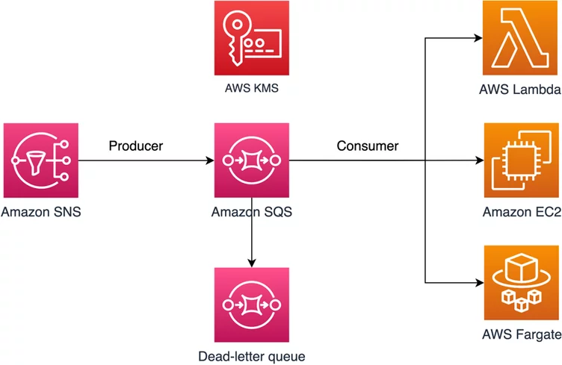
Decouple the layers: Queue management
Queues are the key components to enable asynchronous processing
AWS Simple Queue Service (SQS) - Fully managed message queuing for microservices, distributed systems, and serverless applications
Two modes: standard queue (not guarantee message sequence) and FIFO queue
Visibility timeout: after a msg is read by a consumer, the time period when the message remains in the queue but becomes temporarily invisible to other consumers. The Consumer needs to delete the message once complete processing.
For use cases that multiple consumers consume the same message, consider streaming services (Kinesis)

Slide 37
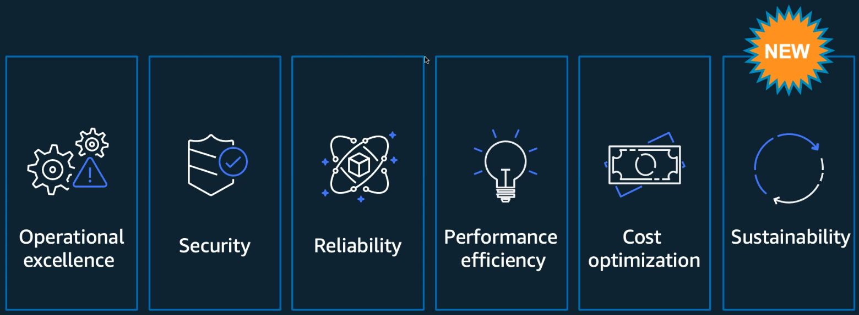
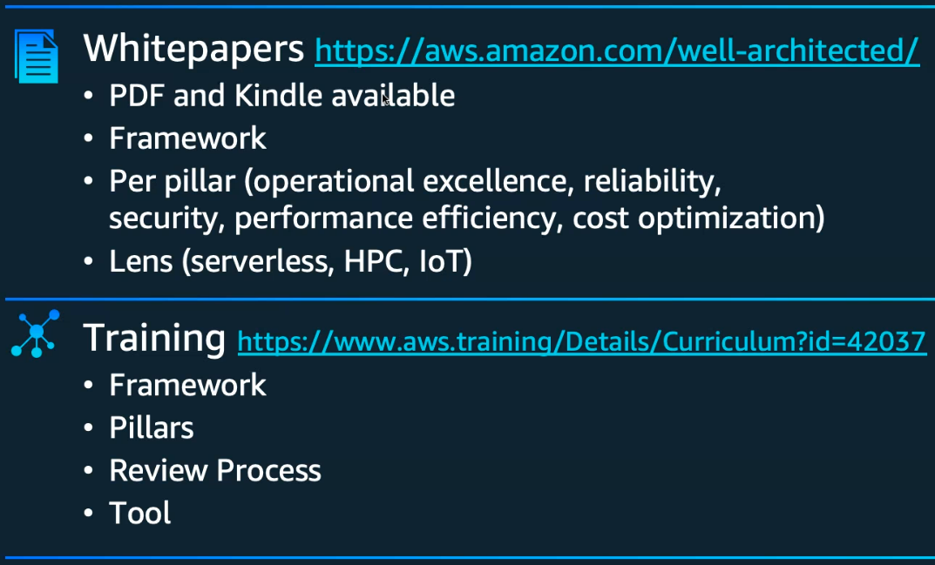
Pillars of Aws well-architected
Well architected tool via AWS console

Slide 38
Assignment
Choose a topic for the project
Form a team of 5~6 students
Discuss about the role of each team member (overlapping roles are allowed)
The group registration link will close at Sep.30 11:59pm
Student who didn’t register will be auto-assigned to a group by the system

