Slide 1
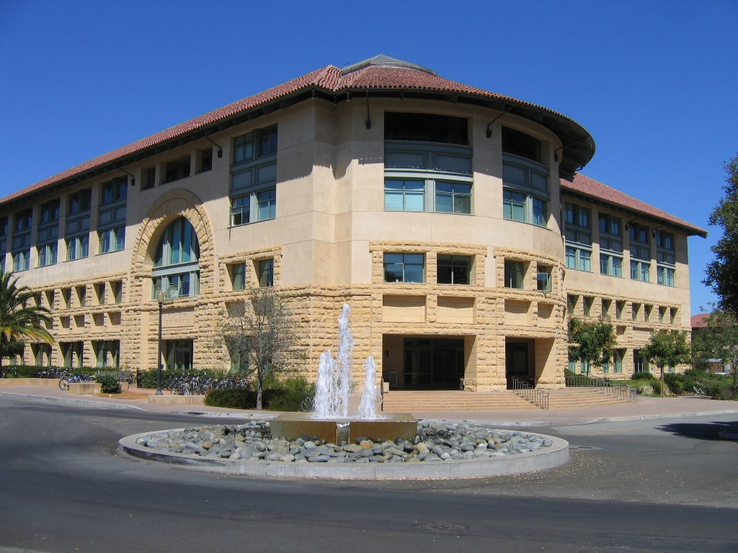
Stanford
GIN

