Slide 2
Topography
Elevation | Slope
Topography
Elevation | Slope
-0.34***
-0.23***
-0.12*
-0.29***
0.08
-0.46***
R₂ = 0.22
R₂ = 0.80
R₂ = 0.36
R₂ = 0.01
R₂ = 0.80
R₂ = 0.08
Climate
MAP | MAT
-1.00***
Season
PS | TS
-0.52***
Clay content
Climate
MAP | MAT
-0.88***
Season
PS | TS
-0.25***
Clay content
-0.32***
-0.99***
-0.56***
0.26***
-0.82***
-0.03
0.14***
-0.37***
R₂ = 0.63
R₂ = 0.17
R₂ = 0.66
R₂ = 0.46
Vegetation
GPP | Shannon_EVI | Rootdepth
-0.12
Soil
pH | BD
Vegetation
GPP | Shannon_EVI | Rootdepth
-0.15***
Soil
pH | BD
-0.43***
0.003
-0.47***
-0.26***
R₂ = 0.16
R₂ = 0.23
CUE
Top_GOF = 0.51
CUE
Sub_GOF = 0.50

Slide 3
Topography
Topography
Elevation | Slope
Elevation
Slope
-0.12*
-0.29***
0.08
-0.12*
-0.29***
0.08
R₂ = 0.01
R₂ = 0.80
R₂ = 0.08
R₂ = 0.01
R₂ = 0.80
R₂ = 0.08
Climate
-0.88***
Seasonality
-0.25***
Clay
content
Climate
MAP | MAT
-0.88***
Season
PS | TS
-0.25***
Clay content
MAT
MAP
TS
PS
-0.37***
-0.56***
0.26***
-0.56***
0.26***
-0.99***
-0.99***
-0.37***
R₂ = 0.63
R₂ = 0.46
Vegetation
-0.15***
Soil
R₂ = 0.66
R₂ = 0.46
GPP
Shannon_EVI
Rootdepth
pH
BD
Vegetation
GPP | Shannon_EVI | Rootdepth
-0.15***
Soil
pH | BD
0.003
-0.47***
R₂ = 0.23
0.003
-0.47***
CUE
GOF = 0.50
R₂ = 0.23
CUE
Sub_GOF = 0.50

Slide 4
Topography
Topography
Elevation | Slope
Elevation
Slope
-0.46***
-0.34***
-0.23***
-0.46***
-0.34***
-0.23***
R₂ = 0.22
R₂ = 0.80
R₂ = 0.36
R₂ = 0.22
R₂ = 0.80
R₂ = 0.36
Climate
-1.00***
Seasonality
-0.52***
Clay
content
Climate
MAP | MAT
-1.00***
Season
PS | TS
-0.52***
Clay content
MAT
MAP
TS
PS
-0.32***
0.14***
-0.82***
-0.03
-0.82***
-0.32***
0.14***
R₂ = 0.63
R₂ = 0.17
-0.03
Vegetation
-0.12
Soil
R₂ = 0.63
R₂ = 0.17
GPP
Shannon_EVI
Rootdepth
pH
BD
Vegetation
GPP | Shannon_EVI | Rootdepth
-0.12
Soil
pH | BD
-0.26***
-0.43***
R₂ = 0.16
-0.43***
CUE
GOF = 0.51
-0.26***
R₂ = 0.16
CUE
Top_GOF = 0.51

Slide 5
Topography
1
2
3
Climate
4
Seasonality
5
Soil texture
6
7
8
9
10
Vegetation
11
Soil properties
12
13
14
15
CUE

Slide 6
Topography
Elevation
Slope
-0.46***
-0.34***
-0.23***
R₂ = 0.22
R₂ = 0.80
R₂ = 0.36
Climate
-1.00***
Seasonality
-0.52***
Clay
content
MAT
MAP
TS
PS
-0.32***
-0.03
0.14***
-0.82***
R₂ = 0.63
R₂ = 0.17
Vegetation
-0.12
Soil
GPP
Shannon_EVI
Rootdepth
pH
BD
-0.43***
-0.26***
R₂ = 0.16
CUE
GOF = 0.51
Topography
Elevation
Slope
-0.12*
-0.29***
0.08
R₂ = 0.01
R₂ = 0.80
R₂ = 0.08
Climate
-0.88***
Seasonality
-0.25***
Clay
content
MAT
MAP
TS
PS
-0.37***
-0.56***
-0.99***
0.26***
R₂ = 0.63
R₂ = 0.46
Vegetation
-0.15***
Soil
GPP
Shannon_EVI
Rootdepth
pH
BD
-0.47***
0.003
R₂ = 0.23
CUE
GOF = 0.50

Slide 7
c) Topsoil
Topography
d) Subsoil
Topography
Elevation
Slope
Elevation
Slope
-0.46***
-0.34***
-0.23***
-0.12*
-0.29***
0.08
R₂ = 0.22
R₂ = 0.80
R₂ = 0.36
R₂ = 0.01
R₂ = 0.80
R₂ = 0.08
Climate
-1.00***
Seasonality
-0.52***
Clay
content
Climate
-0.88***
Seasonality
-0.25***
Clay
content
MAT
MAP
TS
PS
MAT
MAP
TS
PS
-0.32***
0.14***
-0.37***
-0.56***
0.26***
-0.82***
-0.03
-0.99***
R₂ = 0.63
R₂ = 0.17
R₂ = 0.63
R₂ = 0.46
Vegetation
-0.12
Soil
Vegetation
-0.15***
Soil
GPP
Shannon_EVI
Rootdepth
pH
BD
GPP
Shannon_EVI
Rootdepth
pH
BD
-0.43***
-0.26***
0.003
-0.47***
R₂ = 0.16
R₂ = 0.23
GOF = 0.51
CUE
GOF = 0.50
CUE
Positive effect
Negative effect

Slide 8
Topsoil
Topography
Subsoil
Topography
Elevation
Slope
Elevation
Slope
-0.46***
-0.34***
-0.23***
-0.12*
-0.29***
0.08
R₂ = 0.22
R₂ = 0.80
R₂ = 0.36
R₂ = 0.01
R₂ = 0.80
R₂ = 0.08
Climate
-1.00***
Seasonality
-0.52***
Clay
content
Climate
-0.88***
Seasonality
-0.25***
Clay
content
MAT
MAP
TS
PS
MAT
MAP
TS
PS
-0.32***
0.14***
-0.37***
-0.56***
0.26***
-0.82***
-0.03
-0.99***
R₂ = 0.63
R₂ = 0.17
R₂ = 0.63
R₂ = 0.46
Vegetation
-0.12
Soil
Vegetation
-0.15***
Soil
GPP
Shannon_EVI
Rootdepth
pH
BD
GPP
Shannon_EVI
Rootdepth
pH
BD
-0.43***
-0.26***
0.003
-0.47***
R₂ = 0.16
R₂ = 0.23
GOF = 0.51
CUE
GOF = 0.50
CUE
Positive effect
Negative effect
Positive effect
Negative effect

Slide 9
Topsoil
Topography
Subsoil
Topography
Elevation
Slope
Elevation
Slope
-0.46***
-0.34***
-0.23***
-0.12*
-0.29***
0.08
R₂ = 0.22
R₂ = 0.80
R₂ = 0.36
R₂ = 0.01
R₂ = 0.80
R₂ = 0.08
Climate
-1.00***
Seasonality
-0.52***
Clay
content
Climate
-0.88***
Seasonality
-0.25***
Clay
content
MAT
MAP
TS
PS
MAT
MAP
TS
PS
-0.32***
0.14***
-0.37***
-0.56***
0.26***
-0.82***
-0.03
-0.99***
R₂ = 0.63
R₂ = 0.17
R₂ = 0.63
R₂ = 0.46
Vegetation
-0.12
Soil
Vegetation
-0.15***
Soil
GPP
Shannon_EVI
Rootdepth
pH
BD
GPP
Shannon_EVI
Rootdepth
pH
BD
-0.43***
-0.26***
0.003
-0.47***
R₂ = 0.16
R₂ = 0.23
GOF = 0.51
CUE
GOF = 0.50
CUE
Positive effect
Negative effect
Positive effect
Negative effect

Slide 10
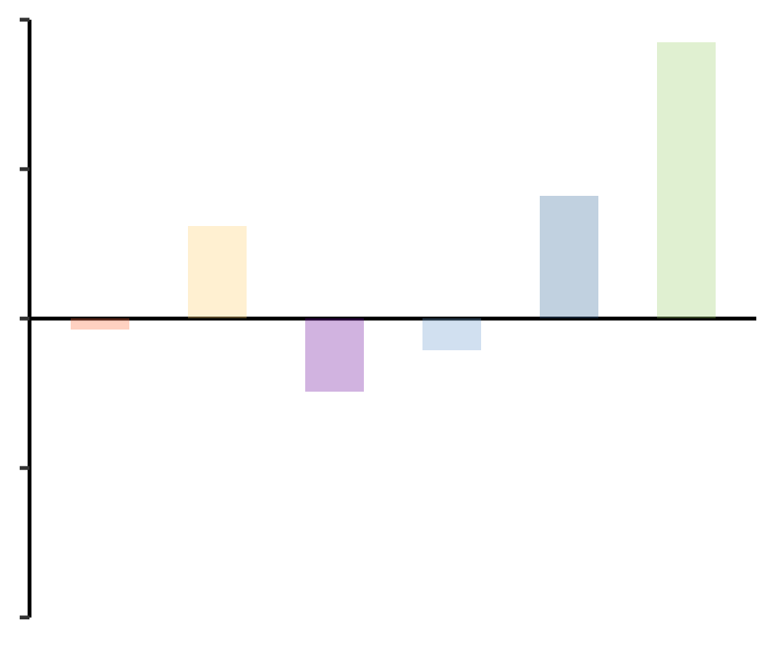
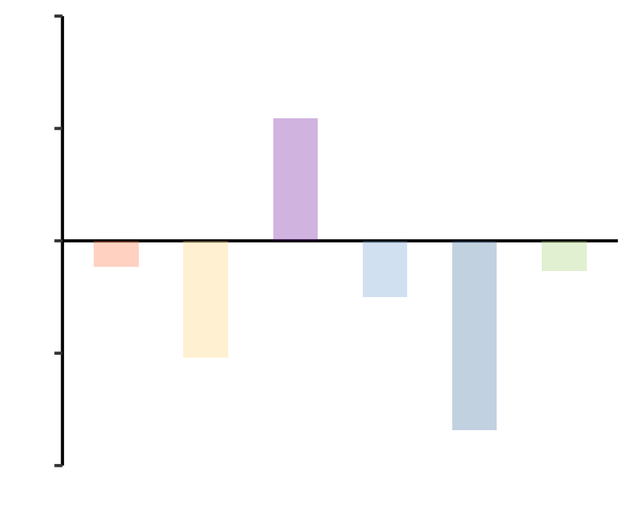
a) Topsoil
c) Topsoil
Topography
0.50
Elevation
Slope
-0.46***
0.13***
-0.30***
R₂ = 0.22
R₂ = 0.81
R₂ = 0.36
0.25
Climate
-1.00***
Seasonality
-0.52***
Clay
content
MAT
MAP
TS
PS
Standardized total effects
0.64***
-0.56***
0.35***
-0.26***
0.00
R₂ = 0.55
R₂ = 0.18
Vegetation
-0.41***
Soil
GPP
AGB
BGB
pH
BD
-0.25
0.46***
0.21***
-0.50
GOF = 0.52
CUE
Climate
Clay
Soil
Topography
Seasonality
Vegetation
R₂ = 0.16
b) Subsoil
d) Subsoil
Topography
Elevation
Slope
0.60
-0.11*
-0.19***
0.13
R₂ = 0.01
R₂ = 0.79
R₂ = 0.08
Climate
-0.88***
Seasonality
Clay
content
0.30
-0.25***
MAT
MAP
TS
PS
Standardized total effects
0.59***
-0.32
-0.64***
0.29***
0.00
R₂ = 0.54
R₂ = 0.50
Vegetation
0.46***
Soil
GPP
AGB
BGB
pH
BD
-0.30
-0.08
-0.51***
-0.60
Clay
Climate
Seasonality
Soil
Vegetation
GOF = 0.50
CUE
Topography
R₂ = 0.28
Positive effect
Negative effect

Slide 11
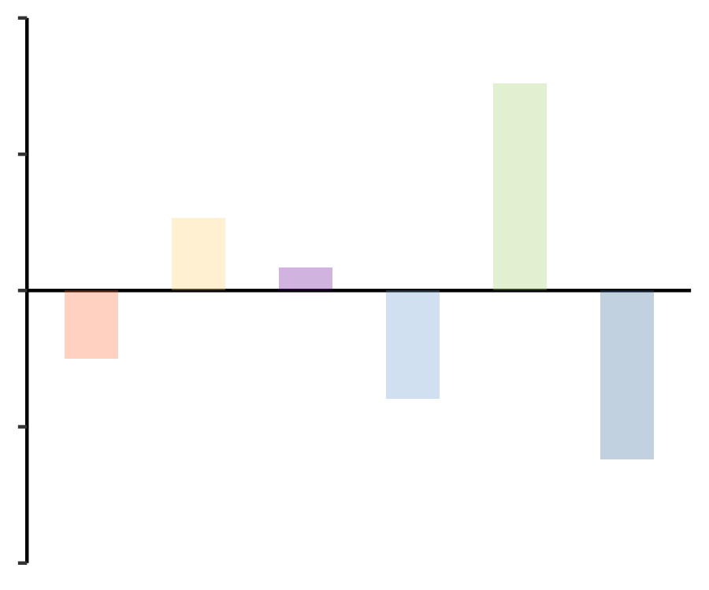
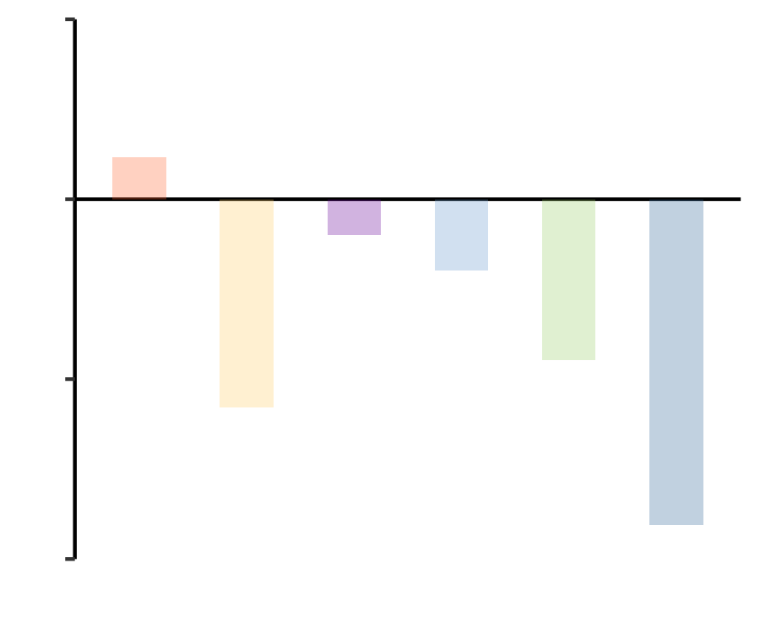
c) Topsoil
d) Topsoil
Topography
0.50
Elevation
Slope
-0.47***
-0.34***
0.24***
R² = 0.22
R² = 0.81
R² = 0.38
0.25
Climate
-1.01***
Seasonality
0.54***
Soil texture
MAT
MAP
TS
PS
Clay
Sand
-0.28***
Standardized total effects
0.52***
-0.09*
0.00
0.23**
-0.26***
R² = 0.55
R² = 0.23
Vegetation
0.19***
Soil properties
GPP
Shannon_EVI
BGB
pH
BD
Moisture
-0.25
0.44***
-0.31***
-0.02***
-0.28***
-0.50
Climate
Soil texture
Vegetation
Soil properties
GOF = 0.51
CUE
Topography
Seasonality
R² = 0.22
e) Subsoil
f) Subsoil
Topography
0.35
Elevation
Slope
-0.13*
-0.29***
-0.07
R² = 0.02
R² = 0.79
R² = 0.06
0.00
Climate
-0.88***
Seasonality
0.21**
Soil texture
MAT
MAP
TS
PS
Clay
Sand
Standardized total effects
0.93***
0.16***
-0.32***
-0.19*
-0.28***
R² = 0.64
-0.35
R² = 0.60
Vegetation
0.41***
Soil properties
GPP
Shannon_EVI
BGB
pH
BD
Moisture
-0.63***
-0.70
-0.05
Climate
Vegetation
-0.17
-0.31***
Topography
Seasonality
Soil texture
Soil properties
GOF = 0.49
CUE
R² = 0.39

Slide 12
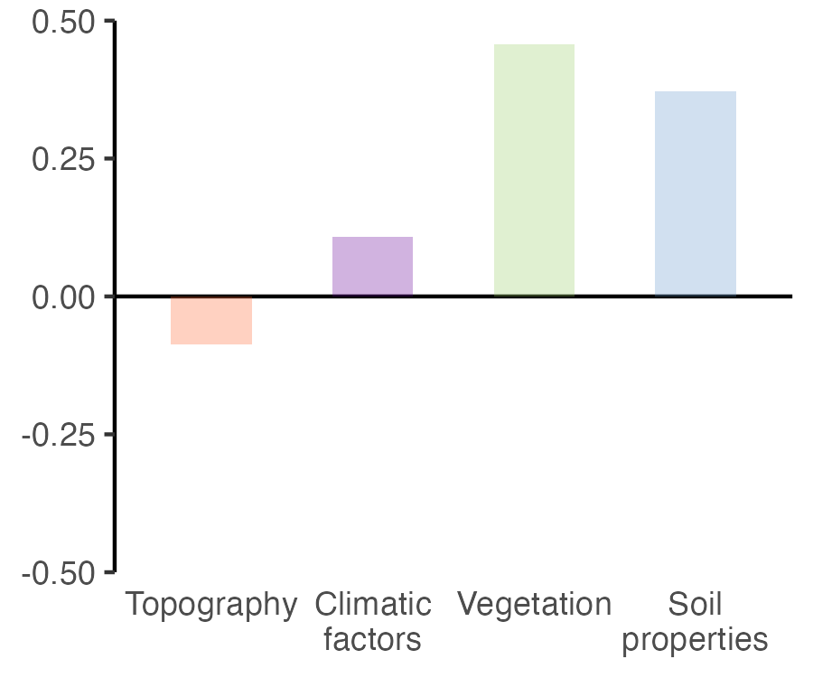
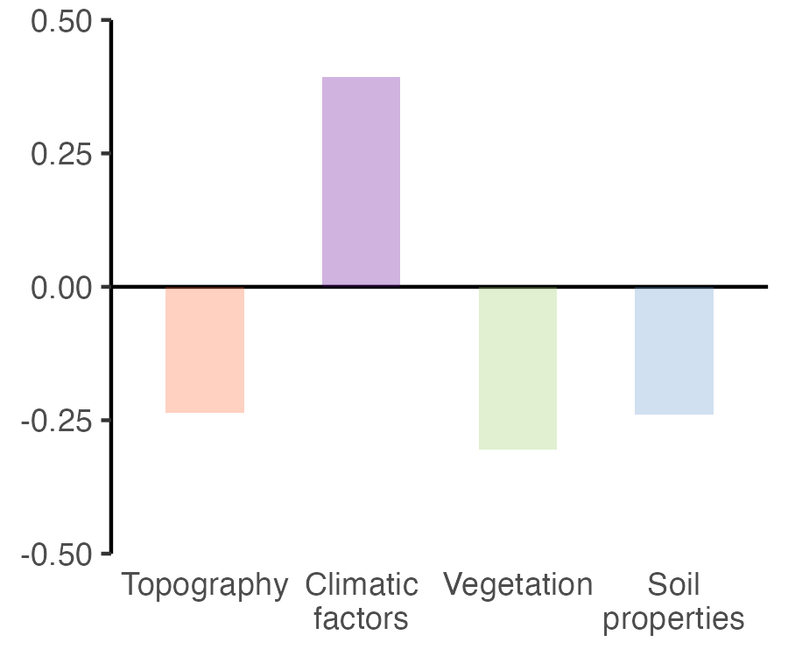
a) Topsoil
b) Topsoil
Climate
-0.30***
Topography
MAT
MAP
TS
PS
Elevation
Slope
R₂ = 0.09
0.23***
-0.15***
0.74***
R₂ = 0.55
R₂ = 0.61
Vegetation
0.52***
Soil properties
Standardized total effects
GPP
Shannon_EVI
BGB
pH
BD
Clay
Moisture
0.26***
-0.31***
0.37***
GOF = 0.45
CUE
R₂ = 0.18
c) Subsoil
d) Subsoil
Climate
-0.51***
Topography
MAT
MAP
TS
PS
Elevation
Slope
R₂ = 0.26
-0.44***
0.14***
-0.74***
R₂ = 0.55
R₂ = 0.55
Vegetation
0.26***
Soil properties
Standardized total effects
GPP
Shannon_EVI
BGB
pH
BD
Clay
Moisture
-0.24***
0.06
-0.24***
GOF = 0.45
CUE
R₂ = 0.24

