Slide 1
Job Matcher v1
A geek’s way of finding a dream job

Slide 2
My Story
Willing to relocation in the USA: I don’t know much about the location. I have to spend extra time research the location of a job.
Decided to change industry: I have a broad interest and an open mind. But I have limited experience in other industries from my past. Say, I don’t know what’s the best match,
I want to create a comprehensive way of search for a dream job, automatically.

Slide 3
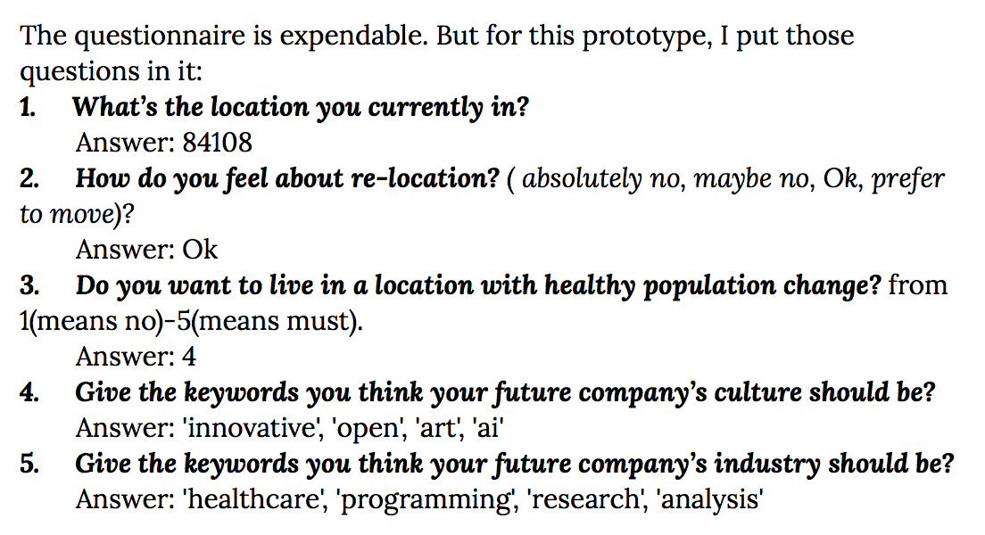
The questionnaire

Slide 4
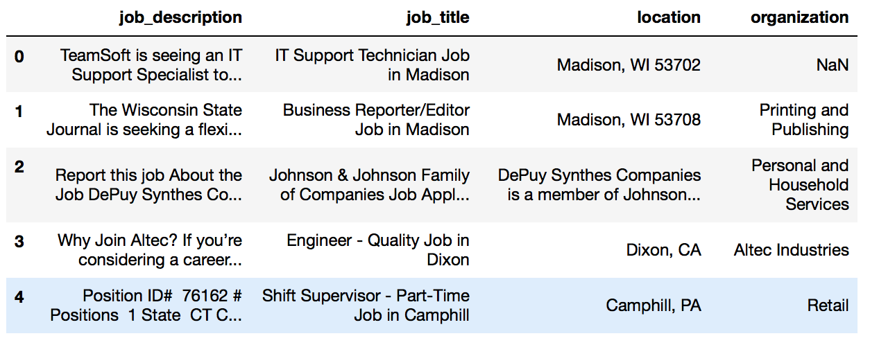
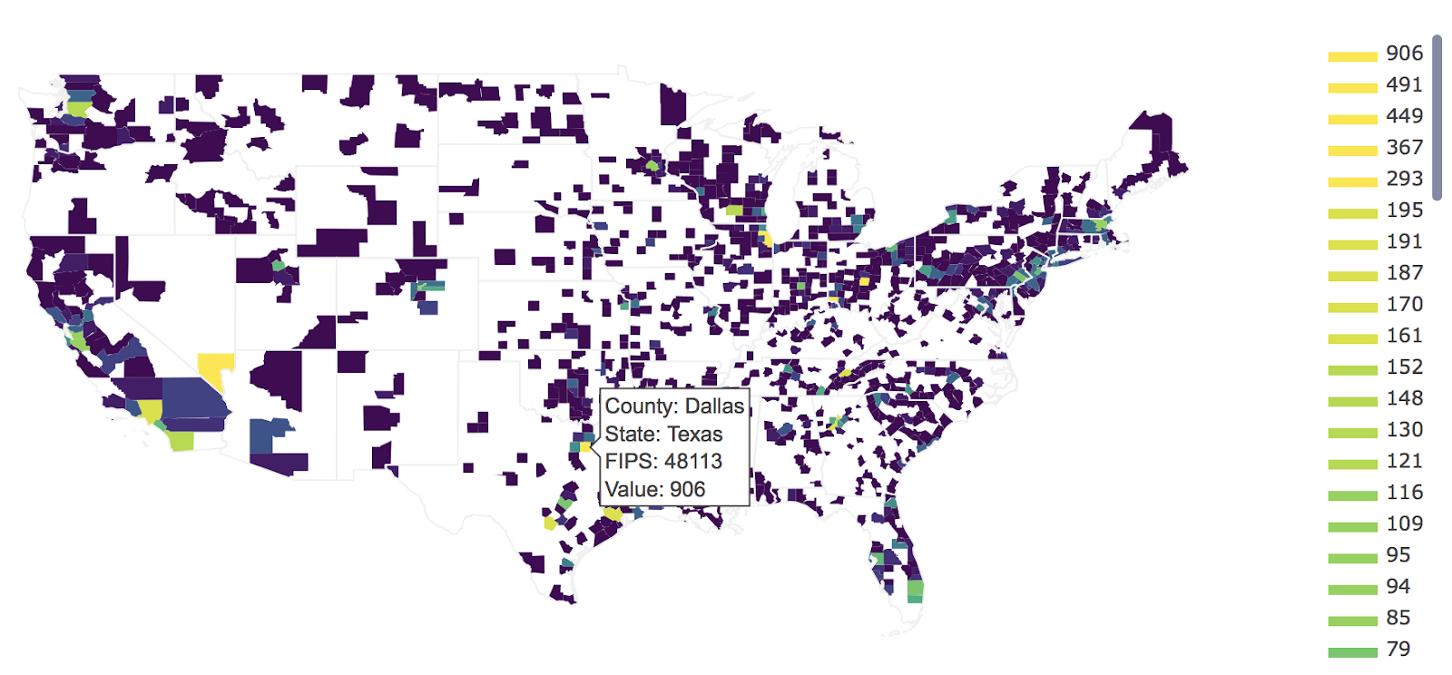
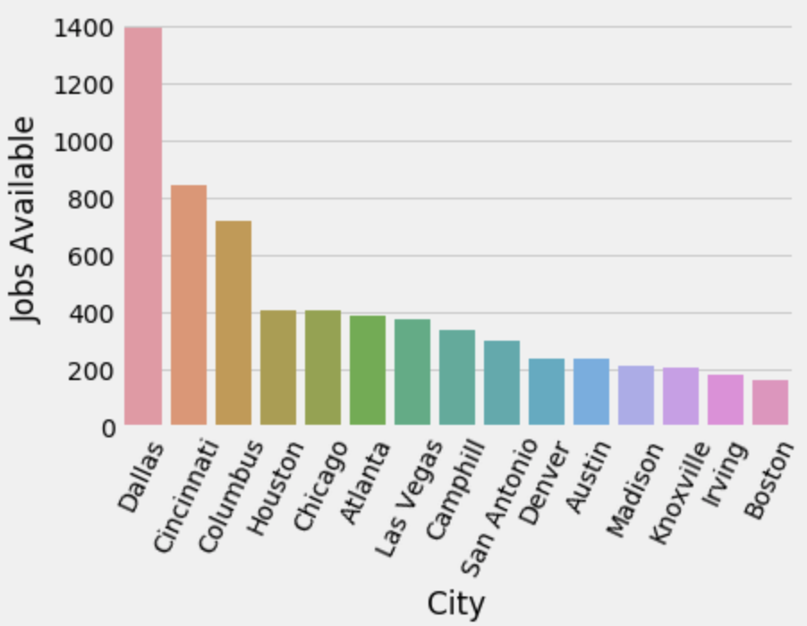
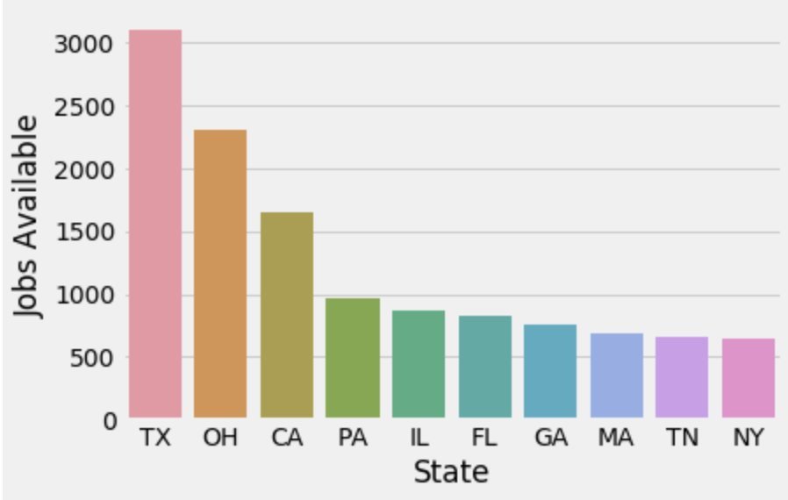
The Dataset

Slide 5
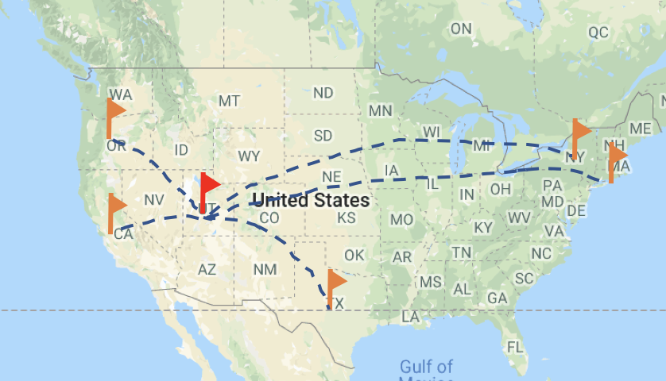
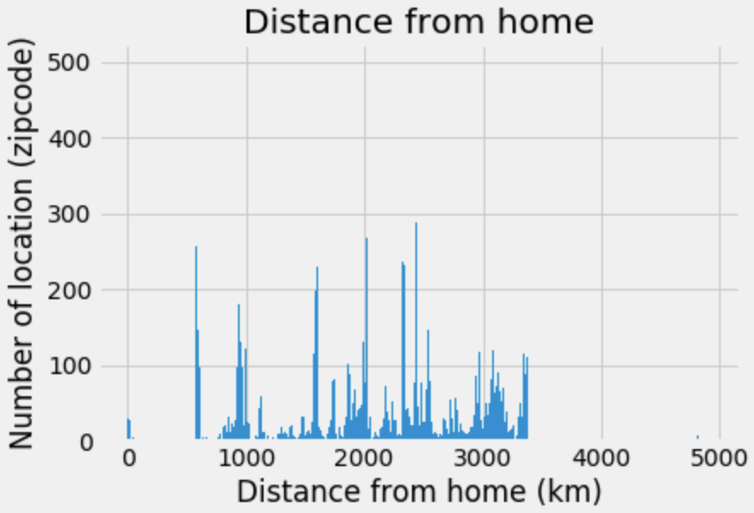
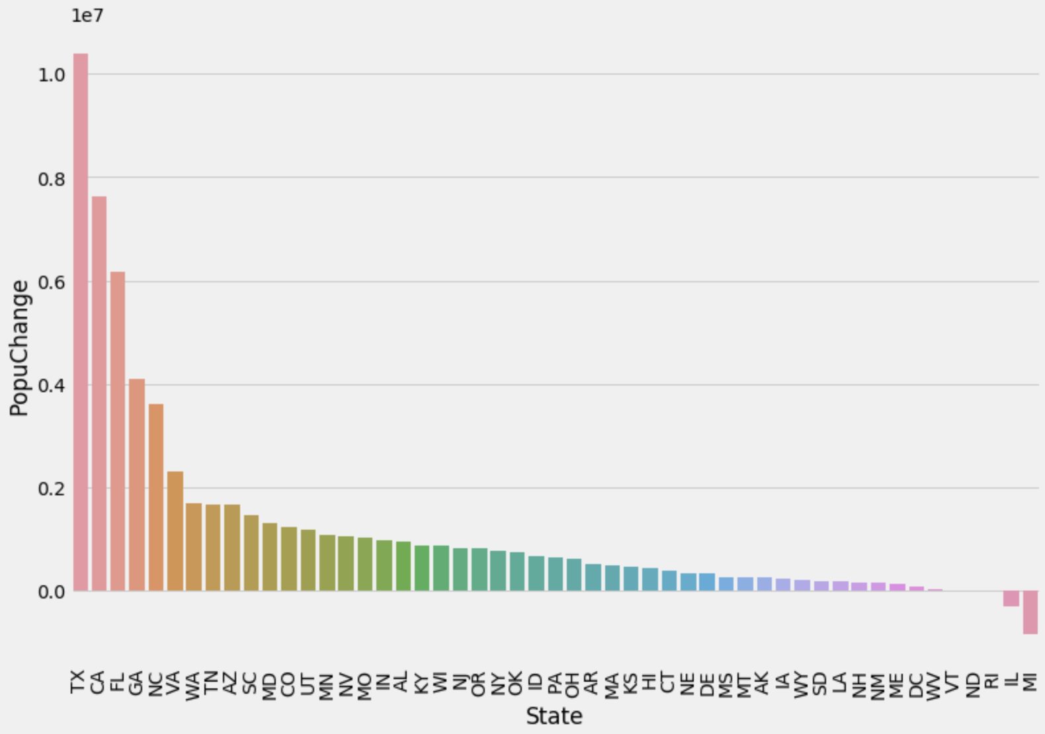
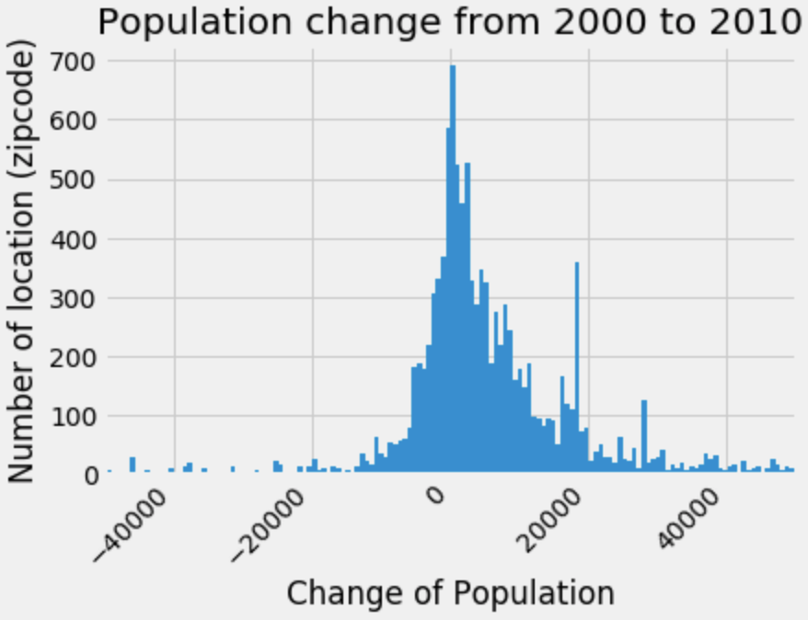
Location index:

Slide 6
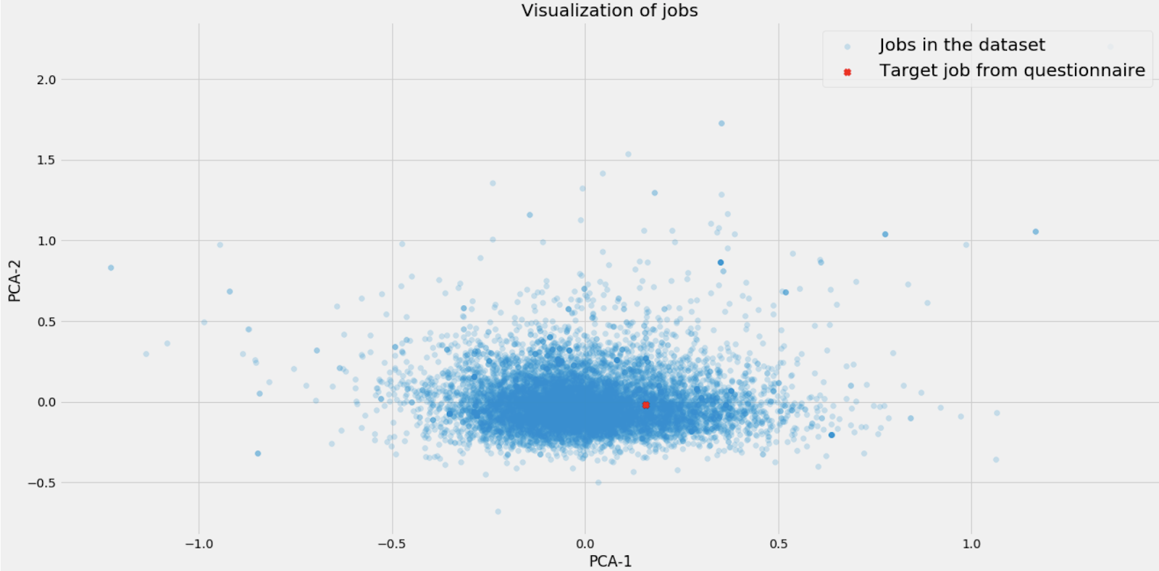
Culture index
Scattering plot of all the jobs’ adjectives (blue dots) in the dataset. The red dot is the target job’s adjective keywords projected by the same PCA model used for all the blue dots.

Slide 7
Recommendations
Culture index = Recommendation – a software develop job
Industry index = Recommendation – a clinic statistic job
Location + Culture + Industry + weights = Recommendation – Science journal editor job
Weights:
Location Index 20%
Industry factor 40%
Culture factor 40%

