Slide 1
A: for i in range(A par m):
B: for j in range(B par n):
addr1, data1 = ...
mem(addr1) = data1 # W1
C: for k in range(C par n):
addr2 = ...
data2 = mem(addr2) # R1
...
x ops
i=0
i=1
i=2
i=3
A=4
B=4
C=2
y ops
x ops
B
j=0
j=1
j=2
j=3
m = 1
n = 1
thrpt = x+y
y ops
C
k=0
k=1
m = 1
n = 1
thrpt = n(x+y)
B
j=0
j=1
C
k=0
m = 1
n = 1
thrpt = mn(x+y)
B
j=0
j=1
C
k=0
Time

Slide 2
ctxB
respW1
init=2
data1
addr1
ack1
credit
mem
token
data2
addr2
ctxC
rqst R1
D: data1 latency
K: ack1 latency
T: token latency
i=0 j=0
i=0 j=1
i=0 j=2
i=1 j=0
i=1 j=1
i=1 j=2
D
K
i=1 j=0
i=1 j=1
i=1 j=2
D
K
ctxB+ respW1
D
K
D
K
D
K
T
D
K
T
D
K
A: addr2 latency
D: data2 latency
C: credit latency
D
K
D
K
T
rqstR1+ ctxC
i=0
i=1
i=2
i=0 k=0
i=0 k=1
i=1 k=0
i=1 k=1
A
D
C
i=2 k=0
i=2 k=1
A
D
C
A
D
A
D
A
D
A
D
C
Time

Slide 3
ctxB
i=0
i=1
i=2 i=3
D: data1 latency
K: ack1 latency
T: token latency
i=0
i=1
i=2
i=3
i=0 j=0
i=0 j=1
i=0 j=2
D
K
i=2 j=0
i=2 j=1
i=2 j=2
D
K
ctxD+
rspdW
D
K
D
K
A: addr2 latency
D: data2 latency
C: credit latency
D
K
T
D
K
T
i=0 j=0
T
i=3 j=0
T
i=0 k=0
C
i=3 k=0
C
rqstR+ ctxF
i=1 k=0
i=1 k=1
D
K
i=4 k=0
i=4 k=1
D
K
D
K
T
D
K
C
ctxD
data1
rspdW
even
addr1
ack1
ctxB
credit
mem
token
odd
data2
addr2
ctxF
rqstR

Slide 4
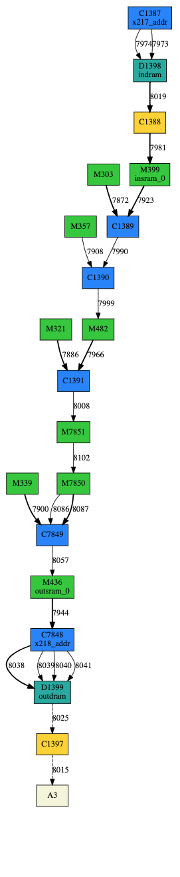
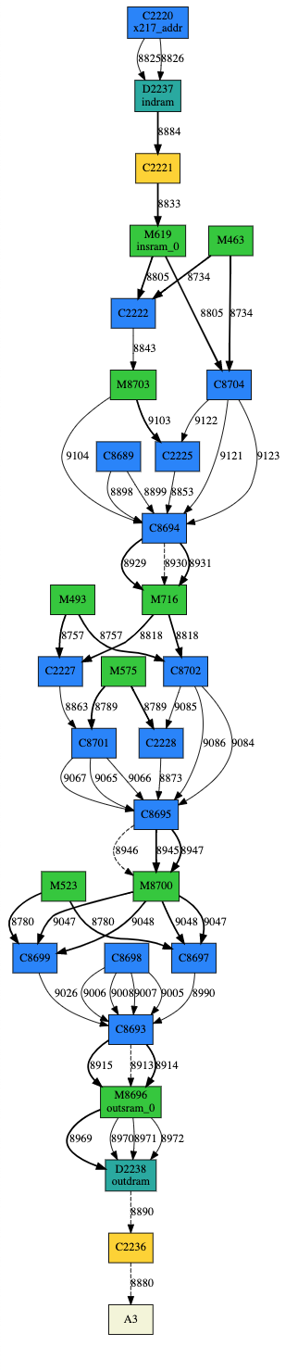
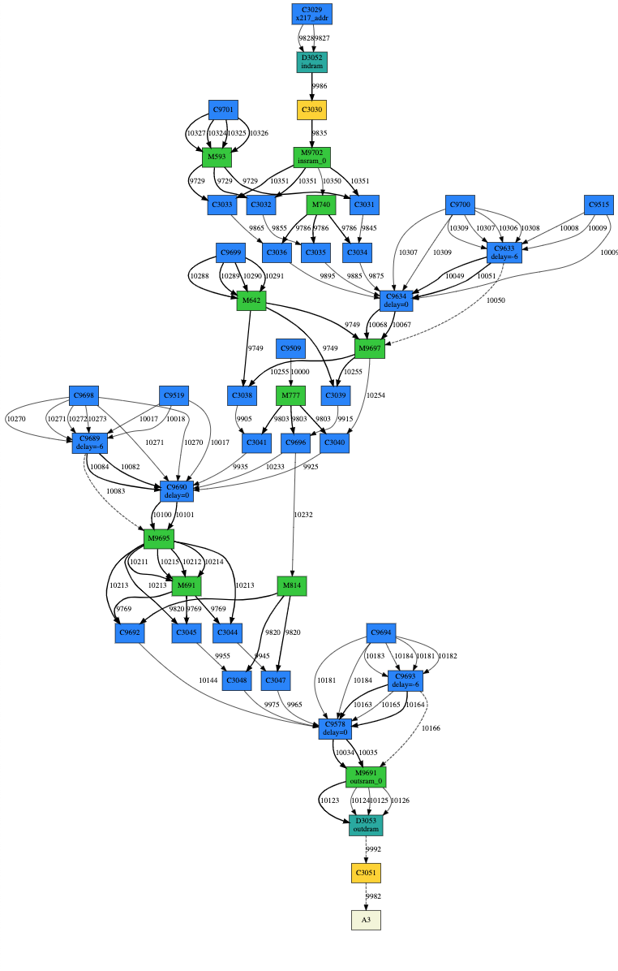
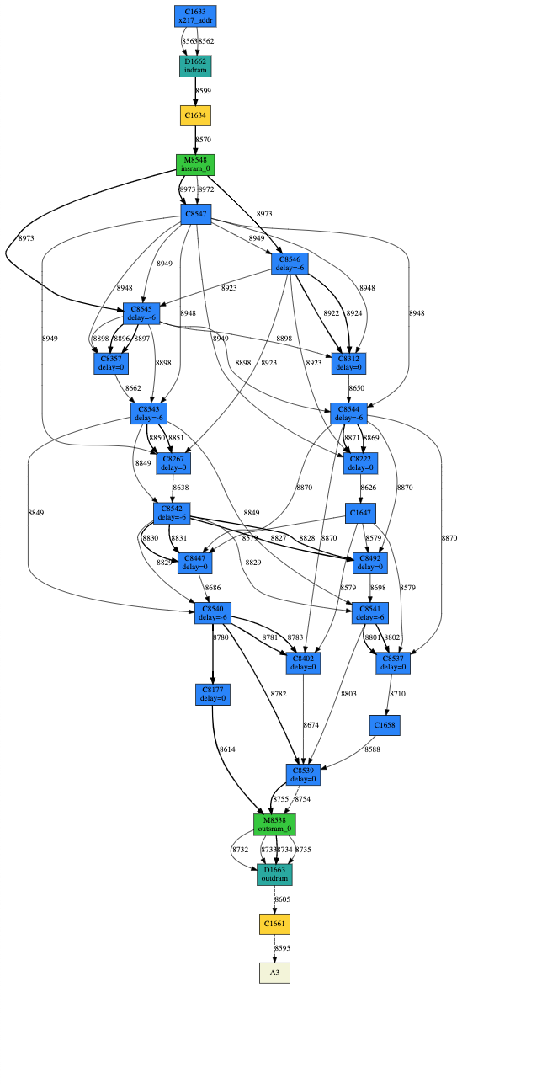




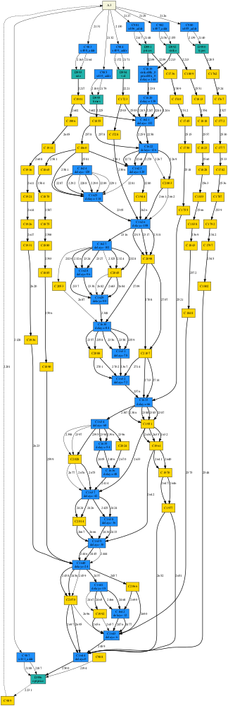
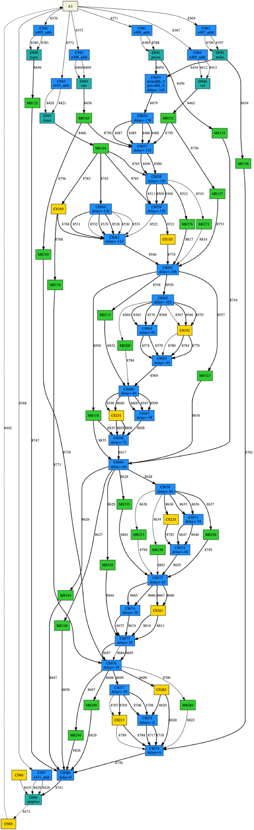
Par 1
Par 2
Par 3
Par 4
PCU
PCU (no operation)
PMU
MCI
PCU
PCU (no operation)
PMU
MCI

Slide 5
Avg. Throughput =
Avg. Utilization x FLOPS Density
CPU
FPGA
Avg. Utilization
RDA
GPU
FLOPS Density

Slide 6
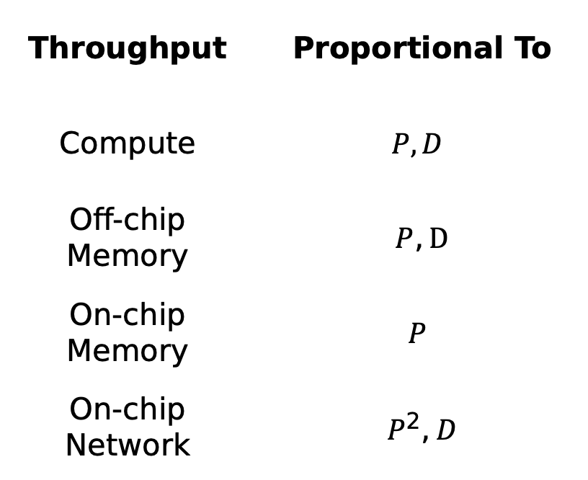
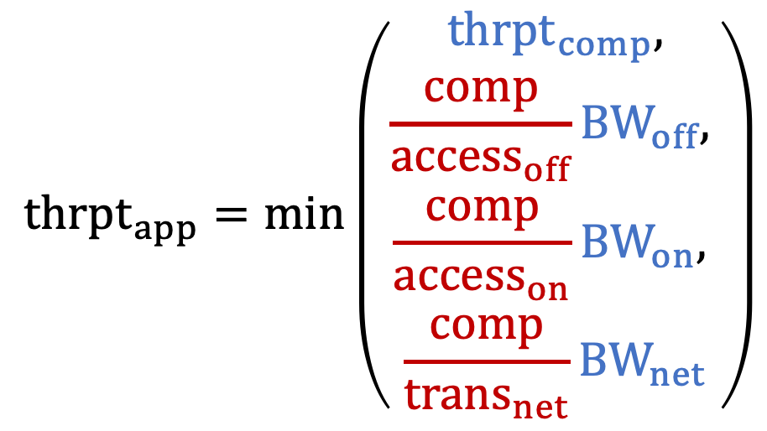
Throughput | Proportional To
Compute | $$P,D$$
Off-chip Memory | $P,D$
On-chip Memory | $$P$$
On-chip Network | $P^{2},D$
$${thrpt}_{app}=\min\left(\begin{aligned}{thrpt}_{comp}, \\ \begin{aligned}\frac{comp}{access_{off}}{BW}_{off}, \\ \begin{aligned}\frac{comp}{access_{on}}BW_{on}, \\ \frac{comp}{trans_{net}}{BW}_{net}\end{aligned}\end{aligned}\end{aligned}\right)$$
Application-specific
Hardware-specific
P: Parallelization factor
D: Pipelining depth

Slide 7
2
1
1
Input
2
2
1
Solution 1
Solution 2
Solution 3
Operation
Partition | 1 | 2
# op | 5 | 3
# input | 0 | 4
# output | 4 | 0
Partition | 1 | 2
# op | 6 | 2
# input | 0 | 3
# output | 3 | 0
Partition | 1 | 2
# op | 6 | 2
# input | 2 | 1
# output | 1 | 2
Operation with live-outs
2
2
1
Input
Solution 1
1
Solution 2
Operation
Partition | 1 | 2
# op | 5 | 2
# input | 1 | 3
# output | 3 | 1
Partition | 1 | 2
# op | 4 | 3
# input | 3 | 1
# output | 1 | 3
Operation with live-outs
back edge in a cycle

Slide 8
Spatial
RTL
PIR
Scaling a Reconfigurable Accelerator
Support imperative control constructs on a distributed network
Systematically handle hardware constraints on a hierarchical architecture
Synthesis
SARA
Placement and Routing
Placement and Routing
FPGA
Plasticine
(Simulation)
Correctness
Virtual Unit DFG Allocation
Spatial mapping of imperative programs to dataflow on a distributed network
Correctness
Virtual Unit Partitioning & Assignment
Partition program to satisfy hardware constraints
Performance & Resource Optimization
Optimization
Improve runtime and reduce resource usage
Performance & Resource Optimization
P&R Guild Generation
Generate heuristics to guide placement and routing

Slide 9
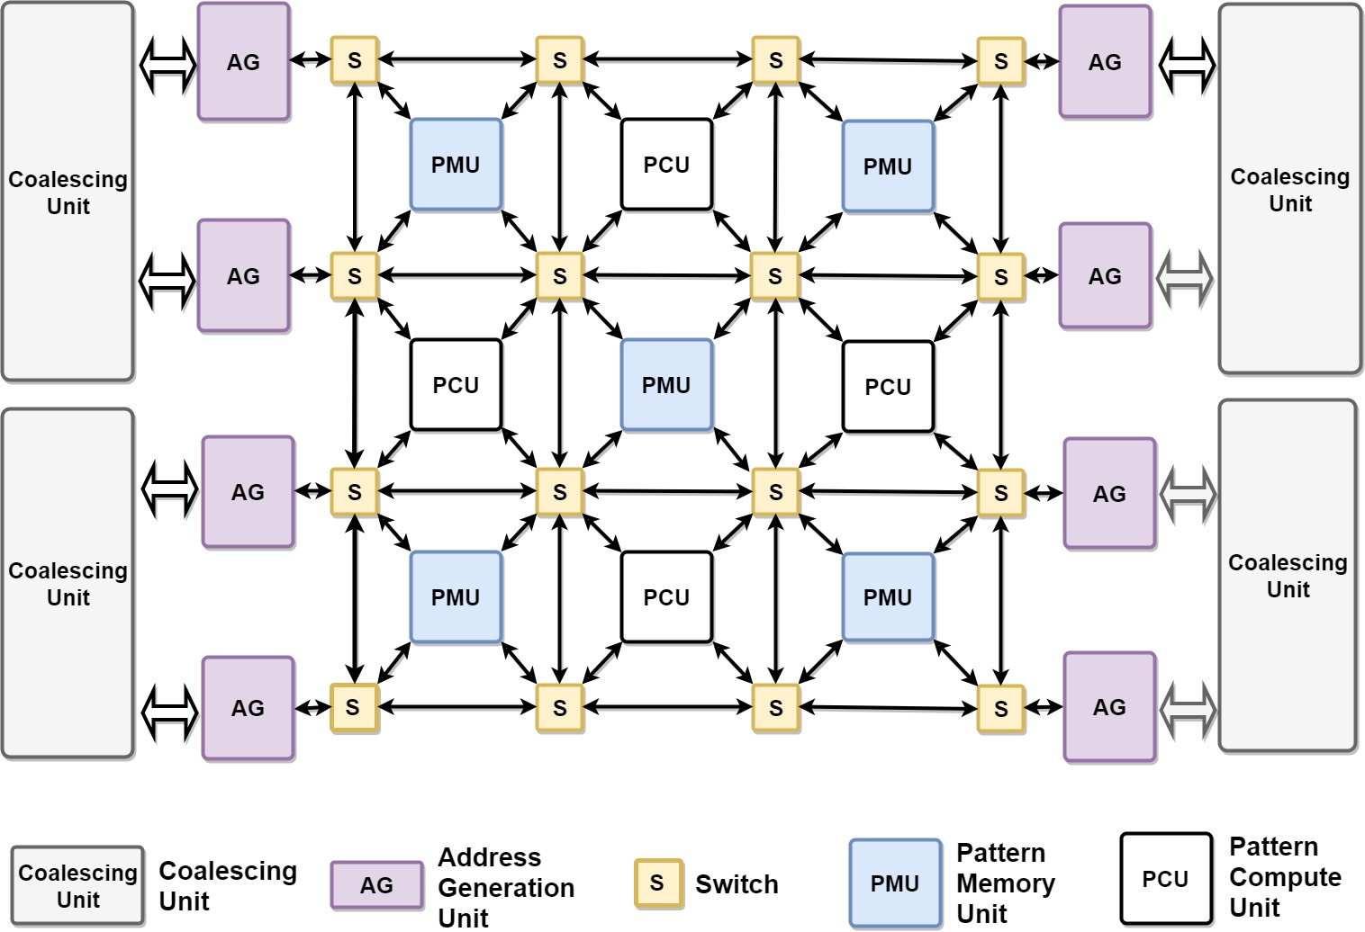

Slide 10
A
B
C
Controller
B
C
SRAM
mem
Vectorized datapath

Slide 11
1
A
4
7
3
B
C
5
VCU
dataflow
2
REQ
VMU
control token
mem
RESP
6
unpredictable network latency
REQ

Slide 12
Work 0
Work 1
Logical Address
Core
Core
Address Remapping
Address Remapping
Cache
P0
BI + BO
Cache
P1
BI₀ 1453
BO₀ ABCD
BI₁ 0276
BO₁ EFGH
BI₀
A₀
BO
A₁
BI₁
S
S
BO₀
BO₁
XAXD
OR
EXFX
M₀
M₁
BO’
M₀
BO_{A} EAFD
BO_{A}
BO_{B}
P_{A} [0-3]
P_{B} [4-7]
BI₀ 1453
D_{A} abcd
BI₀ 1453
D_{B} efgh
D_{A}
D_{B}
R₀
R₁
S⁻¹
S⁻¹
A: read address context
M: merge context
P: memory partition
R: receiver context X: invalid
bXXd
OR
XegX
R₀
D₀ begd

