Slide 1
A: for i in range(A par m):
B: for j in range(B par n):
addr1, data1 = ...
mem(addr1) = data1 # W1
C: for k in range(C par n):
addr2 = ...
data2 = mem(addr2) # R1
...
x ops
y ops
x ops
B
j=0
j=1
j=2
j=3
m = 1
n = 1
thrpt = x+y
y ops
C
k=0
k=1
m = 1
n = 2
thrpt = 2(x+y)
B
j=0
j=1
C
k=0
m = 2
n = 2
thrpt = 4(x+y)
B
j=0
j=1
i=0
i=1
i=2
i=3
C
k=0
Time

Slide 2
ctxB
respW1
init=2
wdata
waddr
ack
credit
mem
token
rdata
raddr
ctxC
rqst R1
i=0 j=0
i=0 j=1
i=0 j=2
i=1 j=0
i=1 j=1
i=1 j=2
W
K
i=1 j=0
i=1 j=1
i=1 j=2
DWW
K
W: wdata latency
K: ack latency
T: token latency A: raddr latency
R: rdata latency
C: credit latency
ctxB+ respW1
W
K
W
K
W
K
T
W
K
T
W
K
W
K
W
K
T
rqstR1+ ctxC
i=0
i=1
i=2
i=0 k=0
i=0 k=1
i=1 k=0
i=1 k=1
A
DRR
C
i=2 k=0
i=2 k=1
A
R
C
A
R
A
R
A
DRR
A
R
C
Time
rqstW1
wdata
ctxB
rqstW1
rqstW1’
wdata
ctxB
init=2
waddr
wdata
waddr+wdata
credit
token
mem
init=2
raddr
credit
token
mem
rqst R1
rqst R1
rqst R1’
raddr
VU
rdata
rdata
ctxC
VU
raddr
ctxC
i=0 j=0
i=0 j=1
i=0 j=2
i=1 j=0
i=1 j=1
i=1 j=2
W
i=1 j=0
i=1 j=1
i=1 j=2
DWW
i=0
i=1
i=2
W: wdata latency R: rdata latency C: credit latency
W
W
ctxB+ rqstW1’
W
W
W
W
W
i=0 k=0
i=0 k=1
i=1 k=0
i=1 k=1
DRR
i=2 k=0
i=2 k=1
R
rqstR1’+ ctxC
R
DRR
R
R
Time

Slide 3
ctxB
i=0
i=1
i=2 i=3
D: data1 latency
K: ack1 latency
T: token latency
i=0
i=1
i=2
i=3
i=0 j=0
i=0 j=1
i=0 j=2
D
K
i=2 j=0
i=2 j=1
i=2 j=2
D
K
ctxD+
rspdW
D
K
D
K
A: addr2 latency
D: data2 latency
C: credit latency
D
K
T
D
K
T
i=0 j=0
T
i=3 j=0
T
i=0 k=0
C
i=3 k=0
C
rqstR+ ctxF
i=1 k=0
i=1 k=1
D
K
i=4 k=0
i=4 k=1
D
K
D
K
T
D
K
C
Time
ctxD
data1
rspdW
even
init=2
addr1
ack1
ctxB
credit
mem
token
odd
data2
addr2
ctxF
rqstR

Slide 4
S
S
S: network latency to send stop
A: network latency to send accum2
ctxC
S
S
i=0
i=1
i=2
i=3
D
i=0 j=0
i=0 j=1
ctxB
ctxD
A
Time
ctxC
stop init=False
ctxB
accum2
ctxD

Slide 5
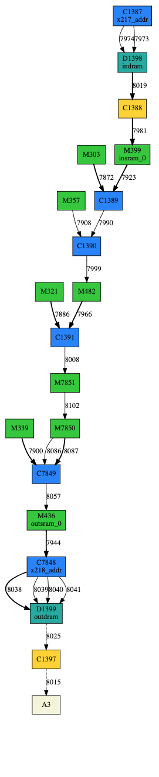
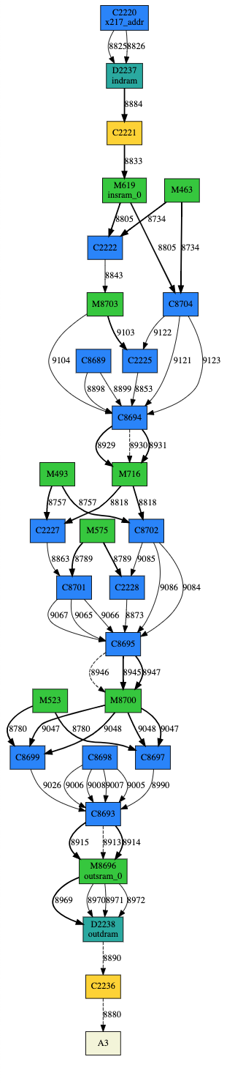
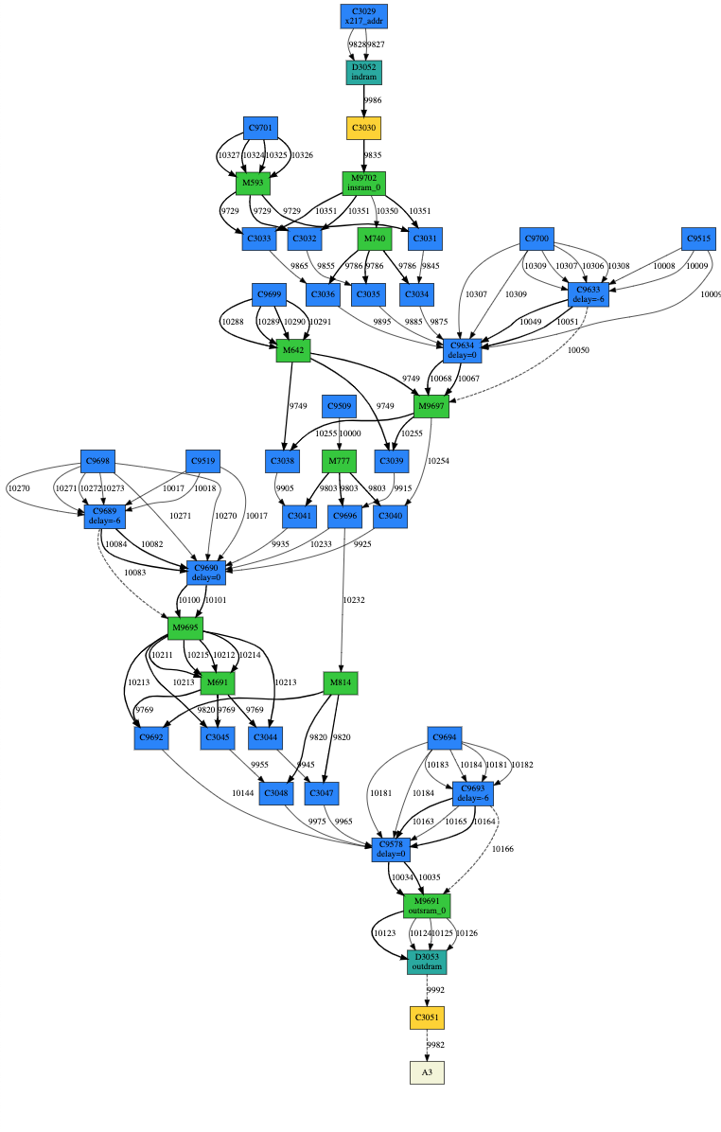
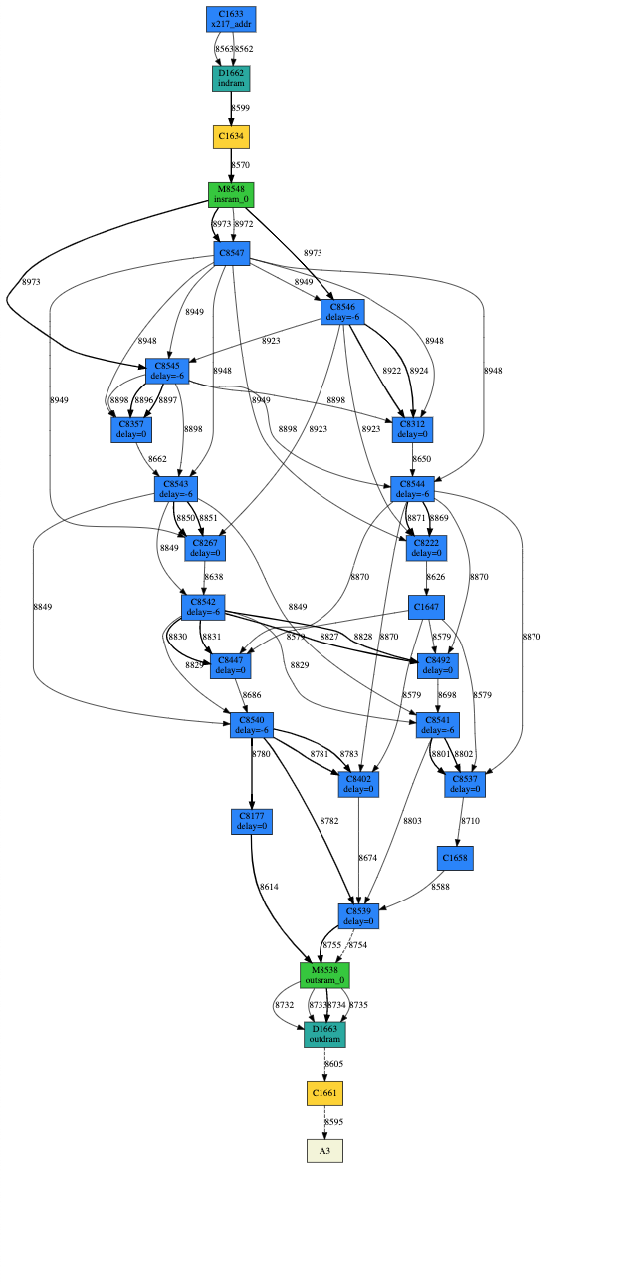




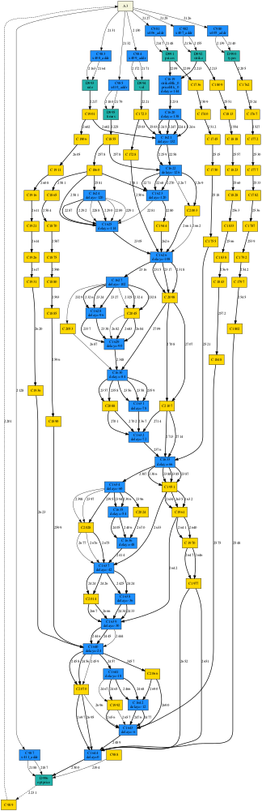
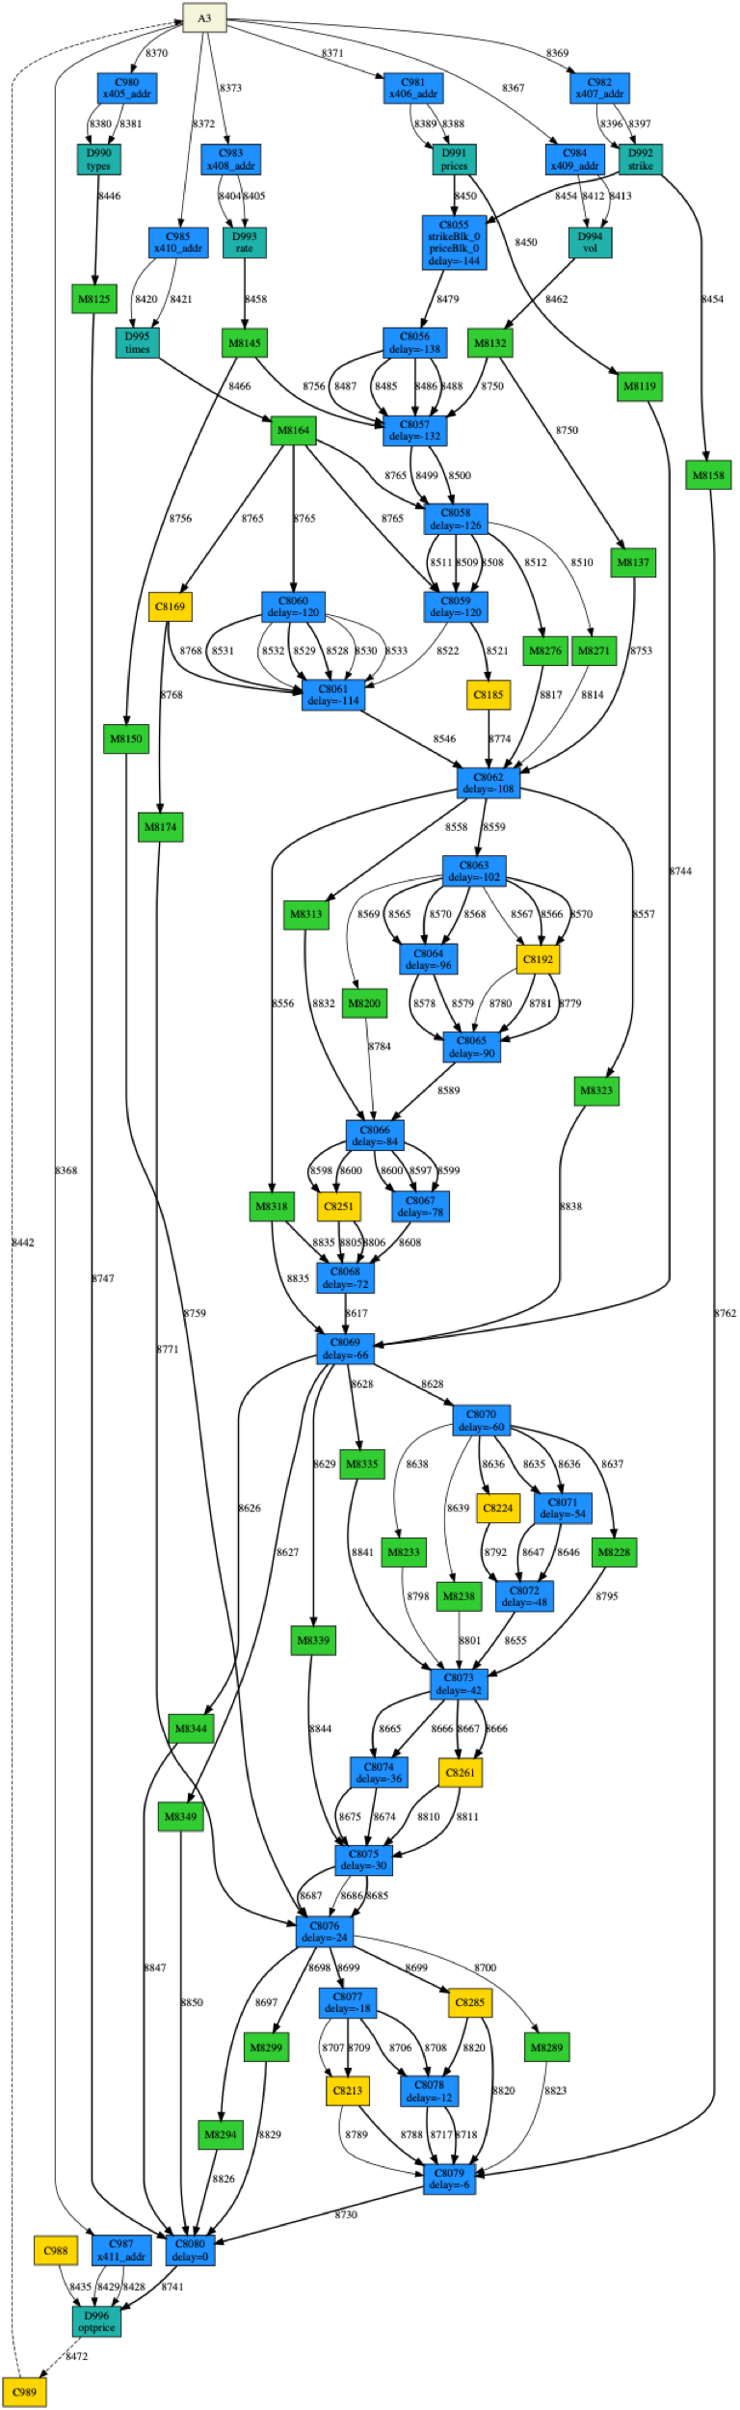
Par 1
Par 2
Par 3
Par 4
CU
CU (no operation)
MU
MCI
CU
CU (no operation)
MU
MCI

Slide 6
Avg. Throughput =
Avg. Utilization x FLOPS Density
CPU
FPGA
Avg. Utilization
RDA
GPU
FLOPS Density

Slide 7
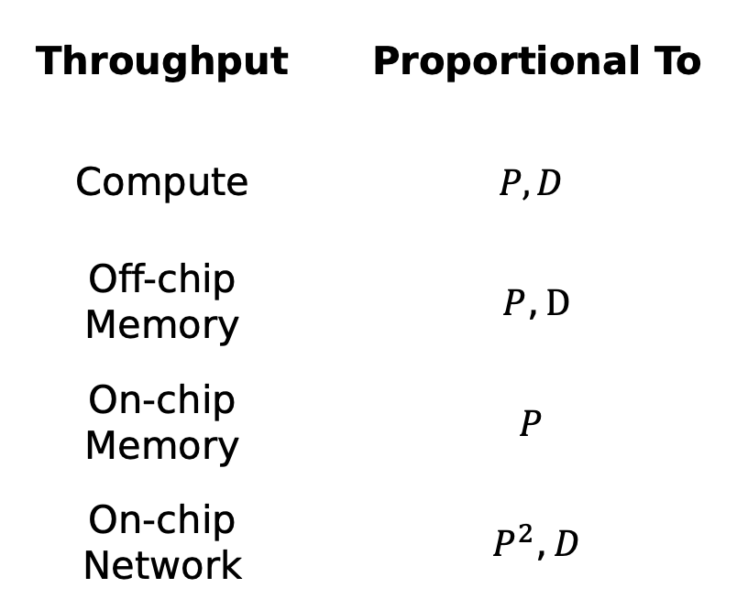
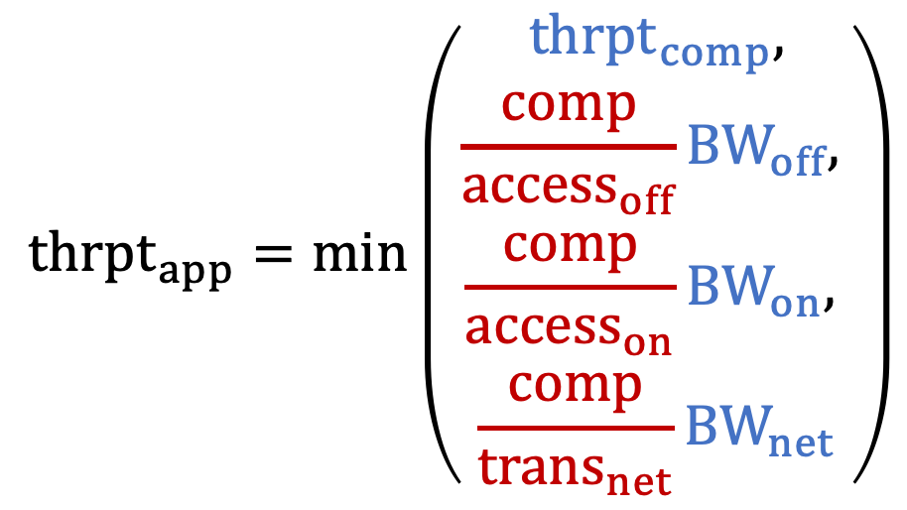
Throughput | Proportional To
Compute | $$P,D$$
Off-chip Memory | $P,D$
On-chip Memory | $$P$$
On-chip Network | $P^{2},D$
$${thrpt}_{app}=\min\left(\begin{aligned}{thrpt}_{comp}, \\ \begin{aligned}\frac{comp}{access_{off}}{BW}_{off}, \\ \begin{aligned}\frac{comp}{access_{on}}BW_{on}, \\ \frac{comp}{trans_{net}}{BW}_{net}\end{aligned}\end{aligned}\end{aligned}\right)$$
Application-specific
Hardware-specific
P: Parallelization factor
D: Pipelining depth

Slide 8
2
1
1
Input
2
2
1
Solution 1
Solution 2
Solution 3
Operation
Partition | 1 | 2
# op | 5 | 3
# input | 0 | 4
# output | 4 | 0
Partition | 1 | 2
# op | 6 | 2
# input | 0 | 3
# output | 3 | 0
Partition | 1 | 2
# op | 6 | 2
# input | 2 | 1
# output | 1 | 2
Operation with live-outs
2
2
1
Input
Solution 1
1
Solution 2
Operation
Partition | 1 | 2
# op | 5 | 2
# input | 1 | 3
# output | 3 | 1
Partition | 1 | 2
# op | 4 | 3
# input | 3 | 1
# output | 1 | 3
Operation with live-outs
back edge in a cycle

Slide 9
Spatial
RTL
PIR
Scaling a Reconfigurable Accelerator
Convert imperative control constructs to streaming dataflow constructs that can execute on a distributed network
Systematically handle hardware constraints in Plasticine
Synthesis
SARA
Placement and Routing
Placement and Routing
FPGA
Plasticine
(Simulation)
Imperative to Streaming Transformation
Convert an imperative IR to a streaming dataflow graph that can execute on a on-chip distributed network
Virtual to physical resource allocation. Partition program graph to satisfy hardware constraints
Correctness
Resource Allocation
Optimizations
Reduce pipeline stall and improve resource usage
Performance & Resource Optimization
P&R Guild Generation
Generate heuristics to guide placement and routing

Slide 10
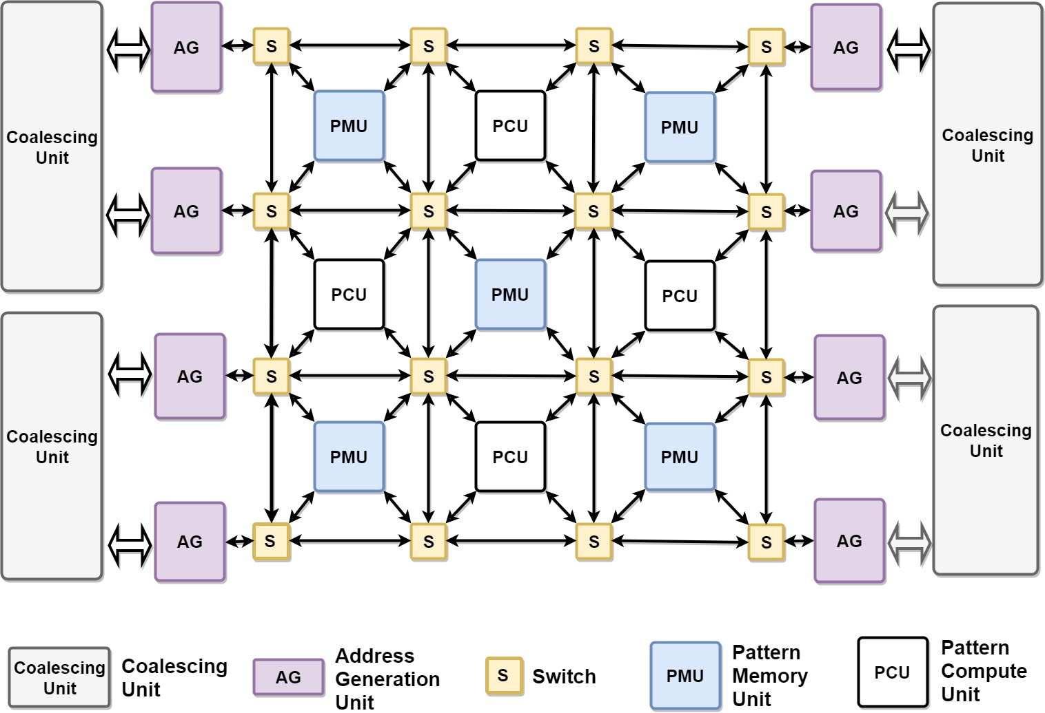

Slide 11
A
B
C
Controller
B
C
SRAM
mem
Vectorized datapath
A
A
A
A
B
C
B
C
C
D
F
D
F
B
... saddr = mem + waddr store saddr, data
A
laddr = mem + raddr
rdata = load laddr ...
C

Slide 12
1
A
4
7
3
A
A
VCU
dataflow
B
C
SYNC
VMU
control token
2
5
B
C
unpredictable network latency
REQ
ACK
R REQ
controller
8
mem
6
mem
REQ
(a)
RESP
W REQ
(b)
DATA

Slide 13
Worker
Worker
Logical Address
Core
Core
Address Remapping
Address Remapping
Cache
Partition
BI + BO
Cache
Partition
BA₀ 1453
BO₀ ABCD
BA₁ 0276
BO₁ EFGH
BA₀
A₀
BO
A₁
BA₁
S
S
BO₀
BO₁
XAXD
OR
EXFX
M_{A}
M_{B}
BO’
M_{A}
BO_{A} EAFD
BO_{A}
BO_{B}
P_{A} [0-3]
P_{B} [4-7]
BA₀ 1453
D_{A} abcd
BA₀ 1453
D_{B} efgh
D_{A}
D_{B}
R₀
R₁
S⁻¹
S⁻¹
A: read address context
M: merge context
P: memory partition
R: receiver context X: invalid, D: data S: shuffle, S⁻¹: inverse shuffle
bXXd
OR
XegX
R₀
D₀ begd

