Slide 1
UML 1 USE CASE DIAGRAMS
offer an approach that facilitates logical, rapid, and thorough methods for creating new systems responsive to a changing business landscape.
Neama Abdulaziz – Systems Analysis instructor, Sana’a University

Slide 2
Object-Oriented Analysis and Design
Works well in situations where complicated systems are undergoing continuous maintenance, adaptation, and design
Objects, classes are reusable
The Unified Modeling Language (UML) is an industry standard for modeling object-oriented systems.
Reusability
Recycling of program parts should reduce the costs of development in computer-based systems.
Maintaining systems
Making a change in one object has a minimal impact on other objects.
Notes:
Object-Oriented Analysis And Design can offer an approach that facilitates logical, rapid, and thorough methods for creating new systems responsive to a changing business landscape.
Object-oriented systems describe entities as objects where objects are part of a general concept called classes.
Reusable – means you can become more efficient, because you do not have to start at the beginning to describe an object every time it is needed for software development.
UML is a powerful tool that can greatly improve the quality of your systems analysis and design, and thereby help create higher-quality information systems.

Slide 3
Object-Oriented Concepts
Objects
Persons, places, or things that are relevant to the system being analyzed
May be customers, items, orders, and so on
May be GUI displays or text areas on a display
Classes
Defines the set of shared attributes and behaviors found in each object in the class
Instantiate is when an object is created from a class.
Should have attributes and methods.
Inheritance
When a derived class inherits all the attributes and behaviors of the base class
Reduces programming labor by using common objects easily
Notes:
Object-oriented programming differs from traditional programming by examining the objects that are part of a system.

Slide 4
What is UML?
UML stands for Unified Modeling Language. This object-oriented system of notation has evolved from the work of Grady Booch, James Rumbaugh, Ivar Jacobson, and the Rational Software Corporation. These renowned computer scientists fused their respective technologies into a single, standardized model. Today, UML is accepted by the Object Management Group (OMG) as the standard for modeling object oriented programs.

Slide 5
The Unified Modeling Language (UML) Concepts and Diagrams
Things
Relationships
Diagrams
Notes:
UML provides a standardized set of tools to document the analysis and design of a software system.
Things - the objects.
Relationships - the glue that holds things together.
Diagrams - categorized as either structure or behavioral.

Slide 6
Interacting during a CRC Session
Identify all the classes you can.
Create scenarios.
Identify and refine responsibilities.
Notes:
Identify all the classes you can – when all classes have been identified, the analysts can then compile them, weed out the illogical ones, and write each one on its own card.
Creating scenarios – actually walkthroughs of system functions.
The responsibilities will eventually evolve into methods in the UML.
The think statements can later be converted to attributes in the UML.

Slide 7
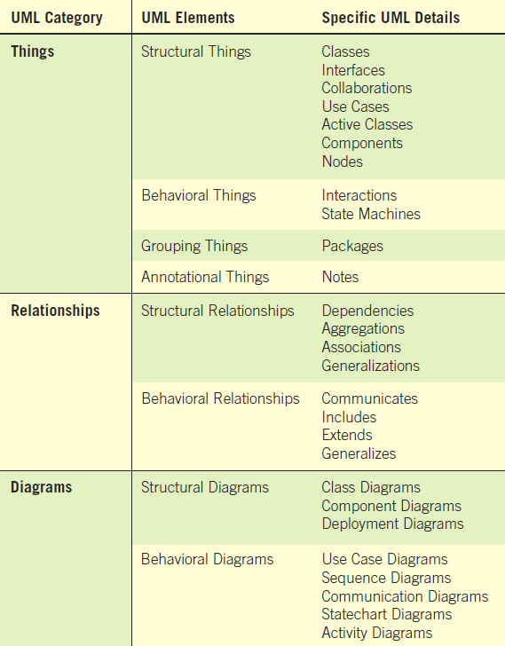
An Overall View of UML and its Components: Things, Relationships, and Diagrams (Figure 10.4)

Slide 8
Commonly Used UML Diagrams
Use case diagram
Describing how the system is used
The starting point for UML modeling
Use case scenario
A verbal articulation of exceptions to the main behavior described by the primary use case
Activity diagram
Illustrates the overall flow of activities

Slide 9
Commonly Used UML Diagrams (Continued)
Sequence diagrams
Show the sequence of activities and class relationships.
Class diagrams
Show classes and relationships.
Statechart diagrams
Show the state transitions.
Notes:
Each use case may create one or more sequence diagrams.
Statechart diagrams – useful for determining class methods.

Slide 10
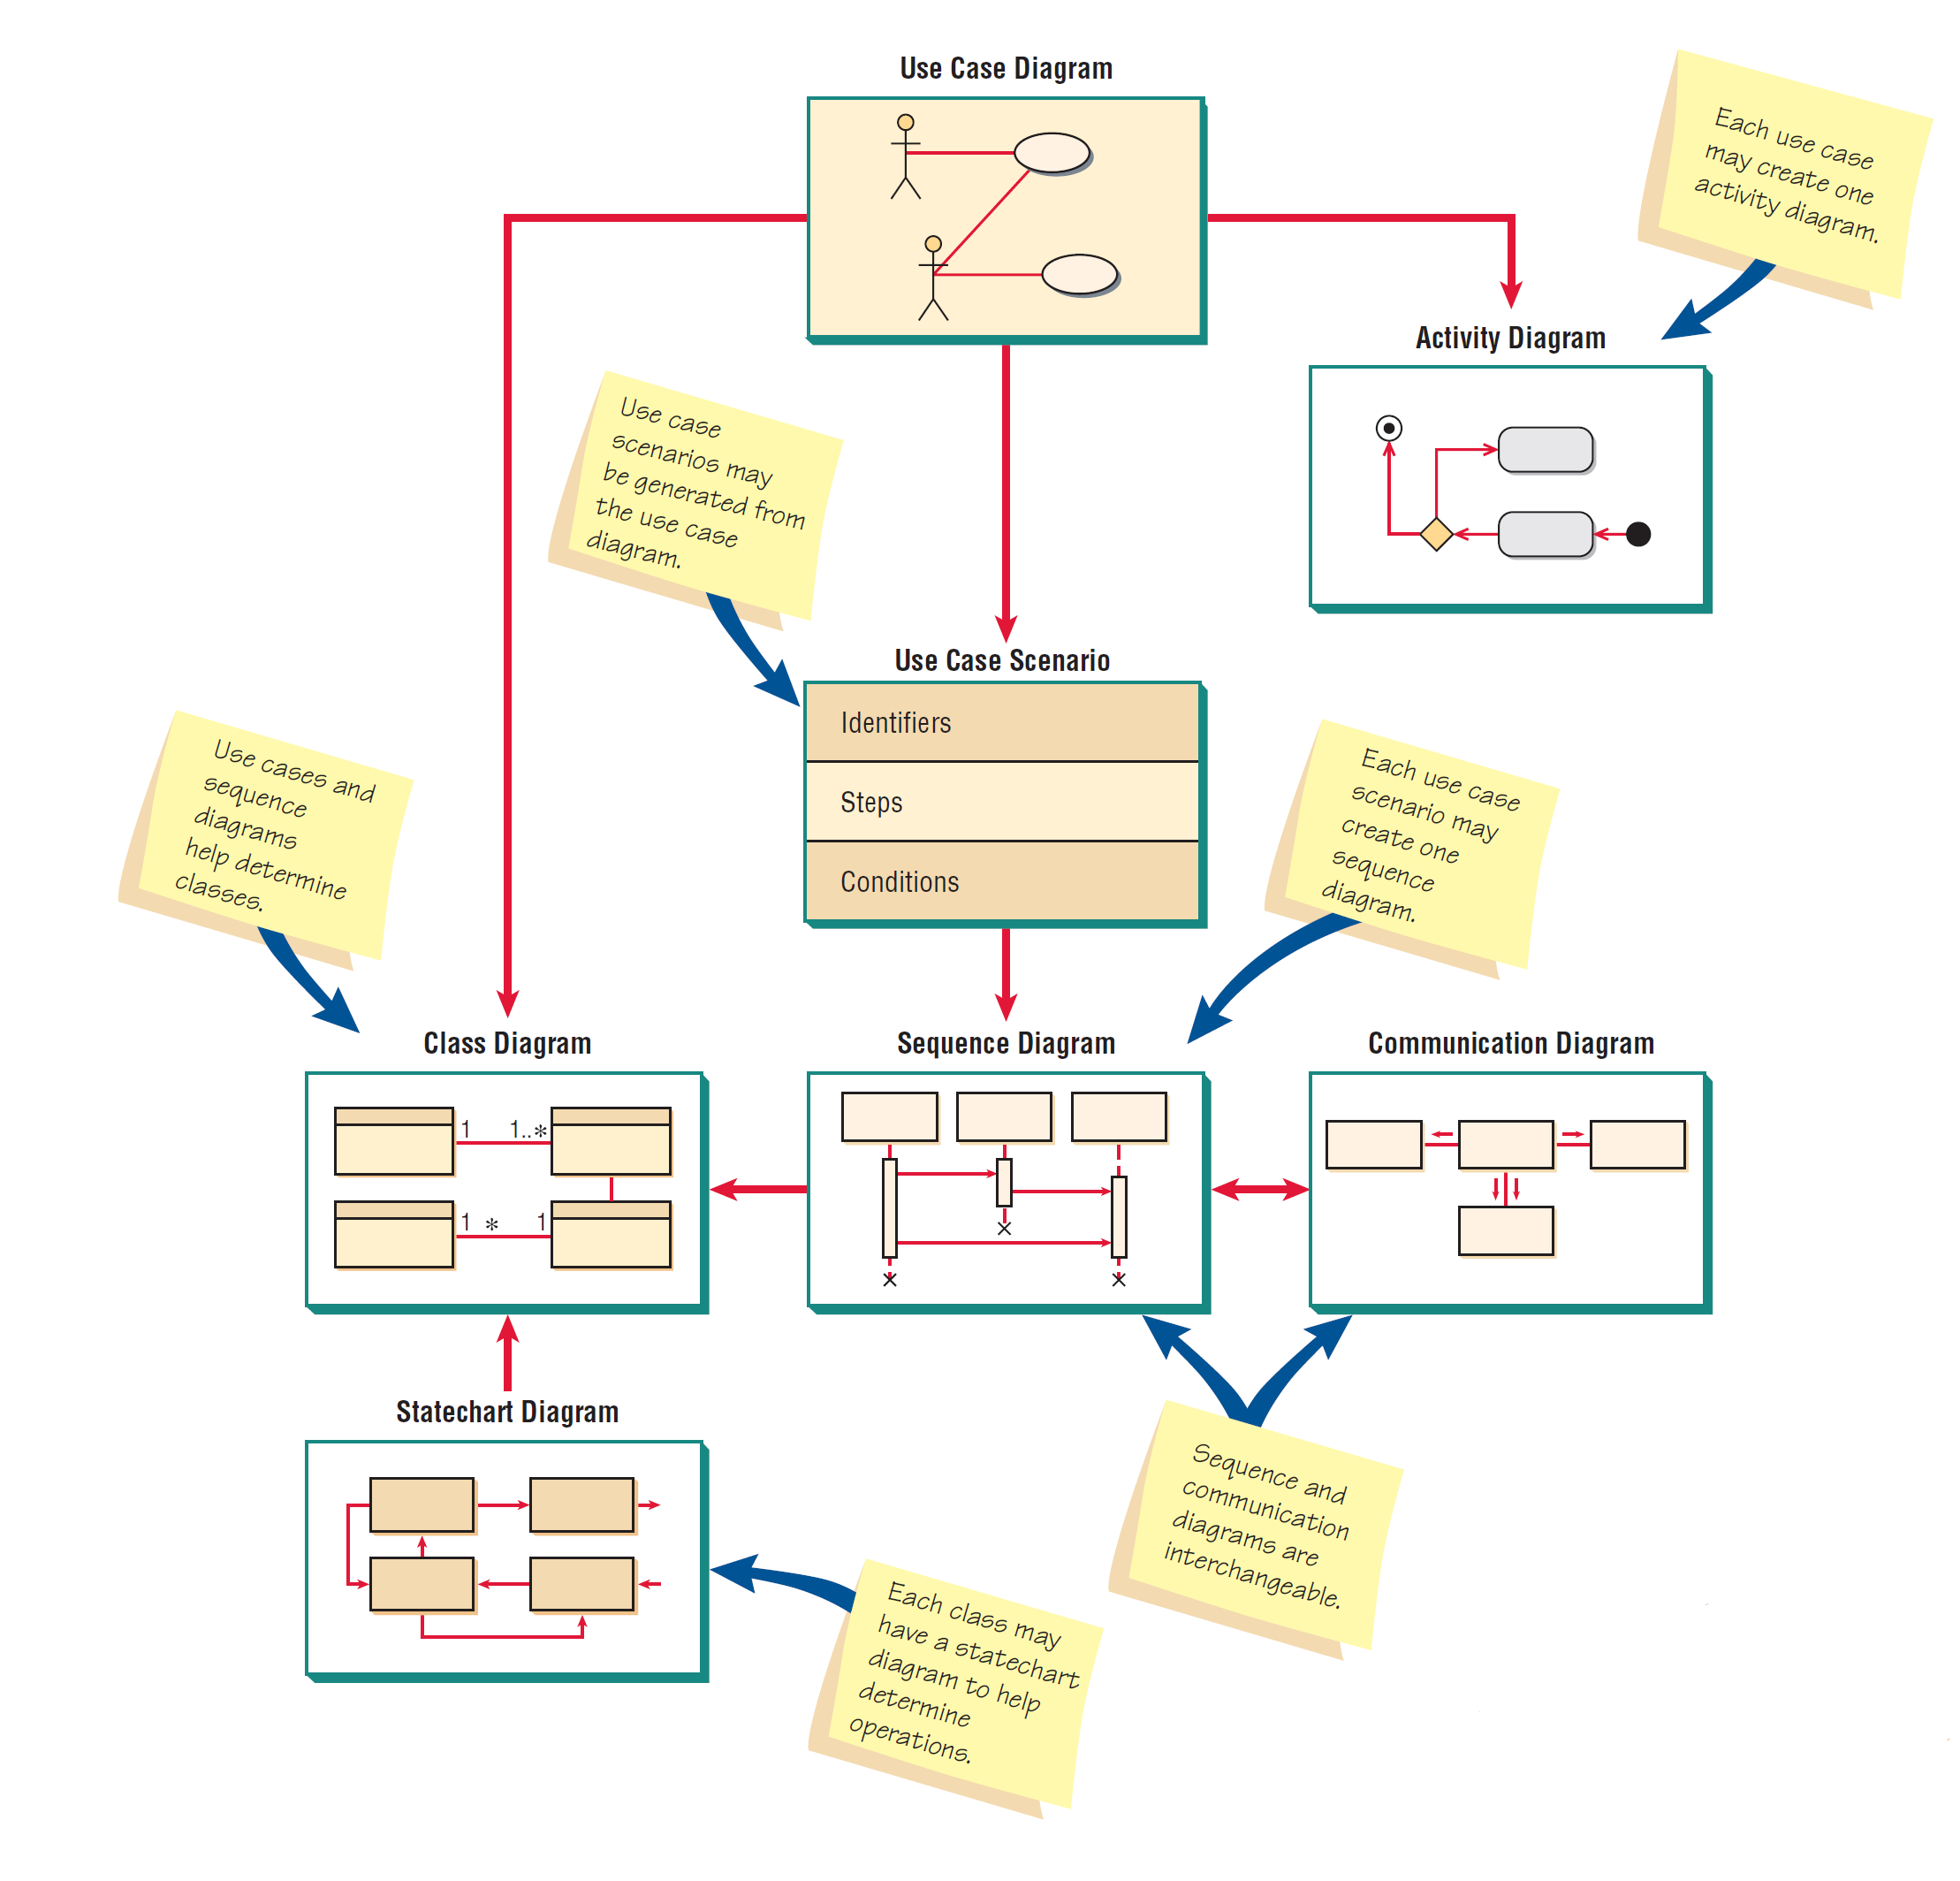
An Overview of UML Diagrams Showing How Each Diagram Leads to the Development of Other UML Diagrams (Figure 10.5)

Slide 11
Use Case Modeling
Describes what the system does, without describing how the system does it
it only summarizes some of the relationships between use cases, actors, and systems.
the diagram does not show the order in which steps are performed to achieve the goals of each use case.
Based on the interactions and relationships of individual use cases
deal only in the functional requirements for a system.
Use case describes
Actor
Event
Use case
Notes:
In a use case, an actor using the system initiates an event that begins a related series of interactions in the system.
Use cases are used to document a single transaction or event.

Slide 12
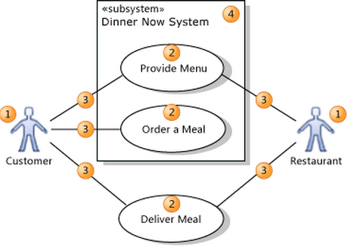
Use case example

Slide 13
Use case diagram notations
An actor (1) is a class of person, organization, device, or external software
component.
interacts with your system. Example actors are Customer, Restaurant, Temperature
Sensor, Credit Card Authorizer.
A use case (2) represents the actions that are performed by one or more
actors in the pursuit of a particular goal.
On a use case diagram, use cases are associated (3) with the actors that
perform them.
Your system (4) is whatever you are developing.
small software component, whose actors are just other software components;
or it might be a complete application; or it
might be a large distributed suite of applications deployed over many computers and devices.
Example subsystems are Meal Ordering Website, Meal Delivery Business.

Slide 14

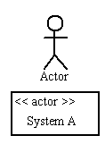
Use Case
Draw use cases using ovals. Label with ovals with verbs that represent the system's functions.
Actors
Actors are the users of a system. When one system is the actor of another system, label the actor system with the actor stereotype.

Slide 15
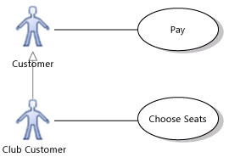
Inheritance between Actors

Slide 16
Actors:
external entities that interact with the system, or another system where each actor has a unique name and description.
Types:
Primary business actor: a stakeholder that primarily benefits from the execution of the use case by receiving something of measurable or observable value, it may or may not initiate the business events, example: bank customer.
Primary system actor: a stakeholder that directly interfaces with the system to initiate or trigger the business or system events. Primary system actors may interact with primary business actors for the purpose of using the actual system, example: bank teller who processes a banking transactions.
External server actor: the stakeholder that responds to a request from a use case, example credit card authorization system.
External receiver actor: the stakeholder that is not primary actor but receive something of measurable value (output) from the use case, example: database management system.

Slide 17
Use Case
a behaviorally related sequence of steps (a scenario), both automated or manual, for the purpose of completing a single business task, it describes the behavior of the system as seen from actor’s point of view. It describes a function provided by the system as a set of events that yields a visible result from the actors.
Actor initiate a use case to access system functionality, the use case can then initiate other use case and gather more information form actors, when the actor and use case exchange information they said to communicate.

Slide 18
Any use case diagram has to be described using use case description table which contains six fields as follows:
Name: each use case has a unique name across the system, so the stakeholders can unambiguously refer to the use case.
Participating actors: are actor interacting with the use case.
Entry condition: describe the conditions that needed to be satisfied before the use case is initiated.

Slide 19
Any use case diagram has to be described using use case description table which contains six fields as follows:
Flow of events: describe the sequence of interactions of the use case, they must be numbered for reference.
The steps in the flow of events are organized in the two columns, the left column representing steps accomplished by the actor, the right column representing steps accomplished by the system (response) (reaction), each pair of actor –system step represent an interaction.
Exit condition: describe the conditions that are satisfied after the completion of the use case.
Quality requirement: are requirements that are not related to the functionality of the system. These include constraints on the performance of the system, its implementation, the hardware platform it runs on, and so on.

Slide 20
The use case written in natural language this:
enables developers to use them for communicating with the clients and users, who do not have extensive knowledge of the software engineering notation.
enables participants to understand the requirements of the system.
allow developers to capture things, special requirements that cannot easily be captures in diagrams.

Slide 21
Scenarios:
A use case is an abstraction that describes all possible scenarios involving the described functionality, it focus on (completeness).
A scenarios is an instance of a use case describing a concrete set of actions, it focus on (understandability).

Slide 22
We describe a scenario using a template with three fields:
Name of the scenario enables us to refer to it unambiguously. The name of a scenario is underlined to indicates that it is an instance.
The participating actor instances field indicates which actor instances are involved in this scenario. Actor instances also have underlined names.
The flow of events of a scenario describes the sequence of events step by step.

Slide 23
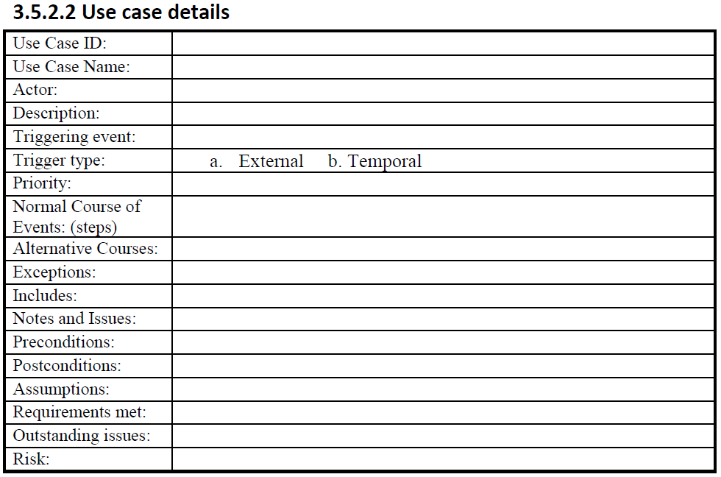
Notes:
Use case scenarios are helpful in drawing sequence diagrams.

Slide 24
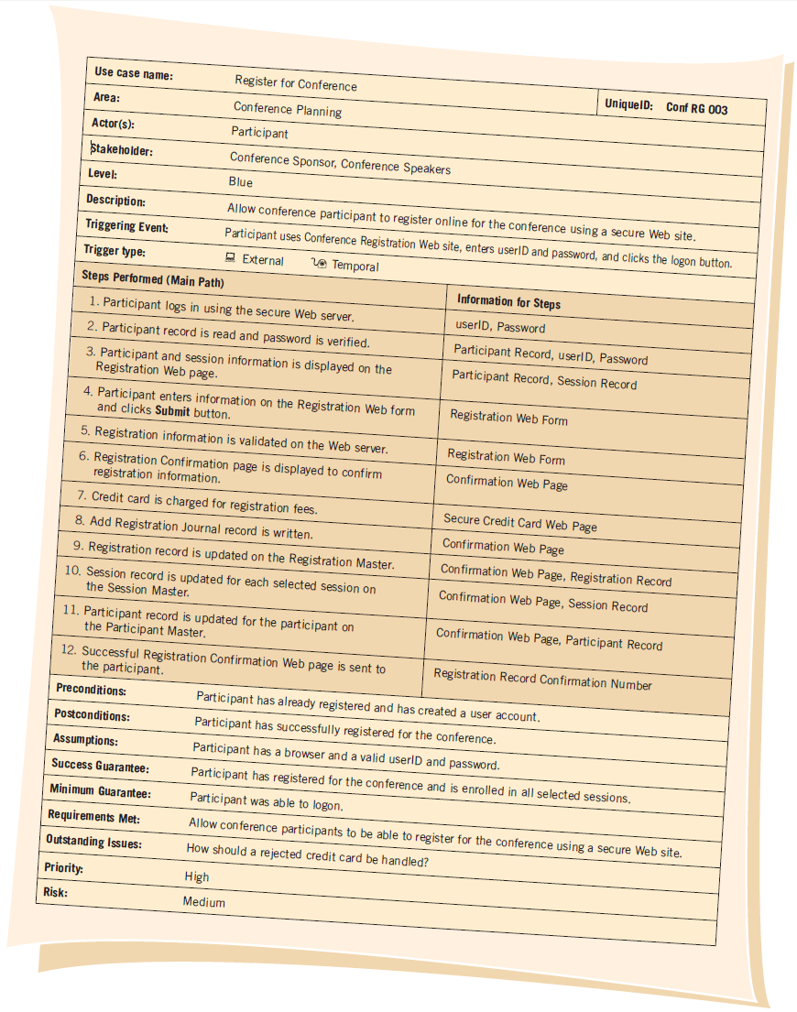

Slide 25
Relationships
Illustrate relationships between an actor and a use case with a simple line. For relationships among use cases, use arrows labeled either "uses" or "extends." A "uses" relationship indicates that one use case is needed by another in order to perform a task. An "extends" relationship indicates alternative options under a certain use case.

Slide 26
Use case relationships:
Communication relationship (association): actors and use cases or use case and use case communicate when information is exchanged between them. Communication relationship is depicted by a solid line.

Slide 27
Use case relationships: … cont
Inclusion relationship (uses): when describing a complex system, its use case model can become quite complex and can contains redundancy. We reduce the complexity of the model by identifying commonalities in the different use cases. Two use cases are related by an include relationship if one of them includes the second one in its flow of events. Include relationships are depicted by a dashed open arrow originating from the including use case.

Slide 28
We represent include relationship in the use case itself with one of two ways:
If the use case can be included at any point in the flow of events we indicate the inclusion in the quality requirements section of the use case.
If the include use case is invoked during an event, we indicate the inclusion in the flow of events.

Slide 29
Use case relationships: … cont
Extension relationship: a use case consisting of steps extracted from a more complex use case in order to simplify the original case and functionality. The extension use case extends the functionality of the original use case.

Slide 30
Use case relationships: … cont
Depends on relationship: a relationship between use cases indicating that one use case cannot be performed until another use case has been performed.

Slide 31
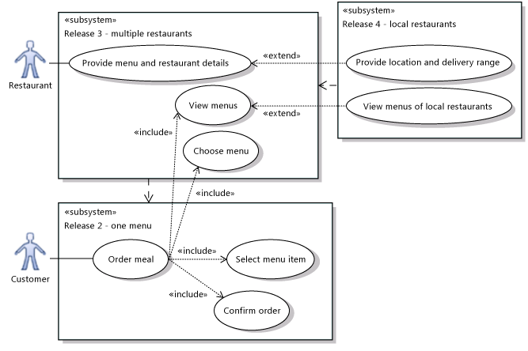
Showing system versions

Slide 32
Use case relationships: … cont
Inheritance relationship: one use case can specialize another more general one by adding more details.

Slide 33
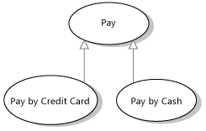
Sharing goals with generalization
Use a Generalization relation to show that a specialized use case is a particular way to achieve the goals expressed by another general use case. The open arrowhead should point at the more general use case.

Slide 34
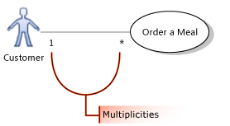
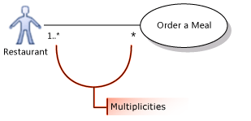
Multiplicities between Actors and Use Cases
Set the Multiplicity property, choosing from the list:
1 to state that exactly one instance of this role participates in each link.
1..* to state that one or more instance of this role participate in each link.
0..1 to state that participation is optional.
* to state that zero or more instances of this role participate in the link.

Slide 35
A Use Case Example of Student Enrollment (Figure 10.6)
Notes:
Use case diagrams provide the basis for creating other types of diagrams such as class diagrams and activity diagrams.

Slide 36
Use Cases Can Be Grouped into Packages (Figure 10.23)

Slide 37
Homework
Do a use case diagram for your projects.
How can you explain this sentence:
“Use case diagram describes what the system does, without describing how the system does it”
Your homework must be delivered manually. Don’t forget to send a copy to: nabdak@gmail.com
Good luck

