Slide 1
Data Structure & Algorithms project Report
Airline Reservation System (ARS)
Group Members:
M. Nabeel Nasir (FA21-BSCS-0042)
Yaqub Hassan (FA21-BSCS-0026)

Slide 2

Problem Statement
The old system of Airline Reservation system was manual or documented or not fully online. There were many problems regarding some categories such as Accuracy, Usability, Effectiveness, Efficiency, Speed etc.

Slide 3
Disadvantages of old system
Time consuming
Manual work (Manually goes to the airport and book the ticket)
Downloading the ticket in documented form to fill the requirements and then submitting to the Airport.
Possibility of losing data
Lack of security
Difficulties in maintain records

Slide 4
Project Introduction
This project (ARS) encourages the reservation of online air tickets for an ordinary passenger intending to travel in airways as it holds flight plans, traveler reservations and ticket records. It saves time and efforts.
Admin is the main authority who can do expansion, and change of flights if required.

Slide 5

Our System Advantage
To save time and accuracy in work
To make system simple and easy to manage
To provide a large number of ticket reservation and cancellation service in a small time.
To guarantee that ticket reservation is simple, easy and user-friendly use for clients.
To keep the information from unauthorized user

Slide 6

Technologies used in the project:
This whole project is based on C++ programming language.
We used basic concepts of OOP such as classes, Inheritance, as well as the concepts of Data structure and algorithms (DSA) such as Circular doubly linked list , etc.

Slide 7
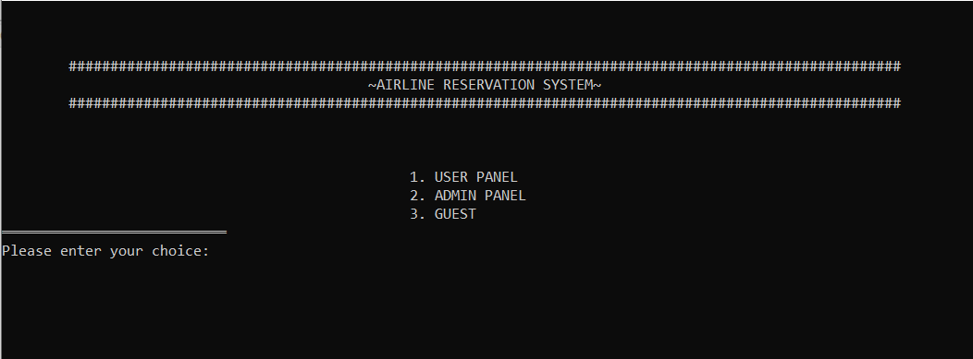
Main Menu

Slide 8
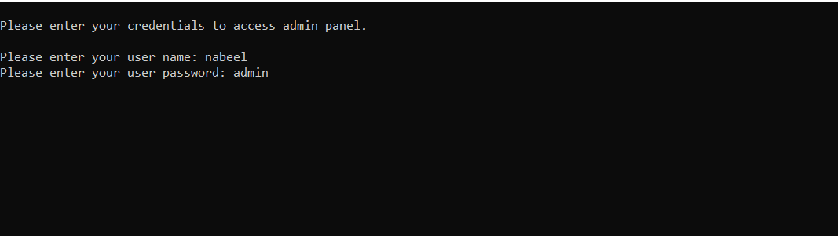
Admin Panel
Login Admin

Slide 9
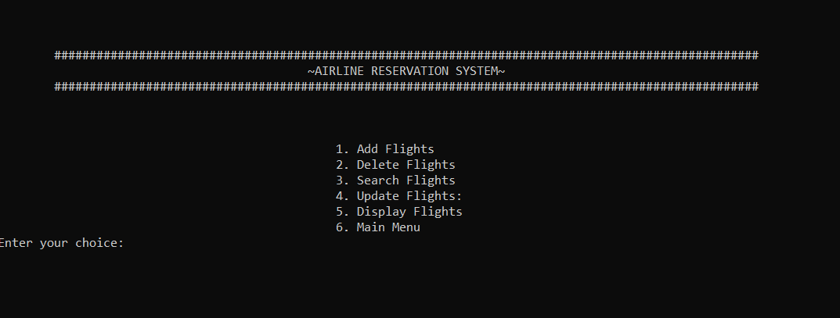
Admin Panel
Admin Functions

Slide 10

User panel login

Slide 11
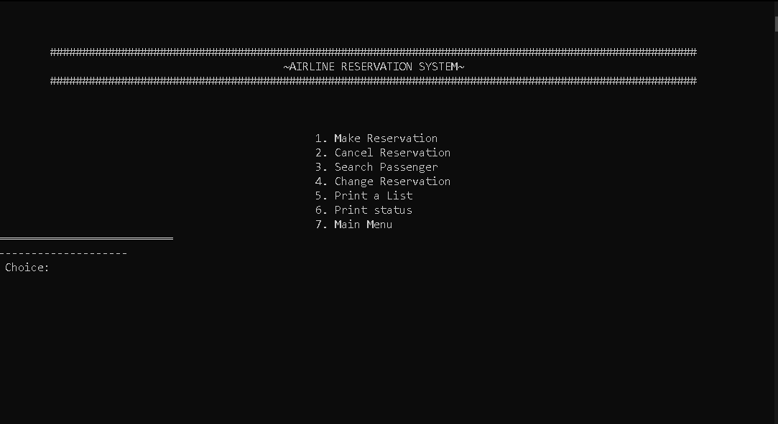
User panel
User Functions

Slide 12
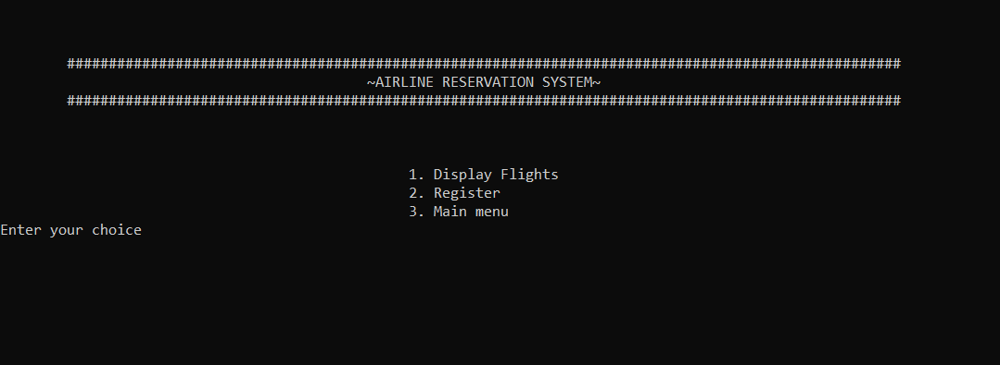
Guest Panel
Guest Functions

Slide 13
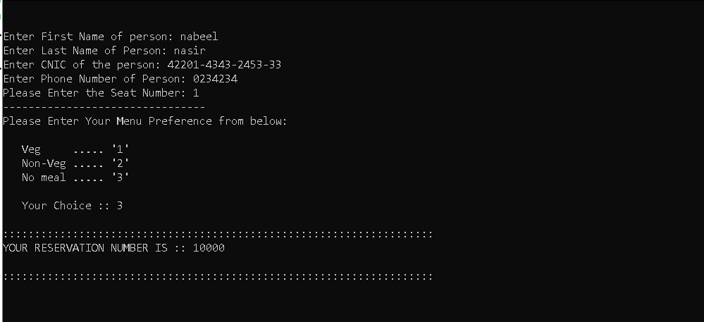
Reservation

Slide 14
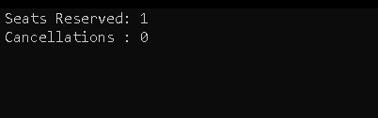
Status

Slide 15
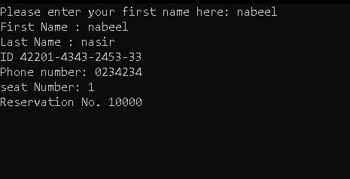
Search Function

Slide 16
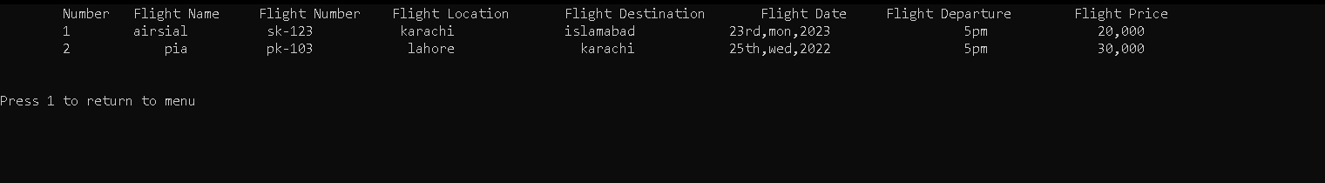
Flight Display

