Slide 1
BZ-Agent
Smart-City Mobility & Event Orchestrator
A cloud-native, multi-agent system on AWS — comparing Lambda vs EC2
Nidhal Karchoud · Abdellah Derf
Cloud Computing and Distributed Systems
github.com/yar01110/bz-agent

Slide 2
The Question
BZ-Agent turns a natural-language request — “visit a museum and find parking nearby”
— into a validated itinerary, grounded in live Bolzano open data.
RESEARCH QUESTION
Serverless vs. server:
which wins, and why?
We deploy the same application two ways and ask:
How do serverless (Lambda) and server-based (EC2) deployments compare in performance, scalability, reliability, and cost — and where is the real bottleneck?
Performance under load
Scalability & reliability
Cost transparency
BZ-Agent · Karchoud & Derf
2

Slide 3
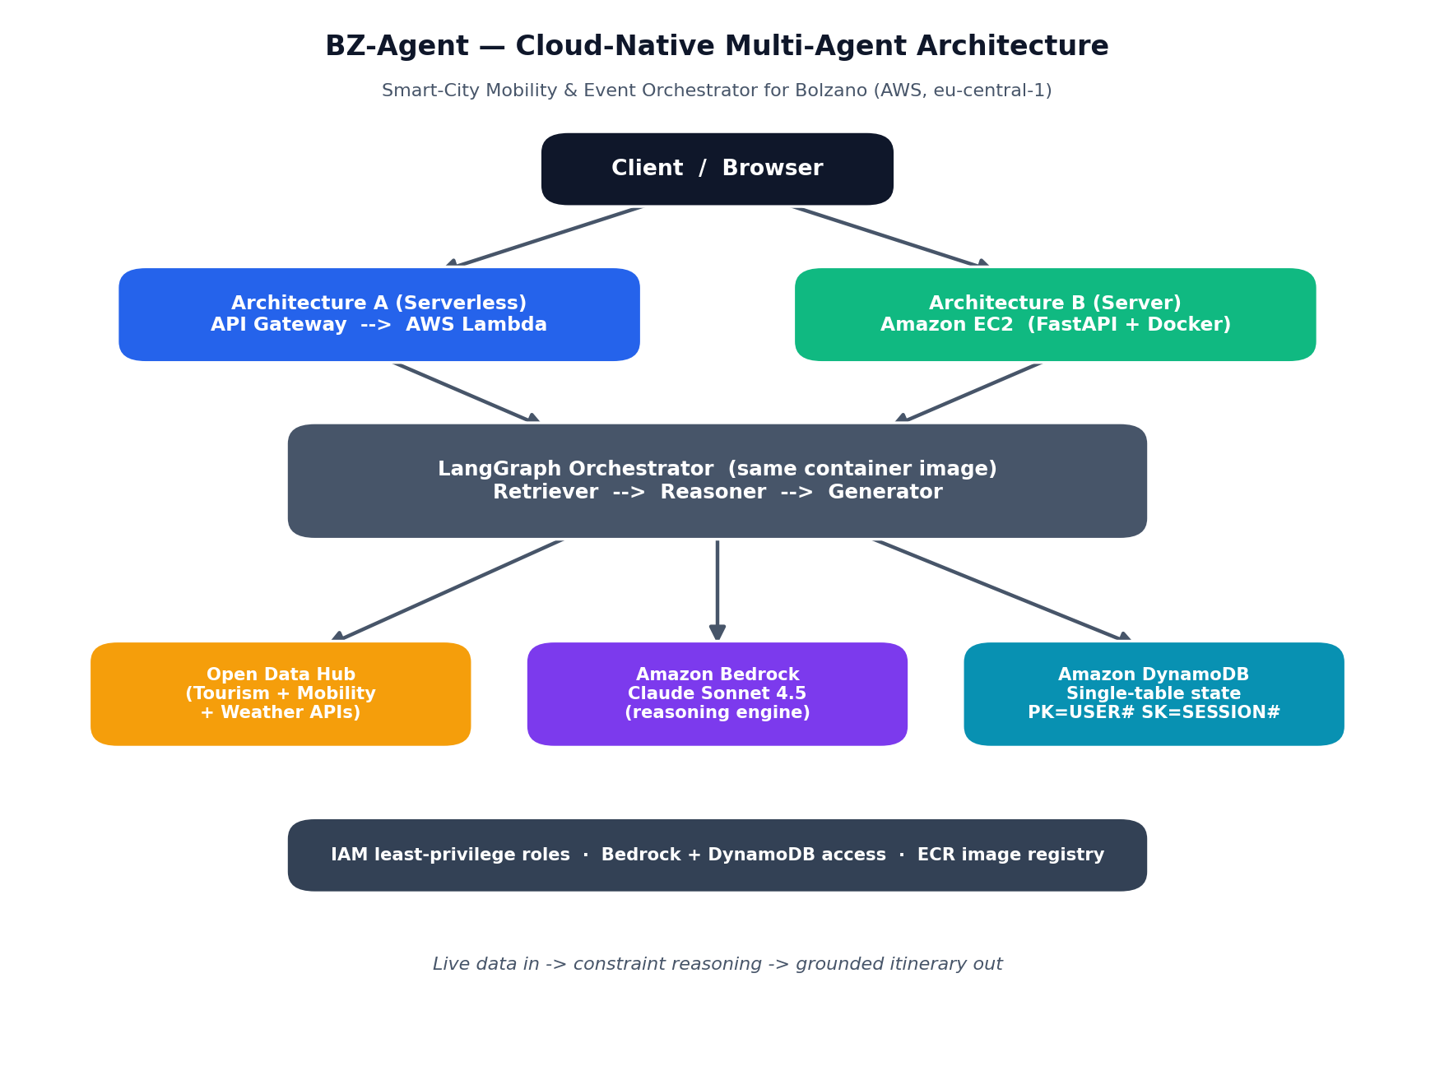
System Architecture
Compute is just the engine.
Lambda / EC2 only orchestrate the LangGraph pipeline.
Amazon Bedrock (Claude) is the reasoning brain.
DynamoDB holds session state & scratchpad.
Open Data Hub provides live POIs, parking & weather.
BZ-Agent · Karchoud & Derf
3

Slide 4
The Agentic RAG Pipeline
1 Retriever
2 Reasoner
3 Generator
Maps the request to ODH tools, fetches data, and SANITISES it to a few flat fields — the key guard against context overflow & hallucination.
Applies hard constraints: proximity, transit buffers, parking availability, and weather (rain → indoor). Outputs a validated draft.
Renders the validated draft into a friendly itinerary. Invents nothing — only formats facts the Reasoner approved.
→
→
State flows one way; each node writes its slice to the DynamoDB scratchpad (full traceability).
BZ-Agent · Karchoud & Derf
4

Slide 5
Two Deployment Architectures
AWS Lambda + API Gateway
Amazon EC2 (in custom VPC)
Architecture A — Serverless
Architecture B — Server
Scales automatically, per request
Zero cost when idle
Cold start ~5–18 s
15-min execution limit
Best for spiky / low-medium load
Always-on, fixed capacity
Billed hourly even when idle
No cold start
No timeout limit
Best for steady, high load
Same container image, two execution models — the basis of every experiment.
BZ-Agent · Karchoud & Derf
5

Slide 6
Experimental Method
1
Measure
Real single-request latency on both endpoints (avg ~16.9 s, Bedrock-bound).
2
Sweep
Concurrency 25→400 on the cost-free /health endpoint (no Bedrock cost).
3
Model
Extrapolate to 50 / 200 / 1000 users from real numbers + AWS service limits.
4
Experiment
Elasticity (ALB + Auto Scaling) and failure-recovery, run live.
Repeated runs → descriptive statistics → charts. Why model 1000 users? A real run = tens of thousands of Bedrock calls (cost + quota throttling).
BZ-Agent · Karchoud & Derf
6

Slide 7
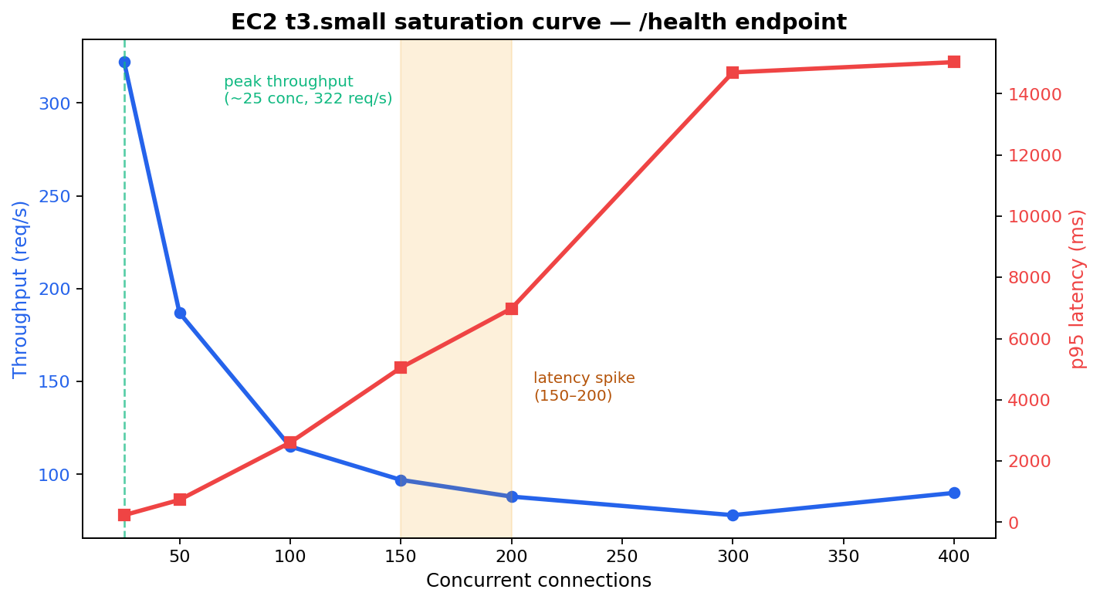
Finding 1 — A Single Instance Saturates
THE BREAKING POINT
~150–200
concurrent connections
Peak throughput at ~25 conc (322 req/s)
By 300+, p95 ≈ 15 s — effectively broken
BZ-Agent · Karchoud & Derf
7

Slide 8
Finding 2 — Elasticity Raises the Ceiling
AT 300 CONCURRENCY
+70%
throughput vs a single instance
≈ half the median latency
0% errors throughout
Capacity follows demand
BZ-Agent · Karchoud & Derf
8

Slide 9
Finding 3 — Self-Healing Under Failure
We killed one fleet instance mid-traffic and measured what the client saw.
0
~117 s
100%
client-visible outage
(0 / 454 health checks failed)
self-heal recovery
(ASG launched a replacement)
outage for a single instance
(until manual redeploy)
“Cattle, not pets”: the load balancer routed around the dead node instantly, and Auto Scaling replaced it automatically. Lambda is resilient the same way by design.
BZ-Agent · Karchoud & Derf
9

Slide 10
Where the Money Goes
KEY INSIGHT
The LLM is ~95% of cost — identical for both architectures.
The compute choice is a rounding error on the bill.
Lambda wins on idle (pay-per-use); EC2 only if ~100% utilised 24/7.
Sanitisation keeps prompts small to control token cost.
BZ-Agent · Karchoud & Derf
10

Slide 11
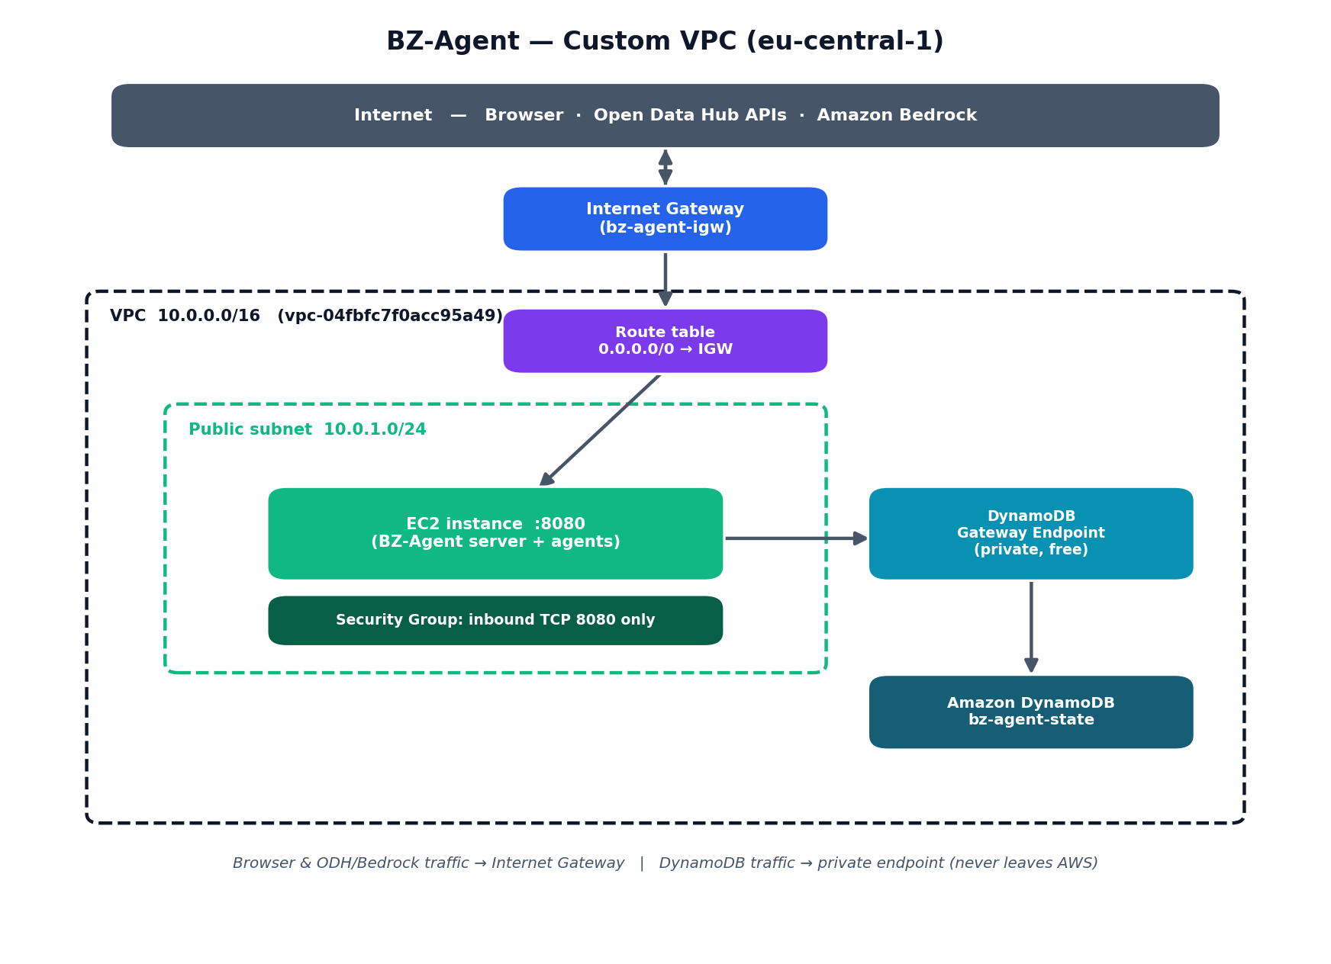
Security & Network Isolation
Custom VPC
Own subnet, internet gateway & routing
Private DynamoDB gateway endpoint (free) — state never leaves AWS
Security group: only port 8080 inbound
Least privilege
Scoped IAM roles (Bedrock + DynamoDB only)
Bedrock via IAM — no long-lived API key
Secrets excluded from git (.gitignore)
BZ-Agent · Karchoud & Derf
11

Slide 12
Conclusions & Reflection
Lambda is the better default
auto-scaling, no single point of failure, $0 idle — ideal for bursty traffic.
EC2 needs help to scale
a single instance breaks at ~150–200 conc; an ALB + Auto Scaling Group fixes it.
Bedrock is the real bottleneck & cost
~95% of spend and the shared limit at high load — compute choice barely matters.
Limitations & next steps
1000 users modelled, not run (cost/quota)
Single region / single AZ baseline
Add target-tracking auto-scaling policy
Lambda in private subnets (NAT cost)
Live SASA bus / GTFS schedules
BZ-Agent · Karchoud & Derf
12

Slide 13
Thank you
Questions & demo welcome
Nidhal Karchoud · Abdellah Derf
github.com/yar01110/bz-agent

